Slide 1
CGS 3066: Web Programming and Design Fall 2019
PHP Session, Cookie

Slide 2
HTTP is Stateless
HTTP is Stateless:
– HTTP client (browser) initiates an HTTP request and waits for the response from the server
– Server processes the request and sends a response back to the client
– Client disconnects the connection
– Repeat
Client and server know each other during the current connection only. Further requests are made on new connection – client and server are new to each other.
Request
Client
Server
Response

Slide 3
HTTP is Stateless
Recall our visitor count example:
The visitor count maintains a file where we keep the counter, we don’t know anything about the visitor.
What if we want a separate visit count for each user?
The server is constantly listening for new requests, need to respond them differently. We need a mechanism to identify each client separately.
Browser stores the state in “Cookies”
Server stores the state in “Sessions”

Slide 4
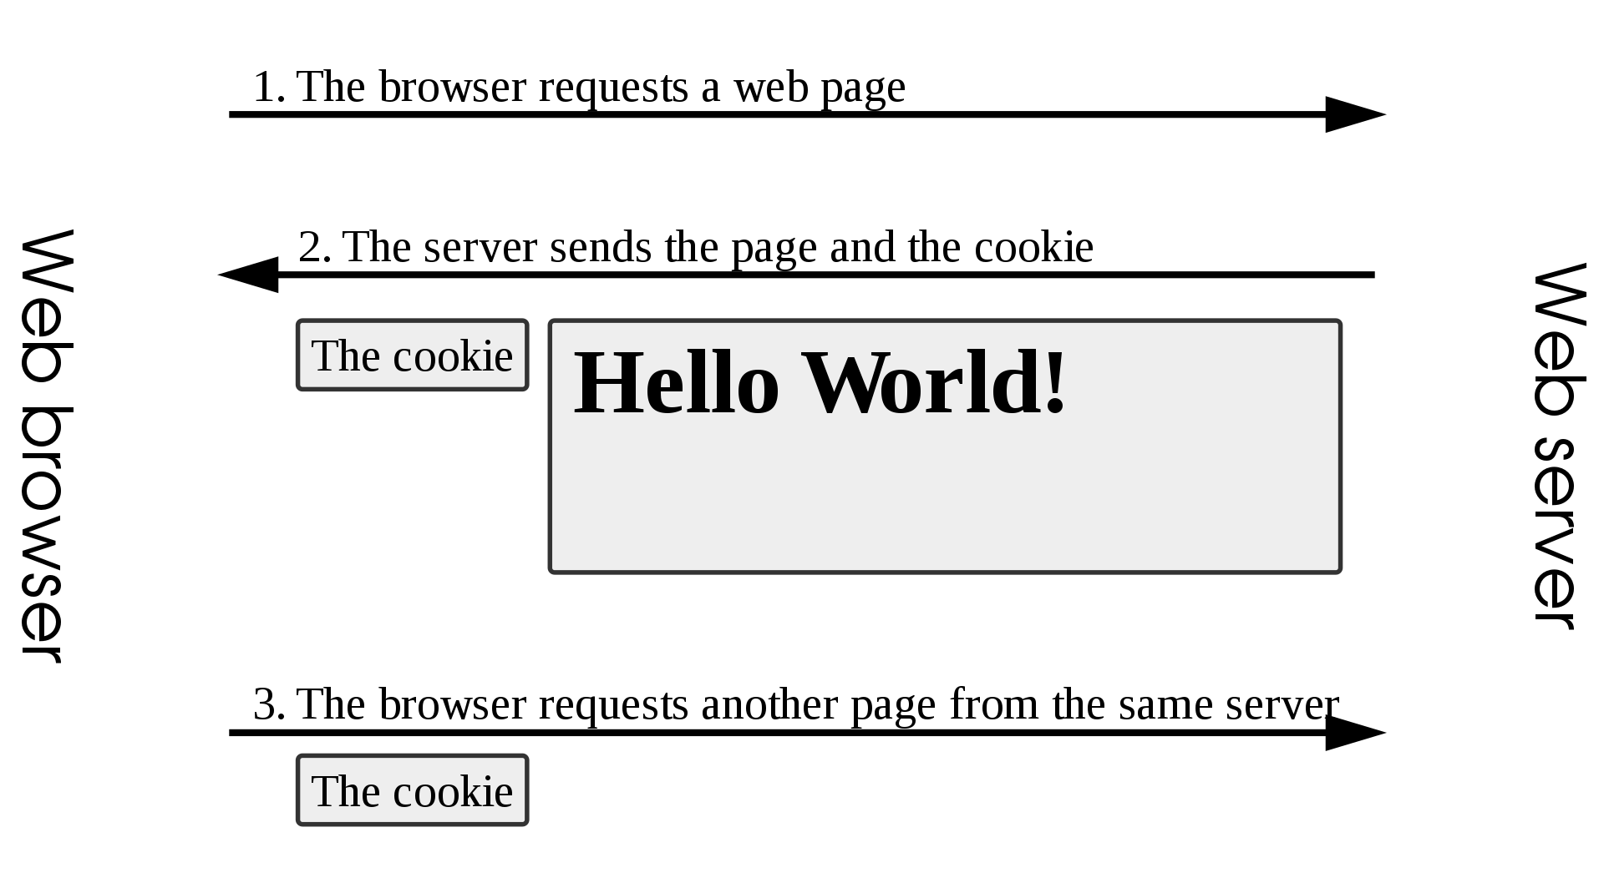
HTTP Cookies
http://en.wikipedia.org/wiki/HTTP_cookie

Slide 5
HTTP Cookies
In internet programming, a cookie is a packet of information sent from the server to client, and then sent back to the server each time it is accessed by the client.
Introduces state into HTTP (remember: HTTP is stateless)
Cookies are transferred between server and client according to http.
PHP supports http cookies
Cookies can also be thought of as tickets used to identify clients and their orders

Slide 6
Cookies in the Browser
Cookies are marked as to the web addresses they come from - the browser only sends back cookies that were originally set by the same web server
Cookies have an expiration date - some last for years - others are short-term and go away as soon as the browser is closed

Slide 7
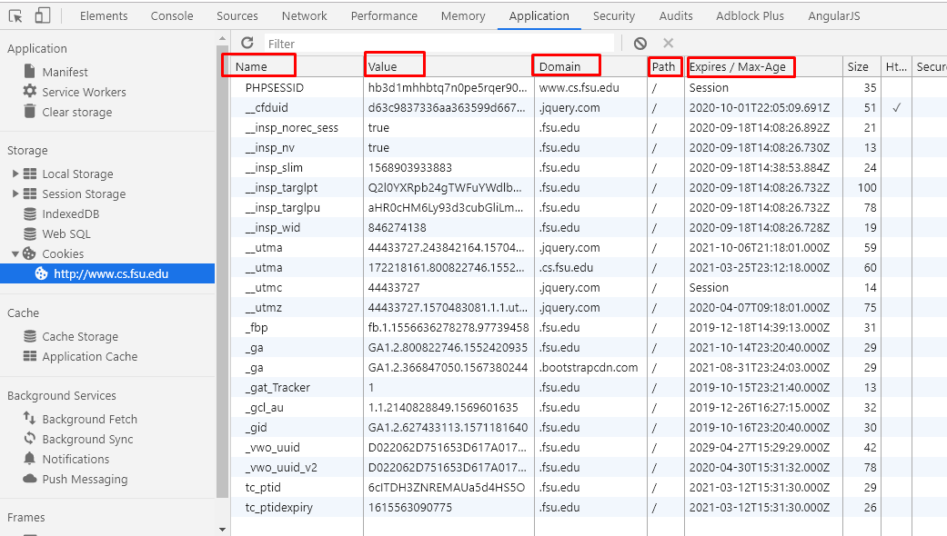
Cookies in the Browser

Slide 8
Implementing Cookies
Cookies are sent from the server to the client via “Set-Cookie” headers
Set-Cookie: NAME=VALUE; expires=DATE; path=PATH; domain=DOMAIN_NAME; secure
The NAME value is a URL-encoded name that identifies the cookie.
The PATH and DOMAIN specify where the cookie applies

Slide 9
setcookie(name,value,expire,path,domain,secure)
Parameter | Description
name | (Required). Specifies the name of the cookie
value | (Required). Specifies the value of the cookie
expire | (Optional). Specifies when the cookie expires. e.g. time()+3600*24*30 will set the cookie to expire in 30 days. If this parameter is not set, the cookie will expire at the end of the session (when the browser closes).
path | (Optional). Specifies the server path of the cookie. If set to "/", the cookie will be available within the entire domain. If set to "/phptest/", the cookie will only be available within the test directory and all sub-directories of phptest. The default value is the current directory that the cookie is being set in.
domain | (Optional). Specifies the domain name of the cookie. To make the cookie available on all subdomains of example.com then you'd set it to ".example.com". Setting it to www.example.com will make the cookie only available in the www subdomain
secure | (Optional). Specifies whether or not the cookie should only be transmitted over a secure HTTPS connection. TRUE indicates that the cookie will only be set if a secure connection exists. Default is FALSE.

Slide 10
Cookies from HTTP
Client/Browser
Server
GET /*.html HTTP/1.1
Host: server.domain
GET /*.html HTTP/1.1
Host: server.domain
Cookie: name=value
Accept: */*
HTTP/1.1 200 OK
Content-type: text/html
Set-Cookie: name=value
(content of page)

Slide 11
Creating Cookies in PHP
Cookies can be set by directly manipulating the HTTP header using the PHP header() function
<?php
header(“Set-Cookie: mycookie=myvalue; path=/; domain=.cs.fsu.edu”);
?>

Slide 12
Creating Cookies in PHP
Use the PHP setcookie() function:
Setcookie (name,value,expire, path, domain, secure)
e.g.
<?php
setcookie("MyCookie", $value, time()+3600*24);
setcookie("AnotherCookie", $value, time()+3600);
?>
Name: name of the file
Value: data stored in the file
Expire: data string defining the life time
Path: subset of URLs in a domain where it is valid
Domain: domain for which the cookie is valid
Secure: set to '1' to transmit in HTTPS

Slide 13
Reading Cookies in PHP
To access a cookie received from a client, use the PHP $_COOKIE superglobal array
<?php
foreach ($_COOKIE as $key=>$val) {
print $key . " => " . $val . "<br/>";
}
?>
Each key in the array represents a cookie - the key name is the cookie name.

Slide 14
Example
<?php
setcookie("MyCookie", $value, time()+7200);
setcookie("AnotherCookie", $value, time()+7);
?>
<?php
foreach ($_COOKIE as $key=>$val) {
print $key . " => " . $val . "<br/>";
}
?>
Cookies only become visible on the next page load

Slide 15
Using headers (wrong approach!)
<!DOCTYPE html PUBLIC "=//W3C//DTD XHMTL 1.1//EN" "http://www.w3.org/TR/xhtml11/DTD/xhtml11.dtd">
<html xmlns="http://www.w3.org/1999/xhmtl" xml:lang="en">
<head><title>PHP Script using Cookies</title>
<meta http-equiv="Content-Type" content="text/html; chatset=ISO-8859-1" />
</head>
<body>
<?php
$strValue = "This is my first cookie";
setcookie ("mycookie", $strValue);
echo "Cookie set<br>";
?>
</body>
</html>
Gets an error!:
Warning: Cannot modify header information - headers already sent by (output started at /var/www/html/TESTandre/159339/PHP/cookie_with_headers.php:9) in /var/www/html/TESTandre/159339/PHP/cookie_with_headers.php on line 11
(adapted from Stobart & Parsons (2008))

Slide 16
Explanation
setcookie() did not run before information was sent to the browser...
Cookies have to be sent before the heading elements

Slide 17
Using headers (correct approach)
<?php
$strValue = "This is my first cookie";
setcookie ("mycookie", $strValue);
echo "Cookie set<br>";
?>
<!DOCTYPE html PUBLIC "=//W3C//DTD XHMTL 1.1//EN" "http://www.w3.org/TR/xhtml11/DTD/xhtml11.dtd">
<html xmlns="http://www.w3.org/1999/xhmtl" xml:lang="en">
<head><title>PHP Script using Cookies</title>
<meta http-equiv="Content-Type" content="text/html; charset=ISO-8859-1" />
</head>
<body>
<?php
echo “<p> A cookie has been set. </p>”;
?>
</body>
</html>
This is the correct approach!

Slide 18
Deleting a cookie
Set the cookie with its name only:
setcookie(“mycookie”);

Slide 19
Multiple Cookie variables
Use explode() e.g.
<?php
$strAddress = $_SERVER['REMOTE_ADDR'];
$strBrowser = $_SERVER['HTTP_USER_AGENT'];
$strInfo = "$strAddress::$strBrowser";
setcookie ("somecookie4",$strInfo, time()+7200);
?>
<?php
$strReadCookie = $_COOKIE["somecookie4"];
$arrListOfStrings = explode ("::", $strReadCookie);
echo "<p>$strInfo</p>";
echo "<p>Your IP address is: $arrListOfStrings[0] </p>";
echo "<p>Client Browser is: $arrListOfStrings[1] </p>";
?>

Slide 20
PHP Sessions
Cookies have some limitations
Security issues
Size limitations
Use Sessions to overcome those limitations
A simple way to store data for individual users against a unique session ID. This can be used to persist state information between page requests.
Session IDs are normally sent to the browser via session cookies and the ID is used to retrieve existing session data.
The absence of an ID or session cookie lets PHP know to create a new session, and generate a new session ID.

Slide 21
PHP Sessions
In most server applications, as soon as we meet a new browser - we create a session
We set a session cookie to be stored in the browser which indicates the session id in use
The creation and destruction of sessions is generally handled by a web framework or some utility code that we just use to manage the sessions

Slide 22
Session Identifier
A large, random number that we place in a browser cookie the first time we encounter a browser.
This number is used to pick from the many sessions that the server has active at any one time.
Server software stores data in the session which it wants to have from one request to another from the same browser.
Shopping cart or login information is stored in the session in the server

Slide 23
Using Session in PHP
First, you need to start the session with:
session_start();
This tells PHP that a session is requested.
PHP initiates the superglobal $_SESSION
A session ID is then allocated at the server end.
session ID looks like:
sess_f1234781237468123768asjkhfa7891234g

Slide 24
Using Session in PHP
session_start();
if(isset($_SESSION["counter"])){
$counter_s = $_SESSION["counter"];
} else{
$counter_s = 0;
$_SESSION["counter"] = 0;
}
$counter_s++;
$_SESSION["counter"] = $counter_s;
echo "<h1>Welcome back, this is your {$counter_s}th visit on this page.</h1>";

Slide 25
Ending Sessions
unset($_SESSION[‘name’])
Remove a session variable
session_destroy()
Destroys all data registered to a session
does not unset session global variables and cookies associated with the session
Not normally done - leave to timeout
session_unset()
frees all session variables currently registered

Slide 26
Another Example - Session
<?php
session_start();
if(!isset($_SESSION['strColourBg'])) $_SESSION['strColourBg'] = "red";
else echo "Currently Bg set to " . $_SESSION['strColourBg'] . "<br>";
if(!isset($_SESSION['strColourFg'])) $_SESSION['strColourFg'] = "yellow";
else echo "Currently Fg set to " . $_SESSION['strColourFg'];
if(isset($_POST["submit"]) ) {
$strColourBg = $_POST["strNewBg"];
$strColourFg = $_POST["strNewFg"];
$_SESSION['strColourBg'] = $strColourBg;
$_SESSION['strColourFg'] = $strColourFg;
echo "<br>New Settings";
}
else {
$strColourBg = $_SESSION['strColourBg'];
$strColourFg = $_SESSION['strColourFg'];
echo "<br>Keep old settings";
}
?>

Slide 27
Another Example - Session
<!DOCTYPE html>
<html>
<head> <style type="text/css">
body {background-color: <?php echo $strColourBg ?>}
p {color: <?php echo $strColourFg?>}
h2 {color: <?php echo $strColourFg?>}
</style>
</head>
<body>
<h2>h2 colour</h2>
<form action = '<?php echo $_SERVER["PHP_SELF"] ?>' method='post'>
<label for="strNewBg"> Background colour: </label>
<select name='strNewBg' id='strNewBg'>
<option>red</option> <option>grey</option>
</select>
<label for="strNewFg"> Text colour: </label>
<select name='strNewFg' id='strNewFg'>
<option>yellow</option> <option>grey</option>
</select>
<input type='submit' name='submit'/>
</form>
</body>
</html>

Slide 28
Acknowledgement
Some content is used (directly or with some modification) from the following sources:
- Charles Severance, University of Michigan School of Information
- Chris Scaffidi, Oregon State University
- Dr. Napoleon H. Reyes, Massey University

