Slide 1
CGS 3066: Web Programming and Design Fall 2019
PHP File Handling

Slide 2
File Upload
To upload a file, the form needs the following attributes:
method=“POST”
enctype=“multipart/form-data”
And an input <input type=“file”>

Slide 3
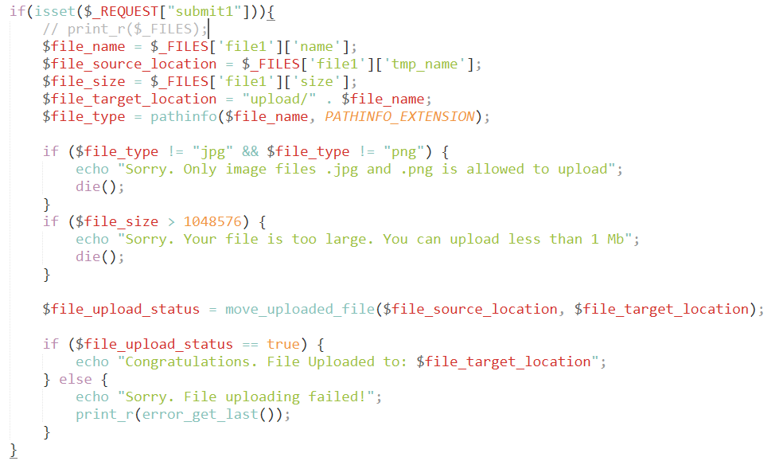
File Upload
Uploaded file details in server-side:
[file1] => Array
 | (
 | [name] => building.jpg
 | [type] => image/jpeg
 | [tmp_name] => C:\xampp\tmp\phpC02.tmp
 | [error] => 0
 | [size] => 8556
 | )

Slide 4
Basic File Handling in PHP
Files are stored in directories on a hard drive, and because they retain their data after the computer is shut down, they are a persistent storage mechanism, instead of temporary storage such as RAM.
As a server-side programming language, PHP allows you to work with files and directories stored on the Web server.
This is very useful, because it means your PHP scripts can store information outside the scripts themselves.
This chapter is all about the PHP functions for working with the file system

Slide 5
Including other files in PHP
You can copy all text/code/markup from another file into your current PHP script using:
include()
include_once()
require()
require_once()
Include: program will copy the content of the other file, won’t halt execution if the file does not exist (produces warning and continues)
Require: program will produce a fatal error if the desired file does not exist, stop execution
Once: will copy once, ignore all subsequent inclusions.
include("path/to/filename"); -Or-
include "path/to/filename";
require("path/to/filename"); -Or-
require "path/to/filename";

Slide 6
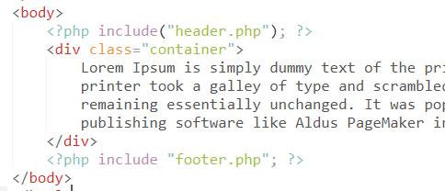
Including Files
We use include when we want to re-use the content from another file – usually a markup (e.g. header, menu, footer, etc.) or some static variables/constants (e.g. list of countries or states)
We use require when we want to include something very important and the program may not continue without the intended file (e.g. some important function/class definitions).
Once: PHP won’t allow defining same functions more than once, to make sure we don’t make any duplicates, we use require/include once.

Slide 7
Operating on Files
Check whether a file exists:
file_exists(“my_file.txt”) //true if exists, false otherwise
Get the file size (in bytes):
filesize(“my_file.txt”)
//returns file size in bytes, produces warning if file does not exist

Slide 8
Opening a file
Usually, to work with a file from within your PHP script, you first need to open the
file.
When you open a file, you create a file handle. A file handle is a pointer associated with the open file that you can then use to access the file's contents.
When you're finished with the file, you close it, which removes the file handle from
memory.
Some PHP functions let you work directly with a file without needing to open or
close it.

Slide 9
fopen
The fopen() function opens a file and returns a file handle associated with the file.
The first argument passed to fopen() specifies the name of the file you want to open, and the second argument specifies the mode , or how the file is to be used.
For example:
$handle = fopen( “data.txt”, “r” );
The first argument can be just a filename ( “ data.txt “ ), in which case PHP will look for the file in the current directory, or it can be a relative ( ” ../data.txt “ ) or absolute ( “ /myfiles/data.txt “ ) path to a file.

Slide 10
File paths
Usually, the current directory is the same directory as the script.
Within a relative path, two dots ( .. ) refer to the immediate parent directory.
For example, data.txt points to a file called data.txt in the current directory, and ../data.txt points to a file called data.txt in the directory above the current directory.
../../../data.txt backs up the directory tree three levels before looking for the
data.txt file.

Slide 11
Opening a file with fopen()
The second argument to fopen() tells PHP how you're going to use the file. It can take one of the following string values:
Value | Description
r | Open the file for reading only. The file pointer is placed at the beginning of the file.
r+ | Open the file for reading and writing. The file pointer is placed at the beginning of the file.
w | Open the file for writing only. Any existing content will be lost. If the file does not exist, PHP attempts to create it.
a | Open the file for appending only. Data is written to the end of an existing file. If the file does not exist, PHP attempts to create it.
a+ | Open the file for reading and appending. Data is written to the end of an existing file. If the file does not exist, PHP attempts to create it.

Slide 12
Opening a file with fopen()
If there was a problem opening the file, fopen() returns false rather than a file handle resource.
Operations on files and directories are prone to errors, so you should always allow for things to go wrong when using them. It's good practice to use some form of error checking procedure so that if an error occurs (perhaps you don't have necessary privileges to access the file, or the file doesn't exist), your script will handle the error gracefully.
For example:
if ( !( $handle = fopen( “data.txt”, “r” ) ) )
die( “Cannot open the file” );

Slide 13
Closing a file with fclose()
Once you've finished working with a file, it needs to be closed.
You can do this using fclose() , passing in the open file's handle as a single argument, like this:
fclose( $handle );
Although PHP should close all open files automatically when your script terminates, it's good practice to close files from within your script as soon as you're finished with them because it frees them up quicker for use by other processes and scripts — or even by other requests to the same script

Slide 14
Reading from files using fread()
Now that you know how to open and close files, it's time to take a look at reading and writing data in a file.
The fread() function can be used to read a string of characters from a file. It takes two arguments: a file handle and the number of characters to read.
The function reads the specified number of characters (or less if the end of the file is reached) and returns them as a string. For example:
$handle = fopen( “data.txt”, “r” );
$data = fread( $handle, 10 );
This code reads the first ten characters from data.txt and assigns them to $data as a string.

Slide 15
Reading from files using fread()
After fread() has finished, the file pointer, which holds the current position in the file, moves forward in the file by the number of characters read.
So after the previous example code runs, the file pointer moves forward to ten characters after the start of the file.
If you repeat the same call to fread() , you'll get the next ten characters in the file.
If there are less than ten characters left to read in the file, fread() simply reads and returns as many as there are.

Slide 16
Reading from files using fgetc()
If you want to read only one character at a time you can use the fgetc() function.
fgetc() takes a single argument — a file handle — and returns just one character from the file it points to; it returns false when it reaches the end of the file:
$one_char = fgetc( $handle );
However, fgetc() is slow when working with large files. It is faster to read a bunch of characters at once using fread() , or one of the other file - reading functions discussed later.

Slide 17
Testing for the End of a File
The feof() function serves a single, simple purpose:
It returns true when the file pointer has reached the end of the file (or if an error occurs) and returns false otherwise.
It takes just one argument — the file handle to test.
Notice that feof() only returns true once the script has tried to read one or more characters past the last character in the file

Slide 18
Testing for the End of a File
// hello_world.txt contains the characters “Hello, world!”
$handle = fopen( "hello_world.txt", "r" );
$hello = fread( $handle, 13 );
echo $hello . " <br /> "; // Displays "Hello, world!"
echo feof( $handle ) . " <br /> "; // Displays "" (false)
$five_more_chars = fread( $handle, 5 );
echo $five_more_chars . " <br /> "; // Displays "" (or possibly a newline)
echo feof( $handle ) . " <br /> "; // Displays "1" (true)
fclose( $handle );

Slide 19
Testing for the End of a File
feof() is useful with fread() or fgetc() in a while loop when you don't know how long the file is:
// hello_world.txt contains the characters “Hello, world!”
$handle = fopen( “hello_world.txt”, “r” );
$text = “”;
while ( !feof( $handle ) ) {
$text .= fread( $handle, 3 ); // Read 3 chars at a time
}
echo $text . “ <br /> ”; // Displays “Hello, world!”
fclose( $handle );

Slide 20
Reading One Line at a Time
The following example uses fgets() to read and display a three-line text file, one line at a time. The while loop exits when fgets() returns false (which means it’s reached the end of the file):
/* milton.txt contains:
The mind is its own place, and in it-self
Can make a Heav’n of Hell, a Hell of Heav’n.
What matter where, if I be still the same,
*/
$handle = fopen( “milton.txt”, “r” );
$lineNumber = 1;
while ( $line = fgets( $handle ) ) {
echo $lineNumber++ . “: $line <br /> ”;
}
fclose( $handle );
Output:
1: The mind is its own place, and in it-self 2: Can make a Heav’n of Hell, a Hell of Heav’n. 3: What matter where, if I be still the same,

Slide 21
Writing to a file using fwrite()
You can use the fwrite() function to write data to a file. It requires two arguments:
a file handle and a string to write to the file.
The function writes the contents of the string to the file, returning the number of characters written (or false if there's an error).
For example:
$handle = fopen( “data.txt”, “w” );
fwrite( $handle, “ABCxyz” );

Slide 22
Writing to a file using fwrite()
The first line opens the file data.txt for writing, which erases any existing data in the file. (If the file doesn't exist, PHP attempts to create it.)
The second line writes the character string “ ABCxyz ” to the beginning of the file.
As with fread() , the file pointer moves to the position after the written string; if you repeat the second line, fwrite() appends the same six characters again, so that the file contains the characters “ ABCxyzABCxyz ”

Slide 23
A Simple Visitor Counter
One very popular use for Web scripts is a visitor hit counter, which is used to show how many times a Web page has been visited and therefore how popular the Web site is.
Hit counters come in different forms, the simplest of which is a text counter.
In a text counter, the current value of the counter is stored in a file and increased each time the page is visited.
Let's create a simple script to do that.

Slide 24
The Script
<!DOCTYPE html>
<head>
<title>Hit counter</title>
<link rel="stylesheet" href="css/style.css">
</head>
<body>
<div class="container">
<h1>This is my home page!</h1>
<?php
$counterFile = "count.dat";
if ( !file_exists( $counterFile ) ) {
if ( !( $handle = fopen( $counterFile, "w" ) ) ) {
die( "Cannot create the counter file." );
} else {
fwrite( $handle, 0 );
fclose( $handle );
}
}

Slide 25
The Script
if ( !( $handle = fopen( $counterFile, 'r' ) ) ) {
die( 'Cannot read the counter file.' );
}
$counter = (int) fread( $handle, 20 );
fclose( $handle );
$counter++;
echo "<h1>You’re visitor No. $counter.</h1>";
if ( !( $handle = fopen( $counterFile, 'w' ) ) ){
die( 'Cannot open the counter file for writing.' );
}
fwrite( $handle, $counter );
fclose( $handle );
?>
</div>
</body>
</html>

Slide 26
How it works?
After displaying a page header, the script stores the filename of the file that will hold the hit count:
$counterFile = “count.dat“;

Slide 27
How it works?
Next, the script checks to see if the counter file exists. If it doesn’t, it is created by opening the file for writing, writing a zero to it (thereby initializing the hit count to zero), then closing it:
if ( !file_exists( $counterFile ) ) {
if ( !( $handle = fopen( $counterFile, "w" ) ) ) {
die( "Cannot create the counter file." );
} else {
fwrite( $handle, 0 );
fclose( $handle );
}
}

Slide 28
How it works?
Next the counter file is opened for reading:
if ( !( $handle = fopen( $counterFile, “r” ) ) ) {
die( “Cannot read the counter file.” );
}

Slide 29
How it works?
The script now uses the file handle to read the hit counter value from the open file.
As you can see, the script calls fread() to read up to 20 bytes from the data file (enough to store a very large integer):
$counter = (int) fread( $handle, 20 );
Because fread() returns a string value, and the counter needs to be an integer value, the return value is cast(converted) into an integer using (int).

Slide 30
How it works?
The call to fclose() closes the file referenced by the file handle $handle, freeing up the file for reading or writing by other processes:
fclose( $handle );
After closing the data file, the script increments the counter and tells the visitor how many times the page has been accessed:
$counter++;
echo “<h1>You’re visitor No. $counter.</h1>”;

Slide 31
How it works?
Next the script writes the new counter value back to the data file. To do this it opens the file in write mode (w), then calls fwrite() to write the $counter variable’s value to the file, followed by fclose() to close the open file again:
if ( !( $handle = fopen( $counterFile, 'w' ) ) ){
die( 'Cannot open the counter file for writing.' );
}
fwrite( $handle, $counter );
fclose( $handle );

Slide 32
Separate the hit-counter
Now, we want to re-use the hit-counter in all of our pages. Should we write (or copy/paste) the same code to all the pages?
What if we want any correction or change to our counter? Should we go and change to all the pages?
We will have only one instance of counter code and will re-use that to all our pages to make our job easy.
Separate the common parts of our site (header, menu, footer, side-bars) and save into files.
Include those in different pages (home page, contact page, and all other pages) as you want.

Slide 33
Separate the hit-counter
$counterFile = "count.dat";
if ( !file_exists( $counterFile ) ) {
if ( !( $handle = fopen( $counterFile, "w" ) ) ) {
die( "Cannot create the counter file." );
} else {
fwrite( $handle, 0 );
fclose( $handle );
}
}
if ( !( $handle = fopen( $counterFile, 'r' ) ) ) {
die( 'Cannot read the counter file.' );
}
$counter = (int) fread( $handle, 20 );
fclose( $handle );
$counter++;
if ( !( $handle = fopen( $counterFile, 'w' ) ) ){
die( 'Cannot open the counter file for writing.' );
}
fwrite( $handle, $counter );
fclose( $handle );

Slide 34
Put everything together
index.php
<?php
include("hit-counter2.php");
include("header.php");
echo "<h1>This is my home page!</h1>";
echo "<h1>You’re visitor No. $counter.</h1>";
include("footer.php");
?>

