Slide 1
CGS 3066: Web Programming and Design Fall 2019
JavaScript Form Validation

Slide 2
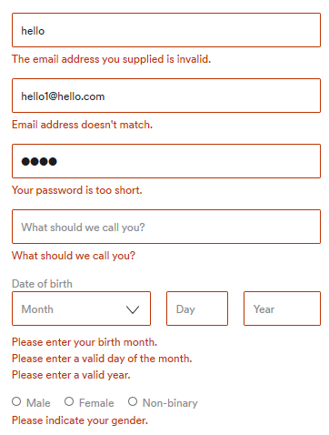
Form Validation
Client-side
Server-side
Validation system
Server-side code
Validation system

Slide 3
Form Validation
Purpose: to verify the form inputs are filled with valid values. Saves additional roundtrips from server to client.
What to validate:
Required inputs are not left blank
Input values are valid (type, format, etc.)
Validation methods:
Client-side
Using JavaScript validation
Using HTML5 validation
Server-side

Slide 4
Why do we need form validation?
Get right data in right format
– make sure required fields are filled out
– make sure provided information is valid, or at least matches expected format
Protect our system
– don’t allow malicious/harmful inputs, remove/clean them
Save a Client-Server round trip
– Save CPU/Bandwidth

Slide 5
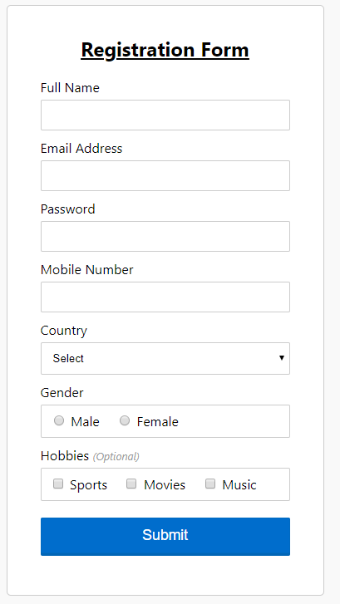
Example JS Form Validation
Name: required field, alphabets only
Email address: required field, check email format
Password: required field, at least 6 characters
Mobile number: required field, 10 digits
Country: required field
Gender: required
Hobbies: optional

Slide 6
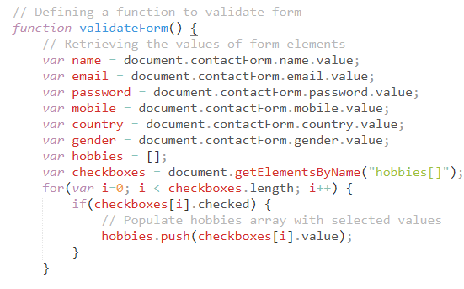
Example JS Form Validation

Slide 7
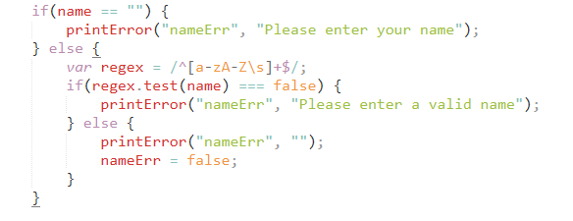
Validate Name
Name:
Required field – cannot be empty
Only alphabetic characters

Slide 8
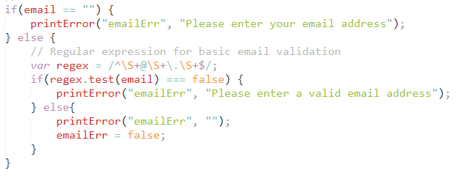
Validate Email Address
Name:
Required field – cannot be empty
Validate input with email format by regular expression

Slide 9
Regular Expressions
Syntax: /pattern/modifiers;
A regular expression is a sequence of characters that forms a search pattern.
When you search for data in a text, you can use this search pattern to describe what you are searching for.
A regular expression can be a single character, or a more complicated pattern.
Regular expressions can be used to perform all types of text search and text replace operations.

Slide 10
Regular Expressions
Modifiers can be used to perform case-insensitive more global searches:
Modifier | Description
i | Perform case-insensitive matching
g | Perform a global match (find all matches rather than stopping after the first match)
m | Perform multiline matching

Slide 11
Regular Expressions - Patterns
Brackets are used to find a range of characters:
Expression | Description
[abc] | Find any of the characters between the brackets
[0-9] | Find any of the digits between the brackets
(x|y) | Find any of the alternatives separated with |

Slide 12
Regular Expressions - Metacharacters
Metacharacters are characters with a special meaning:
Metacharacter | Description
\d | Find a digit
\s | Find a whitespace character
\b | Find a match at the beginning of a word like this: \bWORD, or at the end of a word like this: WORD\b

Slide 13
Regular Expressions - Quantifiers
Quantifiers define quantities:
Quantifier | Description
n+ | Matches any string that contains at least one n
n* | Matches any string that contains zero or more occurrences of n
n? | Matches any string that contains zero or one occurrences of n
Find more details here: https://www.w3schools.com/jsref/jsref_obj_regexp.asp
https://developer.mozilla.org/en-US/docs/Web/JavaScript/Guide/Regular_Expressions

Slide 14
Regular Expressions – Syntax
/n,/r,/t match literal newline, carriage return, tab
\\, \/, \* match a special character literally, ignoring or escaping its special meaning
[…] Match any one character between the brackets
[^…] Match any one character not between the brackets
. Match any character other than the newline
\w, \W Match any word\non-word character
\s, \S Match any whitespace/non-whitespace
\d, \D Match any digit/non-digit
^, $ require match at beginning/end of a string or in multi-line mode, beginning/end of a line
\b, \B require a match at a word/non-word boundary
? Optional term : Match zero or one time
+ Match previous term one or more times

Slide 15
Regular Expressions – Syntax
* Match term zero or more times
{n} Match pervious term n times
{n,} Match previous term n or more times
{n,m} Match prev term at least n time but no more than m times
a | b Match either a or b
(sub) Group sup-expression sub into a single term and remember the text that it matched
\n Match exactly the same chars that were matched by sup-expression number n
$n In replacement strings, substitute the text that matched the nth sub-expression

Slide 16
Regular Expressions
A couple of very useful methods
search( ) - similar to indexOf( )
method on String
String.search(regex)
return -1 for no match; integer starting position if a match is found
argument is a regular expression
test( )
method on regexObject
returns boolean
regex.test(String)
false if no matches are found in String, true otherwise
argument is a String

Slide 17
Regular Expressions
Examples:
var re = /test/i;
var str = “This is the test string”;
var indx = str.search(re); //12
var str2 = “This is the test string. This is second test string”;
var replaced = str2.replace(re, “replaced”); // This is the replaced string. This is second test string
var re = /test/ig; // Try the replace again
var pattern = /[1-9]{5}/
var found = pattern.test(“Looking for five consecutive digits 12345”); //found = true

Slide 18
HTML5 Validations
Required attribute
Input type: text, email, url, number, range
Specify length: minlength, maxlength
Validate with element.validity.tooShort, element.validity.tooLong
Use regular expression patterns
Can use CSS pseudoclasses to apply styles for invalid inputs
input:required:invalid {border: 1px solid red;}
Example:
<input type=“text” name=“fullname” required=“required” minlength=“3” maxlength=“30”>
<input type=“email” name=“email_address” required=“required”>
<input type=“number” name=“zip” pattern=“[\d]{5}”>
More details on form validation: https://developer.mozilla.org/en-US/docs/Learn/HTML/Forms/Form_validation

