Slide 1
CGS 3066: Web Programming and Design Fall 2019
Forms , HTML5 layout
Department of Computer Science, Florida State University

Slide 2
HTML Forms
One of the main points of interaction between a user and a web site
Used to collect different kinds of user input/data and pass them to the server.
Primarily contains input controls such as text fields, checkboxes, radio-buttons, submit buttons,drop-down lists etc.
Also non-input elements(e.g. labels, fieldsets) for presentation
HTML tag: <form> ..</form>

Slide 3
HTML Forms(contd)
Forms are submitted for processing using the submit button input
Input controls should have their name attributes set
form data submitted in (name, value) pair

Slide 4
Form input controls <input>
The <input> element is the most important form element. The <input> element can be displayed in several ways, depending on the type attribute. Here are some examples:
Type | Description
<input type="text"> | Defines a one-line text input field
<input type="radio"> | Defines a radio button (for selecting one of many choices)
<input type="submit"> | Defines a submit button (for submitting the form)
<input type="checkbox"> | Defines a checkbox

Slide 5
<input type=“text”>
<input type="text"> defines a one-line text input field:
<form> First name:<br> <input type="text" name="firstname"><br> Last name:<br> <input type="text" name="lastname"> </form>

Slide 6
<input type=“password”>
<input type="password"> defines a password field :
The characters in a password field are masked (shown as asterisks or circles).
<form> User name:<br> <input type="text" name="username"><br> User password:<br> <input type="password" name="psw"> </form>

Slide 7
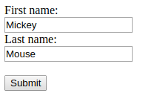
<input type=“submit”>
<input type=“submit"> defines a button for submitting form data to a form-handler :
The form-handler is typically a server page with a script for processing input data. We will learn this later when we talk about back-end code.
<form action="/action_page.php"> First name:<br> <input type="text" name="firstname" value="Mickey"><br> Last name:<br> <input type="text" name="lastname" value="Mouse"><br><br> <input type="submit" value="Submit"> </form>

Slide 8
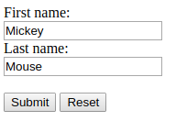
<input type=“reset”>
<input type=“reset"> defines a reset button that will reset all form values to their default values:
<form action="/action_page.php"> First name:<br> <input type="text" name="firstname" value="Mickey"><br> Last name:<br> <input type="text" name="lastname" value="Mouse"><br><br> <input type="submit" value="Submit"> <input type="reset"> </form>

Slide 9
<input type=“radio”>
<input type=“radio"> defines a radio button:
Radio buttons let a user select ONLY ONE of a limited number of choices.
<form> <input type="radio" name="gender" value="male" checked> Male<br> <input type="radio" name="gender" value="female"> Female<br> <input type="radio" name="gender" value="other"> Other </form>

Slide 10
<input type=“checkbox”>
<input type=“checkbox"> defines a checkbox:
Checkboxes let a user select ZERO or MORE options of a limited number of choices.
<form> <input type="checkbox" name="vehicle1" value="Bike"> I have a bike<br> <input type="checkbox" name="vehicle2" value="Car"> I have a car </form>

Slide 11
The <select> element (dropdown list)
The <select> element defines a drop-down list The <option> elements defines an option that can be selected. By default, the first item in the drop-down list is selected.
<form> <select name="cars"> <option value="volvo">Volvo</option> <option value="saab">Saab</option> <option value="fiat">Fiat</option> <option value="audi">Audi</option> </select>
</form>

Slide 12
The <select> element (dropdown list)
To define a pre-selected option, add the selected attribute to the option.
<form> <select name="cars"> <option value="volvo">Volvo</option> <option value="saab">Saab</option> <option value="fiat" selected>Fiat</option> <option value="audi">Audi</option> </select>
</form>

Slide 13
The <select> element (dropdown list)
Use the multiple attribute to allow the user to select more than one value: Use the size attribute to specify the number of visible values.
<form> <select name="cars" size="3" multiple> <option value="volvo">Volvo</option> <option value="saab">Saab</option> <option value="fiat">Fiat</option> <option value="audi">Audi</option> </select>
</form>

Slide 14
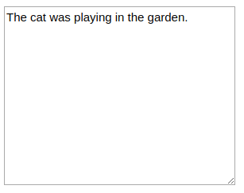
The <textarea> element
The <textarea> element defines a multi-line input field (a text area)
The rows attribute specifies the visible number of lines in a text area.
The cols attribute specifies the visible width of a text area.
<form> <textarea name="message" rows="10" cols="30"> The cat was playing in the garden. </textarea>
</form>
You can also define the size of the text area by using
CSS properties width and height

Slide 15
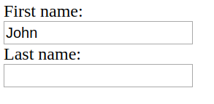
<input> Attributes – value
The value attribute specifies the initial value for an input field
<form> First name:<br> <input type="text" name="firstname" value ="John"> <br> Last name:<br> <input type="text" name="lastname"> </form>

Slide 16
<input> Attributes – readonly
The readonly attribute specifies that the input field is read only (cannot be changed):
<form> First name:<br> <input type="text" name="firstname" value ="John" readonly> <br> Last name:<br> <input type="text" name="lastname"> </form>

Slide 17
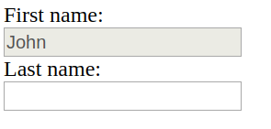
<input> Attributes – disabled
The disabled attribute specifies that the input field is disabled. A disabled input field is unusable and un-clickable, and its value will not be sent when submitting the form
<form> First name:<br> <input type="text" name="firstname" value ="John" disabled> <br> Last name:<br> <input type="text" name="lastname"> </form>

Slide 18
<input> Attributes – size
The size attribute specifies the size (in characters) for the input field
<form> First name:<br> <input type="text" name="firstname" value="John" size="40">
<br>Last name:<br> <input type="text" name="lastname"> </form>

Slide 19
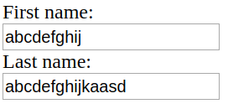
<input> Attributes – maxlength
The maxlength attribute specifies the maximum allowed length for the input field:
With a maxlength attribute, the input field will not accept more than the allowed number of characters.
The maxlength attribute does not provide any feedback. If you want to alert the user, you must write JavaScript code.
<form> First name:<br> <input type="text" name="firstname" maxlength="10">
<br>Last name:<br> <input type="text" name="lastname"> </form>

Slide 20
HTML5 input types
HTML5 introduces several new input types
Browser support varies. Unsupported input types shown as textboxes
Try http://robertnyman.com/html5/forms/input-types.html on different browsers
color
date
datetime-local
email
month
number
range
search
tel
time
url
week
Source: http://robertnyman.com/

Slide 21
Other Form related tags
<textarea>: defines a multi-line text input
<select>: defines a drop-down list
<option>: defines an option inside a drop-down list(<select>)
<optgroup>: groups <option> elements inside a drop-down list(<select>)
<fieldset>: Group related elements in a form.
<legend> defines caption of a <fieldset>.
<label>: defines a label for an <input> element.
Uses for attribute to associate to any specific <input>
Example:
<label for="lastname">Last Name</label>
<input type="text" name="lastname" />

Slide 22
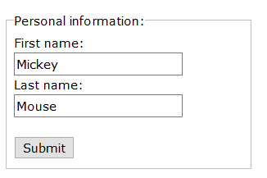
Grouping with <fieldset> and <legend>
<form action="/action_page.php"> <fieldset> <legend>Personal information:</legend> First name:<br> <input type="text" name="firstname" value="Mickey">
<br>Last name:<br> <input type="text" name="lastname" value="Mouse"><br><br> <input type="submit" value="Submit"> </fieldset> </form>

Slide 23
HTML Form attributes
action: Specifies the URL where form data is to be submitted.
Typically another server page that can process form data
If not set, form data is submitted to a new copy of the submitting page itself
method: [get/post]
In get method, form data are appended to the destination URL(e.g. Youtube search query)
In post method, form data put inside the body of the HTTP request
autocomplete : [on/off]
*Submit buttons have action and formmethod attributes, can respectively override action and method attributes of the form containing it

Slide 24
HTML Layouts
Layouts were created using the <div> tag in older versions of HTML.
Partitions the page into columns/blocks, each used for a specific purpose.
<div> was paired with CSS styles using the id attributes.
Layouts can also be created using tables, but it is not recommended.
HTML5 introduces new semantic elements to handle layouts.

Slide 25
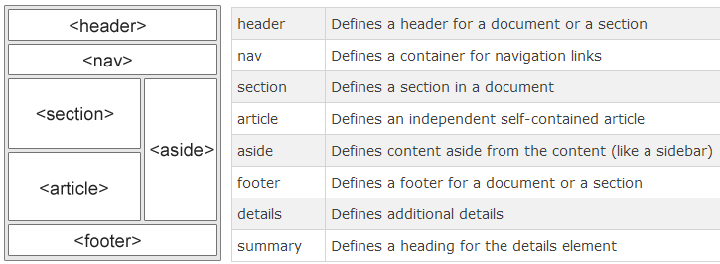
HTML5 Layouts
Source: http://www.w3schools.com/html/html_layout.asp

Slide 26
HTML5 Semantic Elements
A semantic element clearly describes its meaning to both the browser and the developer.
All the layout tags in the previous slide are semantic elements.
Other semantic elements include:
<figure>: Specifies self-contained content, like illustrations, diagrams, photos, code listings, etc.
<figcaption>: Defines a caption for a <figure> element.
<main>: Specifies the main content of a document.
<mark>: Defines marked/highlighted text.
<time>: Defines a date/time.

Slide 27
Embedding Web Content in HTML
An inline frame is used to embed a web page within a web page.
Use src attribute to set the URL of the page to embed, height and width to set dimensions
<iframe src=“http://www.cs.fsu.edu”
width=“600" height=“600“ name="iframe1">
</iframe>
An iframe can be used as the target frame for a link.
<a href="http://www.w3.org" target="iframe1">
World Wide Web Consortium</a>
<!-- Upon click on hyperlink, loads content from
“http://www.w3.org” into the target iframe -->

Slide 28
Embedding audio/video in HTML
<video>: Defines a video or movie.
<source>: Defines multiple media resources for media elements, such as <video> and <audio>
<video width=“480" height=“360" autoplay controls>
<source src="movie.mp4" type="video/mp4">
<source src="movie.ogg" type="video/ogg">
</video>

Slide 29
Embedding audio/video in HTML(contd.)
Video plays automatically when autoplay attribute is present
controls attribute adds video controls(e.g. play/pause, volume etc)
Multiple <source> elements can link to different video files. The browser will use the first recognized format.
<audio> works in a similar way as <video> tags

Slide 30
HTML5 supported audio/video types
Supported type attribute for <video>:
video/webm
video/ogg
video/mp4
Supported type attribute for <audio>:
audio/webm
audio/ogg
audio/mp4
audio/wav

Slide 31
HTML <embed> element
Used to embed interactive content from external application (e.g. Flash animations, Java Applets) on HTML document
Attributes: src, height, width, type
Example:
<embed src="catgame.swf“ type=“application/x-shockwave-flash” height=“200” width=“200” quality="high">
No end tag
Any parameter to the external application is passed as attribute name in <embed>

