Slide 1
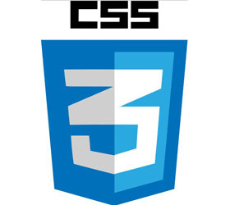
CGS 3066: Web Programming and Design Fall 2019 CSS Extra
Department of Computer Science, Florida State University

Slide 2
CSS Pseudo Classes
A pseudo-class is used to define a special state of an element. for example:
Style an element when a user mouses over it
Style visited and unvisited links differently
Style an element when it gets focus
selector:pseudo-class {
property:value;
}

Slide 3
Pseudo Class for Anchor tag
Links can be displayed in different ways:
/* unvisited link */
a:link {
color: #FF0000;
}
/* visited link */
a:visited {
color: #00FF00;
}
/* mouse over link */
a:hover {
color: #FF00FF;
}
/* selected link */
a:active {
color: #0000FF;
}
Note: a:hover MUST come after a:link and a:visited in the CSS definition in order to be effective! a:active MUST come after a:hover in the CSS definition in order to be effective! Pseudo-class names are case-sensitive.

Slide 4
Combining Pseudo Classes with CSS Classes
Pseudo-classes can be combined with CSS classes
When you hover over the link that belongs to highlight class in this example, it will change color:
a.highlight:hover {
color: #ff0000;
}
You can find the complete list of Pseudo-Classes here.

Slide 5
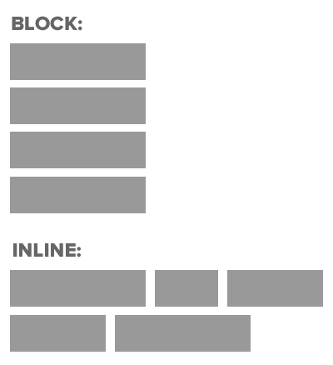
HTML Block and Inline Elements
Every HTML element has a default display value.
The default display value for most elements is block or inline. A block-level element always starts on a new line and takes up the full width available (stretches out to the left and right as far as it can).
An inline element does not start on a new line and only takes up as much width as necessary.

Slide 6
HTML Block and Inline Elements
Example Block Elements:
<p> , <pre> , <table> , <ul> , <ol>, ...
Example Inline Elements:
<img> , <a> , <b> , <strong> , <small> , ...

Slide 7
<div> Element
The <div> element is often used as a container for other HTML elements.
The <div> element has no required attributes, but both style and class are common. When used together with CSS, the <div> element can be used to style blocks of content <div style="background-color:black;color:white;padding:20px;">
<h2>London</h2>
<p>London is the capital city of England. It is the most populous city in the United Kingdom, with a metropolitan area of over 13 million inhabitants.</p>
</div>

Slide 8
<span> Element
The <span> element is often used as a container for some text.
The <span> element has no required attributes, but both style and class are common.
When used together with CSS, the <span> element can be used to style parts of the inline text <h1>My <span style="color:red">Important</span> Heading</h1>

Slide 9
Overriding Box Behavior
We can override the default box type of HTML elements with the CSS display property.
display property can have inline or block as its value.
span, strong{
display: block;
}
<h2>Headings are block elements</h2>
<p>Paragraphs are block as well</p>
However, <span>Spans are not block</span>, similarly <strong>Strong is not
a block element</strong> But we can override the box behavior.

Slide 10
More on Display properties
Display: block/inline/inline-block
“block” means the element should be displayed as a block element
“inline” means the element should be displayed as a inline element
“inline-block”
Allows to set a width and height of the element
Top and bottom margins/paddings are respected
Does not add a line-break after the element, so the element can sit next to other elements.

Slide 11
Examples on Display properties
.menu li{
list-style: none;
display: inline-block;
border: 1px solid blue;
padding: 5px;
width: 100px;
text-align: center;
}
<ul class="menu">
<li>Home</li>
<li>Courses</li>
<li>Staff</li>
<li>About Us</li>
<li>Contact</li>
</ul>

Slide 12
CSS Positioning
Static/Relative/Absolute/Fixed/Sticky
Static Positioning: Default positioning
Static elements are positioned in the normal ﬂow of the page
In normal flow, inline boxes flow from left to right, wrapping to next line when needed.
In normal flow, block boxes flow from top to bottom, making a new line after every box.

Slide 13
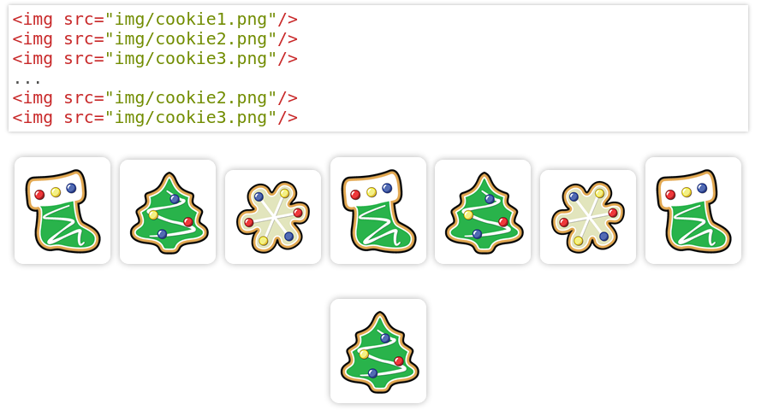
Static Positioning for Inline boxes

Slide 14
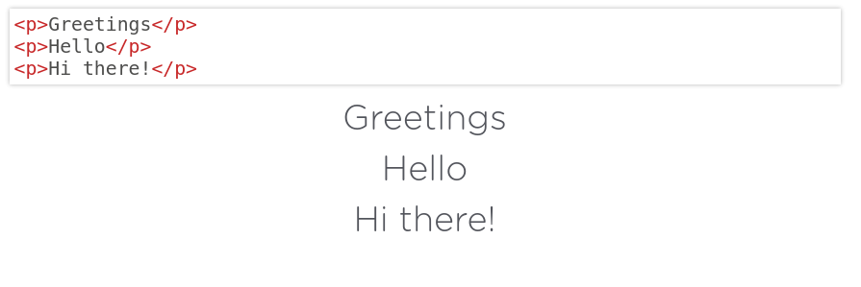
Static Positioning for Block boxes

Slide 15
Relative Positioning
Takes the element out of the normal flow, allowing it to be moved to the top, left, right or bottom.
Does not affect the elements surrounding it.
Makes an element a "positioning context" in which to position other elements relative to it.
Relative positioning and absolute positioning are used together.

Slide 16
Relative Positioning
The "relative" value will still put the element in the normal flow, but then offset it according to top/left/right/bottom properties.

Slide 17
Absolute Positioning
Positions element outside of the normal flow.
An absolutely positioned element is offset from its container block, positioned relative.
Its container block is the first element that has a position other than static.
If no such element is found, the container block is <html>.
Other elements act as if it's not there.
Determined by its oﬀset values in the properties top, bottom, right and left.

Slide 18
Absolute Positioning
The "absolute" value will take the element out of the normal flow and position it in relation to the window (or the closest non-static element).
Top
Bottom

Slide 19
Absolute/Relative Positioning
First, you must understand the normal flow of the web page
Top to bottom. Left to right
Absolute positioning means the position is relative to the first non-static ancestor of the element
The position is relative to another element
Relative positioning means the position is relative to its own static/normal position
The position is relative to the position that the very same element would have in the normal flow

Slide 20
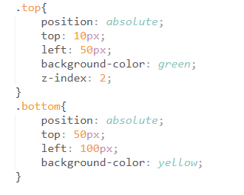
Z-Index
Sometimes elements overlap. You can change the order of overlapping with z-index.
The element with highest z-index goes on top.
Top
Bottom

