Slide 1
CGS 3066: Web Programming and Design Fall 2019 CSS Part 2
Department of Computer Science, Florida State University

Slide 2
The CSS Box Model
All printable HTML elements can be represented as rectangular boxes
Each box consist of the following spaces:
Content Area: displays the actual text/graphic
Padding: spaces surrounding the content area
Border: Surrounds contents and padding
Margin: spaces to separate an element from other adjacent elements or its container

Slide 3
The CSS Box Model
Margin
Border
Padding
Content

Slide 4
The CSS “containing element”
Each element has an associated containing element
“each box sits inside some bigger box”
Only block level elements(<div>,<table>,<h1>..<h6> etc) or the webpage itself(<html> tag) are considered as containing element
In case of multiple block-level nesting, the containing element of a box/element will be the closest block level element
Will be referred as simply ‘container’

Slide 5
CSS Width and height properties
height: [length units]
width: [length units]
Used to set width and height of the Content Area of an Element
div{
height: 100px;
width: 300px;
}
Length values can be absolute(in,cm,mm,px) or % of the height/width of its container

Slide 6
CSS Padding properties
padding-top: [length units]
padding-right:[length units]
padding-bottom:[length units]
padding-left:[length units]
Shorthand expression: padding: [top][right][bottom][left]
Start from top and go clockwise

Slide 7
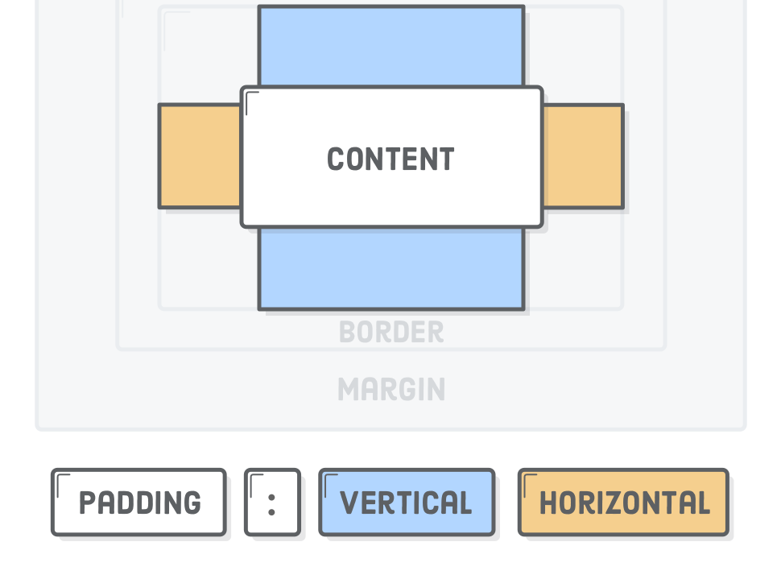
Shorthand format
Typing out all of these properties out can be tiresome, so CSS provides an alternative “shorthand” form of the padding property that lets you set the top/bottom and left/right padding with only one line of CSS.
p { padding: 20px 10px; }
Vertical
Horizontal

Slide 8
CSS Margin properties
margin-top: [length units]
margin-right:[length units]
margin-bottom:[length units]
margin-left:[length units]
Similar to padding, property margin can set all 4 values in top-right-bottom-left sequence

Slide 9
CSS Borders
border-style: [none/hidden/dotted/dashed/solid/double/groove/ridge/inset/outset]
To Add style to specific side of a border:
border-top-style,border-bottom-style ..
border-color: [color value]
Similarly, border-top-color, border-left-color etc.
border-width: [length units]
Applies uniform width to all four borders. Customizable
Shorthand expression:
border: [border-width value] [border-style value] [border-color value]

Slide 10
CSS Borders
h1 { border: 1px solid red; }
And this one creates a thick, dotted green border:
h1 { border: 4px dotted green; }
Heading
Heading

Slide 11
CSS Borders
border-collapse: [collapse/separate]
Applies to Table elements
If separate, adjacent cells each have their own distinct borders.
If collapsed, adjacent table cells share borders.

Slide 12
Default HTML Layout
By default, all visible elements of a web page is displayed in the same sequence they are written in HTML
Page width filled from left to right, then height filled from top to bottom

Slide 13
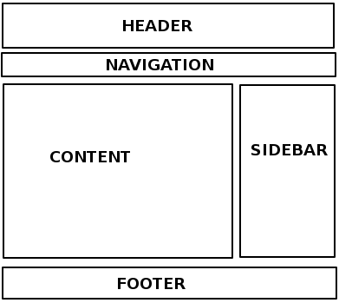
HTML vs CSS Positioning
How to design multi-column layouts on a web page?
Use <table>
Add content blocks as table data
not recommended
Alternatively, use CSS positioning properties

Slide 14
CSS float Property
float: [left/right/none]
Places the selected element at the left or right side of its container
Other texts and inline elements of the container will wrap around it
Widely used

Slide 15
CSS float Property
By default, block-level elements occupy the entire available width of its container
Try printing a small <div> with a background color!
Replace <div> with <span> and compare!
To make the block–level elements float, it should be ‘shrunk’ by setting appropriate width property

Slide 16
CSS float Property
#div1 {
float:right;
width:300px;
height:300px;
background-color:red;
border-style:solid"
}
<p id=“para1”>
<div id=“div1”> floated<br>text</div>
Loren ipsum …. laborum
</p>

Slide 17
CSS clear Property
clear: [left/right/both]
Prevents placement of floating element on the [left/right/both] side of the selected element
Useful to clear past floating elements and resume normal flow

Slide 18
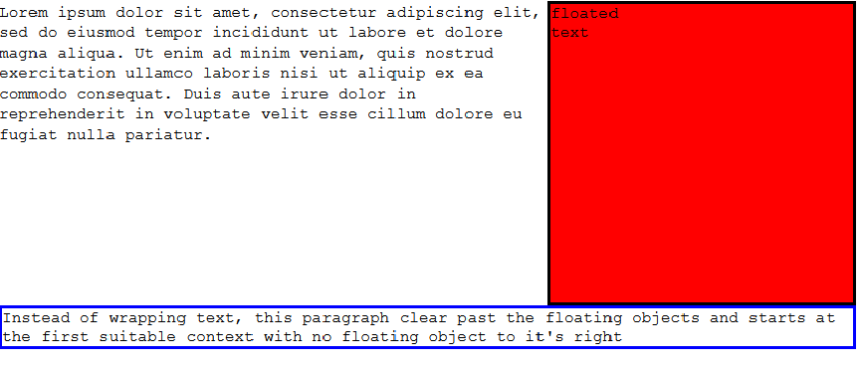
CSS clear Property
#para2{
clear:both;
border-style:solid;
border-color:blue
}
<p id=“para1”>
<div id=“div1”> floated<br>text</div>
Loren ipsum …. Pariatur
<p id=“para2”> Instead of …it’s right </p>
</p>

Slide 19
CSS position property
position: [static|absolute|fixed|relative]
Position value static suggests default, normal flow.
To use absolute/fixed/relative option, one or two of the following must be set:
top: [length units]
bottom: [length units]
left: [length units]
right: [length units]
Specifies exact placement location for the selected element

Slide 20
CSS position property(contd.)
absolute: Positioning values measured from the edge of the entire HTML document
fixed: Positioning values are calculated from the edge of the viewport.
User always sees a fixed element in the same location of his page view
Relative: Positioning values are calculated from the edges of the nearest positioned container
Example: http://learnlayout.com/position-example.html

