Slide 1
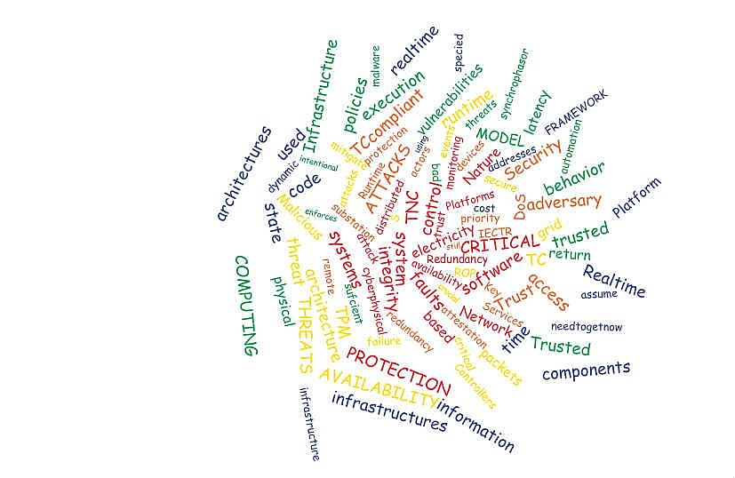
Reliable and resilient interdependent systems
Mike Burmester

Slide 2
Talkthrough
Critical Infrastructure
Resiliency for interdependent systems
Supply Chain Security & Resilience
Privacy preserving vehicular communication
Trusted Computing for Critical Infrastructure Protection
Dynamic Real-time Security Analysis of Electrical Power Systems

Slide 3
1. Critical infrastructures
Highly interdependent systems that integrate a tightly coupled and coordinated ecology of
machines, sensors,
computers,
social systems
financial systems
and cyber networks.
Physical system
Social system
Cyber system
Environment/
ecological
system
Financial system

Slide 4
1. Critical infrastructure ecology
This ecology is critically impacted by the people that control it and access its services.
It is particularly vulnerable to technological failure, social and organizational breakdown and bad actor/malware threats.
Physical system
Social system
Cyber system
Environment/
ecological
system
Financial system
The nature of the services and the potentially devastating effects of failure highlight the critical necessity for solutions that provide effective protection.

Slide 5
2. Resiliency for interdependent systems
Engineering systems: constancy and predictability, stability near an equilibrium steady state (post disaster, etc)
Environment/ecological systems: the capacity to respond to a natural perturbation or disturbance by resisting damage and recovering quickly.
Socio-ecological systems: the capacity to maintain a balance of self-organizing systems.
Financial systems: the capability to adapt to the consequences of failure and to cope with change.

Slide 6
2.1 Threat model
Resilience requires system stability near an equilibrium steady state in the presence of perturbations/disturbances caused by:
  Nature
  Bad/faulty design
  Bad actor/malware behavior

Slide 7
2.2 A Security Framework
What is needed is:
  A complete understanding of the vulnerabilities of such systems
  A framework that captures and holistically integrates the technical and social aspects of such systems with the impact of complex system failures on social, economic, and political institutions.
  To develop socio-technical methodologies/tools that combine
    Risk Analysis/Management
    Economic/Financial and Game Theory models/methods
    Cryptographic methods

Slide 8
2.3 Risk Analysis/Management
ISO 31000

Slide 9
    2.4 Economic/Financial & Game theory models
Game theory is
A theory for strategic decision making.
Involves the study of models of conflict and cooperation.
Applies to a wide range of behavioral relations involving of humans and non-humans.
Used in economics, political sciences, psychology, biology, . . .
Game theory involves
players, actions, strategies and payoffs (in terms of utilities)
A solution of a Game is a set of player strategies that when adopted guarantee a stable system state.

Slide 10
    2.5 Cryptographic methods
Typically cryptographic tools are used to enforce:
Confidentiality, Integrity, Availability
In many cases Best Effort service, or QoS will do.
For Critical Infrastructures, often
  Availability (in real-time)
is the most important service requirement.

Slide 11
3. Supply Chain Security & Resilience
Goals for securing the supply chain
promote efficient and secure services
foster resilience
Goals for efficiency
prioritize efforts to mitigate systematic vulnerabilities
Plans to reconstitute the flows after disruptions adopted
National Strategy for Global
Supply Chain Security
11

Slide 12


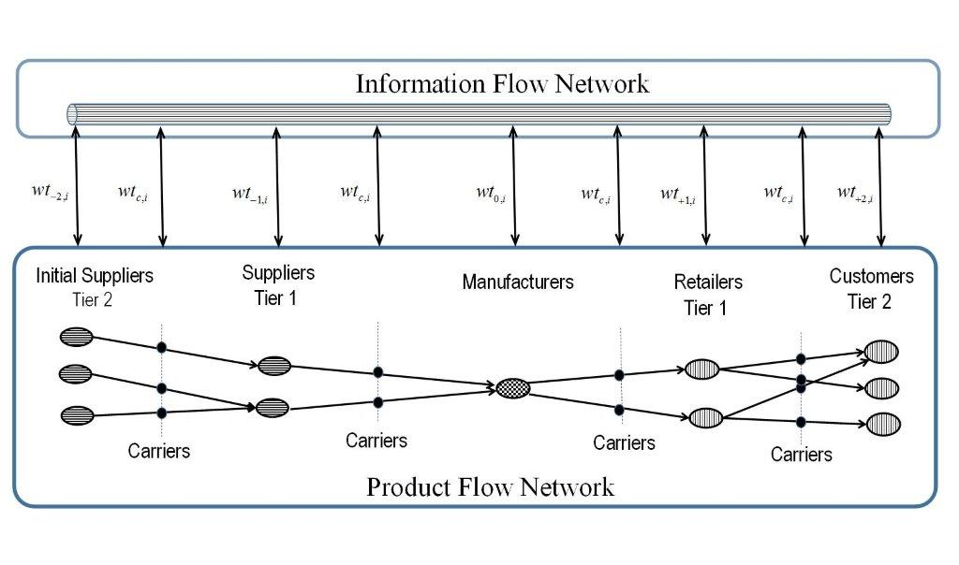




Supply Chain Security & Resilience

Slide 13
Supply Chain Security & Resilience
Threat model
There may be missing tags
Carrier is not Trusted
Batch connectivity

Slide 14
Ownership Transfer
Ownership Transfer
Secure
Guarantee the privacy of both parties
The current owner should not be able to trace the tag once ownership is transferred.
This is challenging because the new owner does not share any private information with the tag that the previous owner does not know.
14

Slide 15


Ownership Transfer
Current owner-eavesdropper
The new owner and tag cannot agree a new private key because the current owner is eavesdropping
1
1
Options to guarantee the privacy
TTP → not appropriate for decentralized process
Isolated Environments → weak threat model
Tag
New Owner
15

Slide 16

Ownership Transfer
Options to guarantee the privacy
TTP→ not appropriate for decentralized process
Isolated Environments → weak threat model
Channels with positive secrecy capacity
Example
Tag is hidden in the crowd
0
0
0
1
1
1
0
0
0
1
1101000100
shared secret
16

Slide 17
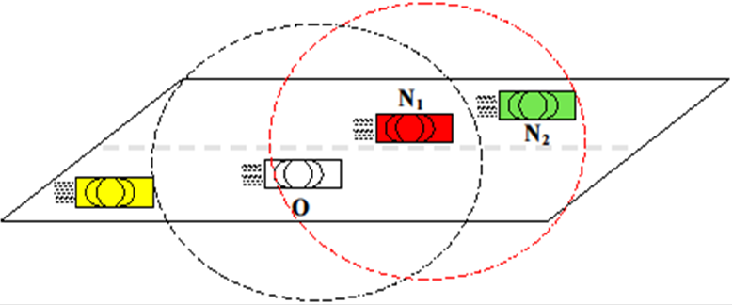
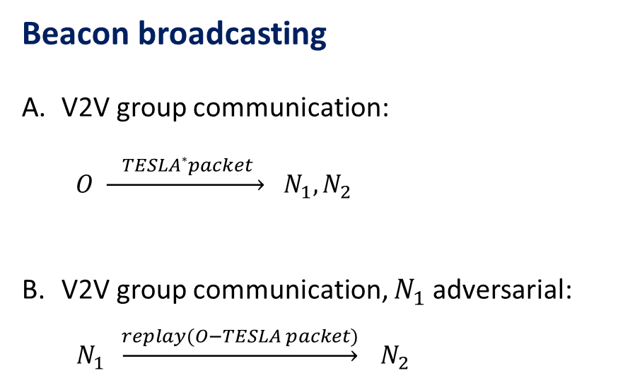
4. Secure, privacy-preserving timed vehicular communication
Beacon broadcasting
V2V group communication:
$O \underset{→}{ TESLA∗packet }$ $N_{1}, N_{2}$
V2V group communication, $N_{1}$ adversarial:
$N_{1} \underset{→}{replay(O−TESLA packet)} N_{2}$
* Time Efficient Stream Loss-tolerant Authentication

Slide 18
4.1. Secure, privacy-preserving timed vehicular communication
Strict schedule beacon broadcasting
Routine safety messages are broadcast ever 300ms
An authenticating key is sent after 100ms
TESLA is used
Solution proposed by TSVC* is
  Flawed (protocol crashes)
  Latency in dense traffic too high
* Time Efficient Secure Vehicular Communication.

Slide 19
4.2. Secure, privacy-preserving timed vehicular communication
Strict schedule beacon broadcasting
A hash chain is used (TESLA)
h₁, h₂, . . . , h_{i}, . . . , h_{n} ,
where Hash(h_{i+1})= h_{i} , and h_{n} is authenticated with a
digital signature (given h_{i} it is hard to compute h_{i+1}).
Routine safety messages are broadcast ever 300ms
An authenticating key is sent after δ =100ms

Slide 20
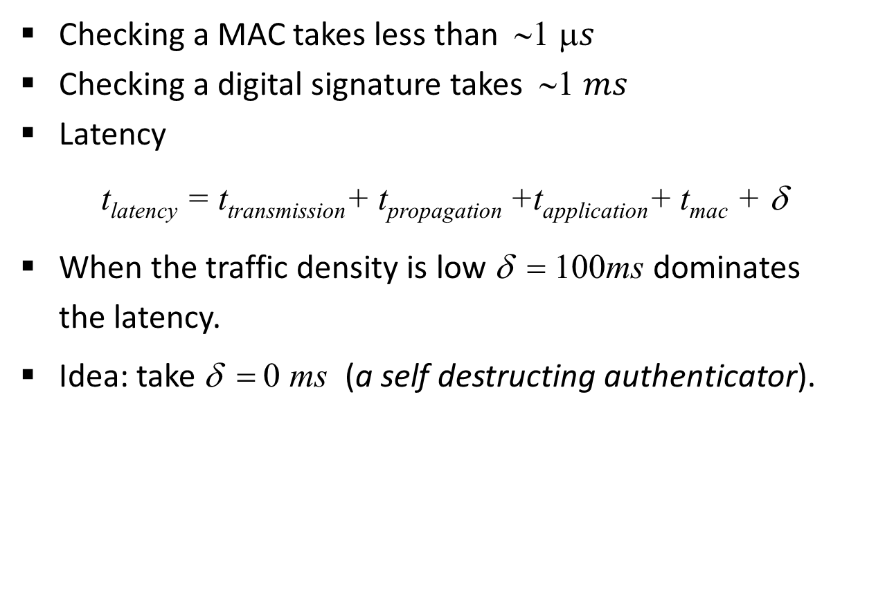
4.3. Secure, privacy-preserving timed vehicular communication
Checking a MAC takes less than ∼1 $s$
Checking a digital signature takes ∼1 $ms$
Latency
t_{latency} = t_{transmission}+ t_{propagation} +t_{application}+ t_{mac} + δ
When the traffic density is low δ = 100ms dominates
the latency.
Idea: take δ = 0 ms (a self destructing authenticator).

Slide 21
4. Trusted Computing for Critical Infrastructure Protection
.
Motivation
  Critical Infrastructures must run trusted applications
  Loadtime and runtime integrity
How do I know that only trusted programs are executed?
  Is the software compromised?
How do I guarantee that an adversary cannot subvert the control flow of a trusted program?
Real-time availability
How do I know that the time required for executing a trusted application does not exceed real-time system thresholds?
  Are all input values available on time?

Slide 22
5. Trusted Computing Architectures
Open standards for trustworthy computing
Supported by industry leaders.
Supports technologies for hardware/software applications.
Features:
  For users
    Anti-virus protection, Anti-hacker protection, Backward compatibility, Can be turned off
  For industry
    Security, licensing

Slide 23
5.1 A security framework for CPS
Threat model
Captures adversarial intent and the scope.
Addresses system features that the adversary can abuse and that may lead to system failure.
Adversarial threats.
  We identify the specific features, which we call system vulnerabilities, that the adversary can exploit. These are identified by:
    the security policies of the system
    vulnerability assessments
    grey-box penetrating tests.
System failure can also result from actions by Nature.

Slide 24
5.2 The ugly (1)
Run-time threats
TC architectures rely on digests of static execution targets to measure the integrity of a trusted platform.
To materially impact on the integrity of a trusted platform the adversary must attack the platform software without requiring the presence of malicious software.
Run-time attacks involve the imposition of unintended behavior on a software target that is executing.
  In a return oriented programming (ROP) attack there is no need to inject new malicious code: instead the code in local libraries may be used.
  ROP overwrites the stack with addresses that point to existing code in a library

Slide 25
5.2 The ugly (2)
For ROP attacks the adversary must be able to control the execution on the stack, and there are (rather costly) ways to prevent this.
However there may be other kinds of run-time attacks. Indeed, proof-carrying code is not closed with respect to composability unless the proofs are Universally Composable.

Slide 26
5.3 Real-time availability threats for
Trusted Computing systems
Access Control for need-to-get-now policies
  The primary concern for most CPS is availability, not confidentiality (“need-to-know” policies (Bell-LaPadula)

Slide 27
5.4 Access Control for need-to-get-now policies
Priority clearance
The header frame of an IP packet has several components.
These include a packet identifier, the priority clearance, and a message authentication code (MAC).

Slide 28
5.5 Congestion level
The congestion level of a link is determined by its traffic flow. This is established dynamically by a real-time intelligent agent that monitors traffic flows.
When the traffic flow exceeds a certain threshold, the congestion level is raised.
The effect is to reduce the traffic flow rate to a level for which availability is guaranteed.
Access control for availability is determined by domination: when the congestion level is Hi then only Hi priority packets are allowed to be transmitted.

Slide 29
5.6 Access Control for need-to-get-now policies
The access control infrastructure enforces need-to-get-now policies.
That is: if the level of traffic is high during a critical event, then all packets with Lo priority will be dropped, and Hi priority packets will always be delivered.
Because the system is
  guaranteed to cope with this level of congestion, and
  all nodes are guaranteed to abide by the policies of the network
  real-time resilience is assured.

Slide 30
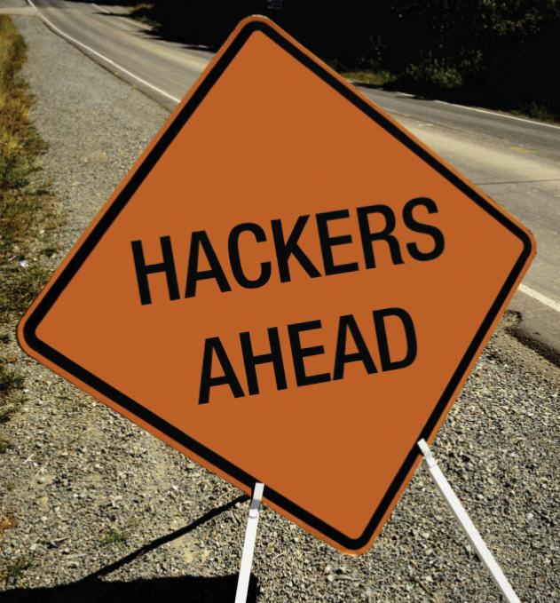
Dynamic Real-time Security Analysis of Electrical Power Systems
Gathering Cyber-Physical Threat Intelligence

Slide 31
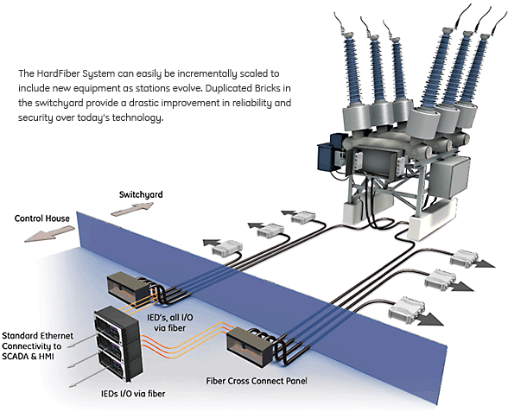
Protection and control architecture for an EG substation
Bricks
Bricks
Ethernet connectivity to SCADA & HMI
IEDs I/O via fiber
IEDs I/O via fiber

Slide 32
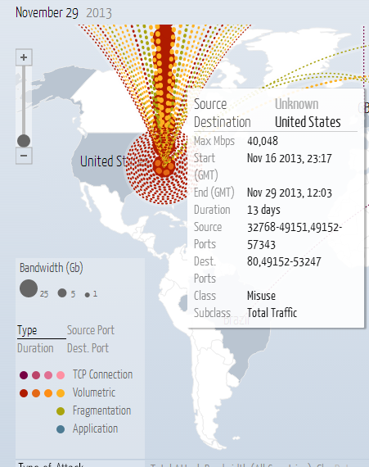
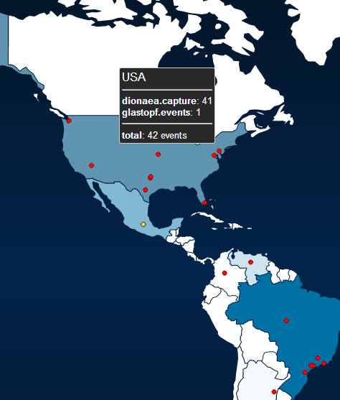
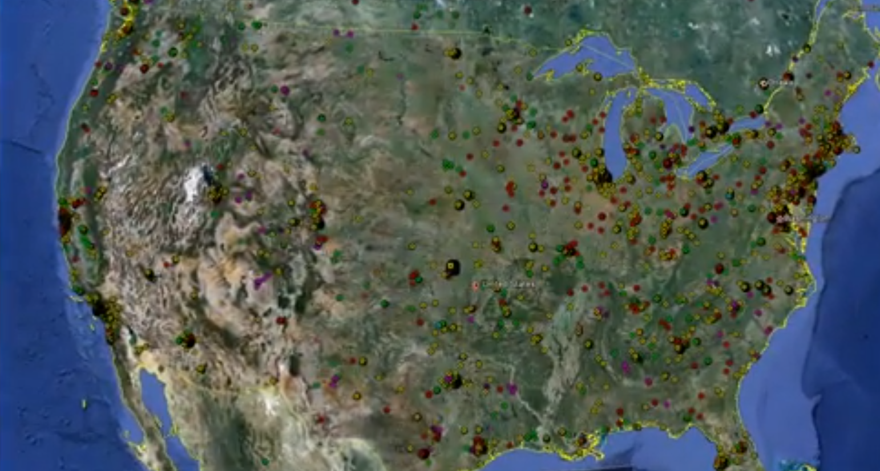
Getting Situational Awareness in ICS / SCADA

Slide 33
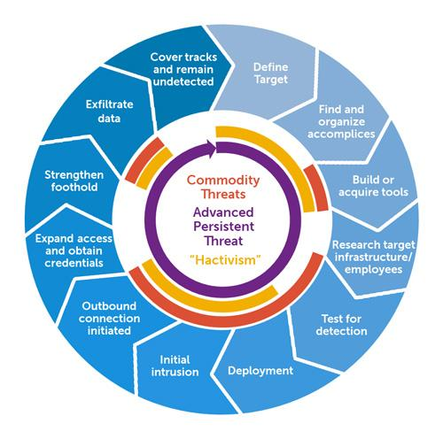
CPS Honeypots
CISCO CIAG’s SCADA HONEYPOT (2004)
DIGITAL BOND’s SCADA Honeynet Project (2010)
CONPOT - The Honeynet Project’s ICS Honeypot
TREND MICRO’s closed-source honeypot project
ROS Honeypot

Slide 34
RobotOS (ROS) Honeypot
The ROS honeypot is the 1st true cyber-physical honeypot
DEFCON 20 experiment
providing a high-interaction vulnerable HMI that interfaces
with actual robotic hardware running ROS.
  Thus, is able to capture cyber attacks against the underlying physical system

Slide 35
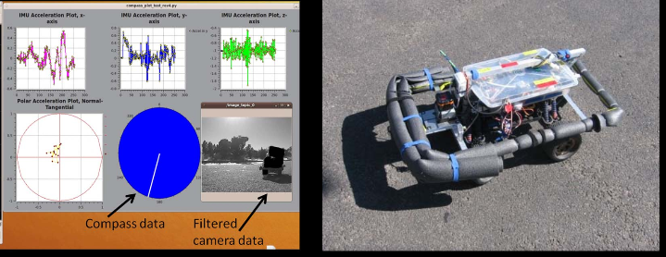
RobotOS (ROS) Honeypot

Slide 36
RobotOS (ROS) Honeypot
But this solution would not scale for large CPS…
Too expensive
Too complicated
High maintenance

Slide 37
Symbolic Cyber-Physical Honeynet (SCyPH) Framework
Novel features:
symbolic simulation/analysis of physical part
emulation of everything else (SCADA / ICS protocols)
  Provides realistic stimuli to HMI = believable target
  Allows capture of post-exploitation behavior
  Organize and highlight attack data in a “cyber-physical-anomaly-centric manner”
Notes:
Modified

Slide 38
Any questions?
References
http://www.cs.fsu.edu/~burmeste/pubs.html

