Slide 1
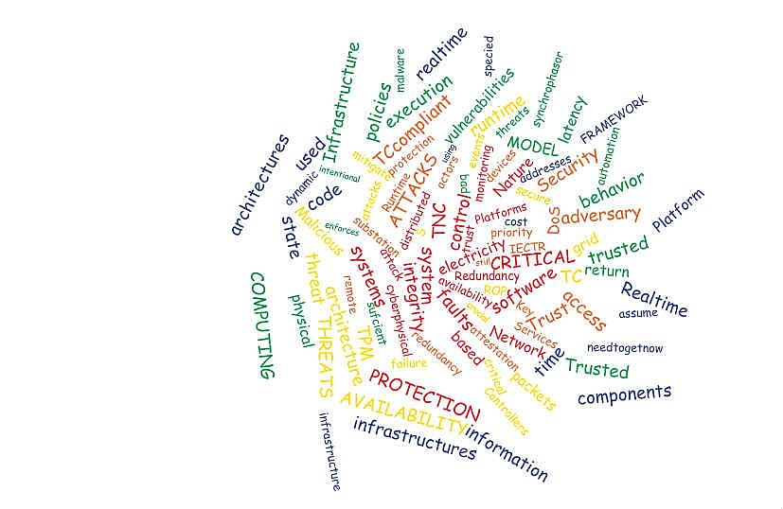
Challenges of securing the Internet of Things
Mike Burmester

Slide 2
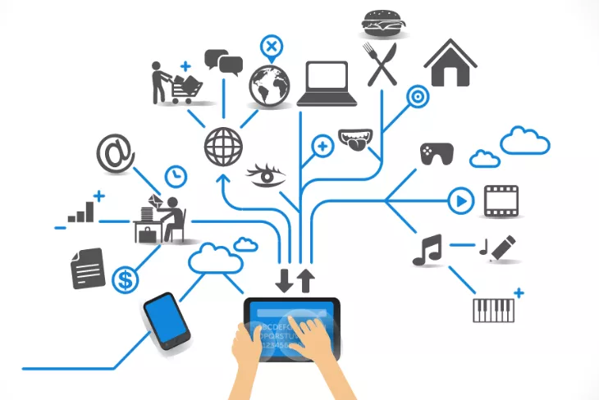
1. The Internet of Things (IOT)
The IoT links identifiable objects to their virtual representation on the Internet making it possible for an end user (or processor) to monitor and link these to additional information regarding their status for efficient control, management and logistics.
Extends the scope of the Internet making it possible to control smart systems and structures, in particular industrial control systems and critical infrastructures

Slide 3
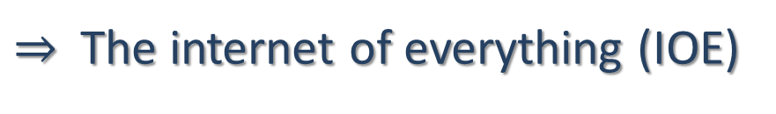
Smart structures and critical infrastructures
Highly interdependent systems that integrate a tightly coupled and coordinated ecology of
machines, sensors,
computers,
social systems
financial systems
and cyber networks.
Physical system
Social system
Cyber system
Environment/
ecological
system
Financial system
$⇒$The internet of everything (IOE)

Slide 4
Smart structures and critical infrastructures
Security does not capture what we need.
We need a broader characterization of expected
“normal” behavior of interdependent systems

Slide 5
Resilience
Engineering systems: constancy and predictability, stability near an equilibrium steady state (post disaster, etc)
Environment/ecological systems: the capacity to respond to a natural perturbation or disturbance by resisting damage and recovering quickly.
Socio-ecological systems: the capacity to maintain a balance of self-organizing systems.
Financial systems: the capability to adapt to the consequences of failure and to cope with change.

Slide 6
Threat model
Perturbations/disturbances caused by:
  Nature (… unpredictable to an absolute degree)
  Bad/faulty design (we are humans …)
  Bad actor/malware behavior (we are not all the same …)

Slide 7
A framework for resilience
We need
  A complete understanding of the vulnerabilities of such systems
  A framework that captures and holistically integrates the technical and social aspects of such systems with the impact of complex system failures on social, economic, and political institutions.
  To develop socio-technical methodologies/tools that combine
    Risk Analysis/Management
    Economic/Financial and Game Theory models/methods
    Cryptographic methods

Slide 8
Risk Analysis/Management
ISO 31000

Slide 9
    Economic/Financial & Game theory models
Game theory
a theory for strategic decision making.
the study of models of conflict and cooperation.
applies to a wide range of behavioral relations involving of humans and non-humans.
Involves
players, actions, strategies and payoffs (in terms of utilities)
A solution of a Game is a set of strategies that guarantee a stable system state.
-- Nash equilibrium

Slide 10
    Cryptographic methods
Typically crypto tools are used to enforce:
Confidentiality, Integrity, Availability
In many cases Best Effort service, or QoS will do.
For Critical Infrastructures, often
  Availability (in real-time)
is the most important service requirement.
--blockchain, provenance

Slide 11
Supply Chain Security & Resilience
motivation
Security
Promote secure and efficient services
Foster resilience
Resilience = security + efficiency + …
Prioritize efforts to mitigate systematic vulnerabilities
Adopt plans to reconstitute flows after disruptions
National Strategy for Global
Supply Chain Security
11

Slide 12


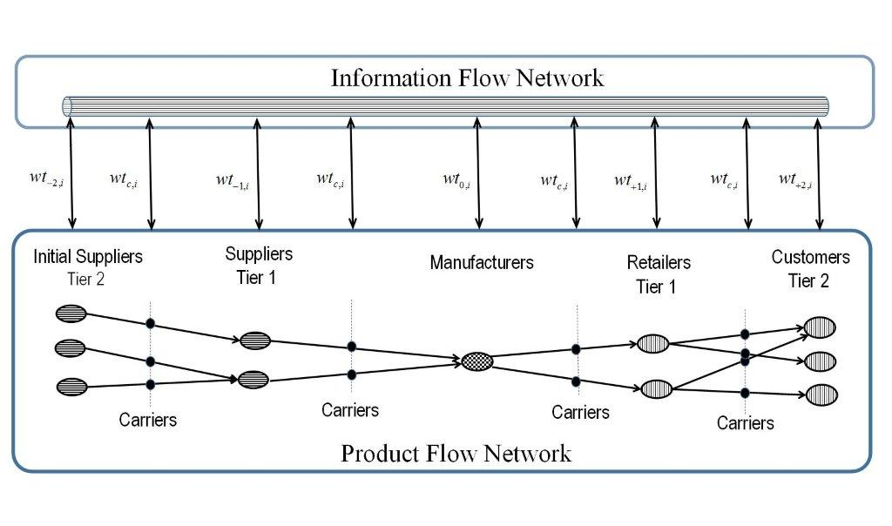




Supply Chain Security & Resilience

Slide 13
Supply Chain Security & Resilience
Threat model
There may be missing tags
Carrier is not Trusted

Slide 14
Ownership Transfer
Ownership Transfer
Secure
Guarantee the privacy of both parties
The current owner should not be able to trace the tag once ownership is transferred.
This is challenging because the new owner does not share any private information with the tag that the previous owner does not know.
14

Slide 15


Ownership Transfer
Current owner-eavesdropper
The new owner and tag cannot agree on a new private key because the current owner is eavesdropping
1
1
Options to guarantee the privacy
TTP → not appropriate for decentralized process
Isolated Environments → weak threat model
Tag
New Owner
15

Slide 16

Ownership Transfer
Channels with positive secrecy capacity
Example
Tag is hidden in a “crowd”
0
0
0
1
1
1
0
0
0
1
1101000100
shared secret

Slide 17
Flyweight, Wiretap channel (Wyner)
“how to add and then subtract noise”
Alphabet Y = {y₀,y₁,y₂,y₃} for tag T with two noisy tags The encoding entropy, error and Fano bounds of the wiretap channel
(Pulse Position Modulation: a bit is encoded by transmitting a pulse
in one of two possible slots)
Mike Burmester, Jorge Munilla: Tag Memory-Erasure Tradeoff of RFID Grouping Codes. IEEE Communications Letters 20(6): 1144-1147 (2016)

Slide 18
Flyweight authentication
Threshold Things That Think (T4)*
Tag erasure-codes
Mike Burmester, Jorge Munilla: Tag Memory-Erasure Tradeoff of RFID Grouping Codes. IEEE Communications Letters 20(6): 1144-1147 (2016)
* Desmedt, Y., Burmester, M., Safavi-Naini, R., & Wang, H. (2001). Threshold Things That Think (T4): Security Requirements to cope with theft of hand/handless Internet devices. In Symposium on Requirement Engineering for Information Security (SREIS), Indianapolis (pp. 354-367).

Slide 19
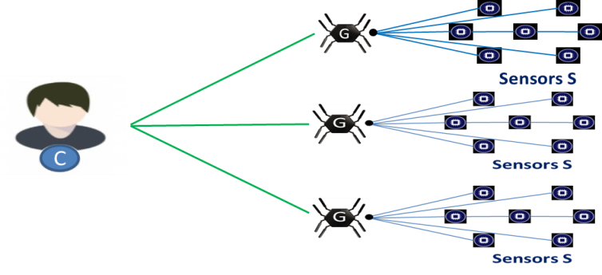
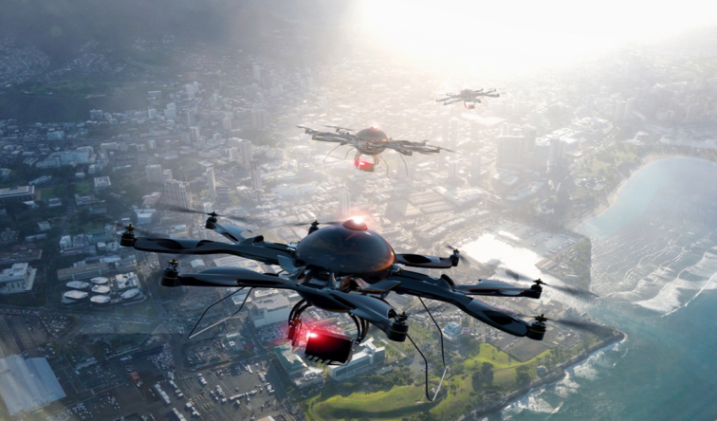
Two problems
Understanding cyber threats and exploits of heterogeneous sensor networks.
Understanding cybersecurity implications of using and protecting drones.

Slide 20
1. Heterogeneous sensor networks
Wearable device system
1. Wireless Body Sensor Network (WSBN)
2. Smart Phone
3. Cloud Server
WD SP CS

Slide 21
Heterogeneous sensor networks
mHeathcare system
1. Wireless Body Sensor Network
Wearable or implantable sensors
Super sensor node
2. Controller Node
3. Public Network
MU PN CN SN

Slide 22




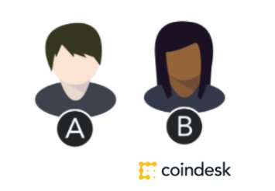
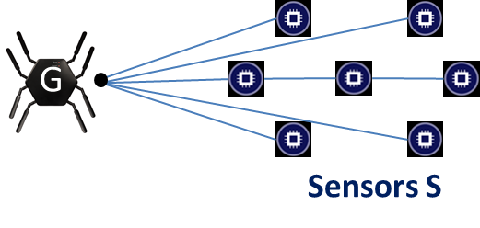
A model for heterogeneous sensor networks
G
1. Client
2. Gateway
3. Sensors
Sensors S
C

Slide 23
Crypto mechanisms
Heavyweight | Lightweight | Featherweight | Flyweight
Public-key crypto | Elliptic curve crypto | Symmetric-key crypto | Hash functions
Symmetric-key crypto | Symmetric-key crypto | Hash functions | PRN
Hash functions | Hash functions | PRN | (harvest entropy)
PRN | PRN | (harvest entropy)
Notes:
Modified

Slide 24
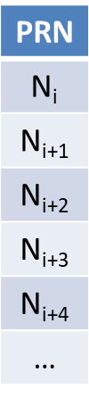
Flyweight authentication (anonymity)
Mike Burmester, Jorge Munilla: Lightweight RFID authentication with forward and backward security. ACM Trans. Inf. Syst. Secur. 14(1): 11:1-11:26 (2011)
Burmester, M., & Munilla, J. (2009). Flyweight authentication with forward and backward security. In WISP Summit 2009, First workshop on Wireless Powered Sensor Networks and Computational RFID, Berkeley, California, INTEL.
Burmester, M., Van Le, T., De Medeiros, B., & Tsudik, G. (2009). Universally Composable RFID Identification and Authentication Protocols. ACM Trans. Inf. Syst. Secur, 12(4), 33 pages.
(only need PRN + timers)

Slide 25

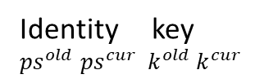





Featherweight authentication (anonymity + forward secrecy)
Gateway Sensor
If $\left(ps,k\right)$ is in database then
compute
$v_{1}^{∗}∥v_{2}^{∗}∥$ $v_{3}^{∗}∥v_{4}^{∗}$
If $v_{1}^{′}=aut$ update
${(ps}^{old}, {ps}^{cur},k^{old}, k^{cur}\text{)}←\left(ps,v_{2}^{∗},k,v_{3}^{∗}\right)$
$conf ←v_{4}^{∗}$
accept
If $conf=v_{4}^{′}$ then update
$(ps,k\text{)}←\left(v_{2},v_{4}\right)$
accept
Identity key
${ps}^{old}$ ${ps}^{cur} k^{old} k^{cur}$
$$ps k$$
challenge $c$
$$ps∥aut$$
$v_{1}∥v_{2}∥$ $v_{3}∥v_{4}←F\left(k;ps∥c\right)$
$$aut ← v_{1}$$
$conf$

Slide 26
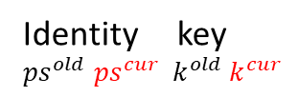




Featherweight authentication (anonymity + forward secrecy)
Gateway Sensor
If $\left(ps,k\right)$ is in database then
compute
$v_{1}^{∗}∥v_{2}^{∗}∥$ $v_{3}^{∗}∥v_{4}^{∗}$
If $v_{1}^{′}=aut$ update
${(ps}^{old}, {ps}^{cur},k^{old}, k^{cur}\text{)}←\left(ps,v_{2}^{∗},k,v_{3}^{∗}\right)$
$conf ←v_{4}^{∗}$
accept
If $conf=v_{4}^{′}$ then update
$(ps,k\text{)}←\left(v_{2},v_{4}\right)$
accept
Identity key
${ps}^{old}$ ${ps}^{cur} k^{old} k^{cur}$
$$ps k$$
challenge $c$
x
$$ps∥aut$$
$v_{1}∥v_{2}∥$ $v_{3}∥v_{4}←F\left(k;ps∥c\right)$
$$aut ← v_{1}$$
$conf$

Slide 27
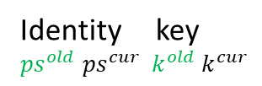

Featherweight authentication (anonymity + forward secrecy)
Gateway Sensor
If $\left(ps,k\right)$ is in database then
compute
$v_{1}^{∗}∥v_{2}^{∗}∥$ $v_{3}^{∗}∥v_{4}^{∗}$
If $v_{1}^{′}=aut$ update
${(ps}^{old}, {ps}^{cur},k^{old}, k^{cur}\text{)}←\left(ps,v_{2}^{∗},k,v_{3}^{∗}\right)$
$conf ←v_{4}^{∗}$
accept
If $conf=v_{4}^{′}$ then update
$(ps,k\text{)}←\left(v_{2},v_{4}\right)$
accept
Identity key
${ps}^{old}$ ${ps}^{cur} k^{old} k^{cur}$
$$ps k$$
challenge $c$
x
$$ps∥aut$$
$v_{1}∥v_{2}∥$ $v_{3}∥v_{4}←F\left(k;ps∥c\right)$
$$aut ← v_{1}$$
$conf$

Slide 28



Featherweight authentication (anonymity + forward secrecy)
Gateway Sensor
Identity key $ps k$
${ps}^{old}$ ${ps}^{cur} k^{old} k^{cur}$
$v_{1}∥v_{2}∥$ $v_{3}∥v_{4}←F\left(k;ps∥c\right)$
$aut ← v_{1}$
If $\left(ps,k\right)$ is in database then
compute
$v_{1}^{∗}∥v_{2}^{∗}∥$ $v_{3}^{∗}∥v_{4}^{∗}$
If $v_{1}^{′}=aut$ update
${(ps}^{old}, {ps}^{cur},k^{old}, k^{cur}\text{)}←\left(ps,v_{2}^{∗},k,v_{3}^{∗}\right)$
$conf ←v_{4}^{∗}$
accept
If 𝑐𝑜𝑛𝑓=$v_{4}^{}$ then update
(𝑝𝑠,𝑘)←($v_{2},v_{4}$)
accept
challenge $c$
$$ps∥aut$$
$conf$
X

Slide 29


Featherweight authentication (anonymity + forward secrecy)
Gateway Sensor
Identity key $ps k$
${ps}^{old}$ ${ps}^{cur} k^{old} k^{cur}$
$v_{1}∥v_{2}∥$ $v_{3}∥v_{4}←F\left(k;ps∥c\right)$
$aut ← v_{1}$
If $\left(ps,k\right)$ is in database then
compute
$v_{1}^{∗}∥v_{2}^{∗}∥$ $v_{3}^{∗}∥v_{4}^{∗}$
If $v_{1}^{′}=aut$ update
${(ps}^{old}, {ps}^{cur},k^{old}, k^{cur}\text{)}←\left(ps,v_{2}^{∗},k,v_{3}^{∗}\right)$
$conf ←v_{4}^{∗}$
accept
If 𝑐𝑜𝑛𝑓=$v_{4}^{}$ then update
(𝑝𝑠,𝑘)←($v_{2},v_{4}$)
accept
challenge $c$
$$ps∥aut$$
$conf$
X

Slide 30
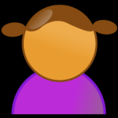









Lightweight authentication (anonymity)
“encrypted key exchange”
Client Gateway Sensor
“Secure lightweight password authenticated key exchange for heterogeneous wireless sensor networks”, IEEE Internet of Things, Sept 2018, submitted.
$$ps{,k}_{c},ctr$$
${ps}^{old}$, ${ps}^{cur}{,K}_{g},ctr$
${id}_{s}{,k}_{s}$
$ps∥{id}_{s}$ $∥$ $enc1∥t_{1}$
$${id}_{g}∥n_{g}∥enc1∥enc2∥t_{2}$$
$${id}_{s}∥n_{g}∥aut1∥{enc3∥t}_{3}$$
$$ps^{′}∥aut1∥{enc2∥enc3∥t}_{3}$$

Slide 31
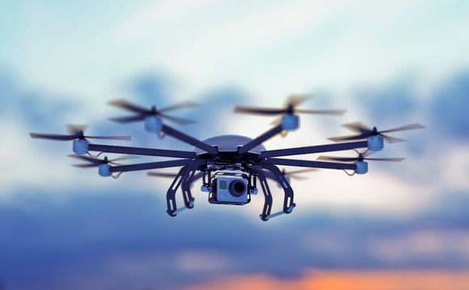
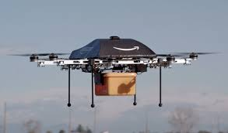
2. Drones: defend and attack
Understanding cybersecurity implications of using and protecting drones
Surveillance drones
Delivery drones

Slide 32

2. Drones: defend and attack
Military drones

Slide 33
Understanding cybersecurity implications of using and protecting drones
Physical threats
Software hacking
  Threat model
  Vulnerabilities
  Anti-tamper protection for drone system deployments
  Countermeasures to mitigate adverse mission effects
  Offensive measures to compromise, deny, control unknown/ enemy assets

Slide 34
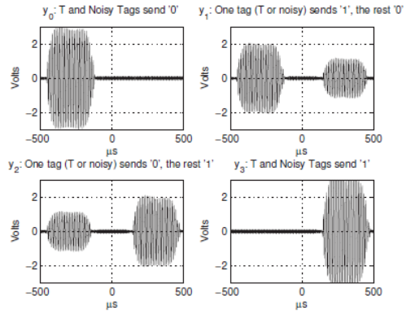
Understanding cybersecurity implications of using and protecting drones
Obfuscating communication using Wyner’s wiretap channel
  Your drones send random pulses
  Your drones can subtract the pulses and get the information
  The adversary cannot get any information
  (purely probabilistic unpredictability)
Cross-Site Scripting (XSS) attack and Universal Cross-Site Scripting (UXSS) attacks

Slide 35
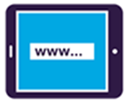
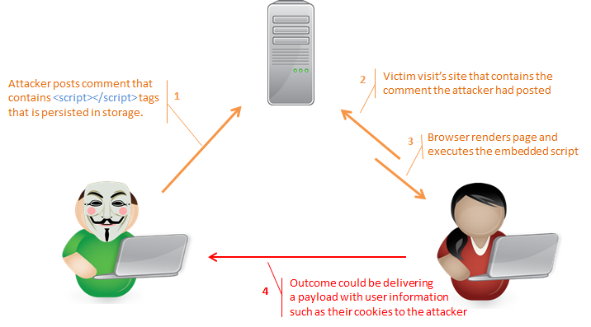
Understanding cybersecurity implications of using and protecting drones
Cross-Site Scripting (XSS) attacks and Universal Cross-Site Scripting (UXSS) attacks
  XSS:
    a. Find website that allows to inject scripts; a. b. inject script that steals visitor’s session cookie
    Malicious code activated
    Session cookie sent to hacker
  UXSS
    Replace website by user’s browser.
2
1
3

Slide 36
3. Another probem
Scalable anonymous Internet communication

Slide 37
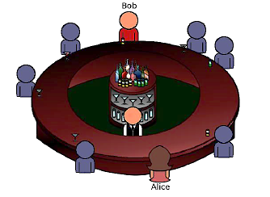
Broadcast anonymous routing: a scalable anonymous Internet communication system
P. Kotzanikolaou, G. Chatzisofroniou, M. Burmester: Broadcast anonymous routing (BAR): scalable real-time anonymous communication. Int. J. Inf. Sec. 16(3): 313-326 (2017)

Slide 38
Broadcast anonymous routing: a scalable anonymous Internet communication system
P. Kotzanikolaou, G. Chatzisofroniou, M. Burmester: Broadcast anonymous routing (BAR): scalable real-time anonymous communication. Int. J. Inf. Sec. 16(3): 313-326 (2017)

Slide 39
Broadcast anonymous routing: a scalable anonymous Internet communication system

Slide 40
Broadcast anonymous routing: a scalable anonymous Internet communication system

Slide 41
Any questions?
Current funding
2017-2019, NSA, CNAP Initiatives, H98230-17-1-0322, $289,027.
2017-2019, NSA, CyberSecurity Curricula Development, H98230-17-1-0322, $289,027.
2016-2021, NSF, Cybercorps: Scholarship for Service at FSU, $4,559,546
2018-2019, NSA, IASP, $66,107.
References
http://www.cs.fsu.edu/~burmeste/pubs.html

