Slide 1
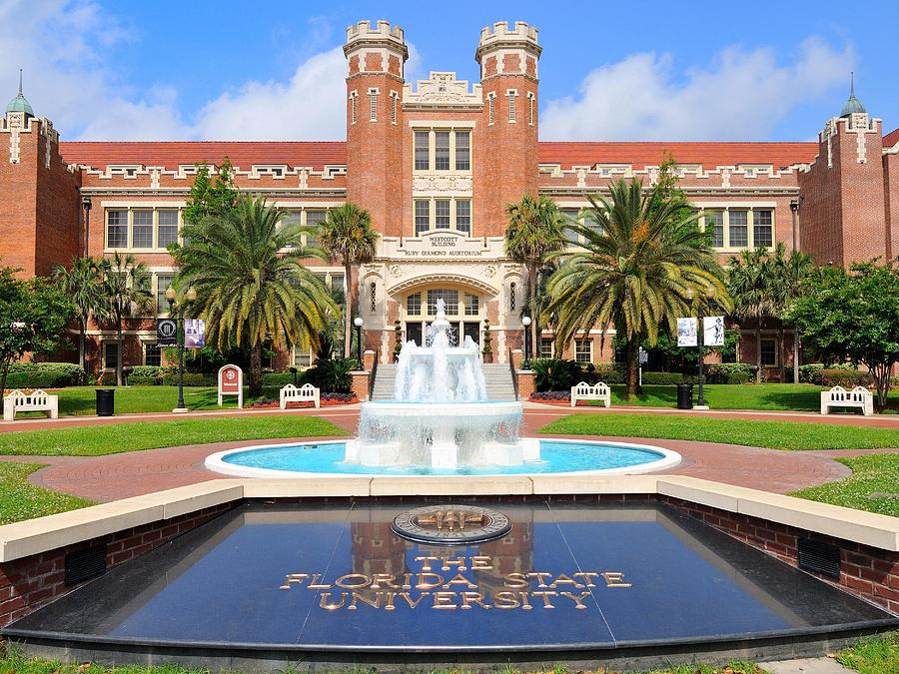

Introductory Seminar on Research: Fall 2018
Shayok Chakraborty
Assistant Professor
Department of Computer Science, FSU

Slide 2
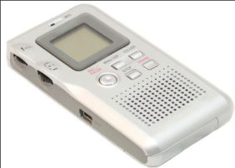
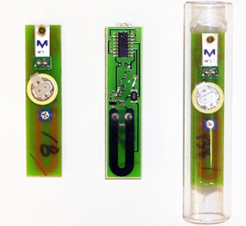
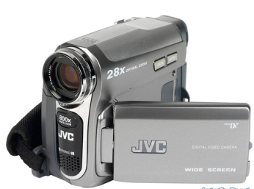
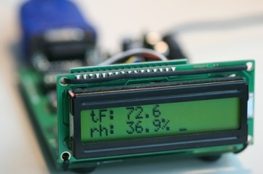
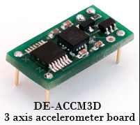
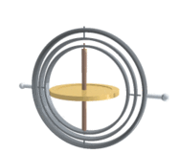

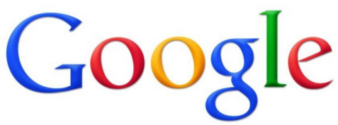

What is Machine Learning ?
Sensors and Actuators in today’s world generate humongous amounts of digital data
Produces about 25-30 frames per second
Processes about 100 peta-bytes of data per day
About 300 hours of video uploaded every minute

Slide 3
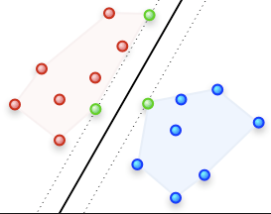
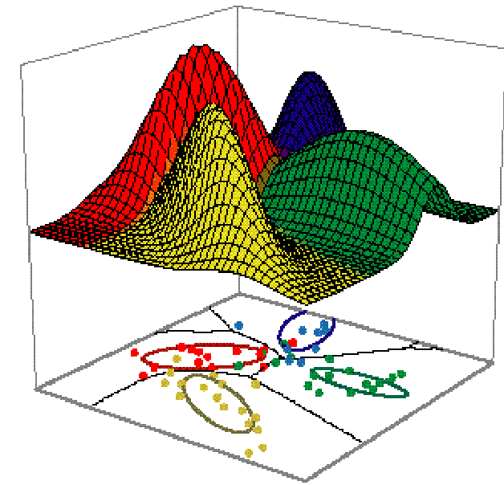
What is Machine Learning ?
Machine Learning to develop predictive models
Machine Learning is used to…
Organize, categorize and make sense of large volumes of data
Develop a model that is a good and useful approximation to the data
Predict the future behavior of a system by making use of past data (e.g. weather forecasting)

Slide 4
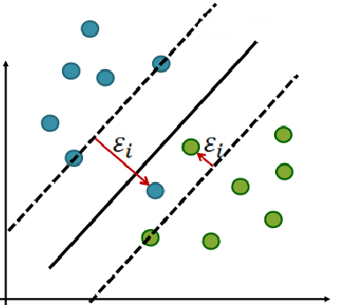
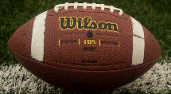
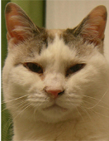
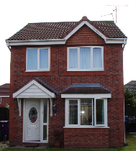
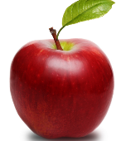
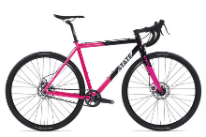
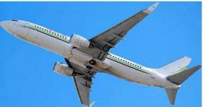
A Typical Machine Learning System
TRAINING
Collect Unlabeled Data
Label the Data
Train ML Model
Data Hand-Labeled by Human Experts
TESTING
Apply the trained model on unseen data to get predictions

Slide 5
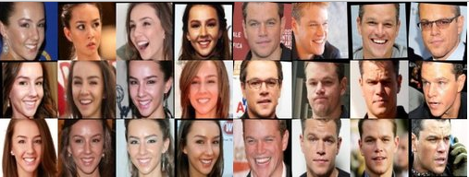
Learning with Weak Supervision
Face Recognition

Slide 6
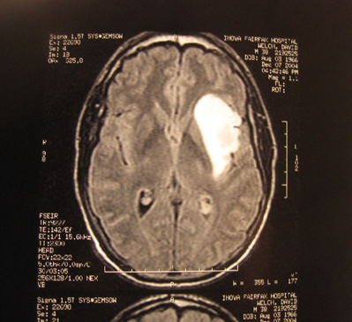
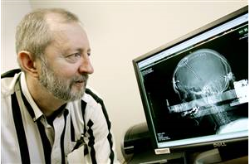
Learning with Weak Supervision
Medical Image Classification
Data Hand-Labeled by Human Experts
Cancer or non-cancer image ??
Experienced doctors are rare and busy

Slide 7
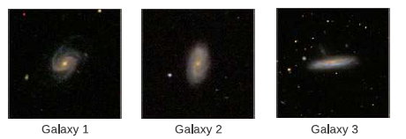
Learning with Weak Supervision
Galaxy Classification
Data Hand-Labeled by Human Experts

Slide 8
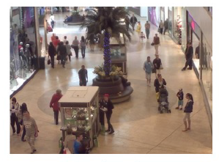
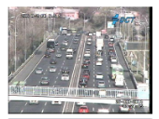
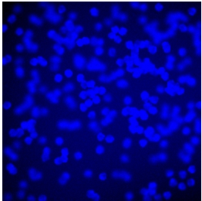
Learning with Weak Supervision
Object Counting
Pedestrians
Cars
Microscopic Cells
Data Hand-Labeled by Human Experts

Slide 9
ACTIVE LEARNING

Slide 10
Active Learning
Active vs. Passive Learning
World
Input
Passive Learner
Output
Model / Classifier
Query
Output
World
Active
Learner
Model / Classifier
Response
Tong and Koller, JMLR 2000

Slide 11
Active Learning - Applications
Active Learning
Text Categorization
Image Retrieval
Spam email filter design
Face Recognition
Optical Character Recognition (OCR)
Medical Image Classification
Natural Language Parsing

Slide 12
Batch Mode Active Learning - Illustration
Human Annotator
Unlabeled pool of points
Classifier update module
Training Set

Slide 13
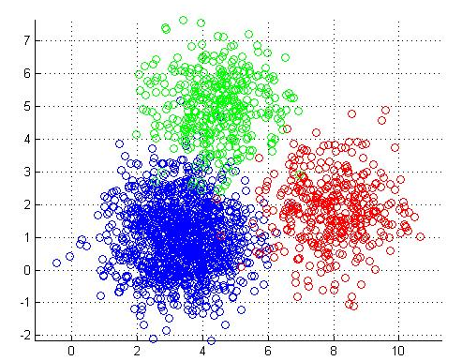
Active Learning
Random Sampling: Select k samples at random from the unlabeled set
Clustering based Sampling
Cluster the unlabeled data using k-means clustering
Select the cluster centers for annotation

Slide 14
Active Learning
Margin-based Sampling
Unlabeled Samples
Query
Decision Boundary
Train an SVM on the labeled data
Query the unlabeled samples that are close to the decision boundary

Slide 15
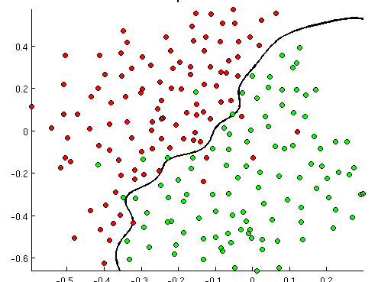
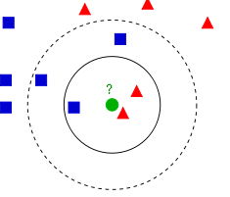
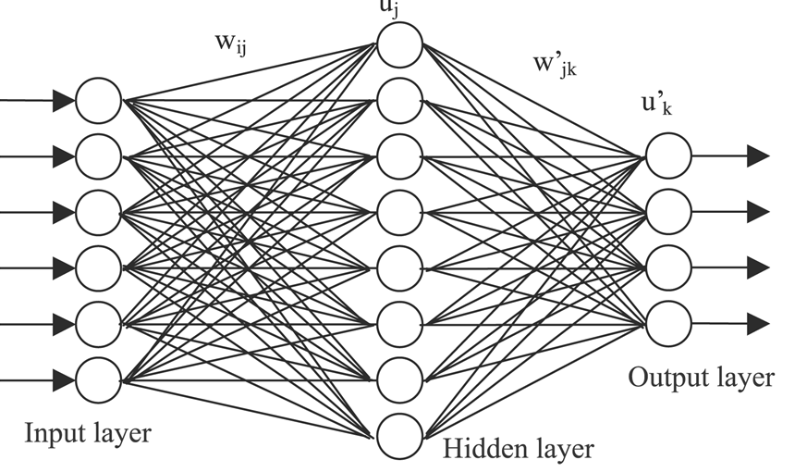
Active Learning
Committee-based Sampling
SVM
K-NN
Neural Network
Train a committee of classifiers on the labeled data
Use them to predict the unlabeled samples
Query the samples where there is a disagreement on the class labels among the committee members

Slide 16
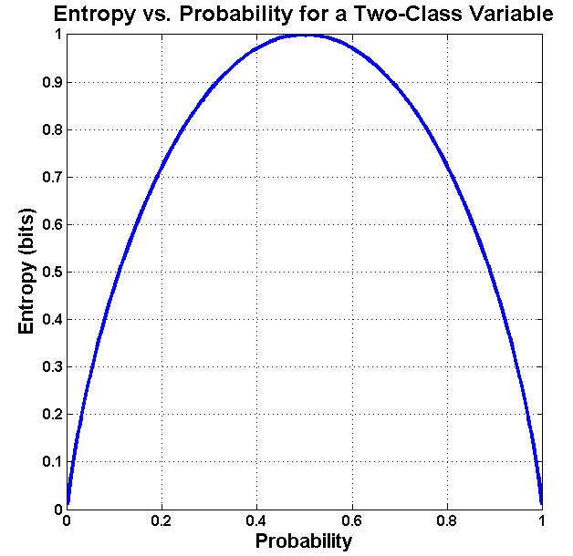

Active Learning
Entropy-based Sampling
Suppose we are working on a binary classification problem
Train a classifier on the labeled data
Apply the trained model on the unlabeled set to derive probabilities with respect to the two classes
Let us say we have this:
Sample 1: p1 = 0.1, p2 = 0.9
Sample 2: p1 = 0.5, p2 = 0.5
Which one to query?
Query the sample which has high entropy

Slide 17
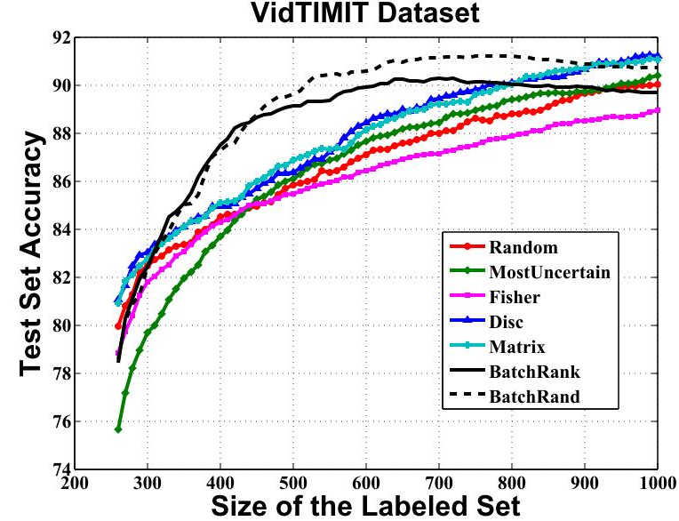
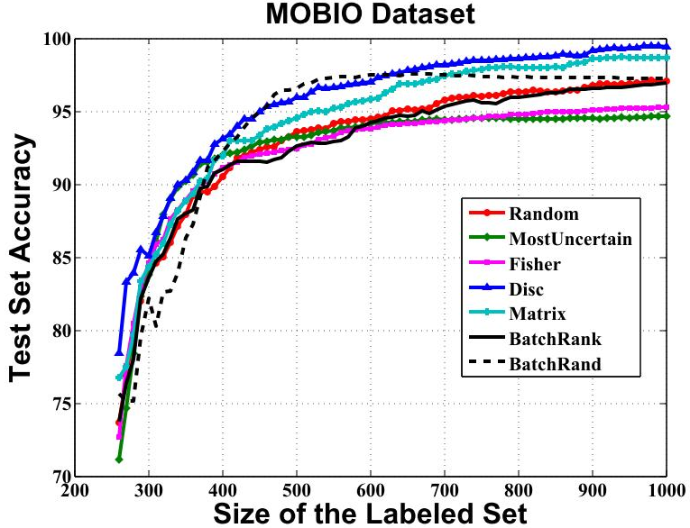
Active Learning
Performance on Face Recognition Datasets

Slide 18
TRANSFER LEARNING / DOMAIN ADAPTATION

Slide 19
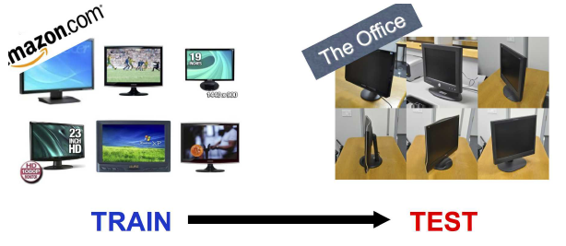
Domain Adaptation Examples
Source Domain
Target Domain

Slide 20
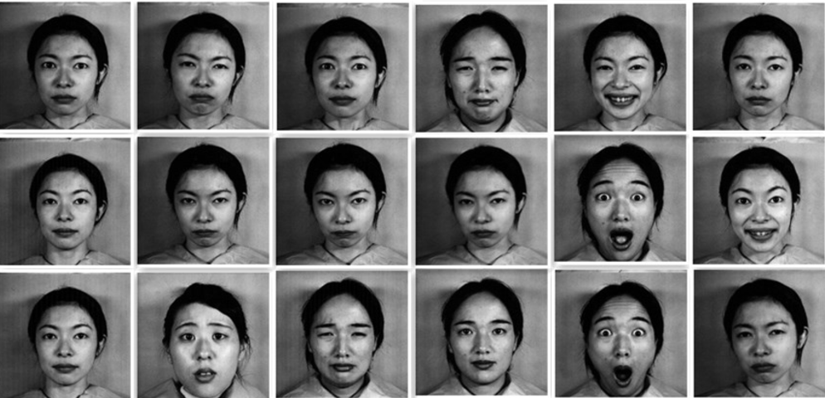
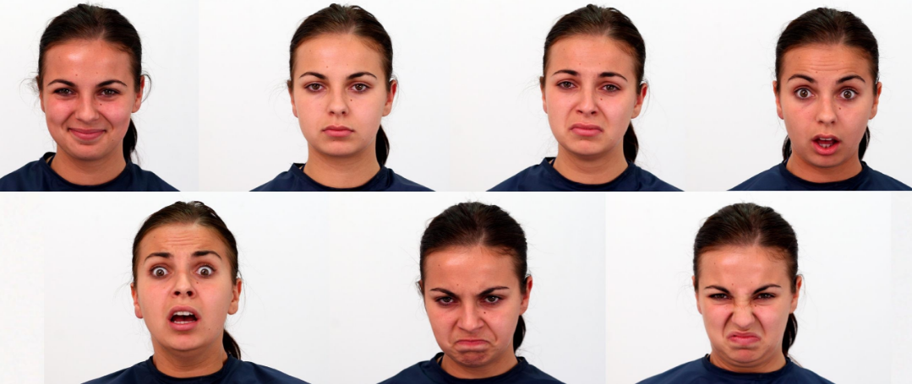
Domain Adaptation Examples
Training Set (Source)
Testing Set (Target)

Slide 21
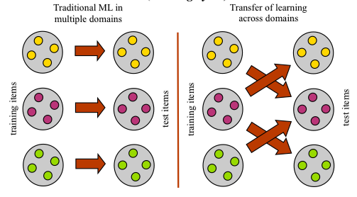
Transfer Learning / Domain Adaptation
A major assumption in traditional machine learning is that the training and test data come from the same domain and follow the same distribution
In a real-world setting, training and test data can come from different probability distributions

Slide 22
Transfer Learning / Domain Adaptation
A Psychological point of view
The study of dependency of human conduct, learning or performance on prior experience
C++ -> Java
Maths/Physics -> Computer Science
Driving a Car -> Driving a Truck
Data Mining point of view
The ability of a system to recognize and apply knowledge and skills learned in previous domains/tasks to novel tasks/domains, which share some commonality
Given a target domain/task, how to identify the commonality between the domain/task and previous domains/tasks, and transfer knowledge from the previous domains/tasks to the target one?

Slide 23
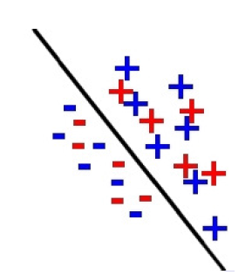
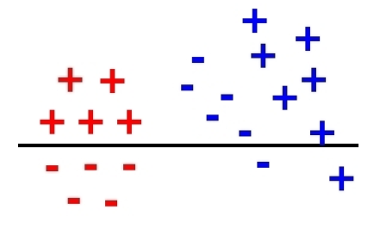
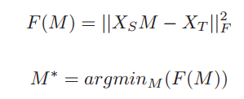
Transfer Learning / Domain Adaptation
Subspace Alignment (ICCV 2013): Transform the source data (X_{S}) so that it aligns well with the target data (X_{T})
Before Domain Adaptation
After Domain Adaptation
Error Matrix

Slide 24
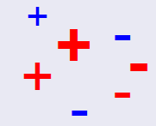
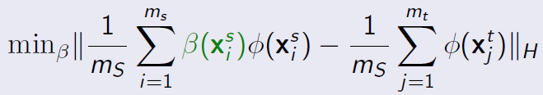
Transfer Learning / Domain Adaptation
Instance Re-weighting: Assign weights to the source data (X_{S}) so that the weighted source data has similar distribution as the target data (X_{T})
Before Domain Adaptation
After Domain Adaptation
Instance Re-weighting
Maximum Mean Discrepancy to measure the difference between S and T distributions
weights

Slide 25
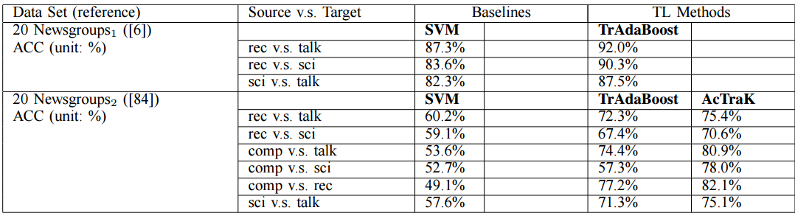
Transfer Learning / Domain Adaptation
A Survey on Transfer Learning, Pan and Yang, IEEE TKDE 2009

Slide 26
DEEP LEARNING

Slide 27
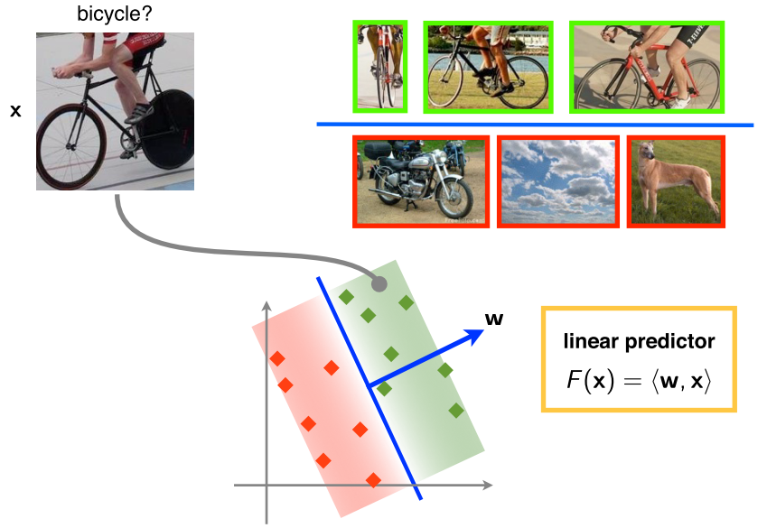
Deep Learning
A feature extractor maps the data to a vector representation
Samples are represented as points in a high dimensional space
Slide based on Andrea Vedaldi, 2014

Slide 28
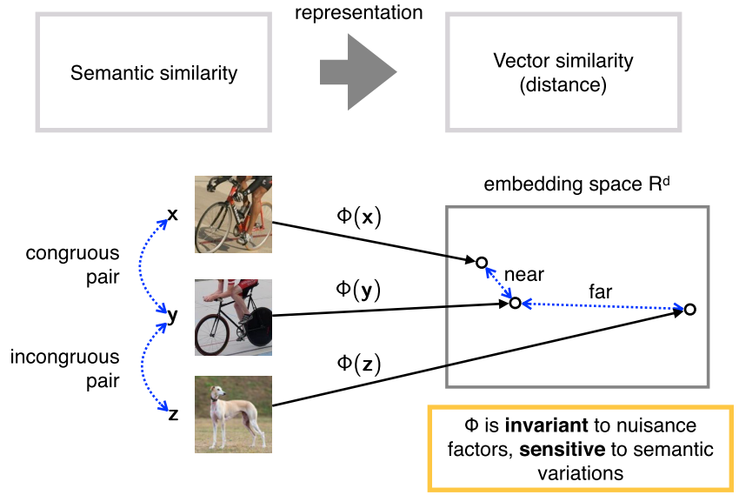
Deep Learning
Slide based on Andrea Vedaldi, 2014

Slide 29
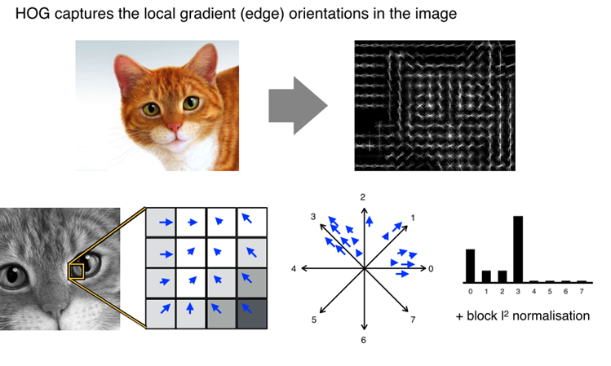
Deep Learning
Histogram of Oriented Gradients (HoG) – Dalal and Triggs, 2005
Slide based on Andrea Vedaldi, 2014

Slide 30
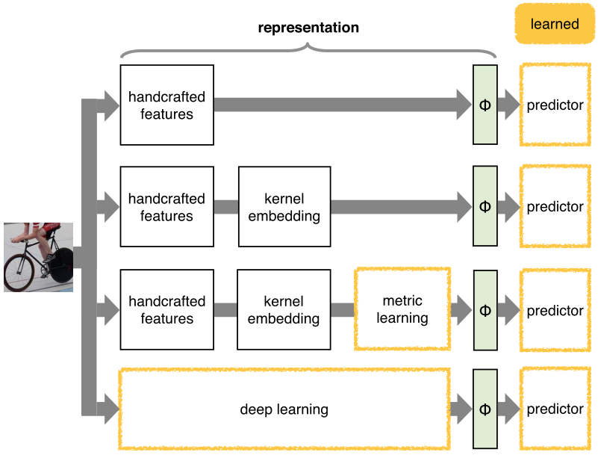
Deep Learning
Slide based on Andrea Vedaldi, 2014

Slide 31
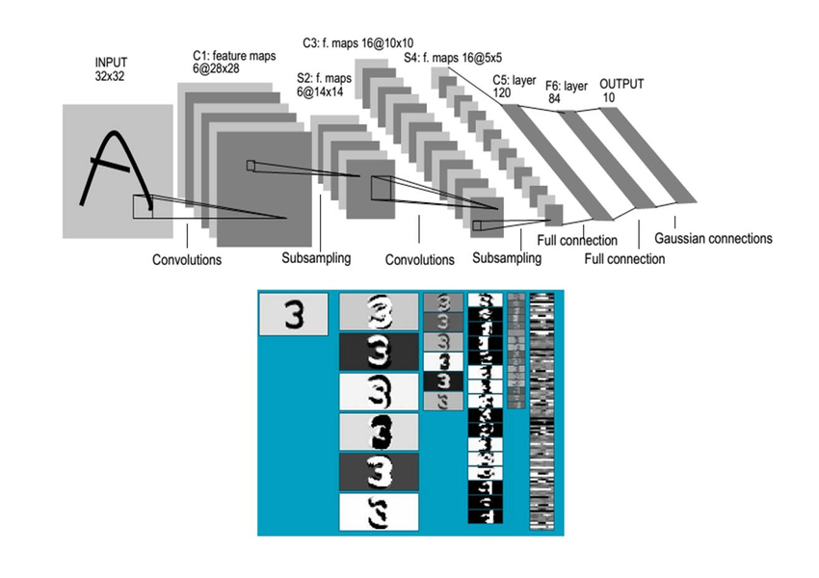
Deep Learning
http://yann.lecun.com/exdb/lenet/

Slide 32
Deep Learning
The Visual Chatbot Demo

Slide 33
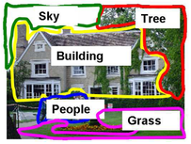
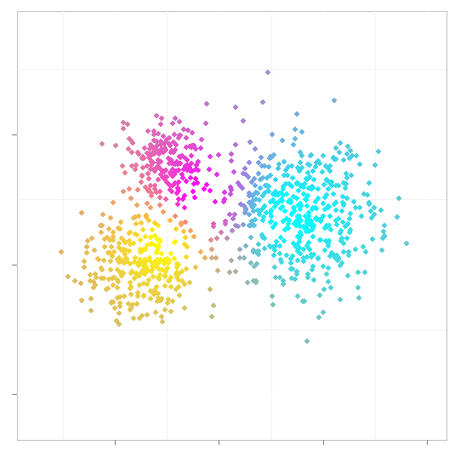
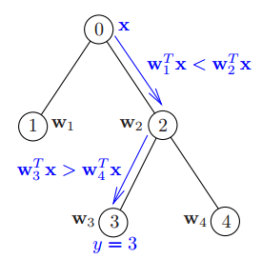
Label Spaces
Multi-Class
Multi-Label
Fuzzy Label
Hierarchical Label

Slide 34
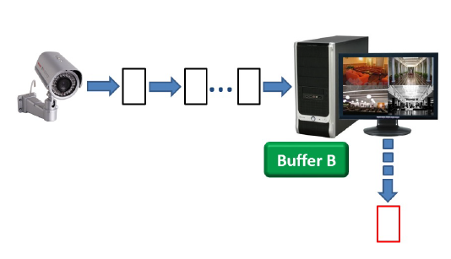

Data Setups
Online
Distributed

Slide 35
Thank You
Shayok Chakraborty
Assistant Professor
Department of Computer Science
Florida State University
Lov 0264
shayok@cs.fsu.edu

