Slide 1
Data Science Research in
Big Data Era
Introduction to Research Seminar, 2018
Peixiang Zhao
Department of Computer Science
Florida State University
zhao@cs.fsu.edu

Slide 2
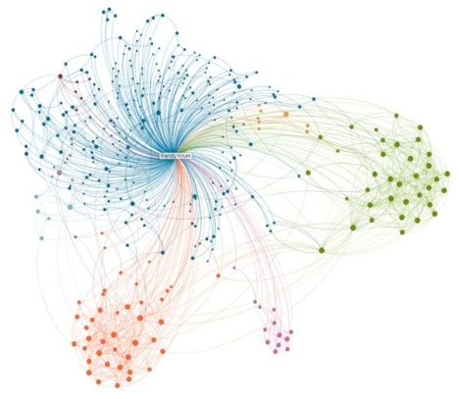

Synopsis
Introduction to Data Sciences
How to prepare yourself for (data) research
My research portfolio
Conclusions

Slide 3

Who am I?
Peixiang Zhao
  Associate Professor at CS @ FSU
  Homepage: http://www.cs.fsu.edu/~zhao/
  Office: 262 Love Building, FSU
  Ph.D.: University of Illinois at Urbana-Champaign, Aug. 2012
  Research Interest:
    Database, data mining, data-intensive computation and analytics, and Graph/Information Network Analysis!

Slide 4
Who am I?
Courses I am offering
  COP4710: Introductory database systems
    What are databases and how to use databases
    A programming project on Web-based DB programming
  COP 5725: Advanced databases systems
    Database internals and advanced topics, such as MapReduce, data mining and Web search
    A research/implementation project
I am hiring highly-motivated Ph.D. students!

Slide 5
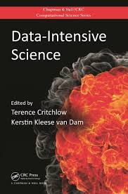
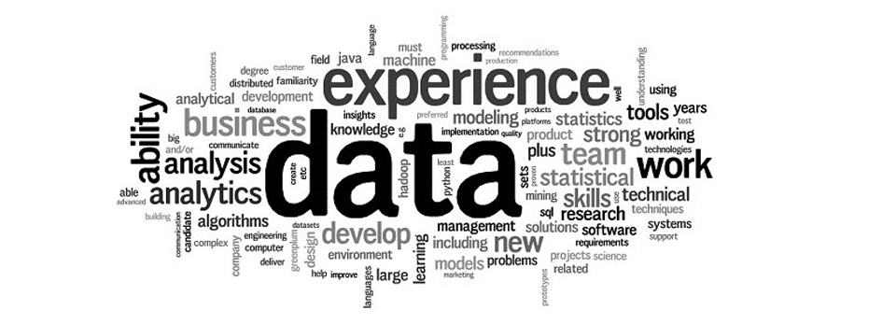
Introduction
What are data sciences?
  The sub-area of computer science dealing with the acquisition, management, querying and mining data drawn from real-world applications
  Include, but are not limited to
    Database systems
    Data mining
    Information retrieval
    Web technologies
    Network science
    Big data

Slide 6
Data Sciences
Data:
  Model: Fully structured or relational, semi-structured, unstructured, schema-less, graphical, ……
  Format: textual, numeric, categorical, sequential, graph-structured, audio/video, time-series, streaming data
  Scale: from megabytes to zetabytes
  Quality, resolution, privacy, usability ……
Common Tasks:
  Data acquisition, storage, maintenance and integration
  Knowledge discovery, mining and machine learning
  Indexing , querying and ranking
  ……
Notes:
Information networks have formed a critical component of modern information infrastructure

Slide 7
Data Sciences
Skillsets and Requirement
  Motivation and passion to work on the state-of-the-art problems
  Strong mathematical reasoning and algorithm design abilities
  Good programming skills
Your Bright Future
  DBAs at Goldman-Sachs or D. E. Shaw
  Data scientists at Google, Facebook, Twitter or Foursquare
  Data engineers at Oracle, IBM or Microsoft
  Researchers at MSR or IBM Research
  Professors showing up in SIGMOD, KDD or SIGIR

Slide 8

How to prepare yourself for (data) research
What is research?
  Discover new knowledge
  Seek answers to non-trivial questions
Research Process
  Identification of the topic (e.g., Web search)
  Hypothesis formulation (e.g., algorithm X is better than Y=state-of-the-art)
  Experiment design (measures, data, etc) (e.g., retrieval accuracy on a sample of web data)
  Test hypothesis (e.g., compare X and Y on the data)
  Draw conclusions and repeat the cycle of hypothesis formulation and testing if necessary (e.g., Y is better only for some queries, now what?)

Slide 9
What is Good Research?
Solid work:
  A clear hypothesis (research question) with conclusive result (either positive or negative)
  Clearly adds to our knowledge base (what can we learn from this work?)
  Implications: a solid, focused contribution is often better than a non-conclusive broad exploration
High impact = high-importance-of-problem * high-quality-of-solution
  Open up an important problem
  Close a problem with the best solution
  Major milestones in between

Slide 10
Challenge-Impact Analysis
Level of Challenges
High impact
High risk (hard)
Good long-term
research problems
Difficult
basic research
Problems,
but questionable impact
High impact
Low risk (easy)
Good short-term
research problems
Low impact
Low risk
Bad research problems
(May not be publishable)
Good applications
Not interesting
for research
Unknown
Known
“entry point” problems
Impact/Usefulness

Slide 11
How to Do Research in Data Sciences?
Curiosity: allow you to ask questions
Critical thinking: allow you to challenge assumptions
  Make sense of what you have read/heard
Learning: take you to the frontier of knowledge
  Start with textbooks and courses
  Read papers in top-notch conferences/journals
  Implement your prototype ideas
Persistence: so that you don’t give up
Respect data and truth: ensure your research is solid
  Don’t throw away negative results
Communication: publish and present your work

Slide 12
Tuning the Problem
Level of Challenges
Make an easy problem harder
Increase impact (more general)
Make a hard problem easier
Unknown
Known
Impact/Usefulness

Slide 13
Where to Publish?
Databases
  SIGMOD, VLDB, ICDE
  ACM TODS, VLDB J., IEEE TKDE
Data Mining
  KDD, ICDM, SDM
  ACM TKDD
Information Retrieval
  SIGIR, CIKM
  ACM TOIS
Web & Applications
  WWW, WSDM

Slide 14

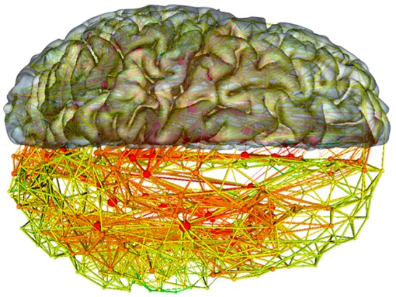

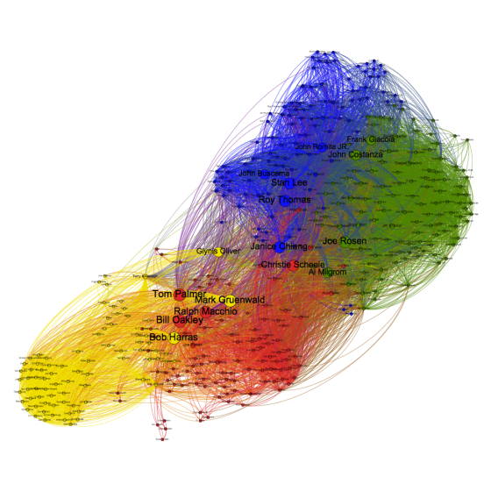
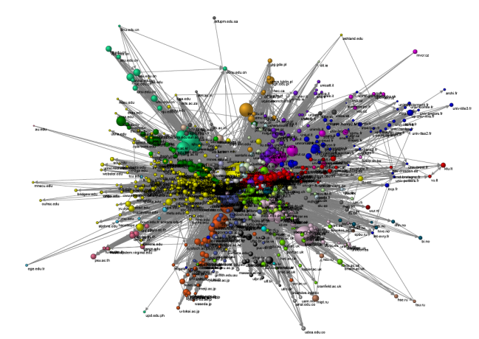
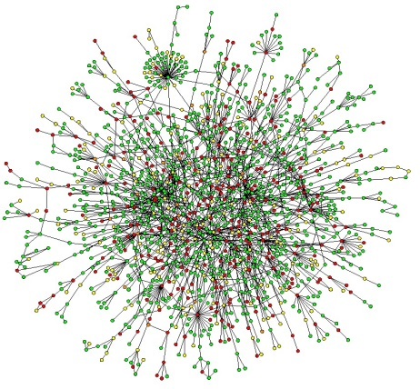
My Research Theme
Modelling, managing, querying, and mining
big graph-structured, networked data
IoT
Social network
Brain graph
WWW
Collaboration network
Protein network
Notes:
Information networks have formed a critical component of modern information infrastructure

Slide 15
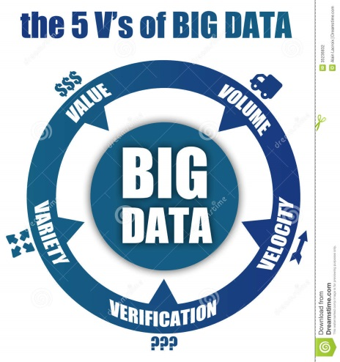
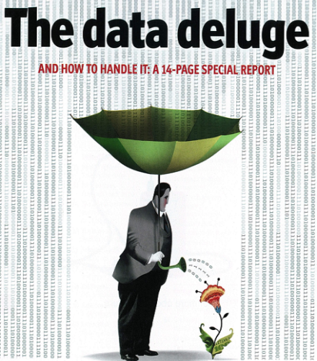
Key Challenges
Real-world graphs and networks are
  BIG
    Web graph: 8.94 billion pages
    Facebook: 901 million active users and 125 billion friendship relations
  Heterogeneous
    Complicated interplay of topologies and multi-dimensional contents
  Dynamic
    Facebook U.S. grows 149% in 2009
  Dirty
    Structure/content are noisy, inconsistent, and distorted
  Volatile and vulnerable

Slide 16
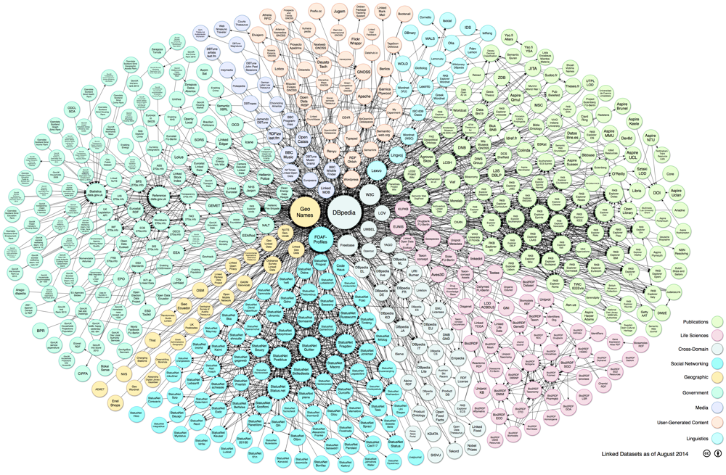
Research Thrusts
Managing and querying big networked data
  Scalable indexing solutions for exact/approximate graph query processing in graph databases and information networks
  Summarizing big graphs
  Querying dynamic graph streams
Representative Applications
Business intelligence
Biology and bioinformatics
Network evolution

Slide 17
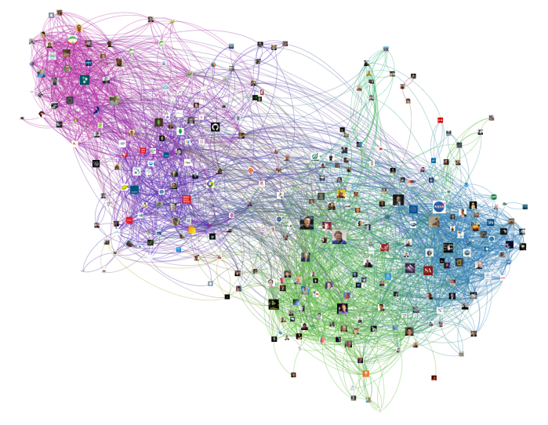
Research Thrusts
Mining social/information networks
  Graph classification, prediction, outlier detection
  Graph partitioning, clustering, and community detection
  Credibility/Accountability analysis in social networks
Representative Applications
Social targeting and viral marketing
Recommendation
User studies
Veracity analysis

Slide 18
Other Research Topics
Location-based mining and ranking
  Mobile local search, ranking, and recommendation
Text mining
  Classification, clustering, graphical models
Mining structural patterns
  Association analysis on structured patterns
Industry-strength systems
  Hadoop-ML with IBM research
  Trinity with Microsoft research

Slide 19
Future Research Agenda
Foundations and models of Information Networks
  Model, manage and access multi-genre heterogeneous information networks
  Querying and mining volatile, noisy and uncertain information networks
  Cyber-physical information networks
Efficient and scalable computation in Information Networks
  A unified declarative language for graph and network data
  A distributed graph computational framework for large-scale information networks
Knowledge discovery in large Information Networks

Slide 20
Conclusions
We are in an information network era!
  Internet, social networks, collaboration and recommender networks, public health-care networks, technological/biological networks ……
Data are pervasive, big, and of great value
Research in data sciences is interesting and highly rewarding
Follow your heart and don’t give up!

Slide 21
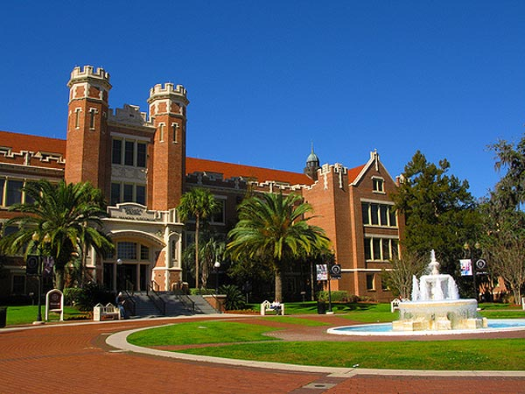
Good Luck!
Q & A

