Slide 1
Blockchains
. or
.
How to avoid paying $40,000,000 for two pizzas
Mike Burmester

Slide 2
The Blockchain distributed consensus model
the most important invention since the Internet itself
Marc Andreessen, inventor of Netscape.
the most disruptive invention since the Internet itself
many … others

Slide 3
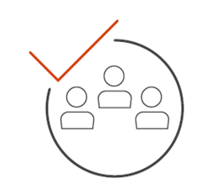
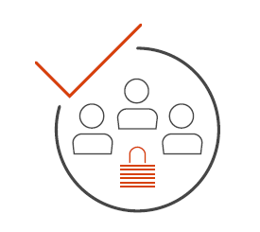


The Blockchain consensus model
Availability
Integrity
Dynamic
  fair = no cheating (double spending)
Prevent anyone from taking control
  decentralized

Slide 4
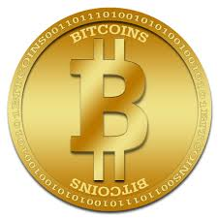
The Blockchain consensus model
Guide for beginners: How much is a worth?
On May 22, 2010, Laszlo Hanyecz pays 10,000 Bitcoins for two pizzas delivered to his house (valued at about $25).
On April 1, 2017 a Bitcoin was worth $1,085.03
On August 20, 2017 a Bitcoin was worth $4,104.99

Slide 5
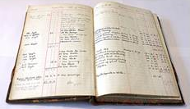
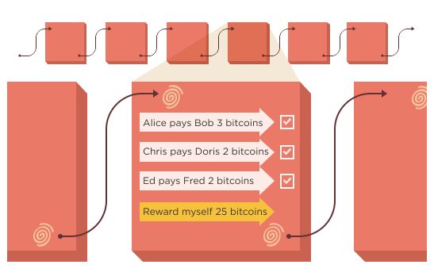

Bitcoin
Blockchain consensus model
a digital ledger
blockchain
block
lots of crypto
probability theory

Slide 6
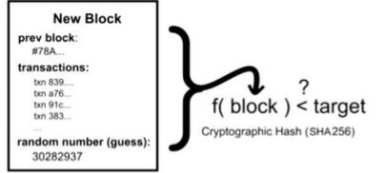
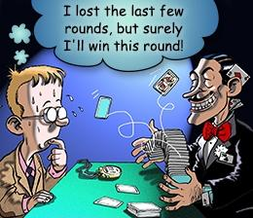
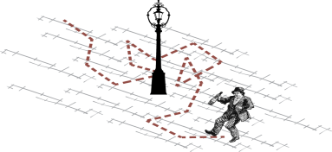
Decentralized management
To validate a block a consensus mechanism based on:
an “Adam Back Hashcash proof-of-work” is used
Works like a lottery (1 winner/10 minutes)
Accept the longest proof-of-work blockchain
“one-CPU-one-vote” rather than “one-IP-address-one-vote”
gamblers ruin problem
binary random walk

Slide 7
Decentralized management
Bitcoin miners (the consensus) manage the system
Payments:
  Who gets them?
    The miners: when a new bitcoin block is identified (generated with a successful hash).
  Who pays them?
      The persons making the transactions: voluntary (!?! doesn’t work)
      The Bitcoin system (WoW, must be another Fire Creek)

Slide 8
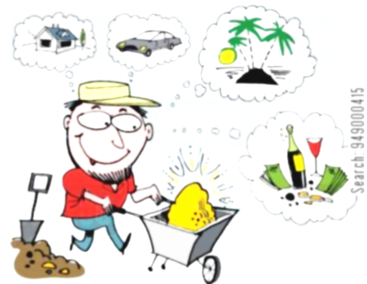


Everybody gets rich! pays!
Fool’s gold
whose the fool?
not me! I’m a miner
$$

Slide 9
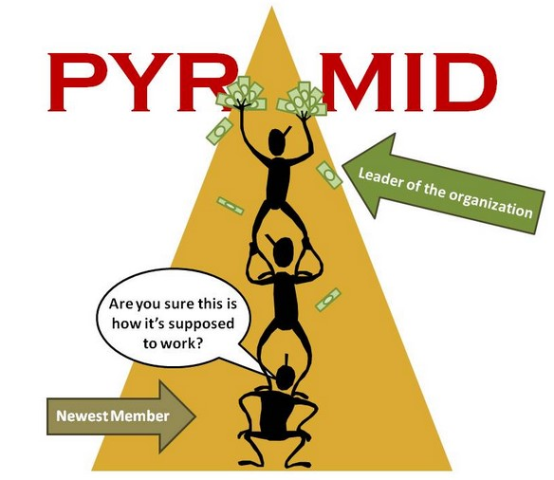
WoW
$100,000 per block
I can mine 1 block every
10 minutes
Bitcoin miner
$4000 is
too much for a bitcoin
newest investor

Slide 10

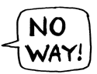



Who can fix it?
The consensus, i.e., the miners !!!
Satoshi Nakamoto !?!
miners
my 10⁶ Bitcoins
are worth $4⋅10⁹
miners
miners
miners

Slide 11
Blockchain consensus model smart technologies
It’s not about money! its about the potential applications
The true value of blockchain technology has just began to be explored!
  Smart contracts, property, legal documents
  Smart Healthcare
  Smart cities
  Blockchain + IoT

Slide 12
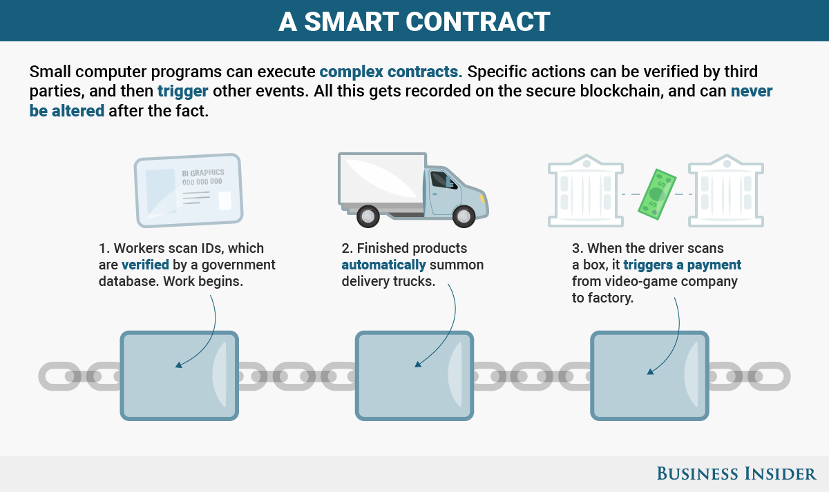

A contracts Blockchain dynamic, distributed, decentralized database (D4)
Small computer programs can execute complex contracts. Specific actions can be verified by a consensus of other parties and then trigger events/actions.
All events get recorded on a contract blockchain that cannot be altered after recorded events.
1. Workers scan IDs which are verified by the system
2. Finished products automatically summon delivery trucks
3. When the driver scans a box, the system automatically triggers a payment from the receiver to the factory.

Slide 13

The Bitcoin Valuation Bubble
WSJ 8-28-2017
Faithful techies: in coming decades a bitcoin will be worth $500,000
Around 1,700 bitcoins are payed per day to miners
  $7M rewards and $1M fees
Visa & Mastercard are based on: 300 basis-point fees (3%)
Blockchain bitcoin is based on: 0.1 basis-point fees
In the digital world,
but can be slow!
“… what is for some a speculative bubble,
for others is an investment opportunity with potential”

Slide 14
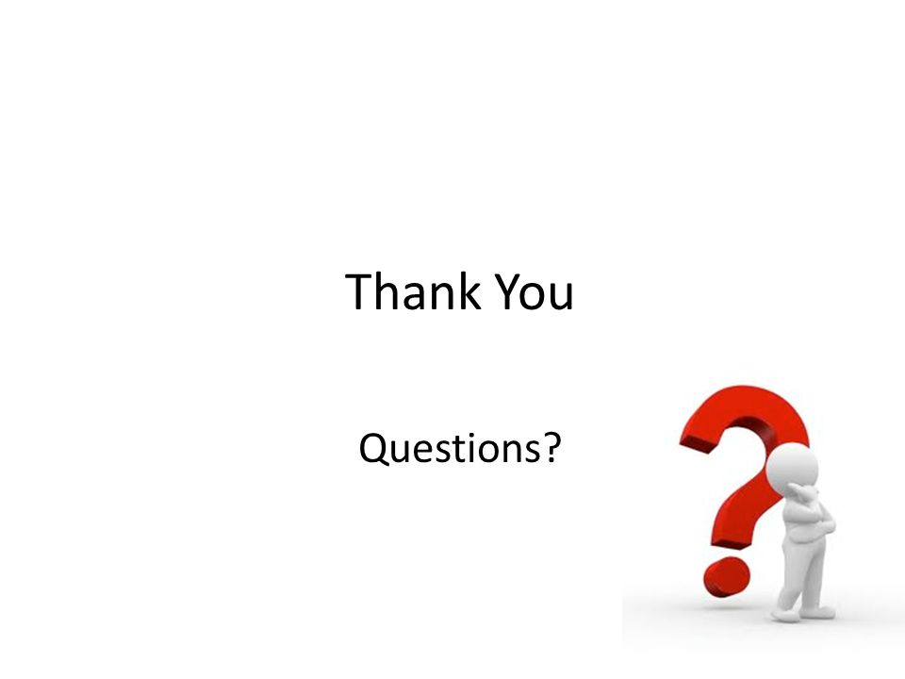
Any Questions
https://bitcoin.org/bitcoin.pdf
http://www.cs.fsu.edu/~burmeste/pubs.html

