Slide 1
International Etruscan
Sigla Project
By Team Blue Hat

Slide 2
About Team Blue Hat
What makes Blue Hat Innovative?
What makes Blue Hat Award Winning?
What makes Blue Hat Disruptive?
Honorable Members
Adil Arif – Project Manger
Robert Hall – Assistant Project Manager
Geoff Montee – Software Engineer
Patrick Yount – Software Engineer
Yao Yuan – Software Engineer

Slide 3
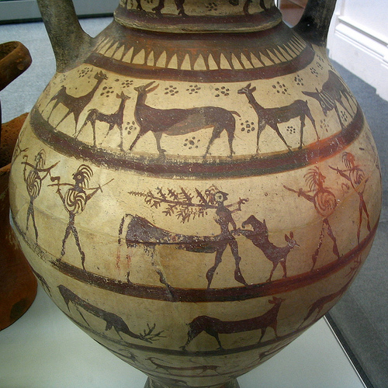
Purpose
The purpose of this Software Requirements Specification document is to clearly define the system under development, that is, the International Etruscan Sigla Project (IESP).
The intended audience of this document is the user including the staff of the project, researchers, and the general public.
Other intended audience include the development team such as the requirements team, requirements analyst, design team, and other members of the developing organization.

Slide 4
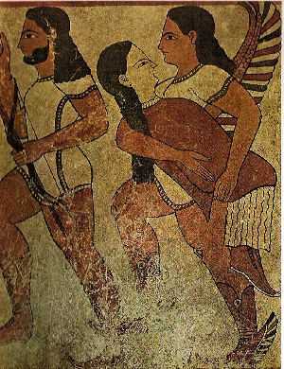
Origin of Need
To attempt to find the meaning(s) of these “Sigla” and how they were used to communicate in Etruscan Society by allowing researchers easy access and collaborative software to discover its meanings.
Find and catalog as many of the existing Etruscan “Sigla” as possible.
To create a dictionary of these “Sigla” for use by other scholars in discovering more details of the Etruscan society and culture.
An easy to use Web based system so that Researchers all around the world can collaborate on this endeavor.

Slide 5
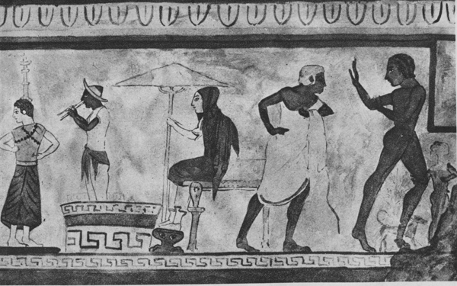
Product Perspective
The IESP is a web-based system.
The system requires a Database Management interact with the system through any modern Web browser (i.e.: Firefox, Internet Explorer, Safari).
The main purposes of the system are to allow for cataloguing of research on Etruscan sigla on their Artifacts to enable researchers to share each other’s work, and also to allow for grouping of similar sigla to increase productivity of researchers who conventionally analyze and sort sigla manually.
The project will be staffed with researchers in the field and some technical staff to maintain the system and provide support to researchers.

Slide 6
Product Functions
Users can access the system through any modern Web browser. Upon reaching the site, users can browse the database of Etruscan artifacts. Artifacts that have the same sigla are tagged together for easy viewing. Users will also be allowed to search for sigla based on various criteria such as attributes.
If a user is a researcher, the user can register to have an account created in the system. The user can register through the Web site; however, the user’s credentials must be validated by a staff member of the IESP before the account will be active. Upon registration, the user enters personal information, such as his or her name, research institution, and e-mail address.
Once a user has an active account, the user can login to the Web site with the username and password. IESP staff members will also be able to login in the same manner. Once logged in, validated researchers can add comments to artifacts. Researchers can also edit or delete their own comments, while staff members can delete comments made by any user. Validated users can also upload new artifacts to the Web site, specifying attributes that describe the artifact and images of it. A validated user who has uploaded artifacts can modify the attributes of their artifact.
Staff members can add new sigla tags to the site.
All aspects of the system are easy enough to use for non-technical people with moderate experience using a Web browser.

Slide 7
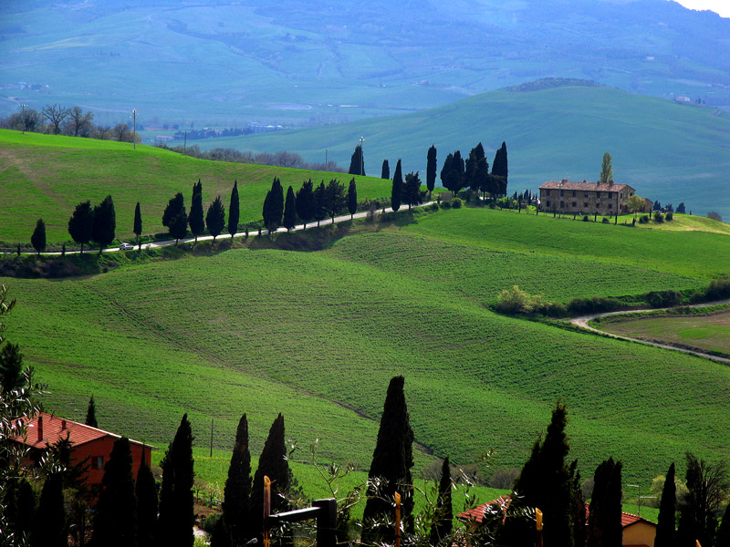
Characteristics
The three main groups of users are the general public, validated researchers, and IESP staff members.
The general public can search and browse the collection of sigla. The general public do not log into the Web site. These users are assumed to have very little technical training. Their educational background and location is unknown.
Validated researchers are those who have registered and whose credentials have been validated by IESP staff members. Researchers are also assumed to have little technical training. Their education is assumed to be on the college-level, anywhere between undergraduate and post-doctoral. Researchers will be able to log into the Web site after validation.
IESP staff members are given various jobs such as managing the entire system, verifying researcher applications, and deleting inappropriate comments.

Slide 8
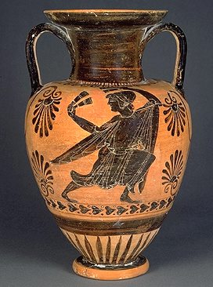
Constraints
The system provides web access for all user functions, with the exception that IESP technical staff may have to access certain parts of the system through other means for software maintenance.
The user interface will be intuitive enough for the untrained public to navigate.
The system will be robust to allow for persistence storage of researcher information and sigla data.
The system will be reliable enough to allow for use by the general public and researchers at their convenience.

Slide 9
Functional Requirements
Functional Requirements
3.1.The system shall use a Home page which shall be the entry point for all users. The home page shall be aesthetic and simple to navigate.
3.2.The system shall allow users to login and validate themselves as researchers or staff members.
3.2.1.The system shall allow users to register themselves as researchers.
3.2.2.The system shall validate the registering user email by emailing them a randomly generated password.
3.2.3.The system shall allow users to change their password.
3.2.4.The system shall allow users to request their password. The password shall be sent to the email entered during registration.
3.3.The system shall allow researchers to upload artifacts to the database.
3.3.1.The system shall allow staff members to delete an artifact as long as the artifact has not been published.
3.3.2.The system shall allow the owner of the artifact to edit its attributes as long as the artifact has not been published.
3.3.3.The system shall allow the owner of the artifact to delete the artifact as long as the artifact has not been published.
3.3.4.The system shall allow the owner of the artifact to publish the artifact. A published artifact will guarantee the general public that the artifact will no longer be edited or subject to deletion.

Slide 10
Functional Requirements
3.4.The system shall allow researchers to post comments on any uploaded artifact.
3.4.1.The system shall allow the owner of a comment to edit the comment's content. Upon editing, a copy of the comment shall be created while the original version shall be archived.
3.4.2.The system shall allow users to report inappropriate comments to the staff.
3.4.3.The system shall allow staff members to disable any comment. Upon disabling, the comment is removed from the Artifact's page. The original comment shall still be accessible through the archives.
3.5.The system shall allow the user to search the artifacts in the collection by specifying keywords, by specifying tags, or by entering artifact attributes in an advanced search form.
3.5.1. The system shall display the search results in a orderly manner. The search result page shall contain all the Artifacts matching the searching criteria, represented by a small thumbnail of the Artifact image. There shall also be a minimal description of each Artifact to allow Users to recognize an Artifact without the need of accessing the Artifact's detail page.
3.5.2.The system shall allow users who are not familiar with the terminology, to browse through the Artifacts without needing to specify any search criteria.
3.6.The system shall allow the user to view the artifacts in the collection.
3.6.1.The system shall display the artifacts information and images, in an ordered and complete fashion.
3.6.2. The system shall display the location where the Artifact was found in a rendered sky-view map.
3.6.3. The system shall display other Artifacts that were found near the location of the viewed Artifact.
3.7.The system shall allow researchers to post information about themselves on their profile.
3.7.1.The system shall allow researchers to edit their personal information.
3.7.2.The system shall allow users to view researchers' profiles.

Slide 11
Functional Requirements
3.8.The system shall allow staff members to create new Sigla tags.
3.9.The system shall allow staff members to manage Users accounts.
3.9.1. The system shall allow staff members to verify registering users.
3.9.2. The system shall allow staff members to edit researchers' profiles
3.9.3. The system shall allow staff members to revoke users privileges.
3.10.The system shall allow staff members to publish news articles.
3.10.1.The system shall allow users to view published news articles.
3.1.The system shall allow researchers to create a personal collection of artifacts.
3.1.1.The system shall allow a researcher to add or remove artifacts from the researcher's personal collection.
3.12.The system shall provide a help feature that shall explain to Users how to Navigate the site, along with documentation on other functionalities of the site.
3.13.The system shall provide an About page. This page shall display the system's purpose, history and contact information.

Slide 12
NON Functional
Requirements
Non-functional Requirements
4.1.The system shall be compatible with the major web browsers (Internet Explorer, Firefox, Opera, Chrome, Safari.)
4.2.The system shall backup its data to prevent information loss as a result of system failures.
4.3.The system shall be flexible enough to allow modifications of Artifact tags without corrupting existing Artifacts in the database.
4.4.The system shall be simple enough to be used without specialized training other than the knowledge of using a web browser.
4.5.The system shall be internationalized in the sense that users may specify a language upon registration. Certain keywords in the website shall be translated to the chosen language.
4.5.1.The default language shall be an universal language since the System will be used worldwide.
4.6.The system shall use a consistent style format across the web-site.
4.7.The system shall use a standard image format that keeps file size to a minimum while prioritizing the quality of the image.
4.8.The system shall use an universal measurement system.
4.9.The system shall be build using Open Source alternatives. It shall not be required to purchase any software, tool or component licenses.
4.10. The system shall support Unicode character encoding with the purpose of allowing most languages to be represented.

Slide 13
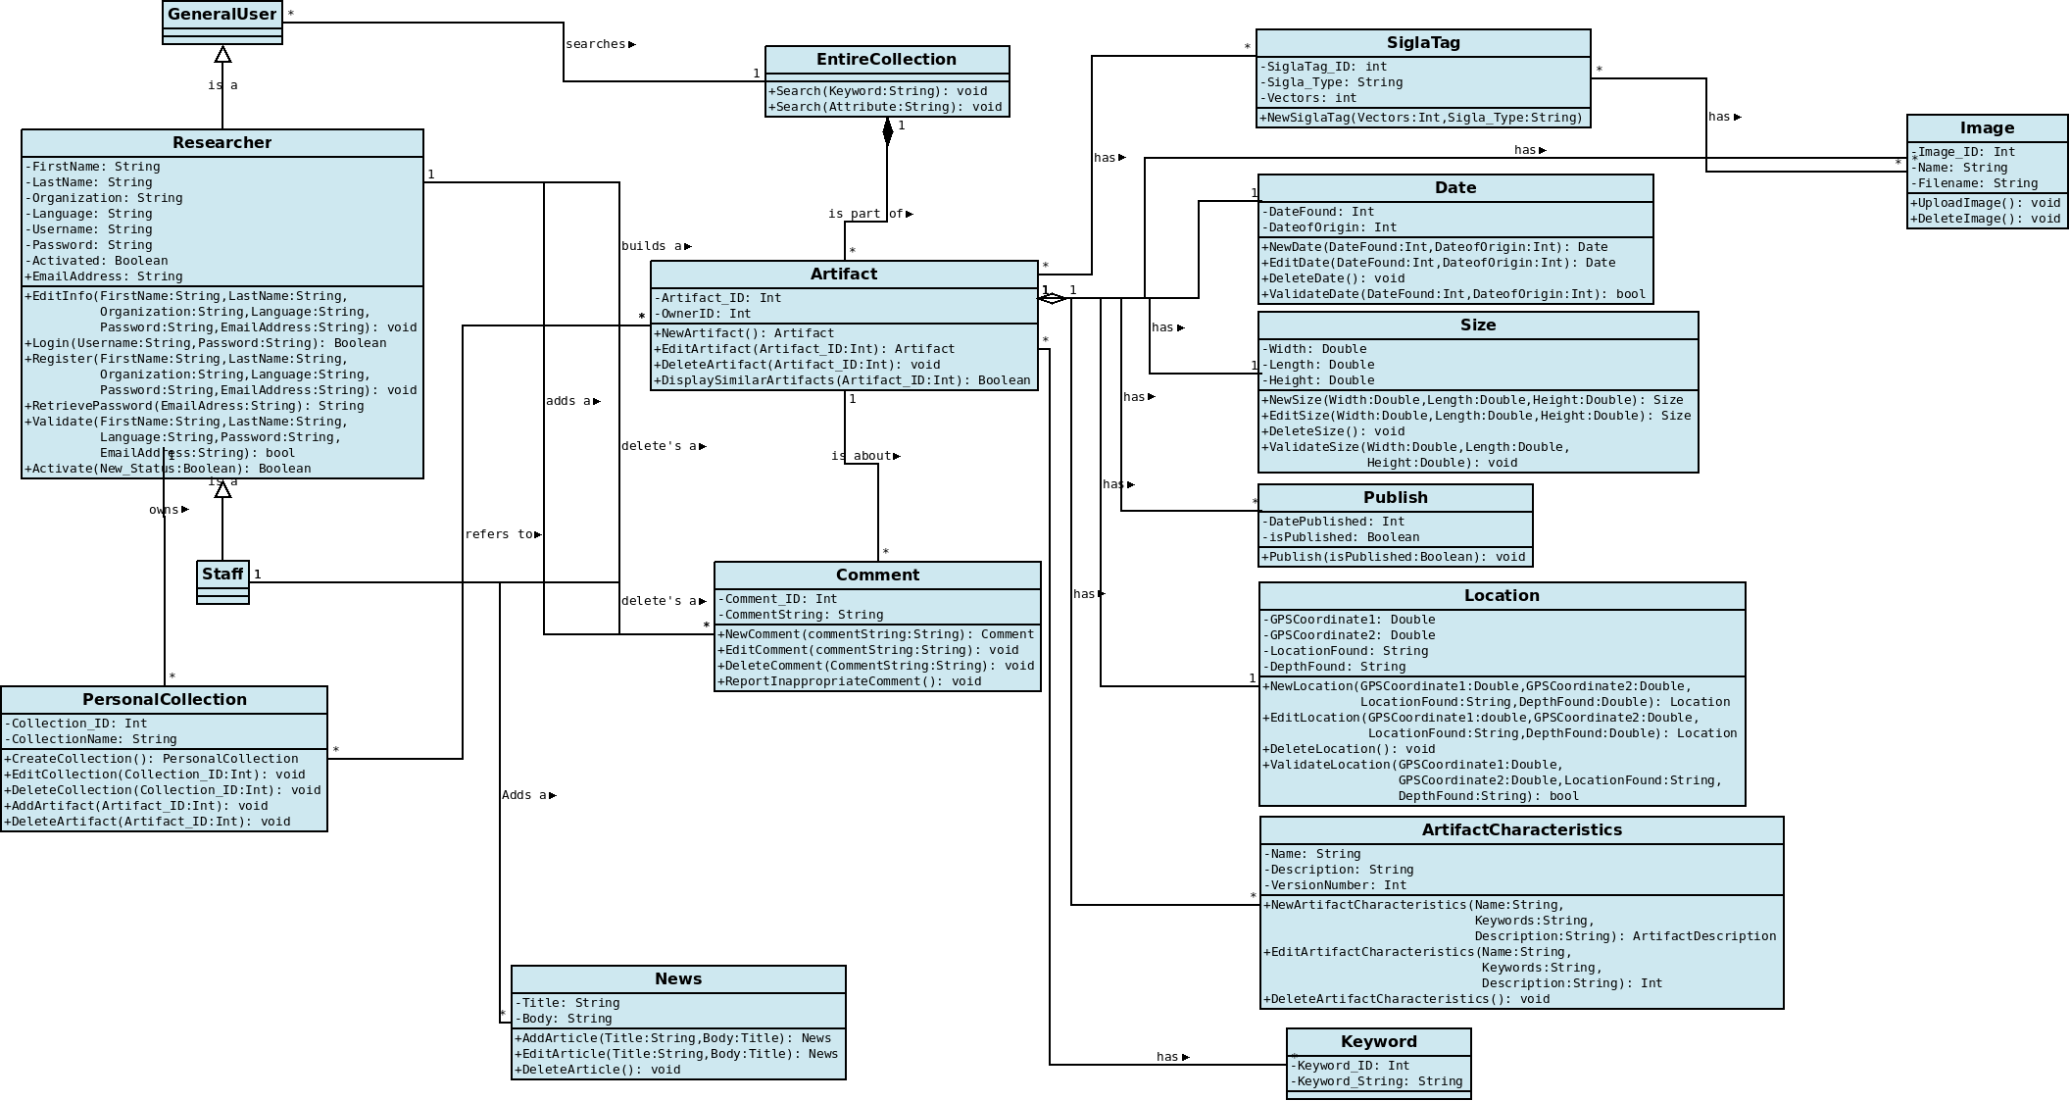
Class Diagram

Slide 14
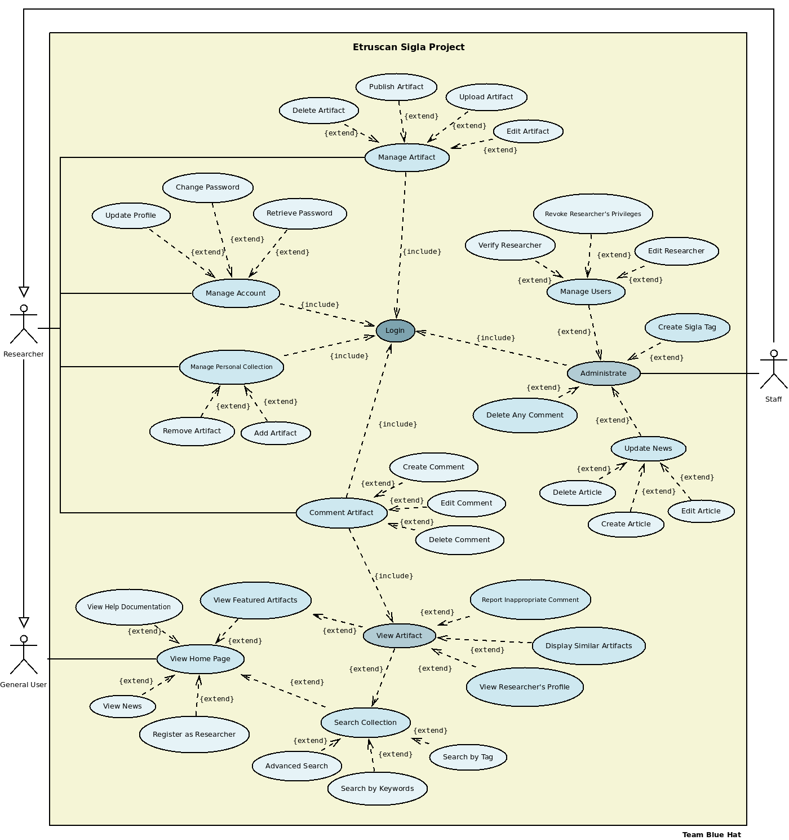
Use Case Diagram

Slide 15
THANK YOU ON
BEHALF OF Team BLUE HAT

