Slide 1
C
O
R
F
U
Clusters Of Raw Flash Units
Mahesh Balakrishnan, John Davis, Dahlia Malkhi, Vijayan Prabhakaran, Ted Wobber
Microsoft Research Silicon Valley
Thanks: Phil Bernstein, Ken Eguro, Jeremy Elson , Ed Nightingale,
Colin Reid, Michael Wei, Ming Wu
Notes:
Geo-distribution

Slide 2
tape is dead
disk is tape
flash is disk
RAM locality is king
- Jim Gray, Dec 2006
Notes:
in 2006 Jim Gray observed the trends in memory/storage technology, and predicted that (around) today,
flash will be as cheap as disk, the same size, but faster
RAM is almost getting cheaper, and available in almost the same size as NV drives
the numbers he predicated are almost right on…

Slide 3
flash in the data center
can flash clusters eliminate the trade-off between consistency and performance?
what new abstractions are required to manage and access flash clusters?
Notes:
in this project, we were looking at how to integrate flash in large data centers
what has changed?
before, disk was significantly slower than memory (especially random-access); flash is not
before, networks were significantly slower than local bus; today they are not
before, real memory was significantly smaller than hard drives; today they are perhaps only 1-order of magnitude smaller
the traditional view is that SHARING STORAGE with STRONG CONSISTENCY is costly
PARTITIONING is feasible
hence trading consistency for performance
we posit that flash has the potential to break this fundamental tradeoff between (strong) consistency and performance
in order to break this trade off , we need to design cluster storage differently. the talk presents our design and the design-choices behind it.

Slide 4

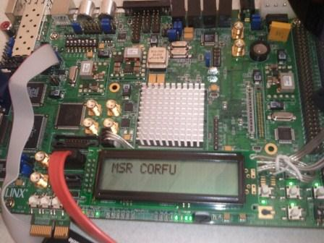
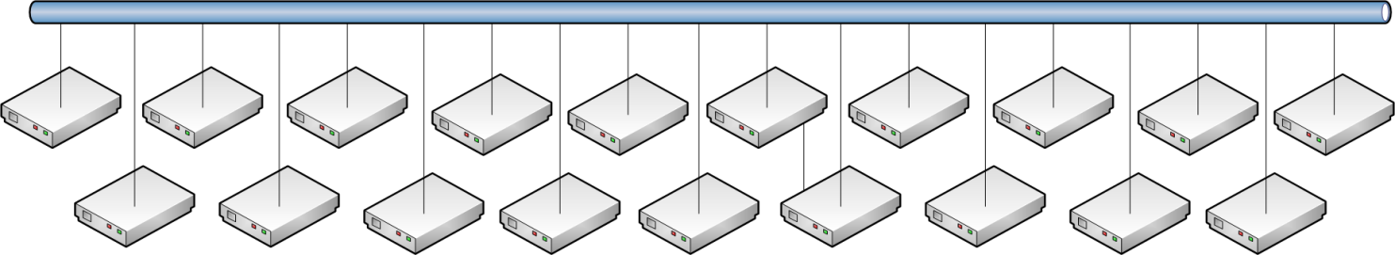
what is CORFU?
infrastructure applications:
key-value stores databases
SMR (st mach rep, voting)
filesystems
virtual disks
application
application
TOFU (trans over)
append(value)
read(offset)
CORFU
Replicated, fault-tolerant append
read from anywhere
append to tail
network-attached flash
1 Gbps, 15W, 75 µs reads, 200 µs writes (4KB)
cluster of 32 server-attached SSDs, 1.5 TB
0.5M reads/s, 0.2M appends/s (4KB)
flash cluster
Notes:
take a bunch of FLASH UNITS and make them available to clients over a network
in order to COMPLETELY PARALLELIZE streaming data to/from the cluster, expose a single shared log abstraction
most of the logic is implemented on a client-side library, which implements append/read, and DIRECTLY accesses the flash units.
the log-abstraction is really only the first, raw step;
we are building a set of service-layer apps which organize and index data in the log.
(we will highlight one such design called TOFU in this talk; it is NOT the only one)
apps sit on top of TOFU-like service layers
flash units are simple “dumb” and allow clients; we have prototyped one in HW, yielding promising performance

Slide 5
the case for CORFU
applications append/read data
why a shared log interface?
easy to build strongly consistent (transactional) in-memory applications
effective way to pool flash:
  SSD uses logging to avoid write-in-place
  random reads are fast
  GC is feasible
Notes:
two themes
from a top down view, we revive the old idea of LFS and implement it over a distributed cluster
flash + giant RAM enables a new class of in-memory applications, built for high-performance, yet providing strict consistency
applications dump all updates over the network onto a single shared log
a log is a source of strong consistency, state machine replication, total ordering
CORFU can be used to manage any cluster of flash
cluster-wide log, avoid duplicate functionality

Slide 6
CORFU is a distributed SSD with a shared log interface
getting 10 Gbps random-IO from 1TB flash farm:
 | Configuration | Unit cost | Unit power consumption | Summary
competition | ten SATA SSDs in 1Gbps server | $200/SSD + $2K/server | 150W | $22K 1500W fault tolerance incremental scalability
 | individual PCI-e controller in 10 Gbps server | $20K/Fusion-IO controller + $10K/server | 500W | $30K 500W fault tolerance incremental scalability
CORFU | ten 1Gbps CORFU units (no servers) | $50/raw flash + $200/custom-made controller | 10W | $2.5K 100W fault tolerance incremental scalability
Notes:
from a bottom-up, engineering point of view
we pool all the resources in a cluster of flash in one management layer,
we avoid expensive/slow/energy-consuming HW

Slide 7

the CORFU design
mapping resides at the client
CORFU API:
read(O)
append(V)
trim(O)
application
CORFU append throughput: # of 64-bit tokens issued per second
CORFU library
filled 1
13
filled 2
filled 3
filled 4
filled 5
filled 6
filled 7
filled 8
10
11
12
14
15
16
filled 9
read from anywhere
append to tail
sequencer
4KB log entry
each logical entry is mapped to a replica set of physical flash pages

Slide 8
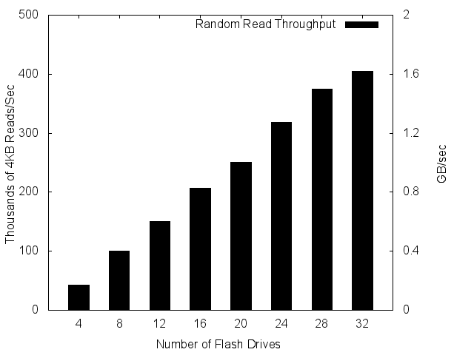
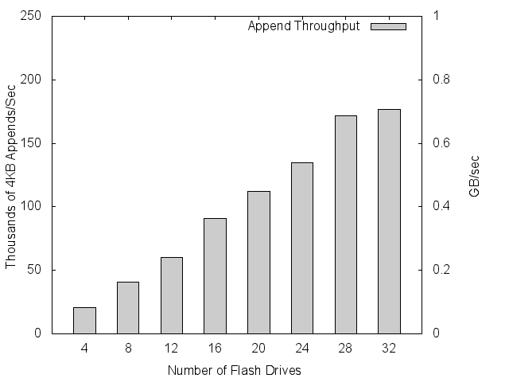
CORFU throughput (server+SSD)
[CORFU: A Shared Log Design for Flash Clusters, NSDI 2012]
capped at sequencer bottleneck
scales linearly

Slide 9

the CORFU protocol: mapping
client
page 0
page 1
…
D1/D2
L₀
L₄
...
D3/D4
L₁
L₅
...
D5/D6
L₂
L₆
...
D7/D8
L₃
L₇
...
application
read(pos)
D1 D3 D5 D7
CORFU library
Projection:
D1 D2
D3 D4
D5 D6
D7 D8
read(D1/D2, page#)
D2 D4 D6 D8
CORFU cluster
L₀
L₁
L₂
L₃
L₄
L₅
L₆
L₇
.
.
Notes:
Projection

Slide 10
the CORFU protocol: tail-finding
client
CORFU append throughput: # of 64-bit tokens issued per second
reserve next position in log (e.g., 100)
sequencer (T0)
application
read(pos)
append(val)
D1 D3 D5 D7
CORFU library
Projection:
D1 D2
D3 D4
D5 D6
D7 D8
write(D1/D2, val)
D2 D4 D6 D8
CORFU cluster
Notes:
Append protocol

Slide 11
the CORFU protocol: (chain) replication
client C1
client C2
client C3
safety under contention:
if multiple clients try to write to same log position concurrently, only one ‘wins’
durability:
data is only visible to reads if entire chain has seen it

Slide 12
handling failures: clients
client obtains token from sequencer and crashes: holes in the log
solution: other clients can ‘fill’ the hole
fast fill operation in CORFU API (<1ms):
completes half-written entries
writes junk on unwritten entries (metadata operation, conserves flash cycles, bandwidth)
0
1
3
4
5
7
8
9

Slide 13
handling failures: flash units
each Projection is a list of views
0 -
D1 D2
D3 D4
D5 D6
D7 D8
0 - 7
D1 a
D3 D4
D5 D6
D7 D8
8 -
D1 D9
D3 D4
D5 D6
D7 D8
Projection 0
Projection 1
Projection 2
0 - 7
D1 a
D3 D4
D5 D6
D7 D8
8 – 9
D1 D9
D3 D4
D5 D6
D7 D8
9 -
D10 D11
D12 D13
D14 D15
D16 D17
5
0
1
2
3
4
6
7
5
0
1
2
3
4
6
7
5
0
1
2
3
4
6
7
8
9
D1 D3 D5 D7
D10 D12 D14 D16
D9
D2 D4 D6 D8
D11 D13 D15 D17

Slide 14
handling failures: sequencer
the sequencer is an optimization
  clients can instead probe for tail of the log
log tail is soft state
value can be reconstructed from flash units
sequencer identity is stored in Projection

Slide 15
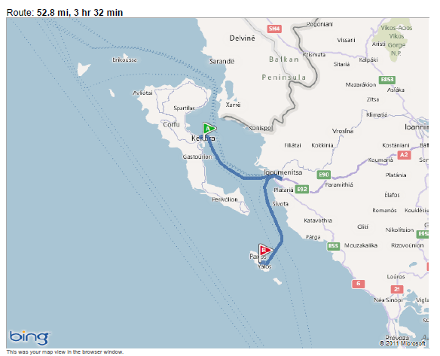
from State-Machine-Replication to CORFU
[From Paxos to CORFU: A Flash-Speed Shared Log, ACM SIGOPS, 2012]
SMR
CORFU
form a sequence of agreement decisions
leader-based solutions:
  leader proposes each entry to group of replicas
  same leader, same replicas, for all entries
  throughput capped at leader IO capacity
scale-out through partitioning:
  multiple autonomous sequences
  decide on sequence of log-entry values
  CORFU-chain:
    first in chain proposes value (due to seq’cer, no contention)
    each entry has a designated replica-set
    throughput capped at rate of sequencing 64-bit tokens
  scale-out by partitioning over time rather than over data
Corfu
Paxos

Slide 16
how far is CORFU from Paxos?
Paxos
instance
Paxos
instance
Paxos
instance
A0
A1
A2
A3
…
C0
C1
C2
C3
…
A0
B0
C0
A1
B1
C1
...
B0
B1
B2
B3
…
CORFU partitions across time, not space
(CORFU replica chain == Paxos instance)
Notes:
pause to discuss how does CORFU stand in a foundational view.
Clearly, CORFU implements some form of SMR. Paxos is the traditional solution for SMR replication
is CORFU a Paxos instance, and if not, why not?
when constructing reliable stores over clusters, one uses SMR to replicate data.
the limitation of an SMR instance is that throughput is capped at the IO capacity of each individual participant, e.g., a leader
hence, the tranditional approach to scaling storage clusters is to partition data object and construct multiple independent instances of SMR
instead, CORFU stripes a single stream of updates over multiple replica sets, and lets the sequencer—which is NOT IO bound—arbitrate the position in the sequence
in this way, no IO-bound process is the bottleneck
note that the sequencer is NOT a Paxos leader, it is just a contention manager. This is the reason that the sequencer need not perform IO on each operation and operates at much higher rates than any IO bound process

Slide 17
how do we build CORFU applications?

Slide 18
TOFU: lock-free transactions with CORFU
application
where is your data?
TOFU library
read/update
(key, version, value)
did you and I do all reads/updates atomically?
versioned table store
(BigTable, HBase, PacificA, FDS)
key | vrs | val
k | 3 | 5
…
Notes:
The industry today offers a variety of no-SQL table/multi-versioned store
shared by clients over the network
a key and version uniquely identify an object
to share data, clients need to share information about the latest versions they store
the challenge is to share data atomically and provide multi-item transactions

Slide 19
TOFU: lock-free transactions with CORFU
application
key | locator
k | o
lookup
TOFU library
read/update
(key, version, value) entries
versioned table store
(BigTable, HBase, PacificA, FDS)
update index
Notes:
conceptually, we want to build an index
shared by clients
updated with data-updates
supports high-level semantics, e.g., multi-operation transactions

Slide 20
TOFU: lock-free transactions with CORFU
application
key | locator
k | o
lookup
TOFU library
CORFU library
read/update
(key, version, value) entries
append “commit” intention- record
construct index by
“playing” log
versioned table store
(BigTable, HBase, PacificA, FDS)
Notes:
we use CORFU to assist in maintaining a completely decentralized and high-throughput index

Slide 21
TOFU: lock-free transactions with CORFU
application
key | locator
k | o
lookup
TOFU library
CORFU library
read/update
(key, version, value) entries
append “commit” intention- record
construct index by
“playing” log
versioned table store
(BigTable, HBase, PacificA, FDS)
ref
conflict zone
intent
Notes:
we use CORFU to assist in maintaining a completely decentralized and high-throughput index

Slide 22
CORFU applications
key-value store
what: data + commit
why: multi-put/get, snapshots, mirroring
database (Hyder, Bernstein et al.)
what: speculative commit records
why: decide commit/abort
C
O
R
F
U
virtual disk storage
what: volume sectors
why: multiplex flash cycles / IOPS / bytes
state machine replication
what: proposed commands
why: order/persist commands
others: metadata services, distributed STM, filesystems…

Slide 23
grieving for HD
Denial:
  too expensive, vulnerable, wait for PCM
Anger:
  SSD-FTL, use flash as a block-device
    random writes exhibit bursts in performance
    duplicate functionality
Bargaining:
  use flash as memory-cache/memory-extension
Depression:
  throw money and power at it, PCI-e controllers
Acceptance:
  new design for farms of flash in a cluster

Slide 24
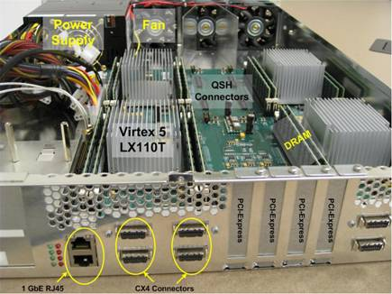
CORFU Beehive-based flash unit
[A Design for Network Flash, NVMW 2012]
Beehive architecture over
BEE3 and XUPv5 FPGAs
Multiple slow (soft) cores
Token ring interconnect
Vehicle for practical
architecture research

Slide 25
Conclusion
CORFU is a distributed SSD: 1 million write IOPS, linearly scalable read IOPS
CORFU is a shared log: strong consistency at wire speed
CORFU uses network-attached flash to construct inexpensive, power-efficient clusters
Notes:
pause to discuss how does CORFU stand in a foundational view.
Clearly, CORFU implements some form of SMR. Paxos is the traditional solution for SMR replication
is CORFU a Paxos instance, and if not, why not?
when constructing reliable stores over clusters, one uses SMR to replicate data.
the limitation of an SMR instance is that throughput is capped at the IO capacity of each individual participant, e.g., a leader
hence, the tranditional approach to scaling storage clusters is to partition data object and construct multiple independent instances of SMR
instead, CORFU stripes a single stream of updates over multiple replica sets, and lets the sequencer—which is NOT IO bound—arbitrate the position in the sequence
in this way, no IO-bound process is the bottleneck
note that the sequencer is NOT a Paxos leader, it is just a contention manager. This is the reason that the sequencer need not perform IO on each operation and operates at much higher rates than any IO bound process

Slide 26
backup slides

Slide 27
reconfiguration
to reconfigure, a client must:
seal the current Projection on drives
determine last log position modified in current Projection
propose a new Projection to the auxiliary as the next Projection
an auxiliary stores a sequence of Projections
propose kth Projection; fails if it already exists
read kth Projection; fails if none exists
why an auxiliary?
can tolerate f failures with f+1 replicas
can be implemented via conventional Paxos
reconfiguration latency = tens of milliseconds

Slide 28
flash unit design
device exposes sparse linear address space
three message types: read, write, seal
write-once semantics:
  reads must fail on unwritten pages
  writes must fail on already written pages
bad-block remapping
Three form factors:
  FPGA+SSD: implemented, single unit
  server+SSD: implemented, 32-unit deployment
  FPGA+flash: under development

Slide 29
the FPGA+SSD flash unit
BeeHive architecture over BEE3 and XUPv5 FPGAs
BEE3: 80 GB SSD, 8 GB RAM
power: 15W
tput: 800 Mbps
end-to-end latency:
  reads: 400 µsecs
  mirrored appends: 800 µsecs

Slide 30
garbage collection
once appended, data does not move in the log
application is required to trim invalid positions
log address space can become sparse
∞
invalid entries
valid entries

Slide 31
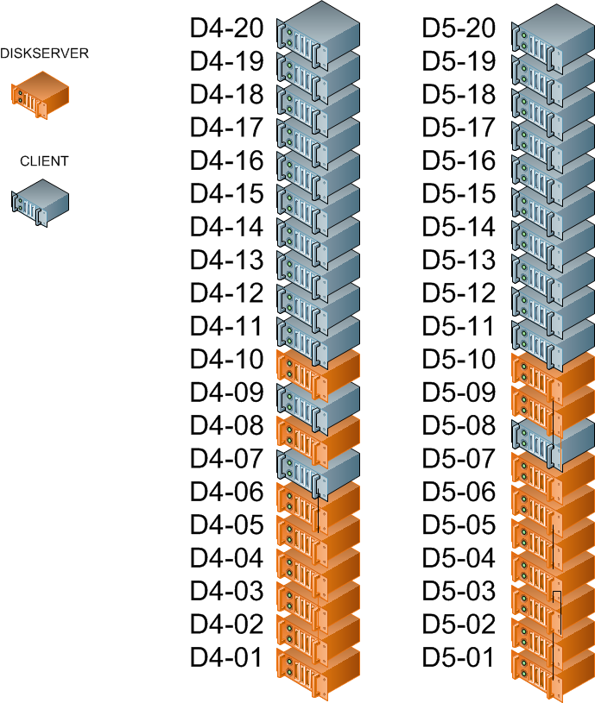
the CORFU cluster (server+SSD)
$3K of flash
32 drives, 16 servers, 2 racks
  Intel X25V (40 GB)
  20,000 4KB read IOPS
  each server limited by 1 Gbps NIC at 30,000 4KB IOPS
mirrored across racks
max read tput: 500K 4KB IOPS (= 16 Gbps = 2 GB/s)
max write tput: 250K 4KB IOPS

Slide 32
flash unit design
- message-passing ring of cores
- logical separation of functionality + specialized cores
- slow cores (100 MHz) = low power (15W)

Slide 33
flash primer
page granularity (e.g., 4KB)
fast random reads
overwriting 4KB page requires surrounding 512KB block to be erased
  erasures are slow
  erasures cause wear-out (high BER)
SSDs: LBA-over-log
  no erasures in critical path
  even wear-out across drive
Notes:
to justify the design decisions we make in CORFU, we first need to overview the special characteristics of flash that are of relevance here.

