Slide 1



Silhouette: Leveraging Consistency Mechanisms to Detect Bugs in Persistent Memory-Based File Systems
Bing Jiao Ashvin Goel Andy Wang
Florida State University University of Toronto Florida State University
Notes:
Good afternoon, everyone. Today, I am going to present Silhouette—a tool leverages consistency mechanisms to detect bugs in Persistent Memory-based file systems. This work is a collaboration between researchers at Florida State University and the University of Toronto.
Persistent Memory (PM) file systems promise high performance, but they’re prone to subtle bugs due to out-of-order persistence. In this talk, I’ll explain the challenges of detecting these bugs in file systems, how Silhouette addresses them, and the results we’ve achieved.

Slide 2
Detecting Bugs in Persistent Memory FSes
Challenges:
Persistent Memory (PM) programs are prone to bugs due to out-of-order persistence
Exponential search space in PM FSes
  N in-flight (not guaranteed to be persisted) stores at a fence point → 2^{N} crash scenarios
  (crash plans)
Proposed Silhouette, which:
First checks whether a PM file system implements its consistency mechanisms correctly
If so, then all stores associated with the consistency mechanism are not reordered during testing, which dramatically reduces the search space
Notes:
It is challenging to detect bugs in PM-based file sytems.
First, PM programs are prone to bugs due to out-of-order persistence
Second, the number of possible crash scenarios grows exponentially with the number of in-flight stores—those not guaranteed to be persisted stores. With N in-flight stores at a fence point (fence instruction), there are 2^N crash scenarios (we name it crash plans) to test. It is prohibitive to explore them exhaustively.
To address this, we proposed Silhouette, it :
First checks whether a PM file system implements its consistency mechanisms correctly
If so, then all stores associated with the consistency mechanism are not reordered during testing, which dramatically reduces the search space

Slide 3
Out-of-order Persistence
Store A, 2
Flush A
Store B, 3
Fence
CPU
Cache
(Line 1, A: 0)
(Line 2, B: 0)
PM
(A: 0)
(B: 0)
Notes:
This slide illustrates the concept of out-of-order persistence in PM programs. In this figure, we have the CPU, CPU Cache, and the PM.
Initially, there are variable A and B in the system and both are 0 at the beginning.
On the left side, we have 4 instructions, store A with number 2, flush A from the cache to the PM, store B with number 3, and fence, fence is the memory barrier.

Slide 4
Out-of-order Persistence
Store A, 2
Flush A
Store B, 3
Fence
CPU
Cache
(Line 1, A: 0)
(Line 2, B: 0)
PM
(A: 0)
(B: 0)
Notes:
First, we store A with number 2

Slide 5
Out-of-order Persistence
Store A, 2
Flush A
Store B, 3
Fence
CPU
Cache
(Line 1, A: 2)
(Line 2, B: 0)
PM
(A: 0)
(B: 0)
Notes:
variable A in CPU cache will be updated as 2

Slide 6
Out-of-order Persistence
Store A, 2
Flush A
Store B, 3
Fence
CPU
Cache
(Line 1, A: 2)
(Line 2, B: 0)
PM
(A: 0 or 2)
(B: 0)
Notes:
However, due to the incoherence between the cpu cache and the PM, the variable A could be either 0 or 2.

Slide 7
Out-of-order Persistence
Store A, 2
Flush A
Store B, 3
Fence
CPU
Cache
(Line 1, A: 2)
(Line 2, B: 0)
PM
(A: 0 or 2)
(B: 0)
Notes:
Then, we are trying to flush Variable A from the CPU cache to the PM.
At this moment, however, flush does not guarantee Variable A is persisted to PM.
This is because (NEXT PAGE) the flush instruction might be reordered and does not take effect immediately.

Slide 8
Out-of-order Persistence
Store A, 2
Flush A
Store B, 3
Fence
CPU
Cache
(Line 1, A: 2)
(Line 2, B: 0)
The execution of an instruction might be reordered by either compiler or CPU.
PM
(A: 0 or 2)
(B: 0)
Notes:
This is because the flush instruction might be reordered by either compiler or CPU, and does not take effect immediately.

Slide 9
Out-of-order Persistence
Store A, 2
Flush A
Store B, 3
Fence
CPU
Cache
(Line 1, A: 2)
(Line 2, B: 0)
PM
(A: 0 or 2)
(B: 0)
Notes:
Next, we update variable B with number 3

Slide 10
Out-of-order Persistence
Store A, 2
Flush A
Store B, 3
Fence
CPU
Cache
(Line 1, A: 2)
(Line 2, B: 3)
PM
(A: 0 or 2)
(B: 0)
Notes:
Similarly, variable B in the cache is updated. but in PM, (NEXT PAGE) it could be either 0 or 3

Slide 11
Out-of-order Persistence
Store A, 2
Flush A
Store B, 3
Fence
CPU
Cache
(Line 1, A: 2)
(Line 2, B: 3)
PM
(A: 0 or 2)
(B: 0 or 3)
Notes:
but in PM, it could be either 0 or 3

Slide 12
Out-of-order Persistence
Store A, 2
Flush A
Store B, 3
CPU
Cache
(Line 1, A: 2)
(Line 2, B: 3)
PM
(A: 0 or 2)
(B: 0 or 3)
Fence
Notes:
If a crash occurs before the fence instruction. In PM, we have Variable A either 0 or 2 and Variable B either 0 or 3, which creates (NEXT PAGE) four possible crash scenarios.

Slide 13
Out-of-order Persistence
CPU
4 (i.e., 2²) crash plans:
A and B are persisted
A is persisted
B is persisted
A and B are not persisted
Store A, 2
Flush A
Store B, 3
Cache
(Line 1, A: 2)
(Line 2, B: 3)
PM
(A: 0 or 2)
(B: 0 or 3)
N in-flight stores → 2^{N} crash plans
Fence
Notes:
If a crash occurs before the fence instruction. In PM, we have Variable A either 0 or 2 and Variable B either 0 or 3, which creates four possible crash scenarios.
A and B are persisted
A is persisted
B is persisted
A and B are not persisted
Suppose we have N in-flight stores, it could yield at most 2^N crash plans.

Slide 14
Out-of-order Persistence
Store A, 2
Flush A
Store B, 3
Fence
CPU
Cache
(Line 1, A: 2)
(Line 2, B: 3)
PM
(A: 2)
(B: 0 or 3)
Notes:
Only the fence instruction can prevent the instruction ordering and guarantees all flushed variables are persisted to PM.
In this diagram, the fence instruction guarantees variable A is updated as 2 in PM.
However, since B is not flushed, it is still could be either 0 or 3.
If we have more instructions after Line 4 (NEXT PAGE)

Slide 15
Out-of-order Persistence
Store A, 2
Flush A
Store B, 3
Fence
Store C, 4
Store D, 5
Flush C, D
Fence
Notes:
If we have more instructions after Line 4,
for example, store C, D, flush C and D, and fence
IF a crash occurs before Line 8 (NEXT PAGE)

Slide 16
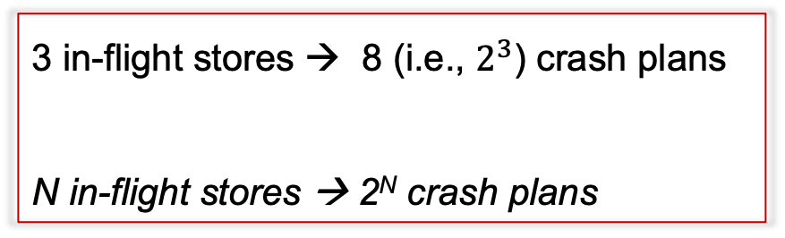
Out-of-order Persistence
Store A, 2
Flush A
Store B, 3
Fence
Store C, 4
Store D, 5
Flush C, D
Fence
3 in-flight stores → 8 (i.e., $2^{3}$) crash plans
N in-flight stores → 2^{N} crash plans
How to avoid search space explosion?
[1] Assume B, C, and D are in different cache lines.
Notes:
IF a crash occurs before Line 8, there will be 3 in-flight stores, B, C, and D, which yields 8 crash plans (2 to the power of 3).
If there are N in-flight stores, there would be 2 to the power of N crash plans.
So, how to avoid search space explosion?
By studying PM file systems (NEXT PAGE)

Slide 17
Observations
PM FSes can have 20-40 in-flight stores at fence points
→ millions and trillions of crash plans
Notes:
By studying PM file systems, we observed that PM file systems can have 20-40 in-flight stores at fence points, which could yield million and trillions of crash plans, so that testing them exhaustively is prohibitive.,

Slide 18
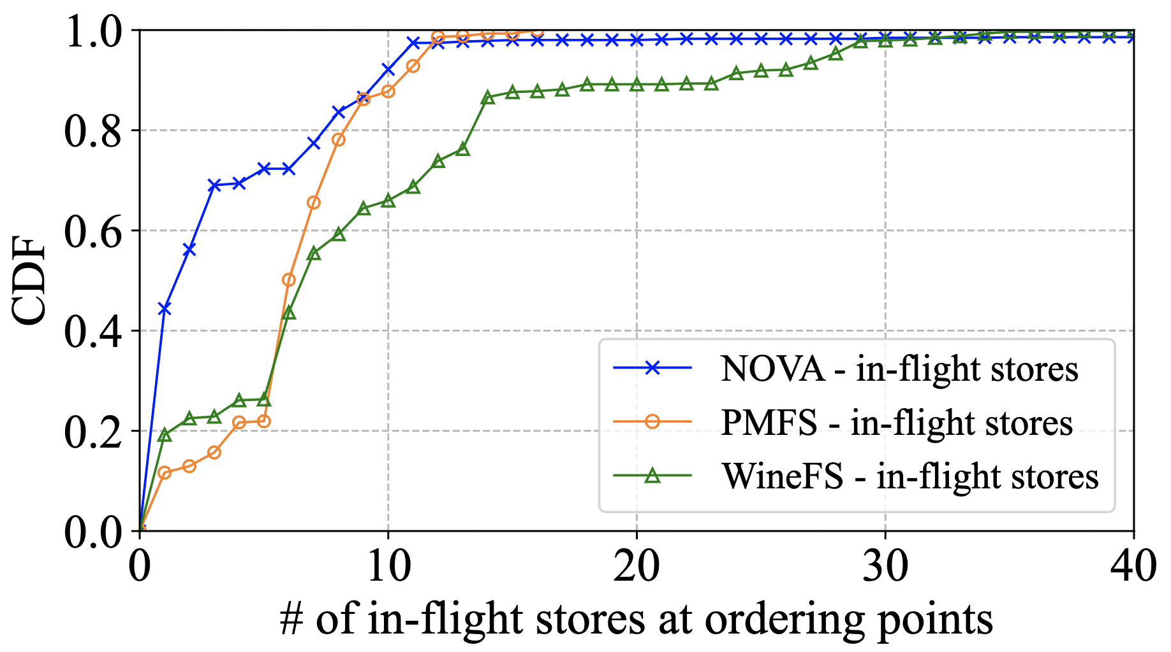
In-flight Stores in FSes
Long tails
# of in-flight stores at fence points
Fig 1. Cumulative Distribution Function (CDF) of in-flight and unprotected stores in PMFS, NOVA, and WineFS under the ACE workloads.
Notes:
Although more than 60 precent of fence points have fewer than 10 in-flight store, especially for PMFS and NOVA, it is 90 precent.
They have long tails. And the long tail dominates the number of crash plan.
We also observed that (NEXT PAGE)

Slide 19
Observations
PM FSes can have 20-40 in-flight stores at fence points
→ millions and trillions of crash plans
PM FSes use well-known crash-consistency mechanisms (e.g., journaling) to provide atomicity and durability guarantees
→ < ~10 in-flight stores that are not associated with any crash-consistency mechanisms (denote unprotected store) at fence points
→ < ~1000 crash plans
Notes:
We also observed that PM file systems rely on well-known crash-consistency mechanisms, like journaling, to provide atomicity and durability guarantees.
The real vulnerabilities lie in the stores that are not associated with any crash-consistency mechanisms (we call it unprotected store).
These unprotected stores are fewer than 10 at fence points, which yields fewer than 1 thousand crash plans.

Slide 20
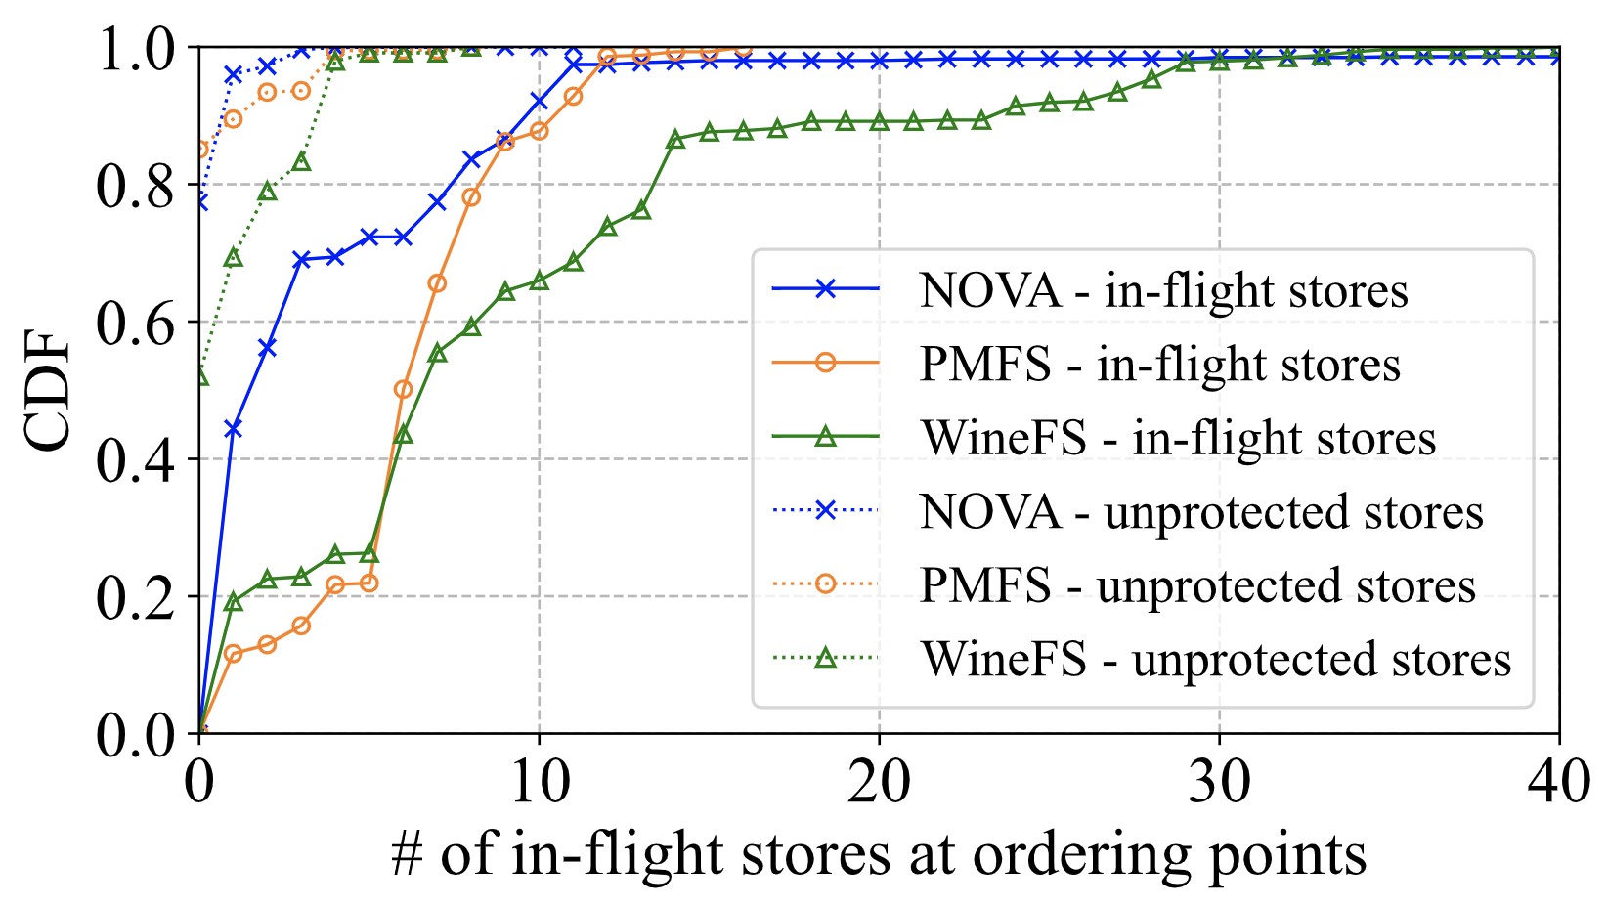
In-flight vs. Unprotected In-flight Stores
Focusing on in-flight stores not associated with consistency mechanisms (unprotected stores) eliminates the long tail.
# of in-flight stores at fence points
Fig 1. CDF of in-flight and unprotected stores in PMFS, NOVA, and WineFS under the ACE workloads.
Notes:
The dotted line shows only the in-flight store that are not associated with crash-consistency mechanisms.
It shows almost 95 precent of fence points have fewer than 5 in-flight stores.
Which eliminates the long tail.
However, with 10 in-flight stores (NEXT PAGE), we still need to test one thousands crash scenarios. Can we further reduce this number?

Slide 21
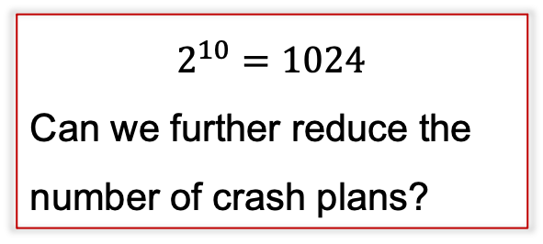
In-flight vs. Unprotected In-flight Stores
Focusing on in-flight stores not associated with consistency mechanisms (unprotected stores) eliminates the long tail.
$$2^{10}=1024$$
Can we further reduce the number of crash plans?
# of in-flight stores at fence points
Fig 1. CDF of in-flight and unprotected stores in PMFS, NOVA, and WineFS under the ACE workloads.
Notes:
However, with 10 in-flight stores, we still need to test one thousands crash plan. Can we further reduce this number?
By studying PM programs (NEXT PAGE)

Slide 22
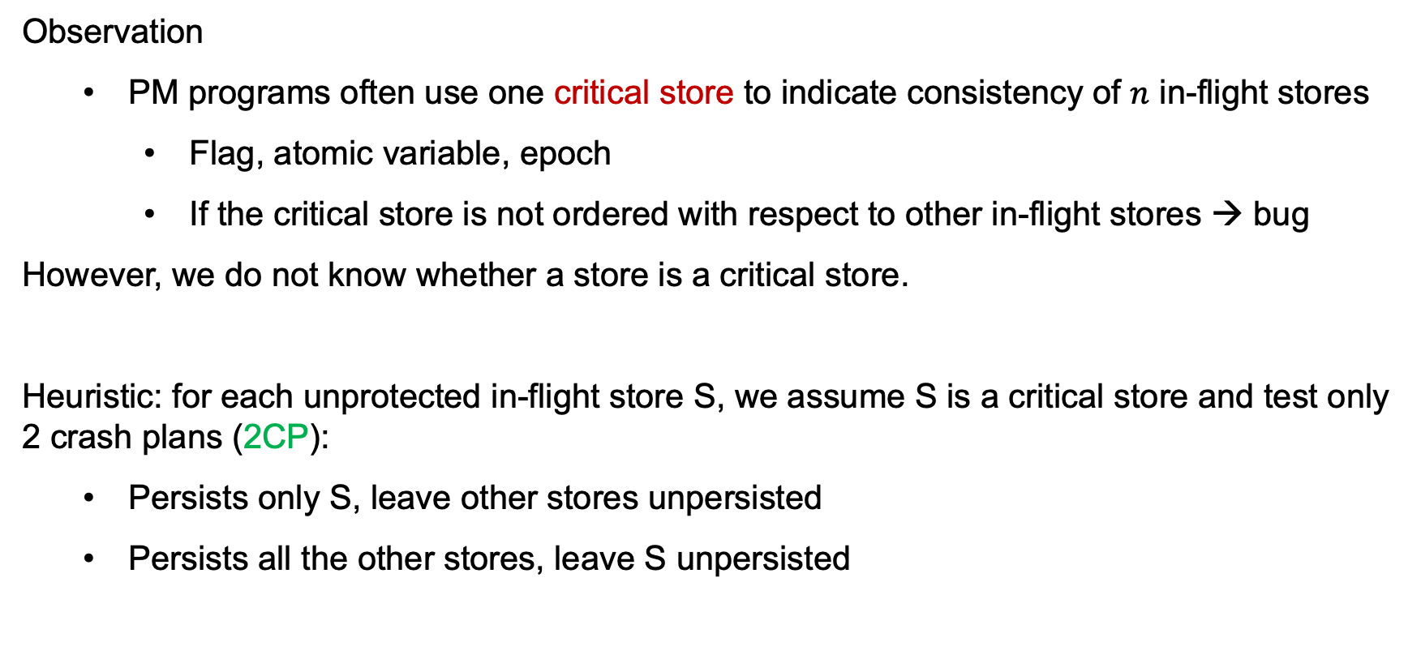
Our Approach: Heuristic Reordering
Observation
  PM programs often use one critical store to indicate consistency of $n$ in-flight stores
    Flag, atomic variable, epoch
    If the critical store is not ordered with respect to other in-flight stores → bug
However, we do not know whether a store is a critical store.
Heuristic: for each unprotected in-flight store S, we assume S is a critical store and test only 2 crash plans (2CP):
  Persists only S, leave other stores unpersisted
  Persists all the other stores, leave S unpersisted
Notes:
We also observed that, PM programs often use one critical store to indicate consistency of n in-flight stores, such as Flag, atomic variable, epoch.
If the critical store is not ordered with respect to other in-flight stores, it will be a bug
However, we do not know whether a store is a critical store.
We simply assume each unprotected store S, could be this critical store, and test only 2 crash plans (2CP):
first, Persists only this unprotected store S, leave other stores unpersisted
second, Persists all the other stores, leave this unprotected store S unpersisted
With N in-flight store (NEXT PAGE)

Slide 23
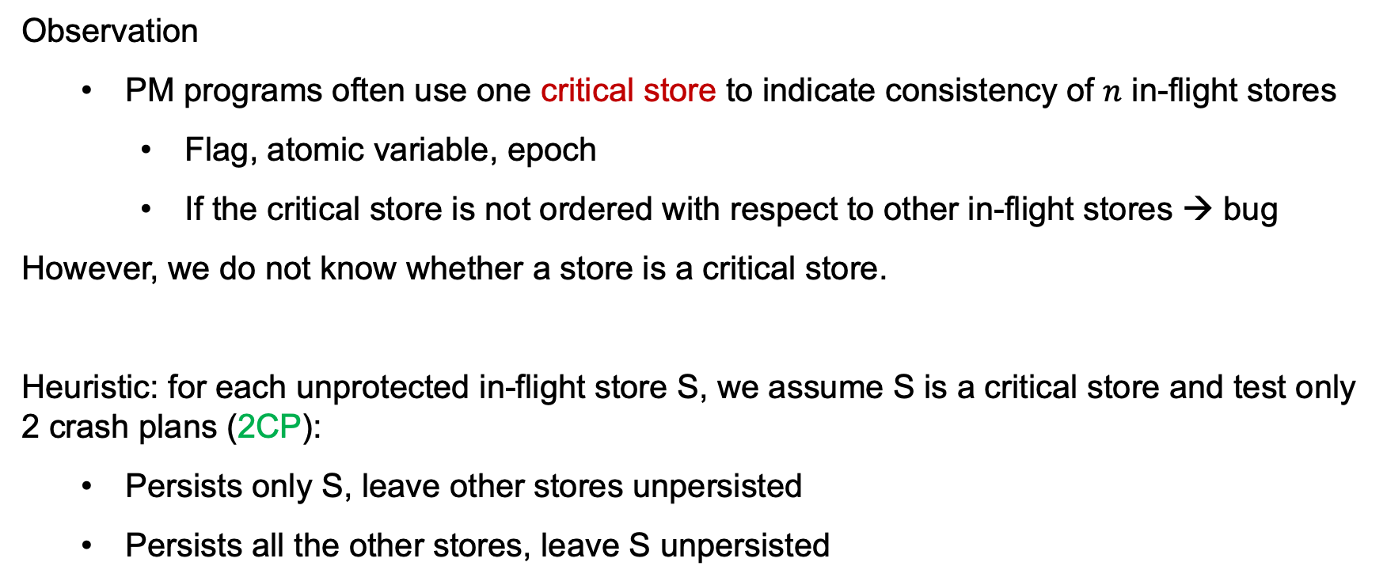

Our Approach: Heuristic Reordering
Observation
  PM programs often use one critical store to indicate consistency of $n$ in-flight stores
    Flag, atomic variable, epoch
    If the critical store is not ordered with respect to other in-flight stores → bug
However, we do not know whether a store is a critical store.
Heuristic: for each unprotected in-flight store S, we assume S is a critical store and test only 2 crash plans (2CP):
  Persists only S, leave other stores unpersisted
  Persists all the other stores, leave S unpersisted
With $N$ in-flight stores:
Traditionally combinatorial approach: 2^{N} crash plans
Our 2CP approach: $2N$ crash plans
Notes:
With N in-flight stores, the traditionally combinatorial approach will generate 2 to the power of N crash plans
Our heuristic approach generates 2 times N crash plans.

Slide 24
Silhouette
Key Ideas:
Detect crash-consistency mechanisms and check their invariants to ensure the associated stores are crash-consistent w.r.t. persistence reordering.
Use the heuristic (2CP) approach to test unprotected stores.
Challenges:
How to define invariants for crash-consistency mechanisms?
How to check these invariants?
More details in the paper
Notes:
Based on our observation and studies, we proposed Silhouette.
The key ideas are:
Detect crash-consistency mechanisms and check their invariants to ensure the associated stores are crash-consistent w.r.t. persistence reordering.
Use the heuristic (2CP) approach to test unprotected stores.
There still have some challenges remaining:
How to define invariants for crash-consistency mechanisms?
How to check these invariants?
More details are in the paper.

Slide 25
Consistency Invariants
head
Crash-consistency mechanisms order writes in multiple phases.
Take an undo-journal as an example:
journal
tail
0x8100
0x8000
block
Notes:
Crash-consistency mechanisms order writes in multiple phases.
Take an undo-journal as an example.
In this figure, both the log and the block are in the PM. The journal has a tail pointer and head pointer to indicates the logged writes.
This undo journal has 4 phases, including (NEXT PAGE) allocate logs by moving the tail pointer, log writes to the allocated space, in-place updates to the destination address, and reclaim logs to checkpoint this transaction by moving the head pointer points to the tail.

Slide 26
Consistency Invariants
head
Crash-consistency mechanisms order writes in multiple phases.
Take an undo-journal as an example:
Allocate logs
journal
tail
update
flush
fence
0x8100
0x8000
block
Notes:
Crash-consistency mechanisms order writes in multiple phases.
Take an undo-journal as an example.
In this figure, both the log and the block are in the PM. The journal has a tail pointer and head pointer to indicates the logged writes.
This undo journal has 4 phases, including (NEXT PAGE) allocate logs by moving the tail pointer, log writes to the allocated space, in-place updates to the destination address, and reclaim logs to checkpoint this transaction by moving the head pointer points to the tail.

Slide 27
Consistency Invariants
head
Crash-consistency mechanisms order writes in multiple phases.
Take an undo-journal as an example:
Allocate logs
Log writes
journal
tail
4. write
5. flush
6. fence
7. commit write
8. flush
9. fence
0x8100
0x8000
block
Notes:
Crash-consistency mechanisms order writes in multiple phases.
Take an undo-journal as an example.
In this figure, both the log and the block are in the PM. The journal has a tail pointer and head pointer to indicates the logged writes.
This undo journal has 4 phases, including (NEXT PAGE) allocate logs by moving the tail pointer, log writes to the allocated space, in-place updates to the destination address, and reclaim logs to checkpoint this transaction by moving the head pointer points to the tail.

Slide 28
Consistency Invariants
head
Crash-consistency mechanisms order writes in multiple phases.
Take an undo-journal as an example:
Allocate logs
Log writes
In-place updates
journal
tail
10. write
11. flush
fence
0x8100
0x8000
block
Notes:
Crash-consistency mechanisms order writes in multiple phases.
Take an undo-journal as an example.
In this figure, both the log and the block are in the PM. The journal has a tail pointer and head pointer to indicates the logged writes.
This undo journal has 4 phases, including (NEXT PAGE) allocate logs by moving the tail pointer, log writes to the allocated space, in-place updates to the destination address, and reclaim logs to checkpoint this transaction by moving the head pointer points to the tail.

Slide 29
Consistency Invariants
head
Crash-consistency mechanisms order writes in multiple phases.
Take an undo-journal as an example:
Allocate logs
Log writes
In-place updates
Reclaim logs
journal
tail
13. update
14. flush
15. fence
0x8100
0x8000
block
Notes:
Crash-consistency mechanisms order writes in multiple phases.
Take an undo-journal as an example.
In this figure, both the log and the block are in the PM. The journal has a tail pointer and head pointer to indicates the logged writes.
This undo journal has 4 phases, including (NEXT PAGE) allocate logs by moving the tail pointer, log writes to the allocated space, in-place updates to the destination address, and reclaim logs to checkpoint this transaction by moving the head pointer points to the tail.

Slide 30
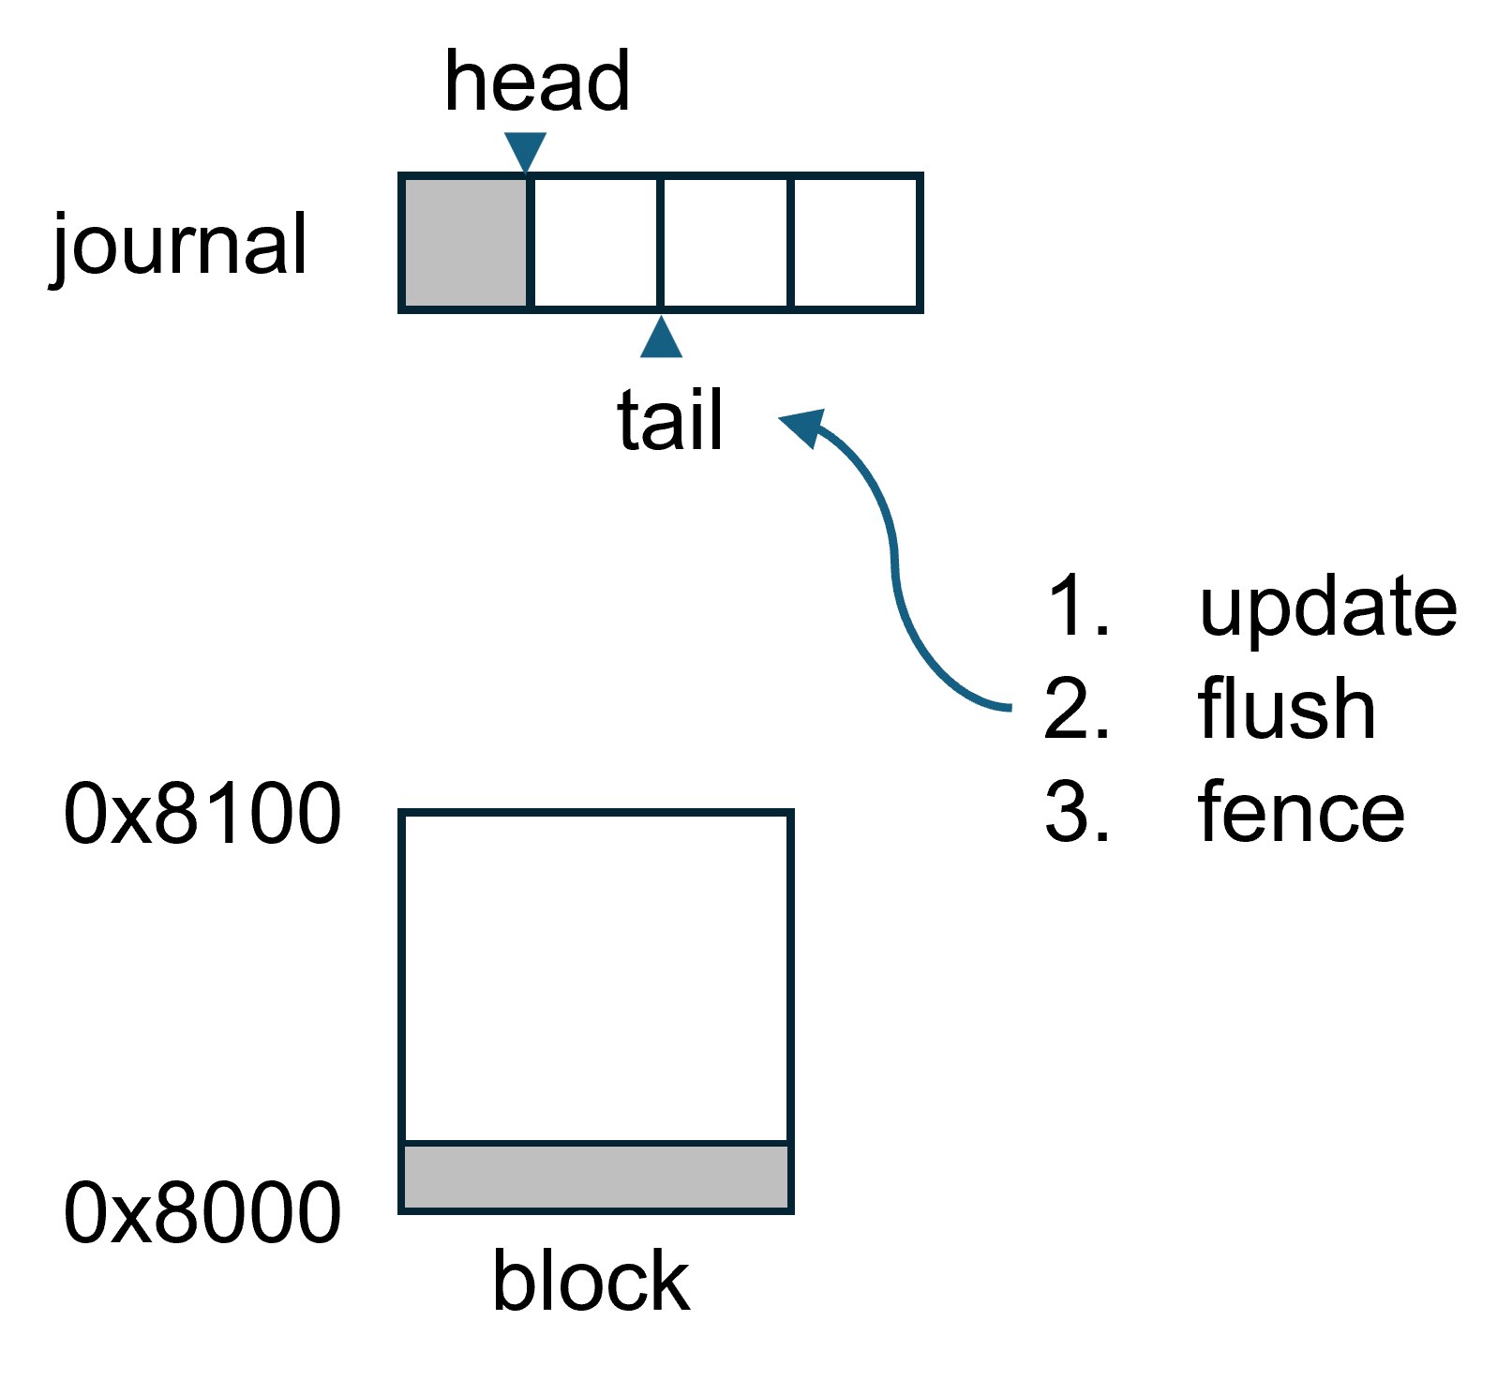
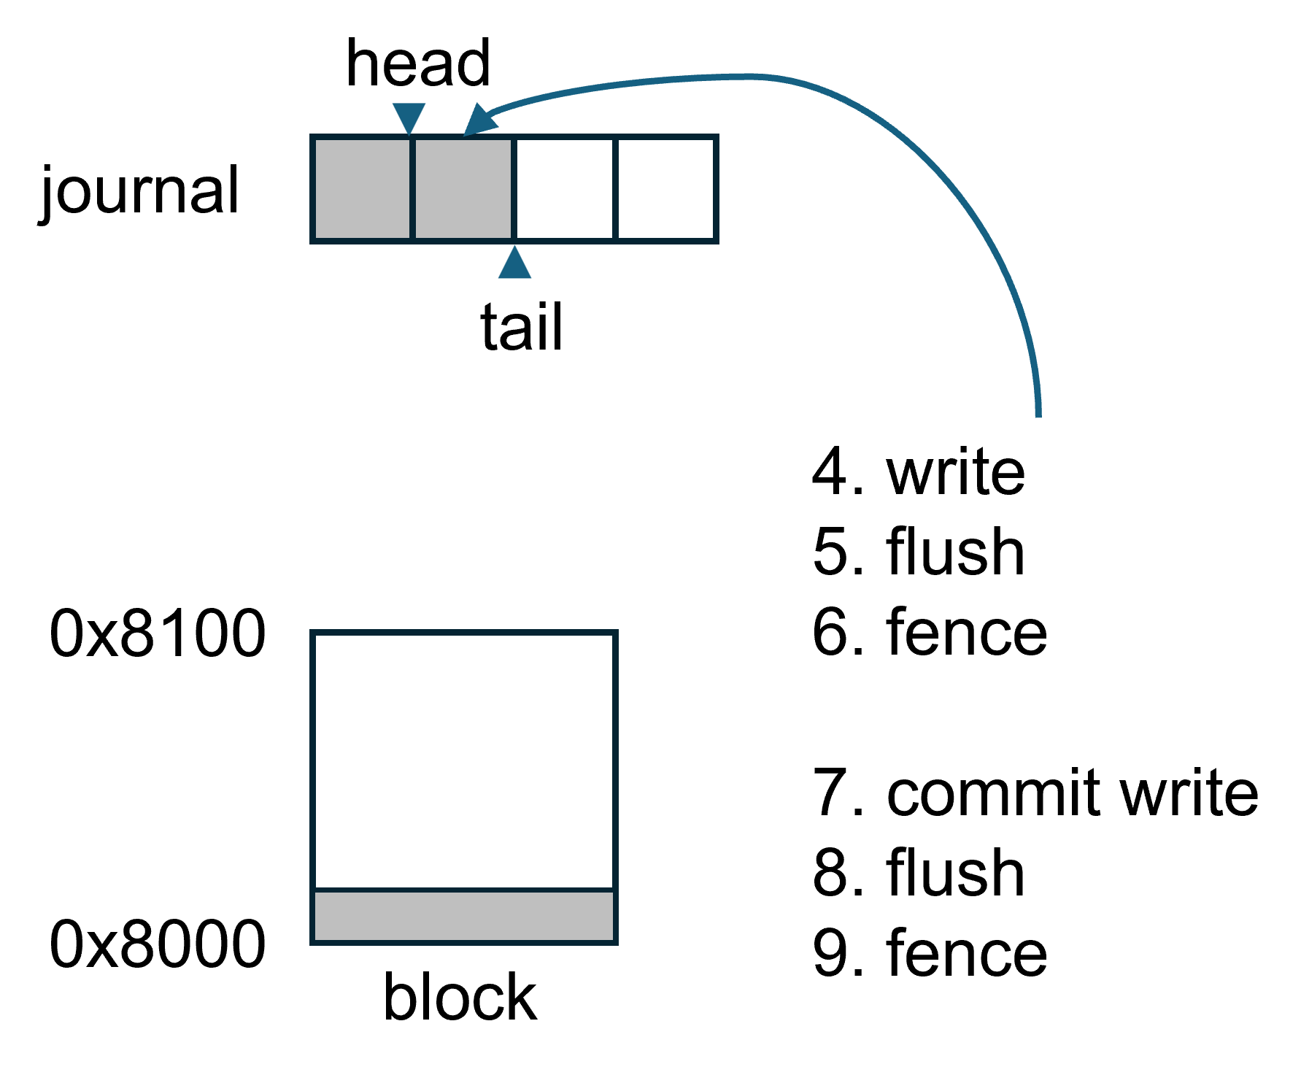
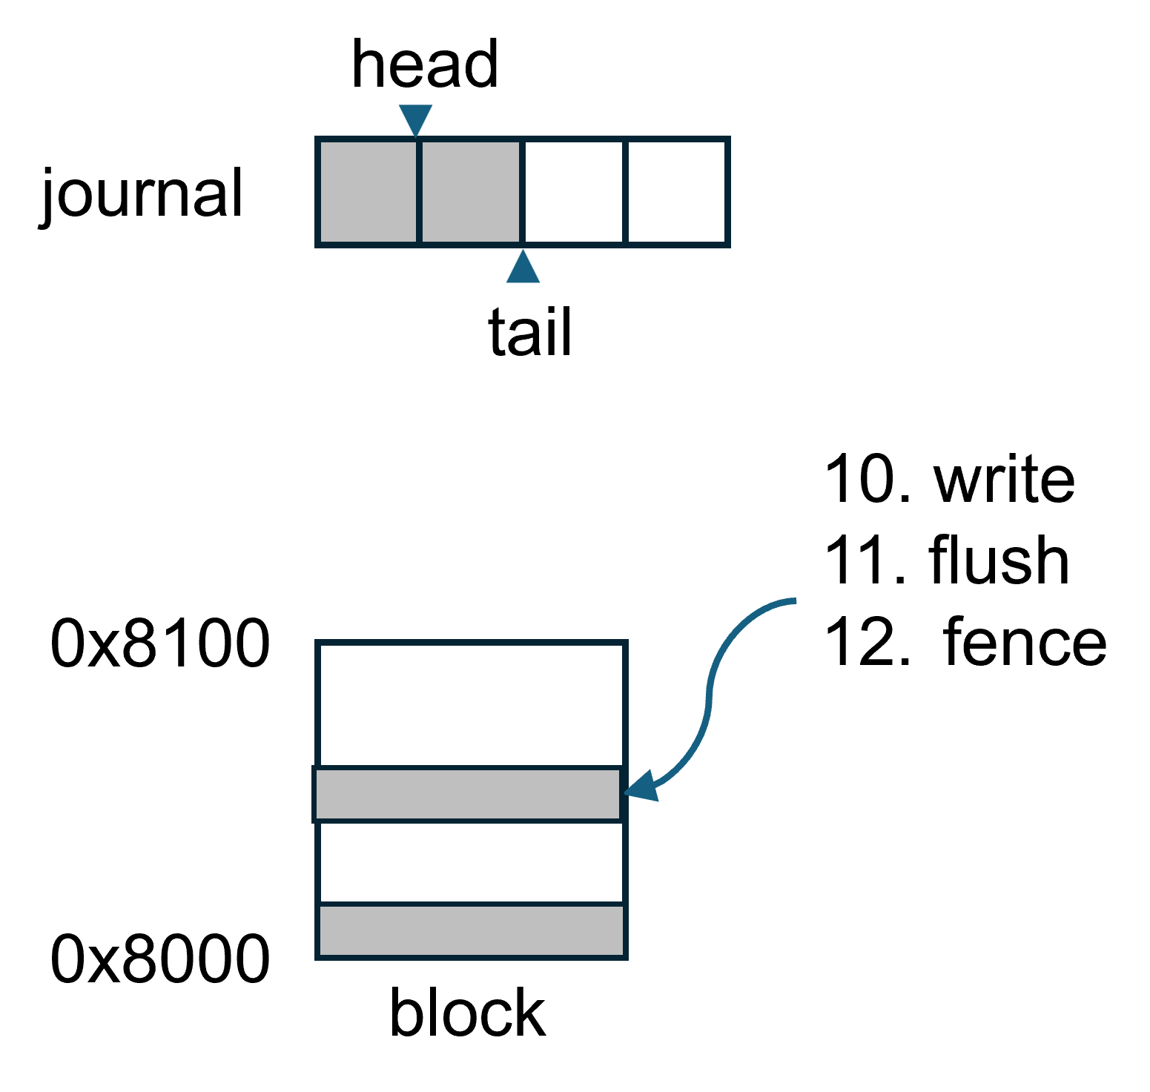
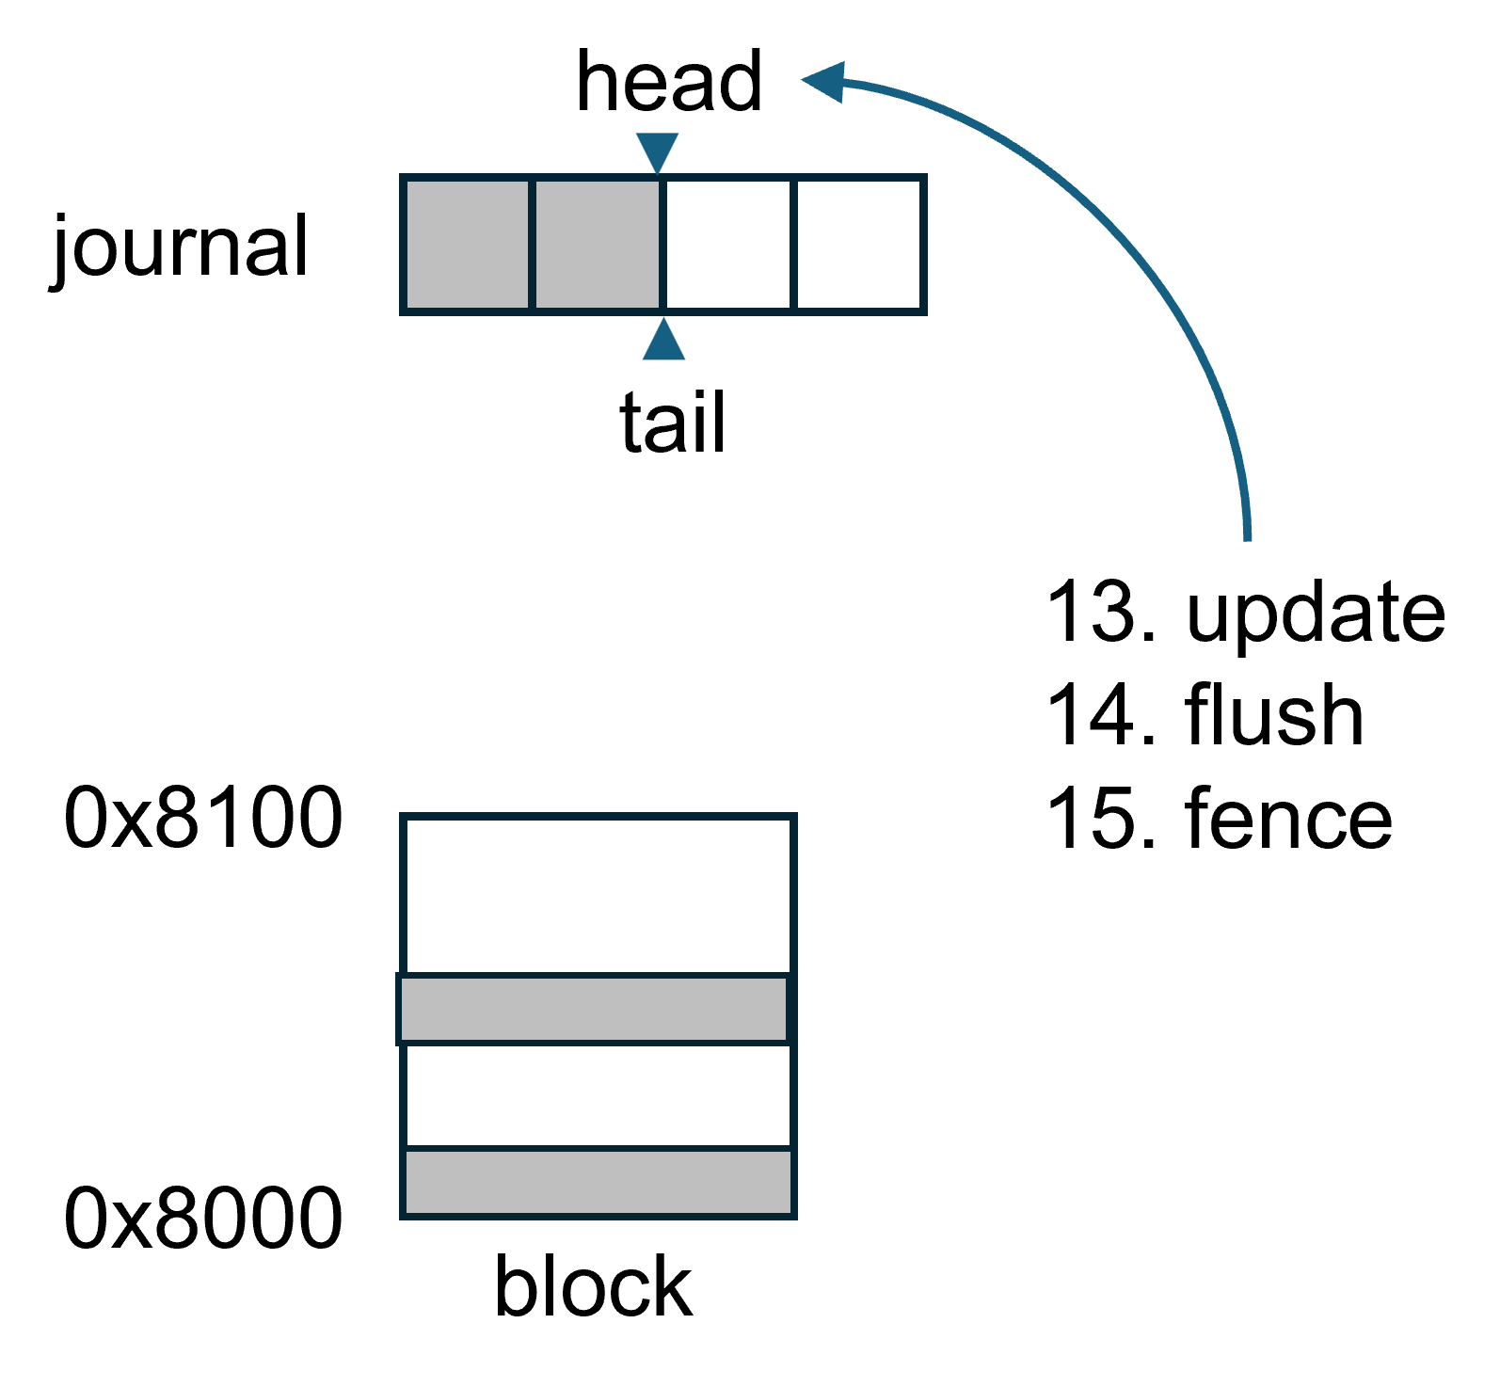
Consistency Invariants
Invariants for this undo-journal:
Ordering invariants: phases must persist in sequence.
Location invariants: logs must be written to valid regions.
  No double writes, no missing or skipped entries
Data invariants: logged writes must match in-place updates.
  No missing writes
1
2
3
4
Notes:
With these clear phases, we defined 3 consistency invariants for this undo journal:
includes:
Ordering invariants: phases must persist in sequence, which means the persist time of writes in a phase must precede the update time of writes in the next phase.
Location invariants: logs must stay within valid regions, indicating log space is allocated within the valid journal area (typically a circular buffer), and log writes are performed within the allocated space (between the head and tail pointers).
Data invariants: logged writes must match in-place updates.
Silhouette will check stores based on these invariants and report warnings if any check failed.
The question is how to check such consistency invariants.

Slide 31
Checking Consistency Invariants
Use LLVM Pass to instrument FS source code to dynamically trace instructions.
Tag stores (e.g., stores, CAS, memcpy) in the trace with data types (e.g., structure names, fields).
Use a lightweight annotation to determine the stores associated with the consistency mechanism.
Implement invariant checking on these associated stores.
If invariants pass, mark these stores as protected.
Notes:
The steps are:
Use LLVM Pass to instrument FS source code to dynamically trace instructions.
Tag stores (e.g., stores, CAS, memcpy) in the trace with data types (e.g., structure names, fields).
Use a lightweight annotation to determine the stores associated with the consistency mechanism.
Implement invariant checking on these associated stores.
If invariants pass, mark these stores as protected.

Slide 32
Lightweight Annotation Example
Metadata | Annotation
Journal head | pmfs_journal.base + pmfs_journal.head
Journal tail | pmfs_journal.base + pmfs_journal.tail
Dest addr | pmfs_logentry_t.addr_offset
Dest size | pmfs_logentry_t.size
… | …
An annotation example for PMFS’s undo journal.
Notes:
This table shows the annotation for PMFS’s undo journal. The first column is the attributes of the undo journal, and the second column is the structure fields that correspond to these attributes.
This annotation is lightweight because:
No code level modifications (it acts as a configuration file).
Only need the struct names and fields.
Support simple arithmetic operations
<10 lines per mechanism

Slide 33
Lightweight Annotation Example
Metadata | Annotation
Journal head | pmfs_journal.base + pmfs_journal.head
Journal tail | pmfs_journal.base + pmfs_journal.tail
Dest addr | pmfs_logentry_t.addr_offset
Dest size | pmfs_logentry_t.size
… | …
No code level modifications.
Only need the struct names and fields.
Support simple arithmetic operations
<10 lines per structure
An annotation example for PMFS’s undo journal.
Notes:
This table shows the annotation for PMFS’s undo journal. The first column is the attributes of the undo journal, and the second column is the structure fields that correspond to these attributes.
This annotation is lightweight because:
No code level modifications (it acts as a configuration file).
Only need the struct names and fields.
Support simple arithmetic operations
<10 lines per mechanism

Slide 34
Evaluation
We implemented Silhouette in C++ and Python.
Tested FSes: PMFS, NOVA, WineFS
PM device: Emulated via QEMU
Workload: ACE-seq1/2/3 and custom test cases
Comparison:
  Chipmunk [EuroSys ‘23]
  Vinter [ATC ‘22]
Open-sourced: https://github.com/iaoing/Silhouette
Notes:
We implemented Silhouette and tested it on NOVA, PMFS, and WineFS. We found 15 new bugs.
For example, in NOVA, an incorrect pointer persistence caused the segmentation fault. Another bug in NOVA caused data leaks since truncate function is not atomic.
And a data loss bug in PMFS and WineFS due to reusing inodes in orphan list.
Full details and reproduction steps are on our GitHub repository

Slide 35
New Bugs Found by Silhouette
We tested Silhouette on NOVA, PMFS, and WineFS and found 15 new bugs:
Segfault due to incorrect pointer persistence in NOVA
Data leak since truncate is not atomic in NOVA
Data loss due to reusing inodes in orphan list in PMFS and WineFS
…
The full bug reports and reproduction guide can be found in our repository.
Notes:
We implemented Silhouette and tested it on NOVA, PMFS, and WineFS. We found 15 new bugs.
For example, in NOVA, an incorrect pointer persistence caused the segmentation fault. Another bug in NOVA caused data leaks since truncate function is not atomic.
And a data loss bug in PMFS and WineFS due to reusing inodes in orphan list.
Full details and reproduction steps are on our GitHub repository

Slide 36
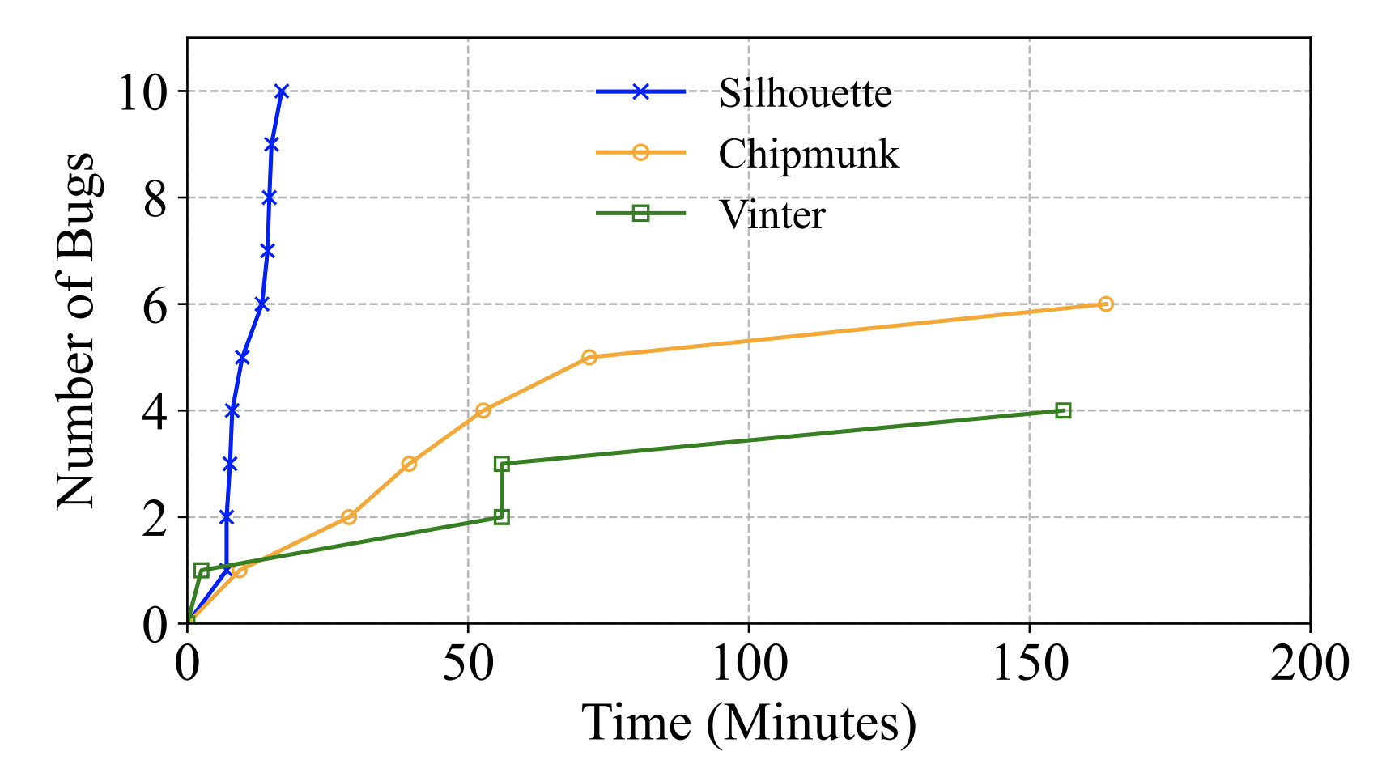
Scalability – Bug Finding Time
Silhouette found more bugs in less time than Chipmunk and Vinter.
Fig 3. Bugs found in Nova with the ACE Seq3 workload. Time was truncated since no bugs were found beyond this time.
Notes:
We also evaluated the scalability of Silhouette.
This graph compares the bug finding time of Silhouette, Chipmunk, and Vinter. With the ACE Seq3 workload, Silhouette found more bugs in less time compared to Chipmunk and VInter.
This is contributed to Silhouette’s find-grained tracing, mechanism detection, heuristic approach, and a new framework, which makes it faster and more effective.

Slide 37
Scalability – Number of Crash Plans
Scheme | NOVA | PMFS | WineFS
Vinter | 1.9M | 2.3M | 3.3M
Chipmunk | 3.3M | 1.6M | 1M
Silhouette | 14K | 2.3K | 1K
Notes:
Here’s a table showing crash plans generated by three Vinter, Chipmunk, and Silhouette.
it shows Silhouette produces orders of magnitude fewer plans than Vinter and Chipmunk.
By focusing on unprotected stores, we reduce overhead without sacrificing bug-finding power.

Slide 38

Conclusions
Silhouette is a novel tool designed to detect bugs in PM file systems by leveraging consistency mechanisms.
  Checks the implementation of the consistency mechanism.
  Only reorders the stores not associated with the consistency mechanisms.
  Further reduces the bug search space with the 2CP heuristic
Silhouette is efficient, scalable, and outperforms existing approaches
  Has identified 15 new bugs with 10x speedup
Silhouette is open-sourced and available on GitHub: https://github.com/iaoing/Silhouette
Notes:
In summary,
Silhouette is a novel tool designed to detect bugs in Persistent Memory (PM) file systems by leveraging consistency mechanisms.
It:
Checks the implementation of the consistency mechanism.
Only reorders the store not associated with the consistency mechanisms.
Further reduces the bug search space with the 2CP heuristic
Silhouette is efficient, scalable, and outperforms existing approaches, and found 15 new bugs with 10 times speedup
Silhouette is open-sourced and available on GitHub: https://github.com/iaoing/Silhouette

Slide 39
Thank you!
Q&A
Notes:
Thank you! Feel free to ask about Silhouette.

Slide 40
Scalability – Number of Crash Plans
Scheme | NOVA | PMFS | WineFS
Vinter | 1.9M | 2.3M | 3.3M
Chipmunk | 3.3M | 1.6M | 1M
Silhouette (2CP + invarants) | 14K | 2.3K | 1K
2CP | 115K | 26K | 6K
Invariants + Comb | 25K | 13K | 7K
Ran on Silhouette framework
Table 2. The number of crash plans generated by Vinter, Chipmunk, and Silhouette for the ACE seq3 workload.
Notes:
Here’s a table showing crash scenarios generated in the same workload.
The compared schemes include Vinter, Chipmunk, Silhouette, the 2CP approach only, and invariants + Combinatial approach.
In which, Silhouette, 2CP, and invariants + Combinatorial are ran on Silhouette’s framework, while Vinter and Chipmunk are ran on their framework.
This table shows Silhouette produces orders of magnitude fewer plans than Vinter and Chipmunk. By focusing on unprotected stores, we reduce overhead without sacrificing bug-finding power.
This table also shows that 2CP approach only can also produce a good number.
Comparing Silhouette with 2CP shows the mechanism detection and invariant checks reduce the number of crash scenarios by 10 times
Comparing Silhouette with invariant + Comb shows the 2CP approach has 2-7 times reductions. Considering invariant checks limits unprotected fewer than 10. This is a large improvement.

Slide 41
Scalability – Number of Crash Plans
Scheme | NOVA | PMFS | WineFS
Vinter | 1.9M | 2.3M | 3.3M
Chipmunk | 3.3M | 1.6M | 1M
Vinter (unique) | 28K | 26K | 8K
Witcher (unique) | 61K | 15K | 2K
Silhouette (2CP + invarants) | 14K | 2.3K | 1K
2CP | 115K | 26K | 6K
Invariants + Comb | 25K | 13K | 7K
Ran on Silhouette-deduped workload
Ran on Silhouette framework
Table 2. The number of crash plans generated by Vinter, Chipmunk, and Silhouette for the ACE seq3 workload.
Notes:
Here’s a table showing crash plans generated for the same workload. Silhouette produces orders of magnitude fewer plans than Vinter or Chipmunk. By focusing on unprotected stores, we reduce overhead without sacrificing bug-finding power. This table also shows that 2CP approach only can also produce a good number.

Slide 42
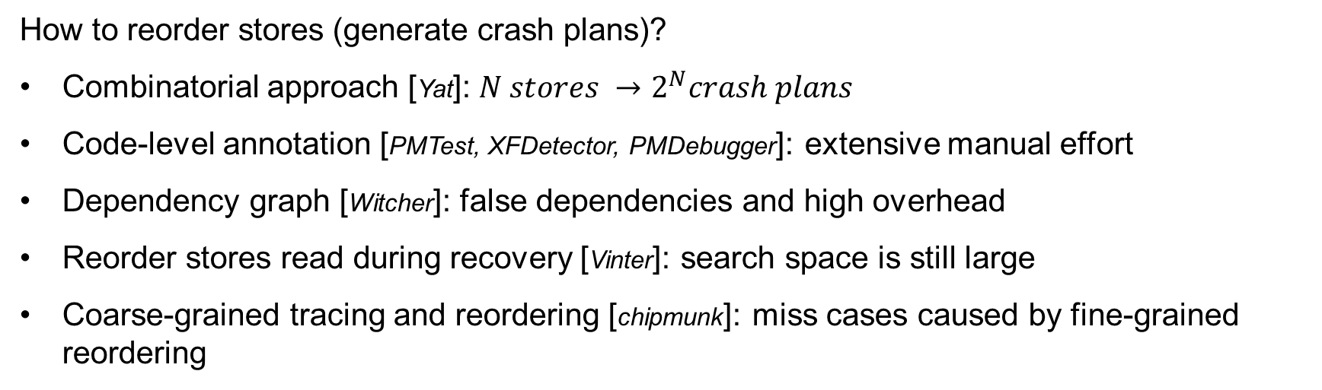
Other Approaches to Reorder Stores
How to reorder stores (generate crash plans)?
Combinatorial approach [Yat]: $N stores →2^{N}crash plans$
Code-level annotation [PMTest, XFDetector, PMDebugger]: extensive manual effort
Dependency graph [Witcher]: false dependencies and high overhead
Reorder stores read during recovery [Vinter]: search space is still large
Coarse-grained tracing and reordering [chipmunk]: miss cases caused by fine-grained reordering
Notes:
Other tools like PMTest or Witcher use brute-force or cross-failure testing, but they struggle with scalability. Silhouette’s heuristic approach strikes a balance—targeting high-risk scenarios without exhaustive testing.

Slide 43
Instrumentation and Trace
We use LLVM to instrument file system source code to dynamically trace instructions in two passes:
First pass:
  Determines the top-level VFS operations by searching the initializer for the Linux inode and file operations structures.
  Assigns a unique ID to each LLVM bytecode instruction.
Second pass:
  Instrument instructions (e.g., store, CAS, memcpy, flush, fence).
  Instrumentation logs the old (before the store) and new (after the store) data for all store-related instructions.
Unique ID helps detect duplicate instruction sequences. We consider two instruction sequences as duplicates when the PM-related instructions (store, nt_store, cas, xchg, memset, memcpy, flush and fence) in these sequences have the same IDs.

Slide 44
Check FS Consistency
Pre-op stat
S1
S2
S3
Flush
Fence
S4
S5
S6
S7
Flush
Fence
Post-op Stat
Assume S5 is the critical store
S1, S2, S3
S5, S7
S1, S2, S3,
S4, S6, S7
Generate FS image (crash image)
Trace
Image 1
Image 2
Remount
…
FS
stat()
Store in green: mechanism-protected stores
Store in black: unprotected stores
Store in red: selected unprotected store to reorder
Recovered Stat

Slide 45
Check FS Consistency (Cont.)
After recovery, we conduct:
Syslog Test: check error reports (e.g., kernel panic) in system logs.
State Test: compared the recovered stat with the pre/post-op state.
Write Test: check files/dirs in the recovered system is writeable, readable, and removable.
File Operation Test: use operation-specific checks to verify the expected behavior of some file operations.
Unprotected Store Test: check the chosen unprotected store matches its old value (the value before this operation) or the new value (the value after this operation).

Slide 46
Reference
[Yat]: Philip Lantz, Subramanya Dulloor, Sanjay Kumar, Rajesh Sankaran, and Jeff Jackson. Yat: A validation framework for persistent memory software. In 2014 USENIX Annual Technical Conference (USENIXATC 14), pages 433–438, 2014.
[PMTest]: Sihang Liu, Yizhou Wei, Jishen Zhao, Aasheesh Kolli, and Samira Khan. PMTest: A fast and flexible testing framework for persistent memory programs. In Proceedings of the Twenty-Fourth International Conference on Architectural Support for Programming Languages and Operating Systems, pages 411–425, 2019.
[XFDetector]: Sihang Liu, Korakit Seemakhupt, Yizhou Wei, Thomas Wenisch, Aasheesh Kolli, and Samira Khan. Cross-failure bug detection in persistent memory programs. In Proceedings of the Twenty-Fifth International Conference on Architectural Support for Programming Languages and Operating Systems, pages 1187–1202, 2020.
[PMDebugger]: Bang Di, Jiawen Liu, Hao Chen, and Dong Li. Fast, flexible, and comprehensive bug detection for persistent memory programs. In Proceedings of the 26th ACM International Conference on Architectural Support for Programming Languages and Operating Systems, pages 503–516, 2021.
[Witcher]: Xinwei Fu, Wook-Hee Kim, Ajay Paddayuru Shreepathi, Mohannad Ismail, Sunny Wadkar, Dongyoon Lee, and Changwoo Min. Witcher: Systematic crash consistency testing for non-volatile memory key-value stores. In Proceedings of the ACM SIGOPS 28th Symposium on Operating Systems Principles, pages 100–115, 2021.
[Vinter]: Samuel Kalbfleisch, Lukas Werling, and Frank Bellosa. Vinter: Automatic non-volatile memory crash consistency testing for full systems. In 2022 USENIX Annual Technical Conference (USENIX ATC 22), pages 933–950, 2022.
[Chipmunk]: Hayley LeBlanc, Shankara Pailoor, Om Saran KRE, Isil Dillig, James Bornholt, and Vijay Chidambaram. Chipmunk: Investigating crash-consistency in persistent-memory file systems. In Proceedings of the Eighteenth European Conference on Computer Systems, pages 1–20, 2023.

