Slide 1
Computer Architecture
A Quantitative Approach, Fifth Edition
Networks

Slide 2
Networking
Transport Protocols
  UDP
  TCP
Sockets – Programming Review
Sockets – TCP/IP Implementation

Slide 3
Communication Is Important
Various computer environments
  Embedded devices (sensors)
  Hand-held devices
  Desktop computers and Servers
  Large-scale data centers and supercomputers
Performance, power, and reliability
  Main energy consumer in embedded and mobile devices
  Main latency bottlenecks in wide-area networks
    Propagation delay: 2*10⁸ meters/sec; 5 ns per meter.
Latency matters in servers and data centers
  Processor: 1 IOPS → 1 ns per instruction
  Memory: 10 GB/sec → 1 ns per 10B

Slide 4
Conventional Communication Stack
host
host
HTTP message
HTTP
HTTP
TCP segment (20 bytes – 64K)
TCP
TCP
router
(20 bytes – 64K)
router
IP
IP packet
IP packet
IP packet
IP
IP
IP
Ethernet
interface
Ethernet
interface
SONET
interface
SONET
interface
Ethernet
interface
Ethernet
interface
(Synchronous Optical Network )
(packet size: 64B - 1518B)

Slide 5


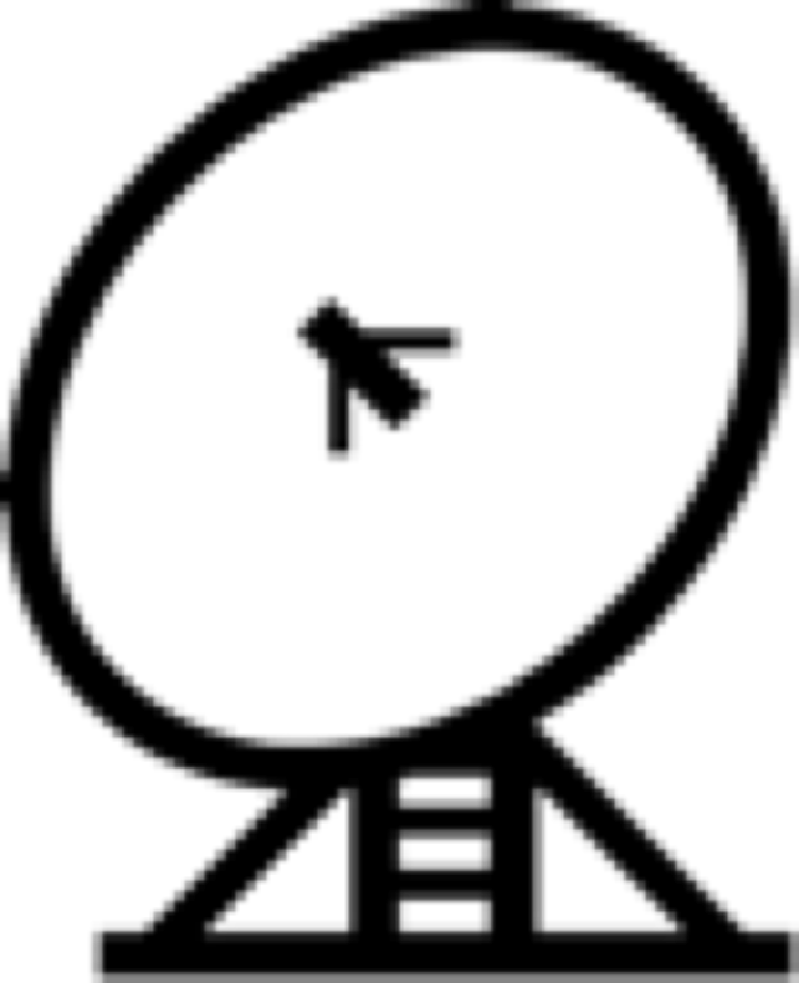


Transport Protocols
Provide logical communication between application processes running on different hosts
Run on end hosts
  Sender: breaks application messages into segments,
  and passes to network layer
  Receiver: reassembles segments into messages, passes to application layer
Multiple transport protocol available to applications
  Internet: TCP and UDP
application
transport
network
data link
physical
network
data link
physical
network
data link
physical
network
data link
physical
logical end-end transport
network
data link
physical
network
data link
physical
application
transport
network
data link
physical

Slide 6
Roles of Transport Layer
Application layer
  Communication for specific applications
  E.g., HTTP and FTP
Transport layer
  Communication between processes (e.g., socket)
  Relies on network layer and serves the application layer
  E.g., TCP and UDP
Network layer
  Logical communication between nodes
  Hides details of the link technology
  E.g., IP

Slide 7
Internet Transport Protocols
Datagram messaging service (UDP)
Reliable, in-order delivery (TCP)
  Connection set-up
  Discarding of corrupted packets
  Retransmission of lost packets
  Flow control
  Congestion control
Other services not available
  Delay guarantees
  Bandwidth guarantees

Slide 8
Simple Demultiplexer (UDP)
Extends host-to-host delivery service of the underlying network into a process-to-process communication service (via ports)
Adds a level of demultiplexing which allows multiple application processes on each host to share the network

Slide 9
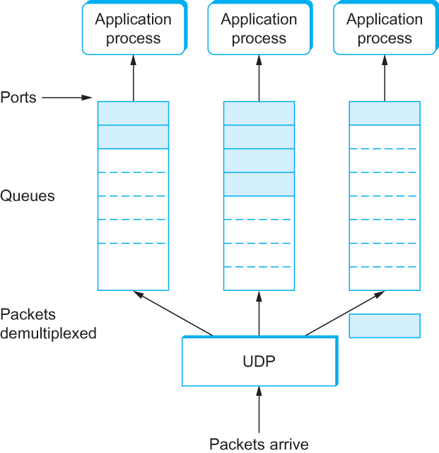
UDP multiplexing of applications
UDP Message Queue

Slide 10
Transmission Control Protocol (TCP)
Connection oriented
  Explicit set-up and tear-down of TCP session
Stream-of-bytes service
  Sends and receives a stream of bytes, not messages
Reliable, in-order delivery
  Checksums to detect corrupted data
  Acknowledgments & retransmissions for reliable delivery
  Sequence numbers to detect losses and reorder data
Flow control
  Prevent overflow of the receiver’s buffer space
Congestion control
  Adapt to network congestion for the greater good

Slide 11
TCP Byte stream definition
TCP is a byte-oriented protocol, which means that the sender writes bytes into a TCP connection and the receiver reads bytes out of the TCP connection.
Although “byte stream” describes the service TCP offers to application processes, TCP does not, itself, transmit individual bytes over the Internet.

Slide 12
TCP: Byte Streaming
Host A
Byte 0
Byte 1
Byte 2
Byte 3
Byte 80
Host B
Byte 0
Byte 1
Byte 2
Byte 3
Byte 80

Slide 13
TCP Segment
TCP on the source host buffers enough bytes from the sending process to fill a reasonably sized packet and then sends this packet to its peer on the destination host.
TCP on the destination host then empties the contents of the packet into a receive buffer, and the receiving process reads from this buffer at its leisure.
The packets exchanged between TCP peers are called segments.

Slide 14
Emulated Using TCP “Segments”
Host A
Byte 0
Byte 1
Byte 2
Byte 3
Byte 80
Segment sent when:
Segment = max segment size (MSS),
Not full, but times out, or
“Pushed” by application.
TCP Data
TCP Data
Host B
Byte 0
Byte 1
Byte 2
Byte 3
Byte 80

Slide 15
Sliding Window
Allow a larger amount of data “in flight”
  Allow sender to get ahead of the receiver
  … though not too far ahead
Sending process
Receiving process
TCP
TCP
Last byte written
Last byte read
Next byte expected
Last byte ACKed
Last byte received
Last byte sent

Slide 16
Receiver Buffering
Window size
  Amount that can be sent without acknowledgment
  Receiver needs to be able to store this amount of data
Receiver advertises the window to the sender
  Tells the sender the amount of free space left
  … and the sender agrees not to exceed this amount
Window Size
Data ACK’d
Outstanding
Un-ack’d data
Data OK
to send
Data not OK
to send yet

Slide 17
Three-way Handshake to Establish Connection
A
B
SYN
SYN ACK
Each host tells its initial sequence number (ISN) to the other host.
ACK
Data
Data
Three-way handshake to establish connection
  Host A sends a SYN (open) to the host B
  Host B returns a SYN acknowledgment (SYN ACK)
  Host A sends an ACK to acknowledge the SYN ACK

Slide 18
Tearing Down the Connection
B
ACK
SYN
SYN ACK
Data
ACK
FIN
FIN ACK
FIN
ACK
A
time
Closing the connection
  Finish (FIN) to close and receive remaining bytes
  And other host sends a FIN ACK to acknowledge
  Reset (RST) to close and not receive remaining bytes

Slide 19
Outline
Transport Protocols
  UDP
  TCP
Sockets – Programming Review
Sockets – TCP/IP Implementation

Slide 20
Socket: End Point of Communication
Sending message from one process to another
  Message must traverse the underlying network
Process sends and receives through a “socket”
  In essence, the doorway leading in/out of the house
Socket as an Application Programming Interface
  Supports the creation of network applications
User process
User process
socket
socket
Operating
System
Operating
System

Slide 21
Identifying the Receiving Process
Sending process must identify the receiver
  Name or address of the receiving end host
  Identifier that specifies the receiving process
Receiving process
  Host with a 32-bit IP address that uniquely identifies the host
  And a 16-bit port that uniquely identifies the socket/service
Server host 128.2.194.242
Client host
Service request for
128.2.194.242:80
(i.e., the Web server)
Web server
(port 80)
Client
OS
Echo server
(port 7)

Slide 22
TCP Socket
Server
socket()
bind()
Client
listen()
socket()
accept()
3-way
handshaking
connect()
Blocks until server
receives a connect request
read()
data
write()
write()
data
read()
close()
close()

Slide 23
Example – TCP Client and Server
Initialization:
  socket – create socket
  bind – bind to an address
Connection Establishment
  listen – listen to new connection request
  accept – accept request and create a new socket
  connect – request for new connection
Transmission:
  write – send message to server
  read – receive message from server
Termination:
  close - close socket

Slide 24
UDP socket
Server
socket()
Client
socket()
bind()
optional
bind()
recvfrom()
Blocks until server
receives data from client
data
sendto()
sendto()
data
recvfrom()
close()
close()

Slide 25
UDP Client and Server
Initialization:
  socket – create socket
  bind – bind to an address. Optional for the client
  Must use SOCK_DGRAM for the protocol
  No connection establishment. Less overhead
Transmission:
  sendto – send message
  recvfrom – receive message from socket
  Must be done at the boundaries of datagrams
Termination:
  close - close socket

Slide 26
Software Architecture of Sockets
Application
BSD Socket
INET Socket
Address resolution protocol: maps IP address to MAC addresses
TCP
UDP
IP (caches some MAC addr)s
ARP
Networks
(Ethernet, WIFI, etc)
Notes:
26

Slide 27
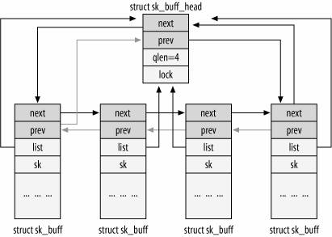
Socket buffer: struct sk_buff
Double Link List of sk_buff
Pointers to the data buffer

Slide 28
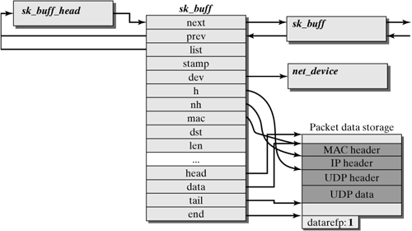
sk_buff cont’d

Slide 29
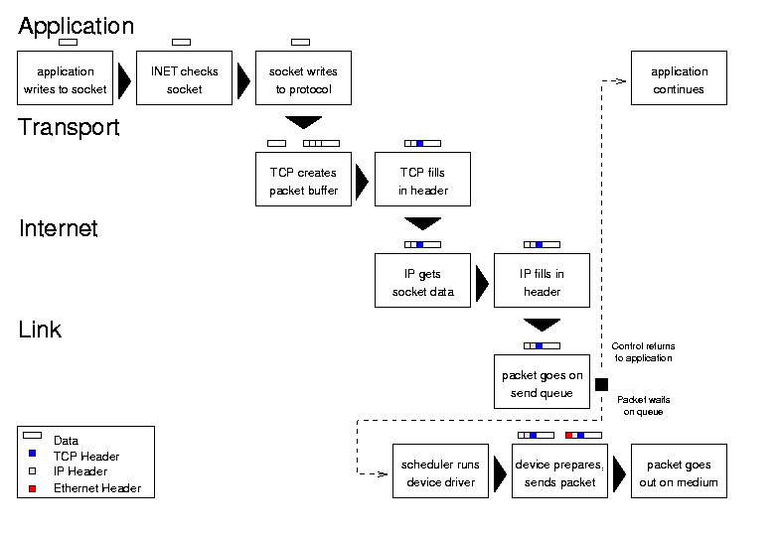
Sending Data via Sockets
Courtesy of Glenn Herrin, Univ. of New Hampshire

Slide 30
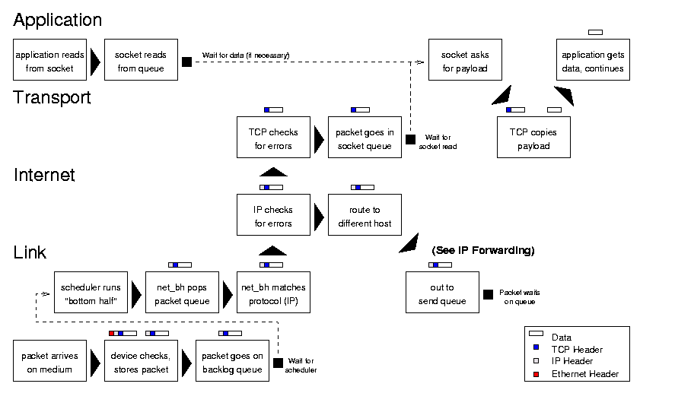
Receiving Data
Courtesy of Glenn Herrin, Univ. of New Hampshire

Slide 31
Example Data Flow from A to B
A
socket()
bind()
B
socket()
listen()
3-way
handshaking
accept()
connect()
write()
User space
Kernel space
sys_write()
socket_write()
socket_sendmesg()

Slide 32
Socket → INET → TCP
A
socket_sendmesg()
inet_sendmesg()
Ready to send sk_buff’s
tcp_v4_sendmesg()
allocate sk_buff and data storage
skb_put(): copy data from user space
skb_push(): add header
tcp_do_sendmesg()
tcp_send_skb()
tcp_transmit_skb()
Complete TCP header and checksum it

Slide 33
TCP→ IP→ Device → Media
A
tcp_transmit_skb()
Find destination
Possible fragmentation
Add IP header
Checksum the header
ip_queue_xmit()
skb->output()
dev_queue_xmit()
q->enqueue()
dev->hard_start_xmit()

Slide 34
Media→ Device
B
net_bh()
do_bottom_half()
skb_queue_tail()
netif_rx()
ei_receive()
ei_interrupt()

Slide 35
Device→ IP
B
ip_local_deliver()
Possible reassembly
ip_recv()
skb_clone()
net_bh()
Find header
Extract Protocol

Slide 36
IP→ TCP
B
data_ready()
Recv’d packet
queue
tcp_data_queue()
skb_queu_tail()
tcp_v4_do_rcv()
tcp_v4_rcv()
Validate TCP header
Send ACK
ip_recv()

Slide 37
TCP→ Application
B
socket()
connect()
read()
sys_read()
Sock_read()
Inet_rcvmesg()
Recv’d packet
queue
tcp_rcvmesg()

Slide 38
Data Flow Summary
At least four data copies
  Application to TCP sk_buff’s
  Sk_buff’s to network media
  Media to TCP sk_buff’s
  TCP to Application
Cost per byte: checksum and data copying
Cost per packet:
  Interrupt processing
  sk_buff management
  header filling in and extraction

Slide 39
Sockets Performance Metrics
Latency
  Time for an end-to-end message from source to destination
  Typically measure with a ping-pong or request/reply pair of same-size messages
Breakdown of Latency
  Sender and Receiver overheads
  Queue delay
  Propagation delay

Slide 40
Bandwidth and CPU Utilization
Bandwidth (throughput)
  The amount of data transferred in a unit of time
  Dependent on data size, block size of transfer, etc
CPU Utilization
  CPU time spent in processing network protocols
  Include per-packet cost and per-byte cost

Slide 41
CPU Utilization
Measures the amount of CPU time spent in networking
CPU may also be referred as overhead
  As it is needed because of network protocols
High for small message transfers
Low for large messages
Much is also due to interrupt handling

Slide 42
Benchmark: netperf
Available:
  ftp://ftp.netperf.org//netperf/
Compilation
  ./configure && make
Programs:
  ./netserver
  ./netperf -H hostname [options]
Tests:
  TCP_RR, TCP_STREAM, TCP_MAERTS
  UDP_RR, UDP_STREAM
  Also can measure CPU utilization

Slide 43
Benchmark: iperf
Available:
  http://sourceforge.net/projects/iperf/
Compilation
  ./configure && make
Programs:
  ./iperf [-s|-c host] [options]
Tests:
  TCP
  UDP with an option: –u
  Multiple parallel flows: -P#

Slide 44
Performance Tunables
Socket Buffer Size
  net.ipv4.tcp_rmem (/proc/sys/net/ipv4/tcp_rmem)
  (min, default, max)
  tcp_wmem:
  tcp_mem (threshold for memory pressure)
Send and Receive Segment Offload
Interrupt coalescing
Others
  TCP_NODELAY
  TCP SACK

Slide 45
Computer Architecture
A Quantitative Approach, Fifth Edition
Topic 3
TCP/IP Congestion Avoidance

Slide 46
TCP Congestion Control
A host sends packets without a reservation
  The host reacts to observable events.
Each source determines how much capacity is available to a given flow in the network.
ACKs are used to ‘pace’ the transmission of packets such that TCP is “self-clocking”.

Slide 47
AIMD (Additive Increase / Multiplicative Decrease)
CongestionWindow (cwnd) is a variable held by the TCP source for each connection.
cwnd is set based on the perceived level of congestion. The Host receives implicit (packet drop) or explicit (packet mark) indications of internal congestion.
MaxWindow :: min (CongestionWindow , AdvertisedWindow)
EffectiveWindow = MaxWindow – (LastByteSent -LastByteAcked)

Slide 48
Additive Increase
Additive Increase is a reaction to perceived available capacity.
For each “cwnd’s worth” of packets sent, increase cwnd by 1 packet.
In practice, cwnd is incremented fractionally for each arriving ACK.
Source
Destination
Maximum segment size
increment = MSS x (MSS /cwnd)
cwnd = cwnd + increment

Slide 49
Multiplicative Decrease
The key assumption is that a dropped packet and the resultant timeout are due to congestion at a router or a switch.
TCP reacts to a timeout by halving cwnd.
Although cwnd is defined in bytes, the literature often discusses congestion control in terms of packets.
  Formally, MSS == Maximum Segment Size
cwnd is not allowed below the size of a single packet.

Slide 50
AIMD Drawbacks
Linear additive increase takes too long to ramp up a new TCP connection from cold start.
TCP Tahoe Slow start provides an initial exponential increase in the size of cwnd.

Slide 51
TCP Tahoe
Slow Start – Increases the window size exponentially (e.g., for every ack, sends two packets)
Congestion Avoidance - Reducing sender’s window size by half at experience of loss, and increase the sender’s window at the rate of about one packet per RTT (round-trip time) (NOTE: not per ack)
Fast Retransmit - Don’t wait for retransmit timer to go off, retransmit packet if 3 duplicate acks received

Slide 52
Tahoe Slow Start
The source starts with cwnd = 1.
Every time an ACK arrives, cwnd is incremented.
  cwnd is effectively doubled per RTT.
Two slow start situations:
  At the very beginning of a connection
  When the connection goes dead waiting for a timeout to occur (i.e., the advertized window goes to zero!)
It has to be guarded by a threshold
  ssthresh
Source
Destination

Slide 53
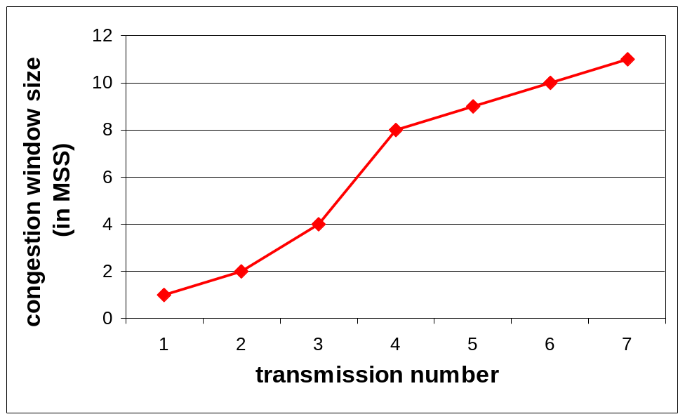
Example: Slow Start/Congestion Avoidance
S
R
cwnd = 1
assume ssthresh = 8*MSS
cwnd = 2
cwnd = 4
cwnd= 8
Eight packets
ssthresh
Eight ACKs
cwnd = 9
Nine packets
Nine ACKs
cwnd = 10
Ten packets
Ten ACKs
cwnd = 11

Slide 54
Protocol of Slow Start & Congestion Avoidance
Initially:
- cwnd = 1*MSS
- ssthresh = very high
If a new ACK comes:
  - if cwnd < ssthresh → update cwnd according to slow start
  if cwnd > ssthresh → update cwnd according to congestion avoidance
  If cwnd = ssthresh → either
If timeout (i.e. loss) :
  - ssthresh = flight size/2;
  - cwnd = 1*MSS
cwnd
(initial) ssthresh
Loss, e.g. timeout
ssthresh
slow start – in green
time
congestion avoidance – in blue

Slide 55
Fast Retransmit
Coarse timeouts remained a problem, and Fast retransmit was added with TCP Tahoe.
Since the receiver responds every time a packet arrives, this implies the sender will see duplicate ACKs.
Use duplicated ACKs (out of sequence acks) to signal lost packet
  Three duplicated Acks

Slide 56
TCP Tahoe’s Fast Retransmit
Sender receives 3 dupACKS.
  Sender infers that the segment is lost.
Sender re-sends the segment immediately!
Sender returns to slow-start.
S
R
cwnd = 1
segment 1
ACK 1
cwnd = 2
segment 2
segment 3
ACK 2
ACK 3
cwnd = 4
segment 4
segment 5
segment 6
ACK 3
segment 7
3 duplicate
ACKs
ACK 3
ACK 3
segment 4
fast-retransmit
of segment 4
Notes:
Recall: a duplicate ACK means that an out-of sequence segment was received
Notes:
duplicate ACKs due packet reordering!
if window is small don’t get duplicate ACKs!

Slide 57
Fast Retransmit Benefits
Generally, fast retransmit eliminates about half the coarse-grain timeouts.
This yields roughly a 20% improvement in throughput.
Note – fast retransmit does not eliminate all the timeouts due to small window sizes at the source.

Slide 58
Various TCP Protocol Variants
TCP Tahoe
  Slow start
  Congestion Avoidance
  Fast Retransmit
TCP Reno
  Fast Recovery
TCP newReno
  Partial Ack
TCP Vegas
  Predict Congestion
  Modified slow start and congestion avoidance
  Aggressive retransmission and congestion window update
TCP SACK

