Slide 1
Threads, Events, and Scheduling
Andy Wang
COP 5611
Advanced Operating Systems

Slide 2
Basic Concept of Threads/Processes
Thread: A sequential execution stream
Address space: Chunks of memory and everything needed to run a program
Process: An address space + thread(s)
Two types of threads
  Kernel threads
  User-level threads

Slide 3
Kernel vs. User Threads
OS only knows about kernel threads
user threads
processes
user
kernel
kernel threads

Slide 4
Characteristics of User Threads
User threads
  + Good performance
    Scheduling involves voluntary yields of CPUs
    Analogy: getting loans from friends vs. banks
  - Sometimes incorrect behaviors
    A user thread blocked on I/O may prevent other ready user threads from running
    Kernel knows nothing about the priorities among threads
      A low-priority user thread may preempt a high-priority user thread

Slide 5
Characteristics of Kernel Threads
Kernel threads (each user thread mapped to a kernel thread)
  + Correct concurrency semantics
  - Poor performance
    Scheduling involves kernel crossing

Slide 6
One Solution: Scheduler Activations
Additional interface
  Thread system can request kernel threads dynamically
  Thread system can advice kernel scheduler on preemptions
  Kernel needs to notify the thread system of various events (e.g., blocking) via upcalls
  Kernel needs to make a kernel thread available to activate user-level scheduler

Slide 7
Why Threads Are A Bad Idea
(for most purposes) by John Ousterhout
Threads
  Grew up in OS world (processes)
  Every programmer should be a thread programmer?
Problem: threads are very hard to program
Alternative: events
Claims
  For most purposes, events are better
  Threads should be used only when true CPU concurrency is needed

Slide 8
What Are Threads?
Shared state
(memory, files, etc.)
Threads
General-purpose solution for managing concurrency
Multiple independent execution streams
Shared state
Pre-emptive scheduling
Synchronization (e.g. locks, conditions)

Slide 9
What Are Threads Used For?
OSes: one kernel thread for one user process
Scientific applications: one thread per CPU
Distributed systems: process requests concurrently (overlap I/Os)
GUIs:
  Threads correspond to user actions; can service display during long-running computations
  Multimedia, animations

Slide 10
What's Wrong With Threads?
casual
all programmers
wizards
Visual Basic programmers
C programmers
C++ programmers
Threads programmers
Too hard for most programmers to use
Even for experts, development is painful

Slide 11
Why Threads Are Hard
Synchronization
  Must coordinate access to shared data with locks
  Forget a lock? Corrupted data
Deadlock
  Circular dependencies among locks
  Each process waits for some other process: system hangs
thread 1
lock A
lock B
thread 2

Slide 12
Why Threads Are Hard, cont'd
Hard to debug: data and timing dependencies
Threads break abstraction: can't design modules independently
Callbacks don't work with locks
T1
T2
T1
deadlock!
calls
Module A
Module A
deadlock!
Module B
Module B
callbacks
sleep
wakeup
T2

Slide 13
Why Threads Are Hard, cont'd
Achieving good performance is hard
  Simple locking yields low concurrency
  Fine-grain locking reduces performance
  OSes limit performance (context switches)
Threads not well supported
  Hard to port threaded code (PCs? Macs?)
  Standard libraries not thread-safe
  Kernel calls, window systems not multi-threaded
  Few debugging tools (LockLint, debuggers?)

Slide 14
Event-Driven Programming
One execution stream: no CPU concurrency
Register interest in events (callbacks)
Event loop waits for
events, invokes handlers
No preemption of event handlers
Handlers generally short-lived
Event
Loop
Event Handlers

Slide 15
What Are Events Used For?
Mostly GUIs
  One handler for each event (press button)
  Handler implements behavior (undo, delete file, etc.)
Distributed systems
  One handler for each source of input (i.e., socket)
  Handler processes incoming request, sends response
  Event-driven I/O for I/O overlap

Slide 16
Problems With Events
Long-running handlers make application non-responsive
  Fork off subprocesses for long-running things (e.g., multimedia), use events to find out when done
  Break up handlers (e.g. event-driven I/O)
  Periodically call event loop in handler (reentrancy adds complexity)
Can't maintain local state across events (handler must return)

Slide 17
Problems With Events
No CPU concurrency (not suitable for scientific apps)
Event-driven I/O not always well supported (e.g. poor write buffering)

Slide 18
Events vs. Threads
Events avoid concurrency as much as possible
  Easy to get started with events: no concurrency, no preemption, no synchronization, no deadlock
  Use complicated techniques only for unusual cases
  With threads, even the simplest application faces the full complexity

Slide 19
Events vs. Threads
Debugging easier with events
  Timing dependencies only related to events, not to internal scheduling
  Problems easier to track down: slow response to button vs. corrupted memory

Slide 20
Events vs. Threads, cont'd
Events faster than threads on single CPU
  No locking overheads
  No context switching
Events more portable than threads
Threads provide true concurrency
  Can have long-running stateful handlers without freezes
  Scalable performance on multiple CPUs

Slide 21
Should You Abandon Threads?
No: important for high-end servers
But, avoid threads wherever possible
  Use events, not threads, for GUIs,
  distributed systems, low-end servers
  Only use threads where true CPU
  concurrency is needed
  Where threads needed, isolate usage
  in threaded application kernel: keep
  most of code single-threaded
Event-Driven Handlers
Threaded Kernel

Slide 22
Summary
Concurrency is fundamentally hard; avoid whenever possible
Threads more powerful than events, but power is rarely needed
Threads are for experts only
Use events as primary development tool (both GUIs and distributed systems)
Use threads only for performance-critical kernels

Slide 23
Process Scheduling
Goals
  Low latency
  High throughput
  Fairness

Slide 24
Basic Scheduling Approaches
FIFO
  + Fair
  - High latency
Round robin
  + fair
  + low latency
  - poor throughput

Slide 25
Basic Scheduling Approaches
STCF/SRTCF (shortest time/remaining time to completion first)
  + low latency
  + high throughput
  - unfair

Slide 26
Priority Scheduling (Multilevel Queues)
Priority scheduling: The process with the highest priority runs first
Priority 0:
Priority 1:
Priority 2:
Assume that low numbers represent high priority
C
A
B
C
A
B
Time
Priority Scheduling

Slide 27
Priority Scheduling
+ Generalization of SJF
  With SJF, higher priority is inversely proportionally to requested_CPU_time
- Starvation

Slide 28
Priority Inversion Problem
A low priority task acquires a lock on a data buffer
A high priority task tries to acquires the same lock and blocks
A lower priority task slowly completes its computation due to its low priority
The high priority task resumes

Slide 29
Basic Scheduling Approaches
Multilevel feedback queues
  A job starts with the highest priority queue
  If time slice expires, lower the priority by one level
  If time slice does not expire, raise the priority by one level
  Higher priorities for IOs, since they tend to be slow
  Age long-running jobs

Slide 30
Multilevel Feedback Queues
time = 0
Priority 0 (time slice = 1):
Priority 1 (time slice = 2):
Priority 2 (time slice = 4):
A
B
C
Time

Slide 31
Multilevel Feedback Queues
time = 1
Priority 0 (time slice = 1):
Priority 1 (time slice = 2):
Priority 2 (time slice = 4):
B
C
A
A
Time

Slide 32
Multilevel Feedback Queues
time = 2
Priority 0 (time slice = 1):
Priority 1 (time slice = 2):
Priority 2 (time slice = 4):
C
A
B
A
B
Time

Slide 33
Multilevel Feedback Queues
time = 3
Priority 0 (time slice = 1):
Priority 1 (time slice = 2):
Priority 2 (time slice = 4):
A
B
C
A
B
C
Time

Slide 34
Multilevel Feedback Queues
time = 3
Priority 0 (time slice = 1):
Priority 1 (time slice = 2):
Priority 2 (time slice = 4):
A
B
C
suppose process A is blocked on an I/O
A
B
C
Time

Slide 35
Multilevel Feedback Queues
time = 3
Priority 0 (time slice = 1):
Priority 1 (time slice = 2):
Priority 2 (time slice = 4):
A
B
C
suppose process A is blocked on an I/O
A
B
C
Time

Slide 36
Multilevel Feedback Queues
time = 5
Priority 0 (time slice = 1):
Priority 1 (time slice = 2):
Priority 2 (time slice = 4):
A
C
suppose process A is returned from an I/O
A
B
C
B
Time

Slide 37
Multilevel Feedback Queues
time = 6
Priority 0 (time slice = 1):
Priority 1 (time slice = 2):
Priority 2 (time slice = 4):
C
A
B
C
B
A
Time

Slide 38
Multilevel Feedback Queues
time = 8
Priority 0 (time slice = 1):
Priority 1 (time slice = 2):
Priority 2 (time slice = 4):
C
A
B
C
B
A
C
Time

Slide 39
Multilevel Feedback Queues
time = 9
Priority 0 (time slice = 1):
Priority 1 (time slice = 2):
Priority 2 (time slice = 4):
A
B
C
B
A
C
C
Time

Slide 40
Lottery Scheduling
Claim
  Priority-based schemes are ad hoc
Lottery scheduling
  Randomized scheme
  Based on a currency abstraction
  Idea
    Processes own lottery tickets
    CPU randomly draws a ticket and execute the corresponding process

Slide 41
Properties of Lottery Scheduling
Guarantees fairness through probability
Guarantees no starvation, as long as each process owns one ticket
To approximate SRTCF
  Short jobs get more tickets
  Long jobs get fewer

Slide 42
Examples
Each short job gets 10 tickets
Each long job gets 1 ticket
Suppose we have the following scenarios
# short jobs/ # long jobs | % of CPU for each short job | % of CPU for each long job
1/1 | 91% | 9%
0/2 | N/A | 50%
2/0 | 50% | N/A
10/1 | 10% | 1%
1/10 | 50% | 5%

Slide 43
Partially Consumed Tickets
What if a process does not consume the entire time slice?
  The process receives compensation tickets
  Idea
    Get chosen more frequently
    But with shorter time slice

Slide 44
Process Dependencies
If process A is blocked waiting for results from process B
  Process A can hand over its tickets to B
  Can partially address the priority inversion problem

Slide 45
Ticket Currencies
Load Insulation
  A process can change its ticketing policies without affecting other processes
Need to convert currencies before transferring tickets
base:3000
1000
2000
Alice:200
Bob:100
200
100
process1:500
process2:100
200
300
100
thread1
thread2
thread3

Slide 46
Pros and Cons of Lottery Scheduling
+ Good for coordinating computers with different computing power
+ Good for controlling the schedules for child processes
- Not as good for real-time systems
- Need to be deployed system-wide, not just for a few processes
- spinlocks ignores priority

Slide 47
Multicore Scheduling
Single-queue multiprocessor scheduling
  CPU1
  CPU2
Another SQMS
  CPU1
  CPU2
A
C
B
A
C
B
A
C
B
A
C
B
A
C
B
B
A
C
B
A
C
B
A
C
B
A
C
B
A
C
Expensive to migrate jobs across CPUs
(Poor CPU affinity)
Time
A
C
A
C
A
C
A
C
A
C
A
B
C
B
C
B
C
B
C
B
C
Time

Slide 48
More Schedulers
Multi-queue scheduling
O(1) scheduler
Completely Fair Scheduler (CFS)

Slide 49
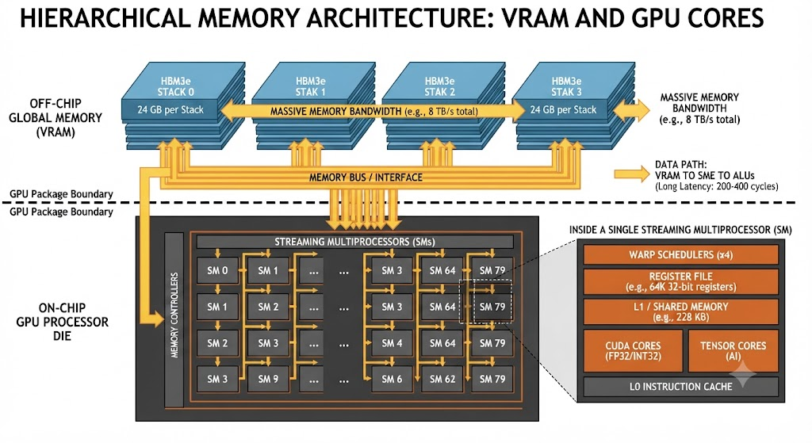
GPU

Slide 50
GPU Scheduler
Warp scheduler (on board)
  A warp is ~32 threads using ~1K registers
  A streaming multiprocessor contains ~64K registers
  When a warp is stalled, switch to another warp that is ready
  ns-scale context switches

