Slide 1
Course Introduction
Andy Wang
COP 5611
Advanced Operating Systems

Slide 2
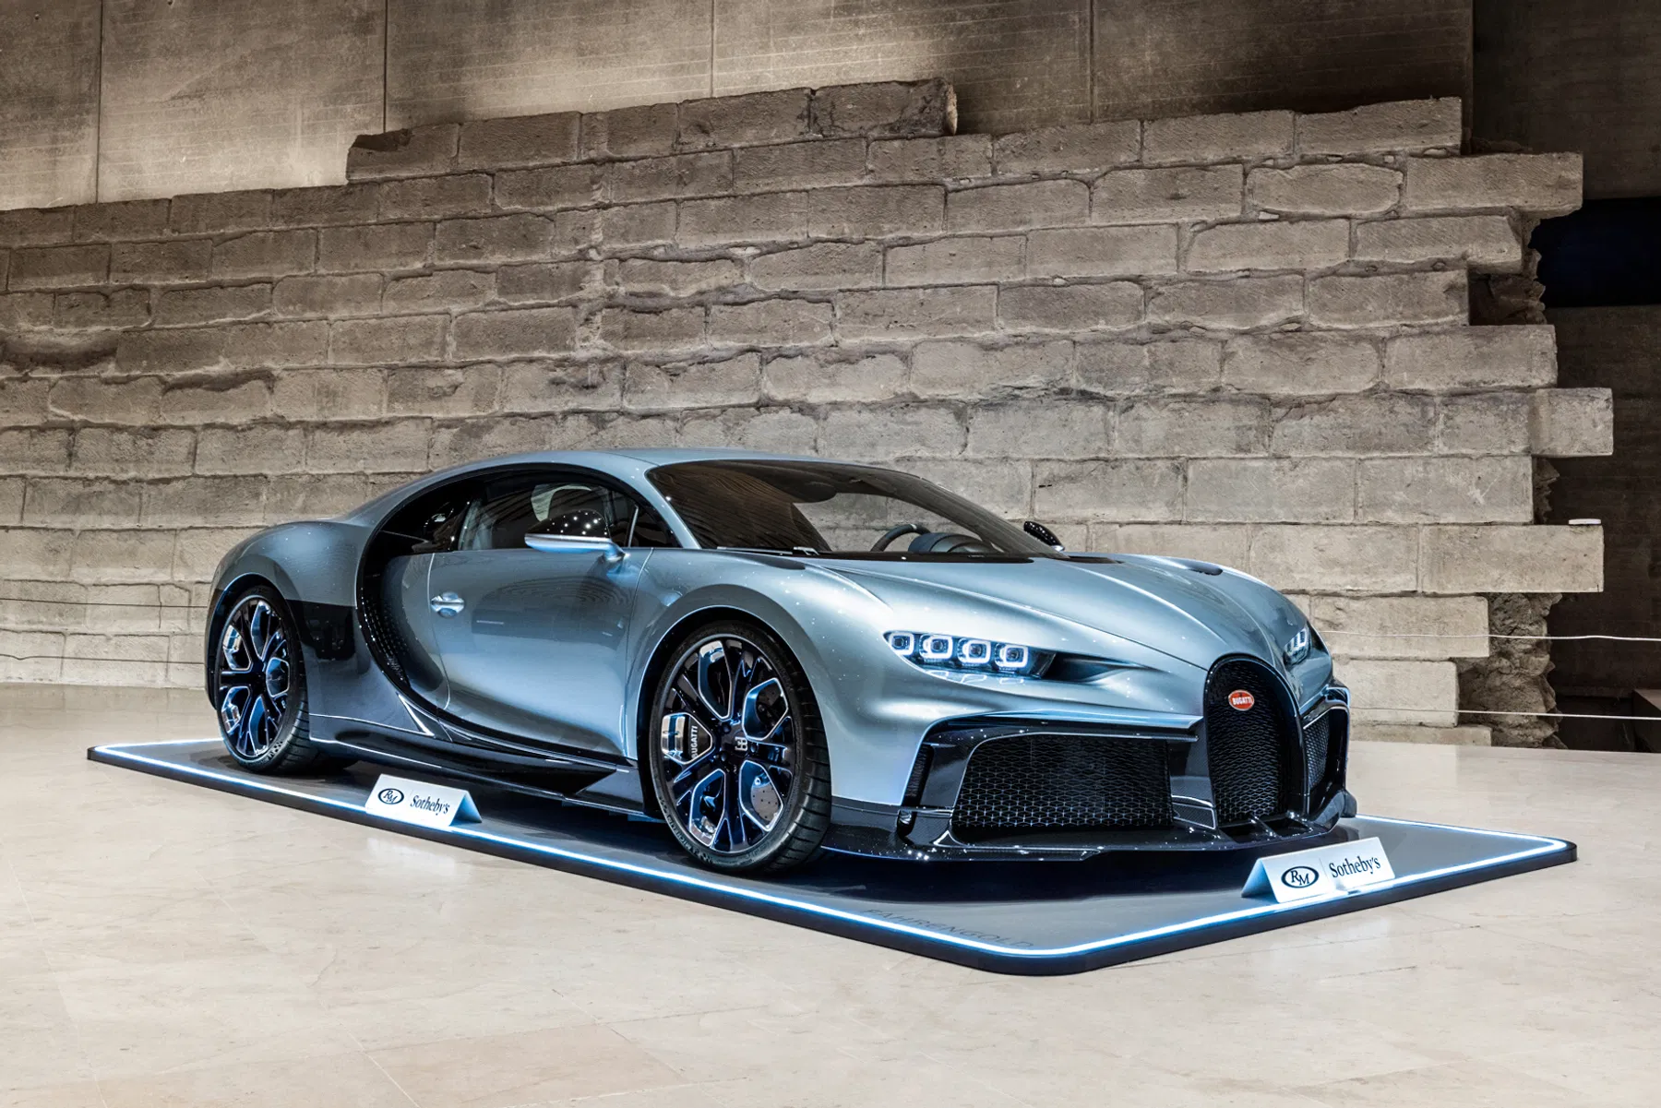
A Few Words on “Design”

Slide 3

A Few Words on “Design”
Bugatti
  1,500 horsepower
    1 hp = lifting 550 lb up for 1 ft per sec
  273 MPH
    400 ft / s
    Bullet speed 500 – 4000 ft/s
  4 turbos
  10 radiators
  Ceramic brakes
  Fuel tank with only enough capacity to last for 12 minutes
    Or tires will melt

Slide 4
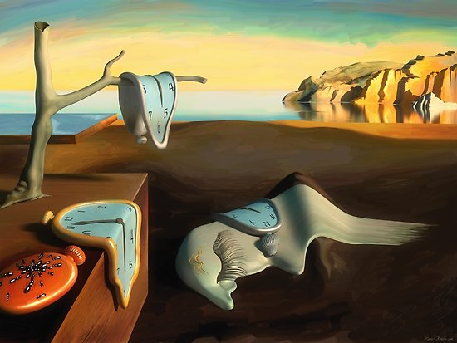
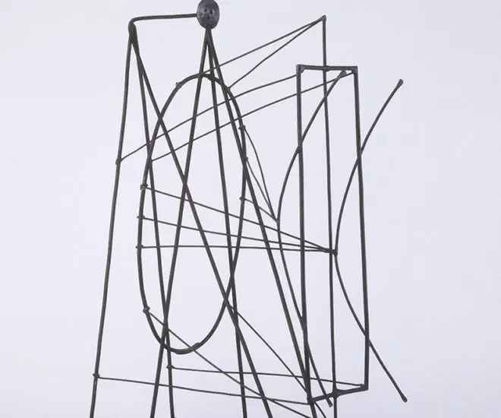
A Few Words on “Design”
A unique perspective of the world

Slide 5
Design Approaches
Bottom-up
Top-down
Elegance of system
OSes/file systems
  Provide a single unifying interface to programmers
    Open/close/read/write to processes, memory, files, devices
  Ease programmers’ access to hardware
  Hard to decide the level of abstraction
    VM makes it hard to predict performance
Elegance of semantics
  Databases
    Insulate programmers from the system with well-defined semantics of data and queries
    - Hard to leverage new technology without extensive changes

Slide 6
Location of Complexities
Infrastructure (layering)
Endpoints
Better modularity
Each layer evolves independently
Example: file transfer
  Network packet checksum
  Message level checksum
    TCP retransmission
  File system checksum
  Application-level checksum
Based on the end-to-end argument
  If the endpoints still need to check, why the redundancy?
  - If errors are frequent, the success rate of retransmitting a large file is low
  Makes more sense to encrypt end-to-end without decrypting in the middle
Redundancies in apps

Slide 7
History of OS: Change!
 |  | 2021 | 2026 | Factor
Speed | CPU | 5 GHz, 128 cores | 5.7 GHz 256 cores, | 2.3x
 | GPU | 312 TFLOPS, NVIDIA A100 | 18 PFLOPs NVIDIA Blackwell | 58x
 | TPU | 275 TFLOPS | 1.8 TOPS | 6.7x
 | NPC | 15 TOPS | 100 TOPS | 6.7x
 | Memory | 2 TB/s | 8 TB/s | 4.0x
 | Storage | 7 GB/s | 28 GB/s | 4.0x
 | Network | 400 Gb/s | 1.8 TGb/s | 4.5x

Slide 8
History of OS: Change!
 |  | 2021 | 2026 | Factor
Capacity | Memory | 128 GB | 512 GB | 4.0x
 | Storage | 15 TB | 123 TB | 8.2x
Cost | CPU | $7.9K ($123/core) | $14K ($70/core) | 1.8x
 | GPU | $15K ($1.7) | $45K ($2.4) | 3.0x
 | Memory | $5/GB | $12/GB | 2.4x
 | Storage | $130/TB/s | $450/TB/s | 3.5x
 | Network switch | $3K | $40K | 13x

Slide 9
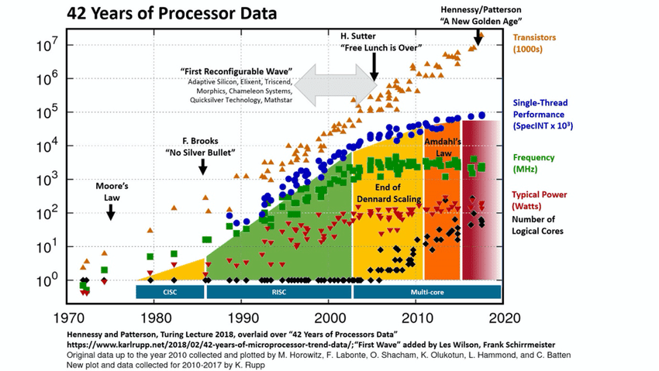
Multicore Trend

Slide 10
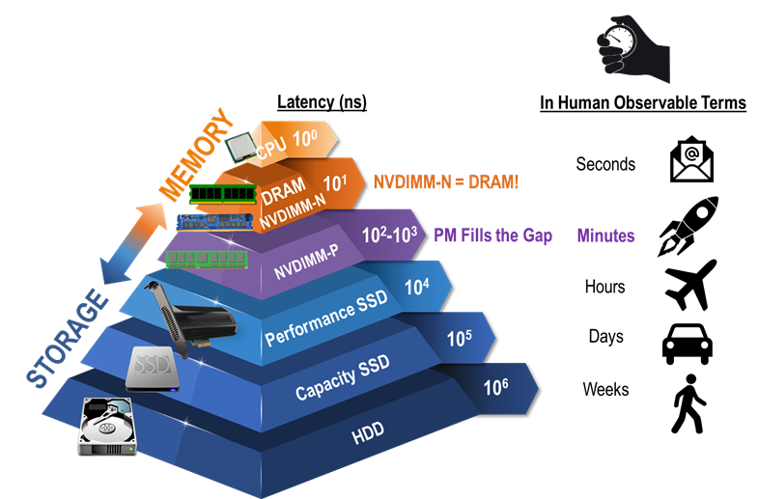
Deeper Storage Hierarchy

Slide 11
Changing Roles of the OS
What OS does depend on available hardware and software
And on changing uses of machines
And on changing expectations of users

Slide 12
Course Emphasis
Advanced background
Major concepts and design principles
Well-known systems

Slide 13
Homework 1
Submit online (counts as one critique)
  A recent photo
  Two words with the same starting letters as your first and last name
    Artistic wizard for Andy Wang
    An image of these two words
  Your favorite quote
Email me your project team info + team name + team leader

