Slide 1
Advanced File Systems Issues
Andy Wang
COP 5611
Advanced Operating Systems

Slide 2
Outline
File systems basics
Better performance
Reliability
Extensibility
Using other forms of persistent storage

Slide 3
File System Basics
File system: a collection of files
File system vs. databases
  File systems serve unstructured data
  NoSQL databases serve unstructured or semi-structured without relations
    Key-value stores (memcached)
    Document (JSON, XML) databases (MongoDB)
  Databases serve structured data

Slide 4
File System Basics
An OS may support multiples FSes
  Instances of the same type
  Different types of file systems
All file systems are typically bound into a single namespace
  Often hierarchical

Slide 5
Why not a single FS?

Slide 6
Pros of Having Multiple FSes
Easier support for multiple HW devices
More control over storage usage
Fault isolation
Quicker to run consistency checks
Support for multiple types of FSes

Slide 7
A Hierarchy of File Systems

Slide 8
Hierarchical Organizations
Constrained
Unconstrained

Slide 9
Constrained Organizations
Independent FSes located at particular places
Usually at the highest level in the hierarchy (e.g., DOS/Windows and iOS)
+ Simplicity, simple user model
- lack of flexibility

Slide 10
Unconstrained Organizations
Independent FSes can be put anywhere in the hierarchy (e.g., UNIX)
+ Generality, invisible to user
- Complexity, not always what user expects
These organizations requires mounting

Slide 11
Some Questions…
Why hierarchical? What are some alternative ways to organize a namespace?

Slide 12
Types of Namespaces
Flat
Hierarchical
Relational
Contextual
Content-based

Slide 13
Example: “Internet FS”
Flat: each URL mapped to one file
Hierarchical: navigation within a site
Relational: keyword search via search engines
Contextual: page rank to improve search results
Content-based: searching for images without knowing their names

Slide 14
Mounting File Systems
Each FS is a tree with a single root
Its root is spliced into the overall tree
  Typically, on top of another file/directory
    Or the mount point
  Complexities in traversing mount points

Slide 15
Mounting Example
tmp
root
mount(/dev/sd01, /w/x/y/z/tmp)

Slide 16
After the Mount
tmp
root
mount(/dev/sd01, /w/x/y/z/tmp)

Slide 17
Before and After the Mount
Before mounting, if you issue
  ls /w/x/y/z/tmp
  You see the contents of /w/x/y/z/tmp
After mounting, if you issue
  ls /w/x/y/z/tmp
  You see the contents of root

Slide 18
Questions
Can we end up with a cyclic graph?
  What are some implications?
What are some security concerns?

Slide 19
What is a File?
A collection of data and metadata (often called attributes)
Usually in persistent storage
In UNIX, the metadata of a file is represented by the i_node data structure

Slide 20
Logical File Representation
i-node
  File attributes
Data
Name(s)
File

Slide 21
File Attributes
Typical attributes include
  File length
  File ownership
  File type
  Access permissions
Typically stored in special fixed-size area

Slide 22
Extended Attributes
Some systems store more information with attributes (e.g., iOS)
  Sometimes user-defined attributes
Some such data can be very large
  In such cases, treat attributes similar to file metadata

Slide 23
Storing File Data
Where do you store the data?
Next to the attributes, or elsewhere?
Usually elsewhere
  Data is not of single size
  Data is changeable
  Storing elsewhere allows more flexibility
Co-placement is also possible (see WAFL)

Slide 24
Physical File Representation
i-node
  File attributes
  Data locations
Data blocks
Name(s)
File

Slide 25
Ext2/3 i-node
data block location
data block location
data block location
data block location
12
data block location
data block location
data block location
data block location
index block location
index block location
index block location
index block location
index block location
index block location
i-node
How about making each block pointing to its parent?

Slide 26
A Major Design Assumption
File size distribution
number of files
22KB – 64 KB
file size

Slide 27
Pros/Cons of i_node Design
+ Faster accesses for small files (also accessed more frequently)
+ No external fragmentations
- Internal fragmentations
- Limited maximum file size

Slide 28
Directories
A directory is a special type of file
Instead of normal data, it contains “pointers” to other files
Directories are hooked together to create the hierarchical namespace

Slide 29
Ext2/3 Dir Representation
data block location
data block location
file1
file1
file i-node location
file1 i-node number
file1
file2
data block location
file i-node location
file2 i-node number
index block location
Why need i-node number?
Why not just use names?
index block location
index block location
i-node

Slide 30
Links
Different names for the same file
A Hard link: A second name that points to the same file
A Symbolic link: A special file that directs name translation to take another path

Slide 31
Hard Link Diagram
data block location
data block location
file1
file1
file i-node location
file1 i-node number
file1
file2
data block location
file i-node location
file1 i-node number
index block location
index block location
index block location
i-node

Slide 32
Implications of Hard Links
Indistinguishable pathnames for the same file
Need to keep link count with file for garbage collection
“Remove” sometimes only removes a name
Do not work across file systems

Slide 33
Symbolic Link Diagram
data block location
data block location
file1
file1
file i-node location
file1 i-node number
file1
file2
data block location
file1
file i-node location
file1
file2 i-node number
index block location
index block location
index block location
i-node

Slide 34
Implications of Symbolic Links
If file at the other end of the link is removed, dangling link
Only one true pathname per file
Just a mechanism to redirect pathname translation
Less system complications

Slide 35
Ext4 i-node
data block location
index node location
data block location
extent
i-node

Slide 36
Disk Hardware
One head/platter; they typically move together, with one head activated at a time
One or more rotating disk platters
Disk arm

Slide 37
Disk Hardware
Smallest atomic access unit (512B – 4KB)
Track (hundreds of atoms wide)
Sector
Cylinder

Slide 38
More Complexities
Zone-bit recording
  More sectors near outer tracks
Track skews
  Track starting positions are not aligned
  Optimize sequential transfers across multiple tracks

Slide 39
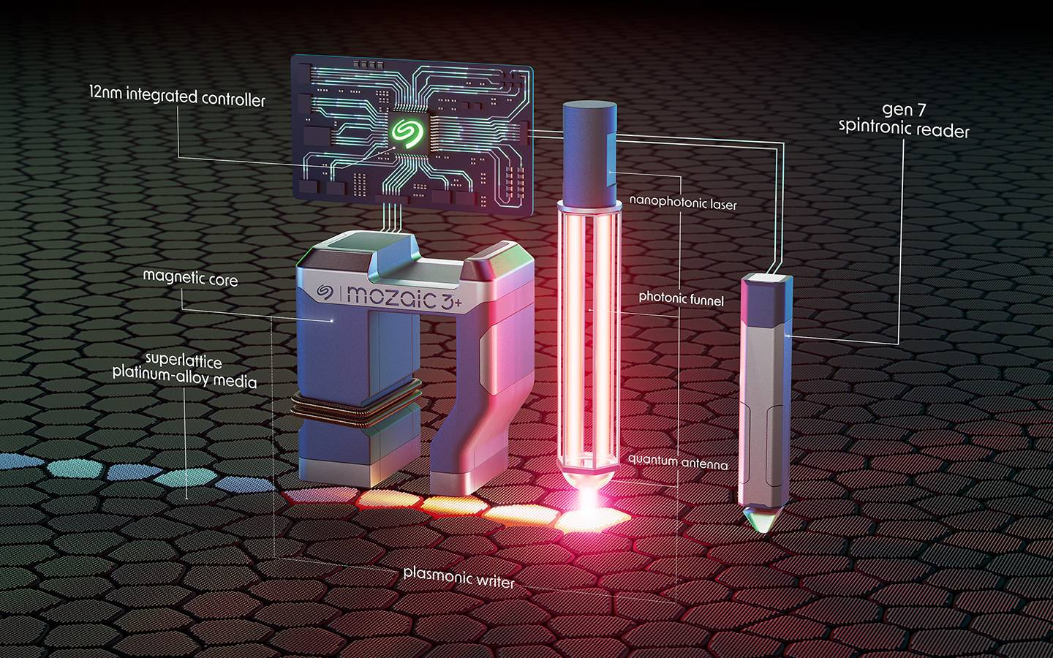
Seagate Mosaic 3+

Slide 40
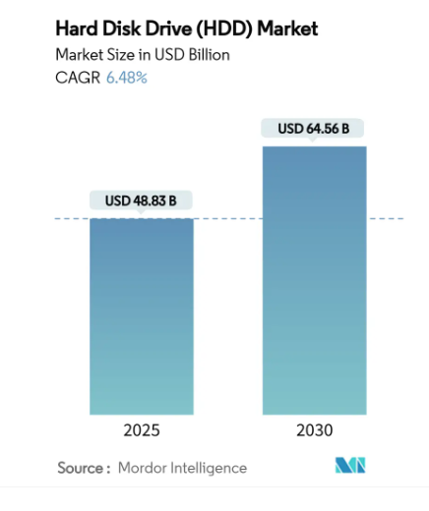
Disk Sales Trend
HDDs: $10-16/TB
  Mostly for clouds and recording devices
  $110 for 6TB
  $450 for $28TB
SSDs: $7-128/TB
  $16K for 122TB
  $1.8K for 15TB
Notes:
Seagate 2025
Solidigm d5p5336 2025

Slide 41
Laying Out Files on Disks
Consider a long sequential file
And a disk divided into sectors with 1-KB blocks
Where should you put the bytes?

Slide 42
File Layout Methods
Contiguous allocation
Threaded allocation
Segment-based allocation
  Variable-sized, extent-based
Indexed allocation
  Fixed-sized, extent-based
Multi-level indexed allocation
Inverted (hashed) allocation

Slide 43
Contiguous Allocation
+ Fast sequential access
+ Easy to compute random offsets
- External fragmentation

Slide 44
Threaded Allocation
Example: FAT
+ Easy to grow files
- Internal fragmentation
- Not good for random accesses
- Unreliable

Slide 45
Segment-based Allocation
A number of contiguous regions of blocks
+ Combines strengths of contiguous and threaded allocations
- Internal fragmentation
- Random accesses are not as fast as contiguous allocation

Slide 46
Segment-Based Allocation
segment list location
segment list location
begin block location
begin block location
end block location
i-node
end block location
begin block location
begin block location
end block location
end block location

Slide 47
Indexed Allocation
+ Fast random accesses
- Internal fragmentation
- Complexity in growing/shrinking indices
data block location
data block location
data block location
data block location
i-node

Slide 48
Multi-level Indexed Allocation
UNIX, ext2/3/4
+ Easy to grow indices
+ Fast random accesses
- Internal fragmentation
- Complexity to reduce indirections for small files

Slide 49
Multi-level Indexed Allocation
data block location
data block location
data block location
data block location
12
data block location
data block location
data block location
data block location
index block location
index block location
index block location
index block location
index block location
index block location
Ext2/3 i-node

Slide 50
Inverted Allocation
Venti
+ Reduced storage requirement for archives (deduplication)
- Slow random accesses (for disks)
data block location
data block location
data block location
data block location
data block location
data block location
data block location
data block location
i-node for file A
i-node for file B

Slide 51
FS Performance Issues
Disk-based FS performance limited by
  Disk seek
  Rotational latency
  Disk bandwidth

Slide 52
Typical Disk Overheads
~3 msec seek time
~2 msec rotational delay
~0.003 msec to transfer a 1-KB block (based on 300MB/sec)
To access a random location
  ~5 msec to access a 1-KB block
  ~ 200KB/sec effective bandwidth

Slide 53
How are disks improving?
Density: 25-40% per year
Capacity: 25% per year
Transfer rate: 10-15% per year
Seek time: 5% per year
All slower than processor speed increases
Notes:
http://www.storagenewsletter.com/news/disk/hdd-technology-trends-ibm

Slide 54
The Disk/Processor Gap
Since aggregate CPU processing cycles double every 2-3 years
And disk access times half every 10-20 years
CPUs are waiting longer and longer for data from disk
Important for OS to cover this gap

Slide 55
Disk Usage Patterns
57% of disk accesses are writes
  Optimizing writes is a very good idea
18-33% of reads are sequential
  Read-ahead of blocks likely to win
Notes:
http://users.soe.ucsc.edu/~elm/Papers/usenix08.pdf

Slide 56
Disk Usage Patterns (2)
8-12% of writes are sequential
  Perhaps not worthwhile to focus on optimizing sequential writes
50-75% of all I/Os are synchronous
  Keeping files consistent is expensive
67-78% of writes are to metadata
  Need to optimize metadata writes

Slide 57
Disk Usage Patterns (3)
13-42% of total disk access for user I/O
  Focusing on user patterns isn’t enough
10-18% of writes are to previously written block
  Savings possible by clever delay of writes

Slide 58
What Can the OS Do?
Minimize amount of disk accesses
Improve locality on disk
Maximize size of data transfers
Fetch from multiple disks in parallel

Slide 59
Minimizing Disk Access
Avoid disk accesses when possible
Use caching (LRU) to hold file blocks in memory
  Generally used for all I/Os, not just disk
Effect: decreases latency by removing the relatively slow disk from the path

Slide 60
Buffer Cache Design Factors
Most files are small
Large files can be very large
User access is bursty
70-90% of accesses are sequential
75% of files are open < ¼ second
65-80% of files live < 30 seconds

Slide 61
Implications
Design for holding small files
Read-ahead is good for sequential accesses
  Read blocks that are likely to be used later
  During times where disk would otherwise be idle

Slide 62
Pros/Cons of Read-ahead
+ Very good for sequential access of large files (e.g., executables)
+ Allows immediate satisfaction of disk requests
- Contend memory with LRU caching
- Extra OS complexity

Slide 63
Buffering Writes
Buffer writes so that they need not be written to disk immediately
  Reducing latency on writes
But buffered writes are asynchronous
Potential cache consistency and crash problems
Some systems make certain critical writes synchronously

Slide 64
Should We Buffer Writes?
Good for short-lived files
  But danger of losing data in face of crashes
  And most short-lived files are also short in length
  ¼ of all bytes deleted/overwritten in 30 seconds

Slide 65
Improved Locality
Make sure next disk block you need is close to the last one you got
File layout is important here
Ordering of accesses in controller helps
Effect: Less seek time and rotational latency

Slide 66
Maximizing Data Transfers
Transfer big blocks or multiple blocks on one read
Readahead is one good method here
Effect: Increase disk bandwidth and reduce the number of disk I/Os

Slide 67
Use Multiple Disks in Parallel
Multiprogramming can cause some of this automatically
Use of disk arrays can parallelize even a single process’ access
  At the cost of extra complexity
Effect: Increase disk bandwidth

