Slide 1
Bitcoin: A Peer-to-Peer Electronic Cash System
Satoshi Nakamoto

Slide 2
Bitcoin
19.9 out of 21 million bitcoins have been mined
Today, it is trading at $64K per coin

Slide 3
Motivation
Seller: renders a non-reversible service
Buyer: pays a check
  The bank account may not have the money
  If the buyer writes two $100 checks with only $100 is in the account
Alternatives:
  Physical cash
  Uses a credit card where the third-party bank holds the buyer accountable

Slide 4
Motivation
Need a way to pay over a communication channel
  Without a trusted third party
Need to rely on cryptographic proof instead of trust
  My claimed account balance can be independently verified
  Allow two parties to transact directly with each other
    Without the need of a trusted third party
Bitcoin: a solution to double spending problem
  Using a distributed timestamp server to generate proof of the chronological order of transactions
Assumptions: Honest nodes control more CPU power than attacking nodes

Slide 5
Transaction
An electronic coin as a chain (cryptographic transfer history) of digital signatures

Slide 6
Transaction
Each owner j transfer the coin to the next j+1 by digitally signing a hash
  Of the previous transaction and the public of key of j + 1
Transaction 1
Key_{public_j+1}
hash
PKE
Owner j’s
signature
Key_{private_j}

Slide 7
Transaction
Each owner j transfer the coin to the next j+1 by digitally signing a hash
  Of the previous transaction and the public of key of j + 1
Transaction 1
Transaction 2
Key_{public_j+1}
hash
PKE
Owner j’s
signature
Key_{private_j}

Slide 8
Transaction (Coin = a Chain of Signatures)
Each owner j transfer the coin to the next j+1 by digitally signing a hash
  Of the previous transaction and the public of key of j + 1
Transaction 1
Transaction 2
Transaction 3
Key_{public_j+1}
Key_{public_j+2}
hash
hash
PKE
PKE
Owner j’s
signature
Owner j+1’s
signature
Key_{private_j}
Key_{private_j+1}

Slide 9
Transaction
D(Key_{public_j+1}, transaction 3) = hash(transaction 2, Key_{public_j+2})
Can verify owner j + 1’s signature using j + 1’s public key
  Can verify the entire chain of signatures
Transaction 1
Transaction 2
Transaction 3
Key_{public_j+1}
Key_{public_j+2}
hash
hash
PKE
PKE
Owner j’s
signature
Owner j+1’s
signature
Key_{private_j}
Key_{private_j+1}

Slide 10
Problem with this Transaction Model
Double spending
  One can verify that transaction 2 has a legitimate chain of signatures
  Another one can verify that transaction 2’ also has a legitimate chain of signatures
Transaction 1
Transaction 2
Key_{private_j}
Transaction 2’

Slide 11
One Solution
Use a trusted central authority—mint
After each transaction
  Coin must be returned to the mint to issue a new coin
  Only coins issued from the mint are trusted
Drawback
  Every transaction needs to go through the mint

Slide 12
Arriving Another Solution
If someone signs the same transaction (history) twice
  Only the first signature counts
To be able to detect the second signature
  Global knowledge is required
  Mint’s centralized model relies on global knowledge
Without a trusted party
  Transactions must be publically announced
  All participants need to agree on a single history of the order in which the announcement was received
The payee needs proof that at the time of transaction
  Majority of nodes agreed he received the first signature

Slide 13
Timestamp Server
Take a hash of a block of items to be timestamped and publish the hash
  E.g., in a newspaper or Usenet post
  Timestamp proves that the data must have existed at the time to get into the hash
Each timestamp includes the previous timestamp in its hash, forming a chain
Hash
Hash
Block of items
Block of items

Slide 14
Proof of Work
If effort to generate the timestamp hash chain is low, someone with the CPU cycles to rewrite the history
Need proof of work to make this process expensive

Slide 15
Proof of Work
hash(previous hash, transactions, nonce) < threshold
  Where nonce is a random guess, not published
  Smaller the threshold, exponentially increasingly computational effort is needed to generate this legitimate hash
  A block cannot be changed without redoing the work of guessing the nonce
    And the nonce for the subsequent blocks
Block
Block
Previous hash
Hash
Previous hash
Txs
nonce
Txs
nonce

Slide 16
Proof of Work
The majority decision is based on the longest block chain or the greatest proof of work effort invested
Note
  Proof of work is not voted by the number of IP addressed
  But by the number of CPU cycles
If most CPU cycles are controlled by honest nodes, the honest chain will grow faster than competing chains
To modify the past, an attacker would have to redo the proof for all blocks

Slide 17
Proof of Work
As hardware speed increases overtime
  The threshold for proof of work reduces
    Difficulty of guessing a correct nonce increases
  Targeting an average number of blocks generated per hour

Slide 18
Proof-of-Work Network
Run the following steps
  New transactions are broadcast to all nodes
  Each node collects new transactions into a block
  Each node solves for the nonce for its block
  If the nonce is found, broadcasts the block to all nodes
  Nodes accept the block if all transactions in it are valid and not already spent
  Nodes accept the block by creating the next block in the chain, using the hash of the accepted block

Slide 19
Proof-of-Work Network
Nodes always consider the longest chain
If two chains are received, the tie will be broken with the next proof
Nodes working on the shorter chain will switch to the longer chain
Nodes can detect a missed block if the previous hash field mismatched

Slide 20
Incentive
The first transaction in a block is a special transaction
  Starts a new coin owned by the creator the block
  Encourages nodes to support the proof-of-work network
    Compensates for electricity expended
  Done without centralized authority
Alternative
  Use transaction fees
Encourage nodes to stay honest
  CPU cycles are better spent generating new coins than rewriting the history

Slide 21
Reclaiming Disk Space
Once a coin is buried under enough transactions, older transactions can be discarded to save disk space
Transactions are stored in a Merkle tree
Block
Previous hash
nonce
Root hash
hash01
hash23
hash0
hash1
hash2
hash3
Tx0
Tx1
Tx2
Tx3

Slide 22
Reclaiming Disk Space
When pruning (e.g., Tx0 – Tx2)
  Interior hashes do not need to be stored
Block
Previous hash
nonce
Root hash
hash01
hash23
hash2
hash3
Tx3

Slide 23
Combining and Splitting Value
Unwieldy to make a separate transaction for every cent
Transactions contain multiple inputs and outputs
Normally, one input when a larger amount is going to be spent on smaller amount
Multiple inputs when smaller amounts are combined to be spent
At most two outputs
  One for payment
  One returning the change

Slide 24
Privacy
All transactions are announced publicly
Need to keep public key anonymous
Ideally a new key pair is used for each transaction
Still a problem for multi-input transactions

Slide 25
Calculations
Attackers are likely to change one of its own transactions to take back money recently spent
For large transactions, wait for 5-6 blocks to be committed based on the transacted block
  Very difficult for an attacker to alter the history beyond this chain length

Slide 26
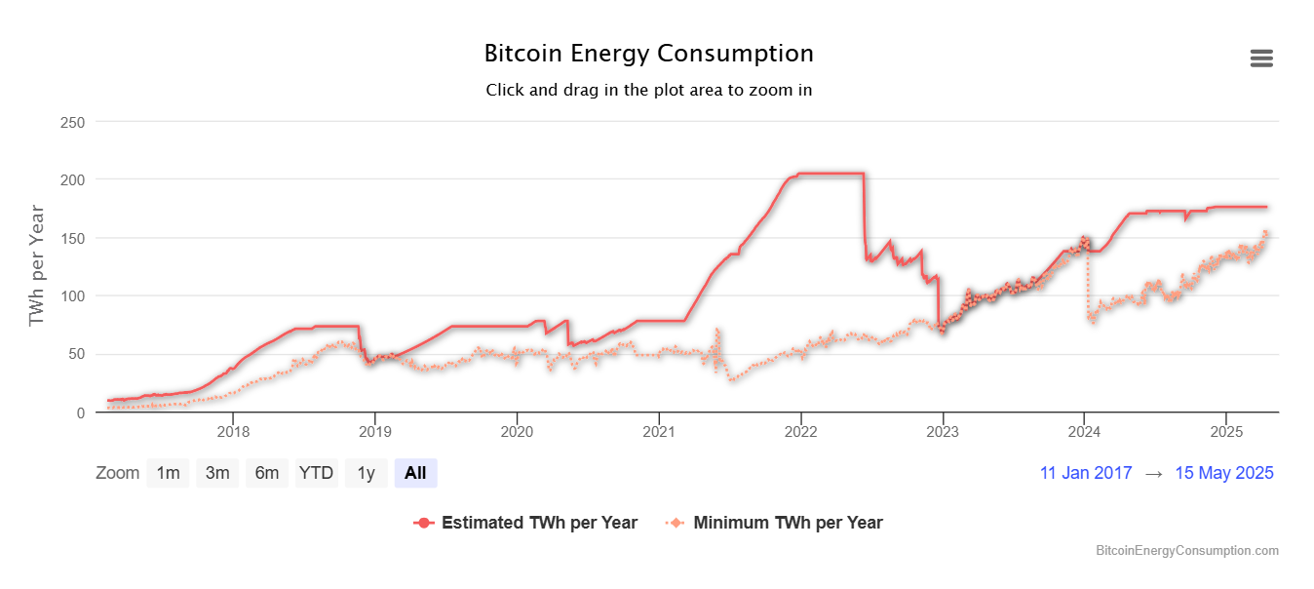
Design Issues
Scalability: ~7 transactions per second
  Vs. VISA: ~24K transactions per second
Number of CPUs involved
  2023: used 2.3% of U.S. electricity…
What if all the miners stop?

