Slide 1
Genesis: From Raw Hardware to Processes
Andy Wang
Operating Systems
COP 4610 / CGS 5765

Slide 2
How is the first process created?
What happens when you turn on a computer?
How to get from raw hardware to the first running process, or process 1 under UNIX?
Well…it’s a long story…
It starts with a simple computing machine

Slide 3
Long,
Long, Long
Ago…(During
the 1940s)

Slide 4
Long, Long, Long Ago…(during the 1940s)
John von Neumann invented von Neumann computer architecture
A CPU
A memory unit
I/O devices (e.g.,
disks and tapes)

Slide 5
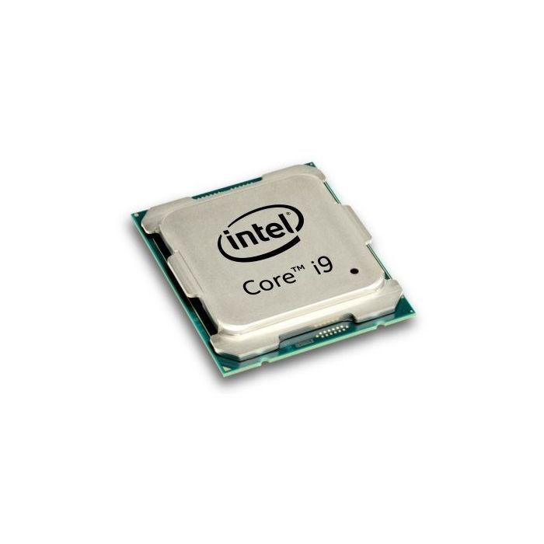
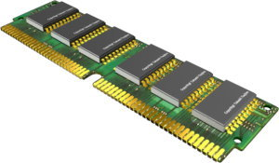
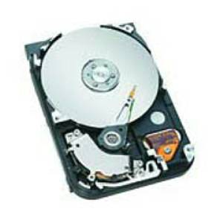
In von Neumann Architecture,
Programs are stored on storage devices
Programs are copied into memory for execution
CPU reads each instruction in the program and executes accordingly

Slide 6
A Simple CPU Model
Fetch-execute algorithm
During a boot sequence, the program counter (PC) is loaded with the address of the first instruction
The instruction register (IR) is loaded with the instruction from the address

Slide 7
Fetch-Execute Algorithm
PC = <address of the first instruction>
…
PC
3000
load r3, b
3000
load r4, c
3004
IR
load r3, b
…
Memory addresses

Slide 8
Fetch-Execute Algorithm
while (not halt) {
// increment PC
…
PC
3000
load r3, b
3000
load r4, c
3004
IR
load r3, b
…
Memory addresses

Slide 9
Fetch-Execute Algorithm
while (not halt) {
// increment PC
…
PC
3004
load r3, b
3000
// execute(IR)
load r4, c
3004
IR
load r3, b
…
Memory addresses

Slide 10
Fetch-Execute Algorithm
while (not halt) {
// increment PC
…
PC
3004
load r3, b
3000
// execute(IR)
load r4, c
3004
IR
load r4, c
…
// IR = memory
// content of PC
}
Memory addresses

Slide 11
Booting Sequence
The address of the first instruction is fixed
It is stored in read-only-memory (ROM)

Slide 12
Booting Procedure for i386 Machines
On i386 machines, ROM stores a Basic Input/Output System (BIOS)
BIOS contains information on how to access storage devices
Being replaced with United Extended Firmware Interface (UEFI)
To access storage > 2TB

Slide 13
BIOS Code
Performs Power-On Self Test (POST)
Checks memory and devices for their presence and correct operations
For ancient computers, you will hear memory counting, which consists of noises from the hard drive and CDROM, followed by a final beep

Slide 14
After the POST
The master boot record (MBR) is loaded from the boot device (configured in BIOS)
The MBR is stored at the first logical sector of the boot device (e.g., a hard drive) that
Fits into a single 512-byte disk sector (boot sector)
Describes the physical layout of the disk (e.g., number of tracks)
MBR is being replaced by GUID Partition Table (GPT) for 64-bit addressing

Slide 15
After Getting the Info on the Boot Device
BIOS loads a more sophisticated loader from other sectors on disk
The more sophisticated loader loads the operating system

Slide 16
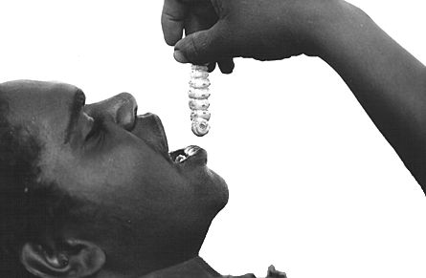
Operating System Loaders
Under old Linux, this sophisticated loader is called LILO (Linux Loader)
It has nothing to do with Lilo and Stitch
Linux uses GRUB
(GRand Unified
Bootloader) nowadays

Slide 17
More on OS Loaders
LILO
Partly stored in MBR with the disk partition table
A user can specify which disk partition and OS image to
boot
Windows loader assumes only one bootable disk partition
After loading the kernel image, LILO sets the kernel mode and jumps to the entry point of an operating system

Slide 18
Booting Sequence in Brief
A CPU jumps to a fixed address in ROM,
Loads the BIOS (UEFI),
Performs POST,
Loads MBR (GPT) from the boot device,
Loads an OS loader (LILO, GRUB),
Loads the kernel image,
Sets the kernel mode, and
Jumps to the OS entry point.

Slide 19
Linux Initialization
Set up a number of things:
Trap table
Interrupt handlers
Scheduler
Clock
Kernel modules
…
Process manager

Slide 20
Process 1
Is instantiated from the init (now systemd for parallelism) program
Is the ancestor of all processes
Controls transitions between runlevels
Executes startup and shutdown scripts for each runlevel

Slide 21
Runlevels
Level 0: shutdown
Level 1: single-user
Level 2: multi-user (without network file system)
Level 3: full multi-user
Level 5: X11
Level 6: reboot

Slide 22
Process Creation
Via the fork system call family
Before we discuss process creation, a few words on system calls…

Slide 23
System Calls
System calls allow processes running at the user mode to access kernel functions that run under the kernel mode
Prevent processes from doing bad things, such as
Halting the entire operating system
Modifying the MBR

Slide 24
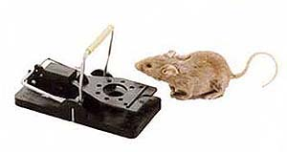
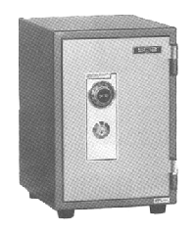
UNIX System Calls
Implemented through the trap instruction
trap
set kernel mode
user level
kernel level
branch table
trusted code

Slide 25
A fork Example, Nag.c
#include <stdio.h>
#include <unistd.h>
#include <sys/types.h>
int main() {
pid_t pid;
if ((pid = fork()) == 0) {
while (1) {
printf(“child’s return value %d: I want to play…\n”, pid);
}
} else {
while (1) {
printf(“parent’s return value %d: After the project…\n”, pid);
}
}
return 0;
}
Parent process

Slide 26
A fork Example, Nag.c
#include <stdio.h>
#include <unistd.h>
#include <sys/types.h>
int main() {
pid_t pid;
if ((pid = fork()) == 0) {
while (1) {
printf(“child’s return value %d: I want to play…\n”, pid);
}
} else {
while (1) {
printf(“parent’s return value %d: After the project…\n”, pid);
}
}
return 0;
}
Parent process

Slide 27
A fork Example, Nag.c
#include <stdio.h>
#include <unistd.h>
#include <sys/types.h>
int main() {
pid_t pid;
if ((pid = fork()) == 0) {
while (1) {
printf(“child’s return value %d: I want to play…\n”, pid);
}
} else {
while (1) {
printf(“parent’s return value %d: After the project…\n”, pid);
}
}
return 0;
}
#include <stdio.h>
#include <unistd.h>
#include <sys/types.h>
int main() {
pid_t pid;
if ((pid = fork()) == 0) {
while (1) {
printf(“child’s return value %d: I want to play…\n”, pid);
}
} else {
while (1) {
printf(“parent’s return value %d: After the project…\n”, pid);
}
}
return 0;
}
Parent process
Child process

Slide 28
A fork Example, Nag.c
#include <stdio.h>
#include <unistd.h>
#include <sys/types.h>
int main() {
pid_t pid;
if ((pid = 3128) == 0) {
while (1) {
printf(“child’s return value %d: I want to play…\n”, pid);
}
} else {
while (1) {
printf(“parent’s return value %d: After the project…\n”, pid);
}
}
return 0;
}
#include <stdio.h>
#include <unistd.h>
#include <sys/types.h>
int main() {
pid_t pid;
if ((pid = 0) == 0) {
while (1) {
printf(“child’s return value %d: I want to play…\n”, pid);
}
} else {
while (1) {
printf(“parent’s return value %d: After the project…\n”, pid);
}
}
return 0;
}
Parent process
Child process

Slide 29
A fork Example, Nag.c
#include <stdio.h>
#include <unistd.h>
#include <sys/types.h>
int main() {
pid_t pid;
if ((pid = 3128) == 0) {
while (1) {
printf(“child’s return value %d: I want to play…\n”, pid);
}
} else {
while (1) {
printf(“parent’s return value %d: After the project…\n”, pid);
}
}
return 0;
}
#include <stdio.h>
#include <unistd.h>
#include <sys/types.h>
int main() {
pid_t pid;
if ((pid = 0) == 0) {
while (1) {
printf(“child’s return value %d: I want to play…\n”, pid);
}
} else {
while (1) {
printf(“parent’s return value %d: After the project…\n”, pid);
}
}
return 0;
}
Parent process
Child process

Slide 30
Nag.c Outputs
>a.out
child’s return value 0: I want to play…
child’s return value 0: I want to play…
child’s return value 0: I want to play…
…// context switch
parent’s return value 3218: After the project…
parent’s return value 3218: After the project…
parent’s return value 3218: After the project…
…// context switch
child’s return value 0: I want to play…
child’s return value 0: I want to play…
child’s return value 0: I want to play…
^C
>

Slide 31
Why clone a process?

Slide 32
Why clone a process?
Simplifies parameter passing
Environmental variables, permissions, etc.
Performance optimization
Copy on write

Slide 33
Also,…don’t do this at home
while (1) {
fork();
}

Slide 34
The exec System Call Family
A fork by itself is not interesting
To make a process run a program that is different from the parent process, you need exec system call
exec starts a program by overwriting the current process

Slide 35
A exec Example, HungryEyes.c
#include <stdio.h>
#include <unistd.h>
#include <sys/types.h>
#include <string.h>
#include <malloc.h>
#define LB_SIZE 1024
int main(int argc, char *argv[]) {
char fullPathName[] = “/usr/X11R6/bin/xeyes”;
char *myArgv[LB_SIZE]; // an array of pointers
myArgv[0] = (char *) malloc(strlen(fullPathName) + 1);
strcpy(myArgv[0], fullPathName);
myArgv[1] = NULL; // last element should be a NULL pointer
execvp(fullPathName, myArgv);
return(0); // should not be reached
}
At a shell prompt:
>whereis xeyes
/usr/X11R6/bin/xeyes
A process

Slide 36
A exec Example, HungryEyes.c
#include <stdio.h>
#include <unistd.h>
#include <sys/types.h>
#include <string.h>
#include <malloc.h>
#define LB_SIZE 1024
int main(int argc, char *argv[]) {
char fullPathName[] = “/usr/X11R6/bin/xeyes”;
char *myArgv[LB_SIZE]; // an array of pointers
myArgv[0] = (char *) malloc(strlen(fullPathName) + 1);
strcpy(myArgv[0], fullPathName);
myArgv[1] = NULL; // last element should be a NULL pointer
execvp(fullPathName, myArgv);
return(0); // should not be reached
}
A process

Slide 37
A exec Example, HungryEyes.c
#include <stdio.h>
#include <unistd.h>
#include <sys/types.h>
#include <string.h>
#include <malloc.h>
#define LB_SIZE 1024
int main(int argc, char *argv[]) {
char fullPathName[] = “/usr/X11R6/bin/xeyes”;
char *myArgv[LB_SIZE]; // an array of pointers
myArgv[0] = (char *) malloc(strlen(fullPathName) + 1);
strcpy(myArgv[0], fullPathName);
myArgv[1] = NULL; // last element should be a NULL pointer
execvp(fullPathName, myArgv);
return(0); // should not be reached
}
A process

Slide 38
A exec Example, HungryEyes.c
#include <stdio.h>
#include <unistd.h>
#include <sys/types.h>
#include <string.h>
#include <malloc.h>
#define LB_SIZE 1024
int main(int argc, char *argv[]) {
char fullPathName[] = “/usr/X11R6/bin/xeyes”;
char *myArgv[LB_SIZE]; // an array of pointers
myArgv[0] = (char *) malloc(strlen(fullPathName) + 1);
strcpy(myArgv[0], fullPathName);
myArgv[1] = NULL; // last element should be a NULL pointer
execvp(fullPathName, myArgv);
return(0); // should not be reached
}
A process

Slide 39
A exec Example, HungryEyes.c
#include <stdio.h>
#include <unistd.h>
#include <sys/types.h>
#include <string.h>
#include <malloc.h>
#define LB_SIZE 1024
int main(int argc, char *argv[]) {
char fullPathName[] = “/usr/X11R6/bin/xeyes”;
char *myArgv[LB_SIZE]; // an array of pointers
myArgv[0] = (char *) malloc(strlen(fullPathName) + 1);
strcpy(myArgv[0], fullPathName);
myArgv[1] = NULL; // last element should be a NULL pointer
execvp(fullPathName, myArgv);
return(0); // should not be reached
}
A process

Slide 40
A exec Example, HungryEyes.c
#include <stdio.h>
#include <unistd.h>
#include <sys/types.h>
#include <string.h>
#include <malloc.h>
#define LB_SIZE 1024
int main(int argc, char *argv[]) {
char fullPathName[] = “/usr/X11R6/bin/xeyes”;
char *myArgv[LB_SIZE]; // an array of pointers
myArgv[0] = (char *) malloc(strlen(fullPathName) + 1);
strcpy(myArgv[0], fullPathName);
myArgv[1] = NULL; // last element should be a NULL pointer
execvp(fullPathName, myArgv);
return(0); // should not be reached
}
A process

Slide 41
A exec Example, HungryEyes.c
#include <stdio.h>
#include <unistd.h>
#include <sys/types.h>
#include <string.h>
#include <malloc.h>
#define LB_SIZE 1024
int main(int argc, char *argv[]) {
char fullPathName[] = “/usr/X11R6/bin/xeyes”;
char *myArgv[LB_SIZE]; // an array of pointers
myArgv[0] = (char *) malloc(strlen(fullPathName) + 1);
strcpy(myArgv[0], fullPathName);
myArgv[1] = NULL; // last element should be a NULL pointer
execvp(fullPathName, myArgv);
return(0); // should not be reached
}
A process

Slide 42
A exec Example, HungryEyes.c
#include <stdio.h>
#include <unistd.h>
#include <sys/types.h>
#include <string.h>
#include <malloc.h>
#define LB_SIZE 1024
int main(int argc, char *argv[]) {
char fullPathName[] = “/usr/X11R6/bin/xeyes”;
char *myArgv[LB_SIZE]; // an array of pointers
myArgv[0] = (char *) malloc(strlen(fullPathName) + 1);
strcpy(myArgv[0], fullPathName);
myArgv[1] = NULL; // last element should be a NULL pointer
execvp(fullPathName, myArgv);
return(0); // should not be reached
}
To be passed to
main() of xeyes
A process

Slide 43
A exec Example, HungryEyes.c
#include <stdio.h>
#include <unistd.h>
#include <sys/types.h>
#include <string.h>
#include <malloc.h>
#define LB_SIZE 1024
int main(int argc, char *argv[]) {
char fullPathName[] = “/usr/X11R6/bin/xeyes”;
char *myArgv[LB_SIZE]; // an array of pointers
myArgv[0] = (char *) malloc(strlen(fullPathName) + 1);
strcpy(myArgv[0], fullPathName);
myArgv[1] = NULL; // last element should be a NULL pointer
execvp(fullPathName, myArgv);
exit(0); // should not be reached
}
A process

Slide 44
Thread Creation
Use pthread_create() instead of fork()
A newly created thread will share the address space of the current process and all resources (e.g., open files)
+ Efficient sharing of states
- Potential corruptions by a misbehaving thread

