Slide 1
The Composite-File File System: Decoupling the One-to-one Mapping of Files and Metadata for Better Performance
Shuanglong Zhang, Helen Catanese, Andy An-I Wang
Computer Science Department, Florida State university
1/12/2017

Slide 2
Background
A file consists of two parts: metadata and data
To access the data of a file, its metadata needs to be accessed first
File
Metadata |  |  |  |  | Data
Introduction
Design
Implementation
Performance
Conclusion
Notes:
Fast food example:

Slide 3
Linux Storage Stack
Applications
VFS
ext4
FUSE
Block Layer
Device Driver
Storage Device
Notes:
take out XFS btrfs
entire stack

Slide 4
Background
Virtual File System (VFS) provides a generalized, unique interface to application for file related operations.
  Read, write, open, close, …
Benefits
  Same interface for different file systems
    DVD, HDD, thumb drive (flash, also known as SSD)
  Dispatches operations to file-system-specific routines
Introduction
Design
Implementation
Performance
Conclusion
Notes:
Take out sync ….

Slide 5
Background
Ext4 is the most commonly used local file system on Linux
  Derived from Ext3, with more advanced file system features such as extended attributes
  Performance is good on various workloads and different storage types (HDD, SSD)
Introduction
Design
Implementation
Performance
Conclusion
Notes:
Merge Slide 5 and 6 if possible

Slide 6
Overview
Current state
  One-to-one mapping of a logical file and its physical metadata (i-node) and data representations
Observations
  Files are accessed in groups
    Tend to be small and share similar metadata
Composite-File File System (CFFS)
  Many logical files can be consolidated into a single composite file with its shared metadata and representation
  Up 27% performance gain
Introduction
Design
Implementation
Performance
Conclusion

Slide 7
Current State
Each logical file is mapped to its physical metadata and data representations
  Deep-rooted data structures
  Natural granularity for many file system mechanisms
    VFS API, prefetching, etc.
Suppose we relax this constraint
  Can we create new optimization opportunities?
Introduction
Design
Implementation
Performance
Conclusion
Notes:
Prefetching: stop at the file boundary
Storage -> memory

Slide 8
Observations
Frequent accesses to small files
  Metadata a major source of overhead for small files (~40% slowdown)
Redundant metadata information (e.g., file owner)
  Potential opportunities to consolidate
Files accessed in groups
  Why physically represent them separately?
Limitation of prefetching
  High per-file access overhead even with warm cache
Introduction
Design
Implementation
Performance
Conclusion
Notes:
Warm cache:

Slide 9
A Composite File
file 1
i-node with consolidated metadata
Subfile 1
Subfile 2
Subfile 3
file 2
data blocks
data blocks
data blocks
file 3
Introduction
Design
Implementation
Performance
Conclusion

Slide 10
Metadata Design Highlights
Upper bits | Lower bits
00 | 0
00 | 1
01 | 0
01 | 1
10 | 0
10 | 1
11 | 0
11 | 1
Modified i-node numbers
  If number > X (e.g., 011)
    Treats zero-extended upper bits as i-node numbers
    Treats lower bits as subfile numbers
Directory representation
  Names are mapped to modified i-node numbers
Subfile’s metadata stored in extended attributes
  Permission: first check the permission of the composite file, then that of the target subfile
Notes:
Directory: folder

Slide 11
Subfile Operations
Open/close
  Open the composite file and seek to the offset of target subfile
  Close the entire composite file
Add a subfile
  Append to the end
Remove a subfile
  Mark it as freed
Introduction
Design
Implementation
Performance
Conclusion
Notes:
Add: append is easier and files can grow

Slide 12
Subfile Operations (cont.)
Read/write operation
  Read from the starting offset of the subfile, bounded by subfile size
  Write from the starting offset of the subfile, bounded by subfile size
    May move the entire subfile to the end if there is not enough space
Space compaction
  When half of the space is marked as freed
Introduction
Design
Implementation
Performance
Conclusion

Slide 13
Ways to Form Composite Files
Directory-based consolidation
  Groups all files in one directory
Embedded-reference-based consolidation
  Groups files based on the extracted references (e.g., URLs)
Frequency-mining-based consolidation
  Based on variants of Apriori Algorithm
    Frequently encountered file request sequences must contain frequently encountered sub sequences
Introduction
Design
Implementation
Performance
Conclusion

Slide 14
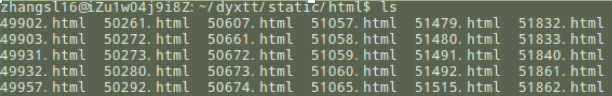
Directory-based
Notes:
Use smaller example

Slide 15
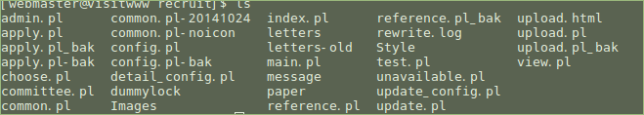
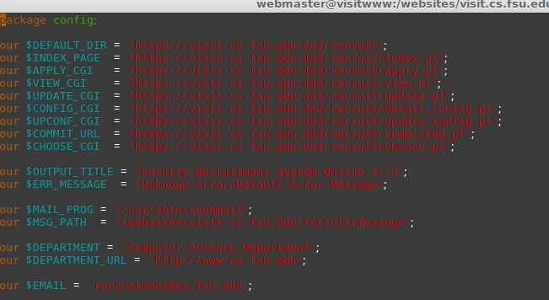

Embedded Links

Slide 16
Apriori Algorithm
Proposed in 1994, used to discover frequent item set
Uses a “bottom-up” approach, generates candidate item sets of length k from item sets of length k-1
Threshold can be set to filter results
Introduction
Design
Implementation
Performance
Conclusion

Slide 17
Apriori example
Per IP/PID Item sets
{1,2,3,4}
{1,2,4}
{1,2}
{2,3,4}
{2,3}
{3,4}
{2,4}
Item | Support
{1} | 3
{2} | 6
{3} | 4
{4} | 5
Input sequence
1, 2, 3, 4, 1, 2, 4, 1, 2, 2, 3, 4, 2, 3, 3, 4, 2, 4, …
Min_support: 3
Introduction
Design
Implementation
Performance
Conclusion
Notes:
Stream requests -> IP and timestamps grouping
Not good example

Slide 18
Apriori example
Items | Support
{1,2} | 3
{1,3} | 1
{1,4} | 2
{2,3} | 3
{2,4} | 4
{3,4} | 3
Items | Support
{2,3,4} | 2
Introduction
Design
Implementation
Performance
Conclusion
Notes:
Consistent color

Slide 19
Optimizations
Form only non-overlapping sets
Use sliding window to reduce memory requirement
Use normalized threshold (support), between 0 and 1
Create composite-file layout based on the order of sub-file references
Introduction
Design
Implementation
Performance
Conclusion

Slide 20
Comparison of three ways
Directory-based consolidation
  Tends to have good prediction accuracy and least processing overhead
Embedded-reference-based consolidation
  Tends to have the best prediction accuracy, needs to be aware of the content
Frequency-mining-based consolidation
  Tends to have better prediction accuracy than first approach, but comes with higher processing overhead
Introduction
Design
Implementation
Performance
Conclusion

Slide 21
Implementation
Prototyped CFFS via FUSE+ext4
  Intercepted file related system calls and performed the changes described in the design section
  Mapped multiple file names to the composite file i-node
  Used extended attributes to store consolidated metadata
Notes:
Other

Slide 22
FUSE
File system in userspace (FUSE) is a framework that allows people to implement a file system in userspace
  Redirects the file related requests from VFS to the file system implementation in userspace
  Allows file system stacking
  Comes with performance overhead
Introduction
Design
Implementation
Performance
Conclusion
Notes:
Talk about hard to develop in kernel level. Crash leads to reboot

Slide 23
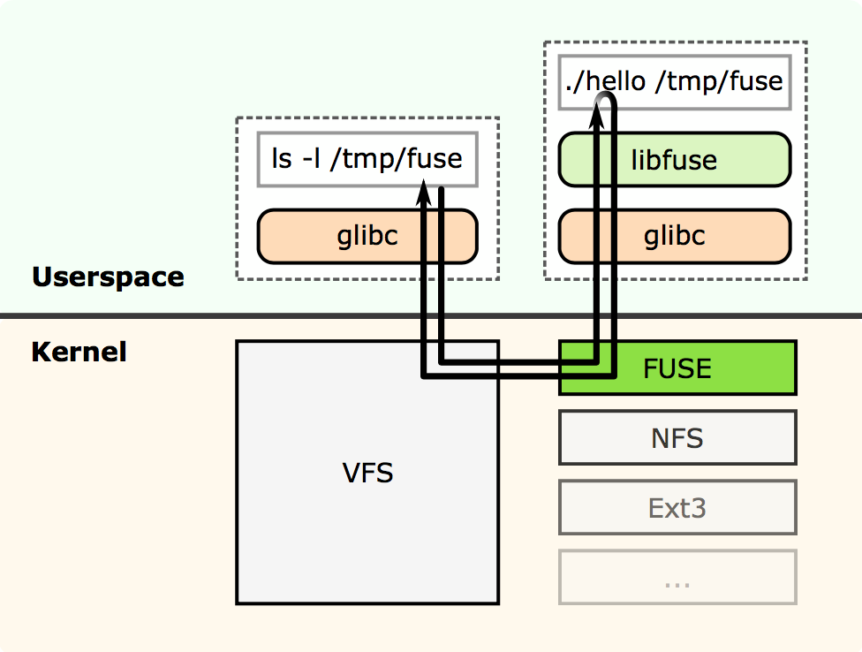
FUSE
Notes:
look on glibc

Slide 24
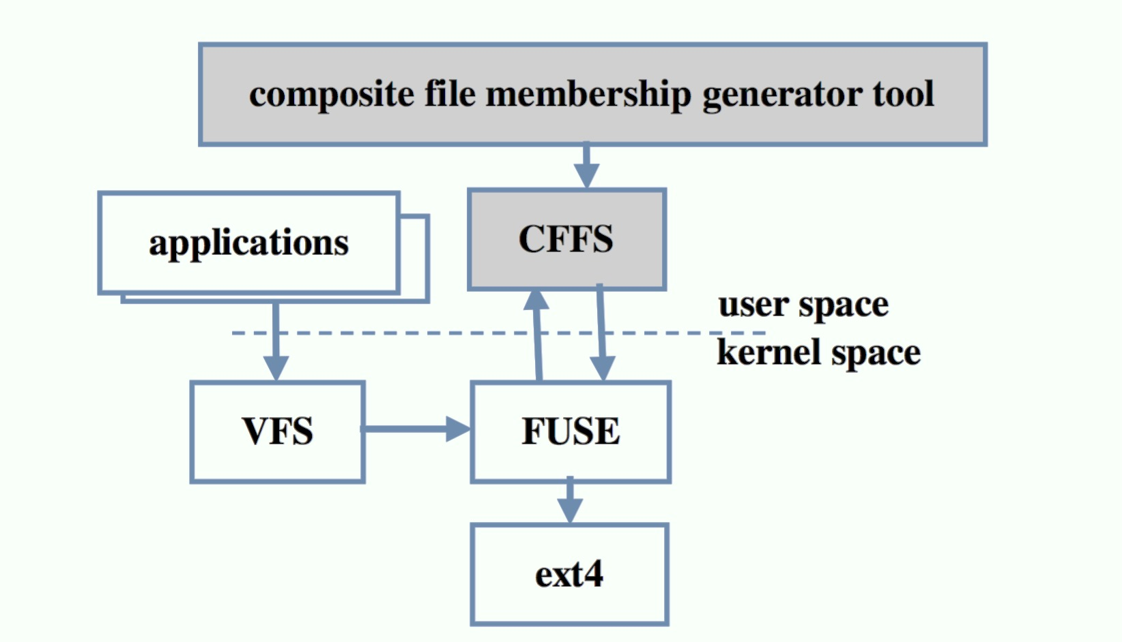
CFFS Components
Introduction
Design
Implementation
Performance
Conclusion
Notes:
High contrast
FUSE do the job, then pass to ext4

Slide 25
System Configurations
Platform
  Processor: 2.8GHz Intel Xeon E5
  Memory: 2GB * 4, 1067MHz
  Hard Disk: 250GB, 7200 RPM
  Flash Disk: 200GB, Intel SSD
Introduction
Design
Implementation
Performance
Conclusion

Slide 26
Workloads
Web server trace
  3-month long, 14 M references to 1TB of data (76GB unique)
  Create dummy file content
Software development workstation
  11-day long, 240M file-system-related system calls to 24GB of data (2.9GB unique)
Local zero-think time replays
  Only replay open, close, read, write
Notes:
Number of unique bytes and references

Slide 27
Experimental Setups
FUSE+CFFS+ext4 vs. FUSE+ext4
Various composite-file approaches
Introduction
Design
Implementation
Performance
Conclusion

Slide 28
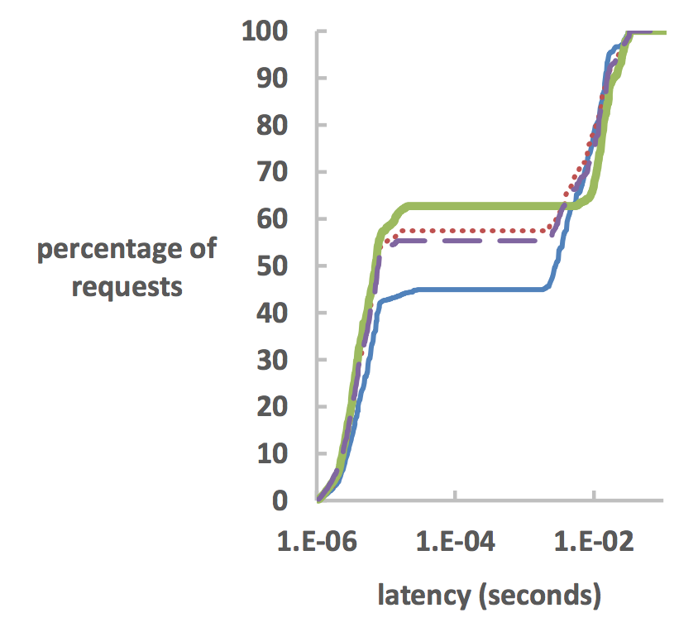
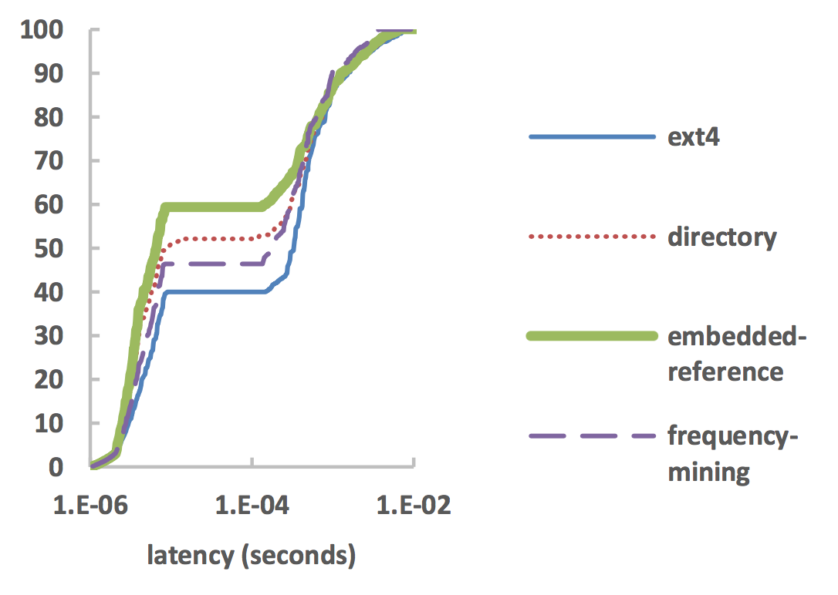
Web Server Latency
HDD
SSD
Introduction
Design
Implementation
Performance
Conclusion
Notes:
Describe the graph: axis, latency, CDF,

Slide 29
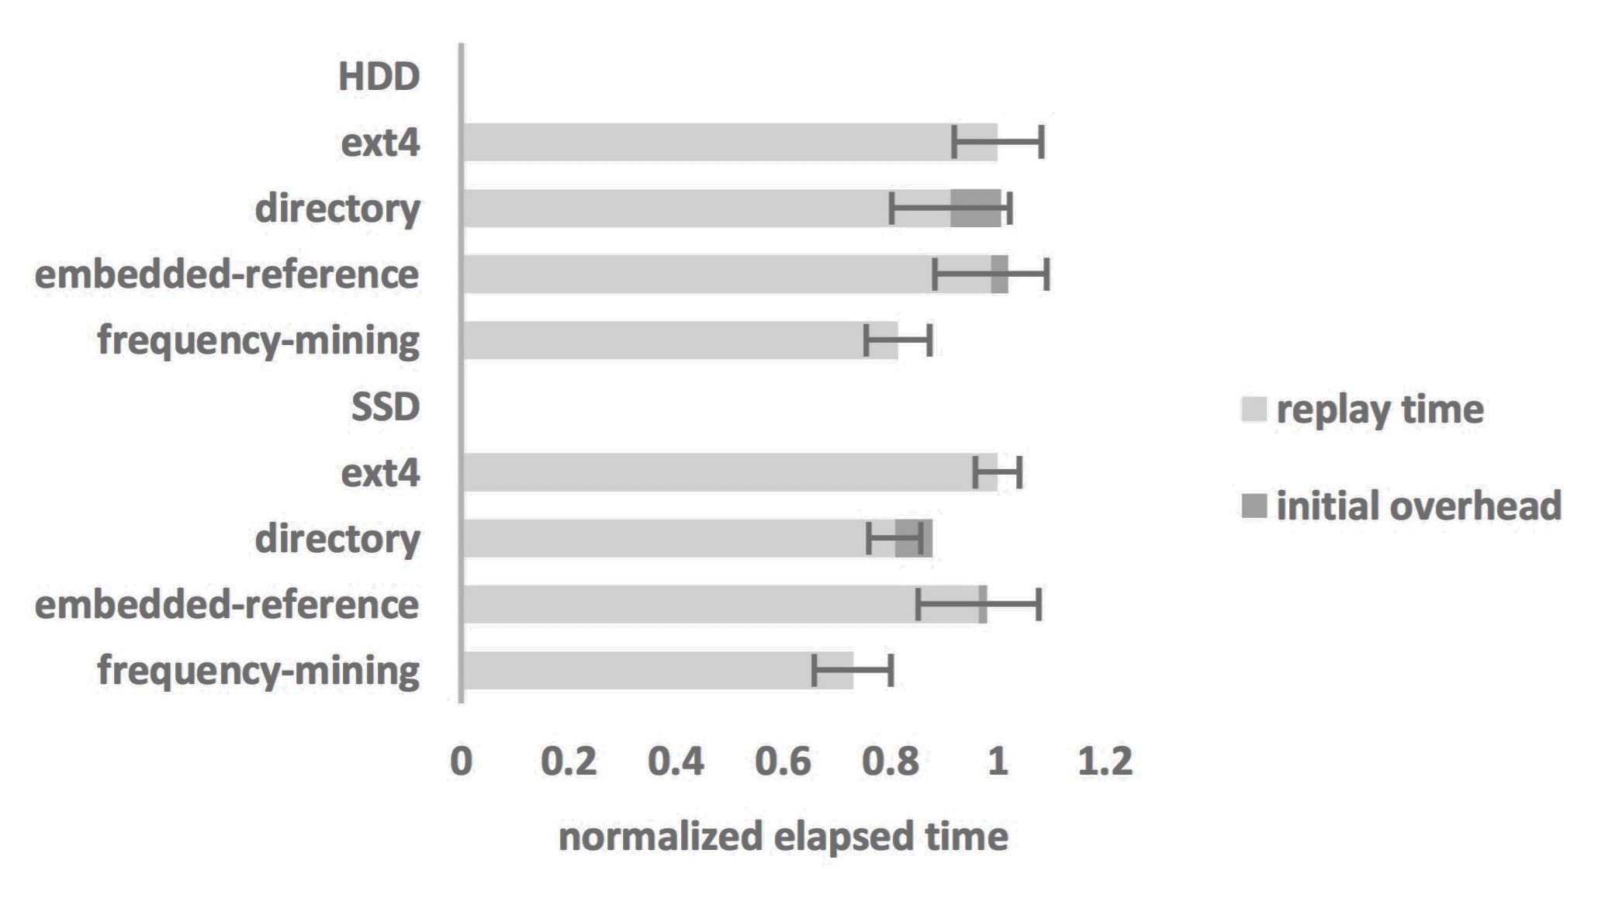
Software Development Trace Replays
Introduction
Design
Implementation
Performance
Conclusion
Notes:
Darker the color
Explain
Embedded-reference: scan valid files for references
Confidence interval

Slide 30
Discussion
CFFS can benefit both read-mostly and read-write workloads using HDDs and SSDs
  Performance gains are mostly from reduction of metadata IOs (~20%)
Performance gain from modified data layout is about 10%
Directory and embedded-reference-based schemes incur an initial deployment cost
Overhead for frequency-mining-based scheme is offset from the performance gain
Introduction
Design
Implementation
Performance
Conclusion
Notes:
Explain the overhead of frequency-mining-based scheme

Slide 31
Conclusion
CFFS decouples the one-to-one mapping of files and metadata
  Increases throughput up to 27%
  Reduces latency up to 20%
The CFFS approach is promising
Introduction
Design
Implementation
Performance
Conclusion

