Slide 1
Introduction and History
Andy Wang
Operating Systems
COP 4610 / CGS 5765

Slide 2
What is an Operating System?

Slide 3
What is an Operating System?
A virtual machine
  Hides the complexity and limitations of hardware from application programmers
Applications
Virtual machine interface
Operating system
(virtual machine)
Physical machine interface
Raw machine

Slide 4
Hiding Complexity of Hardware
Advantages

Slide 5
Hiding Complexity of Hardware
Advantages
  Simpler user model
    Can access flash and disk drives in the same way
  Don’t need to worry about physical limitations
    e.g., the illusion of infinite memory size

Slide 6
Hiding Complexity of Hardware
Disadvantages

Slide 7
Hiding Complexity of Hardware
Disadvantages
  Lack of control
  Can make false assumptions about the black box
    e.g., everything runs in memory

Slide 8
For Each OS Component
There are two major design questions:
  What is the hardware interface?
    The physical reality
  What is the application interface?
    The nicer abstraction

Slide 9
Reality vs. Abstraction
Reality | Abstraction
A single CPU | Multiple CPUs
Limited RAM capacity | Infinite capacity
Solid-State Disk (SSD) | Memory speed access
Insecure and unreliable networks | Reliable and secure
Many physical machines | A single machine

Slide 10
Two General OS Functions
Standard services
  Screen display
  Storage accesses
Coordination among applications
  Goals: correctness, efficiency, and fairness

Slide 11
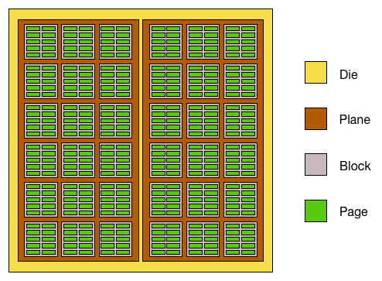
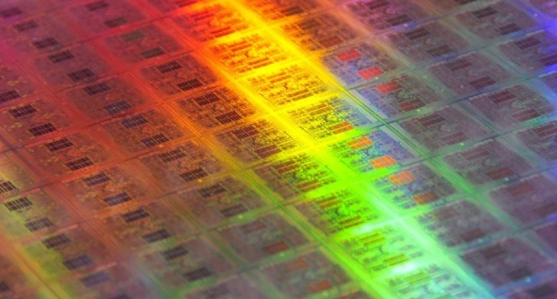
Standard Services
Example: Solid-state disk (SSD, flash)

Slide 12
SSD Access
Raw SSD access
  write(address, page);
OS-level access
  lseek(file, file_size, SEEK_SET);
  write(file, text, len);

Slide 13
Coordination
Example: Protection
  Applications should not crash one another
    Address space: all memory addresses that an application can touch
  Applications should not crash the OS
    Dual-mode operations
      Kernel mode: anything goes
      User mode: an application can only access its own address space

Slide 14
Four Recurring Themes
OS as an illusionist
  Overcomes hardware limitations
OS as a government
  Protects users from one another
  Allocates resources efficiently and fairly
OS as a complex system
OS as a history teacher
  Learns from the past to predict the future

Slide 15
History of OS: Change!
 |  | 1980 | 2025 | Factor
Speed | CPU | 1 MIPS | 195K MIPS | 1.6 x 10⁵
 | Memory | 500 ns | 25ns, 6GT/s (0.16 ns) | 2.0 x 10, 3.1 x 10³
 | Storage | 18 ms | 12µs, 1.5KB IOPS (645 ns) | 1.5 x 10², 2.8 x 10⁴
 | Network | 300 bits/sec | 100 Gb/s | 3.6 x 10⁸
Capacity | Memory | 64 Kbytes | 3 TB | 5.0 x 10⁷
 | Disk | 1 Mbytes | 16 TB | 1.6 x 10⁷
Cost | Per MIP | $100K/MIP | $0.0014/MIP | 7.1 x 10⁷
Other | Address bits | 8 | 64 | 8
 | Users/CPU | 10s | 0.001 | 1.0 x 10⁻⁴
Notes:
https://gamersnexus.net/cpus/intels-300w-core-i9-14900k-cpu-review-benchmarks-gaming-power
https://www.crucial.com/articles/about-memory/everything-about-ddr5-ram
https://www.memorybenchmark.net/latency_ddr5.html
chrome-extension://efaidnbmnnnibpcajpcglclefindmkaj/https://download.semiconductor.samsung.com/resources/data-sheet/samsung_nvme_ssd_990_pro_with_heatsink_datasheet_rev.3.0.pdf

Slide 16
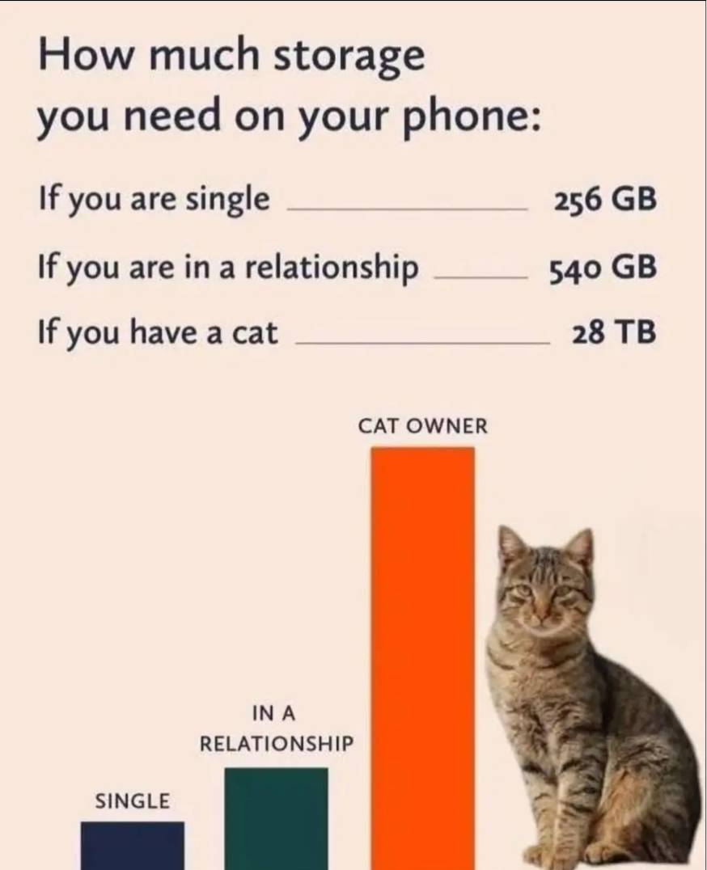
Amount of Storage Needed

Slide 17
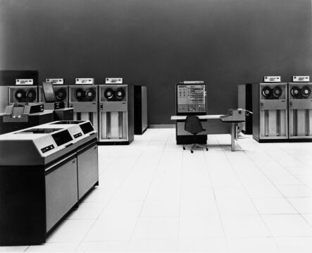
History Phase I: Hardware Expensive, Humans Cheap
Hardware: mainframes
OS: human operators
  Handle one job (a unit of processing) at a time
  Computer time
  wasted while
  operators walk
  around the
  machine room

Slide 18
OS Design Goal
Efficient use of the hardware
  Batch system: collects a batch of jobs before processing them and printing out results
    Job collection, job processing, and printing out results can occur concurrently
  Multiprogramming: multiple programs can run concurrently
    Example: I/O-bound jobs and CPU-bound jobs

Slide 19
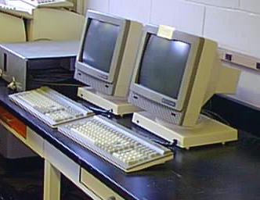
History Phase II: Hardware Cheap, Humans Expensive
Hardware: terminals
OS design goal: more efficient use of human resources
  Timesharing systems: each user can afford to own
  terminals to interact
  with machines

Slide 20
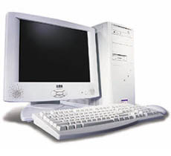
History Phase III: Hardware Very Cheap, Humans Very Expensive
Hardware: personal computers
OS design goal: allowing a user to perform many tasks at the same time
  Multitasking: a single user can run multiple programs on the same machine at the same time
  Multiprocessing: the ability
  to use multiple processors
  on the same machine

Slide 21

History Phase IV: Distributed Systems
Hardware: computers with networks
OS design goal: ease of resource sharing among machines

Slide 22
History Phase V, VI, VII?
Mobile computing (ubiquitous computing)?
Cloud computing?
Internet of things?

Slide 23
The Bottom Line
OS designs need to adapt to changing technology

Slide 24
The Faster OS, the Better?

Slide 25
The Faster OS, the Better?
Not necessarily
  e.g., OS for microwave
  More complexity
    Less secure
    Less stable and reliable
    More bugs
  Energy may be the bottleneck
    e.g., mobile phones

Slide 26
Homework 1
Posted on Canvas

