Slide 1
TrueErase: Per-file Full-data-path
Secure Deletion for Electronic Storage
Sarah Diesburg  Christopher Meyers  Mark Stanovich
Michael Mitchell  Justin Marshall  Julia Gould
An-I Andy Wang
Florida State University
Geoff Kuenning
Harvey Mudd College

Slide 2
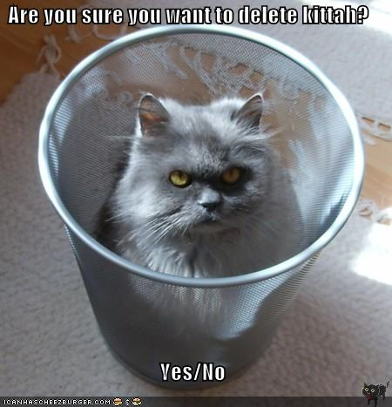
Overview
Problem
  People want to delete sensitive info on storage
  But, existing methods may not work or easy to use
Solution
  TrueErase brings backward-compatible deletion to the average user

Slide 3
Motivation
Amount of stored, sensitive data is growing
  Financial & customer info
  Trade secrets
  Usernames
  Passwords
  Correspondence
  Personal media files

Slide 4
Problem
Normal file deletion leaves data behind
  Even formatting the device may not erase data
    E.g., MSDOS format removes < 0.1% of data
Secure-deletion solutions are designed to irrecoverably delete information
  Must delete both data and metadata, which is information about the data such as file name

Slide 5
Existing Solutions
Device- or partition-wide secure deletion
  Inflexible and may not work on some media
Per-file solutions
  Many solutions are incomplete
  Encryption-based solutions
    Need to delete per-file keys
    Encryption schemes may expire
  Generally do not work with average users or different combinations of file systems and storage media (e.g., disks, thumb drives)

Slide 6
Why Per-file?
Assists with
  Selective destruction of expired data (client data, government policies, statute of limitations)
  Deleting temporarily shared trade secrets
  Immediate destruction of sensitive data (military)
  Disposing of media in one-time-use applications
May be performed without turning off computer or disrupting storage access
Follow user expectations of delete

Slide 7
Why is it hard?
Storage components do not share info
  Low-level components have no notion of files
  Intrusive to expand interfaces
Must retrofit secure deletion into the entire storage data path
  With legacy optimizations
applications
file system
storage
management
storage

Slide 8
Why is it hard?
Legacy storage components have no existing mechanisms to delete file data
  May require extensive changes to legacy components
How do we know if our solution works?
  What is the structure of various corner cases?
  What if a crash occurs during deletion?

Slide 9
Our Focus
Dead forensic attacks on local storage
  Occur after the computer has been shut down properly
  Future work: backups, compromised systems, covert channels, memory attacks
Strong assumptions to simplify solution
  Uncompromised, single-user, single-file-system, non-RAID, non-distributed system

Slide 10
Research Question
Under the most benign environments
What can we design and build to ensure that the secure deletion of a file is honored?
  Throughout the legacy storage data path
Missing/complimentary piece to support other secure-deletion solutions
  Encryption-based solutions
  Tainting-based solutions

Slide 11
Approach
Use a parallel data path to pass file deletion information to lower storage components
  Leaves original data flow unmodified
  Backward compatible with legacy optimizations
When in doubt, handle deletion securely
  Simplifies hard corner cases
Avoid storing persistent states
  No need to recover them after crashes

Slide 12
TrueErase Framework Overview
User model sets files for secure deletion
Components report secure-deletion info to TAP module
Storage management query TAP for info and issue secure-deletion commands
applications
user model
file system
TAP
storage
management
secure-deletion
commands
storage

Slide 13
User Model
Use secure-deletion bit or extended attributes
  Specify files/dirs for secure deletion
  Too expensive to delete all files securely
Compatible with legacy applications
With some deviations
applications
user model
file system
TAP
storage
management
secure-deletion
commands
storage

Slide 14
User Model
Backwards-compatible semantics
  ‘chattr +s’
  New files within a folder inherit permissions of folder
Some deviations
  Once marked sensitive, always sensitive
  Name handling

Slide 15
Name Handling Deviation
Legacy file-permission semantics
If we were to use these semantics…
  Sensitive status may bubble up to the root
file
i-node
dir
i-node
file
permission
data
Notes:
Dotted lines?

Slide 16
Name Handling Deviation
Legacy file-permission semantics
TrueErase’s sensitive status
file
i-node
dir
i-node
file
permission
data
file
i-node
dir
i-node
file
sensitive
status
data
Notes:
Dotted lines?

Slide 17
Type/Attribute Propagation (TAP) Module
File system reports pending updates
  Uses global unique IDs to track versions
Tracks only in-transit soft states
  Can be reconstructed
applications
user model
file system
TAP
storage
management
secure-deletion
commands
storage

Slide 18
What information to track?
Deletions, but this info is not enough…
  At the secure-deletion time
    Same location of a file may be updated couple times
    Metadata may not reference old versions anymore
    Unless all updates are tracked
  TrueErase deletes old versions as updates occur
  Secure deletion + update = secure write
Tracks all in-transit updates for verification

Slide 19
Tracking: how hard can it be?
Cannot rely on storage data structures, IDs, and memory addresses due to reuse
  Complicated by various access granularities
  Also versions of storage requests in transit
Used memory page IDs and physical storage sector number to form globally unique IDs
  Reset at page allocation time
  Reused page holding different versions of a sector has different IDs

Slide 20
How to interact with TAP?
Report_write() creates a tracking entry
Report_delete() associates deletion info to a tracking entry
Report_copy() clones a tracking entry and transfers deletion info
Check_info() retrieves deletion info
Cleanup_write() deletes a tracking entry

Slide 21
Crash Recovery
Journaling file system protects secure-deletion attributes
During recovery, apply secure ops for all
  Even for data and metadata of non-sensitive files
Securely wipe the journal
  And sensitive info not yet referenced by the file system

Slide 22
Enhanced Storage-management Layer
Can inquire about file-system-level info
Added secure-deletion commands for various media
  Issue erase command for flash; write random 0s and 1s for disk
Encryption-free
applications
user model
file system
TAP
storage
management
secure-deletion
commands
storage

Slide 23
Properties of NAND Flash
Erasure is slow
Reads/writes in flash pages (e.g., 2-8 KB)
Deletes in flash blocks (e.g., 64-512 KB)
  Consisting of contiguous pages
Unlike disks, no in-place updates
  Flash block containing the page needs to be explicitly erased before being written again
    In-use pages are moved elsewhere

Slide 24
To Overcome Flash Property Challenges
To optimize performance
  A storage-management component remaps an overwrite request to an erased empty page
    Old page may stick around

Slide 25
NAND Update Example
Flash block
Suppose we have a flash block

Slide 26
NAND Update Example
Flash page
Each block is divided into flash pages

Slide 27
NAND Update Example
a
b
c
d
e
f
g
h
i
j
k
l
m
n
o
p
q
r
Suppose pages already have some data

Slide 28
NAND Update Example
z
a
b
c
d
e
f
g
h
i
j
k
l
m
n
o
p
q
r
Suppose we want to overwrite a page
  But no in-place overwrites allowed!

Slide 29
NAND Update Example
a
b
c
d
e
f
g
h
i
j
k
l
m
n
o
p
q
r
Flash allocates a new flash block with pre-erased pages

Slide 30
NAND Update Example
z
a
b
c
d
e
f
z
g
h
i
j
k
l
m
n
o
p
q
r
Flash then writes the new data to the new page while marking the old page as invalid

Slide 31
TrueErase NAND Secure-deletion Commands
Flash interface only accepts reads and writes
  Not erases!
We expand the flash interface for two new commands
  Secure_delete()
  Secure_write()

Slide 32
TrueErase NAND Secure-deletion Commands
Secure_delete(pages)
  Copies other in-use pages from the current flash block to elsewhere
  Issue erase command on the current block
Secure_write(page)
  Write the new page
  Call Secure_delete() on the old (if applicable)

Slide 33
Internal Reorganization (Garbage Collection)
Problem
  No respect for file boundaries, sensitive status
Solution: store sensitive-status bit in per-page control areas
  Used to enforce secure-deletion semantics during internal flash reorganization

Slide 34
File-system-consistency Properties and Secure Deletion
Pointer-ordering property ensures that data block in memory is written to storage
  Before referencing metadata block is written to storage

Slide 35
Without Pointer-ordering Property
applications
TrueErase
file system
storage
management
storage

Slide 36
Without Pointer-ordering Property
applications
file A’s
metadata
TrueErase
file system
data
Non-sensitive
storage
management
memory
storage
storage

Slide 37
Without Pointer-ordering Property
applications
file A’s
metadata
TrueErase
file system
data
storage
management
memory
storage
storage
file A’s
metadata
data

Slide 38
Without Pointer-ordering Property
applications
TrueErase
file system
storage
management
memory
storage
storage
file A’s
metadata
data

Slide 39
Without Pointer-ordering Property
applications
file B’s
metadata
TrueErase
file system
data
Sensitive
storage
management
memory
storage
storage
file A’s
metadata
data

Slide 40
Without Pointer-ordering Property
applications
file B’s
metadata
TrueErase
file system
data
storage
management
memory
storage
storage
file A’s
metadata
Non-secure deletion of A can be applied to B’s block
data

Slide 41
Pointer-ordering Property
applications
file A’s
metadata
TrueErase
file system
data
storage
management
memory
storage
storage

Slide 42
Pointer-ordering Property
applications
file A’s
metadata
TrueErase
file system
data
storage
management
memory
Data blocks are propagated first
storage
storage
data

Slide 43
Pointer-ordering Property
applications
Need to turn off storage built-in cache to prevent reordering
  Or issue device-specific flush commands
Need to handle crash at this point
  Remove orphaned sensitive blocks at recovery time
file A’s
metadata
TrueErase
file system
data
storage
management
memory
storage
storage
data

Slide 44
Pointer-ordering Property
applications
file A’s
metadata
TrueErase
file system
data
storage
management
memory
storage
storage
file A’s
metadata
data

Slide 45
Pointer-ordering Property
Does not mention what happens to freed in-memory sensitive data blocks
  Those blocks can be flushed to storage without file system knowing what is going on
  They must not undo our secure deletion

Slide 46
File-system-consistency Properties and Secure Deletion
Reuse-ordering property ensures that a freed block will not be reused
  Before its free status is written to storage
Implications for a secure deletion operation
  Until the free status is written, we can
    Perform secure operations on the block
    Be guaranteed that the block will not change it’s status (file ownership or type)

Slide 47
File-system-consistency Properties and Secure Deletion
Non-rollback property ensures that older versions will not overwrite newer versions on storage
Implications a secure-deletion operation
  Secure-deletion operation and normal updates will be applied in the correct order

Slide 48
Structure of Corner Cases
Ensuring that a secure deletion occurs before a block is persistently declared free
Hunting down stored sensitive blocks left behind after a crash
Making sure that non-secure deletion is not applied to the secure file
Making sure that a securely deleted block is not overwritten by an old, secure unreferenced block
Handling versions of requests in transit

Slide 49
Implementation &Verification
Prototyped under Linux, for disk and flash
  ~12K lines of code (1,700 at the kernel level)
  Used ext3, which holds consistency properties
    Inserted ~60 TAP calls to the legacy code
Core framework component verified via model-checking-like methods and two-version programming
  Systemically verified 10K unique states and 2.7M state transitions
  Include the cases for common crashes

Slide 50
Other More Details
Interchangeable user-level/kernel-level development framework
Flash performance optimizations
Verification framework

Slide 51
Flash Storage Evaluation
Evaluated using OpenSSH compilation and modified PostMark benchmarks
  OpenSSH: 1.6x slowdown when 27% files marked sensitive under openbsd-compat directory
  PostMark: 3.4x slowdown when first 5% files marked sensitive
Performance comparable to other works that involve tailored and extensive system changes

Slide 52
Related Work
Levels | Solutions | F | E | D | S | L | M | C
Storage manage-ment | Secure delete encrypted device/partition key |  |  |  |  | ✓ | ✓ | ✓
 | Specialized hard drive commands |  | ✓ |  |  | ✓ | ✓ | ✓
 | Specialized flash medium commands (page granularity) | ✓ | ✓ |  |  | ✓
File system | Stackable file system deletion | ✓ | ✓ |  |  | ✓ | ✓ | ✓
 | Modified file system – deletion through overwriting | ✓ | ✓ |  |  | ✓ | ✓ | ✓
 | Modified file system – deletion through encryption | ✓ |  |  |  | ? |  | ?
User space | User-space solution on top of flash file system | ✓ | ✓ |  |  | ✓ | ?
 | Overwriting tools | ✓ | ✓ |  |  | ✓
Remote | Dedicated server(s) for encryption keys | ✓ |  |  |  | ✓ | ? | ✓
 | Encrypted backup system | ✓ |  |  |  | ✓ |  | ?
Data-path-wide | Modified flash file systems – device erasures and/or overwriting | ✓ | ✓ | ✓ |  | ✓ | ? | ?
 | Modified flash file systems – encryption with key erasure | ✓ |  | ✓ |  | ? | ✓ | ?
 | Semantically-Smart Disk Systems [Siv03] | ✓ | ✓ | ✓ |  | ✓ |  | ✓
 | Type-Safe Disks [Siv06] | ✓ | ✓ | ✓ |  |  |  | ✓
 | Data Node Encrypted File System [Rea12] | ✓ | ✓ | ✓ |  | ✓ | ✓ | ✓
 | TrueErase | ✓ | ✓ | ✓ | ✓ | ✓ | ✓ | ✓

Slide 53
Future Work
Use TrueErase as a building block for more advanced secure-deletion methods
  Incorporate encryption and tainting
  Handle additional threat models
    Distributed environments
TAP framework can be used to explore other data-path-wide capabilities
  Performance optimizations
  Improve reliability

Slide 54
Lessons Learned
Retrofitting security features is quite complex
  Need to know the entire the data path
File-systems-consistency properties crucial to make verification tractable
Propagating information is tricky
  Especially in the face of asynchrony
  Important to keep legacy flow intact
  Allow secure-deletion operations be defined at the storage-management layer

Slide 55
Lessons Learned
Tracking information can be challenging
  Unlike network, in-transit requests can be cancelled and consolidated
Tracking granularities vary throughout
  Metadata blocks can be shared
    Non-sensitive access can bring sensitive info into memory
Hard to gain raw flash access for research and development
  Vendors should find ways to make HW more open

Slide 56
Conclusion
We have designed, implemented, evaluated, and verified a secure-deletion solution that
  Irrecoverably deletes file data and metadata
  General and backward-compatible to different storage types and popular file systems
  Acceptable performance
  Systematically verified (rare in existing solutions)
  Handles common crashes

Slide 57
Acknowledgements
National Science Foundation
Department of Education
Philanthropic Educational Organization
Florida State University Research Foundation

Slide 58
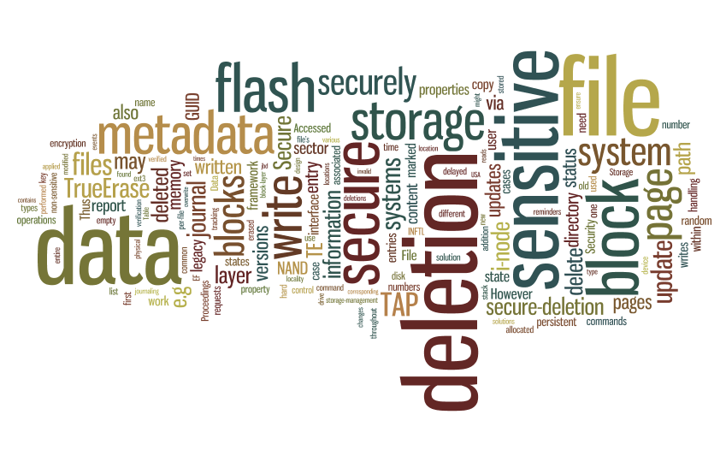
Questions?

