Slide 1
Write off-loading:
Practical power management for enterprise storage
D. Narayanan, A. Donnelly, A. Rowstron
Microsoft Research, Cambridge, UK

Slide 2
Energy in data centers
Substantial portion of TCO
  Power bill, peak power ratings
  Cooling
  Carbon footprint
Storage is significant
  Seagate Cheetah 15K.4: 12 W (idle)
  Intel Xeon dual-core: 24 W (idle)
Notes:
So if you have more than 2 disks per dual-core machine, you are spending more energy on disks than CPU. This trend is going to get worse: processors can become more energy-efficient, but while mechanical disks can also do that, there are limits.

Slide 3
Challenge
Most of disk’s energy just to keep spinning
  17 W peak, 12 W idle, 2.6 W standby
Flash still too expensive
  Cannot replace disks by flash
So: need to spin down disks when idle
Notes:
The big win is in spinning disks down. Previous study shows it confers no benefits. They used TPC benchmarks. Are real workloads really like that?

Slide 4
Intuition
Real workloads have
  Diurnal, weekly patterns
  Idle periods
  Write-only periods
    Reads absorbed by main memory caches
We should exploit these
  Convert write-only to idle
  Spin down when idle

Slide 5
Small/medium enterprise DC
FS1
10s to100s of disks
  Not MSN search
Heterogeneous servers
  File system, DBMS, etc
RAID volumes
High-end disks
Vol 0
Vol 1
FS2
Vol 0
Vol 1
Vol 2
DBMS
Vol 0
Vol 1
5
Notes:
This is the kind of DC that our traces reflect.

Slide 6
Design principles
Incremental deployment
  Don’t rearchitect the storage
    Keep existing servers, volumes, etc.
  Work with current, disk-based storage
    Flash more expensive/GB for at least 5-10 years
    If system has some flash, then use it
Assume fast network
  1 Gbps+

Slide 7
Write off-loading
Spin down idle volumes
Offload writes when spun down
  To idle / lightly loaded volumes
  Reclaim data lazily on spin up
  Maintain consistency, failure resilience
Spin up on read miss
  Large penalty, but should be rare

Slide 8
Roadmap
Motivation
Traces
Write off-loading
Evaluation

Slide 9
How much idle time is there?
Is there enough to justify spinning down?
  Previous work claims not
    Based on TPC benchmarks, cello traces
  What about real enterprise workloads?
    Traced servers in our DC for one week

Slide 10
MSRC data center traces
Traced 13 core servers for 1 week
    File servers, DBMS, web server, web cache, …
    36 volumes, 179 disks
    Per-volume, per-request tracing
    Block-level, below buffer cache
Typical of small/medium enterprise DC
  Serves one building, ~100 users
  Captures daily/weekly usage patterns
Notes:
Obviously these don’t represent every possible kind of workload, but it is a broad range, and we believe much more realistic than previous studies of enterprise disk spin down.

Slide 11
Idle and write-only periods
Notes:
Assuming a spin-down timeout of 60 sec.

Slide 12
Roadmap
Motivation
Traces
Write off-loading
Preliminary results
Notes:
High-level design, and the properties … more details are in the paper.

Slide 13
Write off-loading: managers
One manager per volume
  Intercepts all block-level requests
  Spins volume up/down
Off-loads writes when spun down
  Probes logger view to find least-loaded logger
Spins up on read miss
  Reclaims off-loaded data lazily

Slide 14
Write off-loading: loggers
Reliable, write-optimized, short-term store
  Circular log structure
Uses a small amount of storage
  Unused space at end of volume, flash device
Stores data off-loaded by managers
  Includes version, manager ID, LBN range
  Until reclaimed by manager
    Not meant for long-term storage

Slide 15
Off-load life cycle
Invalidate
Reclaim
Probe
Write
Read
Write
Spin down
v1
Spin up
v2

Slide 16
Consistency and durability
Read/write consistency
  manager keeps in-memory map of off-loads
  always knows where latest version is
Durability
  Writes only acked after data hits the disk
Same guarantees as existing volumes
  Transparent to applications

Slide 17
Recovery: transient failures
Loggers can recover locally
  Scan the log
Managers recover from logger view
  Logger view is persisted locally
  Recovery: fetch metadata from all loggers
  On clean shutdown, persist metadata locally
    Manager recovers without network communication
Notes:
Optimize for the common case: failures are rare, and clean shutdowns happen occasionally. This is a data center with highly available servers.

Slide 18
Recovery: disk failures
Data on original volume: same as before
  Typically RAID-1 / RAID-5
  Can recover from one failure
What about off-loaded data?
  Ensure logger redundancy >= manager
  k-way logging for additional redundancy

Slide 19
Roadmap
Motivation
Traces
Write off-loading
Experimental results

Slide 20
Testbed
4 rack-mounted servers
  1 Gbps network
  Seagate Cheetah 15k RPM disks
Single process per testbed server
  Trace replay app + managers + loggers
  In-process communication on each server
  UDP+TCP between servers

Slide 21
Workload
Open loop trace replay
Traced volumes larger than testbed
  Divided traced servers into 3 “racks”
    Combined in post-processing
1 week too long for real-time replay
  Chose best and worst days for off-load
    Days with the most and least write-only time

Slide 22
Configurations
Baseline
Vanilla spin down (no off-load)
Machine-level off-load
  Off-load to any logger within same machine
Rack-level off-load
  Off-load to any logger in the rack

Slide 23
Storage configuration
1 manager + 1 logger per volume
  For off-load configurations
    Logger uses 4 GB partition at end of volume
Spin up/down emulated in s/w
  Our RAID h/w does not support spin-down
  Parameters from Seagate docs
    12 W spun up, 2.6 W spun down
    Spin up delay is 10—15s, energy penalty is 20 J
      Compared to keeping the spindle spinning always

Slide 24
Energy savings

Slide 25
Energy by volume (worst day)
Notes:
Most idle day is similar, but better for all three, again relatively rack > machine > vanilla.

Slide 26
Response time: 95th percentile

Slide 27
Response time: mean

Slide 28
Conclusion
Need to save energy in DC storage
Enterprise workloads have idle periods
  Analysis of 1-week, 36-volume trace
Spinning disks down is worthwhile
  Large but rare delay on spin up
Write off-loading: write-only → idle
  Increases energy savings of spin-down

Slide 29
Questions?

Slide 30
Related Work
PDC
  Periodic reconfiguration/data movement
  Big change to current architectures
Hibernator
  Save energy without spinning down
  Requires multi-speed disks
MAID
  Need massive scale

Slide 31
Just buy fewer disks?
Fewer spindles → less energy, but
  Need spindles for peak performance
    A mostly-idle workload can still have high peaks
  Need disks for capacity
    High-performance disks have lower capacities
    Managers add disks incrementally to grow capacity
  Performance isolation
    Cannot simply consolidate all workloads

Slide 32
Circular on-disk log
HEAD
TAIL
X
X
X
X
1
X
H
........
8
7
1
2
7-9
7
8
9
4
2
........
Write
Reclaim
Spin up

Slide 33

Circular on-disk log
Header block
Tail
Nuller
Stale versions
Null blocks
Active log
Reclaim
Head
Invalidate

Slide 34
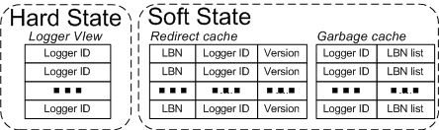
Client state
34

Slide 35
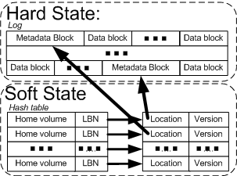
Server state
35
35

Slide 36
Mean I/O rate

Slide 37
Peak I/O rate
Notes:
Peaks are in general much higher than means. That means if you provision for reasonable performance at peak load, then you will have a lot of idle bandwidth. If a volume is idle for a long time, you can spin it down. Even if it is short times, you can use that idle bandwidth to off-load from other volumes that are spun down.

Slide 38
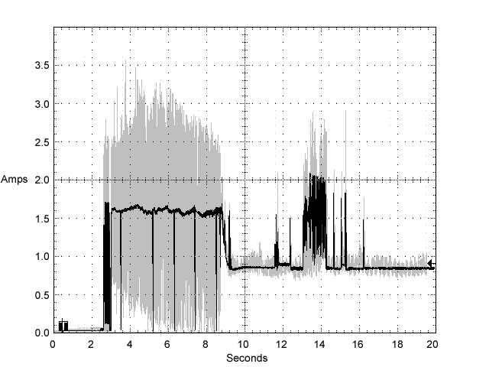
Drive characteristics
Typical ST3146854 drive +12V LVD current profile
38
Notes:
38
The big win is in spinning disks down. Previous study shows it confers no benefits. They used TPC benchmarks. Are real workloads really like that?

Slide 39
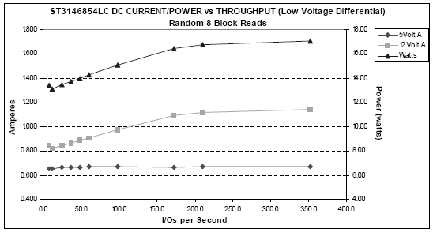
Drive characteristics
39
Notes:
39
The big win is in spinning disks down. Previous study shows it confers no benefits. They used TPC benchmarks. Are real workloads really like that?

