Slide 1
Multiple Linear Regression
Andy Wang
CIS 5105
Computer Systems
Performance Analysis

Slide 2
Multiple Linear Regression
Models with more than one predictor variable
But each predictor variable has a linear relationship to the response variable
Conceptually, plotting a regression line in n-dimensional space, instead of 2-dimensional

Slide 3
Basic Multiple Linear Regression Formula
Response y is a function of k predictor variables x1,x2, . . . , xk

Slide 4
A Multiple Linear Regression Model
Given sample of n observations
model consists of n equations (note + vs. - typo in book):

Slide 5
Looks Like It’s Matrix Arithmetic Time
y = Xb +e

Slide 6
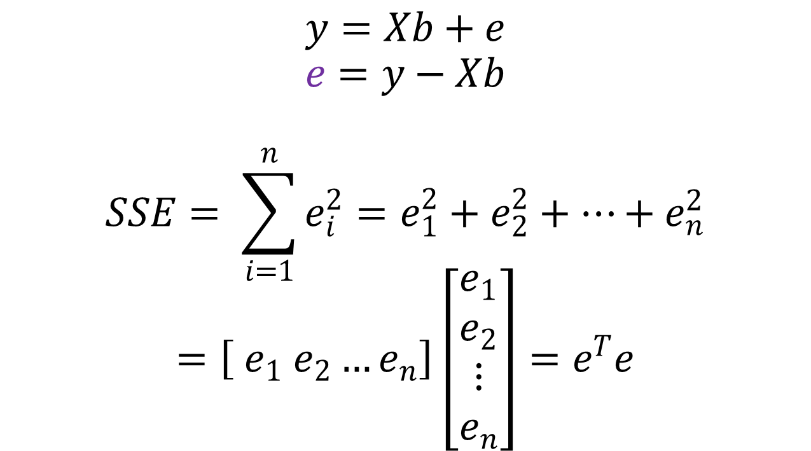
Looks Like It’s Matrix Arithmetic Time
$$y=Xb+e$$
$$e=y−Xb$$
$$SSE= \sum_{i=1}^{n}{e_{i}^{2}}=e_{1}^{2}+e_{2}^{2}+…+e_{n}^{2}$$
$$=\left[ e_{1} e_{2}…e_{n}\right]\left[\begin{matrix}\begin{matrix}e_{1} \\ e_{2}\end{matrix} \\ ⋮ \\ e_{n}\end{matrix}\right]=e^{T}e$$

Slide 7
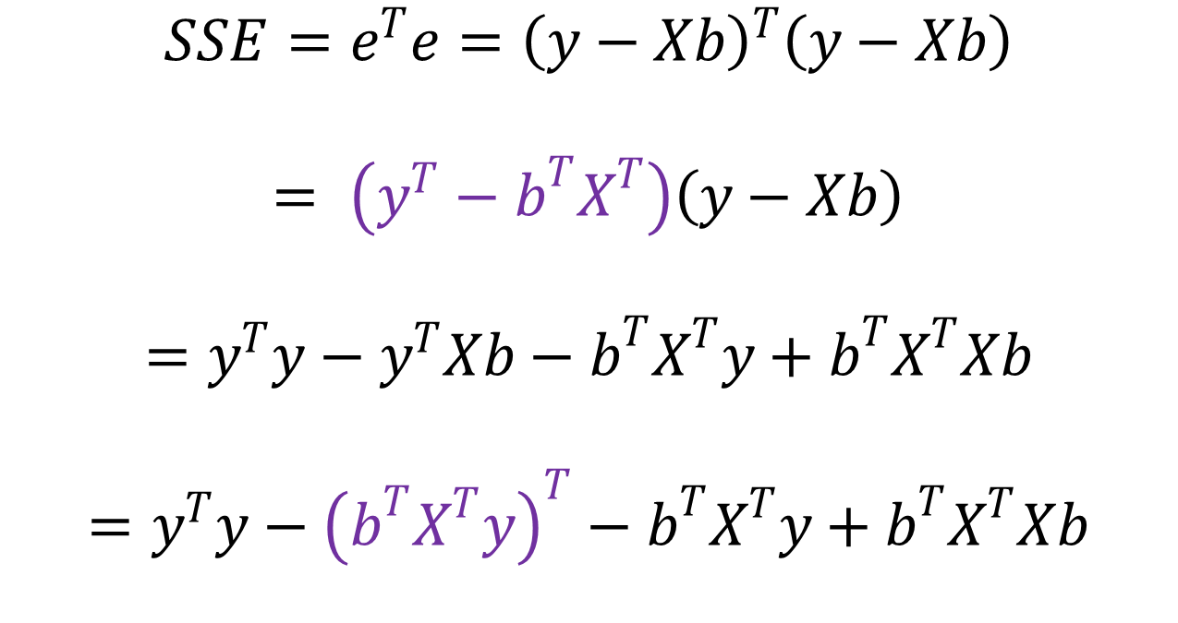
Looks Like It’s Matrix Arithmetic Time
$$SSE=e^{T}e={\left(y−Xb\right)}^{T}\left(y−Xb\right)$$
$$= \left(y^{T}−b^{T}X^{T}\right)\left(y−Xb\right)$$
$$=y^{T}y−y^{T}Xb−b^{T}X^{T}y+b^{T}X^{T}Xb$$
$$=y^{T}y−{\left(b^{T}X^{T}y\right)}^{T}−b^{T}X^{T}y+b^{T}X^{T}Xb$$

Slide 8
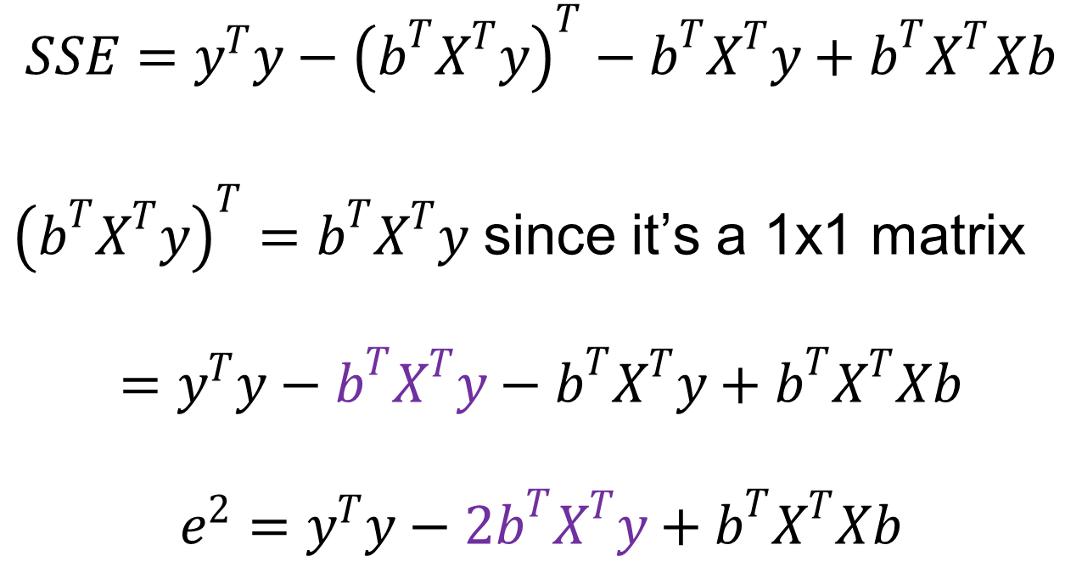
Looks Like It’s Matrix Arithmetic Time
$$SSE=y^{T}y−{\left(b^{T}X^{T}y\right)}^{T}−b^{T}X^{T}y+b^{T}X^{T}Xb$$
${\left(b^{T}X^{T}y\right)}^{T}=b^{T}X^{T}y$ since it’s a 1x1 matrix
$$=y^{T}y−b^{T}X^{T}y−b^{T}X^{T}y+b^{T}X^{T}Xb$$
$$e^{2}=y^{T}y−2b^{T}X^{T}y+b^{T}X^{T}Xb$$

Slide 9
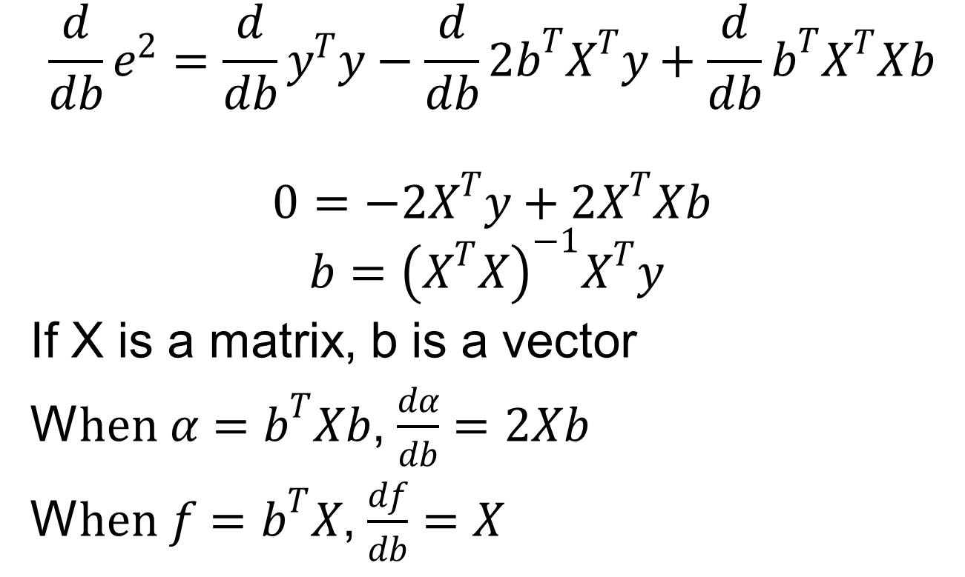
Minimize SSE
$$\frac{d}{db}e^{2}=\frac{d}{db}y^{T}y−\frac{d}{db}2b^{T}X^{T}y+\frac{d}{db}b^{T}X^{T}Xb$$
$$0=−2X^{T}y+2X^{T}Xb$$
$$b={\left(X^{T}X\right)}^{−1}X^{T}y$$
If X is a matrix, b is a vector
W$hen α=b^{T}Xb$, $\frac{dα}{db}=2Xb$
W$hen f=b^{T}X$, $\frac{df}{db}=X$

Slide 10
Analysis of
Multiple Linear Regression
Listed in box 15.1 of Jain
Not terribly important (for our purposes) how they were derived
  This isn’t a class on statistics
But you need to know how to use them
Mostly matrix analogs to simple linear regression results

Slide 11
Example of
Multiple Linear Regression
IMDB keeps numerical popularity ratings of movies
Postulate popularity of Academy Award winning films is based on two factors:
  Year made
  Running time
Produce a regression
  rating = b0 + b1(year) +b2(length)

Slide 12
Some Sample Data
Title Year Length Rating
Silence of the Lambs 1991 118 8.1
Terms of Endearment 1983 132 6.8
Rocky 1976 119 7.0
Oliver! 1968 153 7.4
Marty 1955 91 7.7
Gentleman’s Agreement 1947 118 7.5
Mutiny on the Bounty 1935 132 7.6
It Happened One Night 1934 105 8.0

Slide 13
Now for Some Tedious Matrix Arithmetic
We need to calculate X, XT, XTX,
(XTX)-1, and XTy
Because
We will see that
b = (18.5430, -0.0051, -0.0086 )T
Meaning the regression predicts:
rating = 18.5430 – 0.0051*year
– 0.0086*length

Slide 14
X Matrix for Example

Slide 15
Transpose to Get XT

Slide 16
Multiply To Get XTX

Slide 17
Invert to Get C=(XTX)-1

Slide 18
Multiply to Get XTy

Slide 19
Multiply (XTX)-1(XTy) to Get b

Slide 20
How Good Is This
Regression Model?
How accurately does the model predict the rating of a film based on its age and running time?
Best way to determine this analytically is to calculate the errors
or

Slide 21
Calculating the Errors

Slide 22
Calculating the Errors, Continued
So SSE = 1.08
SSY =
SS0 =
SST = SSY - SS0 = 452.9- 451.5 = 1.4
SSR = SST - SSE = .33
In other words, this regression stinks

Slide 23
Why Does It Stink?
Let’s look at properties of the regression parameters
Now calculate standard deviations of the regression parameters

Slide 24
Calculating STDEV of Regression Parameters
Estimations only, since we’re working with a sample
Estimated stdev of

Slide 25
Calculating Confidence Intervals of STDEVs
We will use 90% level
Confidence intervals for
None is significant, at this level

Slide 26
Analysis of Variance
So, can we really say that none of the predictor variables are significant?
  Not yet; predictors may be correlated
F-tests can be used for this purpose
  E.g., to determine if the SSR is significantly higher than the SSE
  Equivalent to testing that y does not depend on any of the predictor variables
    Alternatively, that no bi is significantly nonzero

Slide 27
Running an F-Test
Need to calculate SSR and SSE
From those, calculate mean squares of regression (MSR) and errors (MSE)
MSR/MSE has an F distribution
If MSR/MSE > F-table, predictors explain a significant fraction of response variation
Note typos in book’s table 15.3
  SSR has k degrees of freedom
  SST matches not

Slide 28
F-Test for Our Example
SSR = .33
SSE = 1.08
MSR = SSR/k = .33/2 = .16
MSE = SSE/(n-k-1) = 1.08/(8 - 2 - 1) = .22
F-computed = MSR/MSE = .76
F[90; 2,5] = 3.78 (at 90%)
So it fails the F-test at 90% (miserably)

Slide 29
Multicollinearity
If two predictor variables are linearly dependent, they are collinear
  Meaning they are related
  And thus second variable does not improve the regression
  In fact, it can make it worse
 |  | X1
 |  | 1 | 0
X2 | 1 | data | No data
 | 0 | No data | data

Slide 30
Multicollinearity
Typical symptom is inconsistent results from various significance tests

Slide 31
Finding Multicollinearity
Must test correlation between predictor variables
If it’s high, eliminate one and repeat regression without it
If significance of regression improves, it’s probably due to collinearity between the variables

Slide 32
Is Multicollinearity a Problem in Our Example?
Probably not, since significance tests are consistent
But let’s check, anyway
Calculate correlation of age and length
After tedious calculation, 0.25
  Not especially correlated
Important point - adding a predictor variable does not always improve a regression
  See example on p. 253 of book

Slide 33
Why Didn’t Regression
Work Well Here?
Check scatter plots
  Rating vs. age
  Rating vs. length
Regardless of how good or bad regressions look, always check the scatter plots

Slide 34
Rating vs. Length

Slide 35
Rating vs. Age

Slide 36
White Slide

