Slide 1
Comparing Systems
Using Sample Data
Andy Wang
CIS 5105
Computer Systems
Performance Analysis

Slide 2
Comparison Methodology
Meaning of a sample
Confidence intervals
Making decisions and comparing alternatives
Special considerations in confidence intervals
Sample sizes

Slide 3
What is a Sample?
How tall is a human?
  Could measure every person in the world
  Or could measure everyone in this room
Population has fixed parameters
  E.g., mean, standard deviation
  Real and meaningful
Sample has statistics
  Drawn from population
  Inherently erroneous

Slide 4
Sample Statistics
How tall is a human?
  People in Lov 103 have a mean height
  People in Lov 301 have a different mean
Sample mean is itself a random variable
  Has own distribution

Slide 5
Estimating Population from Samples
How tall is a human?
  Measure everybody in this room
  Calculate sample mean
  Assume population mean μ equals
What is the error in our estimate?

Slide 6
Estimating Error
Sample mean is a random variable
  Mean has some distribution
  Multiple sample means have “mean of means”
Knowing distribution of means, we can estimate error

Slide 7
Estimating the Value of a Random Variable
How tall is Fred?
Suppose average human height is 170 cm
  Fred is 170 cm tall
  Yeah, right
Safer to assume a range

Slide 8
Confidence Intervals
How tall is Fred?
  Suppose 90% of humans are between 155 and 190 cm
  Fred is between 155 and 190 cm
We are 90% confident that Fred is between 155 and 190 cm

Slide 9
Confidence Interval of Sample Mean
Knowing where 90% of sample means fall, we can state a 90% confidence interval
Key is Central Limit Theorem:
  Sample means are normally distributed
  Only if independent
  Mean of sample means is population mean μ
  Standard deviation of sample means (standard error) is

Slide 10
Estimating
Confidence Intervals
Two formulas for confidence intervals
  Over 30 samples from any distribution: z-distribution
  Small sample from normally distributed population: t-distribution
Common error: using t-distribution for non-normal population
  Central Limit Theorem often saves us

Slide 11
The z Distribution
Interval on either side of mean:
Significance level α is small for large confidence levels
Tables of z are tricky: be careful!

Slide 12
Example of z Distribution
35 samples: 10, 16, 47, 48, 74, 30, 81, 42, 57, 67, 7, 13, 56, 44, 54, 17, 60, 32, 45, 28, 33, 60, 36, 59, 73, 46, 10, 40, 35, 65, 34, 25, 18, 48, 63
Notes:
Actual distribution is triangular(0 100 25). True population mean is 41.66 population standard deviation is 21.25.

Slide 13
Example of z Distribution
Sample mean = 42.1. Standard deviation s = 20.1. n = 35
Confidence interval: 90%
α = 1 – 90% = 0.1, p = 1 – α/2 = 0.95
z_{[p]} = z_{[0.95]} = 1.645
Notes:
Actual distribution is triangular(0 100 25). True population mean is 41.66 population standard deviation is 21.25.

Slide 14
Graph of z Distribution Example
90% C.I.

Slide 15
The t Distribution
Formula is almost the same:
Usable only for normally distributed populations!
But works with small samples

Slide 16
Example of t Distribution
10 height samples: 148, 166, 170, 191, 187, 114, 168, 180, 177, 204
Notes:
Actual population distribution is N(170,20)

Slide 17
Example of t Distribution
Sample mean = 170.5. Standard deviation s = 25.1, n = 10.
Confidence interval: 90%
α = 1 – 90% = 0.1, p = 1 – α/2 = 0.95
t_{[p, n - 1]} = t_{[0.95, 9]} = 1.833
99% interval is (144.7, 196.3)
Notes:
Actual population distribution is N(170,20)

Slide 18
Graph of t Distribution Example
90% C.I.
99% C.I.

Slide 19
Getting More Confidence
Asking for a higher confidence level widens the confidence interval
  Counterintuitive?
How tall is Fred?
  90% sure he’s between 155 and 190 cm
  We want to be 99% sure we’re right
  So we need more room: 99% sure he’s between 145 and 200 cm

Slide 20
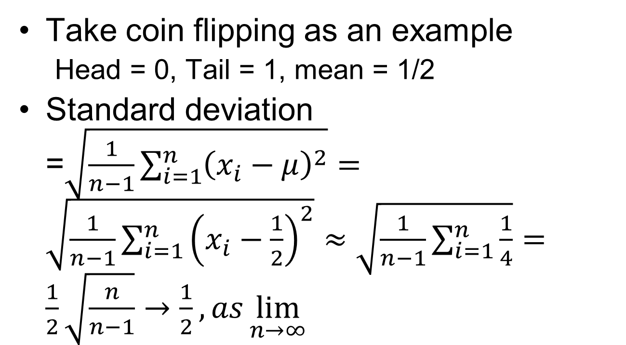
Confidence Intervals vs. Standard Deviations
Take coin flipping as an example
  Head = 0, Tail = 1, mean = 1/2
Standard deviation =$\sqrt{\frac{1}{n−1}\sum_{i=1}^{n}{{\left(x_{i}−μ\right)}^{2}}}=\sqrt{\frac{1}{n−1}\sum_{i=1}^{n}{{\left(x_{i}−\frac{1}{2}\right)}^{2}}}≈\sqrt{\frac{1}{n−1}\sum_{i=1}^{n}{\frac{1}{4}}}=\frac{1}{2}\sqrt{\frac{n}{n−1}}→\frac{1}{2}, as\lim_{n→∞}{}$

Slide 21

Confidence Intervals vs. Standard Deviations
Confidence interval = $z\frac{s}{\sqrt{n}}→0, as \lim_{n→∞}{}$

Slide 22
Making Decisions
Why do we use confidence intervals?
  Summarizes error in sample mean
  Gives way to decide if measurement is meaningful
  Allows comparisons in face of error
But remember: at 90% confidence, 10% of sample C.I.s do not include population mean

Slide 23
Testing for Zero Mean
Is population mean significantly ≠ 0?
If confidence interval includes 0, answer is no
Can test for any value (mean of sums is sum of means)
Our height samples are consistent with average height of 170 cm
  Also consistent with 160 and 180!

Slide 24
Comparing Alternatives
Often need to find better system
  Choose fastest computer to buy
  Prove our algorithm runs faster
Different methods for paired/unpaired observations
  Paired if ith test on each system was same
  Unpaired otherwise

Slide 25
Comparing
Paired Observations
For each test calculate performance difference
Calculate confidence interval for differences
If interval includes zero, systems aren’t different
  If not, sign indicates which is better

Slide 26
Example: Comparing
Paired Observations
Do home baseball teams outscore visitors?
Sample from 9-4-96:
  H 4 5 0 11 6 6 3 12 9 5 6 3 1 6
  V 2 7 7 6 0 7 10 6 2 2 4 2 2 0
  H-V 2 -2 -7 5 6 -1 -7 6 7 3 2 1 -1 6
Mean 1.4, 90% interval (-0.75, 3.6)
  Can’t tell from this data
  70% interval is (0.10, 2.76)

Slide 27
Comparing
Unpaired Observations
CIs do not overlap ➔ A > B | CIs overlap and mean of one is in the CI of the other ➔ A ~= B
CIs overlap and mean of one is in the CI of the other ➔ A ~= B | Cis overlap but mean of one is not in the CI of the other ➔ t-test
A
A
Mean
Mean
B
B
B
A
Mean
A
Mean
B

Slide 28
The t-test (1)
1. Compute sample means and
2. Compute sample standard deviations s_{a} and s_{b}
3. Compute mean difference =
4. Compute standard deviation of difference:

Slide 29
The t-test (2)
5. Compute effective degrees of freedom:
Note
when n_{a} = n_{b}, v = 2n_{a}
when n_{b} → ∞, v → n_{a} - 1

Slide 30
The t-test (2)
6. Compute the confidence interval
7. If interval includes zero, no difference

Slide 31
Comparing Proportions
If k of n trials give a certain result (category, e.g., male/female), then confidence interval is:
If interval includes 0.5, can’t say which outcome is statistically meaningful
Must have k ≥ 10 to get valid results

Slide 32
Special Considerations
Selecting a confidence level
Hypothesis testing
One-sided confidence intervals

Slide 33
Selecting a Confidence Level
Depends on cost of being wrong
90%, 95% are common values for scientific papers
Generally, use highest value that lets you make a firm statement
  But it’s better to be consistent throughout a given paper

Slide 34
Hypothesis Testing
The null hypothesis (H₀) is common in statistics
  Confusing due to double negative
  Gives less information than confidence interval
  Often harder to compute
Should understand that rejecting null hypothesis implies result is meaningful

Slide 35
One-Sided
Confidence Intervals
Two-sided intervals test for mean being outside a certain range (see “error bands” in previous graphs)
One-sided tests useful if only interested in one limit
Use z_{1-α} or t_{1-α;n} instead of z_{1-α/2} or t_{1-α/2;n} in formulas

Slide 36
Sample Sizes
Bigger sample sizes give narrower intervals
  Smaller values of t, ν as n increases
  in formulas
But sample collection is often expensive
  What is minimum we can get away with?

Slide 37
Choosing a Sample Size
To get a given percentage error ±r %:
Here, z represents either z or t as appropriate
For a proportion p = k/n:

Slide 38
Example of
Choosing Sample Size
Five runs of a compilation took 22.5, 19.8, 21.1, 26.7, 20.2 seconds
How many runs to get ±5% confidence interval at 90% confidence level?
= 22.1, s = 2.8, t_{0.95;4} = 2.132
Note that first 5 runs can’t be reused!

Slide 39
White Slide

