Slide 1
Summarizing Measured Data
Andy Wang
CIS 5105
Computer Systems
Performance Analysis

Slide 2
Introduction to Statistics
Concentration on applied statistics
  Especially those useful in measurement
Today’s lecture will cover 15 basic concepts
  You should already be familiar with them

Slide 3
1. Independent Events
Occurrence of one event doesn’t affect probability of other
Examples:
  Coin flips
  Inputs from separate users
  “Unrelated” traffic accidents
What about second basketball free throw after the player misses the first?

Slide 4
2. Random Variable
Variable that takes values probabilistically
Variable usually denoted by capital letters, particular values by lowercase
Examples:
  Number shown on dice
  Network delay

Slide 5
3. Cumulative Distribution Function (CDF)
Maps a value a to probability that the outcome is less than or equal to a:
Valid for discrete and continuous variables
Monotonically increasing
Easy to specify, calculate, measure

Slide 6
CDF Examples
Coin flip (T = 0, H = 1):
Exponential packet interarrival times:

Slide 7
4. Probability Density Function (pdf)
Derivative of (continuous) CDF:
Usable to find probability of a range:

Slide 8
Examples of pdf
Exponential interarrival times:
Gaussian (normal) distribution:

Slide 9
5. Probability Mass Function (pmf)
CDF not differentiable for discrete random variables
pmf serves as replacement: f(x_{i}) = p_{i} where p_{i} is the probability that x will take on the value x_{i}

Slide 10
Examples of pmf
Coin flip:
Typical CS grad class size:

Slide 11
6. Expected Value (Mean)
Mean (mu)
Summation if discrete
Integration if continuous

Slide 12
7. Variance
Var(x) =
Often easier to calculate equivalent
Usually denoted σ ²; square root σ (sigma) is called standard deviation

Slide 13
8. Coefficient of Variation (C.O.V. or C.V.)
Ratio of standard deviation to mean:
Indicates how well mean represents the variable
Does not work well when µ → 0

Slide 14
9. Covariance
Given x, y with means μ_{x} and μ_{y}, their covariance is:
High covariance implies y departs from mean whenever x does

Slide 15
Covariance (cont’d)
For independent variables,
E(xy) = E(x)E(y)
so Cov(x,y) = 0
Reverse isn’t true: Cov(x,y) = 0 doesn’t imply independence
If y = x, covariance reduces to variance

Slide 16
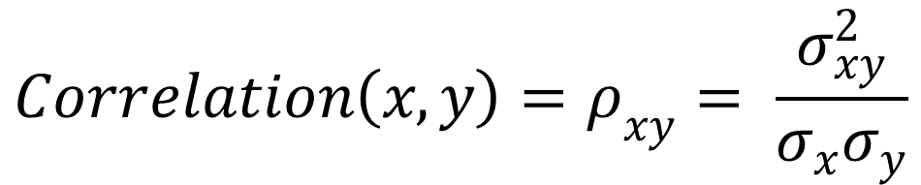
10. Correlation Coefficient
Normalized covariance (rho):
Always lies between -1 and 1
Correlation of 1 ⇒ x ~ y, -1 ⇒
$$Correlation\left(x,y\right)=ρ_{xy}= \frac{σ_{xy}^{2}}{σ_{x}σ_{y}}$$

Slide 17
11. Mean and Variance of Sums
For any random variables,
For independent variables,

Slide 18
12. Quantile
x value at which CDF takes a value α is called α-quantile or 100α-percentile, denoted by x_{α}.
If 90th-percentile score on GRE was 162, then 90% of population got 162 or less

Slide 19
Quantile Example
0.5-quantile
α-quantile

Slide 20
13. Median
50th percentile (0.5-quantile) of a random variable
Alternative to mean
By definition, 50% of population is sub-median, 50% super-median
  Lots of bad (good) drivers
  Lots of smart (not so smart) people

Slide 21
14. Mode
Most likely value, i.e., x_{i} with highest probability p_{i}, or x at which pdf/pmf is maximum
Not necessarily defined (e.g., tie)
Some distributions are bi-modal (e.g., human height has one mode for males and one for females)
Can be applied to histogram buckets

Slide 22
Examples of Mode
Mode
Dice throws:
Adult human weight:
Mode
Sub-mode

Slide 23
15. Normal (Gaussian) Distribution
Most common distribution in data analysis
pdf is:
-∞ ≤ x ≤ +∞
Mean is μ , standard deviation σ

Slide 24
Notation for Gaussian Distributions
Often denoted N(μ,σ)
Unit normal is N(0,1)
If x has N(μ,σ), has N(0,1)
The α-quantile of unit normal z ~ N(0,1) is denoted z_{α} so that

Slide 25
Why Is Gaussian
So Popular?
We’ve seen that if x_{i} ~ N(μ_{ι} ,σ_{ι} ) and all x_{i} independent, then Σα_{i}x_{i} is normal with mean Σα_{i}μ_{i} and variance σ² = Σα_{i}²σ_{i}²
Sum of large no. of independent observations from any distribution is itself normal (Central Limit Theorem)
  Experimental errors can be modeled as
  normal distribution.

Slide 26
Summarizing Data With a Single Number
Most condensed form of presentation of set of data
Usually called the average
  Average isn’t necessarily the mean
Must be representative of a major part of the data set

Slide 27
Indices of
Central Tendency
Mean
Median
Mode
All specify center of location of distribution of observations in sample

Slide 28
Sample Mean
Take sum of all observations
Divide by number of observations
More affected by outliers than median or mode
Mean is a linear property
  Mean of sum is sum of means
  Not true for median and mode

Slide 29
Sample Median
Sort observations
Take observation in middle of series
  If even number, split the difference
More resistant to outliers
  But not all points given “equal weight”

Slide 30
Sample Mode
Plot histogram of observations
  Using existing categories
  Or dividing ranges into buckets
  Or using kernel density estimation
Choose midpoint of bucket where histogram peaks
  For categorical variables, the most frequently occurring
Effectively ignores much of the sample

Slide 31
Characteristics of
Mean, Median, and Mode
Mean and median always exist and are unique
Mode may or may not exist
  If there is a mode, may be more than one
Mean, median and mode may be identical
  Or may all be different
  Or some may be the same

Slide 32
Mean, Median, and Mode Identical
Median
Mean
Mode
pdf
f(x)
x

Slide 33
Median, Mean, and Mode
All Different
pdf
f(x)
Mode
Mean
Median
x

Slide 34
So, Which Should I Use?
If data is categorical, use mode
If a total of all observations makes sense, use mean
If not, and distribution is skewed, use median
Otherwise, use mean
But think about what you’re choosing

Slide 35
Some Examples
Most-used resource in system
  Mode
Interarrival times
  Mean
Load
  Median

Slide 36
Don’t Always
Use the Mean
Means are often overused and misused
  Means of significantly different values
  Means of highly skewed distributions
  Multiplying means to get mean of a product
    Example: PetsMart
      Average number of legs per animal
      Average number of toes per leg
    Only works for independent variables
  Errors in taking ratios of means
  Means of categorical variables

Slide 37
Example: Bandwidth
Experiment number | File size (MB) | Transfer time (sec) | Bandwidth (MB/sec)
1 | 20 | 1 | 20
2 | 20 | 2 | 10
What is the average bandwidth?
  (20 MB/sec + 10 MB/sec)/2 = 15 MB/sec ???

Slide 38
Example: Bandwidth
Experiment number | File size (MB) | Transfer time (sec) | Bandwidth (MB/sec)
1 | 20 | 1 | 20
2 | 20 | 2 | 10
When file size is fixed
  Average transfer time = 1.5 sec
  Average bandwidth = 20 MB / 1.5 sec
  = 13.3 MB/sec (11% difference!)
Another way
  (20MB + 20MB)/(1 sec + 2 sec) = 13.3 MB/sec

Slide 39
Example 2: Same Bandwidth Numbers
Experiment number | File size (MB) | Transfer time (sec) | Bandwidth (MB/sec)
1 | 60 | 3 | 20
2 | 20 | 2 | 10
(60MB + 20MB)/(3 sec + 2 sec) = 16 MB/sec

Slide 40
Example 2: Bandwidth
Experiment number | File size (MB) | Transfer time (sec) | Bandwidth (MB/sec)
1 | 20 | 1 | 20
2 | 60 | 6 | 10
(60MB + 20MB)/(1 sec + 6 sec) = 11 MB/sec

Slide 41
Geometric Means
An alternative to the arithmetic mean
Use geometric mean if product of observations makes sense

Slide 42
Good Places To Use
Geometric Mean
Layered architectures
Performance improvements over successive versions
Average error rate on multihop network path

Slide 43
Harmonic Mean
Harmonic mean of sample {x₁, x₂, ..., x_{n}} is
Use when arithmetic mean of 1/x₁ is sensible

Slide 44
Example of Using
Harmonic Mean
When working with MIPS numbers from a single benchmark
  Since MIPS calculated by dividing constant number of instructions by elapsed time
Not valid if different m’s (e.g., different benchmarks for each observation)
m
x_{i} =
t_{i}

Slide 45
Another Example of Using Harmonic Mean
Bandwidth from a given benchmark
  Constant number of bytes (B) divided by varying elapsed times (t₁, t₂…)
    B/t₁, B/t₂, …
  We really want to average the times first
    T = (t₁ + t₂ ….)/n
    Then compute the bandwidth B/T
      = Bn/(t₁ + t₂…) = n/(t₁/B + t₂/B….)

Slide 46
Means of Ratios
Given n ratios, how do you summarize them?
Can’t always just use harmonic mean
  Or similar simple method
Consider numerators and denominators

Slide 47
Considering Mean of Ratios: Case 1
Both numerator and denominator have physical meaning
Then the average of the ratios is the ratio of the averages

Slide 48
Example: CPU Utilizations
Measurement CPU
Duration Busy (%)
1 40
1 50
1 40
1 50
100 20
Sum 200 %
Mean?

Slide 49
Mean for CPU Utilizations
Measurement CPU
Duration Busy (%)
1 40
1 50
1 40
1 50
100 20
Sum 200 %
Mean? Not 40%

Slide 50
Properly Calculating Mean
For CPU Utilization
Why not 40%?
Because CPU-busy percentages are ratios
  So their denominators aren’t comparable
The duration-100 observation must be weighted more heavily than the duration-1 observations

Slide 51
So What Is the Proper Average?
Go back to the original ratios
0.40 + 0.50 + 0.40 + 0.50 + 20
Mean CPU
Utilization
=
1 + 1 + 1 + 1 + 100
=
21 %

Slide 52
Considering Mean of Ratios: Case 1a
Sum of numerators has physical meaning, denominator is a constant
Take the arithmetic mean of the ratios to get the overall mean

Slide 53
For Example,
What if we calculated CPU utilization from last example using only the four duration-1 measurements?
Then the average is
1
4
(
.40
1
.50
1
.40
1
.50
1
)
+
+
+
=
0.45

Slide 54
Considering Mean of Ratios: Case 1b
Sum of denominators has a physical meaning, numerator is a constant
Take harmonic mean of the ratios
  E.g., bandwidth (same file size/different times)

Slide 55
Considering Mean of Ratios: Case 2
Numerator and denominator are expected to have a multiplicative, near-constant property
a_{i} = c b_{i}
Estimate c with geometric mean of a_{i}/b_{i}

Slide 56
Example for Case 2
An optimizer reduces the size of code
What is the average reduction in size, based on its observed performance on several different programs?
Proper metric is percent reduction in size
And we’re looking for a constant c as the average reduction

Slide 57
Program Optimizer Example, Continued
Code Size
Program Before After Ratio
BubbleP 119 89 .75
IntmmP 158 134 .85
PermP 142 121 .85
PuzzleP 8612 7579 .88
QueenP 7133 7062 .99
QuickP 184 112 .61
SieveP 2908 2879 .99
TowersP 433 307 .71

Slide 58
Why Not Use
Ratio of Sums?
Why not add up pre-optimized sizes and post-optimized sizes and take the ratio?
  Benchmarks of non-comparable size
  No indication of importance of each benchmark in overall code mix
  When looking for constant factor, not the best method

Slide 59
So Use the
Geometric Mean
Multiply the ratios from the 8 benchmarks
Then take the 1/8 power of the result

Slide 60
Summarizing Variability
A single number rarely tells entire story of a data set
Usually, you need to know how much the rest of the data set varies from that index of central tendency

Slide 61
Why Is Variability Important?
Consider two Web servers:
  Server A services all requests in 1 second
  Server B services 90% of all requests in .5 seconds
    But 10% in 55 seconds
  Both have mean service times of 1 second
  But which would you prefer to use?

Slide 62
Indices of Dispersion
Measures of how much a data set varies
  Range
  Variance and standard deviation
  Percentiles
  Semi-interquartile range
  Mean absolute deviation

Slide 63
Range
Minimum & maximum values in data set
Can be tracked as data values arrive
Variability = max - min
Often not useful, due to outliers
Min tends to go to zero
Max tends to increase over time
Not useful for unbounded variables

Slide 64
Example of Range
For data set
2, 5.4, -17, 2056, 445, -4.8, 84.3, 92, 27, -10
  Maximum is 2056
  Minimum is -17
  Range is 2073
  While arithmetic mean is 268

Slide 65
Variance
Sample variance is
Variance is expressed in units of the measured quantity squared
  Which isn’t always easy to understand

Slide 66
Variance Example
For data set
2, 5.4, -17, 2056, 445, -4.8, 84.3, 92, 27, -10
Variance is 413746.6
You can see the problem with variance:
  Given a mean of 268, what does that variance indicate?

Slide 67
Standard Deviation
Square root of the variance
In same units as units of metric
So easier to compare to metric

Slide 68
Standard Deviation Example
For sample set we’ve been using, standard deviation is 643
Given mean of 268, clearly the standard deviation shows lots of variability from mean

Slide 69
Coefficient of Variation
The ratio of standard deviation to mean
Normalizes units of these quantities into ratio or percentage
Often abbreviated C.O.V. or C.V.

Slide 70
Coefficient of Variation Example
For sample set we’ve been using, standard deviation is 643
Mean is 268
So C.O.V. is 643/268
= 2.4

Slide 71
Percentiles
Specification of how observations fall into buckets
E.g., 5-percentile is observation that is at the lower 5% of the set
  While 95-percentile is observation at the 95% boundary of the set
Useful even for unbounded variables

Slide 72
Relatives of Percentiles
Quantiles - fraction between 0 and 1
  Instead of percentage
  Also called fractiles
Deciles - percentiles at 10% boundaries
  First is 10-percentile, second is 20-percentile, etc.
Quartiles - divide data set into four parts
  25% of sample below first quartile, etc.
  Second quartile is also median

Slide 73
Calculating Quantiles
The α-quantile is estimated by sorting the set
Then take [(n-1)α+1]^{th} element
  Rounding to nearest integer index
  Exception: for small sets, may be better to choose “intermediate” value as is done for median

Slide 74
Quartile Example
For data set
2, 5.4, -17, 2056, 445, -4.8, 84.3, 92, 27, -10
(10 observations)
Sort it:
-17, -10, -4.8, 2, 5.4, 27, 84.3, 92, 445, 2056

Slide 75
Quartile Example
Sort it:
-17, -10, -4.8, 2, 5.4, 27, 84.3, 92, 445, 2056
The first quartile Q₁ is the [(10 -1)*.25+1]th or the 3rd element: -4.8
The third quartile Q₃ is the [(10 – 1)*.75 + 1]th or the 8th element: 92

Slide 76
Interquartile Range
Yet another measure of dispersion
The difference between Q3 and Q1
Semi-interquartile range is half that:
Often interesting measure of what’s going on in the middle of the range

Slide 77
Semi-Interquartile Range Example
For data set
-17, -10, -4.8, 2, 5.4, 27, 84.3, 92, 445, 2056
Q₃ is 92
Q₁ is -4.8
Suggesting much variability caused by outliers

Slide 78
Mean Absolute Deviation
Another measure of variability
Mean absolute deviation =
Doesn’t require multiplication or square roots

Slide 79
Mean Absolute Deviation Example
For data set
-17, -10, -4.8, 2, 5.4, 27, 84.3, 92, 445, 2056
Mean absolute deviation is

Slide 80
Sensitivity To Outliers
From most to least,
  Range
  Variance
  Mean absolute deviation
  Semi-interquartile range

Slide 81
So, Which Index of Dispersion Should I Use?
Yes
Range
Bounded?
No
Unimodal
symmetrical?
Yes
C.O.V
No
Percentiles or SIQR
But always remember what you’re looking for

Slide 82
Finding a Distribution for Datasets
If a data set has a common distribution, that’s the best way to summarize it
Saying a data set is uniformly distributed is more informative than just giving its mean and standard deviation
So how do you determine if your data set fits a distribution?

Slide 83
Methods of Determining a Distribution
Plot a histogram
Quantile-quantile plot
Statistical methods (not covered in this class)

Slide 84
Plotting a Histogram
Suitable if you have a relatively large number of data points
1. Determine range of observations
2. Divide range into buckets
3.Count number of observations in each bucket
4. Divide by total number of observations and plot as column chart

Slide 85
Problems With
Histogram Approach
Determining cell size
  If too small, too few observations per cell
  If too large, no useful details in plot
If fewer than five observations in a cell, cell size is too small

Slide 86
Quantile-Quantile Plots
More suitable for small data sets
Basically, guess a distribution
Plot where quantiles of data should fall in that distribution
  Against where they actually fall
If plot is close to linear, data closely matches that distribution

Slide 87
Obtaining
Theoretical Quantiles
Need to determine where quantiles should fall for a particular distribution
Requires inverting CDF for that distribution
  y = F(x) ➔ x = F⁻¹(y)
  Then determining quantiles for observed points
  Then plugging quantiles into inverted CDF

Slide 88
Inverting a Distribution

Slide 89
Inverting a Distribution

Slide 90
Inverting a Distribution

Slide 91
Inverting a Distribution
Common distributions have already been inverted (how convenient…)
For others that are hard to invert, tables and approximations often available (nearly as convenient)

Slide 92
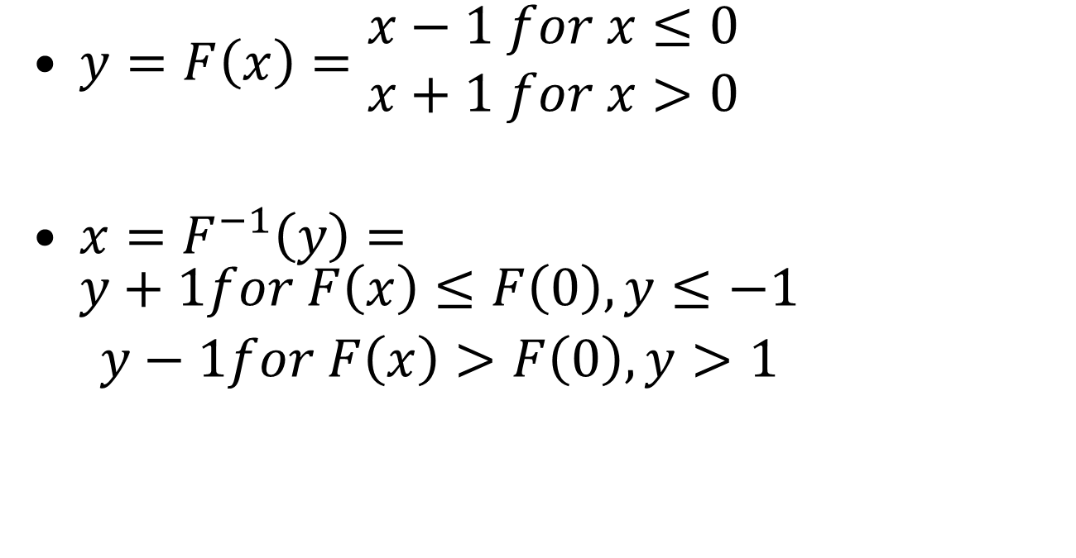
Example: Inverting a Distribution
y
$y=F\left(x\right)=\begin{matrix}x−1 for x≤0 \\ x+1 for x>0\end{matrix}$
$x=F^{−1}\left(y\right)=\begin{matrix}y+1for F\left(x\right)≤F\left(0\right), y≤−1 \\ y−1for F\left(x\right)>F\left(0\right), y>1\end{matrix}$
x
x
y

Slide 93
Is Our Sample Data Set Normally Distributed?
Our data set was
-17, -10, -4.8, 2, 5.4, 27, 84.3, 92, 445, 2056
Does this match normal distribution?
The normal distribution doesn’t invert nicely
  But there is an approximation:
  Or invert numerically

Slide 94
Data For Example Normal Quantile-Quantile Plot
x_{i} = F⁻¹(y_{i}), where y_{i} = q_{i}, F⁻¹(y_{i}), the inverse CDF of normal distribution
i | q_{i} = (i – 0.5)/n | x_{i} | y_{i}
1 | 0.05 | -1.64684 | -17
2 | 0.15 | -1.03481 | -10
3 | 0.25 | -0.67234 | -4.8
4 | 0.35 | -0.38375 | 2
5 | 0.45 | -0.1251 | 5.4
6 | 0.55 | 0.1251 | 27
7 | 0.65 | 0.383753 | 84.3
8 | 0.75 | 0.672345 | 92
9 | 0.85 | 1.034812 | 445
10 | 0.95 | 1.646839 | 2056
y values for data points
Quantiles for normal distribution
Remember to sort this column

Slide 95
Example Normal
Quantile-Quantile Plot

Slide 96
Analysis
Definitely not normal
  Because it isn’t linear
  Tail at high end is too long for normal
But perhaps the lower part of graph is normal?

Slide 97
Quantile-Quantile Plot of Partial Data

Slide 98
Analysis of Partial Data Plot
Again, at highest points it doesn’t fit normal distribution
But at lower points it fits somewhat well
So, again, this distribution looks like normal with longer tail to right
Really need more data points
You can keep this up for a good, long time

Slide 99
Quantile-Quantile Plots: Example 2
i | q_{i} = (i – 0.5)/n | x_{i} | y_{i}
1 | 0.05 | -1.69 | -5
2 | 0.14 | -1.10 | -4
3 | 0.23 | -0.75 | -3
4 | 0.32 | -0.47 | -2
5 | 0.41 | -0.23 | -1
6 | 0.50 | 0.00 | 0
7 | 0.59 | 0.23 | 1
8 | 0.68 | 0.47 | 2
9 | 0.77 | 0.75 | 3
10 | 0.86 | 1.10 | 4
11 | 0.95 | 1.69 | 5

Slide 100
Quantile-Quantile Plots: Example 2

