Slide 1
Operational Laws
Andy Wang
CIS 5105
Computer Systems
Performance Analysis

Slide 2
Operational Laws
Performance analysis can be performed without any assumptions about the distribution of service and interarrival times
Operational laws are measureable and testable
  E.g., Number of job arrivals = number of job completions
Dependency of requests are not testable

Slide 3
Operational Quantities
Directly measured
For a time period T
  We can observe A_{i} arrivals
  C_{i} job completions
  The busy time B_{i} during T

Slide 4
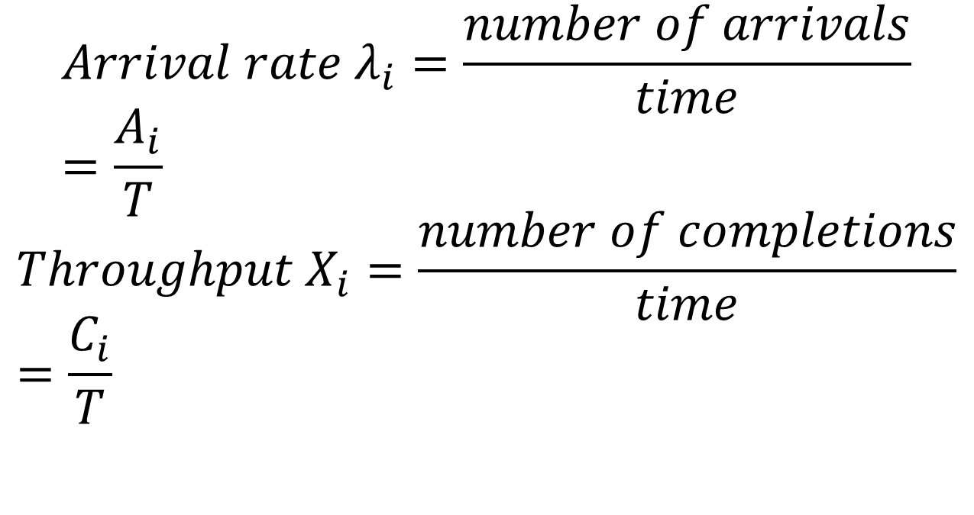
Also…
$$Arrival rate λ_{i}=\frac{number of arrivals}{time}=\frac{A_{i}}{T}$$
$$Throughput X_{i}=\frac{number of completions}{time}=\frac{C_{i}}{T}$$

Slide 5
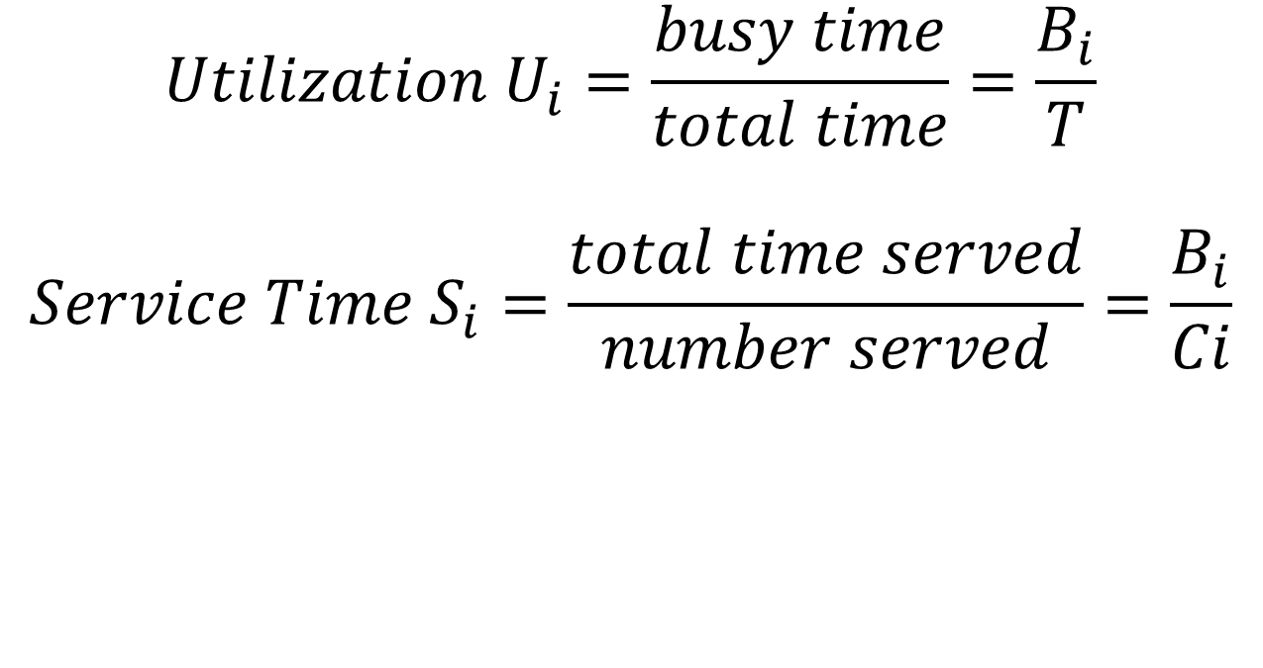
Also…
$$Utilization U_{i}=\frac{busy time}{total time}=\frac{B_{i}}{T}$$
$$Service Time S_{i}=\frac{total time served}{number served}=\frac{B_{i}}{Ci}$$

Slide 6

Utilization Law
$$U_{i}=\frac{B_{i}}{T}=\frac{C_{i} jobs}{T}×\frac{B_{i}}{C_{i} jobs}$$
$$U_{i}=X_{i}{×S}_{i}$$

Slide 7
Utilization Law Example
Network Gateway
λ = 125 packets per second = exit rate = throughput = X_{i}
S_{i} = 2 msec = 0.002 second
Utilization U_{i} = X_{i}S_{i} = 125 x 0.002 = 25%
With Utilization Law, we do not need to assume independent random variables with exponential distribution

Slide 8
Forced Flow Laws
Relates the system throughput to individual device throughputs
For an open system, number of jobs leaving the system = throughput
For a closed system, the out link is connected to the in link of a system
Assume job flow balance, where A_{i} = C_{i} for a period T

Slide 9
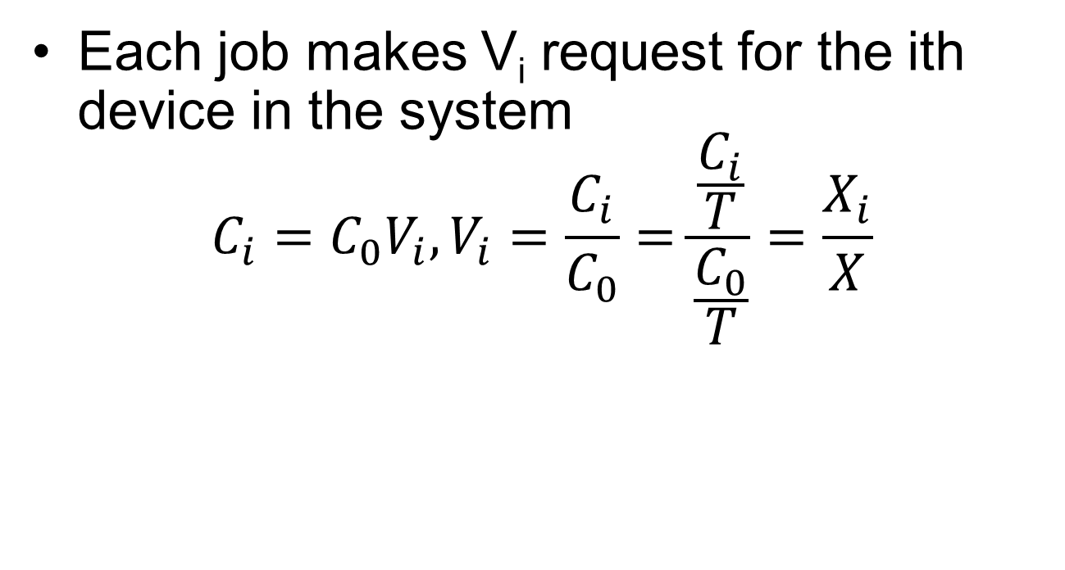
Visit Ratio V_{i}
Each job makes V_{i} request for the ith device in the system
$$C_{i}=C_{0}V_{i}, V_{i}=\frac{C_{i}}{C_{0}}=\frac{\frac{C_{i}}{T}}{\frac{C_{0}}{T}}=\frac{X_{i}}{X}$$
C_{i}
i
C₀
V_{i} requests/job

Slide 10
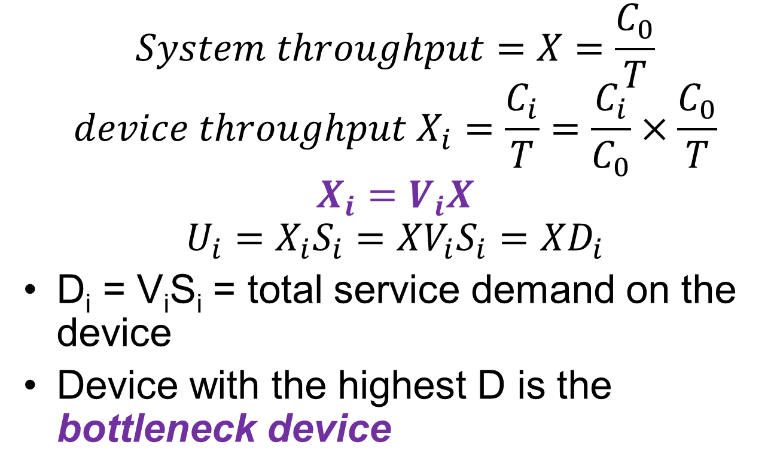
Forced Flow Law
$$System throughput=X=\frac{C_{0}}{T}$$
$$device throughput X_{i}=\frac{C_{i}}{T}=\frac{C_{i}}{C_{0}}×\frac{C_{0}}{T}$$
$$X_{i}=V_{i}X$$
$$U_{i}=X_{i}S_{i}=XV_{i}S_{i}=XD_{i}$$
D_{i} = V_{i}S_{i} = total service demand on the device
Device with the highest D is the bottleneck device

Slide 11
Example
17 terminals
1/181
S_{A} = 50 msecs
80/181
Disk A
X_{A} = 15.7 IO/sec
CPU
S_{B} = 30 msecs
S_{CPU} = 5 seconds
Disk B
100/181

Slide 12
Example
17 terminals
1/181
S_{A} = 50 msecs
80/181
Disk A
C_{A} = 80/181 C_{CPU}
C₀ = 1/181 C_{CPU}
X_{A} = 15.7 IO/sec
CPU
C_{CPU} = C_{A} + C_{B} + C₀
S_{B} = 30 msecs
S_{CPU} = 5 seconds
Disk B
100/181
C_{B} = 100/181 C_{CPU}

Slide 13
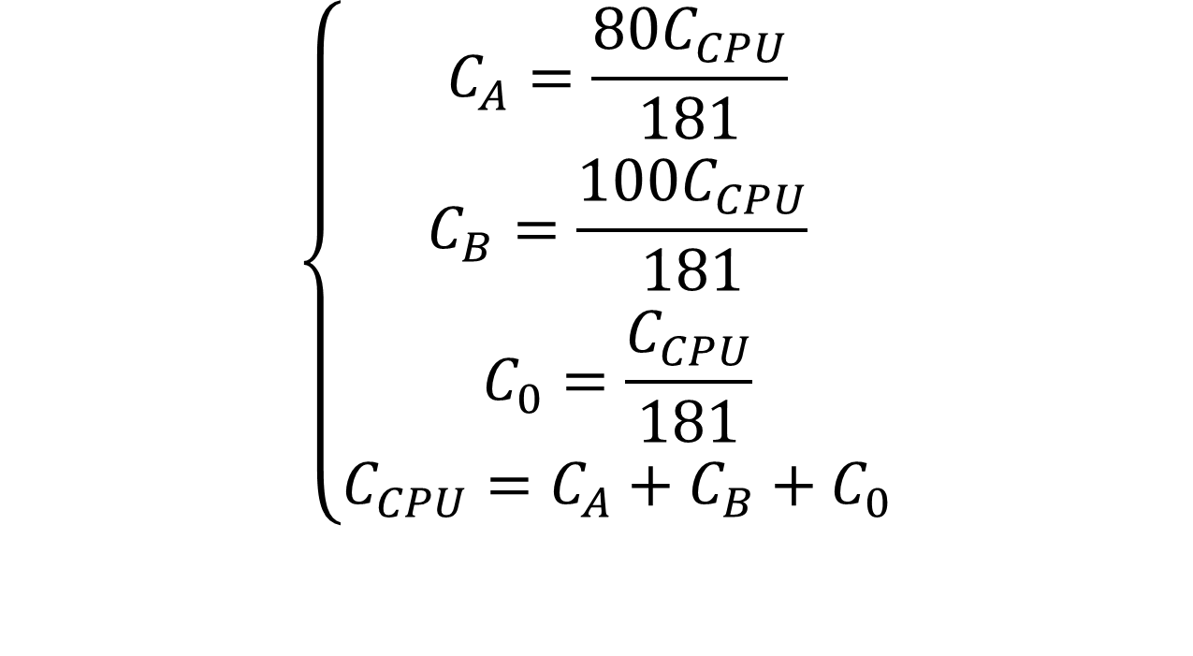
Solving for Visiting Ratios
$$\left\{\begin{aligned}C_{A}=\frac{80C_{CPU}}{181} \\ C_{B}=\frac{100C_{CPU}}{181} \\ C_{0}=\frac{C_{CPU}}{181} \\ C_{CPU}=C_{A}+C_{B}+C_{0}\end{aligned}\right.$$

Slide 14
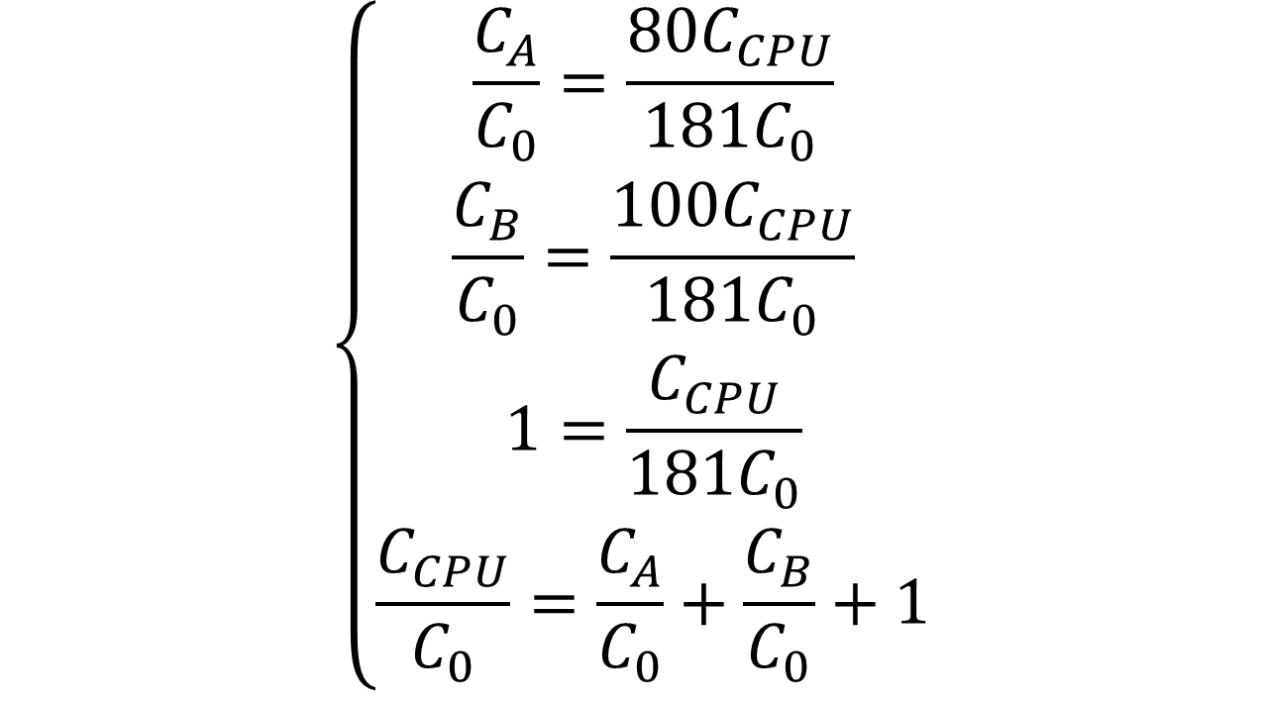
Dividing through C₀
$$\left\{\begin{aligned}\frac{C_{A}}{C_{0}}=\frac{80C_{CPU}}{181C_{0}} \\ \frac{C_{B}}{C_{0}}=\frac{100C_{CPU}}{181C_{0}} \\ 1=\frac{C_{CPU}}{181C_{0}} \\ \frac{C_{CPU}}{C_{0}}=\frac{C_{A}}{C_{0}}+\frac{C_{B}}{C_{0}}+1\end{aligned}\right.$$

Slide 15
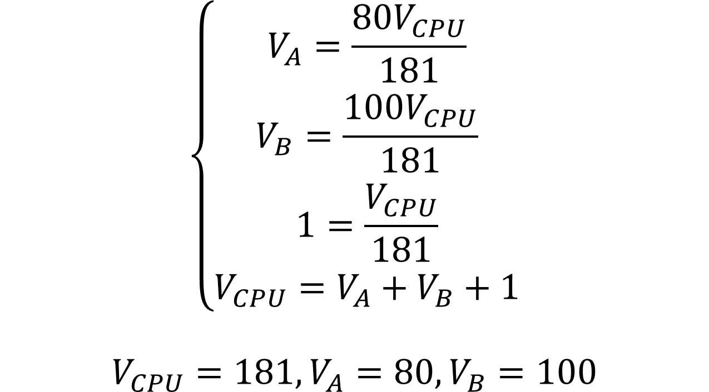
Solving for Visiting Ratios
$$\left\{\begin{aligned}V_{A}=\frac{80V_{CPU}}{181} \\ V_{B}=\frac{100V_{CPU}}{181} \\ 1=\frac{V_{CPU}}{181} \\ V_{CPU}=V_{A}+V_{B}+1\end{aligned}\right.$$
$$V_{CPU}=181, V_{A}=80, V_{B}=100$$

Slide 16
Determine the Service Demand
17 terminals
1/181
S_{A} = 50 msecs/request
80/181
Disk A
X_{A} = 15.7 IO/sec
CPU
S_{B} = 30 msecs/request
D_{CPU} = 5 seconds/job
Disk B
100/181

Slide 17
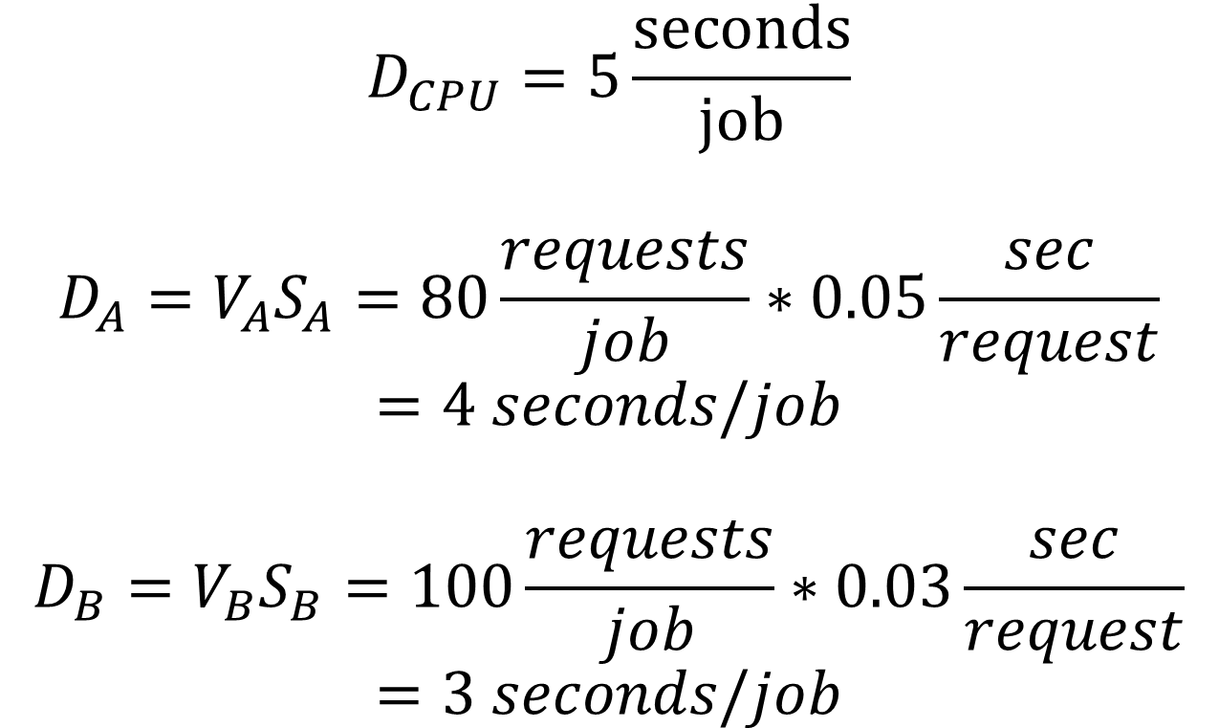
Determine the Service Demands
$$D_{CPU}=5\frac{seconds}{job}$$
$$D_{A}=V_{A}S_{A}=80\frac{requests}{job}∗0.05\frac{sec}{request}$$
$$=4 seconds/job$$
$$D_{B}=V_{B}S_{B}=100\frac{requests}{job}∗0.03\frac{sec}{request}$$
$$=3 seconds/job$$

Slide 18
Determine the Throughputs
17 terminals
1/181
S_{A} = 50 msecs
80/181
Disk A
X_{A} = 15.7 IO/sec
CPU
S_{B} = 30 msecs
S_{CPU} = 5 seconds
Disk B
100/181

Slide 19
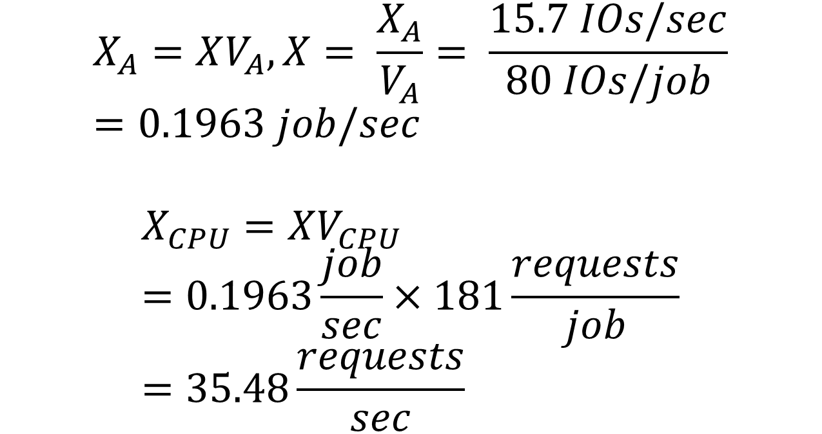
Applying the Forced Flow Law
$$X_{A}=XV_{A}, X= \frac{X_{A}}{V_{A}}= \frac{15.7 IOs/sec}{80 IOs/job}=0.1963 job/sec$$
$$X_{CPU}=XV_{CPU}=0.1963\frac{job}{sec}×181\frac{requests}{job}=35.48\frac{requests}{sec}$$

Slide 20
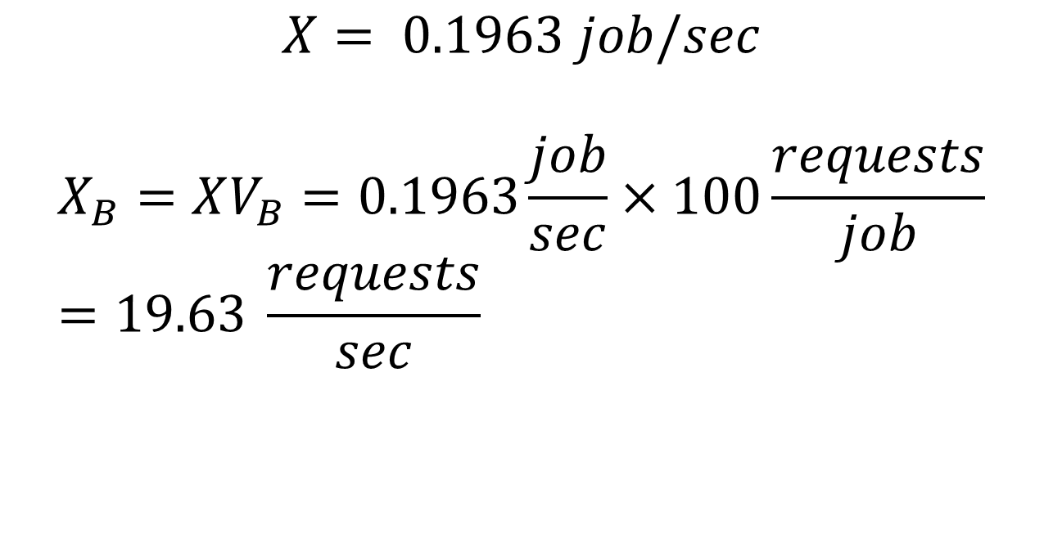
Determine the Throughputs
$$X= 0.1963 job/sec$$
$$X_{B}=XV_{B}=0.1963\frac{job}{sec}×100\frac{requests}{job}=19.63 \frac{requests}{sec}$$

Slide 21
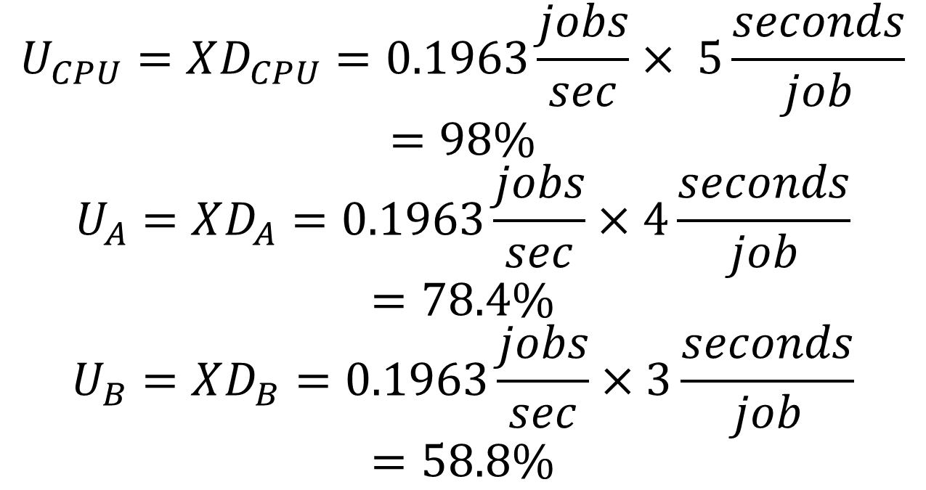
Applying the Utilization Law
$$U_{CPU}=XD_{CPU}=0.1963\frac{jobs}{sec}× 5\frac{seconds}{job}$$
$$=98\%$$
$$U_{A}=XD_{A}=0.1963\frac{jobs}{sec}×4\frac{seconds}{job}$$
$$=78.4\%$$
$$U_{B}=XD_{B}=0.1963\frac{jobs}{sec}×3\frac{seconds}{job}$$
$$=58.8\%$$

Slide 22
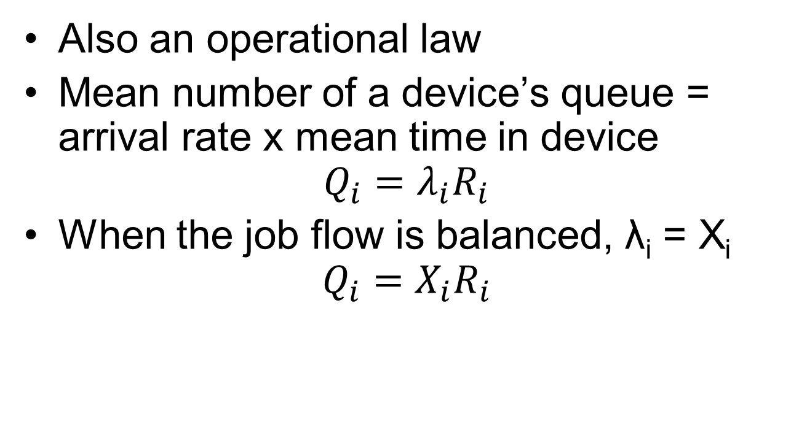
Little’s Law
Also an operational law
Mean number of a device’s queue = arrival rate x mean time in device
$$Q_{i}=λ_{i}R_{i}$$
When the job flow is balanced, λ_{i} = X_{i}
$$Q_{i}=X_{i}R_{i}$$

Slide 23
Example
17 terminals
1/181
S_{A} = 50 msecs
Q_{A} = 3.19
Disk A
X_{CPU} = 35.48 requests/sec
X_{A} = 15.7 IO/sec
CPU
S_{B} = 30 msecs
Q_{CPU} = 8.88
Disk B
Q_{B} = 1.40
X_{B} = 19.6 IO/sec

Slide 24
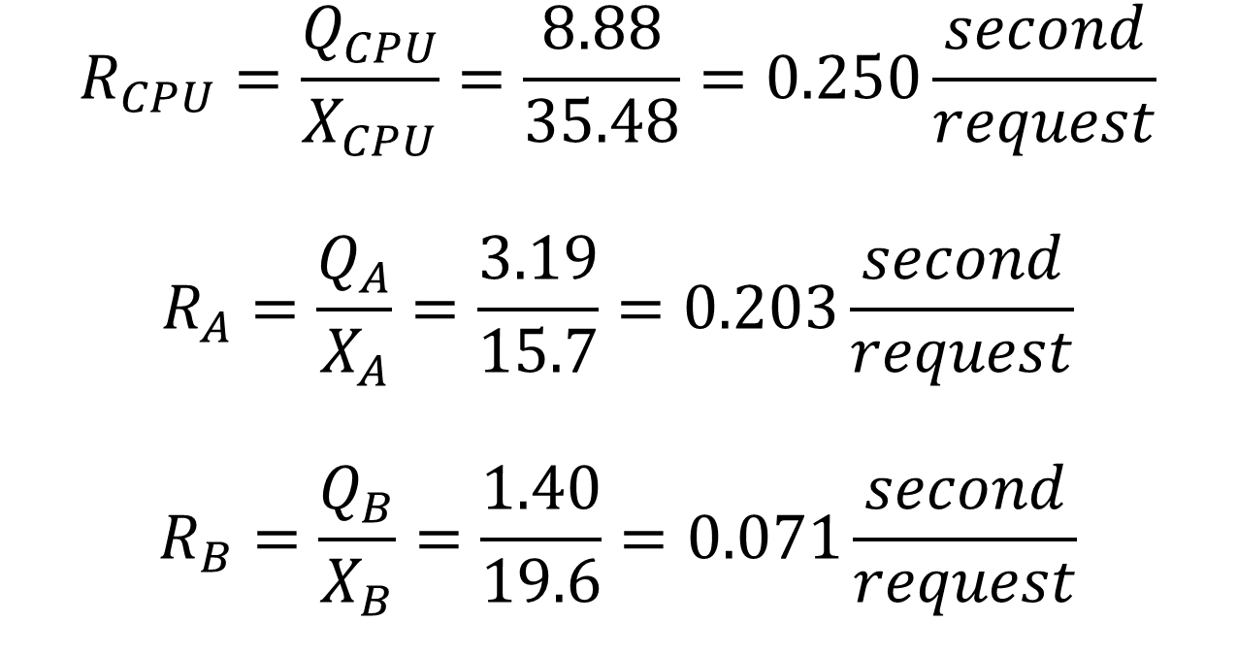
Applying Little’s Law
$$R_{CPU}=\frac{Q_{CPU}}{X_{CPU}}=\frac{8.88}{35.48}=0.250\frac{second}{request}$$
$$R_{A}=\frac{Q_{A}}{X_{A}}=\frac{3.19}{15.7}=0.203\frac{second}{request}$$
$$R_{B}=\frac{Q_{B}}{X_{B}}=\frac{1.40}{19.6}=0.071\frac{second}{request}$$

Slide 25
General Response Time Law
All timesharing systems can be divided into two subsystems
  Terminal subsystem (one per user)
  Central subsystem (shared by all)
terminals
Central
subsystem

Slide 26
General Response Time Law
Little’s Law can be applied to any part of the system
  Assuming job flow in that part is balanced
Q = XR
Q is the total number of jobs in M device queues in the system
R is the system response time
X is the system throughput
Q = Q₁ + Q₂ + … + Q_{M}

Slide 27
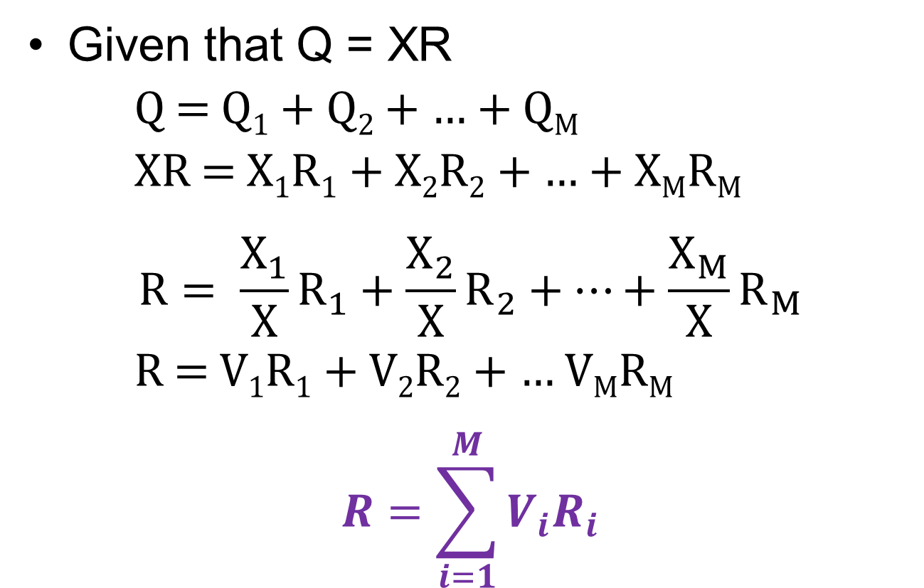
General Response Time Law
Given that Q = XR
Q = Q₁ + Q₂ + … + Q_{M}
XR = X₁R₁ + X₂R₂ + … + X_{M}R_{M}
$$R= \frac{X_{1}}{X}R_{1}+\frac{X_{2}}{X}R_{2}+…+\frac{X_{M}}{X}R_{M}$$
R = V₁R₁ + V₂R₂ + … V_{M}R_{M}
$$R=\sum_{i=1}^{M}{V_{i}R_{i}}$$

Slide 28
Example
17 terminals
R_{A} = 0.203
V_{A} = 80
Disk A
V_{CPU} = 181
CPU
R_{B} = 0.071
R_{CPU} = 0.250
Disk B
V_{B} = 100

Slide 29
Example
R = R_{CPU}V_{CPU} + R_{A}V_{A} + R_{B}V_{B}
= 0.250 x 181 + 0.203 x 80 + 0.071 *
100 = 68.6 seconds

Slide 30
Interactive Response Time Law
In an interactive system
  Users generate requests that are serviced by the central subsystem
  Response comes back to the terminal
  After a think time Z, the users submit the next request
  If the system response time is R, the total cycle time of requests is R + Z
  Each user generates T/(R + Z) requests in time period Z

Slide 31
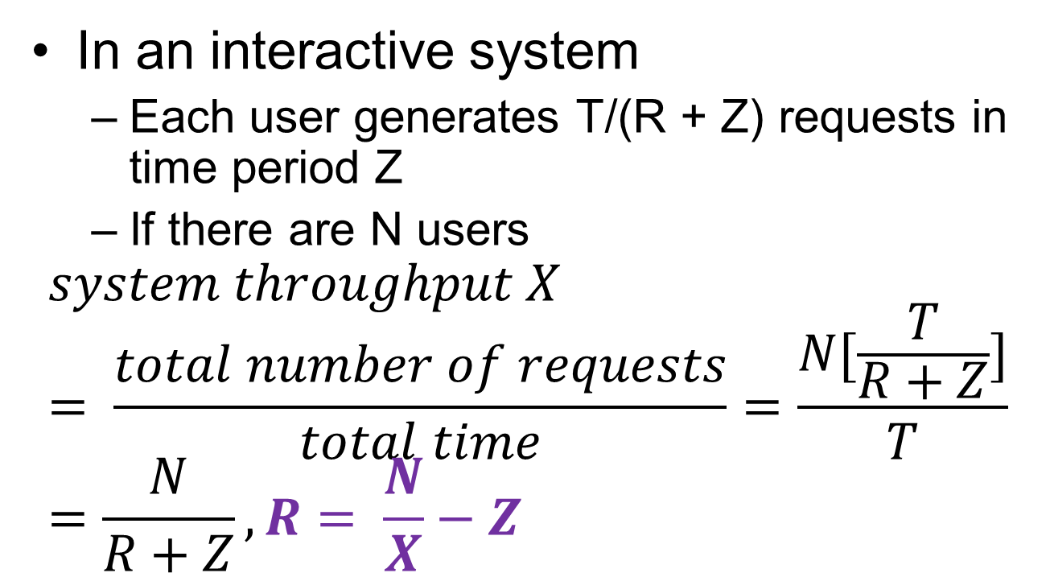
Interactive Response Time Law
In an interactive system
  Each user generates T/(R + Z) requests in time period Z
  If there are N users
$$system throughput X= \frac{total number of requests}{total time}=\frac{N[\frac{T}{R+Z}]}{T}=\frac{N}{R+Z}, R= \frac{N}{X}−Z$$

Slide 32

Example
$$R=\frac{N}{X}−Z$$
$$= \frac{17 }{0.1963}−18$$
$$=68.6 seconds$$
17 terminals
Z = 18 seconds
X = 0.1963 jobs/second
Central
subsystem

Slide 33
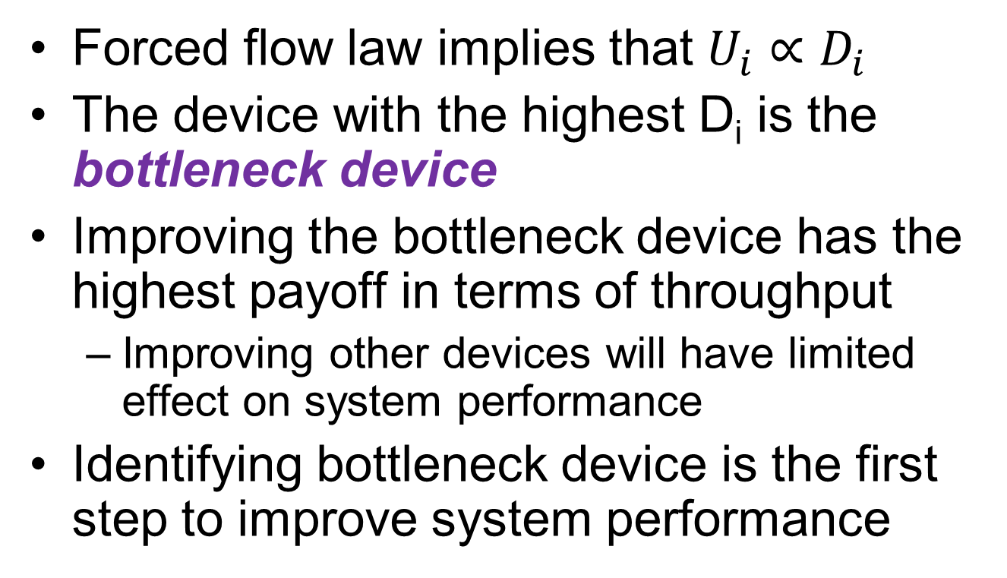
Bottleneck Analysis
Forced flow law implies that $U_{i}∝D_{i}$
The device with the highest D_{i} is the bottleneck device
Improving the bottleneck device has the highest payoff in terms of throughput
  Improving other devices will have limited effect on system performance
Identifying bottleneck device is the first step to improve system performance

Slide 34
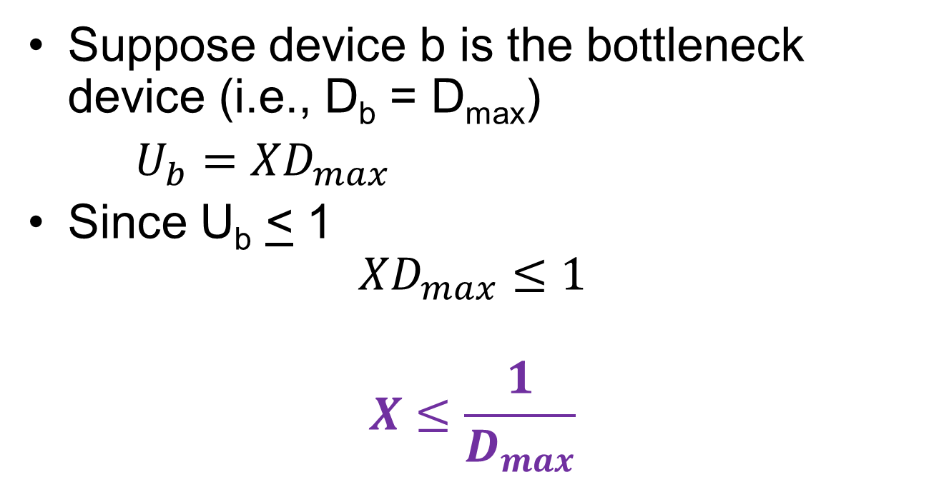
Bottleneck Analysis
Suppose device b is the bottleneck device (i.e., D_{b} = D_{max})
$U_{b}=XD_{max}$
Since U_{b} < 1
$$XD_{max}≤1$$
$$X≤\frac{1}{D_{max}}$$

Slide 35
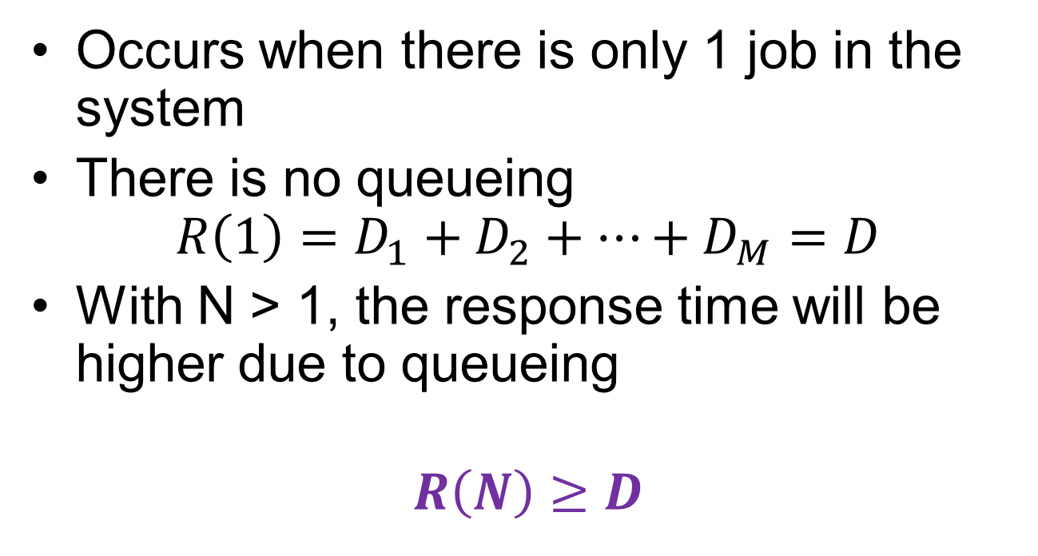
Min Response Time
Occurs when there is only 1 job in the system
There is no queueing
$$R\left(1\right)=D_{1}+D_{2}+…+D_{M}=D$$
With N > 1, the response time will be higher due to queueing
$$R\left(N\right)≥D$$

Slide 36
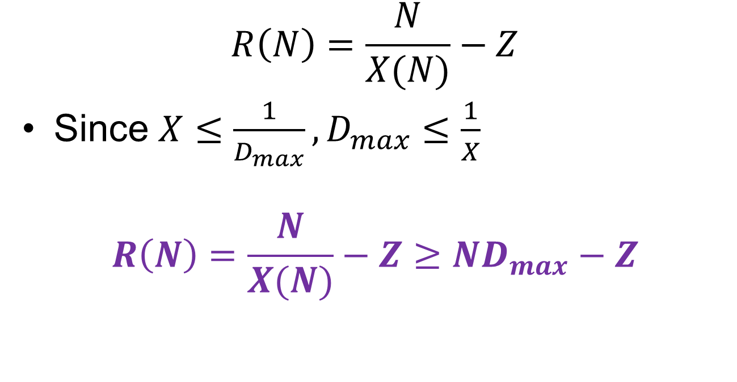
Applying the Interactive Response Time Law
$$R\left(N\right)=\frac{N}{X(N)}−Z$$
Since $X≤\frac{1}{D_{max}}, D_{max}≤\frac{1}{X}$
$$R\left(N\right)=\frac{N}{X(N)}−Z≥ND_{max}−Z$$

Slide 37
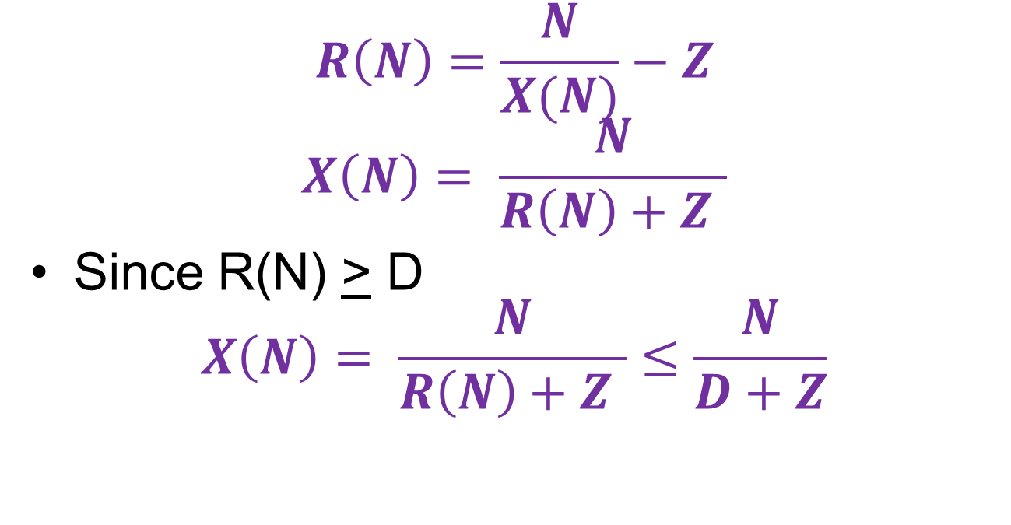
Applying the Interactive Response Time Law
$$R\left(N\right)=\frac{N}{X(N)}−Z$$
$$X\left(N\right)= \frac{N}{R\left(N\right)+Z }$$
Since R(N) > D
$$X\left(N\right)= \frac{N}{R\left(N\right)+Z }≤\frac{N}{D+Z}$$

Slide 38


Summary
$$X(N)≤min⁡\left(\frac{1}{D_{max}},\frac{N}{D+Z}\right)$$
slope = 1/(D+Z)
$$\frac{1}{D_{max}}=\frac{N^{∗}}{D+Z}$$
$$N^{∗}=\frac{D+Z}{D_{max}}$$
X(N)
1/D_{max}
knee = N*
N

Slide 39

Summary
$$R(N)≥max⁡\left(D,ND_{max}−Z\right)$$
slope = D_{max}
R(N)
D
N*
N
-Z

Slide 40
Example
Z = 18
D_{A} = 4
Disk A
D_{CPU} = 5
CPU
D_{B} = 3
Disk B

Slide 41
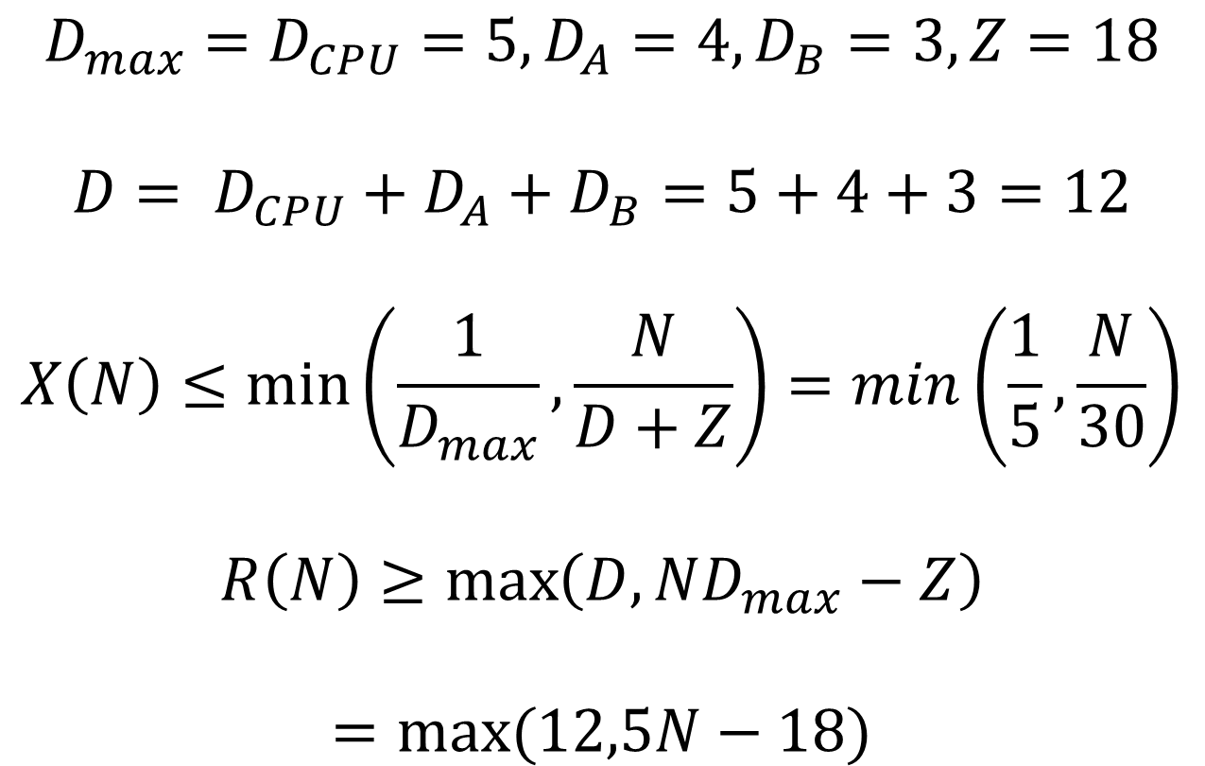
Example
$${D_{max}=D}_{CPU}=5, D_{A}=4, D_{B}=3, Z=18$$
$$D= D_{CPU}+D_{A}+D_{B}=5+4+3=12$$
$$X\left(N\right)≤\min\left(\frac{1}{D_{max}},\frac{N}{D+Z}\right)=min\left(\frac{1}{5},\frac{N}{30}\right)$$
$$R\left(N\right)≥\max\left(D,ND_{max}−Z\right)$$
$$=max⁡(12,5N−18)$$

Slide 42
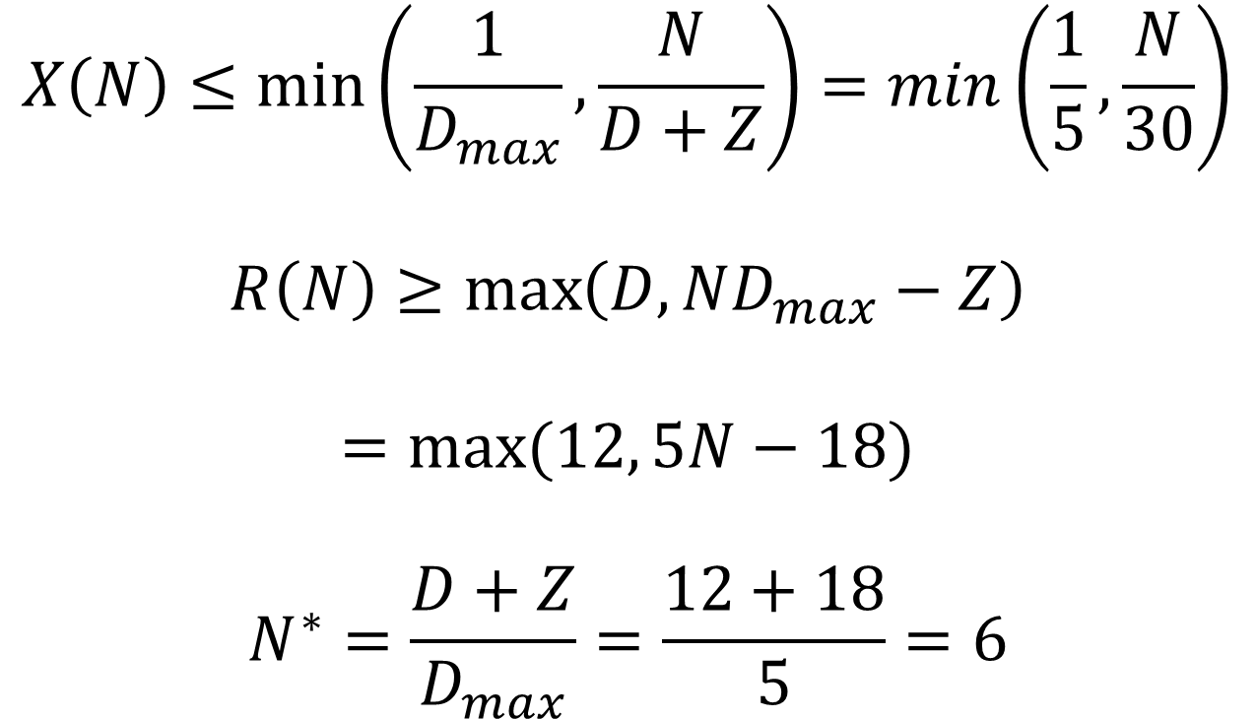
Example
$$X\left(N\right)≤\min\left(\frac{1}{D_{max}},\frac{N}{D+Z}\right)=min\left(\frac{1}{5},\frac{N}{30}\right)$$
$$R\left(N\right)≥\max\left(D,ND_{max}−Z\right)$$
$$=max⁡(12, 5N−18)$$
$$N^{∗}=\frac{D+Z}{D_{max}}=\frac{12+18}{5}=6$$

Slide 43

Example
$$X\left(N\right)≤min\left(\frac{1}{5},\frac{N}{30}\right)$$
slope = 1/30
X(N)
1/5
6
N

Slide 44

Example
$$R\left(N\right)≥max⁡(12, 5N−18)$$
slope = 5
R(N)
12
6
N

Slide 45
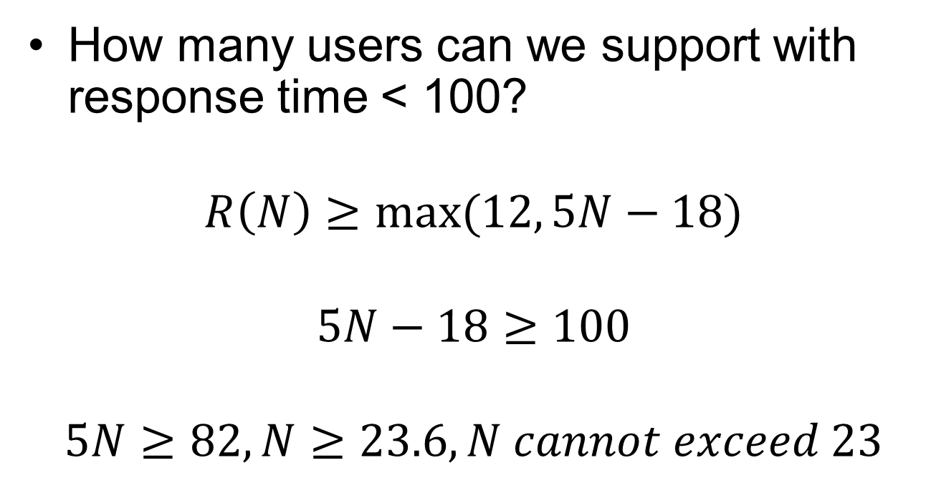
Example
How many users can we support with response time < 100?
$$R\left(N\right)≥max⁡(12, 5N−18)$$
$$5N−18≥100$$
$$5N≥82, N≥23.6, N cannot exceed 23$$

Slide 46
White Slide

