Slide 1
Analysis of a Single Queue
Andy Wang
CIS 5105
Computer Systems
Performance Analysis

Slide 2
Rationale
The simplest queueing model has only one queue
Can be used to analyze individual resources in computer systems
Many of these queues can be modeled as a birth-death process
  Job arrivals and departures

Slide 3
Birth-Death Processes
Useful in modeling systems in which jobs arrive one at a time
The state can be represented by the number of jobs n in the system
Arrival of a new job changes the state to n + 1 (birth)
Departure of a job changes the state to n – 1 (death)

Slide 4
M/M/1 Queue
Most commonly used type of queue
Models single processor systems or individual devices
Interarrival and service times are exponentially distributed
One server
No buffer or population limitations
FCFS service discipline

Slide 5
M/M/1 Queue
λ
λ
λ
λ
λ
λ
λ
Each state represents the probability of n jobs in a system
At steady state, inflow probability of a state equals the outflow probability of a state
  μp_{j+1} + λp_{j-1} = (λ + μ)p_{j}
0
1
2
j-1
j
j+1
μ
μ
μ
μ
μ
μ
μ

Slide 6

M/M/1 Queue
λ
λ
λ
λ
λ
λ
λ
Start with p₁
$$λp_{0}=μp_{1}$$
$$p_{1}=\frac{λ}{μ}p_{0}$$
0
1
2
j-1
j
j+1
μ
μ
μ
μ
μ
μ
μ

Slide 7
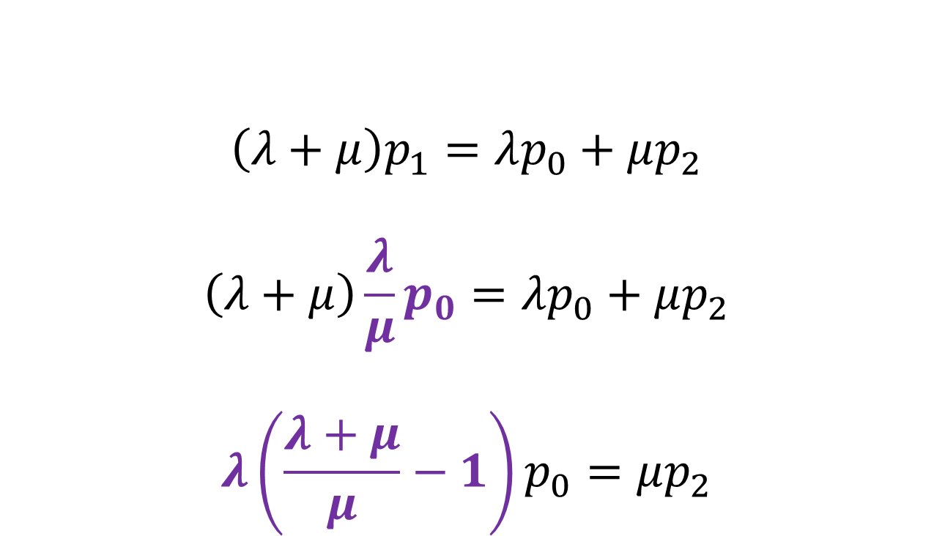
p₂
λ
λ
λ
λ
λ
λ
λ
$$\left(λ+μ\right)p_{1}=λp_{0}+μp_{2}$$
$$\left(λ+μ\right)\frac{λ}{μ}p_{0}=λp_{0}+μp_{2}$$
$$λ\left(\frac{λ+μ}{μ}−1\right)p_{0}=μp_{2}$$
0
1
2
j-1
j
j+1
μ
μ
μ
μ
μ
μ
μ

Slide 8
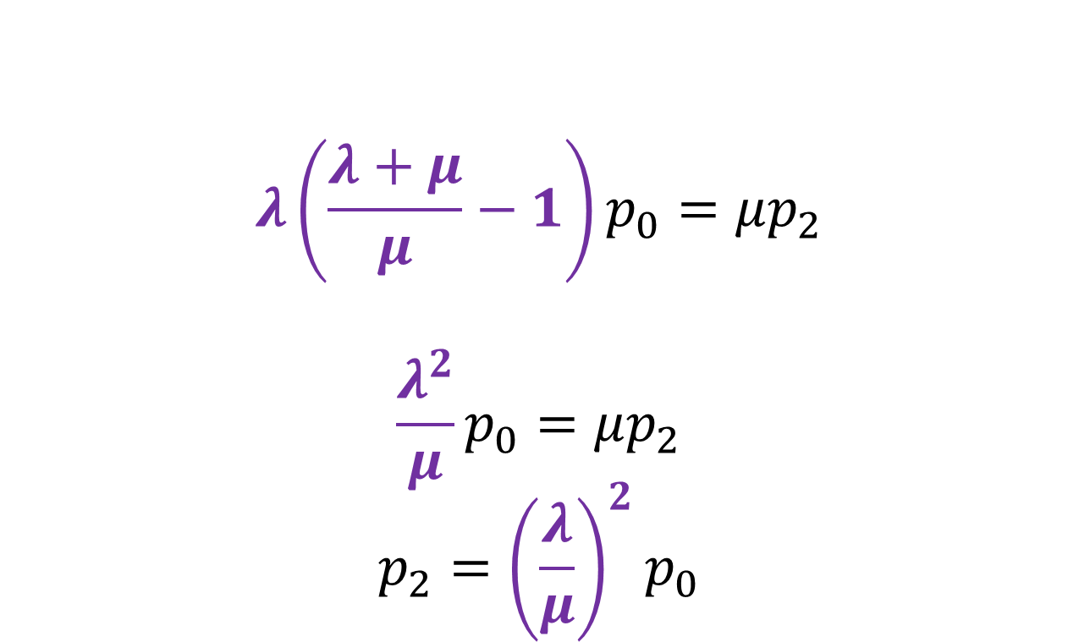
p₂
λ
λ
λ
λ
λ
λ
λ
$$λ\left(\frac{λ+μ}{μ}−1\right)p_{0}=μp_{2}$$
$$\frac{λ^{2}}{μ}p_{0}=μp_{2}$$
$$p_{2}={\left(\frac{λ}{μ}\right)}^{2}p_{0}$$
0
1
2
j-1
j
j+1
μ
μ
μ
μ
μ
μ
μ

Slide 9
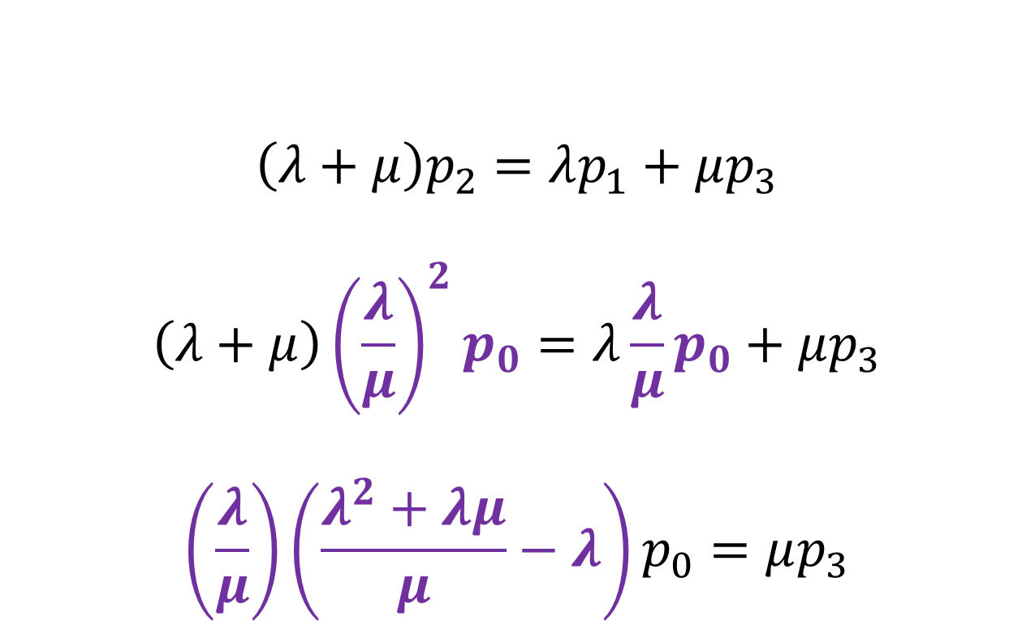
p₃
λ
λ
λ
λ
λ
λ
λ
$$\left(λ+μ\right)p_{2}=λp_{1}+μp_{3}$$
$$\left(λ+μ\right){\left(\frac{λ}{μ}\right)}^{2}p_{0}=λ\frac{λ}{μ}p_{0}+μp_{3}$$
$$\left(\frac{λ}{μ}\right)\left(\frac{λ^{2}+λμ}{μ}−λ\right)p_{0}=μp_{3}$$
0
1
2
j-1
j
j+1
μ
μ
μ
μ
μ
μ
μ

Slide 10
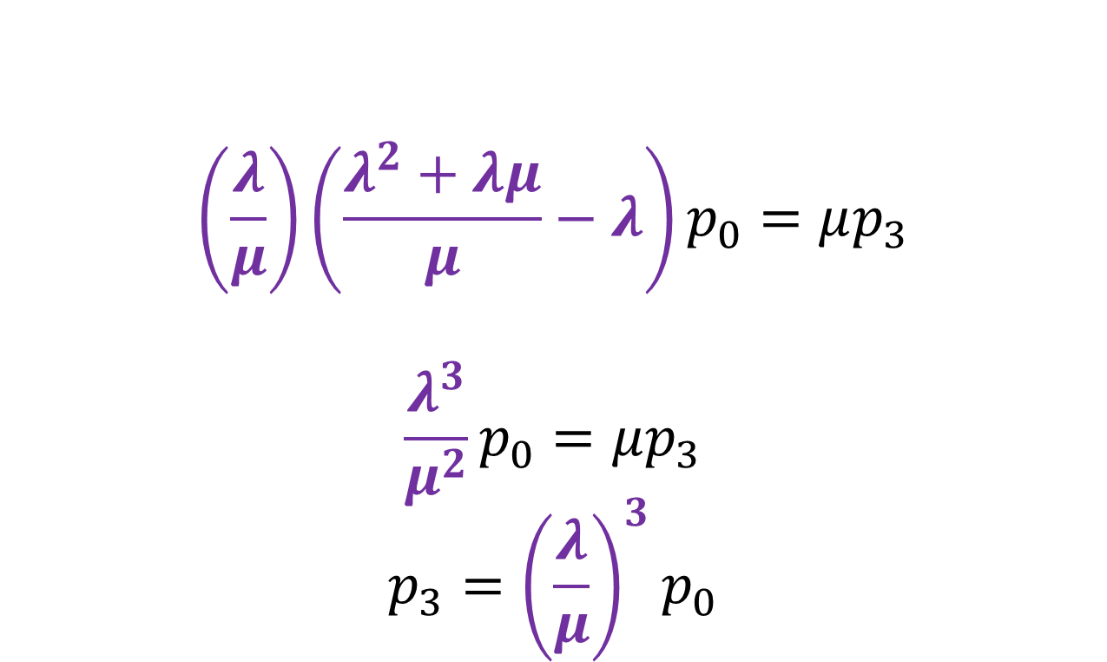
p₃
λ
λ
λ
λ
λ
λ
λ
$$\left(\frac{λ}{μ}\right)\left(\frac{λ^{2}+λμ}{μ}−λ\right)p_{0}=μp_{3}$$
$$\frac{λ^{3}}{μ^{2}}p_{0}=μp_{3}$$
$$p_{3}={\left(\frac{λ}{μ}\right)}^{3}p_{0}$$
0
1
2
j-1
j
j+1
μ
μ
μ
μ
μ
μ
μ

Slide 11

p_{j}
λ
λ
λ
λ
λ
λ
λ
$$p_{j}={\left(\frac{λ}{μ}\right)}^{j}p_{0}$$
0
1
2
j-1
j
j+1
μ
μ
μ
μ
μ
μ
μ

Slide 12
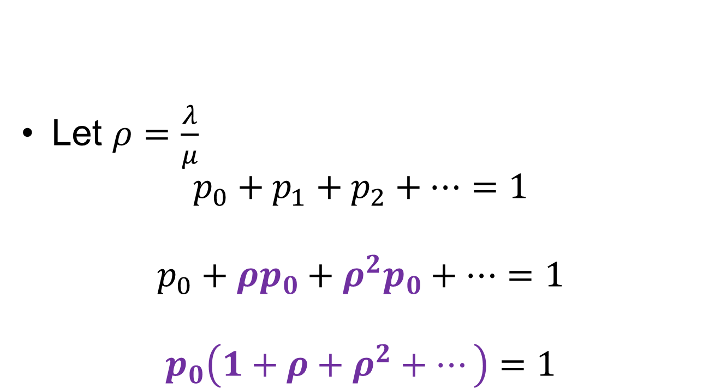
Σp_{j}=1
λ
λ
λ
λ
λ
λ
λ
Let $ρ=\frac{λ}{μ}$
$$p_{0}+p_{1}+p_{2}+…=1$$
$$p_{0}+ρp_{0}+ρ^{2}p_{0}+…=1$$
$$p_{0}\left(1+ρ+ρ^{2}+…\right)=1$$
0
1
2
j-1
j
j+1
μ
μ
μ
μ
μ
μ
μ

Slide 13
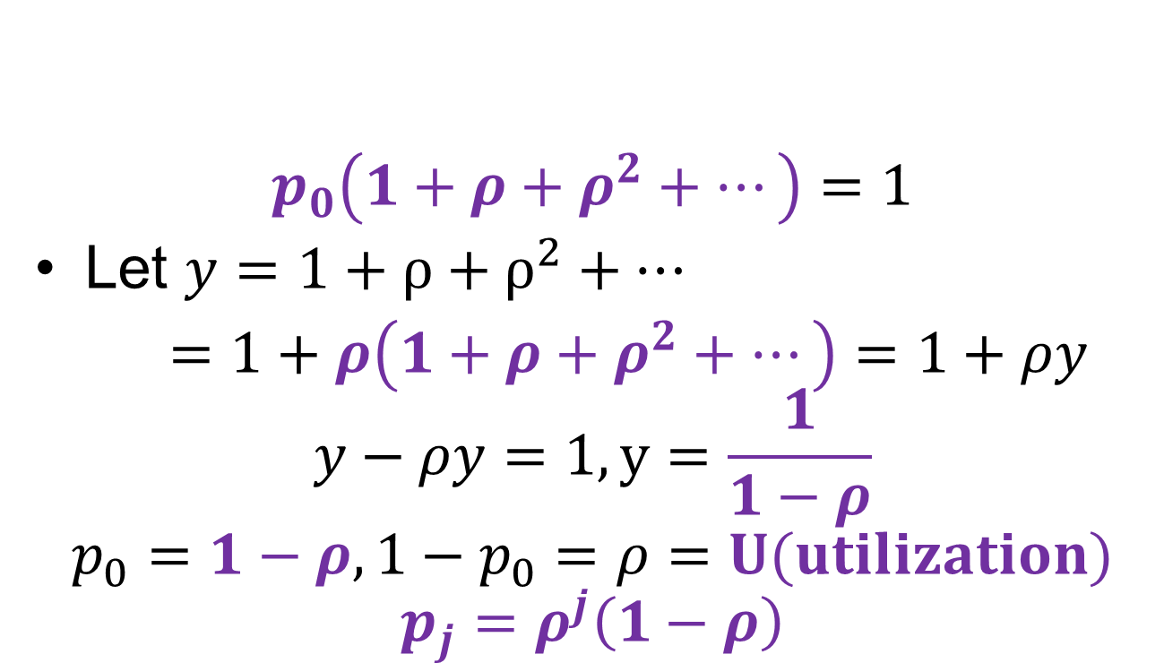
Σp_{j}=1
λ
λ
λ
λ
λ
λ
λ
$$p_{0}\left(1+ρ+ρ^{2}+…\right)=1$$
Let $y=$ $1+ρ+ρ^{2}+…$
$=1+ρ\left(1+ρ+ρ^{2}+…\right)=1+ρy$
$$y−ρy=1, y=\frac{1}{1−ρ}$$
$$p_{0}=1−ρ, 1−p_{0}=ρ=U(utilization)$$
$$p_{j}=ρ^{j}\left(1−ρ\right)$$
0
1
2
j-1
j
j+1
μ
μ
μ
μ
μ
μ
μ

Slide 14

Average Number of Jobs
$$E\left[n\right]= \sum_{i=0}^{∞}{ip_{i}=\sum_{i=0}^{∞}{iρ^{i}\left(1−ρ\right)}}$$
$$=\left(1−ρ\right)\sum_{i=0}^{∞}{iρ^{i}}$$

Slide 15
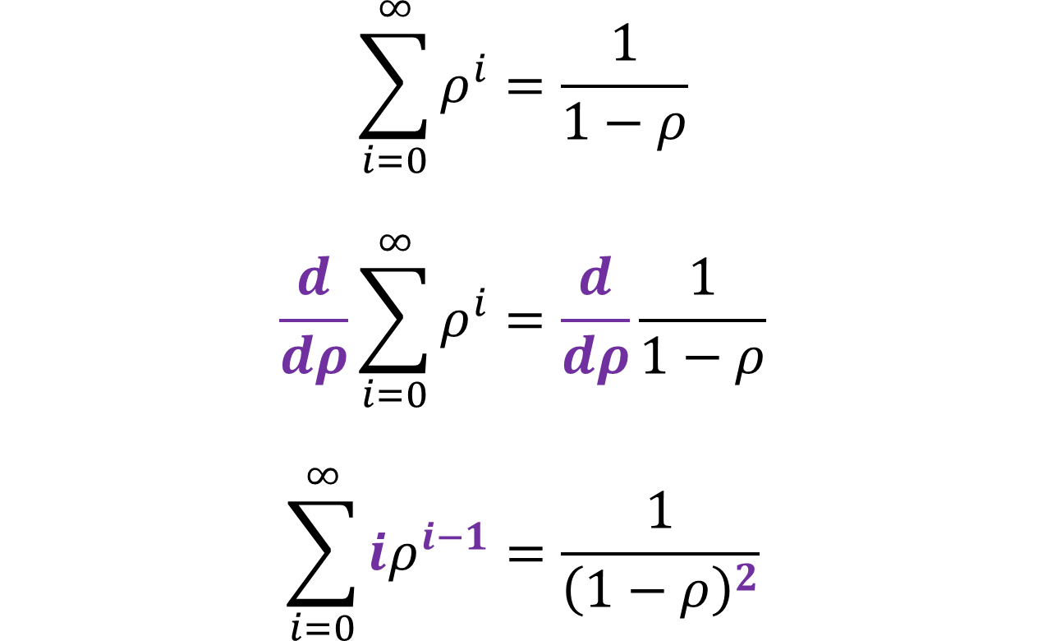
Recall
$$\sum_{i=0}^{∞}{ρ^{i}}=\frac{1}{1−ρ}$$
$$\frac{d}{dρ}\sum_{i=0}^{∞}{ρ^{i}}=\frac{d}{dρ}\frac{1}{1−ρ}$$
$$\sum_{i=0}^{∞}{{iρ}^{i−1}}=\frac{1}{{\left(1−ρ\right)}^{2}}$$

Slide 16
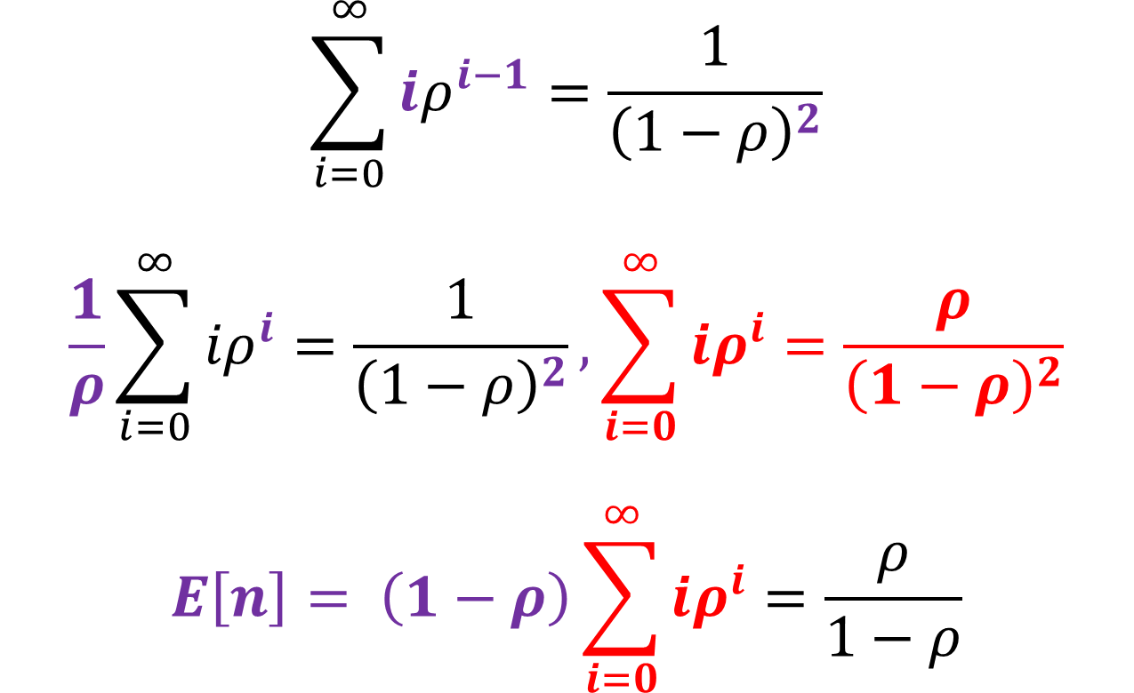
Recall
$$\sum_{i=0}^{∞}{{iρ}^{i−1}}=\frac{1}{{\left(1−ρ\right)}^{2}}$$
$$\frac{1}{ρ}\sum_{i=0}^{∞}{{iρ}^{i}}=\frac{1}{{\left(1−ρ\right)}^{2}}, \sum_{i=0}^{∞}{{iρ}^{i}}=\frac{ρ}{{\left(1−ρ\right)}^{2}}$$
$$E\left[n\right]= \left(1−ρ\right)\sum_{i=0}^{∞}{iρ^{i}=\frac{ρ}{1−ρ}}$$

Slide 17
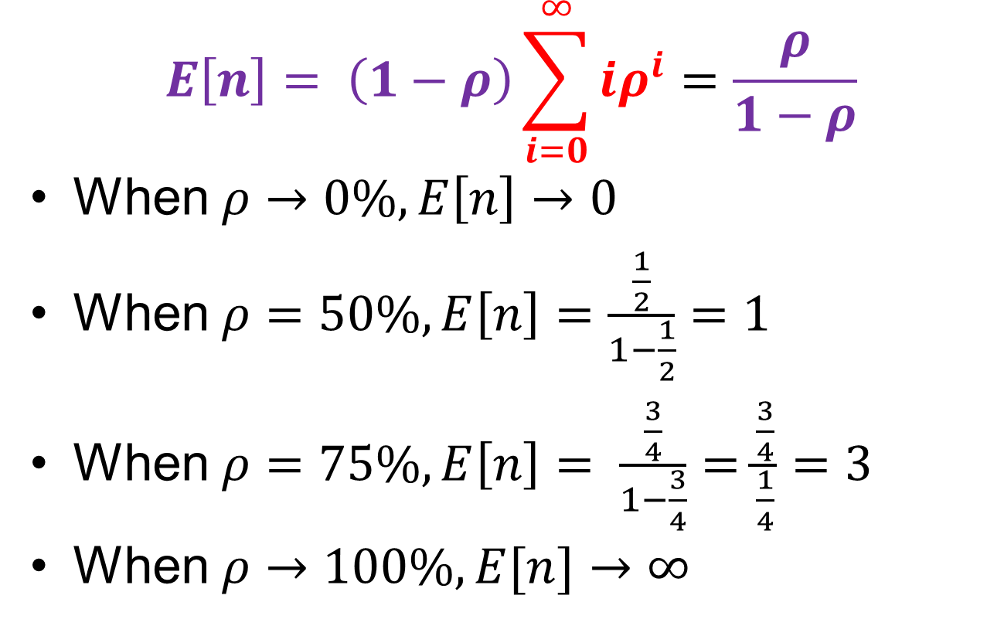
Average Number of Jobs
$$E\left[n\right]= \left(1−ρ\right)\sum_{i=0}^{∞}{iρ^{i}=\frac{ρ}{1−ρ}}$$
When $ρ→0\%, E\left[n\right]→0$
When $ρ=50\%, E\left[n\right]=\frac{\frac{1}{2}}{1−\frac{1}{2}}=1$
When $ρ=75\%, E\left[n\right]= \frac{\frac{3}{4}}{1−\frac{3}{4}}=\frac{\frac{3}{4}}{\frac{1}{4}}=3$
When $ρ→100\%, E[n]→∞$

Slide 18

Average Number of Jobs
$$E\left[n\right]= \left(1−ρ\right)\sum_{i=0}^{∞}{iρ^{i}=\frac{ρ}{1−ρ}}$$

Slide 19
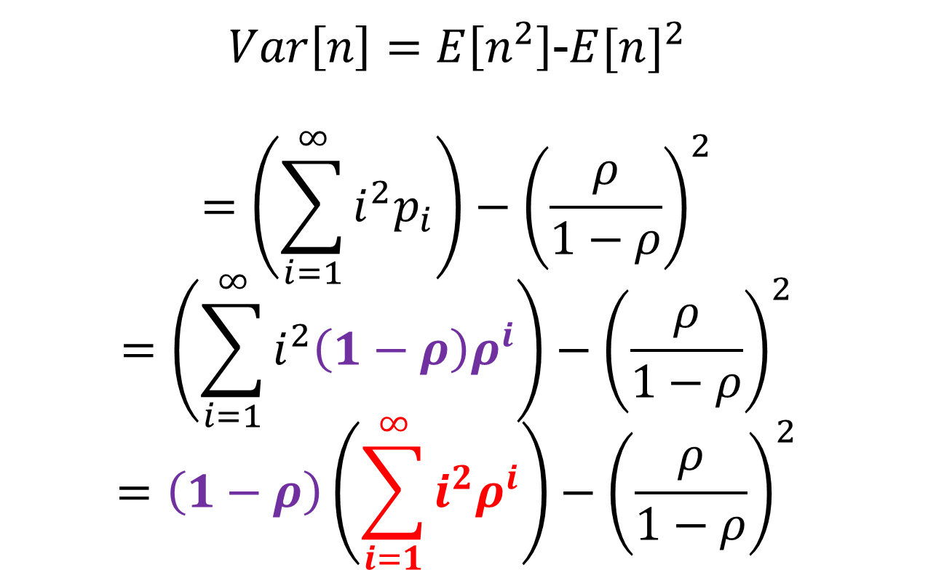
Variance of N
$Var\left[n\right]=E\left[n^{2}\right]$-${E[n]}^{2}$
$$=\left(\sum_{i=1}^{∞}{i^{2}p_{i}}\right)−{\left(\frac{ρ}{1−ρ}\right)}^{2}$$
$$=\left(\sum_{i=1}^{∞}{i^{2}\left(1−ρ\right)ρ^{i}}\right)−{\left(\frac{ρ}{1−ρ}\right)}^{2}$$
$$=\left(1−ρ\right)\left(\sum_{i=1}^{∞}{i^{2}ρ^{i}}\right)−{\left(\frac{ρ}{1−ρ}\right)}^{2}$$

Slide 20
Recall
$$\sum_{i=0}^{∞}{ρ^{i}}=\frac{1}{1−ρ}$$
$$\frac{d}{dρ}\sum_{i=0}^{∞}{ρ^{i}}=\frac{d}{dρ}\frac{1}{1−ρ}$$
$$\sum_{i=0}^{∞}{{iρ}^{i−1}}=\frac{1}{{\left(1−ρ\right)}^{2}}$$

Slide 21
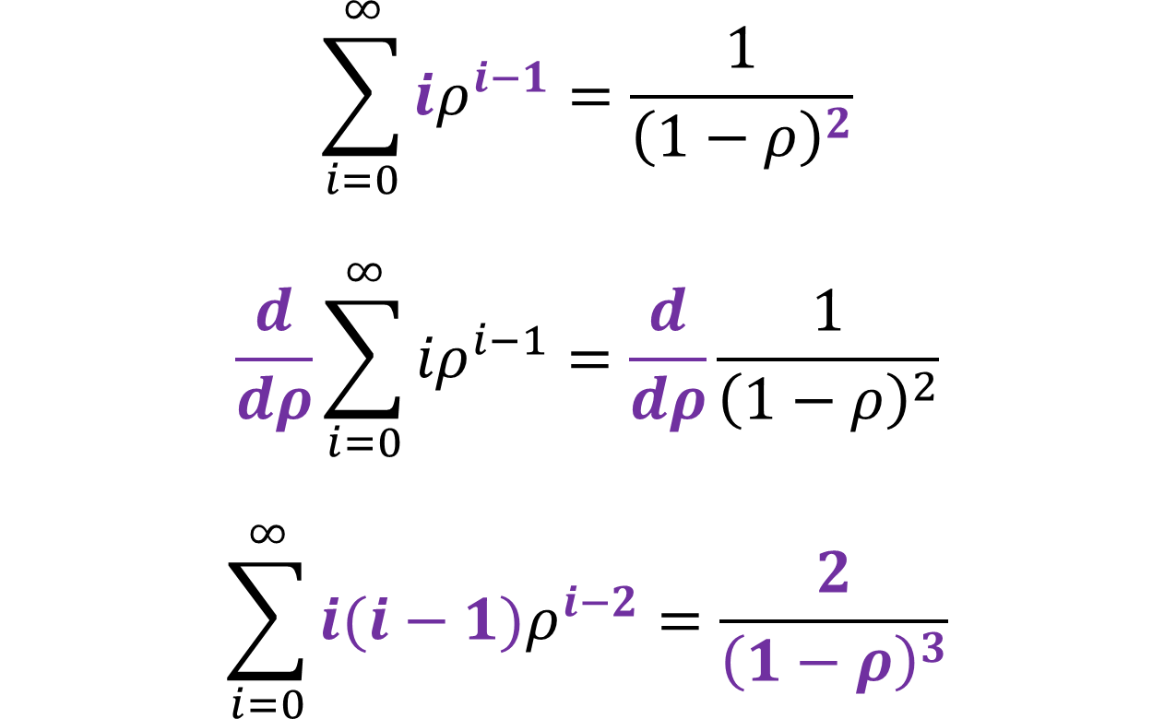
Recall
$$\sum_{i=0}^{∞}{{iρ}^{i−1}}=\frac{1}{{\left(1−ρ\right)}^{2}}$$
$$\frac{d}{dρ}\sum_{i=0}^{∞}{{iρ}^{i−1}}=\frac{d}{dρ}\frac{1}{{\left(1−ρ\right)}^{2}}$$
$$\sum_{i=0}^{∞}{{i(i−1)ρ}^{i−2}}=\frac{2}{{\left(1−ρ\right)}^{3}}$$

Slide 22
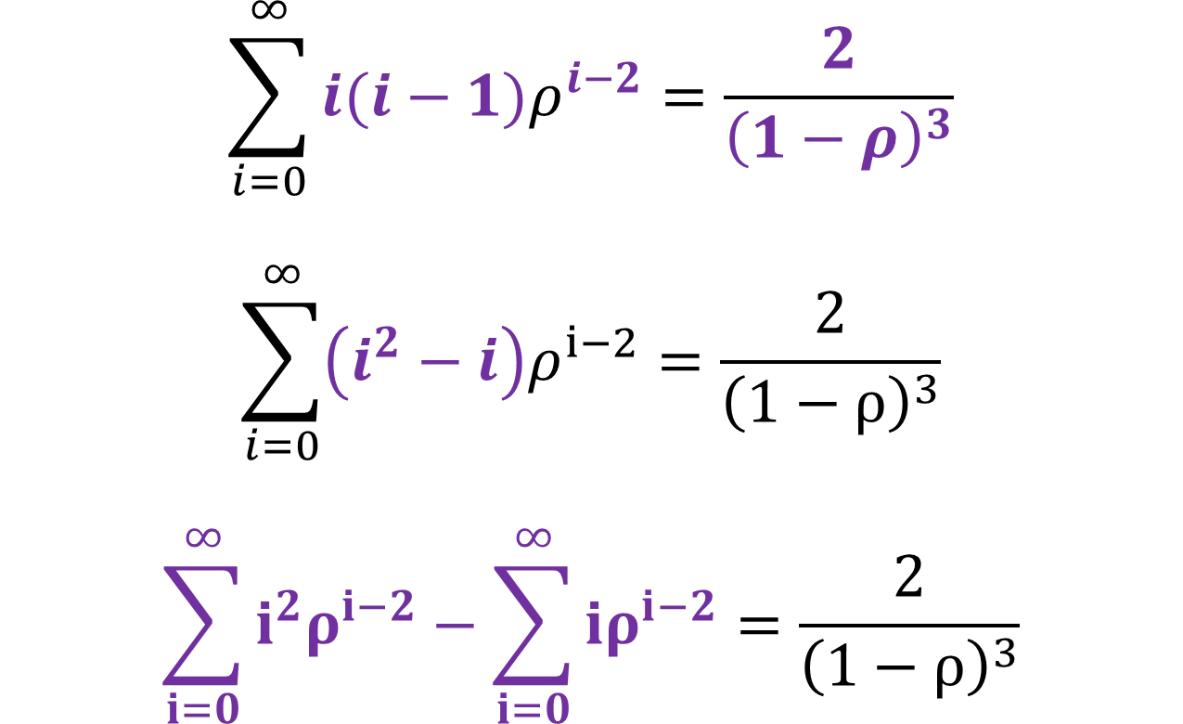
Recall
$$\sum_{i=0}^{∞}{{i(i−1)ρ}^{i−2}}=\frac{2}{{\left(1−ρ\right)}^{3}}$$
$$\sum_{i=0}^{∞}{{\left(i^{2}−i\right)ρ}^{i−2}}=\frac{2}{{\left(1−ρ\right)}^{3}}$$
$$\sum_{i=0}^{∞}{{i^{2}ρ}^{i−2}−\sum_{i=0}^{∞}{iρ^{i−2}}}=\frac{2}{{\left(1−ρ\right)}^{3}}$$

Slide 23
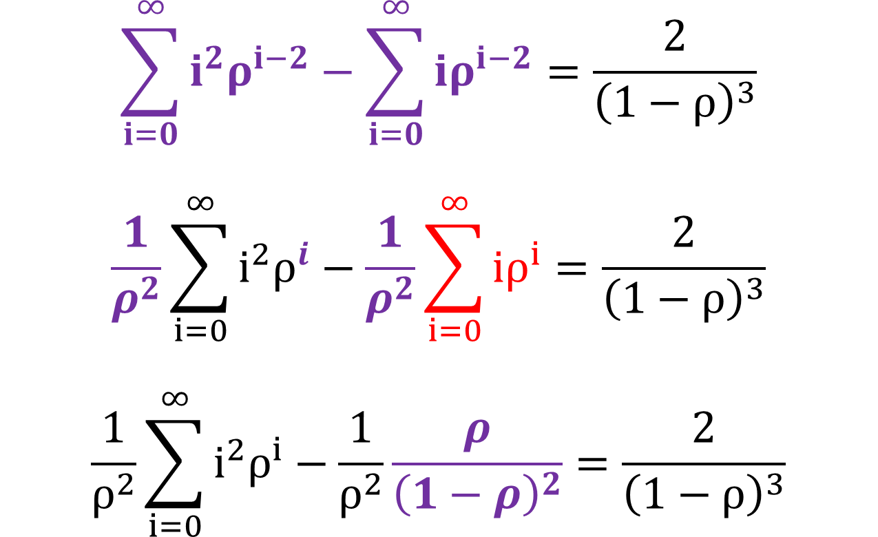
Recall
$$\sum_{i=0}^{∞}{{i^{2}ρ}^{i−2}−\sum_{i=0}^{∞}{iρ^{i−2}}}=\frac{2}{{\left(1−ρ\right)}^{3}}$$
$$\frac{1}{ρ^{2}}\sum_{i=0}^{∞}{{i^{2}ρ}^{i}−\frac{1}{ρ^{2}}\sum_{i=0}^{∞}{iρ^{i}}}=\frac{2}{{\left(1−ρ\right)}^{3}}$$
$$\frac{1}{ρ^{2}}\sum_{i=0}^{∞}{{i^{2}ρ}^{i}−\frac{1}{ρ^{2}}\frac{ρ}{{\left(1−ρ\right)}^{2}}}=\frac{2}{{\left(1−ρ\right)}^{3}}$$

Slide 24
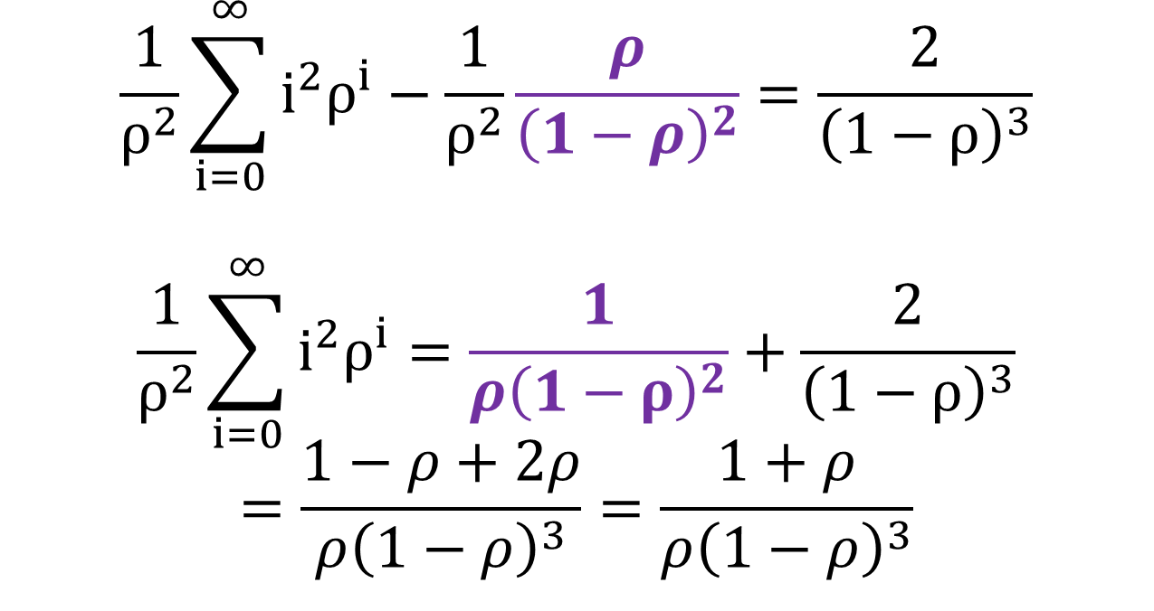
Recall
$$\frac{1}{ρ^{2}}\sum_{i=0}^{∞}{{i^{2}ρ}^{i}−\frac{1}{ρ^{2}}\frac{ρ}{{\left(1−ρ\right)}^{2}}}=\frac{2}{{\left(1−ρ\right)}^{3}}$$
$$\frac{1}{ρ^{2}}\sum_{i=0}^{∞}{{i^{2}ρ}^{i}=\frac{1}{{ρ\left(1−ρ\right)}^{2}}}+\frac{2}{{\left(1−ρ\right)}^{3}}$$
$$=\frac{1−ρ+2ρ}{ρ{\left(1−ρ\right)}^{3}}=\frac{1+ρ}{ρ{\left(1−ρ\right)}^{3}}$$

Slide 25

Recall
$$\frac{1}{ρ^{2}}\sum_{i=0}^{∞}{{i^{2}ρ}^{i}=}\frac{1+ρ}{ρ{\left(1−ρ\right)}^{3}}$$
$$\sum_{i=0}^{∞}{{i^{2}ρ}^{i}=}\frac{ρ\left(1+ρ\right)}{{\left(1−ρ\right)}^{3}}$$

Slide 26
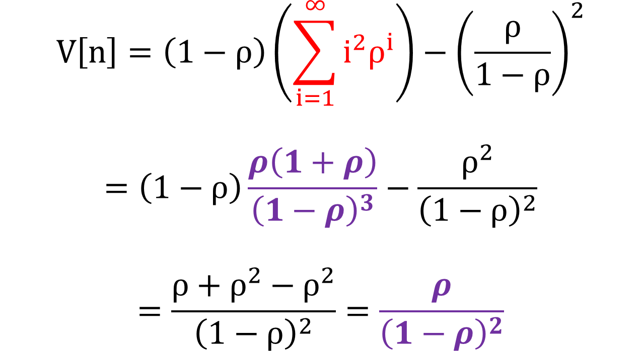
Plug in the value
$$V\left[n\right]=\left(1−ρ\right)\left(\sum_{i=1}^{∞}{i^{2}ρ^{i}}\right)−{\left(\frac{ρ}{1−ρ}\right)}^{2}$$
$$=\left(1−ρ\right)\frac{ρ\left(1+ρ\right)}{{\left(1−ρ\right)}^{3}}−\frac{ρ^{2}}{{\left(1−ρ\right)}^{2}}$$
$$=\frac{ρ+ρ^{2}−ρ^{2}}{{\left(1−ρ\right)}^{2}}=\frac{ρ}{{\left(1−ρ\right)}^{2}}$$

Slide 27

Variance of N
$$V\left[n\right]=\frac{ρ}{{\left(1−ρ\right)}^{2}}$$

Slide 28
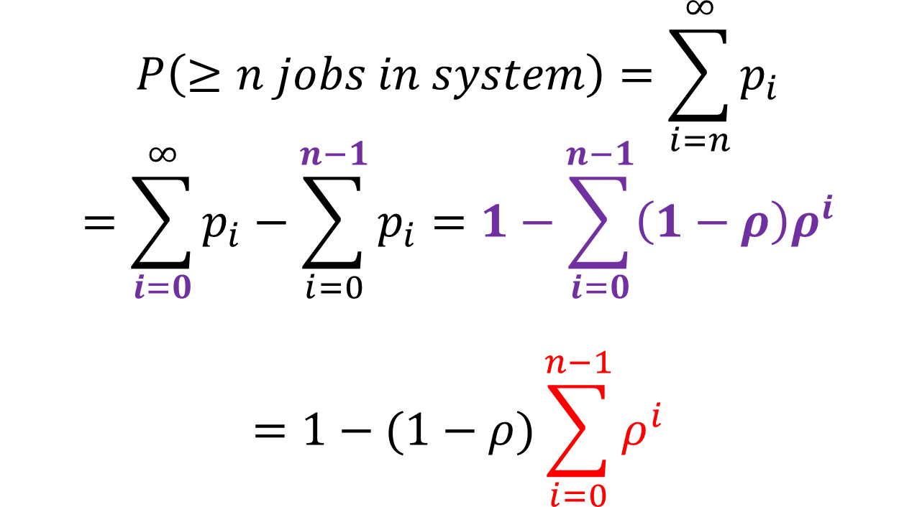
P(>n jobs in system)
$$P\left(≥n jobs in system\right)=\sum_{i=n}^{∞}{p_{i}}$$
$$=\sum_{i=0}^{∞}{p_{i}−\sum_{i=0}^{n−1}{p_{i}}=1−\sum_{i=0}^{n−1}{\left(1−ρ\right)ρ^{i}}}$$
$$=1−(1−ρ)\sum_{i=0}^{n−1}{ρ^{i}}$$

Slide 29
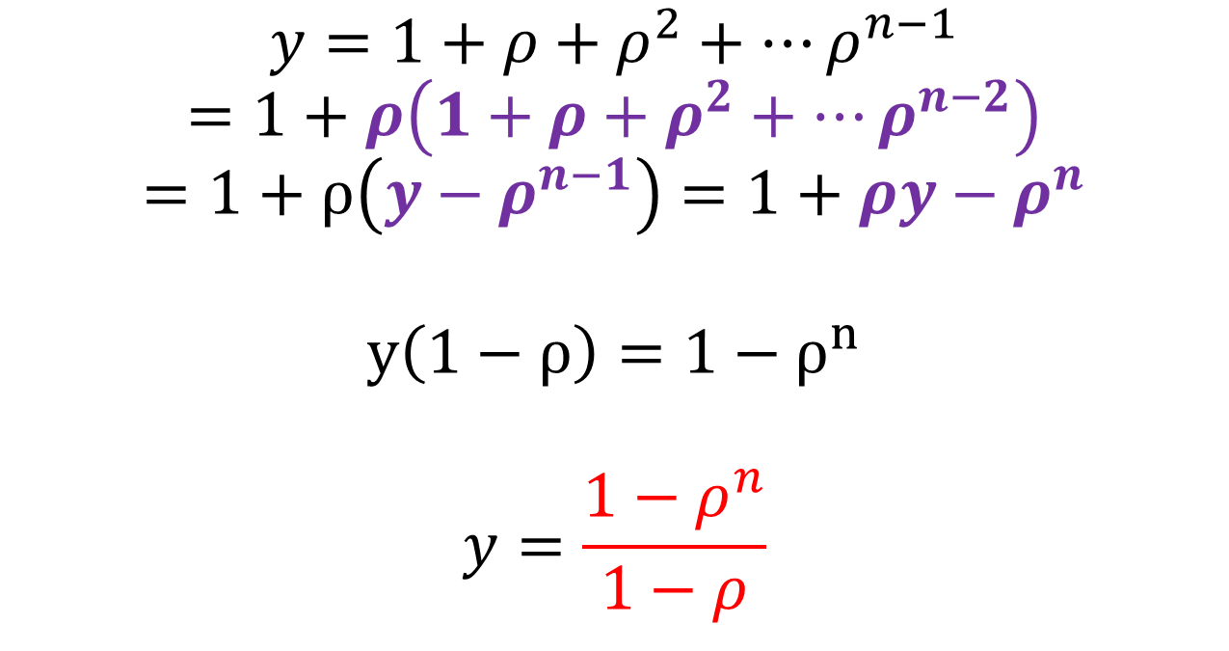
Compute the Bounded Sum
$$y=1+ρ+ρ^{2}+…ρ^{n−1}$$
$$=1+ρ\left(1+ρ+ρ^{2}+…ρ^{n−2}\right)$$
$$=1+ρ\left(y−ρ^{n−1}\right)=1+ρy−ρ^{n}$$
$$y\left(1−ρ\right)=1−ρ^{n}$$
$$y=\frac{1−ρ^{n}}{1−ρ}$$

Slide 30

P(>n jobs in the system)
$$P\left(≥n jobs \right)=1−(1−ρ)\sum_{i=0}^{n−1}{ρ^{i}}$$
$$=1−\left(1−ρ\right)\frac{1−ρ^{n}}{1−ρ}=ρ^{n}$$

Slide 31
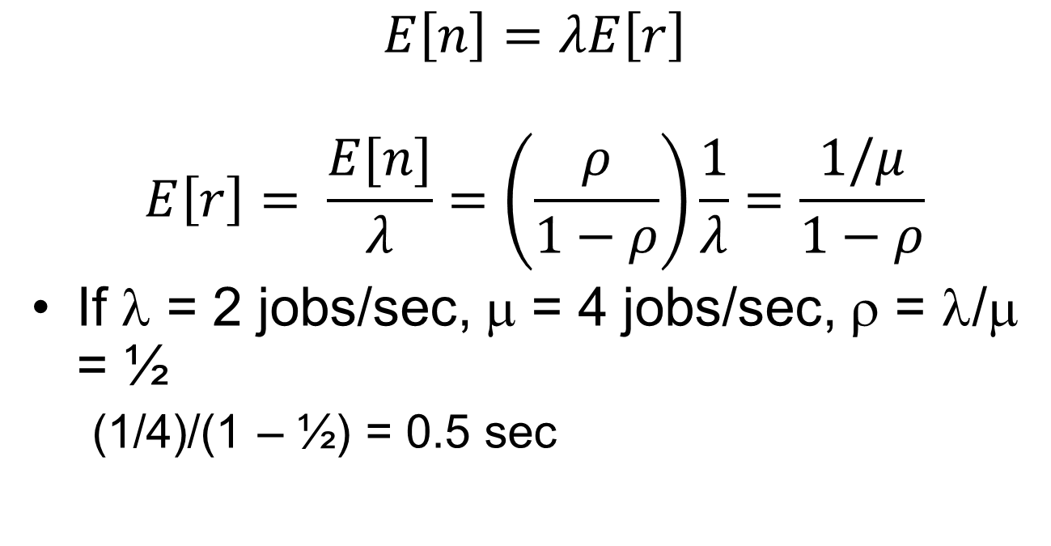
Mean Response Time
$$E\left[n\right]=λE\left[r\right]$$
$$E\left[r\right]= \frac{E[n]}{λ}=\left(\frac{ρ}{1−ρ}\right)\frac{1}{λ}=\frac{1/μ}{1−ρ}$$
If λ = 2 jobs/sec, μ = 4 jobs/sec, ρ = λ/μ = ½
  (1/4)/(1 – ½) = 0.5 sec

Slide 32
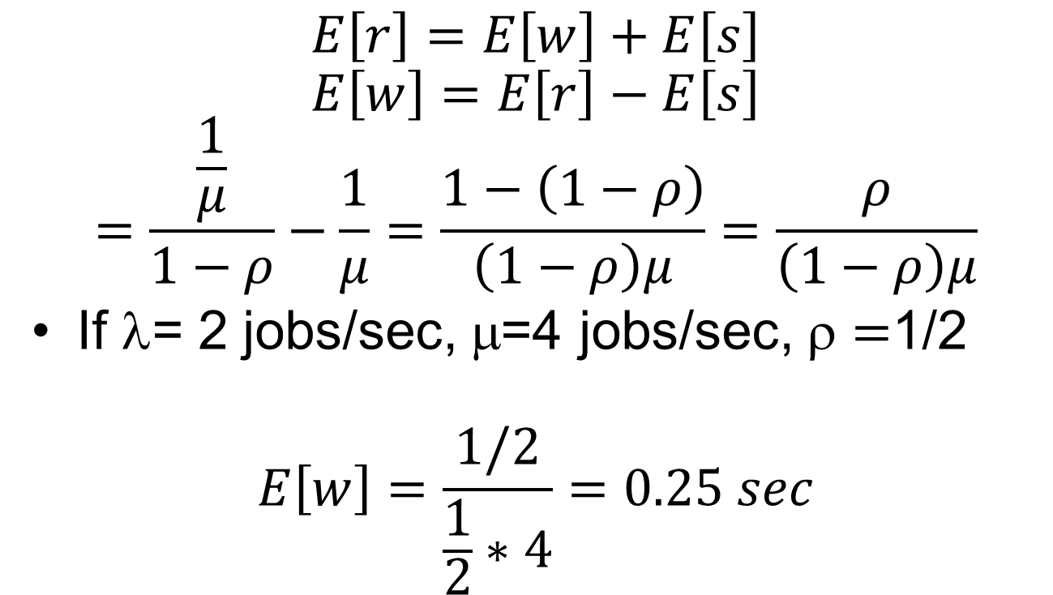
Mean Waiting Time
$$E\left[r\right]=E\left[w\right]+E\left[s\right]$$
$$E\left[w\right]=E\left[r\right]−E\left[s\right]$$
$$=\frac{\frac{1}{μ}}{1−ρ}−\frac{1}{μ}=\frac{1−\left(1−ρ\right)}{\left(1−ρ\right)μ}=\frac{ρ}{\left(1−ρ\right)μ}$$
If λ= 2 jobs/sec, μ=4 jobs/sec, $=$1/2
$$E\left[w\right]=\frac{1/2}{\frac{1}{2}∗4}=0.25 sec$$

Slide 33
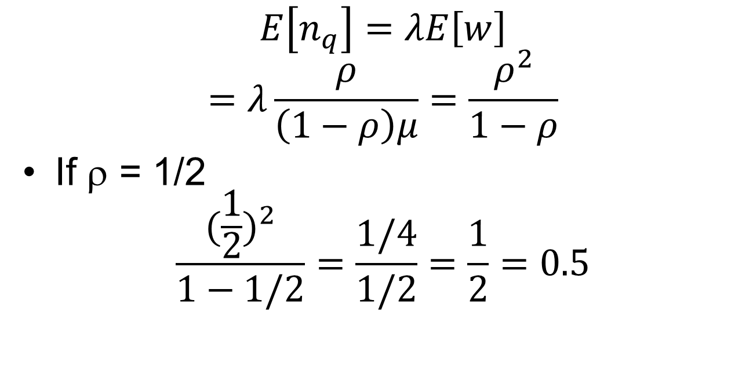
Mean Number of Jobs in the Queue
$$E\left[n_{q}\right]=λE\left[w\right]$$
$$=λ\frac{ρ}{\left(1−ρ\right)μ}=\frac{ρ^{2}}{1−ρ}$$
If ρ = 1/2
$$\frac{{(\frac{1}{2})}^{2}}{1−1/2}=\frac{1/4}{1/2}=\frac{1}{2}=0.5$$

Slide 34
An Network Gateway Example
Arrival rate λ = 125 packets/sec
Service time E[s] = 2 msec
  μ = 1/0.002 = 500 packets/sec
Buffer size: 13 packets
Gateway utilization ρ = λ/μ = 0.25
Mean number of packets E[n] = ρ/(1-ρ) = .25/.75 = 0.33

Slide 35
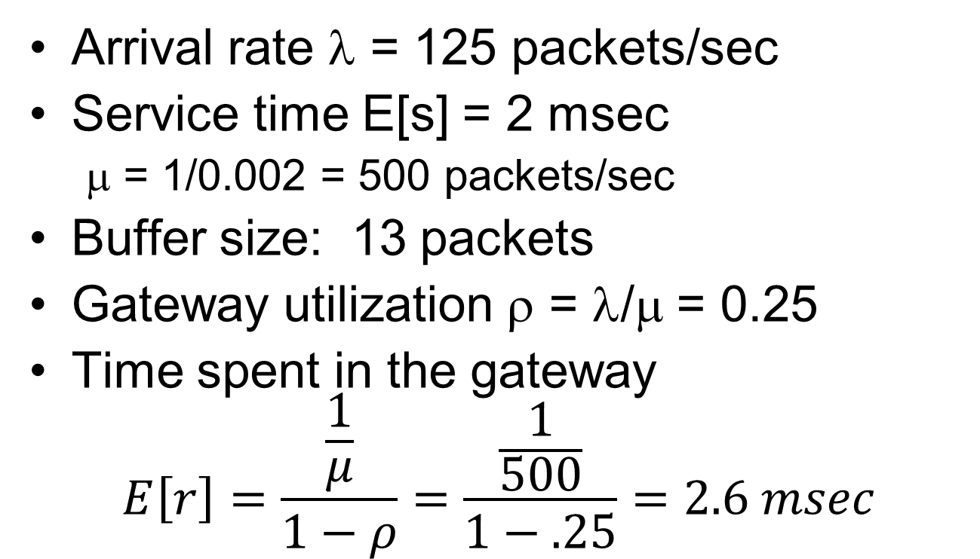
An Network Gateway Example
Arrival rate λ = 125 packets/sec
Service time E[s] = 2 msec
  μ = 1/0.002 = 500 packets/sec
Buffer size: 13 packets
Gateway utilization ρ = λ/μ = 0.25
Time spent in the gateway
$$E\left[r\right]=\frac{\frac{1}{μ}}{1−ρ}=\frac{\frac{1}{500}}{1−.25}=2.6 msec$$

Slide 36

An Network Gateway Example
Time spent in the gateway
$$E\left[r\right]=\frac{\frac{1}{μ}}{1−ρ}=\frac{\frac{1}{500}}{1−.25}=2.6 msec$$

Slide 37
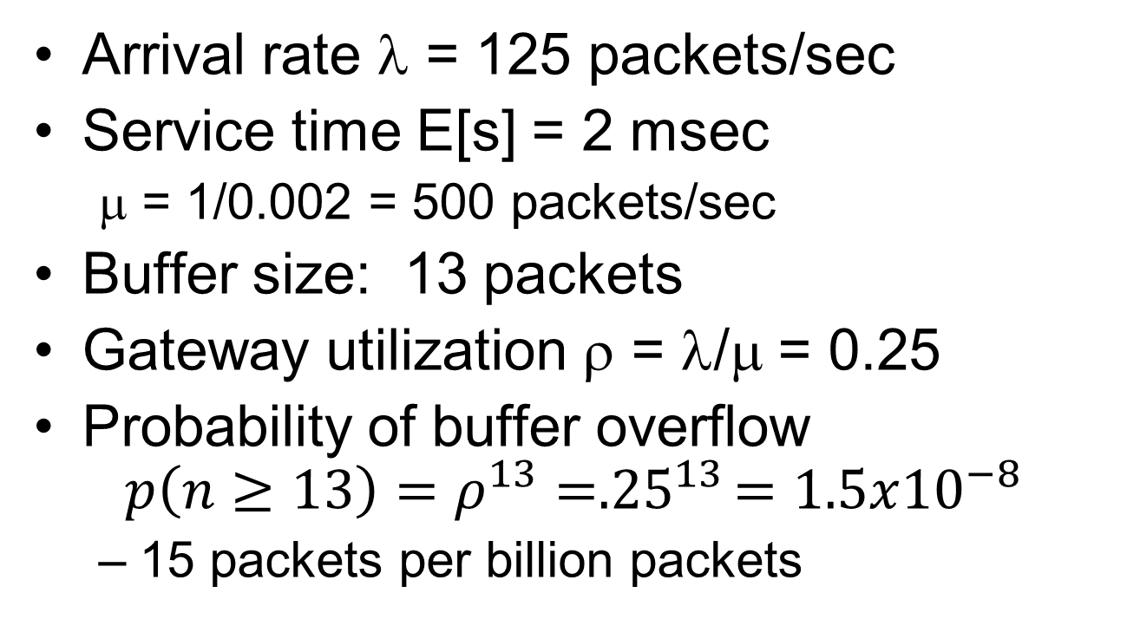
An Network Gateway Example
Arrival rate λ = 125 packets/sec
Service time E[s] = 2 msec
  μ = 1/0.002 = 500 packets/sec
Buffer size: 13 packets
Gateway utilization ρ = λ/μ = 0.25
Probability of buffer overflow
$$p\left(n≥13\right)=ρ^{13}={.25}^{13}=1.5x{10}^{−8}$$
  15 packets per billion packets

Slide 38
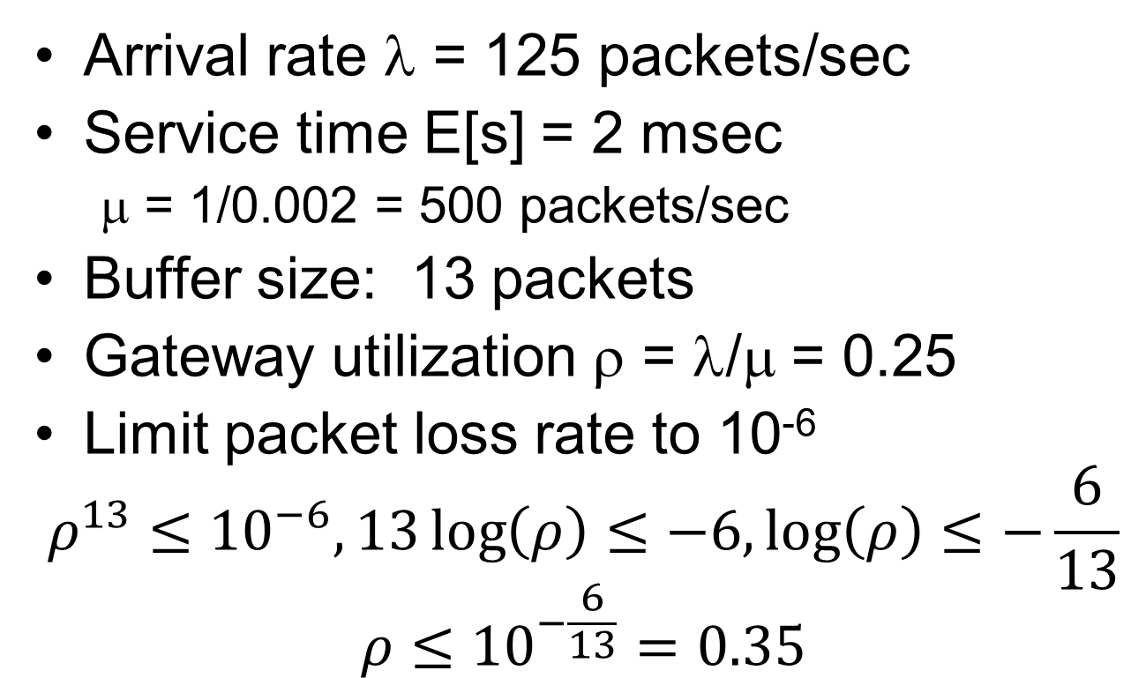
An Network Gateway Example
Arrival rate λ = 125 packets/sec
Service time E[s] = 2 msec
  μ = 1/0.002 = 500 packets/sec
Buffer size: 13 packets
Gateway utilization ρ = λ/μ = 0.25
Limit packet loss rate to 10⁻⁶
$$ρ^{13}≤{10}^{−6}, 13\log\left(ρ\right)≤−6,\log\left(ρ\right)≤−\frac{6}{13}$$
$$ρ≤{10}^{−\frac{6}{13}}=0.35$$

Slide 39
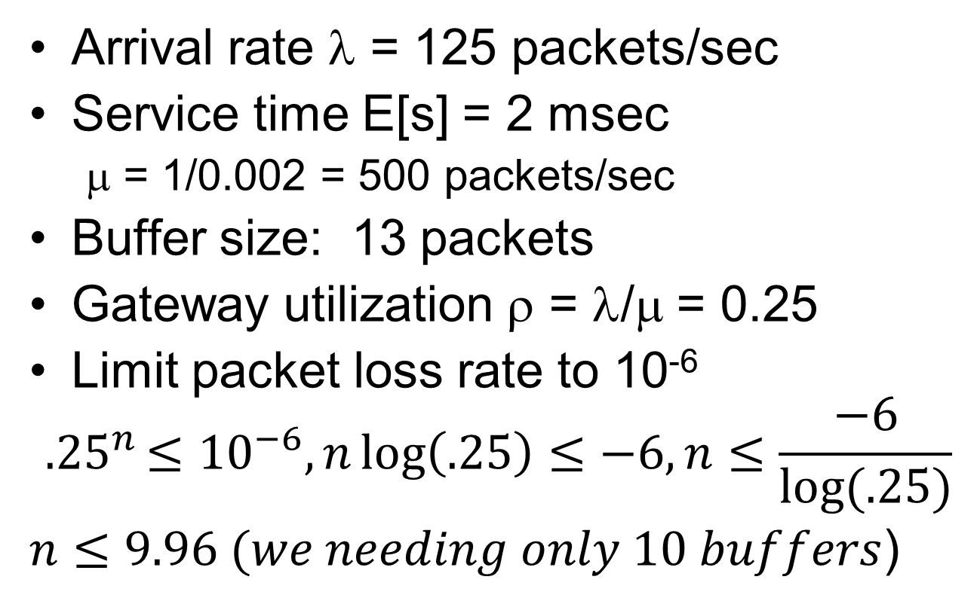
An Network Gateway Example
Arrival rate λ = 125 packets/sec
Service time E[s] = 2 msec
  μ = 1/0.002 = 500 packets/sec
Buffer size: 13 packets
Gateway utilization ρ = λ/μ = 0.25
Limit packet loss rate to 10⁻⁶
$${.25}^{n}≤{10}^{−6}, n\log\left(.25\right)≤−6, n≤\frac{−6}{log⁡(.25)}$$
$n≤9.96 (we needing only 10 buffers$)

Slide 40
M/M/m Queue
Models m processor systems or devices that have identical servers
Interarrival and service times (λ/μ) for each server are exponentially distributed
Queueing starts when > m jobs being served
No buffer or population limitations
FCFS service discipline for each server

Slide 41
M/M/m Queue
λ
λ
λ
λ
λ
λ
λ
Each state represents the probability of n jobs in a system
At steady state, inflow probability of a state equals the outflow probability of a state
0
1
2
m-1
m
m+1
μ
2μ
3μ
(m-1)μ
mμ
mμ
mμ

Slide 42

M/M/m Queue
λ
λ
λ
λ
λ
λ
λ
Start with P₁
$$μp_{1}=λp_{0}$$
$$p_{1}=\frac{λ}{μ}p_{0}$$
0
1
2
m-1
m
m+1
μ
2μ
3μ
(m-1)μ
mμ
mμ
mμ

Slide 43
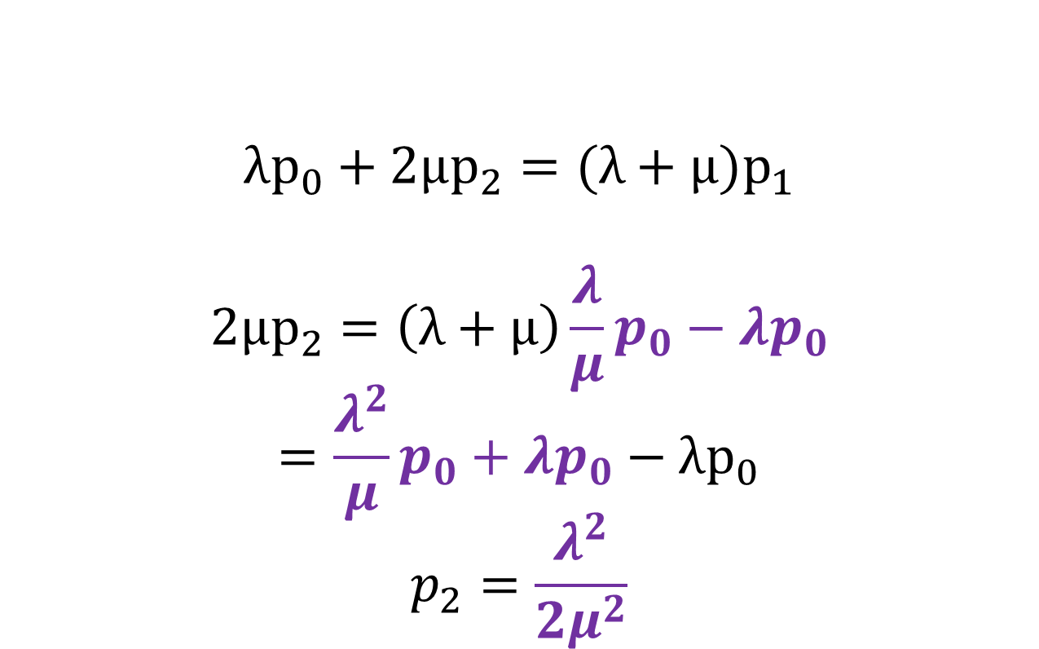
p₂
λ
λ
λ
λ
λ
λ
λ
$$λp_{0}+2μp_{2}=(λ+μ)p_{1}$$
$$2μp_{2}=\left(λ+μ\right)\frac{λ}{μ}p_{0}−λp_{0}$$
$$=\frac{λ^{2}}{μ}p_{0}+λp_{0}−λp_{0}$$
$$p_{2}=\frac{λ^{2}}{2μ^{2}}$$
0
1
2
m-1
m
m+1
μ
2μ
3μ
(m-1)μ
mμ
mμ
mμ

Slide 44
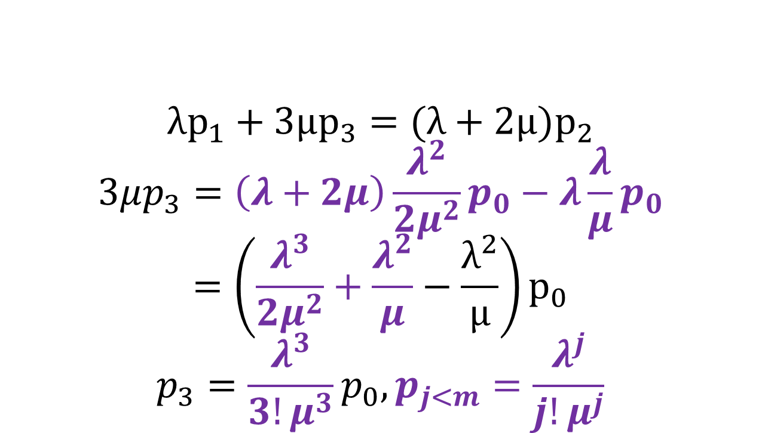
p₃, p_{j<m}
λ
λ
λ
λ
λ
λ
λ
$$λp_{1}+3μp_{3}=(λ+2μ)p_{2}$$
$$3μp_{3}=\left(λ+2μ\right)\frac{λ^{2}}{2μ^{2}}p_{0}−λ\frac{λ}{μ}p_{0}$$
$$=\left(\frac{λ^{3}}{2μ^{2}}+\frac{λ^{2}}{μ}−\frac{λ^{2}}{μ}\right)p_{0}$$
$$p_{3}=\frac{λ^{3}}{3!μ^{3}}p_{0}, p_{j<m}=\frac{λ^{j}}{j!μ^{j}}$$
0
1
2
m-1
m
m+1
μ
2μ
3μ
(m-1)μ
mμ
mμ
mμ

Slide 45
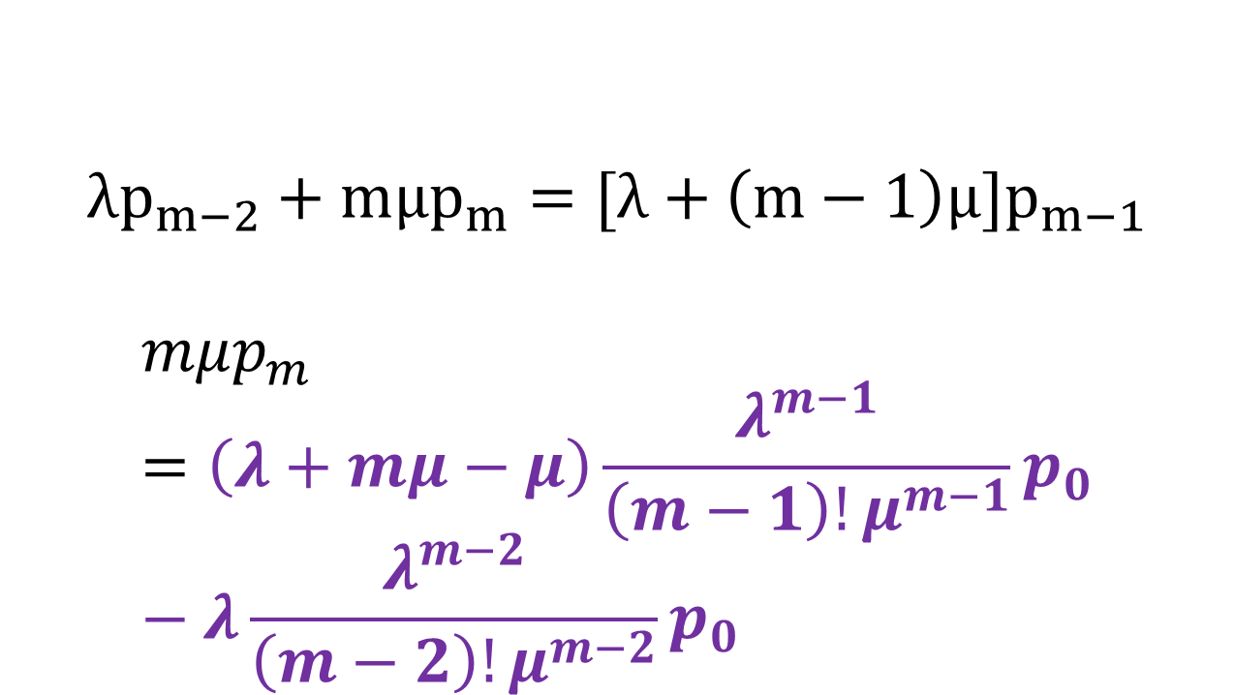
p_{m}
λ
λ
λ
λ
λ
λ
λ
$$λp_{m−2}+mμp_{m}=[λ+\left(m−1\right)μ]p_{m−1}$$
$$mμp_{m}=\left(λ+mμ−μ\right)\frac{λ^{m−1}}{\left(m−1\right)!μ^{m−1}}p_{0}−λ\frac{λ^{m−2}}{\left(m−2\right)!μ^{m−2}}p_{0}$$
0
1
2
m-1
m
m+1
μ
2μ
3μ
(m-1)μ
mμ
mμ
mμ

Slide 46
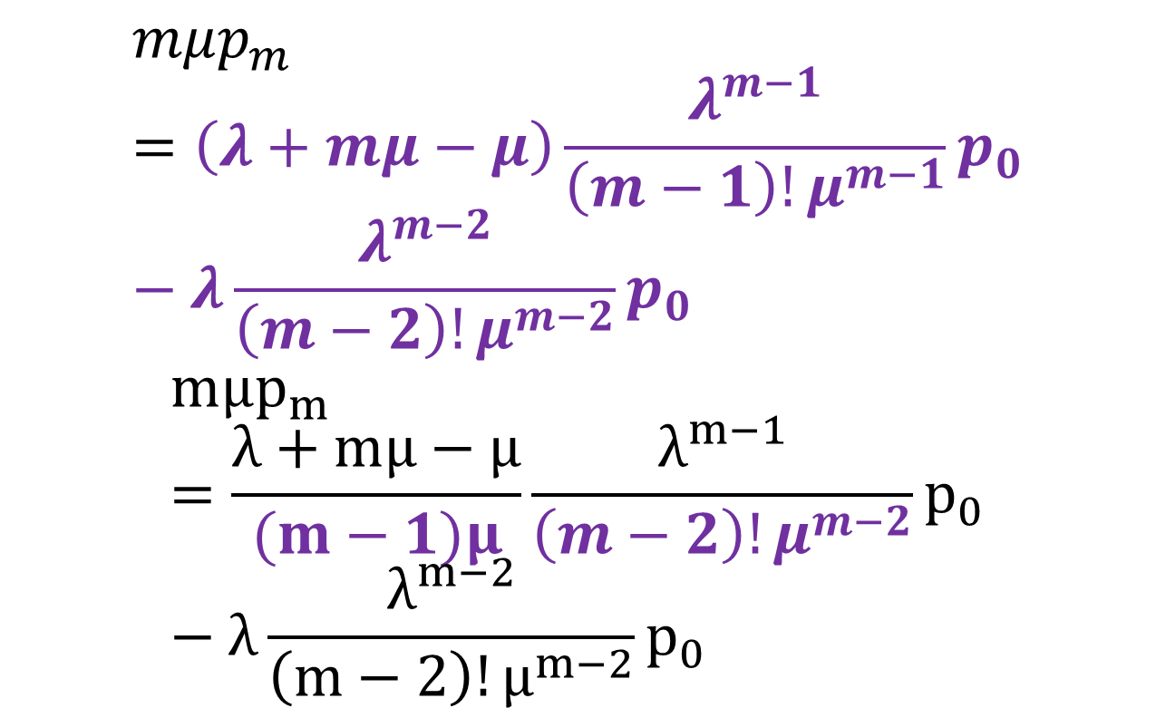
p_{m}
$$mμp_{m}=\left(λ+mμ−μ\right)\frac{λ^{m−1}}{\left(m−1\right)!μ^{m−1}}p_{0}−λ\frac{λ^{m−2}}{\left(m−2\right)!μ^{m−2}}p_{0}$$
$$mμp_{m}=\frac{λ+mμ−μ}{(m−1)μ}\frac{λ^{m−1}}{\left(m−2\right)!μ^{m−2}}p_{0}−λ\frac{λ^{m−2}}{\left(m−2\right)!μ^{m−2}}p_{0}$$

Slide 47
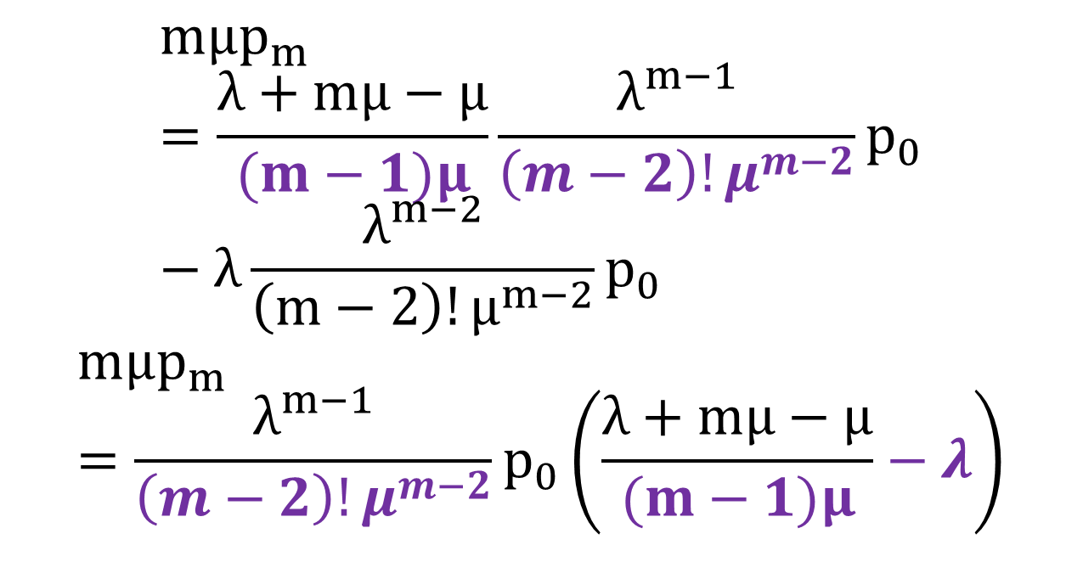
p_{m}
$$mμp_{m}=\frac{λ+mμ−μ}{(m−1)μ}\frac{λ^{m−1}}{\left(m−2\right)!μ^{m−2}}p_{0}−λ\frac{λ^{m−2}}{\left(m−2\right)!μ^{m−2}}p_{0}$$
$$mμp_{m}=\frac{λ^{m−1}}{\left(m−2\right)!μ^{m−2}}p_{0}\left(\frac{λ+mμ−μ}{(m−1)μ}−λ\right)$$

Slide 48
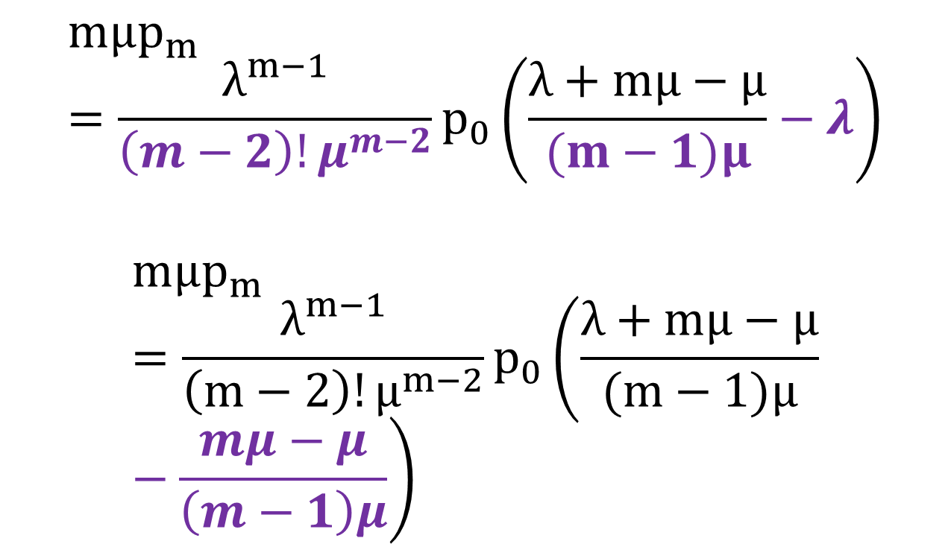
p_{m}
$$mμp_{m}=\frac{λ^{m−1}}{\left(m−2\right)!μ^{m−2}}p_{0}\left(\frac{λ+mμ−μ}{(m−1)μ}−λ\right)$$
$$mμp_{m}=\frac{λ^{m−1}}{\left(m−2\right)!μ^{m−2}}p_{0}\left(\frac{λ+mμ−μ}{(m−1)μ}−\frac{mμ−μ}{\left(m−1\right)μ}\right)$$

Slide 49
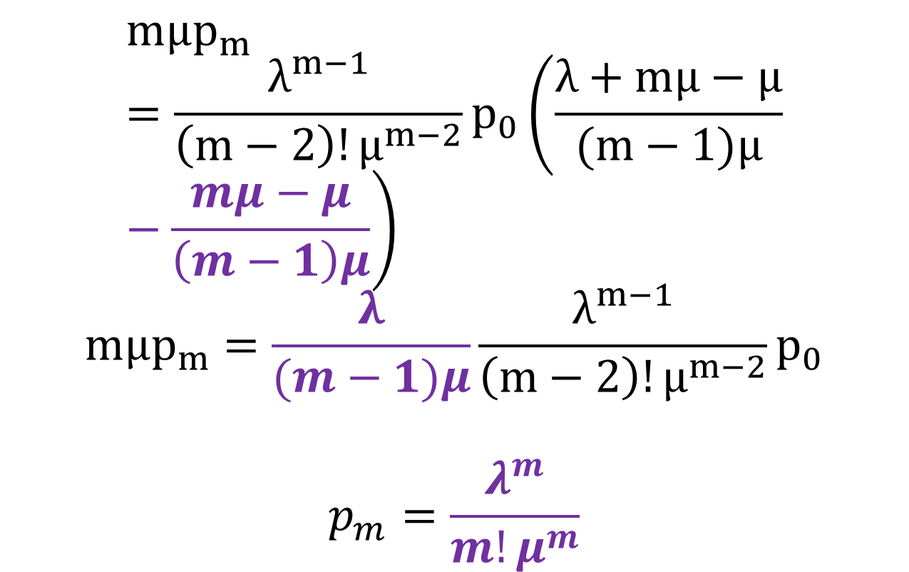
p_{m}
$$mμp_{m}=\frac{λ^{m−1}}{\left(m−2\right)!μ^{m−2}}p_{0}\left(\frac{λ+mμ−μ}{(m−1)μ}−\frac{mμ−μ}{\left(m−1\right)μ}\right)$$
$$mμp_{m}=\frac{λ}{(m−1)μ}\frac{λ^{m−1}}{\left(m−2\right)!μ^{m−2}}p_{0}$$
$$p_{m}=\frac{λ^{m}}{m!μ^{m}}$$

Slide 50
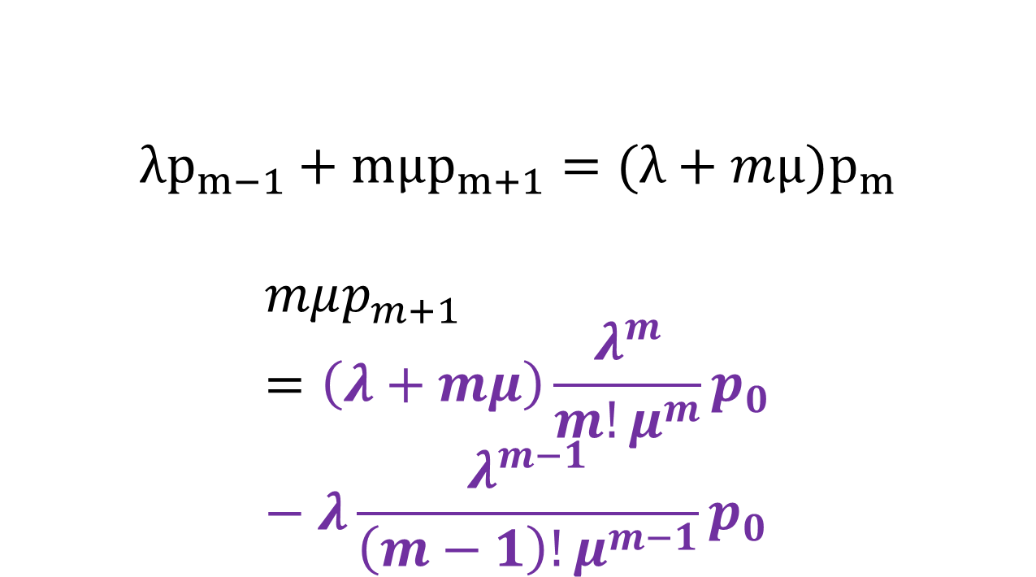
p_{m+1}
λ
λ
λ
λ
λ
λ
λ
$$λp_{m−1}+mμp_{m+1}=(λ+mμ)p_{m}$$
$$mμp_{m+1}=\left(λ+mμ\right)\frac{λ^{m}}{m!μ^{m}}p_{0}−λ\frac{λ^{m−1}}{\left(m−1\right)!μ^{m−1}}p_{0}$$
0
1
2
m-1
m
m+1
μ
2μ
3μ
(m-1)μ
mμ
mμ
mμ

Slide 51
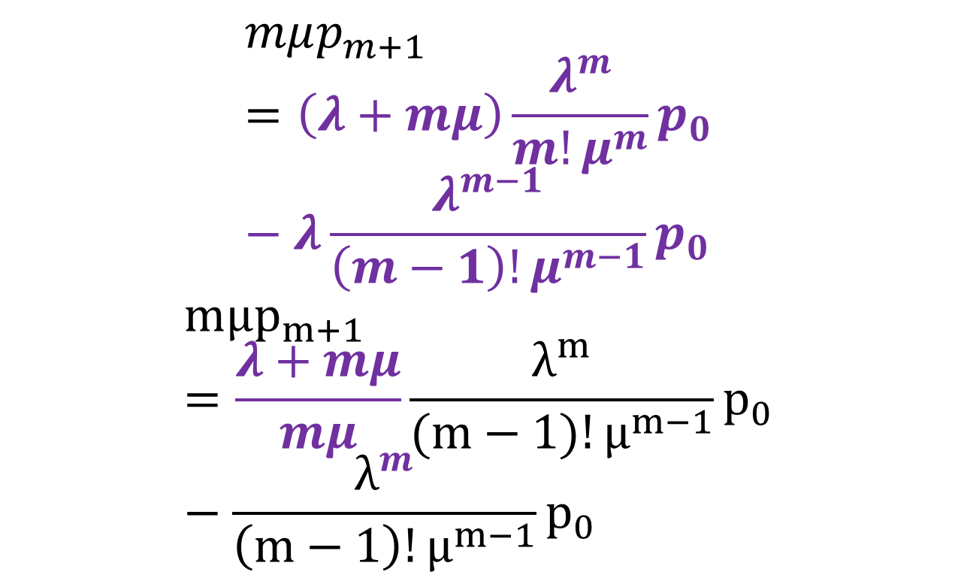
p_{m+1}
$$mμp_{m+1}=\left(λ+mμ\right)\frac{λ^{m}}{m!μ^{m}}p_{0}−λ\frac{λ^{m−1}}{\left(m−1\right)!μ^{m−1}}p_{0}$$
$$mμp_{m+1}=\frac{λ+mμ}{mμ}\frac{λ^{m}}{(m−1)!μ^{m−1}}p_{0}−\frac{λ^{m}}{\left(m−1\right)!μ^{m−1}}p_{0}$$

Slide 52
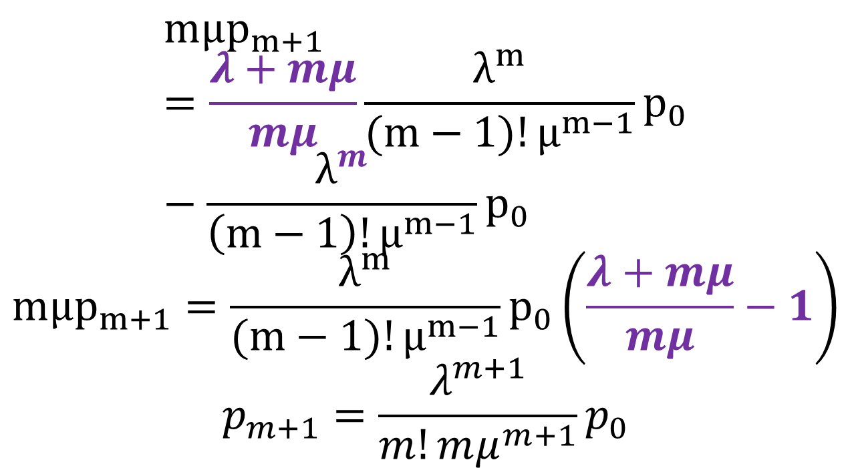
p_{m+1}
$$mμp_{m+1}=\frac{λ+mμ}{mμ}\frac{λ^{m}}{(m−1)!μ^{m−1}}p_{0}−\frac{λ^{m}}{\left(m−1\right)!μ^{m−1}}p_{0}$$
$$mμp_{m+1}=\frac{λ^{m}}{(m−1)!μ^{m−1}}p_{0}\left(\frac{λ+mμ}{mμ}−1\right)$$
$$p_{m+1}=\frac{λ^{m+1}}{m!mμ^{m+1}}p_{0}$$

Slide 53
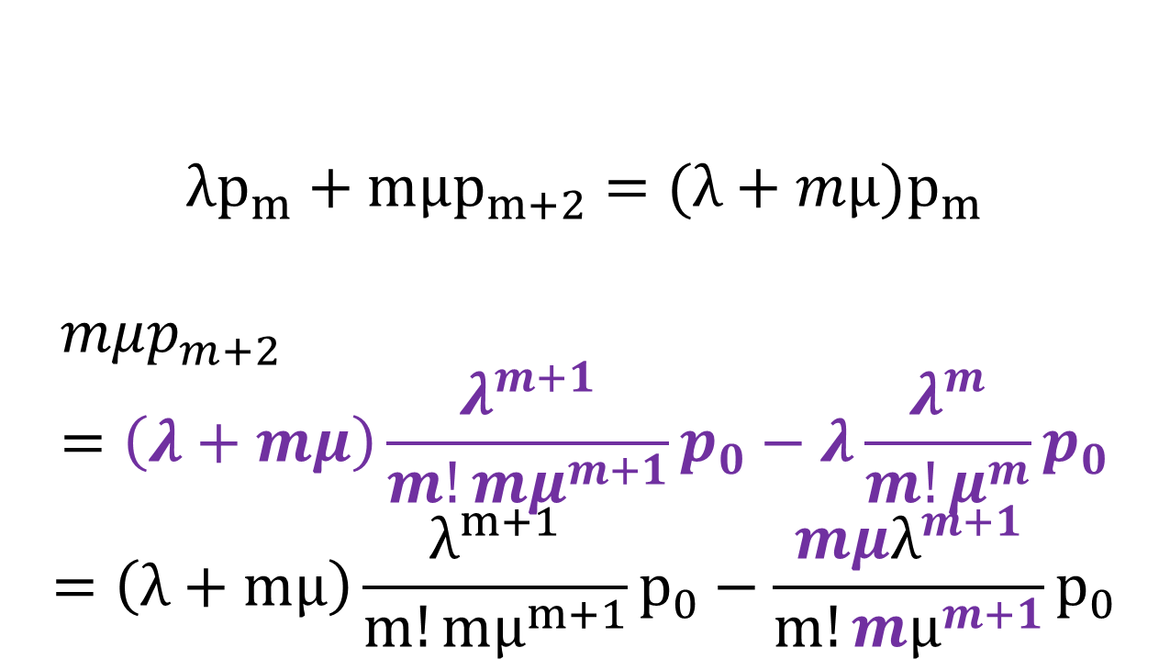
p_{m+2}
λ
λ
λ
λ
λ
λ
λ
$$λp_{m}+mμp_{m+2}=(λ+mμ)p_{m}$$
$$mμp_{m+2}=\left(λ+mμ\right)\frac{λ^{m+1}}{m!mμ^{m+1}}p_{0}−λ\frac{λ^{m}}{m!μ^{m}}p_{0}$$
$$=\left(λ+mμ\right)\frac{λ^{m+1}}{m!mμ^{m+1}}p_{0}−\frac{{mμλ}^{m+1}}{m!{mμ}^{m+1}}p_{0}$$
0
1
2
m-1
m
m+1
μ
2μ
3μ
(m-1)μ
mμ
mμ
mμ

Slide 54
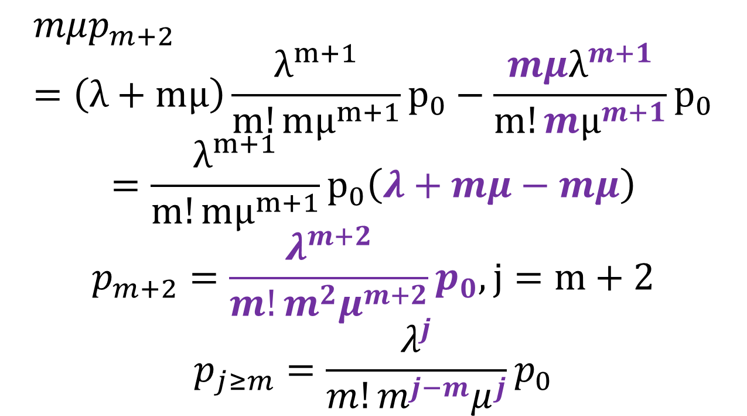
p_{m+2}, p_{j>m}
$$mμp_{m+2}=\left(λ+mμ\right)\frac{λ^{m+1}}{m!mμ^{m+1}}p_{0}−\frac{{mμλ}^{m+1}}{m!{mμ}^{m+1}}p_{0}$$
$$=\frac{λ^{m+1}}{m!mμ^{m+1}}p_{0}\left(λ+mμ−mμ\right)$$
$$p_{m+2}=\frac{λ^{m+2}}{m!m^{2}μ^{m+2}}p_{0},j=m+2$$
$$p_{j≥m}=\frac{λ^{j}}{m!m^{j−m}μ^{j}}p_{0}$$

Slide 55
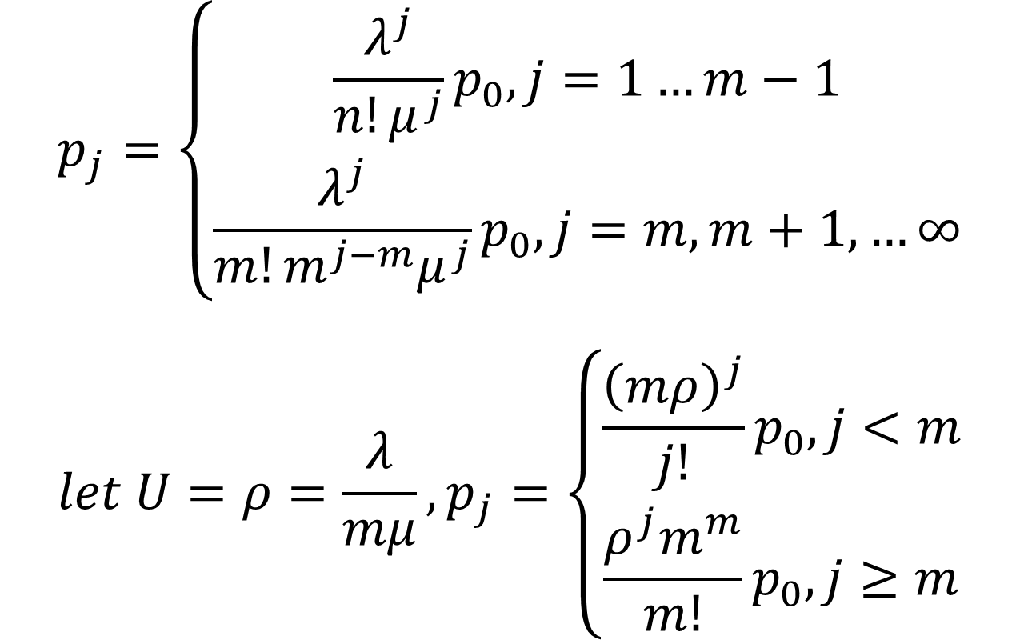
Σp_{j}=1
$$p_{j}=\left\{\begin{aligned}\frac{λ^{j}}{n!μ^{j}}p_{0}, j=1…m−1 \\ \frac{λ^{j}}{m!m^{j−m}μ^{j}}p_{0},j=m, m+1,…∞\end{aligned}\right.$$
$$let U=ρ=\frac{λ}{mμ}, p_{j}=\left\{\begin{aligned}\frac{{\left(mρ\right)}^{j}}{j!}p_{0}, j<m \\ \frac{ρ^{j}m^{m}}{m!}p_{0},j≥m\end{aligned}\right.$$

Slide 56

Σp_{j}=1
$$let U=ρ=\frac{λ}{mμ}, p_{j}=\left\{\begin{aligned}\frac{{\left(mρ\right)}^{j}}{j!}p_{0}, j<m \\ \frac{ρ^{j}m^{m}}{m!}p_{0},j≥m\end{aligned}\right.$$

Slide 57
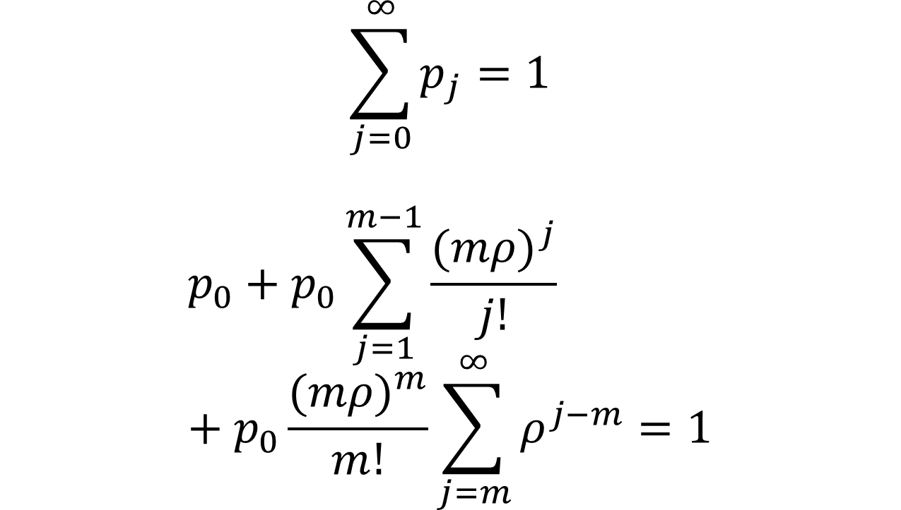
Σp_{j}=1
$$\sum_{j=0}^{∞}{p_{j}=1}$$
$$p_{0}+p_{0}\sum_{j=1}^{m−1}{\frac{{(mρ)}^{j}}{j!}}+p_{0}\frac{{(mρ)}^{m}}{m!}\sum_{j=m}^{∞}{ρ^{j−m}=1}$$

Slide 58
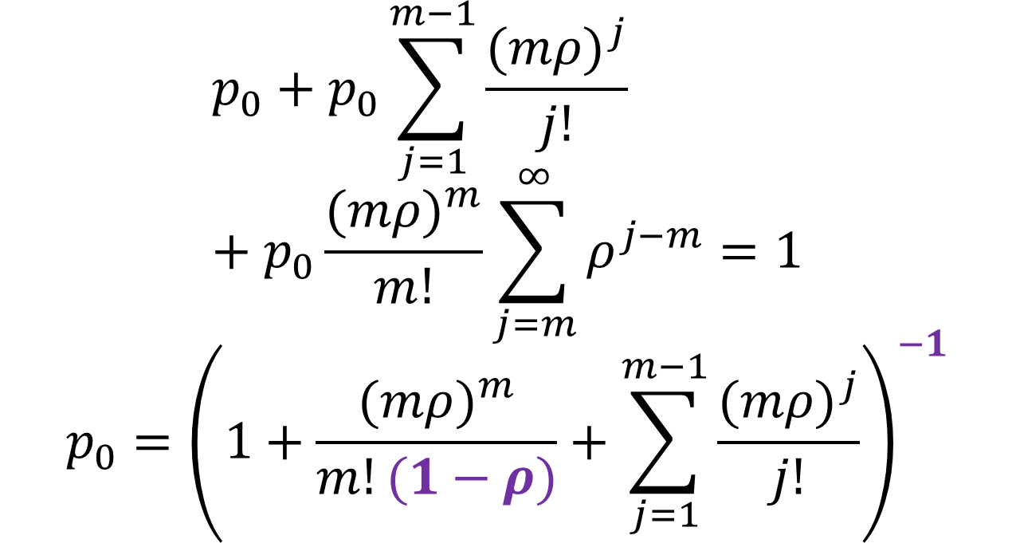
Σp_{j}=1
$$p_{0}+p_{0}\sum_{j=1}^{m−1}{\frac{{(mρ)}^{j}}{j!}}+p_{0}\frac{{(mρ)}^{m}}{m!}\sum_{j=m}^{∞}{ρ^{j−m}=1}$$
$$p_{0}={\left(1+\frac{{(mρ)}^{m}}{m!(1−ρ)}+\sum_{j=1}^{m−1}{\frac{{(mρ)}^{j}}{j!}}\right)}^{−1}$$

Slide 59
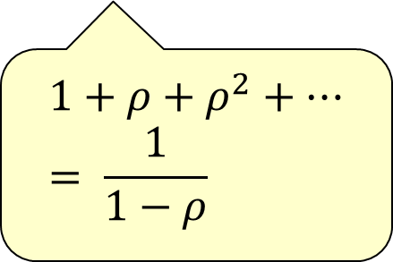

P(>m jobs)
A variant of ρ
$$ρ=P\left(≥m\right)=\sum_{j=m}^{∞}{\frac{ρ^{j}m^{m}}{m!}p_{0}}$$
$$p_{0}\frac{{\left(mρ\right)}^{m}}{m!}\sum_{j=m}^{∞}{ρ^{j−m}}=p_{0}\frac{{\left(mρ\right)}^{m}}{m!(1−ρ)}$$
$$1+ρ+ρ^{2}+…= \frac{1}{1−ρ}$$

Slide 60

E[n_{q}]
$$E\left[n_{q}\right]=p_{m+1}+2p_{m+2}+…$$
$$=\sum_{j=m+1}^{∞}{\left(j−m\right)p_{0}}$$
$$=\sum_{j=m+1}^{∞}{(j−m)\frac{m^{m}ρ^{j}}{m!}p_{0}}$$

Slide 61


E[n_{q}]
$$E[n_{q}]=\sum_{j=m+1}^{∞}{(j−m)\frac{m^{m}ρ^{j}}{m!}p_{0}}$$
$$=p_{0}\frac{{(mρ)}^{m}}{m!}\sum_{j=m+1}^{∞}{\left(j−m\right)ρ^{j−m}}$$
$$=p_{0}\frac{{(mρ)}^{m}ρ}{m!{(1−ρ)}^{2}}=\frac{ρρ}{1−ρ}$$
$$\sum_{j=1}^{∞}{iρ^{i}=\frac{ρ}{{\left(1−ρ\right)}^{2}}}$$

Slide 62

E[n_{s}]
Up to m jobs being served
$$E\left[n_{s}\right]=\sum_{j=1}^{m−1}{jp_{j}}+\sum_{j=m}^{∞}{mp_{j}}$$
$$=p_{1}+2p_{2}+…+\left(m−1\right)p_{m−1}+m\left(p_{m}+p_{m+1}…\right)$$

Slide 63

E[n_{s}]
$$E[n_{s}]=p_{1}+2p_{2}+…+\left(m−1\right)p_{m−1}+m\left(p_{m}+p_{m+1}…\right)$$
$$=\frac{mρ}{1!}p_{0}+2\frac{{\left(mρ\right)}^{2}}{2!}p_{0}+…+\left(m−1\right)\frac{{\left(mρ\right)}^{m−1}}{\left(m−1\right)!}p_{0}+mρ$$

Slide 64

E[n_{s}]
$$E\left[n_{s}\right]=\frac{mρ}{1!}p_{0}+2\frac{{\left(mρ\right)}^{2}}{2!}p_{0}+…+\left(m−1\right)\frac{{\left(mρ\right)}^{m−1}}{\left(m−1\right)!}p_{0}+mρ$$
$$=mρ\left(p_{0}+\frac{mρ}{1!}p_{0}+…+\frac{{(mρ)}^{m−2}}{m−2}p_{0}\right)+mρ$$

Slide 65

E[n_{s}]
$$E[n_{s}]=mρ\left(p_{0}+\frac{mρ}{1!}p_{0}+…+\frac{{(mρ)}^{m−2}}{m−2}p_{0}\right)+mρ$$
$$=mρ\left(1−p_{m−1}−ρ\right)+mρ$$
$$=mρ−mρp_{m−1}−mρρ+mρ$$

Slide 66

E[n_{s}]
$$E[n_{s}] =mρ−mρp_{m−1}−mρρ+mρ$$
$$=mρ−mp_{m}+mρ\left(1−ρ\right)$$
$$=mρ−m\frac{{ρ^{m}m}^{m}}{m!}p_{0}+m\frac{{\left(mρ\right)}^{m}}{m!\left(1−ρ\right)}p_{0}\left(1−ρ\right)=mρ$$

Slide 67

E[n], E[r], E[w]
$$E\left[n\right]=E\left[n_{q}\right]+E[n_{s}]$$
$$=\frac{ρρ}{1−ρ}+mρ$$
$$E\left[r\right]= \frac{E[n]}{λ}=\frac{m}{mμ}+\frac{ρ}{mμ(1−ρ)}$$
$$=\frac{1}{μ}\left(1+\frac{ρ}{m(1−ρ)}\right)$$
$$E\left[w\right]= \frac{E[n_{q}]}{λ}=\frac{ρ}{mμ(1−ρ)}$$

Slide 68

M/M/5 Example
Poisson arrival of students to a computer lab (10 students/hour)
  $$λ=10\frac{students}{hr}∗\frac{1}{60}\frac{hr}{min}=\frac{1}{6}\frac{students}{min}$$
Each student spends E[s] = 20 minutes at a terminal (exponentially distributed)
  $$μ=\frac{1}{E[s]}=\frac{1}{20}\frac{student serviced}{min}$$
The lab has 5 terminals

Slide 69

Utilization
$$U=\frac{λ}{mμ}=\frac{1/6}{5∗1/20}=\frac{2}{3}=67\%$$

Slide 70

Idle Probability
$$p_{0}={\left(1+\frac{{(mρ)}^{m}}{m!(1−ρ)}+\sum_{j=1}^{m−1}{\frac{{(mρ)}^{j}}{j!}}\right)}^{−1}$$
$$={\left(1+\frac{{\left(5∗2/3\right)}^{5}}{5!(1−\frac{2}{3})}+\frac{5∗2/3}{1!}+\frac{{\left(5∗2/3\right)}^{2}}{2!}+\frac{{\left(5∗2/3\right)}^{3}}{3!}+\frac{{\left(5∗2/3\right)}^{4}}{4!}\right)}^{−1}=0.032$$

Slide 71

P(all servers busy) = P(j>m)
$$ρ=\frac{{\left(mρ\right)}^{m}}{m!(1−ρ)}p_{0}$$
$$=\frac{{\left(5∗\frac{2}{3}\right)}^{5}}{5!\left(1−\frac{2}{3}\right)}\left(0.032\right)=0.33$$

Slide 72

E[n], E[n_{q}]
$$E\left[n\right]=mρ+\frac{ρρ}{1−ρ}$$
$$=5∗\frac{2}{3}+\frac{0.33∗\frac{2}{3}}{1−\frac{2}{3}}=3.99$$
$$E\left[nq\right]=\frac{ρρ}{1−ρ}=\frac{0.33∗\frac{2}{3}}{1−\frac{2}{3}}=0.65$$

Slide 73

E[n_{s}], E[r]
$$E\left[n_{s}\right]=E\left[n\right]−E\left[n_{q}\right]=3.99−0.65=3.34$$
$$E\left[r\right]=\frac{1}{μ}\left(1+\frac{ρ}{m(1−ρ)}\right)$$
$$=\frac{1}{1/20}\left(1+\frac{.33}{5(1−\frac{2}{3})}\right)=23.92$$

Slide 74

E[w]
$$E\left[w\right]=E\left[r\right]−E\left[s\right]$$
$$=23.92−20=3.92$$

Slide 75
White Slide

