Slide 1
Introduction to Queueing Theory
Andy Wang
CIS 5105
Computer Systems
Performance Analysis

Slide 2
Why Queueing Theory
A computer system consists of resources
Each resource is often associated with a queue of jobs waiting to be serviced
Queueing theory helps us predict the time spent in various queues and resources

Slide 3


Queueing Notation
Suppose you are waiting at a computer lab

Slide 4
Interarrival Times
Students arrive at times t₁, t₂, …t_{j}
  Random variables τ_{j} = t_{j} – t_{j-1} are called interarrival times
  τ_{j} form a sequence of independent and identically distributed (IID) random variables
    A typical arrival process is the Poisson process
      Interarrival times are IID and exponentially distributed

Slide 5
Service Time Distribution
We need to know how much time each student spends on a lab computer
  This is called the service time
  Often assumed to be IID as described by the exponential distribution

Slide 6
Number of Servers
The number of lab computers is considered as part of the same queueing system
  Assumed to be identical
  If not identical
    Divide up computer into identical groups
    Each group has its own queue

Slide 7
System Capacity
There is a maximum number of students who can wait and use the computers at the computer lab
  To avoid long waiting time
If the total number is large, it is easier to analyze the system assuming infinite capacity

Slide 8
Population Size
The total number of students who can potentially come to the computer lab
  This number can be significantly greater than the system capacity
If this size is large, it is easier to analyze it assuming infinite population size

Slide 9
Service Discipline
Typically students are served according to the first come, first served (FCFS) policy
Other policies are possible
  Last come, first served
  Round robin
  Shortest processing time first
  Shortest remaining time first

Slide 10
Kendall Notation
To specify a queueing system, we need to specify these six parameters in the form A/S/m/B/K/SD
  A: interarrival time distribution
  S: service time distribution
  m: number of servers
  B: number of buffers
  K: population size
  SD: service discipline

Slide 11
Specifying Distributions
Distributions of interarrival times and service times are specified by the following symbols
  M: exponential
    Memoryless with mean = 1/λ
  E_{k}: Erlang with parameter k
  D: Deterministic
  G: General

Slide 12
Bulk Arrivals and Services
M^{[x]} denotes Poisson arrival or service distribution with x representing the group size

Slide 13
M/M/3/20/1500/FCFS
The arrival and service times are exponentially distributed
There are three servers
There are three machines and 17 buffers for jobs waiting for service
There are 1,500 jobs
The service discipline is FCFS

Slide 14
Typically, to simplify analyses
Analyses assume infinite capacity, infinite population, and an FCFS service discipline
  Thus, we often specify G/G/1 as a shorthand for G/G/1/∞/∞/FCFS

Slide 15
Rules for All Queues
Key variables
1
2
λ
μ
m
n_{q}
n_{s}
n
Previous
arrival
Begin
service
End
service
Arrival
time
τ
w
s
r

Slide 16
Rules for All Queues
Key variables
1
2
λ
μ
m
Interarrival time
n_{q}
n_{s}
n
Previous
arrival
Begin
service
End
service
Arrival
time
τ
w
s
r

Slide 17
Rules for All Queues
Key variables
1
2
λ
μ
m
Mean arrival rate = 1/E[τ]
n_{q}
n_{s}
n
Previous
arrival
Begin
service
End
service
Arrival
time
τ
w
s
r

Slide 18
Rules for All Queues
Key variables
1
2
λ
μ
m
Service time per job
n_{q}
n_{s}
n
Previous
arrival
Begin
service
End
service
Arrival
time
τ
w
s
r

Slide 19
Rules for All Queues
Key variables
1
2
λ
μ
m
Mean service rate per server = 1/E[s]
n_{q}
n_{s}
n
Previous
arrival
Begin
service
End
service
Arrival
time
τ
w
s
r

Slide 20
Rules for All Queues
Key variables
1
2
λ
μ
m
Number of jobs in the system
n_{q}
n_{s}
n
Previous
arrival
Begin
service
End
service
Arrival
time
τ
w
s
r

Slide 21
Rules for All Queues
Key variables
1
2
λ
μ
Number of jobs waiting to be serviced
m
n_{q}
n_{s}
n
Previous
arrival
Begin
service
End
service
Arrival
time
τ
w
s
r

Slide 22
Rules for All Queues
Key variables
1
2
λ
μ
m
Number of jobs receiving service
n_{q}
n_{s}
n
Previous
arrival
Begin
service
End
service
Arrival
time
τ
w
s
r

Slide 23
Rules for All Queues
Key variables
1
2
λ
μ
m
Job response time
n_{q}
n_{s}
n
Previous
arrival
Begin
service
End
service
Arrival
time
τ
w
s
r

Slide 24
Rules for All Queues
Key variables
1
2
λ
μ
m
n_{q}
n_{s}
Job wait time
n
Previous
arrival
Begin
service
End
service
Arrival
time
τ
w
s
r

Slide 25
Relationship Among Random Variables
All these variables except λ and μ are random variables
Stability condition
  If n increases without bound, the system is unstable
  To be stable, λ < mμ
  If the population is finite, the system is always stable
  If the buffer size if fixed, and excess jobs are lost, the system is always stable

Slide 26
Number in System vs. Number in Queue
n = n_{q} + n_{s}
E[n] = E[n_{q}] + E[n_{s}]
Service rate of each server is independent of the number in the queue
  Cov(n_{q}, n_{s}) = 0
  Var[n] = Var[n_{q}] + Var[n_{s}]

Slide 27
Number vs. Time
Little’s Law
With infinite buffer
Mean number of jobs in the system = arrival rate x mean response time
  E[n] = λ x E[r]
Mean number of jobs in the queue = arrival rate x mean waiting time
  E[n_{q}] = λ x E[w]

Slide 28
Time in System vs. Time in Queue
r = w + s
E[r] = E[w] + E[s]
If the service rate is independent of the number of jobs in the queue
  Cov(w, s) = 0
  Var[r] = Var[w] + Var[s]

Slide 29
Little’s Law
Mean number in the system = arrival rate x mean response time

Slide 30
Proof
For a large time interval T
  Number of arrivals N ≅ departures
  Arrival rate = N/T
Let J be the total amount of time spent by all jobs in the system (area under each bar)
Mean time spent in the system = J/N
Mean number in the system
= J/T = N/T x J/N
Time in system
1 2 3
Job number

Slide 31
Little’s Law Applied
Can be applied to a subsystem
Mean number in queue = arrival rate x mean waiting time
  E[n_{q}] = λ x E[w]
Mean number in service = arrival rate x mean service time
  E[n_{s}] = λ x E[s]

Slide 32
Example
Average time to serve an IO is 100 ms
IO request rate is 100 requests/second
Mean number of request in the IO server is arrival rate x response time
  100 requests/second x 0.1 second = 10 requests

Slide 33
Types of Stochastic Processes
Random functions of time or sequences are called stochastic processes
Discrete-state processes
  n(t), the number of jobs in a systems, is a discrete-state process
Continuous-state processes
  w(t), the waiting time, is a continuous-state process

Slide 34
Markov Processes
If the future states of a process are independent of the past and depend only on the present
A discrete-state Markov process is called a Markov chain
For continuous-time Markov processes, we need a memory-less (exponential) distribution, so we don’t need to know how long the process has been in the current state

Slide 35
Birth-Death Process
A special case of discrete-space Markov processes
  It is possible to represent states by integers
  A process in state n can change only to state n+1 or n-1
  E.g., the number of jobs in a queue
    Birth +1
    Death -1

Slide 36
Poisson Processes
If the interarrival times are IID and exponentially distributed, the number of arrivals n over a given interval (t, t+x) has a Poisson distribution
This arrival process is referred to as a Poisson process

Slide 37
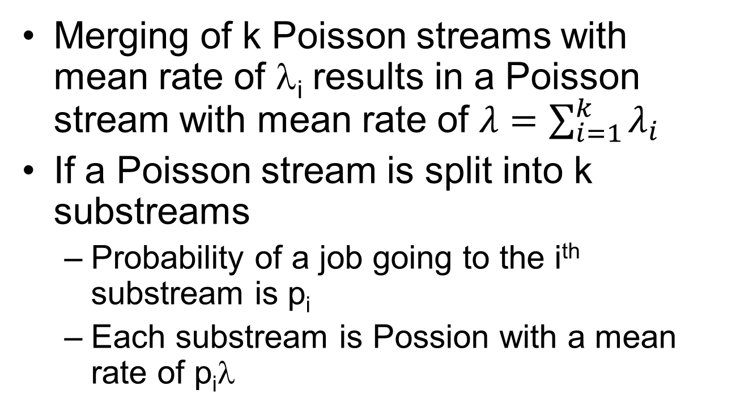
More on Poisson Processes
Merging of k Poisson streams with mean rate of λ_{i} results in a Poisson stream with mean rate of $λ=\sum_{i=1}^{k}{λ_{i}}$
If a Poisson stream is split into k substreams
  Probability of a job going to the i^{th} substream is p_{i}
  Each substream is Possion with a mean rate of p_{i}λ

Slide 38
More on Poisson Processes
If the arrivals to a single server with exponential service time are Poisson with λ
  The departures are also Poisson with the same rate λ

Slide 39
Relationship among Stochastic Processes
Markov Processes
Birth-death
processes
Poisson
processes

Slide 40
White Slide

