Slide 1
Commonly Used Distributions
Andy Wang
CIS 5105
Computer Systems
Performance Analysis

Slide 2
Uniform Distribution, UD(m, n) (Discrete)
Models a finite number of values, over a bounded interval with equal probability
Parameters
  m = lower limit (integer)
  n = upper limit (integer > m)
Range
  x = m, m + 1, … n
PMF

Slide 3
Uniform Distribution (Discrete)
Used to model
  Track numbers for seeks on a disk
  The device number for the next I/O
  The source and destination nodes
Uniform variate generation
  Generate u ~ U(0, 1)
  Return

Slide 4
Bernoulli Distribution, Bernoulli(p)
The simplest discrete distribution
Parameter: p = probability of success (x = 1),
  0 < p < 1
PMF: f(x) =
  1 – p, if x = 0
  p, if x = 1
  0, otherwise
Range: x = 0, 1
Mean: p
Variance: p(1 - p)

Slide 5
Bernoulli Distribution
Experiments to generate a Bernoulli variate are Bernoulli trials
  Assumes independent and identical trials
    Success of one trial is not affected by the outcomes of the past trials
Used to model
  Whether a computer system is up
  Whether a network packet reaches the destination

Slide 6
Bernoulli Variate Generation
Reverse transformation
  Generate u ~ U(0, 1)
  If u < p, return 0; else return 1

Slide 7
Number of ways for x successes and n – x failures
Binomial Distribution, binomial(p, n)
The number of successes x in n Bernoulli trials
Parameters
  p = probability of success in a trial
    0 < p < 1
  n = number of trials, n ∈ integer > 0
Range: x = 0, 1, … n
PMF
Mean: np
Variance: np(1 - p)

Slide 8
Binomial Distribution
Used to model
  N CPUs that are up in a multi-core system
  N packets that reach the destination successfully
  N bits in a packet not affected by noise
  N items in a batch with certain characteristics
The variance of a binomial distribution is always < the mean

Slide 9
Binomial Variate
Generation Methods
Composition method
  Generate n u_{i} ~ U(0, 1) random numbers
  Count the number of u_{i} < p
Inverse transformation method
  Compute the CDF F(x) for x = 0, 1, …, n and store the results in an array
  To generate a binomial variate
    Generate u ~ U(0, 1)
    Find x = array[u], where F(x) < u < F(x + 1)

Slide 10
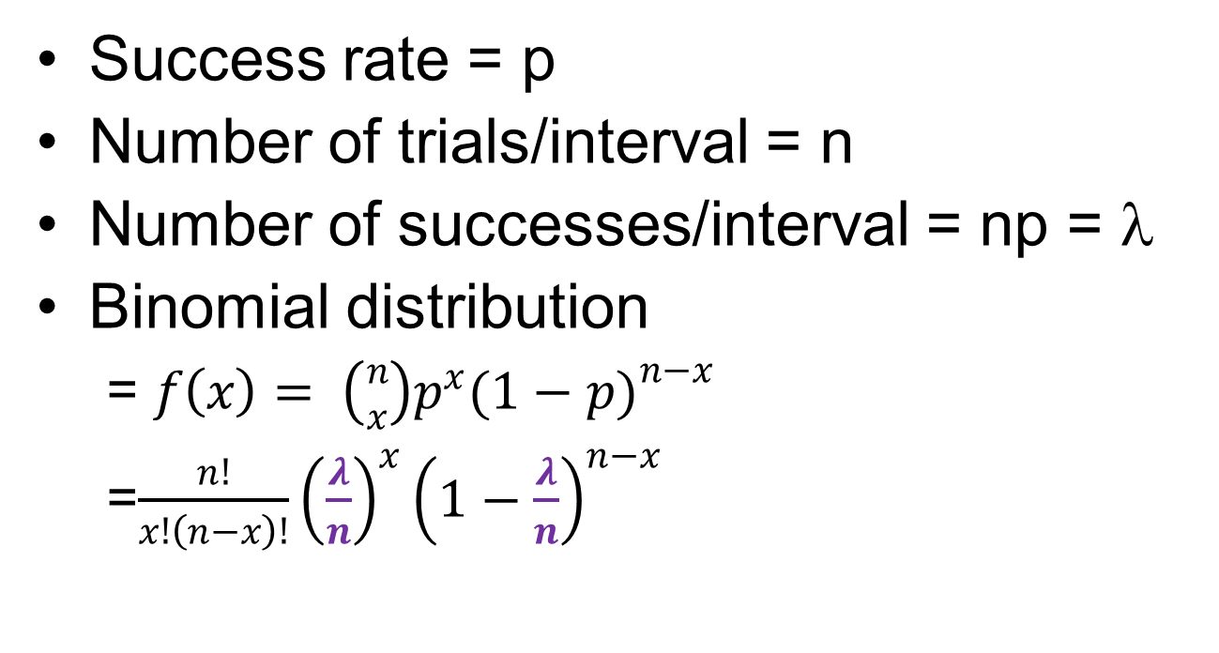
Suppose…
Success rate = p
Number of trials/interval = n
Number of successes/interval = np = λ
Binomial distribution
  = $f\left(x\right)= \left({n \atop x}\right)p^{x}{(1−p)}^{n−x}$
  =$\frac{n!}{x!\left(n−x\right)!}{\left(\frac{λ}{n}\right)}^{x}{\left(1−\frac{λ}{n}\right)}^{n−x}$

Slide 11
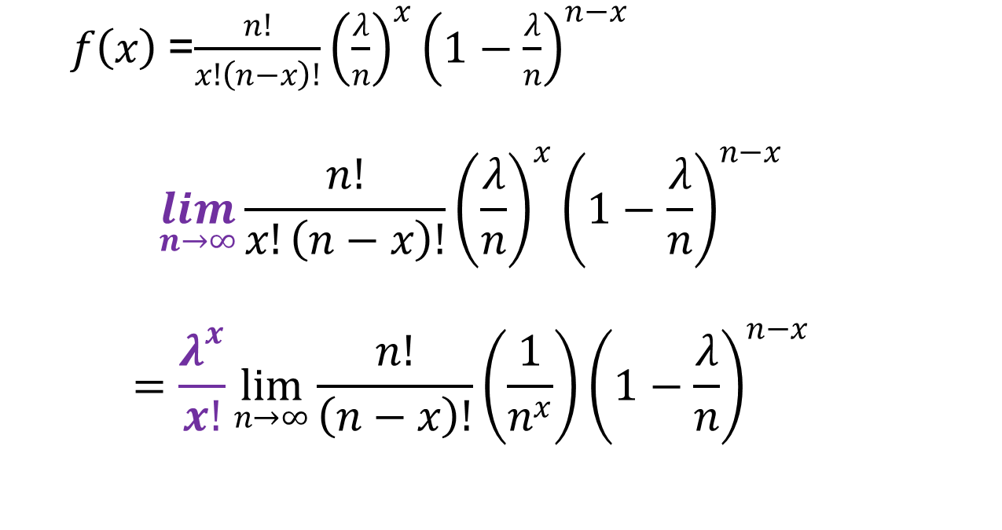
Let’s take a limit…
  $f\left(x\right)$=$\frac{n!}{x!\left(n−x\right)!}{\left(\frac{λ}{n}\right)}^{x}{\left(1−\frac{λ}{n}\right)}^{n−x}$
  $$\lim_{n→∞}{\frac{n!}{x!\left(n−x\right)!}{\left(\frac{λ}{n}\right)}^{x}{\left(1−\frac{λ}{n}\right)}^{n−x}}$$
  $$=\frac{λ^{x}}{x!}\lim_{n→∞}{\frac{n!}{\left(n−x\right)!}{\left(\frac{1}{n^{x}}\right)\left(1−\frac{λ}{n}\right)}^{n−x}}$$

Slide 12
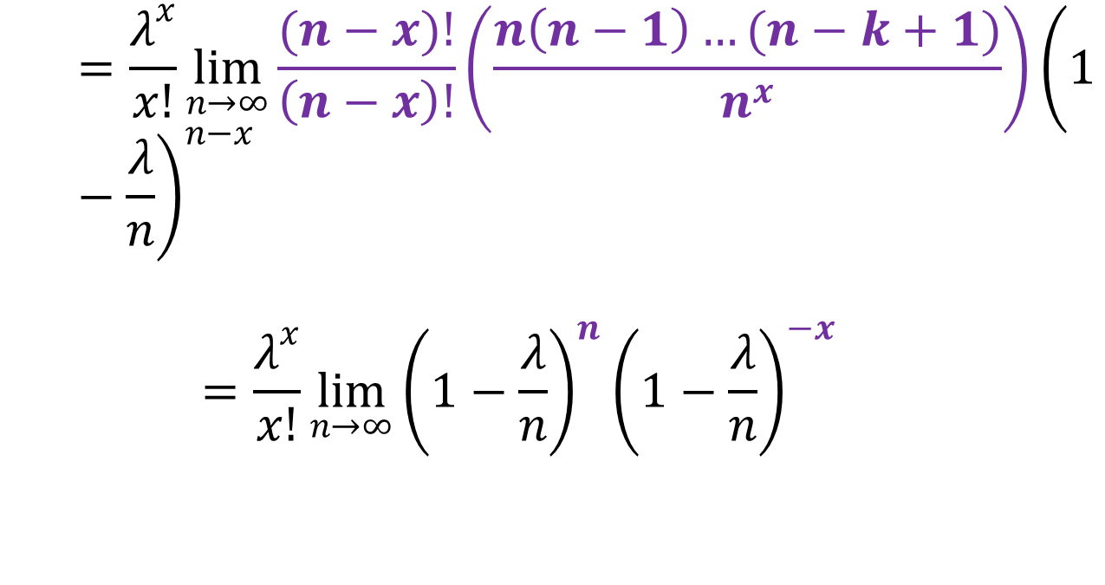
With some math…
  $$=\frac{λ^{x}}{x!}\lim_{n→∞}{\frac{(n−x)!}{\left(n−x\right)!}\left(\frac{n\left(n−1\right)…(n−k+1)}{n^{x}}\right){\left(1−\frac{λ}{n}\right)}^{n−x}}$$
  $$=\frac{λ^{x}}{x!}\lim_{n→∞}{{\left(1−\frac{λ}{n}\right)}^{n}{\left(1−\frac{λ}{n}\right)}^{−x}}$$

Slide 13
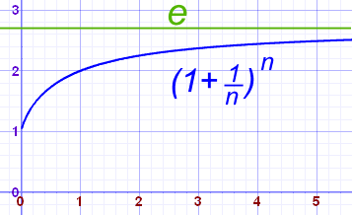

Suppose…
$$z= −\frac{n}{λ}$$
$$f\left(x\right)=\frac{λ^{x}}{x!}\lim_{n→∞}{\lim_{z→∞}{{\left(1+\frac{1}{z}\right)}^{z(−λ)}{\left(1−\frac{λ}{n}\right)}^{−x}}}$$

Slide 14

Then…
$$=\frac{λ^{x}e^{−λ}}{x!}\lim_{n→∞}{{\left(1−\frac{λ}{n}\right)}^{−x}}$$
$$=\frac{λ^{x}e^{−λ}}{x!}$$

Slide 15
Poisson Distribution, Poisson(λ)
A limited form of the binomial distribution
Parameter
  λ = mean number of events in an interval (> 0)
Range
  x = 0, 1, 2, …, ∞
PMF
Mean = variance = λ

Slide 16
Poisson Distribution
Used to model
  N requests to a server in a given interval t
  N component failures per unit time
  N queries to a database system over t seconds
Particularly appropriate
  If arrivals are from a large number of independent sources (Poisson processes)

Slide 17
Poisson Variate
Generation Methods
Inverse transformation method
  Compute CDF F(x) for x = 0, 1, … to a cutoff point and store in an array
  To generate a binomial variate
    Generate u ~ U(0, 1)
    Find x = array[u], where F(x) < u < F(x + 1)
Starting with n = 0
  Generate u_{n} ~ U(0, 1)
  As soon as , return n

Slide 18
Geometric Distribution, G(p)
The number of Bernoulli trials up to and including the first success
Parameter
  p = probability of success in a trial
    0 < p < 1
Range
x = 1, 2, …, ∞
PMF
  f(x) = (1 – p)^{x-1}p
Mean: 1/p
Variance: (1 – p)/p²

Slide 19
Geometric Distribution
Memoryless
  Remembering the results of past attempts does not help in predicting the future
Used to model the number of attempts between successive failures
  N number of packets transmitted successfully between retransmissions
  N error-free bits between error bits

Slide 20
Geometric Variate Generation
Inverse transformation
  Generate u ~ U(0, 1)
  Return

Slide 21
Pascal Distribution
The number of Bernoulli trials up to and including the m^{th} success
Parameters
  p = probability of success in a trial
    0 < p < 1
  m = N successes ∈ integer > 0
Range
  x = m, m + 1, …, ∞
PMF

Slide 22
Pascal Distribution
Used to model
  N attempts to transmit an m-packet message
  N bits to be sent to receive an m-bit signal successfully
Pascal variate generation
  Generate m geometric variates G(p) and return their sum

Slide 23
Uniform Distribution,
U(a, b) (Continuous)
Used when a random variable is bounded with no further available information
Parameters
  a = lower limit
  b = upper limit (> a)
Range: a < x < b
PDF
Mean: (a + b)/2
Variance (b – a)²/12

Slide 24
Uniform Distribution (Continuous)
Used to model
  The distance between the source and the destination of a message on a network
  The seek time on a disk
Uniform variate generation
  Generate u ~ U(0, 1)
  Return a + (b – a)u

Slide 25
Normal (Gaussian) Distribution N(µ, σ)
Parameters
  µ = mean
  σ = standard deviation (> 0)
Range: -∞ < x < ∞
PDF:
N(0, 1) is the unit
normal distribution

Slide 26
Normal Distribution
Used when the randomness is caused by independent sources acting additively
  Errors in measurement
  Modeling factors not included in the model
  Means of a large number of independent observations

Slide 27
Normal Variate Generation
Convolution: Sum of a large number of u_{i} ~ U(0, 1) variates has a normal distribution
Typically, use n = 12

Slide 28
Exponential Distribution, exp(a)
Used to model the time between successive events
Parameter
  a = mean time to arrival (> 0)
Range: 0 < x < ∞
PDF
Variance: a²

Slide 29
Exponential Distribution
Memoryless
Used to model
  The time between successive request arrivals to a device
  The time between failures of a device
Exponential variate generation
  Inverse transformation
    Generate u ~ U(0, 1) and return –aln(u)

Slide 30
Relationship to Poisson Events
Poisson(2 requests/second)
  Variance of 4 requests/second
  Standard deviation of 2 requests/second
  The interarrival time between requests is exponential
Exponential(1/2 second between requests)
  Standard deviation of ½ second between requests

Slide 31
Erlang Distribution, Erlang(a, m)
Model service times of m servers, each with an exponential distributed service time a
Parameters
  a > 0 (scale)
  m ∈ integer > 0 (shape)
Range: 0 < x < ∞
PDF
Mean: am
Variance: a²m

Slide 32
Erlang Variate Generation
Convolution
  Generate m U(0, 1) random number u_{i}
  Return

Slide 33
Weibull Distribution
Used in reliability analysis
Parameters
  a > 0 (scale)
  b > 0 (shape)
Range: 0 < x < ∞
PDF

Slide 34
Weibull Distribution
Models the lifetime of components
  b < 1, the failure rate increases with time
    L-shaped
  b > 1, the failure rate decreases with time
    Bell-shaped
  b = 1, the failure rate is constant
    Lifetimes are exponentially distributed
Weibull variate generation
  Generate u ~ U(0, 1), return a(ln(u))^{1/b}

Slide 35
Other Distributions
Pareto distribution
  Used to model job sizes
  Some jobs are really large
Zipf’s distribution
  Used to model popularity of items

Slide 36
Commonly Used Distributions
Discrete distributions
Negative
binomial(p, m)
Failures before m^{th} success
Bernoulli(p)
Binomial(p, n)
Poisson(λ)
Trials up to first success
Trials up to m^{th} success
np > 25
λ > 9
Geometric(p)
Pascal(p)
Normal(µ, σ)

Slide 37
Commonly Used Distributions
Continuous distributions
Weibull(a, b)
x^{b}
b = 1
b integer
m = 1
Gamma(a, b)
Erlang(a, m)
Exponetial(a)
x₁/(x₁ + x₂)
ln(x)
Beta(a, b)
Uniform(a, b)
Pareto(a)
a = 1, b = 1
x^{-1/a}

Slide 38
Commonly Used Distributions
Continuous distributions
Uniform(a, b)
χ²(v)
F⁻¹(x)
All
distributions
Normal(µ, σ)
F(n, m)
x₁/x₂
ln(x)
Cauchy(a, b)
Lognormal(µ, σ)
t(m)

Slide 39
White Slide

