Slide 1
Example: Obstacle Modeling for Wireless Transmissions
Andy Wang
CIS 5105
Computer Systems
Performance Analysis

Slide 2
Motivation
Typical studies of mobile wireless networks assume an open field
  No physical obstacles (e.g., no buildings)
  Not reflective of urban settings

Slide 3
Goals
Validate the open-field wireless signal attenuation model used in NS-2
Model the signal attenuation caused by physical obstacles

Slide 4
Services
Wireless network signal transmissions
  Broadcast signals
  Listen to signals

Slide 5
Outcomes
Sufficient signal strength for data transmission
  Successful transmissions
  Unsuccessful transmissions (e.g., due to interferences)
Insufficient signal strength for data transmission
  No service

Slide 6
Metric
Signal strength
  dBm (decibels relative to 1 mWatt)
    Decibels are ratios (no units)
      Log transformed
        1 mW = 10log₁₀(1mW/1mW) = 0 dBm
      Tricky unit conversions
        (X_{Watts}* 1000)_{mWatts}
        (X_{dBW} + 30)_{dBm}
        Note: 30 = 10log₁₀(1000mW/1mW)
    Measured in electric power

Slide 7
Implicit Assumptions
Bandwidth, latency, and packet loss rate are largely a function of signal strength
Not measured

Slide 8
Parameters
Open field
  Type of base station and receiver
  Distance between sender and receiver
  Presence of interference
    Self interference
      Ground surface, signal reflections
    Other transmissions
  Weather conditions
  Height of transmission source

Slide 9
Parameters
With obstacles
  Location of obstacles
  Type of obstacles
    Different building codes
Problem
  Difficult to quantify obstacles and their relationship to the base station and receiver

Slide 10
Factors and Evaluation Techniques
Factors
  Distance between sender and receiver
  Presence of obstacles
Evaluation techniques
  Empirical measurements

Slide 11
Workloads
One sender, one receiver
  Continuous transmissions
Open field
  Mike Long Track on campus
With obstacles
  Around a block in downtown Tallahassee
  Around Keen Building

Slide 12
Workloads
Problems
  No interferences
  Only measured two scenarios

Slide 13
Experimental Settings
Base station
  802.11b Linksys
Receiver
  Linux laptop with wireless PCI card
  Used Wavemon to log transmission signals

Slide 14
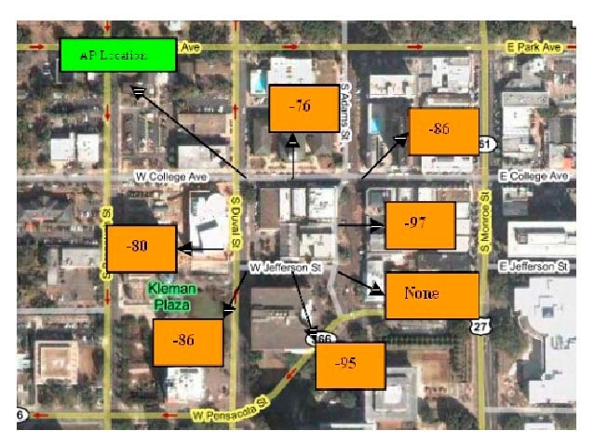
Downtown Tallahassee

Slide 15
Keen Building GPS Coordinates
30.446075, -84.301314
30.446056, -84.301239
30.446010, -84.301143
30.446093, -84.301389
3
a
b
c
h
j
30.445917,
-84.301035
30.445862,
-84.300896
30.445973, -84.301486
30.445880, -84.301175
1
d
i
k
30.445779,
-84.301089
30.445723,
-84.300939
2
g
f
e
30.445862, -84.301486
30.445779, -84.301229
30.445825, -84.301432
30.445806, -84.301347
Possible base station locations

Slide 16
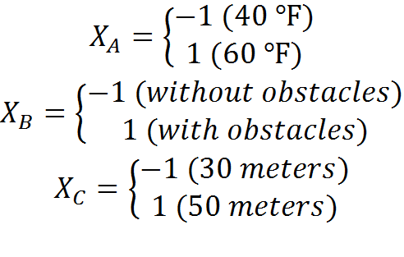
Experimental Design
Ideally, start with 2³r factorial design to identify major factors and interactions

Slide 17
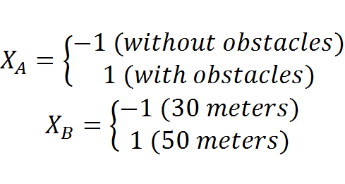
Experimental Design
What really happened
  2² factorial design

Slide 18
Experimental Design
Problems
  Cumbersome setup
    Needed portable battery
    Network measurements drain batteries quickly
  Missing data points for temperature
  Ground surfaces correlate to the presence of obstacles

Slide 19
Experimental Design
Open-field model validation
  Simple design
    Varied the distance between base station and receiver
Obstacle model
  Simple design
    Varied the distance between base station and receiver

Slide 20
Data Analysis
2² factorial design (example 1)
Fractions of variations explained
  * 36% due to the presence of obstacles
  * 60% due to distance
  * 4% due to the interaction between the two
    Okay to create separate models
      With obstacles
      Without obstacles

Slide 21
Open-field Data Analysis
Simple linear regression (example 2)
  Signal = -46 – 0.57(distance)
  R² = 0.78
  Both coefficients are significant

Slide 22
Open-field Data Analysis
However, ANOVA
not satisfactory

Slide 23
Try Transforms (Ex.3)
distance’ = 1/distance
  Signal = -91 + 682/distance
  R² = 0.98
  Both coefficients are significant

Slide 24
Try Transforms (Ex.3)
distance’ = 1/distance
  R² = 0.98
  Weird error patterns

Slide 25
Try Transforms (Ex. 4)
distance’ = 1/distance²
  Signal = -84 + 12925/distance²
  R² = 0.92
  Both coefficients are significant

Slide 26
Try Transforms (Ex. 4)
distance’ = 1/distance²
  R² = 0.92
  Weird error patterns

Slide 27
Try Transforms (Ex. 5)
distance’ = 1/sqrt(distance)
  Signal = -107 + 211/sqrt(distance)
  R² = 0.99
  Both coefficients are significant

Slide 28
Try Transforms (Ex. 5)
distance’ = 1/sqrt(distance)
  R² = 0.99
  Errors not normally
  distributed

Slide 29
Try Transforms (Ex. 6)
distance’ = log₁₀(distance)
  Signal= -18 – 35*log(distance)
  R² = 0.99

Slide 30
Try Transforms (Ex. 6)
distance’ = log₁₀(distance)
  R² = 0.99

Slide 31
Validate Open-field Model
dBm_{r} = -18 – 35*log(distance)
NS-2 model
  * Watt_{r} = Watt_{s}*α/distance²
  * dBm_{r} = 10*log(Power_{s}*α/distance²) + 30
  = dBm_{s} + 10*log(α) – 20*log(distance)
  = (dBm_{s} + A) – B*log(distance)

Slide 32
Obstacle Data Analysis
Simple linear regression
  Signal = -50 – 0.64(distance)
  R² = 0.48
  The second coefficient is not significant

Slide 33
Obstacle Data Analysis (Ex. 7)
ANOVA
  Weird error patterns

Slide 34
Try Log Transform
(Ex. 10)
R² = 0.24
ANOVA shows
patterns

Slide 35
Analyze a Subset of Data
30.446075, -84.301314
30.446056, -84.301239
30.446010, -84.301143
30.446093, -84.301389
3
a
b
c
h
j
30.445917,
-84.301035
30.445862,
-84.300896
30.445973, -84.301486
30.445880, -84.301175
1
d
i
k
Focus on this data set
30.445779,
-84.301089
30.445723,
-84.300939
2
g
f
e
30.445862, -84.301486
30.445779, -84.301229
30.445825, -84.301432
30.445806, -84.301347
Possible base station locations

Slide 36
Keen Building Location 1 (Ex. 13)
Signal = -27 – 36*log₁₀(distance)
R² = 0.70
Both coefficients are significant

Slide 37
Keen Building Location 1
ANOVA so so
Errors not quite
normally distributed

Slide 38
Downtown Data Set
(Ex. 15)
Signal = -16 – 39*log₁₀(distance)
R² = 0.71
Only the second coefficient is significant

Slide 39
Downtown Data Set
ANOVA

Slide 40
Unified Model (Ex. 17)
Signal = -22 - 5.3*(if ob) – 33*log₁₀(dist)
R² = 0.32
All coefficients are significant
Passed F test
The presence of obstacles costs 5.3 dBm

Slide 41
Unified Model (Ex. 17)
Signal = -22 - 5.3*(if ob) – 33*log₁₀(dist)
R² = 0.32
All coefficients are significant

Slide 42
Unified Model
ANOVA not so good…

Slide 43
Problems
Need better ways to describe the relationship between obstacles, sender, and receiver

Slide 44
White Slide

