Slide 1
Cashtags: Protecting the Input and Display of Sensitive Data
Michael J. Mitchell
Dissertation Defense
April 15, 2015

Slide 2
Defense Overview
Shoulder surfing is an increasing concern for mobile computing
  Users frequently compute in public, risk visual leaks
Existing solutions inadequate
  Only handle authentication, other threat vectors
Cashtags allows input and access sensitive data in public
Intro & Motivation
Usage Survey
Related Work
Cashtags
Implementation
Evaluation
Conclusion

Slide 3
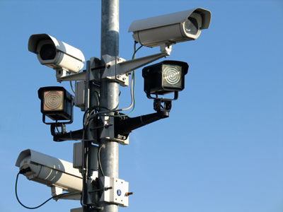

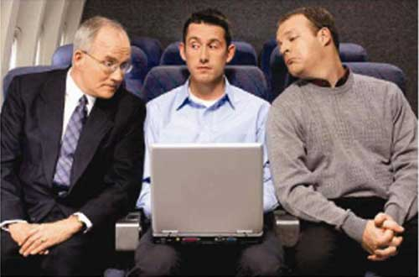


Shoulder Surfing

Slide 4
The Shoulder Surfing Threat
Users access sensitive data (e.g., account numbers) in public
  Risk visual interception from bystander
    Personal, fiscal, identity theft
    Business, espionage, terrorism
The problem is getting worse
  Cameras are everywhere
  Visual analysis tools highly accessible
Intro & Motivation
Usage Survey
Related Work
Cashtags
Implementation
Evaluation
Conclusion

Slide 5
The Threat is Real
>80% of IT professionals:
  Had seen unauthorized sensitive data on screen
  Had own sensitive on-screen data seen
  Had no confidence their users protect their screens
Modern work habits are increasing the threat
  Mobile devices sales now >70% of tech sales
  80% of US workforce is now mobile
  ~70% access sensitive data outside of workplace
  Screen tech near 180 degree viewability
Intro & Motivation
Usage Survey
Related Work
Cashtags
Implementation
Evaluation
Conclusion

Slide 6
The Dangers are Everywhere
Observation-based attacks come in many forms
  3 billion digital camera phones in circulation
    Becoming more capable, 40+ megapixels, 10x+ optical zoom
  Billions of high-res and often unsecured CCTV cameras
  Or simply, but no less threateningly, by human sight
Observation-based attacks can be much more complex
  Sophisticated tools to capture user data
  OCR solutions highly accurate
  Embedded OCR cheap & capable
Exposure can make other attacks possible
  Social engineering attacks, phishing, etc.
Intro & Motivation
Usage Survey
Related Work
Cashtags
Implementation
Evaluation
Conclusion

Slide 7
The Consequences can be Severe
Actual shoulder surf losses
  S&P 500 company’s profit forecasts
  Sensitive British government documents
  Private data of BoA clients
Productivity suffering too
  ~60% stopped work in public over privacy concerns
  70% can be more productive if no one could see their screen
Intro & Motivation
Usage Survey
Related Work
Cashtags
Implementation
Evaluation
Conclusion

Slide 8
Is There Nothing We Can Do?
What if…
  We didn’t have to worry about these visual leaks?
  Our devices can protect us from these risks?
  We could compute freely in presence of others?
Intro & Motivation
Usage Survey
Related Work
Cashtags
Implementation
Evaluation
Conclusion

Slide 9
Thesis Statement
This dissertation supports the following thesis:
The interception of screen display and the use of sensitive data aliases
  Can protect the input and display of sensitive data elements
  Can be usable, convenient, efficient, portable, and legacy compatible
Intro & Motivation
Usage Survey
Related Work
Cashtags
Implementation
Evaluation
Conclusion

Slide 10
Outline of Dissertation
Mobile usage survey
Related work
User & threat models
System design
Implementation
Evaluation
Limitations & future work
Intro & Motivation
Usage Survey
Related Work
Cashtags
Implementation
Evaluation
Conclusion

Slide 11
Mobile Usage Survey Introduction
Goal: Quantify the shoulder surf threat
Do people behave differently in public/private?
  At deeper level, what does privacy mean?
Current understanding of privacy incomplete
  Subjective nature of privacy
  Automatic detection of private situations hard
Important to understand what privacy actually means to people
  Make the right tools to fix the right problems
Intro & Motivation
Usage Survey
Related Work
Cashtags
Implementation
Evaluation
Conclusion

Slide 12
Survey Overview
Empirical data on user privacy behavior limited
Conducted a survey-based study of ~600 users
Major findings include:
  (1) People exercise little caution preserving mobile privacy
  (2) Privacy is not equal to trust
  (3) Users underestimate mobile app privacy threats
  (4) Users’ understanding of privacy is different from that of the security community
Intro & Motivation
Usage Survey
Related Work
Cashtags
Implementation
Evaluation
Conclusion

Slide 13
Mobile Usage Questionnaire
~100 questions in total via mobile app & web
Questions cover:
  Background, demographics, hardware ownership
  Computing tasks performed by location in public and private
  Where/when/why behavior changes
  Usage of privacy/security tools
Intro & Motivation
Usage Survey
Related Work
Cashtags
Implementation
Evaluation
Conclusion

Slide 14
Computing Locations
Intro & Motivation
Usage Survey
Related Work
Cashtags
Implementation
Evaluation
Conclusion

Slide 15
Most Common Public & Private Tasks
Top 5 tasks significantly more frequent
Most have little difference in public/private
Intro & Motivation
Usage Survey
Related Work
Cashtags
Implementation
Evaluation
Conclusion

Slide 16
Categorical Public & Private Tasks
Top 2 categories significantly more frequent
Most have little difference in public/private
Intro & Motivation
Usage Survey
Related Work
Cashtags
Implementation
Evaluation
Conclusion

Slide 17
Public & Private Tasks by Risk Level
More often in private
Little difference in public/private?
Intro & Motivation
Usage Survey
Related Work
Cashtags
Implementation
Evaluation
Conclusion

Slide 18
Public & Private Activity Overall
Behavioral differences in public and private among groups not statistically significant
  Genders, technical backgrounds, and ethnicities
Intro & Motivation
Usage Survey
Related Work
Cashtags
Implementation
Evaluation
Conclusion

Slide 19
Privacy Implications on Systems
Users not concerned about preserving mobile privacy?
  Even tech-savvy users do not alter their behavior based on their surroundings
Obvious critical question:
  Users unaware of the risks? Or aware and don’t care?
Philosophically, is it even our business to care?
In either case, protection mechanisms must be convenient, transparent, and efficient
  Else, users will simply disable them
In shoulder surf context
  Threat is real
  Need automatic protection mechanisms
Intro & Motivation
Usage Survey
Related Work
Cashtags
Implementation
Evaluation
Conclusion

Slide 20
Existing Solutions
Observation-resistant solutions
  Most only address secure authentication
  Diverse mechanisms to achieve similar goal
Protocols & protection over other (non-visual) communication channels
  WiFi, LANs, Internet, 3G/4G mobile, etc.
  SSL, TLS, VPNs
  Proxy servers, Tor
However, no general purpose solution exists for protection of any/all sensitive on-screen data
Intro & Motivation
Usage Survey
Related Work
Cashtags
Implementation
Evaluation
Conclusion

Slide 21
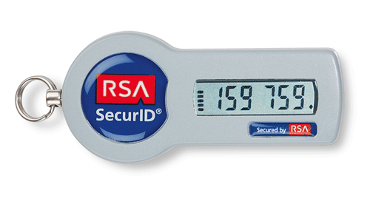
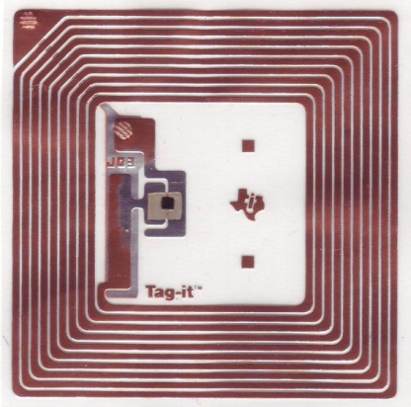
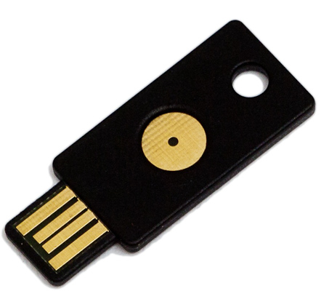
Observation-resistant Solutions
Password managers
  Auto-fill to avoid visual exposure
  Browser extensions, LastPass, 1Password
Hardware-based solutions
  Avoid typing/showing password
  USB dongles, RFID, NFC, Bluetooth
Intro & Motivation
Usage Survey
Related Work
Cashtags
Implementation
Evaluation
Conclusion

Slide 22
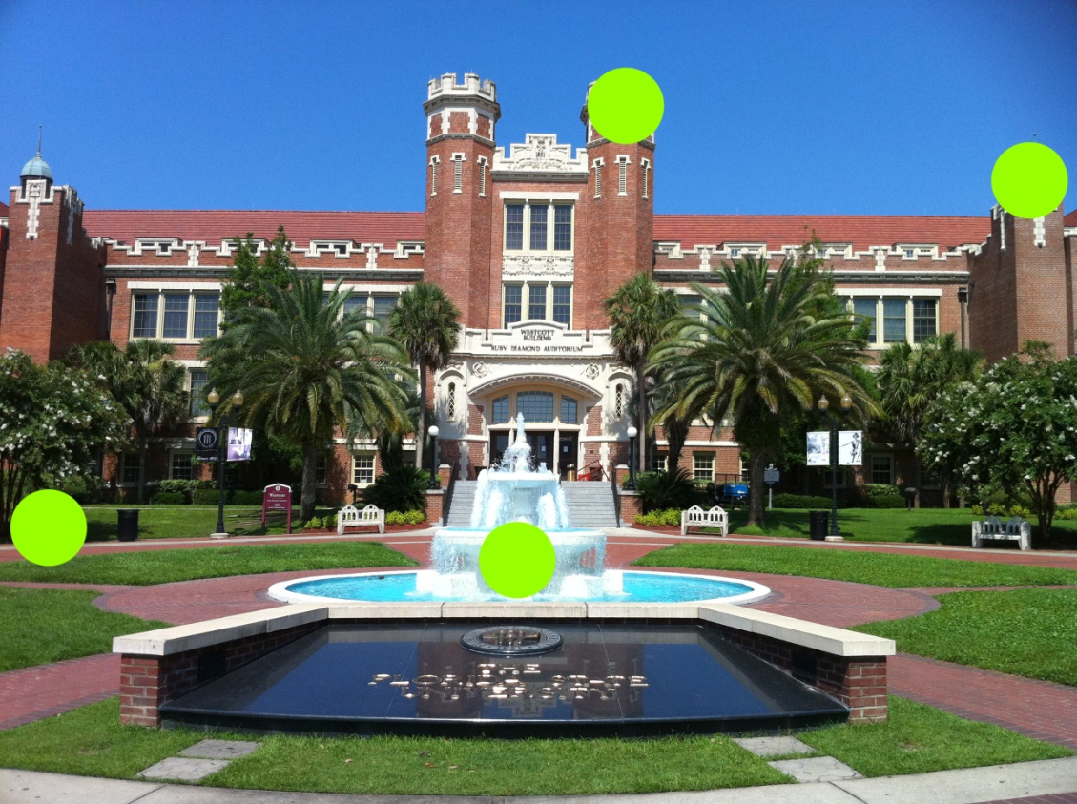

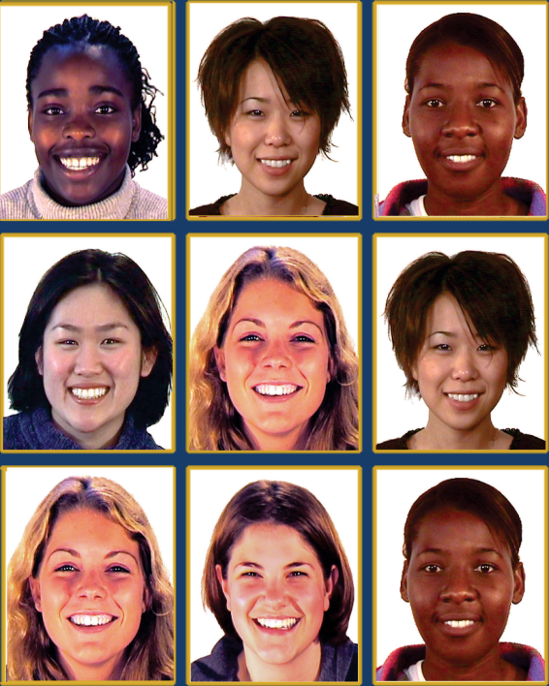
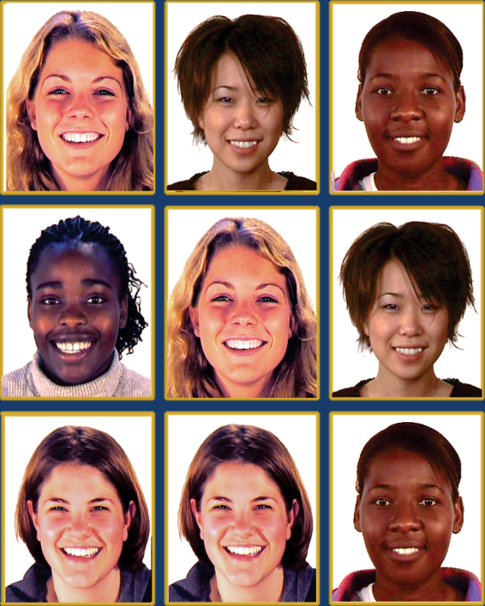
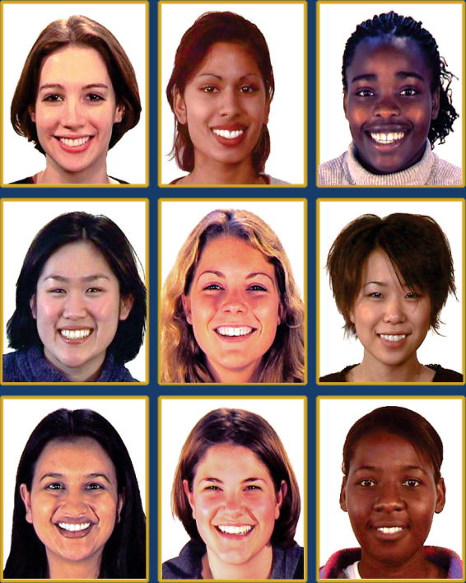
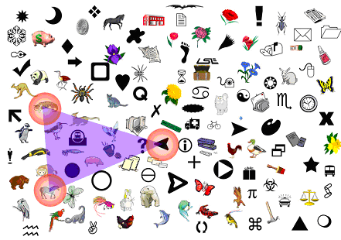
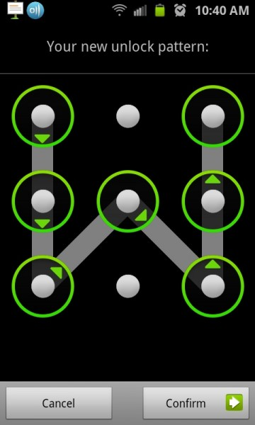
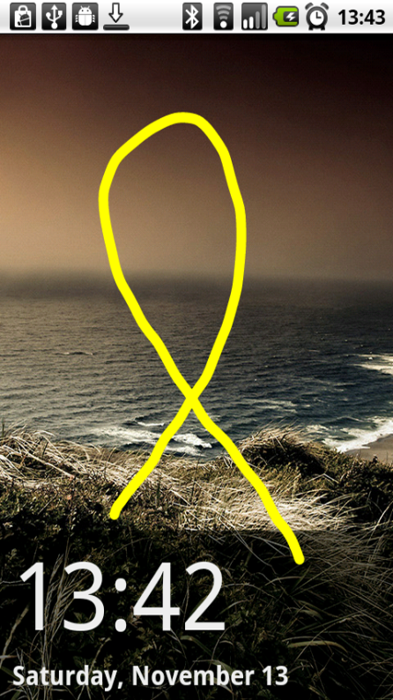
Observation-resistant Solutions
Graphical passwords
Gesture-based authentication
Intro & Motivation
Usage Survey
Related Work
Cashtags
Implementation
Evaluation
Conclusion

Slide 23
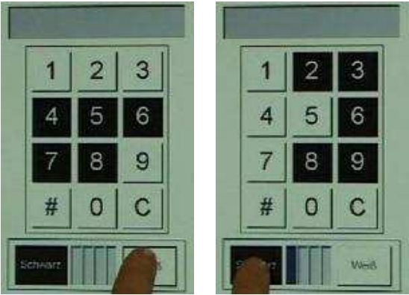
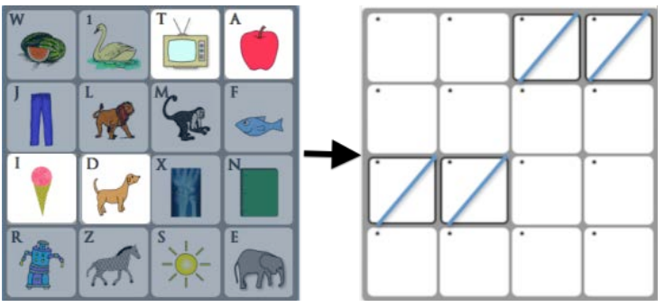
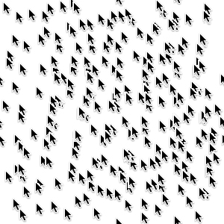
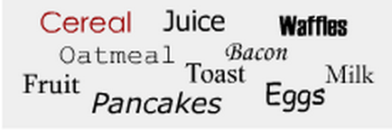
Observation-resistant Solutions
Cognitive-based solutions
  Avoid repeated exposure of same password
Obfuscation/confusion
  Hiding of cursors, recognition over recall

Slide 24
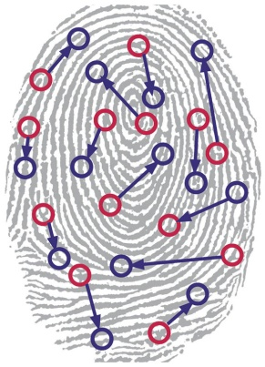
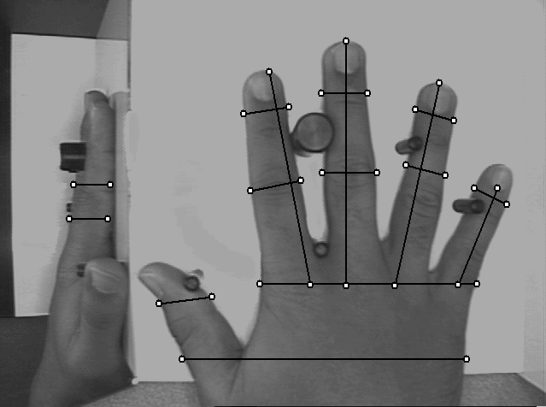
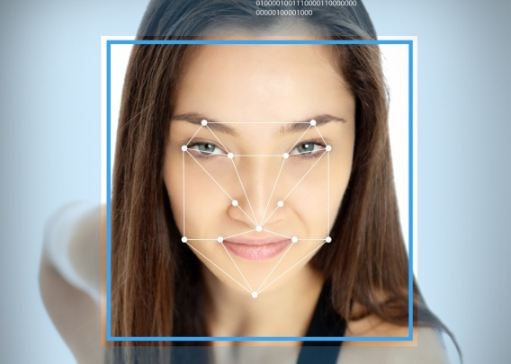
Observation-resistant Solutions
Biometric Identifiers
  Also avoids keyboard contact & exposure
  Something you are, not something you know
  Finger/hand prints, iris/retinal configuration, hand/facial geometries
Intro & Motivation
Usage Survey
Related Work
Cashtags
Implementation
Evaluation
Conclusion

Slide 25
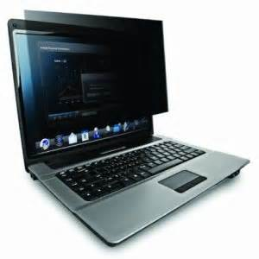
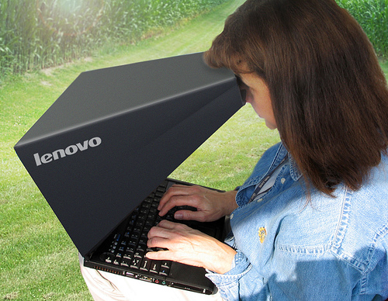
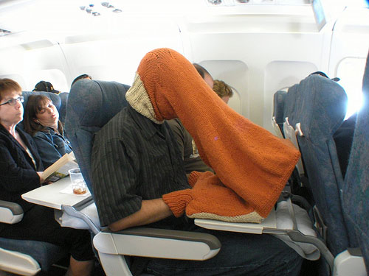
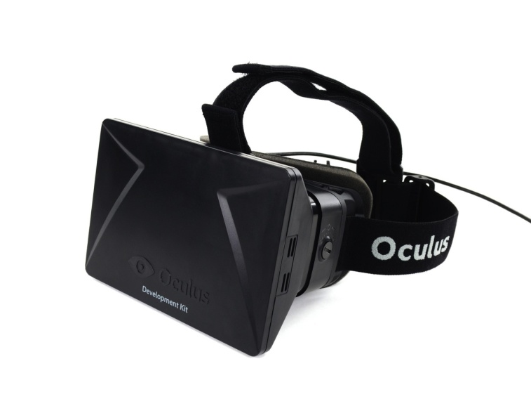
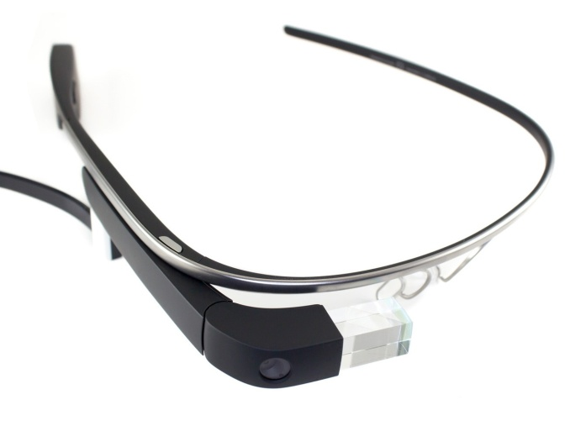
Observation-resistant Solutions
Physical barriers
Wearable technologies
Intro & Motivation
Usage Survey
Related Work
Cashtags
Implementation
Evaluation
Conclusion

Slide 26
Existing Solutions Inadequate
The visual channel remains open
  Existing techniques focus solely on authentication
  Limited tools to obfuscate sensitive data and none sufficiently general purpose
Intro & Motivation
Usage Survey
Related Work
Cashtags
Implementation
Evaluation
Conclusion

Slide 27
Cashtags
Cashtags: a system that defends against observation-based attacks
  Serves as easy-to-remember aliases for valuable sensitive personal identifiers
  Alias consists of $ + text
    E.g. $visa to represent a 16-digit credit-card number
Permits access to sensitive data in public
  Without the fear of screen leaks
Intro & Motivation
Usage Survey
Related Work
Cashtags
Implementation
Evaluation
Conclusion

Slide 28
Cashtags
Intro & Motivation
Usage Survey
Related Work
Cashtags
Implementation
Evaluation
Conclusion

Slide 29
Threat Model
Passive, observation-based attacks
  Direct human observation
  Live or recorded video
Can view screen & key presses from keyboards, keypads, screen, etc.
Absence of active attack
  Observer is not able to influence user
Intro & Motivation
Usage Survey
Related Work
Cashtags
Implementation
Evaluation
Conclusion

Slide 30
Design Overview
Interception of sensitive data elements
Convenient & compatible user interface
Service-specific internal access to sensitive data
Handling of many data formats variants
Efficient & convenient development/deployment
Centralized Cashtag storage repository
Per-application behavior
Intro & Motivation
Usage Survey
Related Work
Cashtags
Implementation
Evaluation
Conclusion

Slide 31
Observation-resistant Design Granularity
Screen-level masking
  Coarse-grained, obscure entire app window or screen
  Completely prevent leaks, also prevents usage
Data-tracking-based approach
  Fine-grained, predefined masked data, track data elements through system
  Usable, but less deployable, very high overhead
Keyword-based approach
  Predefined data element masking
  Data-tracking-based benefits without overhead
Intro & Motivation
Usage Survey
Related Work
Cashtags
Implementation
Evaluation
Conclusion

Slide 32
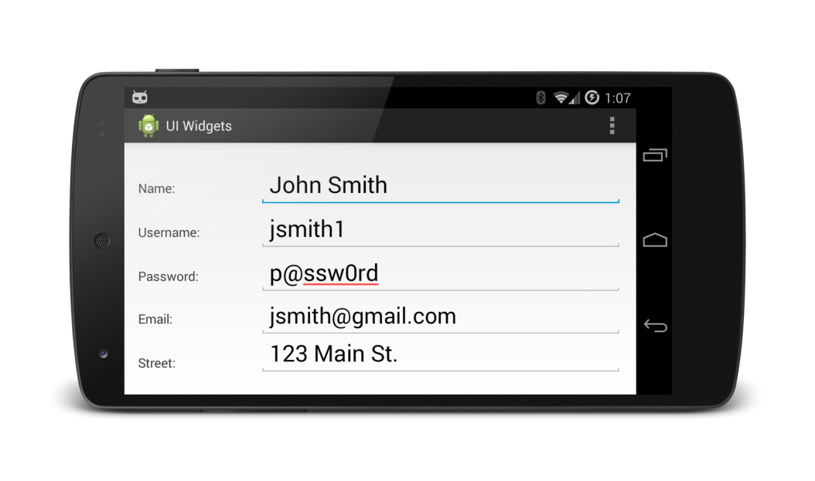
Where to Intercept Sensitive Data?
Applications
Browser
Apps
Cashtags Interception?
Application
Framework
WebKit/Chromium Canvas
WebView
GL Surface
Canvas
GL Widgets & Views
Android API Widgets &Views
Cashtags Interception
Cashtags Interception
Libraries &
Android Runtime
Cashtags Interception?
Surface Flinger
Kernel &
Device Drivers
Frame Buffer

Slide 33
User Interface
Early design
  Code words, e.g. Joe → John
  Separate secure entry keyboard app
  Replace default keyboard app
Direct input of cashtags
  Alias pre-pended with $, to represent sensitive information
Direct input of sensitive data
  Support for auto completion detects first few letters
  Some potential for information leak
Intro & Motivation
Usage Survey
Related Work
Cashtags
Implementation
Evaluation
Conclusion

Slide 34
Additional Cashtags Semantics
Recursion support
  $signature → $first_name $last_name $gmail → John Smith, jsmith@gmail.com
Circular mapping prevention
  $John → $Joe → $John → $Joe → $John ...
Variants of data formats
  Accounts, SSNs, etc. with different schemes
    123456789; 123-45-6789; 123 45 6789)
    Regular expression libraries (java.util.regex.*)
Handle malicious apps, pre-filled cashtags
Intro & Motivation
Usage Survey
Related Work
Cashtags
Implementation
Evaluation
Conclusion

Slide 35
Display Data Paths
Text rendered on-screen via several mechanisms
  Standard widget toolkit/API
  OpenGL (GLES20Canvas) or other graphic rendering libraries
  Browser rendering engines
    WebKit or Chromium
    Cross-platform APIs such as Phonegap, JQuery Mobile, etc.
Intro & Motivation
Usage Survey
Related Work
Cashtags
Implementation
Evaluation
Conclusion

Slide 36
Screen View Decomposition Example

Slide 37
Xposed Code-injection Framework
Xposed code-injection intercepts and modifies runtime behavior
Why Xposed?
  Change code without loss of portability
Android has per-app virtual machines (Dalvik)
  Change there, change everywhere
Overridden library routines inserted into the Java classpath prior to virtual machine execution
  Thus, system behavior altered dynamically without firmware changes
Intro & Motivation
Usage Survey
Related Work
Cashtags
Implementation
Evaluation
Conclusion

Slide 38
Xposed Framework
Individual class methods or constructors are hooked
  Injected code executed before, after, or instead of base method calls
  Alters function params, or return values
  Access control changes: private or protected members accessed or modified
  Add new fields or functions to the base class
Intro & Motivation
Usage Survey
Related Work
Cashtags
Implementation
Evaluation
Conclusion

Slide 39
Widgets Intercepted
Static text
  TextView(android.widget.TextView)
Editable text
  EditText (android.widget.EditText)
Graphical text
  GLCanvas(android.view.GLES20Canvas)
Web text
  Webview(android.WebKit/WebView)
Intro & Motivation
Usage Survey
Related Work
Cashtags
Implementation
Evaluation
Conclusion

Slide 40
Widgets & Android View Hierarchy
View
Java inheritance implicitly
handles all of these
Code-inject here
TextView
CheckedTextView
EditText
Button
AutoCompleteTextView
MultiAutoCompleteTextView
CheckBox
RadioButton
Switch
Intro & Motivation
Usage Survey
Related Work
Cashtags
Implementation
Evaluation
Conclusion

Slide 41
TextView Behavior/Interception
TextView
Alias text
getText()
Spell-check, autocorrect, copy/paste services
getText()
Graphic canvas, Screen display, Alternative outputs
Actual Text
getText()
Current running app, web uploads, local storage
$Cashtags
Intro & Motivation
Usage Survey
Related Work
Cashtags
Implementation
Evaluation
Conclusion

Slide 42
EditText Behavior/Interception
EditText
Spell-check, autocorrect, copy/paste services
Alias text
setText(actual)
setText(alias)
Actual Text
setText(actual)
Current running app, web uploads, local storage
setText(alias)
$Cashtags
Intro & Motivation
Usage Survey
Related Work
Cashtags
Implementation
Evaluation
Conclusion

Slide 43
EditText
Pre-populated text same as TextView (via inheritance)
For user input, similar to, and through same interfaces as auto-correct service
Widgets maintain internal arrays of text event handlers
Multiple granularities
  Per-character
  Per-field
Intro & Motivation
Usage Survey
Related Work
Cashtags
Implementation
Evaluation
Conclusion

Slide 44
WebView
Browser and cross-platform web apps render independently
  Non-native WebKit or Chromium engines
  Can’t dynamically inject; below Android/Java interception points
Explored custom compilations of browser rendering engines
  Abandoned for portability reasons
Explored browser-specific proxy through web servers
  Abandoned for performance, security, and lack of support for local access (Phonegap, Jquery Mobile, etc.)
Intro & Motivation
Usage Survey
Related Work
Cashtags
Implementation
Evaluation
Conclusion

Slide 45
WebView
Instead a browser plug-in type alternative used
  Not a traditional plug-in, this interface does not exist
  Xposed code injection used to create this
Before website or web app is rendered on-screen
  HTML is pre-processed with JavaScript and HTML DOM is extracted
  Iterates over text nodes, makes replacements of sensitive data as required
User input handed through pre-discussed mechanisms
Intro & Motivation
Usage Survey
Related Work
Cashtags
Implementation
Evaluation
Conclusion

Slide 46
Evaluation
Display and input accuracy
  API coverage evaluation
  Market app coverage evaluation
Performance overhead
Usability overhead
Intro & Motivation
Usage Survey
Related Work
Cashtags
Implementation
Evaluation
Conclusion

Slide 47
Display & Input Accuracy
Focus on TextViews & EditTexts
PII chosen based on US gov & NIST standards
Show that PII terms not displayed on-screen
  From the app internally
  As user input of sensitive data directly
  As user input of cashtag alias
For all cases, show that PII term correctly returned when used internally by the app
Intro & Motivation
Usage Survey
Related Work
Cashtags
Implementation
Evaluation
Conclusion

Slide 48
Display & Input Accuracy Diagram
Test Cases:
Input type(4)
Phrase case(2)
Widget type(9)
Layout type(2)
Theme type(3)
Gen method(2)
Lifecycle type(2)
System Input (actual)
System Input (alias)
User Input (actual)
User Input (alias)
Screenshot & OCR
View Hierarchy Dump
Google Docs
Only alias?
Only actual?
Intro & Motivation
Usage Survey
Related Work
Cashtags
Implementation
Evaluation
Conclusion

Slide 49
Android API Test Combinations
Input phrase type (4): Alphabetic phrase, numeric phrase, alphanumeric phrase, Alphanumeric with symbols.
Phrase case (2): Case Sensitive Text, Case In-sensitive Text.
Widget type (9): TextView, CheckedTextView, Button, CheckBox, RadioButton, Switch, EditText, AutoCompleteTextView, MultiAutoCompleteTextView
Layout type (2): LinearLayout, RelativeLayout
Theme type (3): Default theme, System theme, User-defined theme.
Generation method (2): Static XML, Dynamic Java
Lifecycle type (2): Activity-based app lifecycle, Fragment-based app lifecycle
Intro & Motivation
Usage Survey
Related Work
Cashtags
Implementation
Evaluation
Conclusion

Slide 50
Android API Test Results
1,728 tests for static text widgets and inputs
526 additional test cases for user input widgets
  Software keyboards & physical devices (on-board hardware, USB or wireless input devices)
Cashtags behaves correctly for all test cases
Intro & Motivation
Usage Survey
Related Work
Cashtags
Implementation
Evaluation
Conclusion

Slide 51
App Coverage Evaluation
Does Cashtags work on existing apps?
Millions of apps available to thousands of devices
  Hard to enumerate all
Thus, representative subset reasonable to demonstrate Cashtags, selected by:
  Popularity (download metrics)
  Can contain PII: email, messaging, social media, storage, office, and finance
  Can remotely verify correctness
Intro & Motivation
Usage Survey
Related Work
Cashtags
Implementation
Evaluation
Conclusion

Slide 52
App Coverage Evaluation
 |  | User Input Actual | User Input cashtag | Remote Success Actual | Remote Success cashtag
 | AOSP Email | √ | √ | √ | √
Email | Gmail | √ | √ | √ | √
 | K9 Mail | √ | √ | √ | √
 | Messaging | √ | √ | √ | √
Messaging | Google Hangouts | √ | √ | √ | √
 | Snapchat | √ | √ | √ | √
 | Facebook | √ | √ | √ | √
Social | Twitter | √ | √ | √ | √
 | Google+ | √ | √ | √ | √
 | Dropbox | √ | √ | √ | √
Storage | MS OneDrive | √ | √ | √ | √
 | File Manager | √ | √ | √ | √
 | Google Docs | √ | √ | √ | √
Office | MS Office Mobile | √ | √ | X | X
 | QuickOffice | √ | √ | √ | √
 | Google Wallet | √ | √ | √ | √
Finance | Paypal | √ | √ | √ | √
 | Square | √ | √ | √ | √
Intro & Motivation
Usage Survey
Related Work
Cashtags
Implementation
Evaluation
Conclusion

Slide 53

Performance Evaluation Diagram
Without Web Upload
With Web Upload
Test Cases:
Input type(4)
Phrase case(2)
Widget type(9)
Layout type(2)
Theme type(3)
Gen method(2)
Lifecycle type(2)
System Input (actual)
System Input (alias)
User Input (actual)
User Input (alias)
Start
Stop
Upload
Google Docs
Next
Stop
Intro & Motivation
Usage Survey
Related Work
Cashtags
Implementation
Evaluation
Conclusion

Slide 54
Performance Overhead
Intro & Motivation
Usage Survey
Related Work
Cashtags
Implementation
Evaluation
Conclusion

Slide 55
Performance Overhead
Intro & Motivation
Usage Survey
Related Work
Cashtags
Implementation
Evaluation
Conclusion

Slide 56
Usability Overhead
Keystroke Count Comparison
Type | Actual | Alias | Alias | Diff
First Name | 6 | $fname | 6 | 0
Last Name | 6 | $lname | 6 | 0
Full name | 13 | $name | 5 | -8
Email | 20 | $email | 6 | -14
Username | 9 | $user | 5 | -4
Password | 9 | $pass | 5 | -4
Phone number | 10 | $cell | 5 | -5
Birthday | 10 | $bday | 5 | -5
SSN | 9 | $ssn | 4 | -5
Credit Card | 16 | $visa | 5 | -11
Acct. number | 12 | $acct | 5 | -7
Intro & Motivation
Usage Survey
Related Work
Cashtags
Implementation
Evaluation
Conclusion

Slide 57
Future Work
Increase coverage
  Widget-level text interception effective only if devs follow rules
  API deviations need case-specific solutions
Address common name issue
  John → $fname
  Googles for John Adams, John Travolta, or John Williams
  Results $fname Adams, $fname Travolta, or $fname Williams
Handle more data formats
  Removal of spaces and symbols, and caps mismatch all handled
  Field expands across multiple TextViews not recognized, (e.g., credit card split into parts)
  Can be handled by adding each part to Cashtags repository
Intro & Motivation
Usage Survey
Related Work
Cashtags
Implementation
Evaluation
Conclusion

Slide 58
Handling Business Use Cases
Cashtags envisioned to protect PII
  User model, use cases, and evaluation presented to showcase feasibility of system for this goal
  Not limited to this narrow view, generalizes to others
Recursive data processing allows for more complex hierarchal structure
  Range-based or categorical schemes
Simple modifications would permit wildcards
  E.g. mask all accounts with certain prefix, SSNs, CCs, etc.
Additional text processing and contextual data identification
New interfaces, dynamic additions, and on-the-fly masking
Intro & Motivation
Usage Survey
Related Work
Cashtags
Implementation
Evaluation
Conclusion

Slide 59
Re-cap of Cashtags Design
Password-vault-like user model
Screen rendering interception
Auto-correct-like user input interception
Context-aware data return
Code-injection-based development and deployment model
Intro & Motivation
Usage Survey
Related Work
Cashtags
Implementation
Evaluation
Conclusion

Slide 60
Dissertation Contributions
Insight into actual user privacy attitudes
  People exercise little caution preserving privacy
  Privacy is not equal to trust
  Users underestimate mobile app privacy threats
  Users’ privacy ≠ security community
Design, implementation, & evaluation of Cashtags
  Interception of screen rendering to preventing data leaks
  Sensitive data input even under direct observation
  Convenience, efficiency, usability, legacy compatibility
Intro & Motivation
Usage Survey
Related Work
Cashtags
Implementation
Evaluation
Conclusion

Slide 61
Conclusion
Cashtags is a first step toward protection against visual leaks of on-screen data
Feasible to compute in public without exposing sensitive personal data
System is general purpose, maintains full functionality, legacy support
Results suggest near universal app compatibility
Efficient, with minimal perceived overhead
Unified, device-wide protection against shoulder surf threat
Intro & Motivation
Usage Survey
Related Work
Cashtags
Implementation
Evaluation
Conclusion

Slide 62
Thank You
Questions?
Cashtags: Protecting the Input and Display of Sensitive Data
Michael J. Mitchell
All interaction with human subjects was approved by the Florida State University IRB Human Subjects Committee, approvals 2012.8779 and 2013.10175
This work is sponsored by NSF CNS-1065127.
Opinions, findings, and conclusions or recommendations expressed in this document do not necessarily reflect the views of the NSF, FSU, or the U.S. government.
Intro & Motivation
Usage Survey
Related Work
Cashtags
Implementation
Evaluation
Conclusion

