Slide 1
CS Undergraduate Curriculum Committee
Presentation by CS UCC Chair Ann Ford Tyson
aford@fsu.edu
For CS Faculty Workshop
August 2022

Slide 2
Topics for Today
CS UCC & Faculty Accomplishments in 2021-2022
Ongoing in 2022-2023
Useful Information for faculty

Slide 3
CS UCC Activities - Overview
CS always has a large amount of activity by faculty
new courses, course changes, updates
During 2021-2022 the CS Minor was updated, largely driven by CS Advisors noting that the prior track system was confusing to students; this has been simplified
Next slide – major course actions taken and in progress
Please note: If you have a major question about a specific course, please contact the requestor outside of this presentation (we don't have much time to present today!)

Slide 4
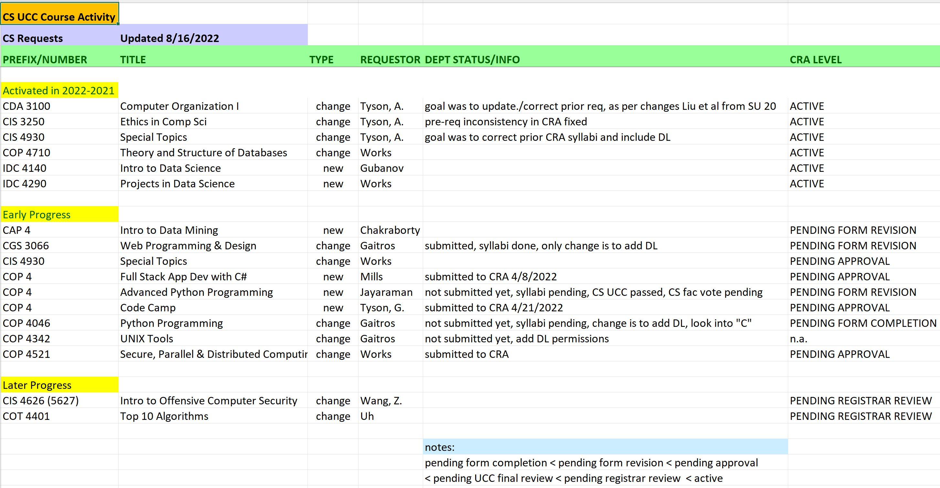

Slide 5
CS UCC Web Materials goal: up-to-date info and support for faculty
CS UCC Meeting Minutes and Other Current Items
Useful Reference Documents
Sample syllabus for Liberal Studies courses
Sample syllabus for Non-Liberal Studies courses
Faculty senate required syllabus text (must use in syllabi)
How to Handout: converting from a traditional to an online syllabus
SCNS Prefix definitions (e.g. COP == Computer Programming, etc.) https://www.cs.fsu.edu/department/resources/ugcc-records/

Slide 6
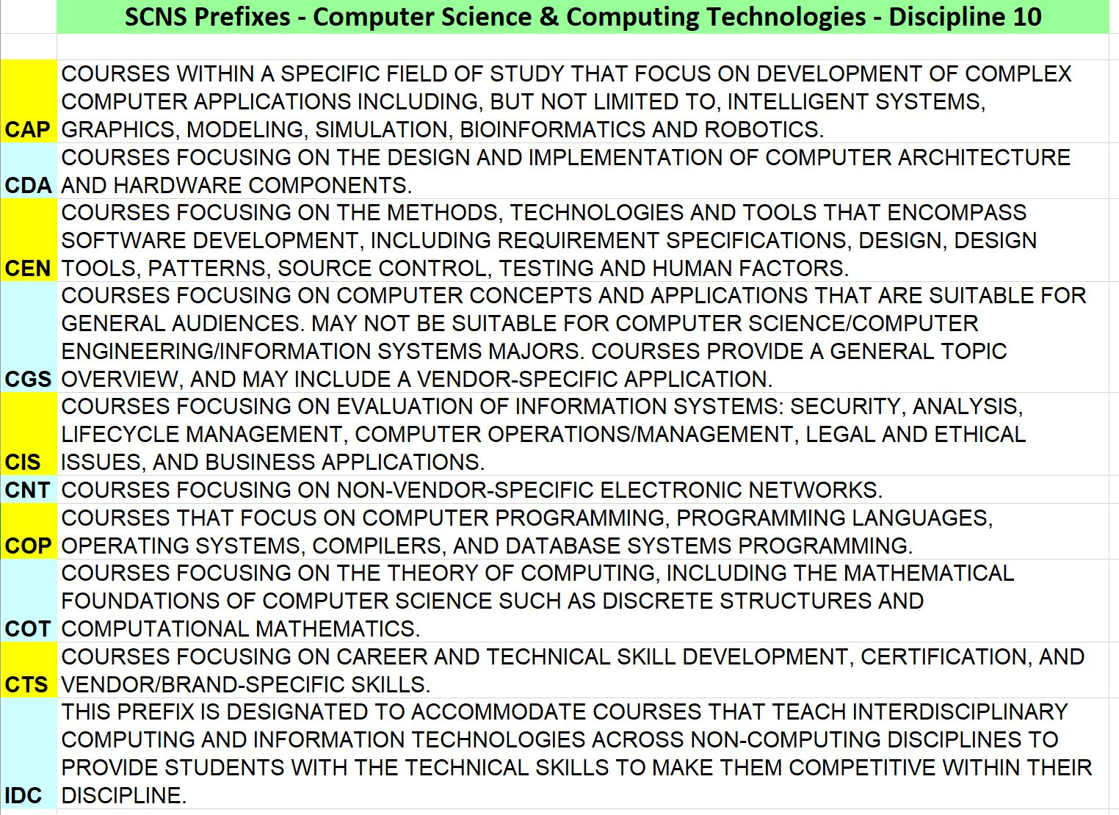
SCNS Prefixes : https://flscns.fldoe.org/

Slide 7
How To: Update/Summary on Undergraduate Course Modification and New Course Requests
Where to go on the Web for request submission into CRA (Course Request Activation system), and to review current info on existing courses
Available at this URL (requires FSU credential login): https://java.odl.fsu.edu/Curriculum_Request_Form/main.jsp
Note: help is available for using this site; click on help link from site main page or use https://java.odl.fsu.edu/Curriculum_Request_Form/support.jsp
Please submit both traditional and online versions at the same time whenever appropriate

Slide 8
Summary of Steps for a New Course Request or Existing Course Change Request
Propose to CS UCC initially: Send idea/syllabus to CS UCC Chair for initial chat and discuss with cognizant faculty; for a new course, check SCNS site to see if similar courses already there. Requestor enters course request into CRA system with syllabi (trad/online) Make CS UCC Chair and Dept Chair reviewers in the CRA system; any involved CS faculty Don't hit SUBMIT button until approved and voted on by CS UCC committee, CS Chair and CS Department faculty (CS UCC Chair will set up votes as needed).
Current CS UCC Chair email address is: aford@fsu.edu
College of Arts and Sciences review (typically by Aline Kalbian; she reviews automatically at the right time, you do not need to ask her to review)
SAC (Science Area Committee) review
ASPC (Arts and Science Policy Committee) review; this is the "College" review
Liberal Studies Committee review, if needed (e.g. ethics, competency, etc.)
FSU UCC review
SCNS (State Course Numbering System) - processing of new prefix/course numbers
FSU Registrar Review
If all goes well… ACTIVATION!

