Slide 1
TBAS: Enhancing Wi-Fi Authentication by Actively Eliciting Channel State Information
Muye Liu, Avishek Mukherjee, Zhenghao Zhang, and Xiuwen Liu
Florida State University

Slide 2
Motivation
Spoofing in Wi-Fi: even a common laptop computer can be configured to send packets with faked identity
Encryption-based protection cannot be relied upon in many cases
users with weak passwords
open networks such as some hotels and coffee shops
A reliable method is needed to detect spoofing without password
Hi, I am Bob!
AP
Alice
Bob

Slide 3
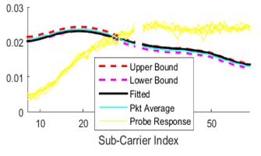
Channel State Information (CSI)
It has been proposed to use Channel State Information (CSI) to identify the user [yang2014]

Slide 4
Challenge in Using CSI for Authentication
The challenge is to obtain the CSI of the legitimate user in time to for comparison
The CSI may change
If the new CSI is different from the ones in record, is it because the new CSI is from the attacker, or because the CSI changed?
When the CSI is needed for comparison, the legitimate user may not be sending any packet
depends on user traffic

Slide 5
Our Approach
Not matching!!!
Our key idea is to actively elicit the CSI: when the AP received a packet is received from Bob, it sends a probe (a small dummy packet), which will to elicit a response from Bob (the ACK)
Hi, I am Bob!
AP
Alice’s packet
Alice
Bob’s packet
Bob

Slide 6
What if Alice also sends a response?
Not matching!!!
The two responses will collide, the AP will not receive it and can also determine the previous packet is spoofed
Hi, I am Bob!
AP
Alice’s packet
Alice
Collision packet
Bob

Slide 7
Key Advantages
The Catch
The CSI is collected when needed, and does not depend on user traffic
Should achieve better performance
Puts the attacker in a delimma
No change to the Wi-Fi protocol, because a node will always send an ACK when it receives a packet
Improving the security by only upgrading the AP, all user devices in the network can stay the same
The additional overhead of probing
However can be managed

Slide 8
Our Key Contributions
The Channel State Check (CSC), which can tell if two packets are from the same sender based on the CSI
A simple protocol to reduce the overhead of probing

Slide 9
Channel State Check (CSC)
Problem: Given the CSI vectors from Packet 1 and Packet 2, are Packet 1 and 2 from the same sender?
In our context
Packet 1 and 2 are received within a short interval, e.g., a few milliseconds
Packet 1 has been received correctly, Packet 2 may not

Slide 10
Channel State Check (CSC)
Strawman Solution. Just subtract the two CSI vectors, and compare the squared error with a threshold
Problem:
The CSI of the legitimate user may change, difficult to select a good threshold value
The threshold value should actually be determined by the time interval, the larger the interval, the more difference it should allow

Slide 11
Channel State Check (CSC)
Therefore, the main idea of CSC is to calculate a check curve to be used as the expected CSI of Packet 2:
not too far from the CSI in Packet 1
the distance determined by the time interval, allow some drifting
best matches the measured CSI in Packet 2
If the CSI in Packet 2 is even far from check curve, something is wrong!

Slide 12
Channel State Check (CSC)
Mathematically, it is to solve an optimization problem of finding a polynomial that :
under the constraint that

Slide 13
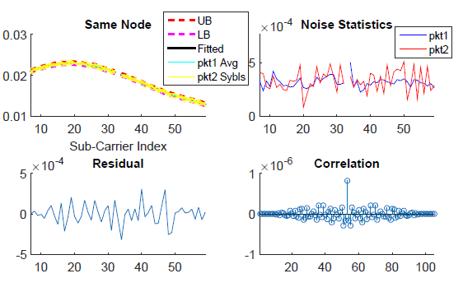
Channel State Check (CSC)
CSC does two checks:
Noise level check: is the noise in Packet 1 and Packet 2 (by comparing with the check curve) similar?
Residual correlation check: is the difference between CSI of Packet 2 and the check curve white noise?

Slide 14
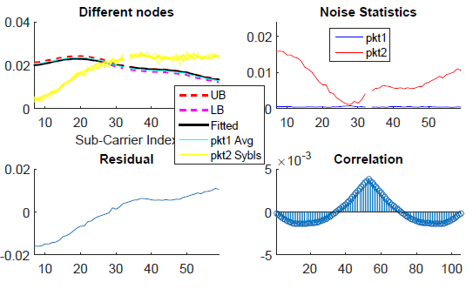
Channel State Check (CSC)
CSC does two checks:
Noise level check: is the noise in Packet 1 and Packet 2 (by comparing with the check curve) similar?
Residual correlation check: is the difference between CSI of Packet 2 and the check curve white noise?

Slide 15
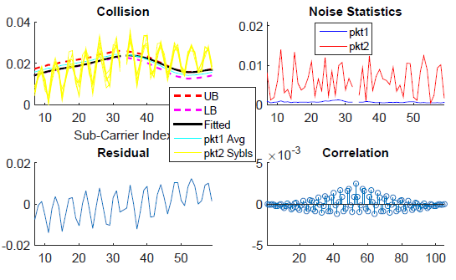
Channel State Check (CSC)
CSC does two checks:
Noise level check: is the noise in Packet 1 and Packet 2 (by comparing with the check curve) similar?
Residual correlation check: is the difference between CSI of Packet 2 and the check curve white noise?

Slide 16
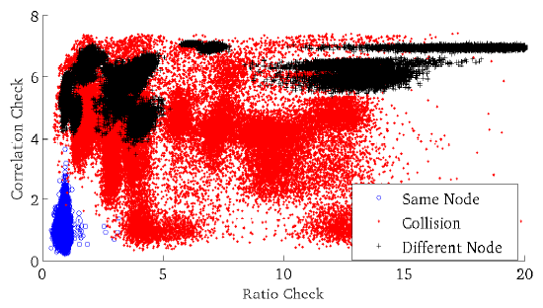
Channel State Check (CSC)
CSC performance on over 8000 packet pairs
The need for two checks is clear

Slide 17
A Simple Protocol to Limit Overhead
Simplest approach based on CSC:
Every time a data packet is received
send a probe, get the CSI in the probe response
run CSC between the CSI in the data packet and the probe response, reject or accept the data packet depending on the decision of CSC
Problem is high overhead

Slide 18
A Simple Protocol to Limit Overhead
The main idea is to store the last accepted packet as history. When a new packet is received,
Run CSC between the new packet and the history
Depending on CSC:
If passes, accepted the new packet, update history
If fails, clear history, send probe, run CSC between the new packet and the probe response
Periodically clear the history
Why it works in most cases when there is no attacker
If the user has a high traffic, history is almost always fresh, and usually no need to send probe
If the user has low traffic, sending a probe for each packet is fine

Slide 19
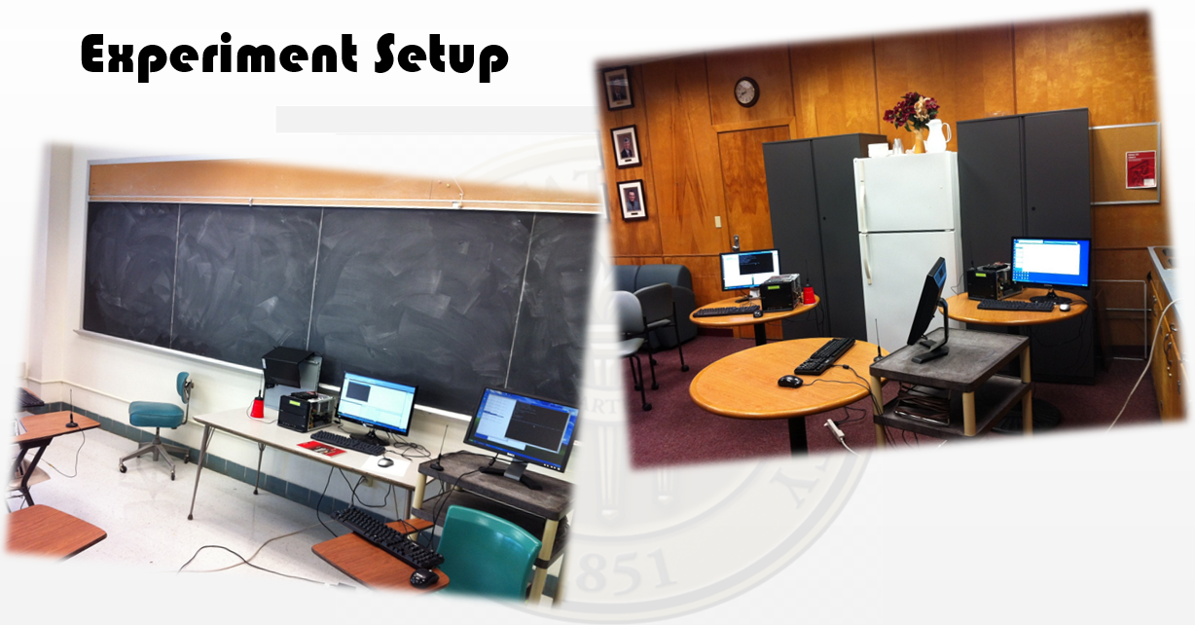
Evaluation
We have verified the approach using Software-Defined Radio, achieving False Positive and False Negative ratios of around 0.1%

Slide 20
Evaluation
Compared with a recent work “Practical User Authentication Leveraging Channel State Information” in ASIACCS 2014, referred to as SVM

Slide 21
False Positive
Under various
traffic load (HT, MT, or LT)
transmission power (high or low)
Channel mobility (stationary or mobile channel)

Slide 22
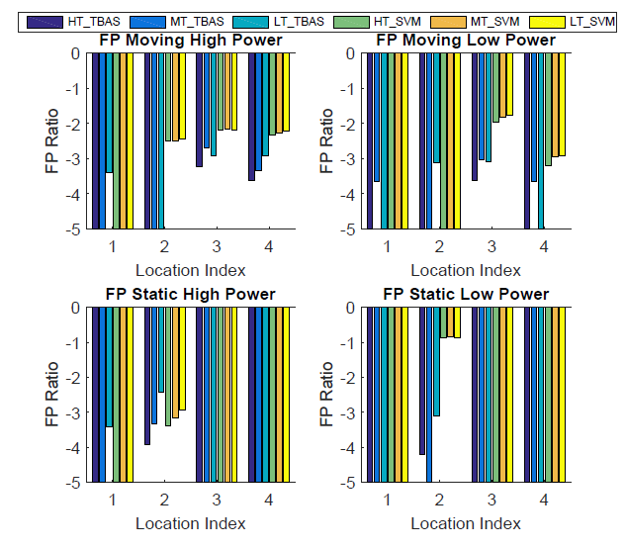
False Positive
TBAS always has low FP ratios of around 0.001 or lower
SVM sometimes has high FP ratio, like 0.1

Slide 23
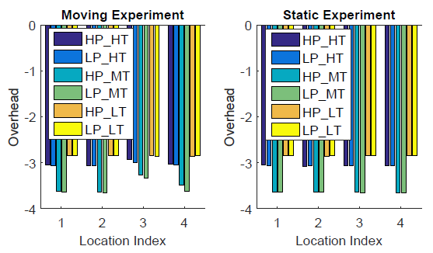
Overhead
Measured by the fraction of time used by probe and probe response
All around 0.001 or lower

Slide 24
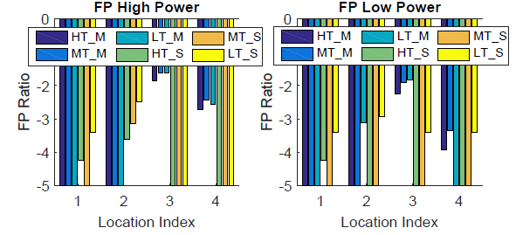
False Positive with Delayed Response
Configure the program to use the response of the next probe as that for this probe
Longer delays between the data packet and the probe response, around 15 ms or more, testing TBAS under extreme conditions
Still around 0.01 or lower, mobile channels affected more

Slide 25
False Negative
Attacker sends the data packet, and has two strategies:
Strategy 0: When a probe is received, do not respond
Strategy 1: When a probe is received, respond
Varying the transmission powers of the user and the attacker

Slide 26
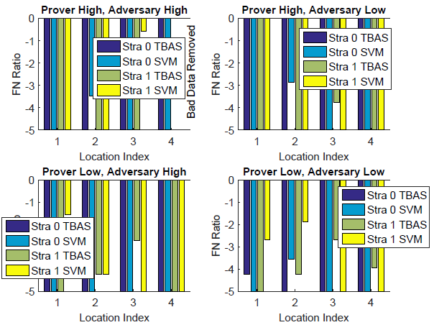
False Negative
TBAS has very low FN ratios, i.e., in the order 0.001 or below in all cases. SVM sometimes has higher FN ratios, such as around 0.26, in one of the cases.

Slide 27
Thank you!

