Slide 1

Revisiting Partial Packet Recovery in 802.11 Wireless LANs
Jin Xie, Wei Hu, Zhenghao Zhang
Florida State University

Slide 2


Wireless Transmission
In a wireless link, a packet may be
  Fully received

Slide 3
Wireless Transmission
In a wireless link, a packet may be
  Erased

Slide 4
Wireless Transmission
In a wireless link, a packet may be
  Partially received

Slide 5
Packet Recovery
Erased Packets
  Sender has to retransmit the entire packet.
Partial Packets
  Current 802.11 will retransmit!
  But partial packets often has only few errors. Whole packet retransmission is not efficient.

Slide 6
Partial Packet Recovery
Block based approach
  Example: Maranello [NSDI 2010]
  Divide the packet into blocks. Retransmit the corrupted block.
    A block is found to be corrupted if it fails the checksum test
1
2
3
4
2
3
1
2
3
4
2
3

Slide 7
Partial Packet Recovery
Error Correction based approach
  Example: ZipTx [Mobicom 2008]
  Divide the packet into blocks and encode into codewords. If there are errors, send parity bytes
1
2
3
4
1
2
3
4
Decode
1
2
3
4

Slide 8
Motivations to Revisit this Problem
Combining the two repair methods
  They are not mutually exclusive

Slide 9
Motivations to Revisit this Problem
Using error estimator
  Determine the optimal repair method and repair parameters
  Error estimators were not available to earlier schemes

Slide 10
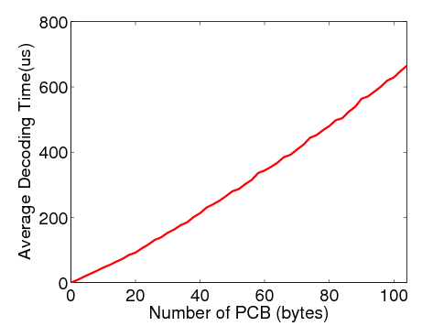
Motivations to Revisit this Problem
Observing the CPU constraint
  Make sure that packet recovery does not consume too much CPU time.
    Software decoding can be time consuming

Slide 11
Our Contribution
Combine block-based and EC based and use three repair methods:
  Block-retran: Traditional block retransmission.
  HEC: Holistic Error Correction. Traditional error correction.
  TEC: Target Error Correction.
Select the optimal repair method that
  Minimizes the number of bytes sent
  Abide by the CPU time constraint β

Slide 12
Combining Block-retran and Error Correction
Block-retran and Error Correction have pros and cons:
  Block-retran
    does not need much CPU time
    but retransmitted blocks may be corrupted and may transmit more data
  Error Correction
    need CPU time
    but is more resilient to errors and need less data

Slide 13
Combining Block-retran and Error Correction
When CPU time is a constraint, it makes sense to take advantage of both:
  For more corrupted packets, use block-retran
  For more lightly corrupted packets, use HEC
The number of errors in a packet is estimated by the estimator.

Slide 14
Code block, interleaving, and checksum block
Code block
Code Block:
  Divide a packet into blocks, encode each into a codeword
Interleaving:
  Simply a random permutation
  To spread the errors evenly in the code blocks
    So we send the same number of parity bytes for all code blocks.
Checksum block:
  Divide the packet into (smaller) blocks
  It is after interleaving because when retransmitting we prefer errors in clusters
1
1
2
2
3
3
4
4
5
5
6
6
7
7
8
8
Interleaving
Checksum block
2
2
8
8
4
4
1
1
6
6
3
3
5
5
7
7

Slide 15
Feedback of a Partial Packet
The checksum is not transmitted with the data.
  Only when the packet is a partial packet, the checksum is calculated at the receiver and sent as a feedback to the sender.
Also in the feedback is the estimated number of errors
  With which the number of parity bytes for each code block can be determined

Slide 16
TEC
In addition we have TEC:
  A partial packet often has only few error bytes.
  For such packets,
    block-retran will waste in transmitting correct bytes.
    EC will waste in decoding correct code blocks.
  Why not find the error checksum block (by checksum test) then send parity bytes for this checksum block only?
A partial packet:
1
2
3
4
Block-retran:
2
Plus decoding
Error Correction:
TEC:

Slide 17
HEC and TEC
Why not use TEC for all packets and not worry about HEC at all?
The problem is that we do not know the number of errors in each checksum block, so we actually do not know how many parity bytes to send if there are many error blocks.

Slide 18
HEC and TEC
If a packet has very few errors (no more than 3 in our implementation), it is qualified for TEC.
  There are usually very few error checksum blocks and we fit them into one codeword.
  We send 10 (no more than 1 error) or 20 (no more than 3 errors) parity bytes.
If a packet has more errors, we have to rely on interleaving to spread the errors evenly in all code blocks.

Slide 19
How do we know how corrupted the packet is?
Knowing which block is corrupted is easy – failed CRC.
Knowing how many error bytes is difficult – one error byte and 100 error bytes both result in a CRC failure.
Have to use error estimator.

Slide 20
AMPS
We are aware of two estimators, EEC [Sigcomm 2010] and AMPS.
All details about AMPS, including the table lookup implementation, getting the prior P(Y) are in:
“Employing coded relay in multihop wireless networks”, http://arxiv.org/abs/1012.4136

Slide 21
AMPS
Data packet:
AMPS estimates the number of errors in a packet based on the Maximum A Posteriori (MAP) criterion.
  The parity bit of multiple bytes is a sample. Multiple samples are sent in the packet header. The receiver compares the received samples and the locally calculated samples. The number of mismatches (X) reveals the error conditions (Y).
  We pick Y such that P(Y|X) is maximized.
Sample:
Mismatch
Local
sample:

Slide 22
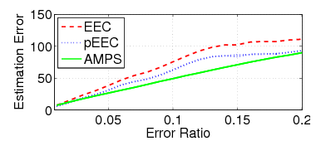
AMPS
Comparing with EEC [Sigcomm 2010]
  1500-bit packet for EEC and 1500-byte packet for AMPS.
  EEC uses all 10 levels with overhead 40 bytes. AMPS has overhead 8 bytes.
  pEEC removes the results when EEC cannot estimate.
Main reason
  EEC is a heuristic with a bound, AMPS follows the MAP optimality criterion.
    For example, EEC has a hard threshold which often leads to underestimation.

Slide 23
Selection of Repair Method
A node may receive the feedback of multiple packets from a feedback frame.
  Which repair method to apply for each packet?

Slide 24
Selection of Repair Method – Some simple rules first
If a packet is qualified for TEC, don’t use HEC
  Means that we are always choosing between block-retran and one error correction method. Binary.
If the more repair data has to be sent for error correction than with block-retran, use block-retran
  Does not happen often but could happen

Slide 25
Selection of Repair Method
For each partial packet, we have
  : the decoding time
  : the transmission time for block-retran
  : the transmission time for required parity bytes
We are given the decoding time budget
…
…
…

Slide 26
Selection of Repair Method
For packet , we define a value and a weight
For packet P_{i} we define binary variable x_{i}:
  x_{i}=0 means should use block-retran
  x_{i}=1 means should use error correction.

Slide 27
Selection of Repair Method
As we want to minimize the total number of bytes under the CPU time constraint, the problem can be formalized as
  under the constraint that
  This is exactly the Knapsack problem which is NP-hard, and we adopt the standard greedy algorithm:
  Select the packet that has the largest ratio of value over weight for error correction.

Slide 28
The Decoding Time Budget
At the Receiver
  : the average time that the receiver encounters a partial packet
  : the CPU time constraint
  : the total number of partial packets in this feedback

Slide 29
Implementation
We implemented our scheme within the Madwifi open source driver.
We call it Unite.
We use a link layer protocol similar to ZipTx:
  Receiver aggregates the feedback of several packets into one feedback frame to reduce the overhead
  Sender has a timeout mechanism to retransmit, in case all feedbacks are lost
  A partial packet is repaired twice

Slide 30
Experiments

Slide 31
Comparing with Other Drivers
ORIG
  Original Madwifi driver
BLCK
  Original Madwifi driver enhanced with block-retran
EOLY
  Original Madwifi driver enhanced with HEC and AMPS under CPU time constraint
2RND
  Original Madwifi driver enhanced with a 2 round, fixed packet repair schedule according to ZipTx

Slide 32
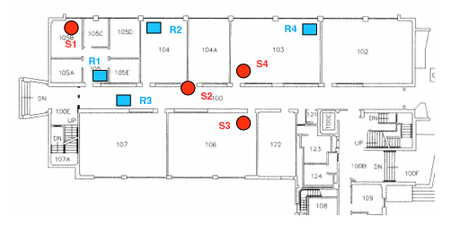
Experiment Setup
Randomly choose 60 sender and receiver locations
Each driver runs for 45 seconds at 54 Mbps
We collect per second data.
= 0.2.

Slide 33
Throughput Comparison
Unite achieves higher throughput than other schemes

Slide 34
Fine-grained Throughput Comparison
ORIG performance drops linearly
Comparison with ORIG

Slide 35
Fine-grained Throughput Comparison
2RND is good when error is low, but drops fast as error goes high
Comparison with 2RND

Slide 36
Fine-grained Throughput Comparison
BLCK is good when error is low, but drops quickly when error is high
Comparison with BLCK

Slide 37
Fine-grained Throughput Comparison
EOLY follows most closely with Unite but is still worse
Comparison with EOLY

Slide 38
CPU Load Comparison
Unite does not over consume CPU time

Slide 39
Repair Method Failure Ratio of Unite
Repair may fail, but Unite’s failure ratio is not high. TEC and HEC’s failure ratio is less than 0.1, meaning AMPS is doing a good job

Slide 40
Throughput under Different CPU Time Constraint
Throughput increases with more CPU time allowed

Slide 41
Measured CPU Load under Different CPU Constraint
CPU usage increases with more CPU time allowed; never above 50% because heavily corrupted packets are not repaired with error correction

Slide 42
The Choice of Repair Method Under Different CPU Constraint
Majority of packets repaired with TEC.
More allowed CPU time, more HEC.

Slide 43
Questions?

