Slide 1
Review

Slide 2
Interger Number Representations
To convert an unsigned decimal number to binary: you divide the number N by 2, let the remainder be the first digit. Then divide the quotient by 2, then let the remainder be d1, then divide the quotient by 2, then let the remainder be d2, until the quotient is less than 2.
  2’s complement. To convert a negative number to binary: invert each bit, and then add 1.

Slide 3
Problem
The binary representation of -57_{ten} in 8 bits in 2’s complement is
(a) 11000111
(b) 10011111
(c) 11010111
(d) None of the above.
Notes:
Answer: (a). 57 is 00111001 -> 11000110 -> 11000111

Slide 4
Number with Fractions
  Numbers with fractions. Convert the integer part and the fraction part to binary separately, then put a dot in between.
    To get the binary representation of the fraction, divide the fraction first by 0.5 (2⁻¹), take the quotient as the first bit of the binary fraction, then divide the remainder by 0.25 (2⁻²), take the quotient as the second bit of the binary fraction, then divide the remainder by 0.125 (2⁻³),…
  Floating numbers. Single precision. 32 bits.

Slide 5
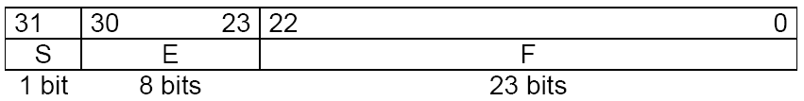
Floating Numbers
Single precision. 32 bits.
Double precision. 64 bits. Bias is 1023.
31 | 30 | 29 | 28 | 27 | 26 | 25 | 24 | 23 | 22 | 21 | 20 | 19 | 18 | 17 | 16 | 15 | 14 | 13 | 12 | 11 | 10 | 9 | 8 | 7 | 6 | 5 | 4 | 3 | 2 | 1 | 0
s | Exponent |  |  |  |  |  |  |  |  |  |  | fraction
1 bit | 11 bits |  |  |  |  |  |  |  |  |  |  | 20 bits
Fraction (continued)
32 bits

Slide 6
Special Cases Considered
Single precision |  | Double precision |  | Object represented
Exponent | Fraction | Exponent | Fraction
0 | 0 | 0 | 0 | 0
0 | nonzero | 0 | nonzero | ±denormalized number
1-254 | anything | 1-2046 | anything | ±floating-point number
255 | 0 | 2047 | 0 | ± infinity
255 | nonzero | 2047 | nonzero | NaN (Not a number)

Slide 7
Problem
The single precision floating number representation of -22.75_{ten} is
(a) 1 10000111 011 0100 0000 0000 0000 0000
(b) 1 10000011 011 0110 0000 0000 0000 0000
(c) 0 10000100 011 1110 0000 0000 0000 0000
(d) None of the above.
Notes:
Answer: (b). 22.75->10110.11->1.011011 *2^4-> 1 1000 0011 011011…

Slide 8
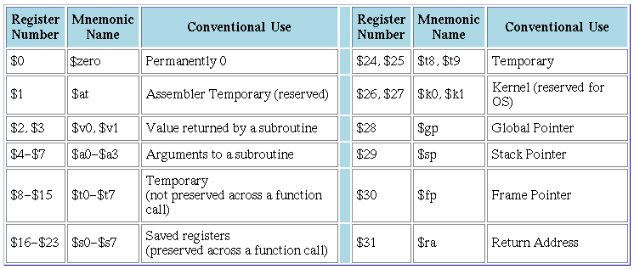
MIPS
MIPS registers

Slide 9
MIPS
MIPS instructions (not complete)
  R-type: add, sub, and, or, sll,…
    add $t0, $t1, $t2 # add $1, $t2, put the result in $t0
  Memory: lw, sw, lb, sb.
    lw $t0, 4($t1) # read the data at the address of # $t1+4, put it in $t0
  Branch: beq, bne, …
    beq $t0, $t1, SOMEWHERE # if $t0 is equal to $t1, the # next instruction to be # executed is at the address
    # specified by SOEMWHERE
    # (PC+4+offset)
  Jump: j, jal, jr
    j SOMEWHERE # the next instruction should be at the address # specified by SOMEWHERE (The upper 4 bits from PC+4, the # lower 26 bits from the instruction, the last 2 bits 0)
  Immediate type:
    addi $t0, $t0, 4 # add $t0 by 4 and put it in $t0

Slide 10
MIPS Instruction Encoding
Each MIPS instruction is exactly 32 bits
  R-type (register type)
  I-type (immediate type)
  J-type (jump type)
op rs rt rd shamt funct
op rs rt 16 bit address or constant
op 26 bit address

Slide 11
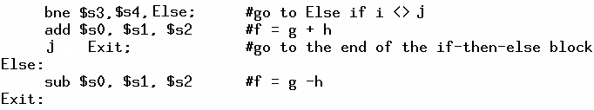
MIPS Coding
If else. Assume f to h are in $s0 to $s4.

Slide 12


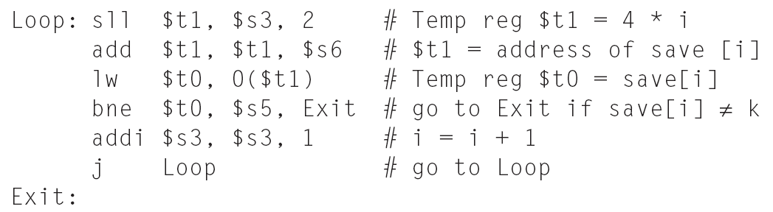
while loop
Assume that i and k correspond to registers $s3 and $s5 and base array save is in $s6

Slide 13
Problem
If $t0 is holding 0, $t1 is holding 1, what will be the value stored in $t2 after the following instructions?
srl $t1, $t1, 1
bne $t0, $t1, L1
addi $t2, $t0, 1
L1: addi $t2, $t0, 2
(a) 1.
(b) 2.
(c) 3.
(d) None of the above.
Notes:
Answer: b.

Slide 14
(b)
bgt $t0, $t1, L1
add $t2, $t0, $s0
sw $t1, 0($t2)
j Exit
L1: add $t2, $t1, $s0
lw $t0, 0($t2)
Exit:
(c)
bgt $t0, $t1, L1
sll $t2, $t0, 2
add $t2, $t2, $s0
lw $t1, 0($t2)
j Exit
L1: sll $t2, $t1, 2
add $t2, $t2, $s0
sw $t0, 0($t2)
Exit:
(d) None of the above.
Consider the following C code
if (a > b)
a = A[b];
else
A[a] = b;
where A is an integer array. Which of the following correctly implements the code above, assume a is in $t0, b is in $t1, and the starting address of A is in $s0? (bgt is “branch if greater than.”)
(a)
bgt $t0, $t1, L1
add $t2, $t0, $s0
lw $t1, 0($t2)
L1: add $t2, $t1, $s0
sw $t0, 0($t2)
Exit:
Notes:
Answer: D. correct one:
bgt $t0, $t1, L1
sll $t2, $t0, 2
add $t2, $t2, $s0
sw $t1, 0($t2)
j Exit
L1:sll $t2, $t1, 2
add $t2, $t2, $s0
lw $t0, 0($t2)
Exit:

Slide 15
MIPS Function
jal Funct:
  The next instruction will be at address specified by Funct
  PC+4 will be stored in $ra
jr $ra:
  The next instruction will be the one at address equal to the content in $ra
Calling a function is more like going to a function and then come back

Slide 16
.data
array:
.word 12, 34, 67, 1, 45, 90, 11, 33, 67, 19
msg_done:
.asciiz "done!\n"
.text
.globl main
main:
la $s7, array
li $s0, 0 #i
li $s1, 0 #res
li $s6, 9
loop:
sll $t0, $s0, 2
add $t0, $t0, $s7
lw $a0, 0($t0)
lw $a1, 4($t0)
jal addfun
add $s1, $s1, $v0
addi $s0, $s0, 1
beq $s0, $s6, done
j loop
done:
li $v0,4
la $a0,msg_done
syscall
jr $ra
addfun:
add $v0, $a0, $a1
jr $ra

Slide 17
Problem
Consider the following code segment. What will the code do?
li $ra, 0x04000000
jal f1
other instructions…
f1: addi $ra, -8
jr $ra
(a) It will enter a loop and can never come out.
(b) It will jump to the instruction located at address 0x04000000.
(c) It will call f1 once, then continue to execute other instructions following the jal f1 instruction.
(d) None of the above.
Notes:
Answer: a.

Slide 18
MIPS Calling Conventions
MIPS assembly follows the following convention in using registers
  $a0 - $a3: four argument registers in which to pass parameters
  $v0 - $v1: two value registers in which to return values
  $ra: one return address register to return to the point of origin

Slide 19
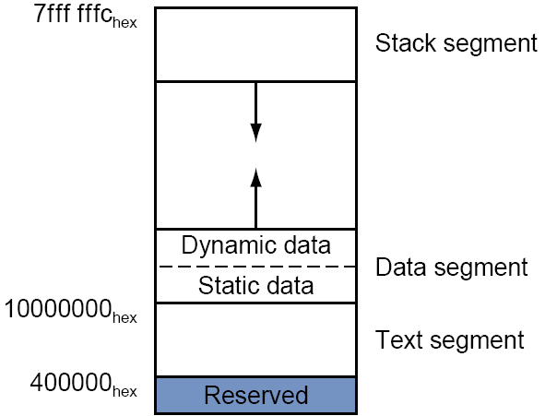
MIPS stack
The stack in MIPS is a memory space starting at 0x7ffffffc and growing DOWN.
The top of the stack is always pointed by the stack pointer, $sp (the address of the first element space in the stack should always be in $sp).
A function should save the registers it touches on the stack before doing anything, and restore it before returning.

Slide 20
MIPS Calling Conventions - more
MIPS software divides 18 of the registers into two groups
  $t0 - $t9: 10 temporary registers that are not preserved by the callee on a procedure call
    These are caller-saved registers since the caller must save the ones it is using
  $s0 - $s7: 8 saved registers that must be preserved on a procedure call
    These are callee-saved registers since the callee must save the ones it uses
In general,
  if there is a register that the callee may change, and the caller still needs it after calling the callee, the caller should save it and restore it before using it, such as $ra.
  If there is a register that the caller is not expected to change after calling the callee, the callee should save it, such as $s0.

Slide 21
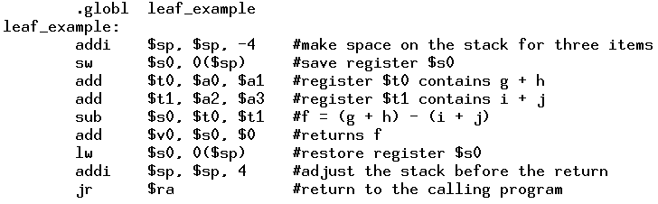
Saving $s0

Slide 22
MIPS interrupt
For external interrupt, your code is executing, and if an event happens that must be processed,
  The address of the instruction that is about to be executed is saved into a special register called EPC
  PC is set to be 0x80000180, where the interrupt handlers are located
  Then, after processing this interrupt, call “eret” to set the value of the PC to the value stored in EPC
  Note the difference between an interrupt and a function call. In a function call, the caller is aware of going to another address. In interrupt, the “main program” is not.

Slide 23
Supporting floating point. Load and Store
Load or store from a memory location (pseudoinstruction ). Just load the 32 bits into the register.
  l.s $f0, val
  s.s $f0, val
Load immediate number (pseudoinstruction )
  li.s $f0, 0.5

Slide 24
Arithmetic Instructions
abs.s $f0, $f1
add.s $f0, $f1, $f2
sub.s $f0, $f1, $f2
mul.s $f0, $f1, $f2
div.s $f0, $f1, $f2
neg.s $f0, $f1

Slide 25
Data move
mov.s $f0, $f1
mfc1 $t0, $f0
mtc1 $t0, $f0

Slide 26
Convert to integer and from integer
cvt.s.w $f0, $f0 # convert the 32 bit in $f0 currently representing an integer to float of the same value
cvt.w.s $f0, $f0 # the reverse

Slide 27
Comparison instructions
c.lt.s $f0,$f1 #set a flag in coprocessor 1if $f0 < $f1, else clear it. The flag will stay until set or cleared next time
c.le.s $f0,$f1 #set flag if $f0 <= $f1, else clear it
bc1t L1 # branch to L1 if the flag is set
bc1f L1 # branch to L1 if the flag is 0

Slide 28
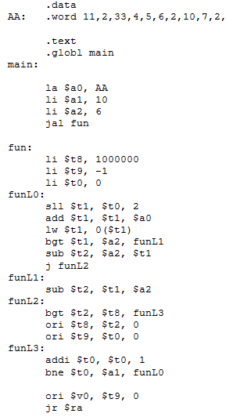
Read the MIPS code and answer the following questions. What does function f1 do? What is the value returned in $v0 after the function is called?
Notes:
Find the index of the element that is closest to the value in $a2. 5.

Slide 29

Digital Logic, gates
Basic Gate: Inverter
Truth Table
I
O
I
O
0
1
1
0
GND
I
O
Resister (limits conductivity)
Vcc

Slide 30
Abstractions in CS (gates)
Basic Gate: NAND (Negated AND)
Truth Table
A
B
A
B
Y
Y
0
0
1
1
0
1
0
1
1
1
1
0
GND
A
B
Y
Vcc

Slide 31
Abstractions in CS (gates)
Basic Gate: AND
Truth Table
A
B
Y
0
0
1
1
0
1
0
1
0
0
0
1
A
B
Y

Slide 32
Abstractions in CS (gates)
Other Basic Gates: OR gate
Truth Table
A
B
Y
0
0
1
1
0
1
0
1
0
1
1
1
A
B
Y

Slide 33
Abstractions in CS (gates)
Other Basic Gates: XOR gate
Truth Table
A
B
Y
0
0
1
1
0
1
0
1
0
1
1
0
A
B
Y

Slide 34
Design flow
Given any function, first get the truth table.
Based on the truth table, use the Karnaugh Map to simplify the circuit.

Slide 35
Karnaugh Map
Draw the map. Remember to make sure that the adjacent rows/columns differ by only one bit.
According to the truth table, write 1 in the boxes.
Draw a circle around a rectangle with all 1s. The rectangle must have size 2,4,8,16…Then, reduce the term by writing down the variables that the values does not change. For example, if there is a rectangle with two 1s representing abc’ and abc, you write a term as ab.
A term may be covered in multiple circles.
The rectangle can wrap-around!
Use the minimum number of circles. A single `1’ is also counted as a circle.

Slide 36
K-map
F=a’bc’+a’bc+abc’+abc+a’b’c
F=b+a’c
ab
c
00
01
11
10
0
0 | 1 | 1 | 0
1 | 1 | 1
1

Slide 37
Problem
A digital circuit has three inputs (X2, X1, X0), and one output O. The output is `1’ if the inputs interpreted as an unsigned integer is an even number less than 5. Which of the following implements the function?
O = (~X2&~X0) | (X2&~X1&X0)
O = (~X2&~X0) | (~X1&~X0)
O = (~X2&~X1&~X0) | (~X2&X1&~X0) | (X2&~X1&X0)
None of the above.
Notes:
Answer : b.

Slide 38
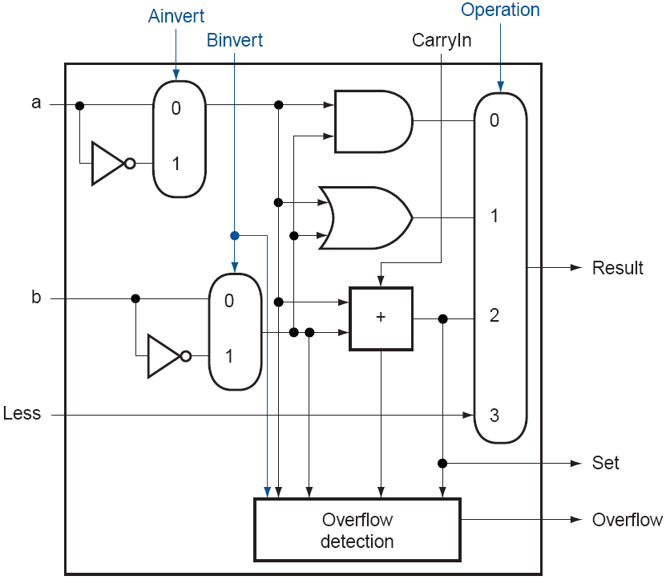
MIPS ALU unit

Slide 39
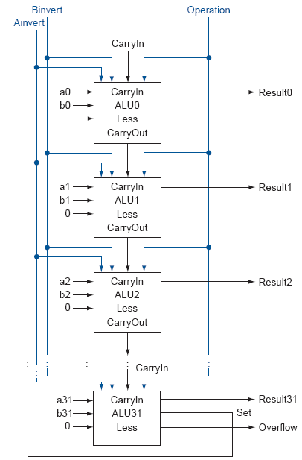
32-bit ALU that Supports Set Less Than

Slide 40
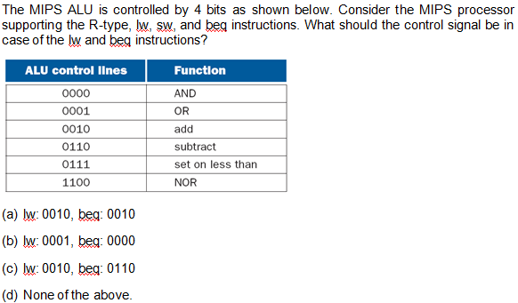
Prblems
Notes:
Answer: c. lw: do add. beq: do sub.

Slide 41
Verilog Data Types
A wire specifies a combinational signal.
A reg (register) holds a value, which can vary with time. A reg need not necessarily correspond to an actual register in an implementation, although it often will.

Slide 42
constants
Constants is represented by prefixing the value with a decimal number specifying its size in bits.
For example:
  4’b0100 specifies a 4-bit binary constant with the value 4, as does 4’d4.

Slide 43
Values
The possible values for a register or wire in Verilog are
  0 or 1, representing logical false or true
  x, representing unknown, the initial value given to all registers and to any wire not connected to something
  z, representing the high-impedance state for tristate gates

Slide 44
Operators
Verilog provides the full set of unary and binary operators from C, including
  the arithmetic operators (+, –, *, /),
  the logical operators (&, |, ~),
  the comparison operators (==, !=, >, <, <=, >=),
  the shift operators (<<, >>)
  Conditional operator (?, which is used in the form condition ? expr1 :expr2 and returns expr1 if the condition is true and expr2 if it is false).

Slide 45
Structure of a Verilog Program
A Verilog program is structured as a set of modules, which may represent anything from a collection of logic gates to a complete system.
A module specifies its input and output ports, which describe the incoming and outgoing connections of a module.
A module may also declare additional variables.
The body of a module consists of
  initial constructs, which can initialize reg variables
  continuous assignments, which define only combinational logic
  always constructs, which can define either sequential or combinational logic
  instances of other modules, which are used to implement the module being defined

Slide 46
The half-adder. Example of continuous assignments
module half_adder (A,B,Sum,Carry);
input A,B;
output Sum, Carry;
assign Sum = A ^ B;
assign Carry = A & B;
endmodule
assign: continuous assignments. Any change in the input is reflected immediately in the output.
Wires may be assigned values only with continuous assignments.

Slide 47
One-bit Full Adder
module full_adder (A,B,Cin,Sum, Cout);
input A,B,Cin;
output Sum, Cout;
assign Sum = (A & B & Cin) | (~A & ~B & Cin) | (~A & B & ~Cin) | (A & ~B & ~Cin);
assign Cout = (A & Cin) | (A & B) | (B & Cin);
endmodule

Slide 48
Four-bit Adder
module four_bit_adder (A,B,Cin,Sum, Cout);
input [3:0] A;
input [3:0] B;
input Cin;
output [3:0] Sum;
output Cout;
wire C0, C1, C2;
full_adder FA1(A[0], B[0], Cin, Sum[0], C0);
full_adder FA2(A[1], B[1], C0, Sum[1], C1);
full_adder FA3(A[2], B[2], C1, Sum[2], C2);
full_adder FA4(A[3], B[3], C2, Sum[3], Cout);
endmodule

Slide 49
D-flip-flop
module Dff1 (D, clk, Q, Qbar);
input D, clk;
output reg Q, Qbar;
initial begin
Q = 0;
Qbar = 1;
end
always @(posedge clk) begin
#1
Q = D;
#1
Qbar = ~Q;
end
endmodule

Slide 50
Delay
Real circuits have delays caused by charging and discharging.
So, once the input to a gate changes, the output will change after a delay, usually in the order of nano seconds. An and gate:
A
B
output

Slide 51
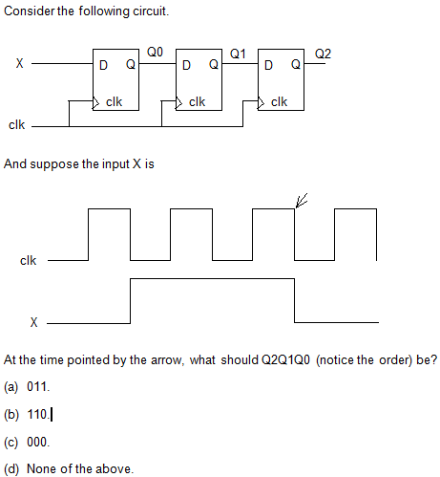
Notes:
Answer: (a)

Slide 52
Sequential Circuits
A three-bit counter.
First, get the next state table. Then, generate D2, D1, D0.
Q2 | Q1 | Q0 | D2 | D1 | D0
0 | 0 | 0 | 0 | 0 | 1
0 | 0 | 1 | 0 | 1 | 0
0 | 1 | 0 | 0 | 1 | 1
0 | 1 | 1 | 1 | 0 | 0
1 | 0 | 0 | 1 | 0 | 1
1 | 0 | 1 | 1 | 1 | 0
1 | 1 | 0 | 1 | 1 | 1
1 | 1 | 1 | 0 | 0 | 0

Slide 53
FSM example – A sequence detector
One input X, and one output O.
X may change every clock cycle. The change happens at the falling edge.
The circuit samples the input at every rising edge of the clock. If the input is 1, consider as read a 1, else read a 0.
O is 1 (for one clock cycle, from positive edge to positive edge) if the last three bits read are 101.

Slide 54
4 states
S0: got nothing. The initial state.
S1: got 1.
S2: got 10.
S3: got 101.
S0
S1
S3
S2
X = 1
X = 0

Slide 55
Assign states
S0 = 00
S1 = 01
S2 = 10
S3 = 11

Slide 56
Next State Function
Q1 | Q0 | X | D1 | D0
0 | 0 | 0 | 0 | 0
0 | 0 | 1 | 0 | 1
0 | 1 | 0 | 1 | 0
0 | 1 | 1 | 0 | 1
1 | 0 | 0 | 0 | 0
1 | 0 | 1 | 1 | 1
1 | 1 | 0 | 1 | 0
1 | 1 | 1 | 0 | 1
D1 = (Q0&~X)|(Q1&~Q0&X)
D0 = X

Slide 57
The output function
Clearly, O = Q1&Q0.

Slide 58
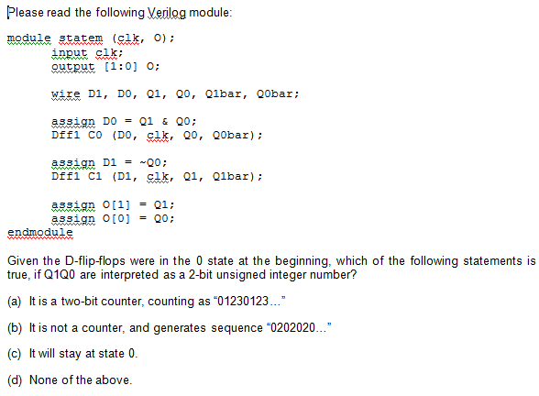
Notes:
Ans. (d). It will be 0222222222…”

Slide 59
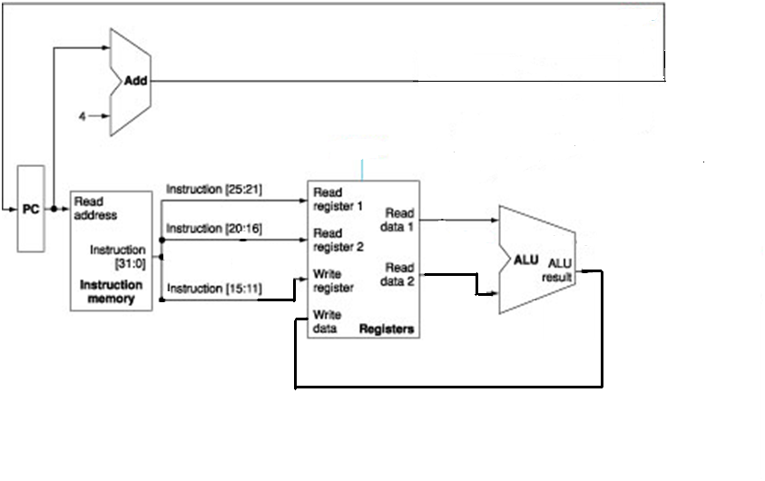
Datapath only for R-type instructions

Slide 60
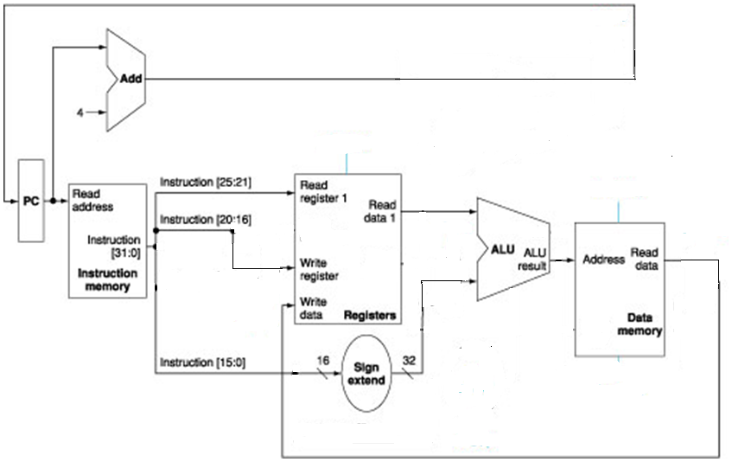
Data path only for lw

Slide 61
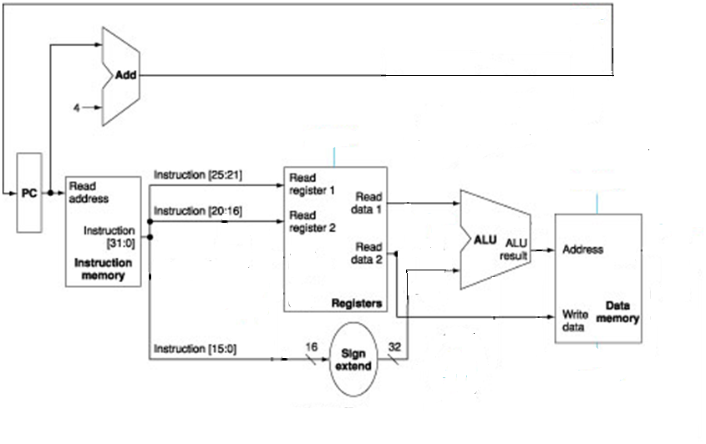
Data path only for sw

Slide 62
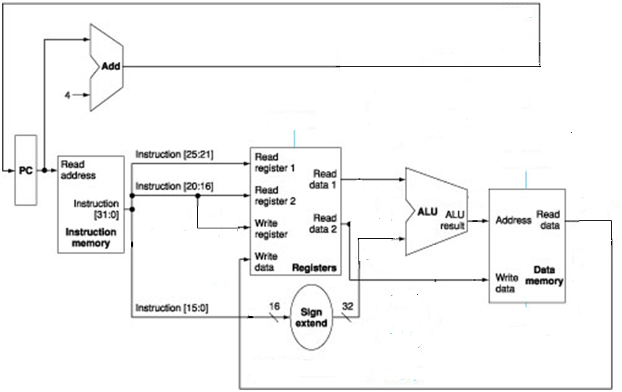
Data path only for lw and sw

Slide 63
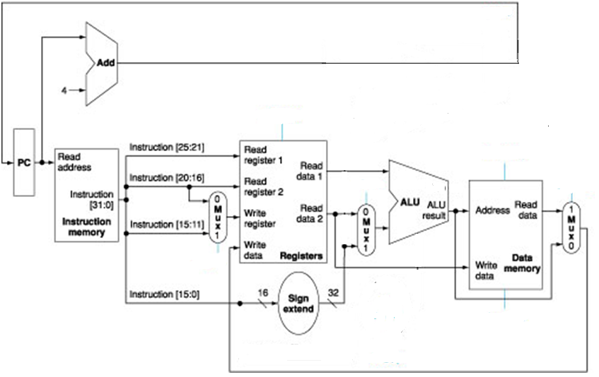
Datapath for Memory and R-type Instructions

Slide 64
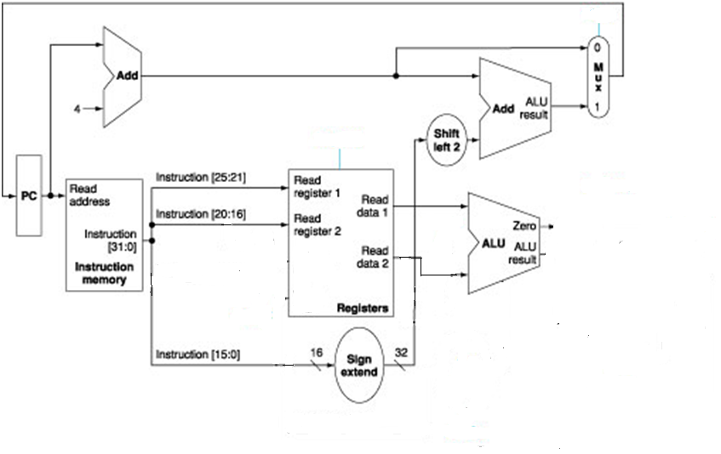
Datapath only for beq

Slide 65
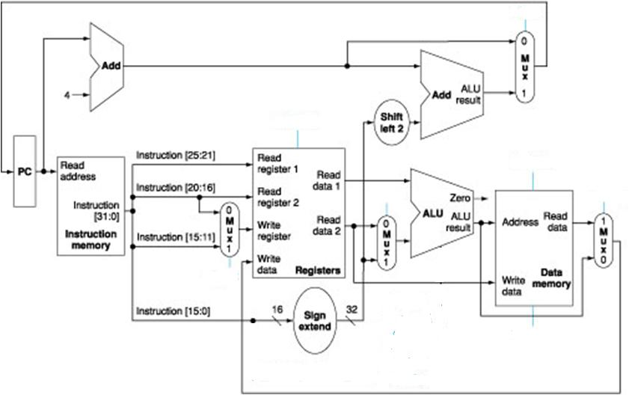
Datapath for R-type, memory, and branch operations

Slide 66
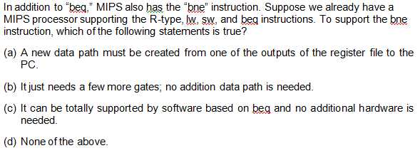
Problem
Notes:
Answer: b.

Slide 67
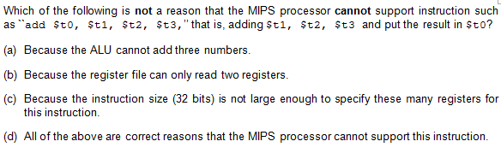
Problem
Notes:
Answer: c.

Slide 68
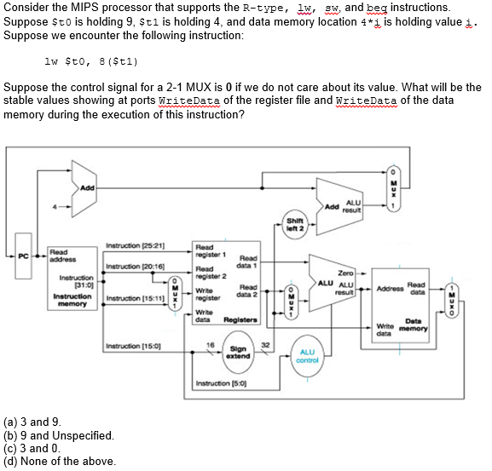
Problem
Notes:
a

Slide 69
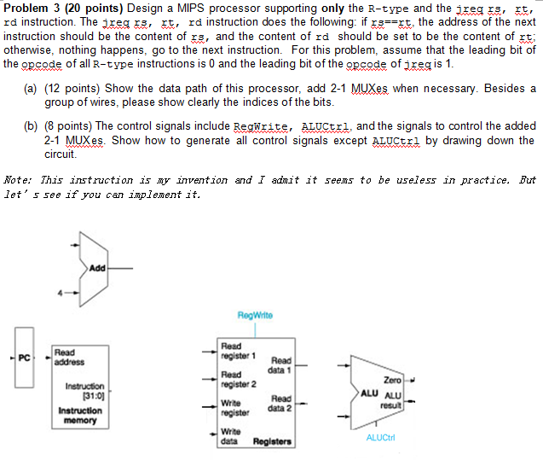

Slide 70
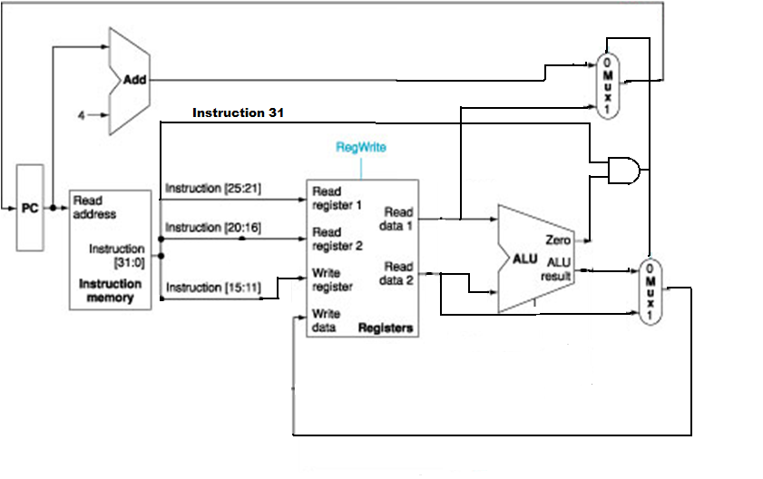
Answer
MuxCtrl = Instruct[31] & zero
RegWrite = ~Instruct[31] | zero

