Slide 1
Truss-based Community Search: a Truss-equivalence Based Indexing Approach
Esra Akbas, Peixiang Zhao
Computer Science, Florida State University
zhao@cs.fsu.edu

Slide 2
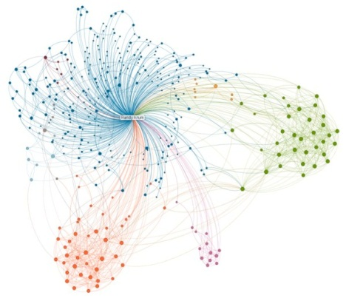
Outline
Introduction
State-of-the-art solutions
Index-free, TCP-Index (SIGMOD’14)
Equi-Truss
Experiments
Conclusion

Slide 3
Community Detection vs. Community Search
Communities in graphs
Densely, cohesively knitted subgraphs revealing latent and critical structures
Community detection
Discovers ALL communities exhaustively from the graph
A priori, top-down
Expensive time/space cost, a lot of fruitless computation!
Q: find for me all the communities in the Facebook graph.
A: (after ten minutes…) Still in progress …… ☹

Slide 4
Community Detection vs. Community Search
Communities in graphs
Densely, cohesively knitted subgraphs revealing latent and critical structures
Community search
Discovers ONLY the communities related to a given vertex
Online, bottom-up
Opens the door to personalized community discovery
Q: find the communities I am involved in from the Facebook graph.
A: BINGO!

Slide 5
K-Truss Communities: Motivation
There are numerous ways to model communities
(Quasi-)Clique, k-core, k–truss, k-plex, nucleus, ……
K-Truss (density)
Largest subgraph with each constituent edge contained in at least (k-2) triangles
Built upon higher-order triangle motifs
Modeling multiple, overlapping
communities
Polynomial-time tractable
O(|E|^{3/2} )
k=5

Slide 6
K-Truss Communities: Motivation
K-Truss community (cohesiveness)
Intuition: communities are supposed to be connected in a strong sense
Triangle-connectivity
Any pair of edges in a community is either
in one triangle;
Or can be connected by a series
of joined triangles
k=4

Slide 7
K-Truss Based Community Search
q = v₇
K=3
K=4
K=5
Problem: Given a graph G, a query vertex q, and an integer k, find as output all k-truss communities containing q

Slide 8
State-of-the-art Solutions
Index-free
Starting from each incident edge of v, perform BSF-like triangle enumeration upon G, and then validate k-truss community properties
Time consuming!
TCP-Index (SIGMOD’14)
Losslessly compress pre-computed edge truss values and triangle-adjacency information into a group of tree-structured indexes
(1) Redundancies in indexes; (2) Community search involves “decompression”, leading to repeated access to G; (3) Dynamic maintenance is complicated

Slide 9
Our Solution: Equi-Truss
K-truss equivalence based graph index
Based upon a novel notion, k-truss equivalence
A graph summary structure
No redundancies in the index
Community search can be performed directly upon Equi-Truss, without repeated access to G
Dynamic maintenance becomes simple and intuitive
Equi-Truss based community search is theoretically optimal !

Slide 10
K-truss Equivalence
Any two edges of G are k-truss equivalent, iff
They have the same truss values, k
They are triangle connected in an even stronger sense, k-triangle connected
K-truss equivalence is an equivalence relation upon E
reflex, symmetric, transitive
K=4

Slide 11
Equi-Truss
A summarized graph structure
Super-nodes represent equivalence classes defined upon k-truss equivalence
Each super-node is a k-truss community!
Super-edges depict triangle-connectivity between super-nodes
Index construction: time O(|E|^{3/2} ), space O(|E|)

Slide 12
Community Search Upon Equi-Truss
The overall search process is solely upon the index
Starting from the super-nodes containing q
BFS exploration upon Equi-truss, return all super-nodes with truss values no less than k
Theoretically optimal
q = v₄ k = 4

Slide 13
Experiments
Evaluation Methods
Index-free
TCP-Index (SIGMOD’14)
Equi-Truss
Datasets
Amazon, DBLP, LiveJournal, Orkut, UK-2002
Evaluation Metric
Index construction cost
Community search performance

Slide 14
Index Construction Cost

Slide 15
Community Search Performance
Amazon Dataset
Orkut Dataset

Slide 16
Conclusions
Problem: community search in large graphs
Modeled on k-truss communities
Equi-Truss: a k-truss equivalence based indexing approach
A novel equivalence relation: k-truss equivalence
A summarized graph index structure
Community search with theoretically optimal performance and practical efficiency

Slide 17
Thank you !
Q & A

