Slide 1
Fast Continuous Subgraph Matching over Streaming Graphs via Backtracking Reduction
Authors: Rongjian Yang, Zhijie Zhang, Weiguo Zheng
Presented by:
Ranga Sai Chimbili (RC23O)
Venkata Aravind Nishtala (VN23A)
Sai Srinivas Kalavakuri Mihiranka(SB23KL)

Slide 2
Introduction
Graphs are widely used in applications like social networks and cybersecurity.
Streaming graphs evolve dynamically, making subgraph matching challenging.
Continuous Subgraph Matching (CSM) is crucial for tracking graph changes efficiently.
The goal of CSM is to find subgraphs in streaming graph 𝐺 that match a query graph 𝑄.
CSM is used in Recommendation Systems, Fraud Detection, Cybersecurity, Social Networks, etc.

Slide 3
Why is CSM Challenging?
Nodes and edges constantly change, making real-time matching hard.
Subgraph isomorphism is NP-hard.
Bottleneck: Incremental match generation dominates cost.
Prior work (e.g., TurboFlux, SymBi) focuses on candidate maintenance, not match generation.
Key Issue: Excessive backtracking over large search spaces.

Slide 4
Proposed Solution
Two innovations to reduce backtracking and speed up CSM.
  CaLiG: A cost-effective index for tighter candidate maintenance.
  KSS: A new matching paradigm to generate matches with less backtracking. (segments query vertices.)
Goal: Improve performance by reducing search space and computational overhead.
Claim: Orders-of-magnitude faster than state-of-the-art (TurboFlux, SymBi).

Slide 5
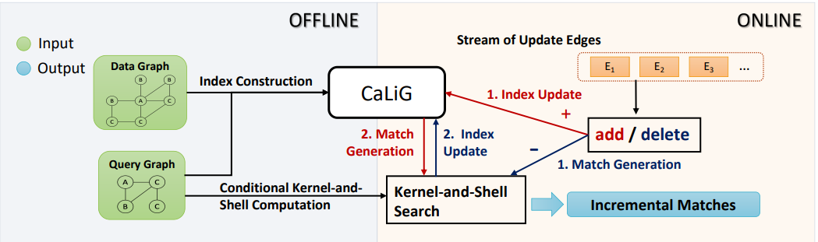
Overview of Approach
Offline Phase: Build the CaLiG index based on 𝑄 and 𝐺, and precompute kernel and shell sets for each edge in 𝑄.
Online Phase:
  For edge addition: Update CaLiG to find new candidates, then perform subgraph matching.
  For edge deletion: Perform subgraph matching first, then update CaLiG.
Key Components:
  CaLiG Update: Maintains the index in real-time as the graph changes.
  Incremental Match Generation: Uses KSS to efficiently find matches without backtracking.

Slide 6
CaLiG: Candidate Lighting Graph
A directed graph where each node represents a matching vertex pair (𝑢,𝑣) with on/off states.
  ON: 𝑣 is a candidate for 𝑢
  OFF: pruned.
Maintains only valid candidates, reducing false positives.
Helps in faster match generation by reducing unnecessary backtracking.
Uses injective matching in bigraphs to prune false positives
Create edges between candidate pairs based on graph structure.
Uses propagation mechanisms to refine the index.
  OFF-propagation (edge deletion),
  ON-propagation (edge addition).

Slide 7
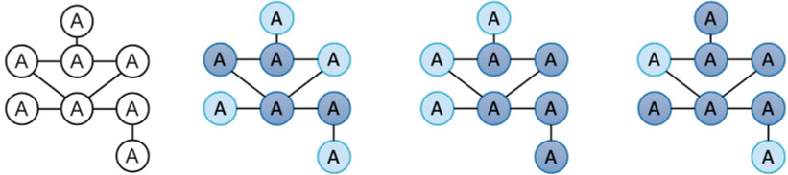
Kernel-and-Shell Search (KSS)
Splits 𝑄 into kernel (connected cover) and shell (independent) vertices.
  Backtrack only on kernel vertices.
  Join shell candidates directly—no backtracking!
Produces incremental matches efficiently without expensive searching.
(a)Query graph (b)Three kernel sets and shell sets.

Slide 8
KSS Execution Process
Start with the update edge e($v_{1}$, $v_{2}$) and find an initial partial match
Start with the update edge e(𝑣_1, 𝑣_2) and find an initial partial match
Use backtracking to match the remaining kernel vertices.
For shell vertices, generate candidates and join them with the partial match to produce complete matches

Slide 9
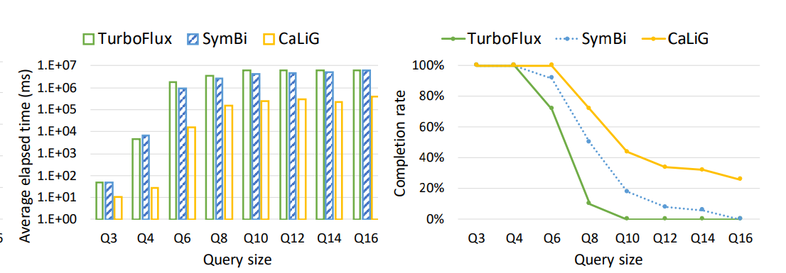
Experimental Results
Tested on SNAP datasets (Lastfm, Facebook, Email, Github, Deezer, Twitch, Skitter, and Netflow).
Speed: CaLiG is 22x–5963x faster than TurboFlux, 18x–978x faster than SymBi.
Scalability: Handles large queries and graphs.
Match Density: Up to 7 orders of better magnitude

Slide 10
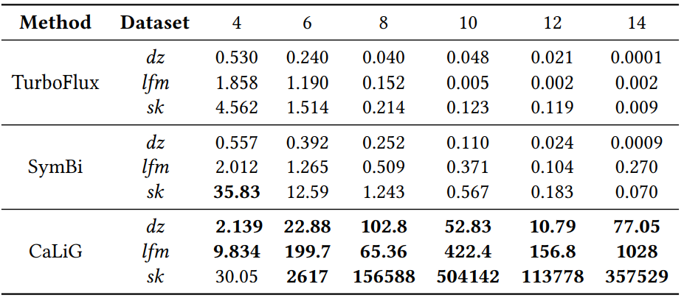
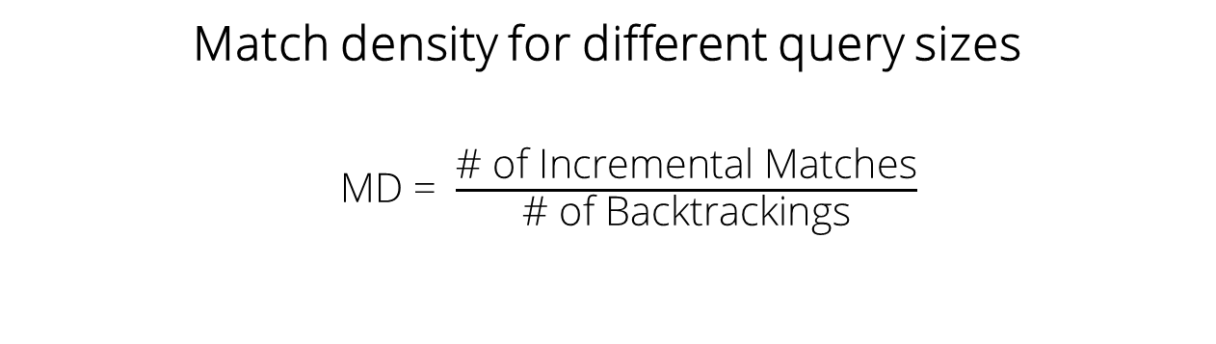
Experimental Results
Match density for different query sizes
MD = $\frac{\text{\# }\text{of} \text{Incremental} \text{Matches}}{\text{\# }\text{of} \text{Backtrackings}}$

Slide 11
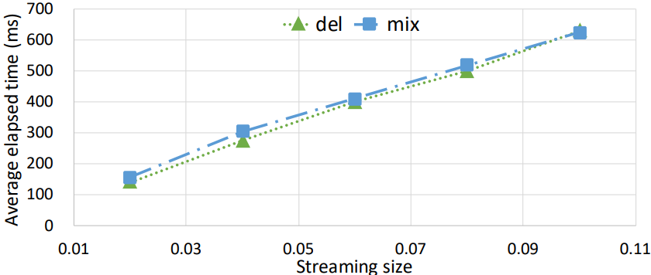
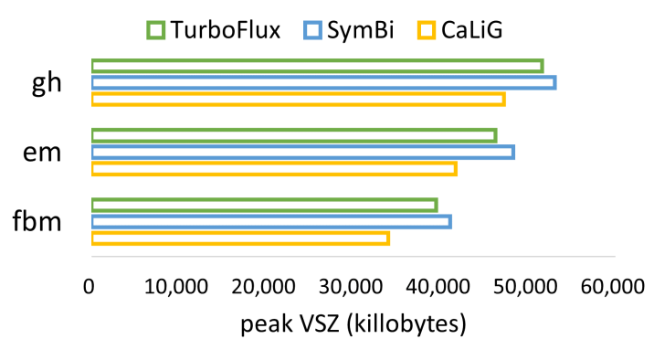
Experimental Results

Slide 12
Conclusion
CaLiG + KSS = Faster CSM by reducing backtracking.
Cost Effective.
CaLiG improves candidate accuracy.
KSS optimizes match generation
Great example of indexing and query optimization in streaming databases.

Slide 13
Thank You

