Slide 1
Approximate String Joins with Abbreviations
Authors: Wenbo Tao, Dong Deng, Michael Stonebraker
Publication: PVLDB 2017
Team :Sanath Chigurumamidi(Sc23z), Krishna Shashank Yadav(ky23b), SaiKiran Bhoomreddy(sb23bt)

Slide 2
Overview/Outline
Motivation and Introduction
Research Problem
Related Work and Limitations
Proposed Solution-pkduck similarity
Conclusion and Futurework
Results
Filter and Verify Framework
Join Algorithm and Signature Generation

Slide 3
Motivation and Introduction
Data Integration: Real-world datasets often have mismatched strings due to errors, variations, or abbreviations.
Abbreviations: Common in domains like universities (e.g., "dept" vs. "department") or medical data.
Problem: Standard joins fail to match strings with abbreviations (e.g., "camp activ compl" vs. "campus activities complex").
Goal: Develop accurate and efficient approximate string joins (ASJ) that handle abbreviations.

Slide 4
Problem Definition
What is ASJ?: Approximate String Join (ASJ) finds pairs of strings in a dataset (or two datasets) that are similar enough, based on a score above a threshold θ (e.g., 80% similarity).
Challenge with Abbreviations: Strings like "dept of CS" and "department of computer science" should match, but standard similarity measures (e.g., word overlap) see them as different due to abbreviated words.
Key Idea: Use a dictionary of abbreviation rules, like "dept" → "department," to guide matching, which might need to be learned from the data itself.
Objective: Develop a method to identify matching string pairs accurately, even when abbreviations hide their similarity, without checking every possible pair.

Slide 5
Related Work
Previous Methods: Techniques like JacCT and SExpand use synonym rules (e.g., "dept" →"department") or expand strings to all possible forms for matching, often relying on predefined synonym lists.
Other Approaches: Standard metrics include Jaccard (counts shared words) or Edit distance (measures letter changes), applied in data cleaning and deduplication.
Context: These methods work for typos or minor variations but struggle with abbreviations, especially in domains like healthcare or education where terms vary widely.

Slide 6
Limitations of Previous Approaches
Dependency on Rules: Methods like JacCT, SExpand require user-provided synonym dictionaries, often incomplete.
Precision Issues: Treating abbreviations as synonyms causes false positives (e.g., matching "CS" across contexts).
Complexity: Generating all derived strings leads to O(2^(2n)) search space for n rules.
Scalability: Baselines (e.g., JacCT) fail to complete on large datasets.

Slide 7
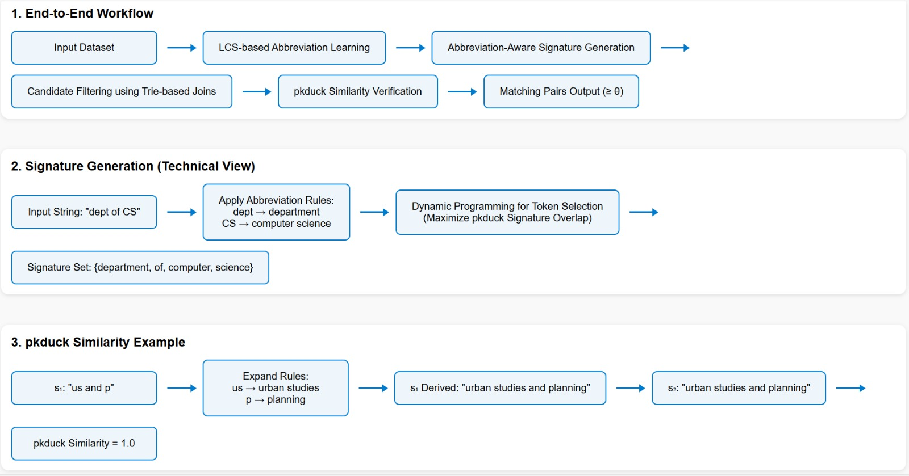
Framework of Our Solution and pkduck Similarity

Slide 8

pkduck Measure
S1 = “us and p”
S2 = “urban studies and planning”
Rules Dictionary
us
urban studies
p
planning
D1: “us and p”
D2: “us and planning”
D3: “urban studies and p”
D4: “urban studies and planning”

Slide 9

Problem Formulation
Problem Statement
Input: S = {s₁, s₂, …}, θ ∈ [0,1]
Learn R from S
Output: { (sᵢ,sⱼ) ∈ S×S pkduck(R,sᵢ,sⱼ) ≥ θ }
S
pkduck
Join Result

Slide 10
Filtering with signatures (Naïve Signature Generation)
S₁′ | Sig_{pt} (S₁′)
us and p | {us}
us and planning | {planning}
urban studies and p | {urban, studies}
urban studies and planning | {planning, urban}
Global Ordering
planning < us< urban < studies < p < and
Rules:
R={(us↔urban studies),(p↔planning)}
Sig_{pt} U(S₁′) = {planning, us, urban, studies}
Prefix formula: I_{θ} (|S|) =⌊(1 - θ ) ⋅ |s|⌋ + 1
S₁ = us and p | Sig_{pf} (S₁) = {us}
S₂ = urban studies and planning | Sig_{pf} (S₂) = {planning, urban}
us
Planning
since I_{θ}(3) = ⌊(1−0.7)⋅3⌋ = 1
studies
Urban
since I_{θ}(4) = ⌊(1−0.7)⋅4⌋ = 2
Sig_{pt} U(S₁)
Sig_{pf} (S₂)

Slide 11
PTIME Signature Generation
The above signature generation takes O(2^{n}) because of enumerating all possible derived strings
Algorithm Steps
1. Sort all tokens in a global order.
2. For each token t, compute X_l: the minimum number of tokens smaller than t in any derived string where t could appear.
3. Check if X_l + 1 ≤ I_θ(l) for some length l (where I_θ(l) is a threshold based on string length).
4. If true, then t ∈ Sig_u(s).
The PTIME algorithm achieves O(k·n) time complexity using dynamic programming to optimize signature computation.
A dynamic programming table tracks the smallest prefix lengths across all derived strings, enabling efficient token inclusion checks without full enumeration.
Key Idea:
For each token t in the universal set (all tokens and their rewrites), check if t belongs to Sig_u(s) by verifying a condition based on the number of smaller tokens in derived strings.

Slide 12
Verifying with pkduck
pkduck Verification:
Computes pkduck score by trying abbreviation expansions to maximize Jaccard similarity (word overlap).
Uses a greedy heuristic to test promising expansions first, avoiding slow exhaustive searches (NP-hard problem).
Details:
Outputs pairs with scores ≥ θ (e.g., 0.8), guaranteeing no false positives.
Heuristic ensures speed, effective in practice as shown in experiments.
Accurate matches, like "dept of CS" with "department of computer science," with high precision and reasonable speed.

Slide 13
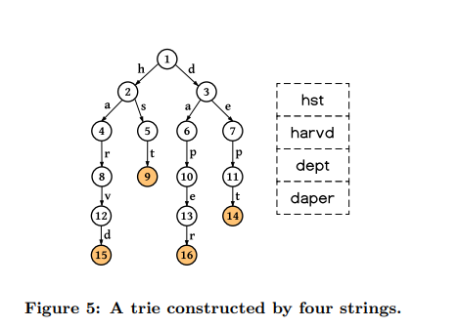
Learning Abbreviation Rules
LCS Approach: Assumes an abbreviation’s letters appear in order within its full form, e.g., Longest Common Subsequence of "harvd" and "harvard" is "harvd." ​
Process: ​
Search for token pairs where one is a subsequence of the other, indicating a potential abbreviation (e.g., "cs" in "computer science"). ​
Use a trie structure to efficiently scan the dataset, avoiding slow pair-by-pair checks that would take quadratic time. ​
Apply filters (e.g., frequency, length) to keep only valid rules, discarding noise like rare matches.​

Slide 14
Experimental Setup
Datasets:
Disease: 634 names, ~2.1 tokens.
Dept: 1,151 MIT names, ~3.4 tokens.
Course: 2049 titles, ~4.1 tokens.
Location: 11239 names, ~3.6 tokens.
Metrics: Precision, Recall, F1; runtime, candidates.
Baselines: Jaccard, SExpand, JacCT (partial), ExampleS dictionary.
Thresholds: θ = 0.7, 0.8, 0.9.

Slide 15
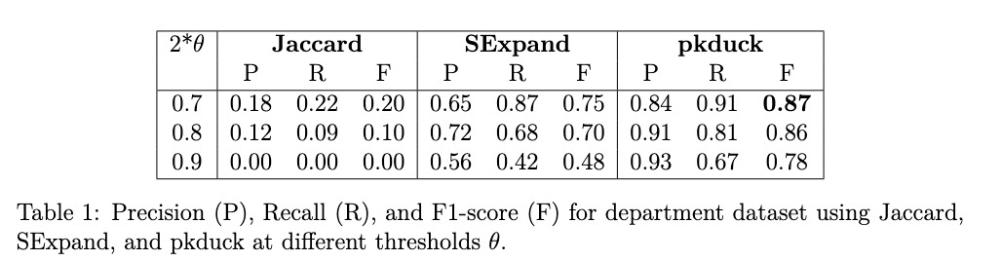
Accuracy Results

Slide 16
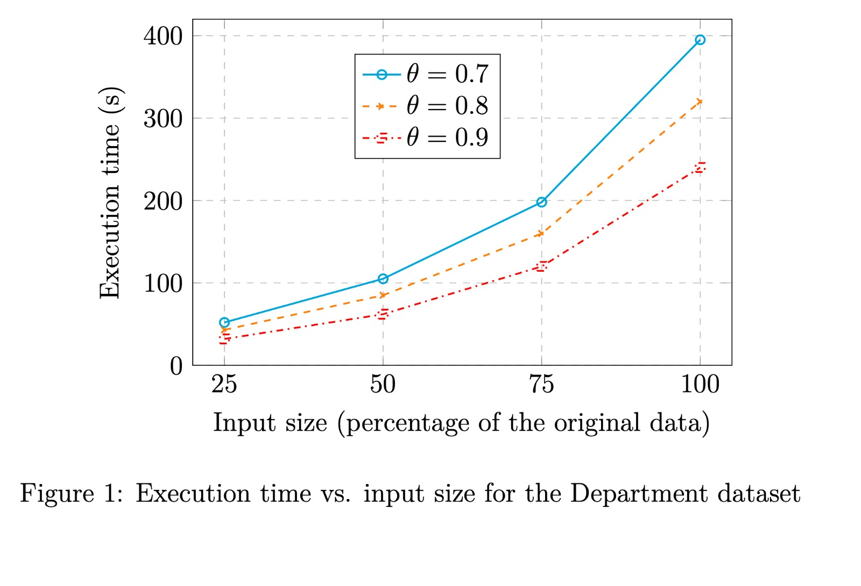
Efficiency Results

Slide 17
Conclusion
pkduck: Robust similarity for abbreviations.
Scalable join with efficient signatures.
LCS-based unsupervised rule learning.
Impact: High accuracy (F1 ~0.8), scalable to 100k+ strings.
Takeaway: Advances ASJ for real-world data integration.

Slide 18
THANK YOU

