Slide 1


Spatial Online Sampling and Aggregation
Authors: Lu Wang, Robert Christensen, Feifei Li, & Ke Yi
Presented by: Ivan Quiñones, Nicholas Ratzlaff, & Alejandro Ugas

Slide 2
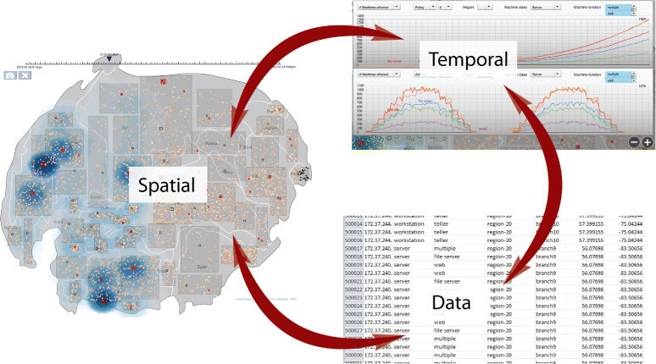

Motivation & Problem Statement
  Explosion of spatial and spatio-temporal data
  Need for interactive analytics (e.g., map apps, live data queries)
  Challenge: full-range query evaluation is too expensive
  Solution: Online sampling with real-time aggregation
Source: https://www.researchgate.net/figure/Three-components-in-spatiotemporal-data-SemanticPrisms-visualizations-show-where_fig1_264157837
Notes:
With smart phones and other mobile devices, we have seen spatial and spatio-temporal data become more popular.
interactive analytics needed to keep these queries done quicker and not just blow up exponentially

Slide 3
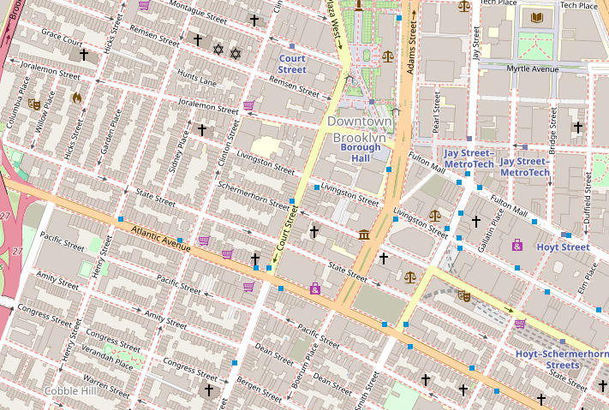
Real Estate Analogy
  Real estate agent wants to look at their sales reports
  Uses Interactive analytics
  Sampling gives faster results in confidence intervals
Source: https://www.openstreetmap.org/#map=16/40.69072/-73.99256
Notes:
Real-Estate agent looking at their sales report in Brooklyn, north of Atlantic, from the last 30 days.
Interactive analytics would get the results quickly based on random sampling with a confidence interval
gives quick reports based on the samples and user can end query to run another or wait for more report that uses more samples (more accurate)
USE INTRODUCTION EXAMPLE IN pg1 interactive spatial exploration and analytics

Slide 4
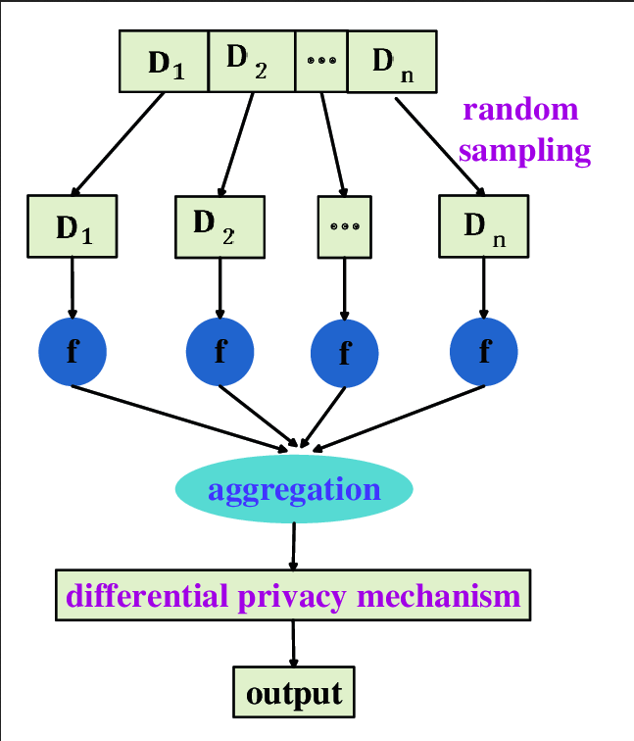
Key Concept — Spatial Online Sampling
  Definition: Incrementally sample from spatial query result P∩Q
    Sampling with and without replacement
    Use for aggregation: average, count, analytic tasks, etc.
  Emphasis on low-latency, high-interactivity
AVG
Source: https://www.researchgate.net/figure/Sample-and-aggregation-mechanism_fig1_365590406
Notes:
given set of n points, P in a dimension space, stored in an index for a given range query Q, returns sampled points
spatial clustering
spatial online estimator should be unbiased, and quality characterized by confidence intervals

Slide 5
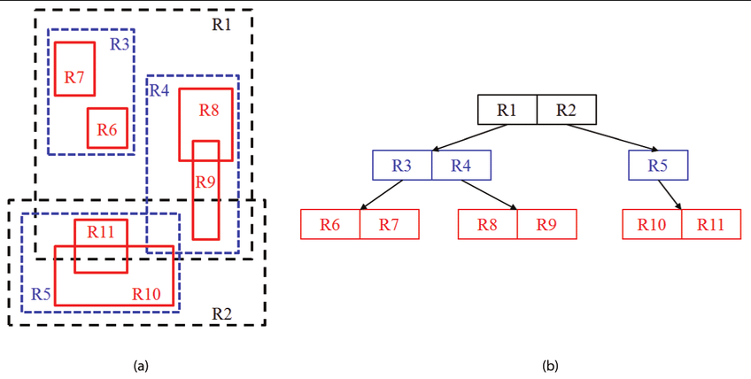
Baseline Methods
  Disk-Based R-Tree
  QueryFirst: full query, then sample
  SampleFirst: sample whole dataset until inside Q
  RandomPath: guided sampling via subtree sizes
  RandomShuffle: scan randomized dataset
Strengths & weaknesses briefly
  Not I/O-efficient or scalable
Source: https://www.researchgate.net/figure/R-Tree-indexing-example-2D-visualization-a-hierarchical-dependencies-b_fig4_225542188
Notes:
R-Tree - stores spatial data indexes, that is height-balanced like B+ Tree and MBB for geographic coordinates
QF - P intersect Q, then sample
SF - sample then check if in Q
RP - goes down random path of tree and sampled recursively using count tree over P (good only in internal memory since disk I/Os would be too expensive)
RS -

Slide 6
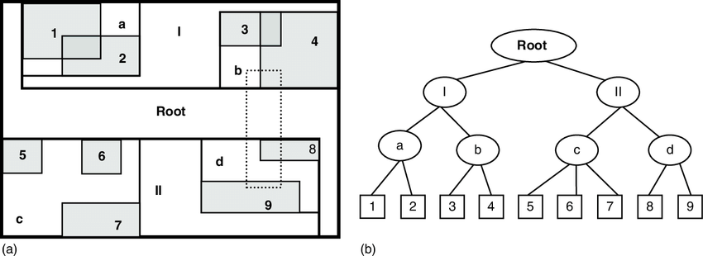
LS-Tree
Level 1
Source: https://www.researchgate.net/figure/Example-of-R-tree-indexing-a-labeled-rectangles-in-different-levels-and-a-dash-line_fig1_314239583
  Multi-level R-tree sampling
  Each level has halved sampling probability (1, ½, ¼, ...)
  Good for query efficiency, but:
    Multiple trees
    Samples not always independent
Level 2
Notes:
LETS RIDE

Slide 7
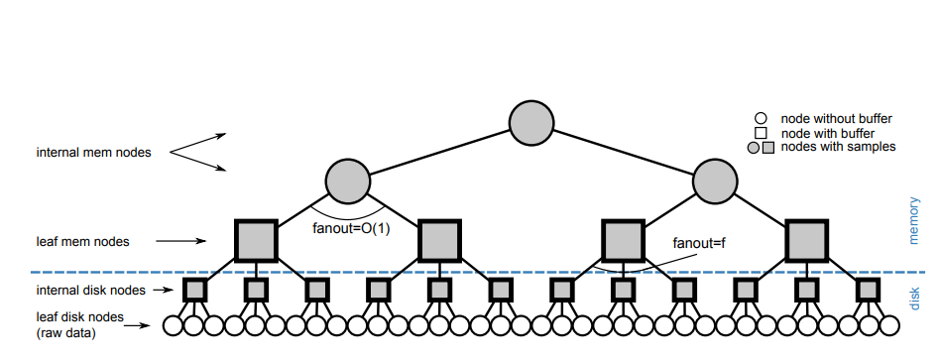
RS-Tree
  Core innovation
    Single R-tree with sample buffers in internal nodes
  Query flow:
    Start at root
    Draw from buffers
    Recurse only as needed
      (lazy traversal)
  Advantages:
    Efficient
    I/O friendly
    Supports dynamic updates
Source: https://vldb.org/pvldb/vol9/p84-wang.pdf
Notes:
- The RS-tree is an improvement upon the LS-tree in that, instead of needing to build multiple R-Trees, the RS-tree is simply a modified R-Tree with sample buffers added to internal nodes,- with the exception of internal nodes directly neighboring leaf nodes.
- These sample buffers contain record samples from all of the leaves under the internal node's subtree.
- This allows for quick and efficient querying, which begins at the root level and reports records from buffers that fulfill records requested from a query. - The querying itself uses lazy exploration to follow the flow to the next correct internal nodes, as it will only go to the next node once a buffer has been spent - whether that be that all of the records are rejected or reported.
- The RS-Tree described in the paper is of a hybrid design, with the root and the majority of the internal nodes residing on memory, while some internal nodes and leaves are stored on disk.
-The sample buffer can also be dynamically changed before construction.

Slide 8
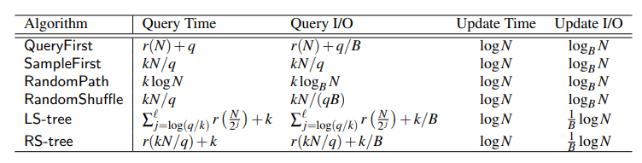
Core Algorithms Summary
Source: https://vldb.org/pvldb/vol9/p84-wang.pdf
Highlighting:
  RS-tree wins on query cost
  All methods summarized by:
    Query time
    Update support
    I/O behavior
Notes:
- From this table, it can be seen that the RS-Tree has the best query time when compared to LS-Tree and the rest of the algorithms.
- It is stated in the paper, however, that the LS-Tree query time can be optimized if it is done within external memory - as it's query is simply multiple R-tree queries back to back.
- Both of the highlighted trees also share the same Update Time and Update I/O.
- These costs and times were all determined prior to the experimentation phase, though do hold up in testing as stated by the authors

Slide 9
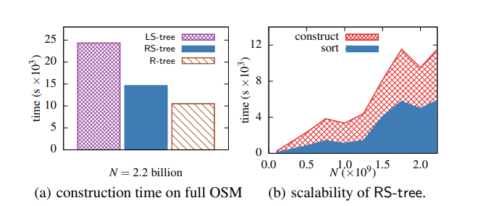
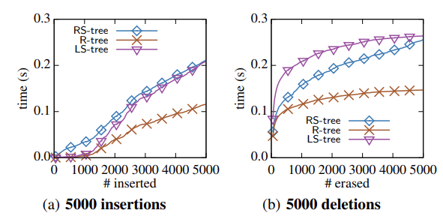
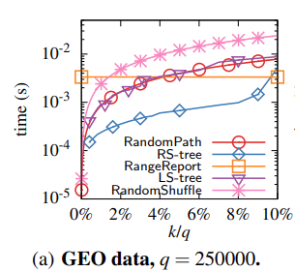
Experimental Results
Datasets: GEO (25M), OSM (2.2B), 4xOSM (8.8B)
  RS-tree is fastest across varying:
    Inserts/Deletions
    Sample sizes k
    Query sizes q
  RS-tree scales extremely well
Notes:
- For experimentation, the authors used two distinct and well known geographic datasets- GEO Life and OSM. -
-Geo Life was about 1.7 GB in size, the OSM dataset selected was about 151 GB, and they extended OSM by using an OSM x4 that was more than 600 GB.
- The RS-Tree, LS-Tree, and R-Tree were tested on these datasets for construction, querying, and update experiments.
-RS-Tree was also subjected the sample size and scalability testing
- RS-Tree was found to the fastest for updates and various types of queries, and demonstrated exceptional scaling.
-LS-Tree did perform better with smaller datasets and queries, but ultimately was the largest in size and took the longest overall.
- The R-Tree was mainly included as a baseline

Slide 10
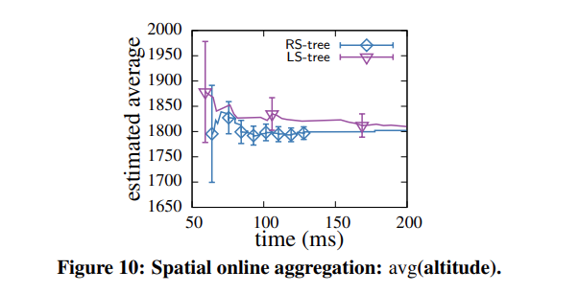
Aggregation & Estimation
  Sampling → aggregation
    Mean, sum, KDE, clustering
  Confidence intervals improve over time
  RS-tree estimates averages on the fly
Notes:
- Aggregation was used to extend the online sampling, and averages were calculated from returned samples from both the RS-Tree and LS-Tree as part of aggregation testing.
- With the same sample size, both of the trees presented similar confidence interval lengths.
-Other methods (such as RandomPath and RandomShuffle) were not included in this testing due to their high time costs.

Slide 11
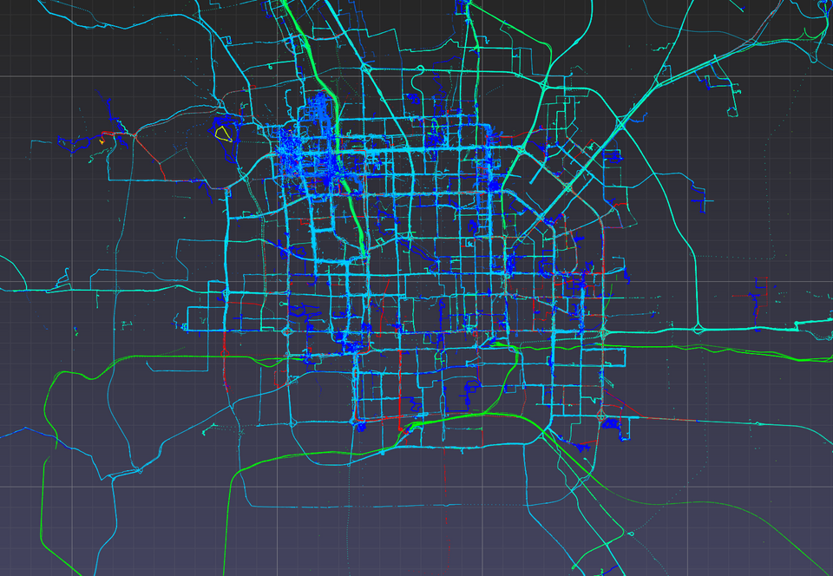
Conclusion & Takeaways
  RS-tree = unified, scalable structure for online sampling
  Real-time analytics for massive spatial datasets
  Efficient, practical, extensible to disk and GiST structures
  Opens doors for spatial online analytics at scale
Source:https://heremaps.github.io/pptk/tutorials/viewer/geolife.html
Notes:
- The authors were ultimately able to create two new trees for use in sampling and aggregations, with these being the LS-Tree and RS-Tree.
- The RS-Tree proved to be exceptional in its ability to scale and quickly return accurate samples, while the LS-Tree proved to be useful in certain scenarios and for use as a building block.
- This research could further be expanded to improve query functionality and operation.

Slide 12
Thank you for your time!

