Slide 1

I/O-Efficient Multi-Criteria Shortest Paths Query Processing on Large Graphs
Xinjie Zhou, Kai Huang, Lei Li, Mengxuan Zhang, Xiaofang Zhou
Presented By :
Yashas Nagesh Gowda
Nilkod Kashinath Yashaswini
Venu Madhuri Devineni

Slide 2
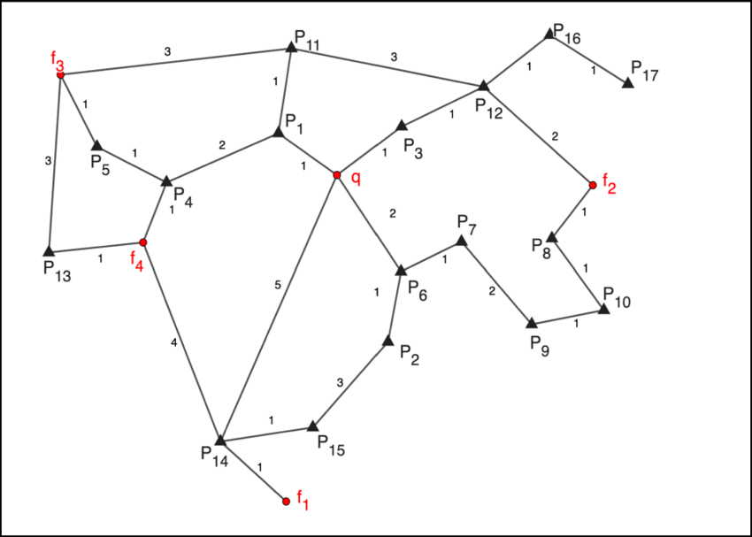
Introduction
Shortest path computation is fundamental in many graph-based applications.
Traditional methods focus on a single criterion.
Real-world problems often require multiple criteria (e.g., distance, time, emissions).
Fig 1 : A diagram of a simple road network with different edge weights
Notes:
This paper addresses the challenge of computing shortest paths across multiple criteria (like distance, time, emissions, etc.) on very large graphs that do not fit entirely in memory.
Why is this important?
In real-world applications (e.g., GPS navigation or social networks), users care about different optimization criteria. However, most existing algorithms:
Only work with one criterion at a time.
Load the whole graph into memory, which is often impossible for large-scale graphs.
Redo the work for each criterion, leading to massive I/O and time overhead.
So, the paper proposes I/O-efficient algorithms that can compute all criteria simultaneously using minimal memory, reducing redundant disk reads.

Slide 3
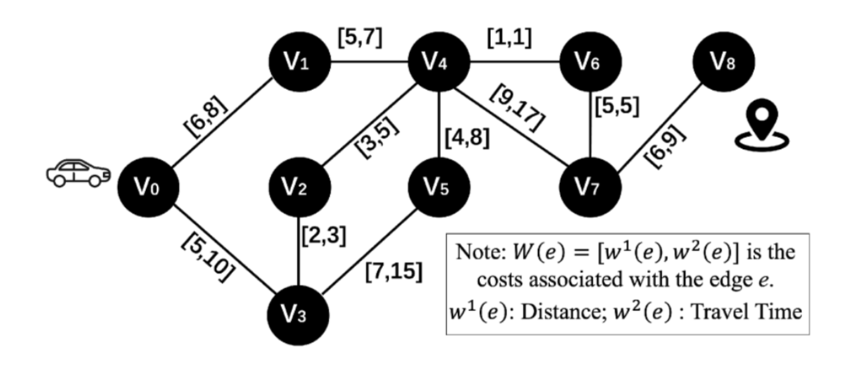
Motivation
Problem:
Need to compute multi-criteria shortest paths (MCSPs) efficiently on large graphs.
Existing methods:
  Handle one criterion at a time (inefficient).
  Require large memory (not feasible for mobile or limited-resource systems).
Example:
User A wants shortest distance, User B wants fastest time → multiple paths needed.
Fig 2 : Example Graph

Slide 4
Problem Definition
Multi-Criteria Shortest Paths (MCSPs) Problem:
Given a graph G(V, E) with N criteria, compute the shortest path for each criterion from source to target.
Why is it challenging?
Memory limitations (large graphs can’t fit in memory).
Need to minimize I/O operations.
Notes:
Given a graph where each edge has multiple weights (each representing a different criterion), and a source-destination pair, find the shortest path for each criterion.
Instead of computing each criterion one after another, the challenge is to compute all of them efficiently and concurrently on large, disk-resident graphs.

Slide 5
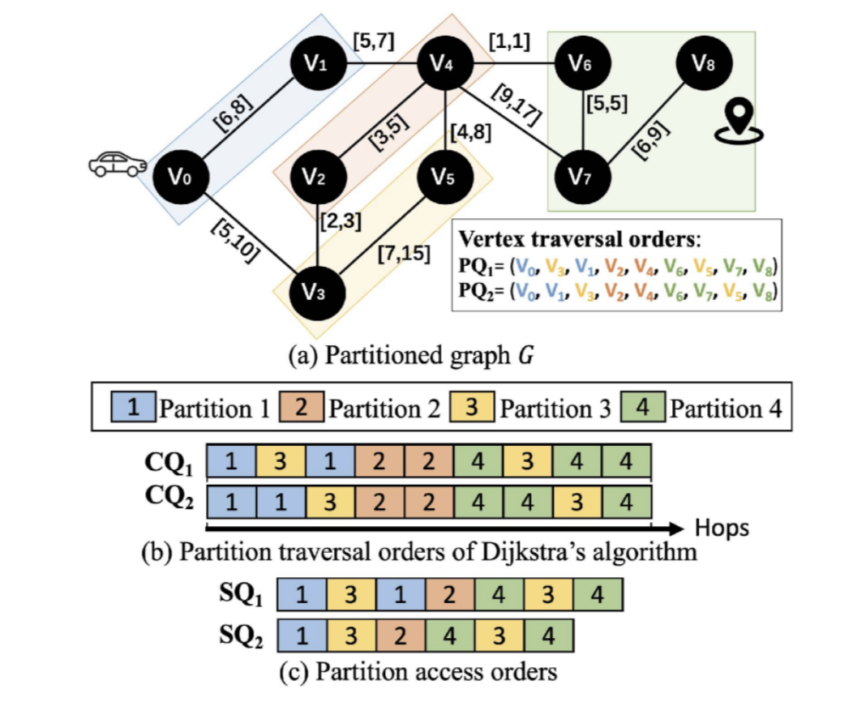
STOP & SHARE Scheme
Core Idea:
Synchronize search processes across criteria to share disk I/O operations and avoid redundant work.
Two Key Mechanisms:
Stop: Delay one criterion to align with others.
Share: Reuse loaded partition for multiple criteria.
Fig 3 : Example Graph with partition
Notes:
It’s a Novel Technique which focuses on A synchronization and sharing framework for efficiently handling multi-criteria searches with minimal I/O.

Slide 6
Algorithms Overview
1. OHP (One-Hop Processing)
Synchronizes all criteria by advancing one hop at a time per criterion.
Increases chances of sharing disk partitions across criteria.
2. MHP (Multi-Hop Processing)
Improves upon OHP by allowing each criterion to process as many hops as possible within the current loaded partition.
Makes better use of in-memory data.

Slide 7
Optimizations Built on Top of MHP
3. BMHP (Bidirectional Multi-Hop Processing)
Adds bidirectional search (from source and destination) to MHP.
Narrows search frontiers and cuts down I/O costs even more.
4. BMHPS (BMHP with In-Partition Shortcuts)
Adds a lightweight, local shortcut system within each partition to skip unnecessary internal traversals.
Avoids repeatedly accessing dense partitions by precomputing distances between key nodes inside a partition.

Slide 8
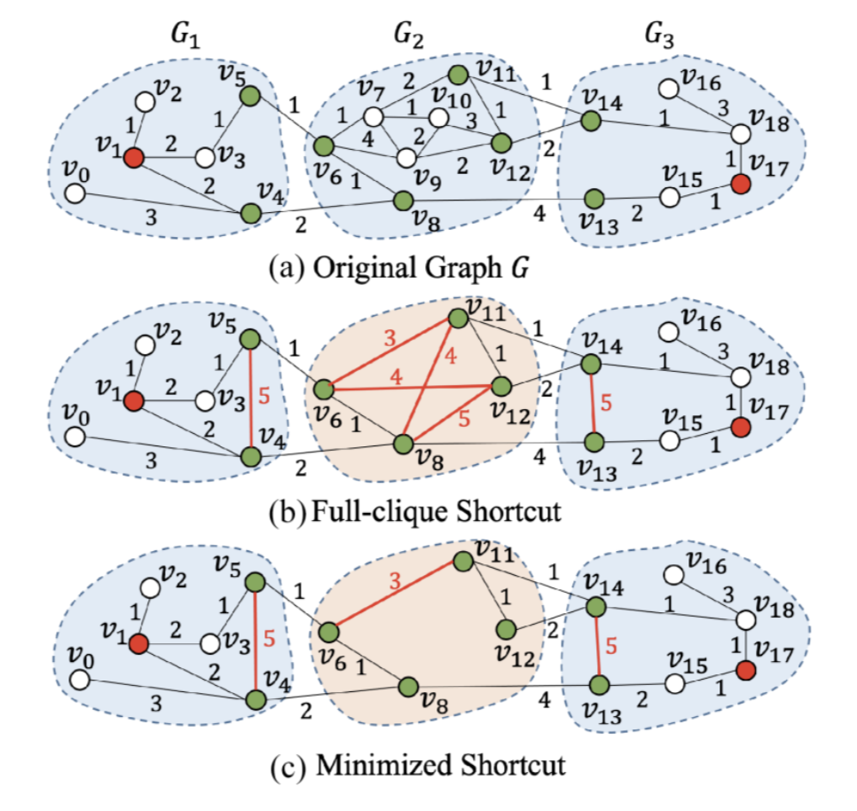
Fig 4 : Illustration of in-partition shortcut optimization.
Notes:
In-Partition Shortcuts in BMHPS: Visual Summary
The graph is split into partitions (G₁, G₂, G₃) for disk-based processing.
Red nodes are the source/target for queries.
Green nodes are boundary nodes—they connect across partitions.
White nodes are internal nodes—used only within a partition.
(a) Original Graph
Every traversal must pass through internal nodes.
Causes repeated I/O when paths span the same partition.
(b) Full-Clique Shortcut
Creates shortcuts (in red) between all boundary nodes.
Skips internal traversal and reduces I/O.
But it's memory-heavy due to many shortcuts.
(c) Minimized Shortcut
Adds only the necessary shortcuts used in actual queries.
Less overhead, but still reduces I/O effectively.
Best balance between performance and memory.

Slide 9
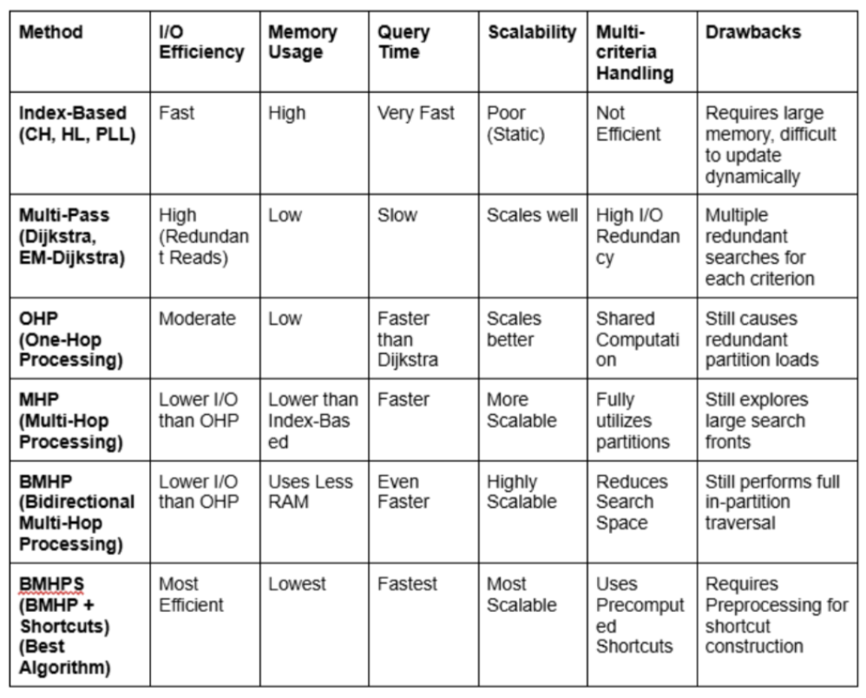
Table 1 : Comparison of different methods for Multi-Criteria Shortest path
Notes:
Index-Based (CH, HL, PLL)
Very fast due to precomputed indexes
Needs high memory and is not efficient for dynamic or multi-criteria queries
Poor scalability (e.g., on updates)
Multi-Pass (Dijkstra, EM-Dijkstra)
Performs multiple full Dijkstra runs (one per criterion)
Slow, with high redundant I/O
But it’s simple and scalable
OHP (One-Hop Processing)
First method under the STOP & SHARE scheme
Reduces redundant work but still loads partitions repeatedly
MHP (Multi-Hop Processing)
Allows processing deeper before switching criteria
More scalable and efficient than OHP
BMHP (Bidirectional MHP)
Adds bidirectional search to reduce search space
Uses less RAM, faster
BMHPS (BMHP + Shortcuts) – ⭐ Best Performing
Adds in-partition shortcuts
Most I/O-efficient, fastest, lowest memory usage, and most scalable
Drawback: requires preprocessing (to build shortcuts)

Slide 10
Experimental Validation
Evaluated on 8 large real-world graphs (e.g., social networks, road networks).
Proposed methods outperform traditional multi-pass Dijkstra approaches by up to 2× to 4× in speed and I/O efficiency.
Especially effective under memory-constrained environments (e.g., mobile devices, edge systems).

Slide 11
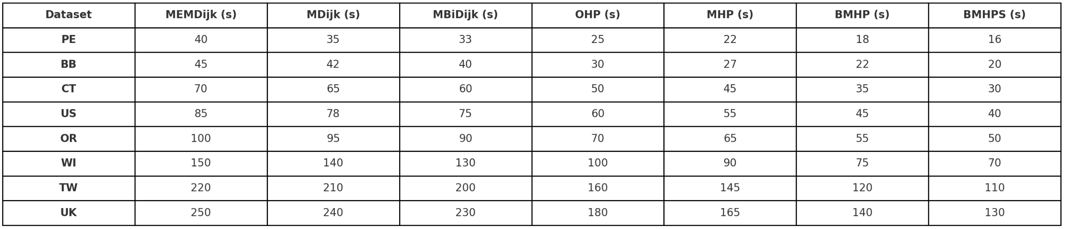
Table 2 : Query time vs. Dataset
Notes:
BMHPS consistently has the lowest query times on every dataset.
E.g., for PE: MEMDijk = 40s → BMHPS = 16s
As we move from OHP → MHP → BMHP → BMHPS, query time drops.
BMHPS shows a 2–4× improvement over traditional methods.
Confirms that:
STOP & SHARE is effective
Shortcuts help significantly, especially in large-scale graphs

Slide 12
Key Contributions
First formal study on MCSPs under memory constraints.
Introduced STOP & SHARE with novel I/O-efficient algorithms.
Integrated bidirectional search and partition-level shortcuts.
Outperformed existing multi-pass approaches.
Graph partitioning based on edge aggregation strategies (Primary, Average, Weighted Average).
A custom I/O-efficient Compressed Sparse Row (IOCSR) index for fast edge access.
Hybrid partition caching strategies using LRU, toss-immediate, and shrinking policies to smartly manage limited memory.

Slide 13
Conclusion
Efficient multi-criteria shortest path computation is essential for real-world graphs.
STOP & SHARE scheme successfully reduces I/O costs.
BMHPS achieves near-optimal performance with minimal overhead.
By synchronizing the searches and sharing loaded data across criteria, the methods significantly reduce disk reads, improve performance, and enable real-world deployment on memory-limited systems.

Slide 14
Thank You

