Slide 1

SCREEN: Stream Data Cleaning under Speed Constraints
Presented By:
JANVI POLAM REDDY (JP23Y)
RAHUL DEBNATH (RD23BC)
SHANTONA PANDAY (SP23BY)

Slide 2
Introduction and Background
What is Stream Data?
  Continuous flow of data points over time (e.g., sensor readings, stock prices, GPS data)
  Arrives in real-time or near real-time
  May arrive out-of-order or with missing values
Why Clean Stream Data?
  It is often dirty (noisy or erroneous) due to:
    Sensor failures
    Data extraction errors
    Network latency or loss
  Dirty data misleads decisions and analysis

Slide 3
Problem Statement
Most existing cleaning methods:
  Use smoothing filters that modify all values
  Cannot distinguish between correct and erroneous data
  Fail in streaming settings (real-time or out-of-order data)
Goal:
A cleaning method that:
  Detects and repairs only incorrect values (a.k.a minimum change principle)
  Works efficiently on real-time streaming data
  Maintains semantic correctness using real-world constraints

Slide 4
SCREEN – Main Idea
SCREEN is the first constraint-based stream data cleaning approach
It uses speed constraints as semantic rules
Defines how fast values are allowed to change
Only incorrect values are modified
Supports:
  Streaming data
  Out-of-order arrivals
  Efficient, minimal repairs
  Adaptive window strategy

Slide 5
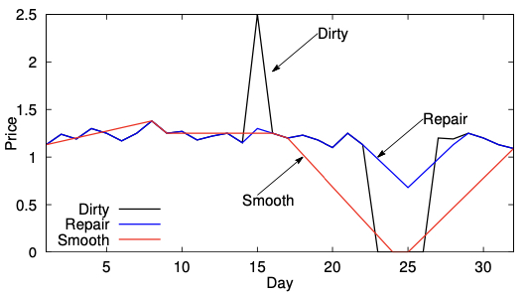
Speed Constraints – Example
Speed constraints define the maximum and minimum rate at which a value can change over time.
Example:
  A stock price must not rise or fall by more than ±0.5 per day
  Price jumps from 1.0 → 10.0 in 1 day → Violation detected
SCREEN identifies this as an invalid change and:
  Only modifies the incorrect spike
  Preserves nearby values that are already clean
SCREEN repairs only incorrect spikes and preserves clean data.

Slide 6
SCREEN Methods – Key Cleaning Strategies
Repairs one point at a time.
Manages late data arrivals.
Dynamically adjusts size.
Global Repair
Local Repair
Uses Linear Programming.
Repairs the full sequence.
Accurate but not online-friendly.
Uses Median Principle.
Suitable for real-time streaming.
Out-of-Order Handling
Methods: Update & Heuristic.
Maintains consistency without full reprocessing.
Adaptive Window
Shrinks when data is stable.
Balances efficiency with cleaning accuracy.
Expands near constraint boundaries.

Slide 7
SCREEN – Global Repair (Monolithic Cleaning)
Repairs the entire data sequence at once
Uses Linear Programming to find the optimal solution
Minimizes the total change from original data
Ensures all speed constraints are satisfied across the sequence
Suitable for offline scenarios with complete data
Achieves highest accuracy, but is computationally expensive
Not suitable for real-time stream processing

Slide 8
SCREEN – Local Repair (Integral Cleaning)
Repairs one data point at a time in a sliding window
Uses the Median Principle for fast and effective repair
Ensures local speed constraints are satisfied within the window
Ideal for streaming and online data settings
Can handle out-of-order arrivals using efficient updates
Achieves accuracy close to global repair
Runs in linear time with much lower overhead

Slide 9
Out-of-Order Data Handling
Streaming data may arrive late or out of order
SCREEN offers:
  Update strategy: Accurate, recomputes affected points
  Heuristic strategy: Fast, updates only if necessary
Ensures consistency without reprocessing everything

Slide 10
Adaptive Window Strategy
Cleaning quality depends on window size
  Too small → misses violations
  Too large → high latency
SCREEN adapts window size based on:
  How close data is to violating constraints
Balances accuracy and performance

Slide 11
Implementation
The three key algorithms proposed in the paper:
  Global Cleaning (Monolithic) using Linear Programming
  Local Cleaning (Streaming) using the Median Principle
  Out-of-Order Handling using Update & Heuristic strategies
Evaluation was done on real-world datasets:
  STOCK – price fluctuations
  FUEL – sensor readings
  GPS – location sequences
Objective: Analyze trade-offs in accuracy, efficiency, and consistency across algorithms

Slide 12
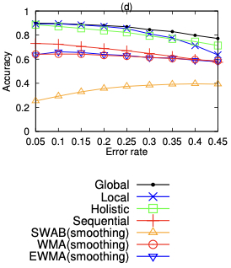
Experiment Evaluation
Compared Methods:
  SCREEN (Global & Local) – proposed methods
  Smoothing: SWAB, WMA, EWMA
  Constraint-based: Holistic, Sequential
Evaluation Metrics:
  Repair Distance – total value changes
  RMS Error – difference from ground truth
  Accuracy – % of correct repairs
  Inconsistency Rate – constraint violations after repair
  Time Cost – computational efficiency

Slide 13
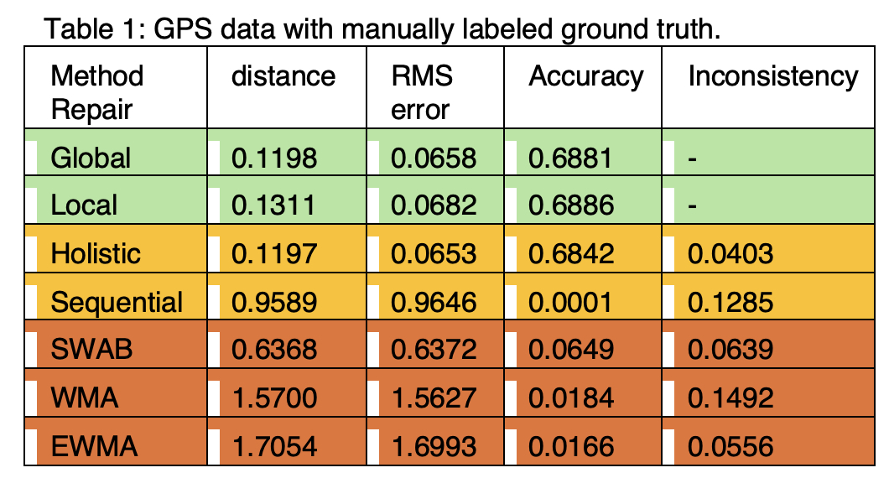
Experiment Results
SCREEN outperforms all existing methods across metrics.
It is:
  Accurate: minimal unnecessary changes
  Consistent: respects speed constraints
  Efficient: scalable for streaming use
  Flexible:
    handles late arrivals
    adjusts window sizes dynamically

Slide 14
Conclusion
SCREEN introduces semantic constraint-based cleaning
Avoids over-smoothing, preserves clean values
Works in streaming, out-of-order, and real-time settings
Auto-tunes itself to balance performance and repair quality
Outperforms prior methods across metrics

Slide 15


Slide 16
Thank you!

