Slide 1
Multiple Dynamic Outlier-Detection
From A Data Stream By
Exploiting Duality Of Data And Queries
- Presented By
Rangineni Aamuktha Rao (ar23co)
Bharadwaj Manne (bm24o)
Sai Pranay Chebium (sc24q)

Slide 2
Motivation
Why Outlier Detection in Data Streams?
Real-time outlier detection is critical in domains like fraud detection and sensor monitoring.
Modern data streams involve high-volume, evolving data and multiple concurrent queries.
These queries often differ in parameters and change dynamically over time.
Existing methods process each query separately, resulting in redundancy and inefficiency.
A scalable solution is needed to handle multiple dynamic queries with minimal computation and memory overhead.

Slide 3
Problem Statement
The core problem is to detect distance-based outliers in real-time from a continuous data stream.
Unlike traditional single-query settings, real-world applications require processing many queries simultaneously.
These queries vary in parameters such as distance threshold, neighborcount, and window size.
They are also dynamic. New queries can be added or removed at any point in time.
Current algorithms are not designed to handle both multiplicity and dynamicity efficiently and accurately.

Slide 4
MDUAL: Unified Processing Approach
MDUAL introduces a duality-based unified processing approach for Multiple Dynamic Distance-Based Outlier Detection.
It groups similar data points and similar queries to process them collectively.
This avoids redundant operations that arise in separate per-query evaluations.
Joint grouping significantly improves computational efficiency and memory usage.

Slide 5
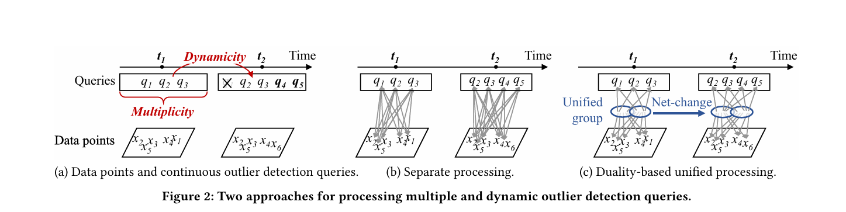
MDUAL: Unified Processing Approach

Slide 6
Key Techniques of MDUAL
Data-Query Grouping
Coarse and Fine Group Processing
Inlier-First Strategy & Result Propagation
Maximal Expanded Range Queries (CBRQ Projection)

Slide 7
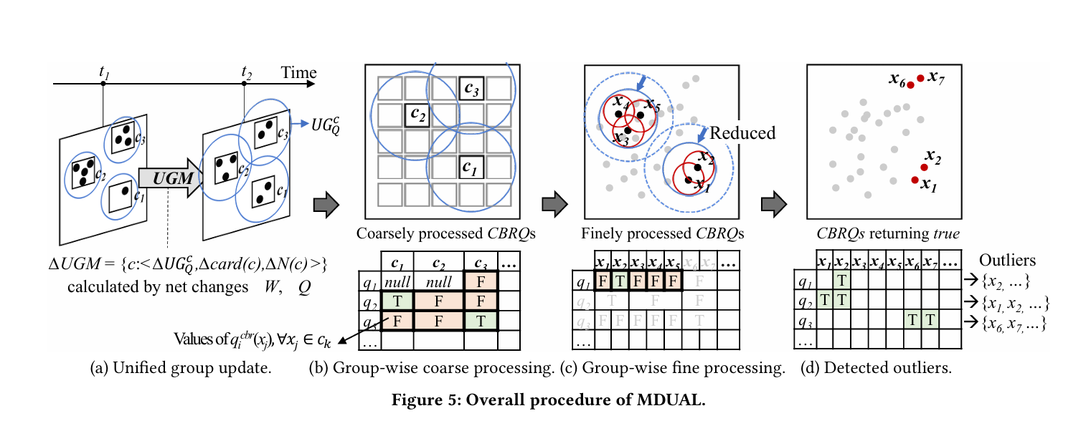
MDUAL Workflow

Slide 8
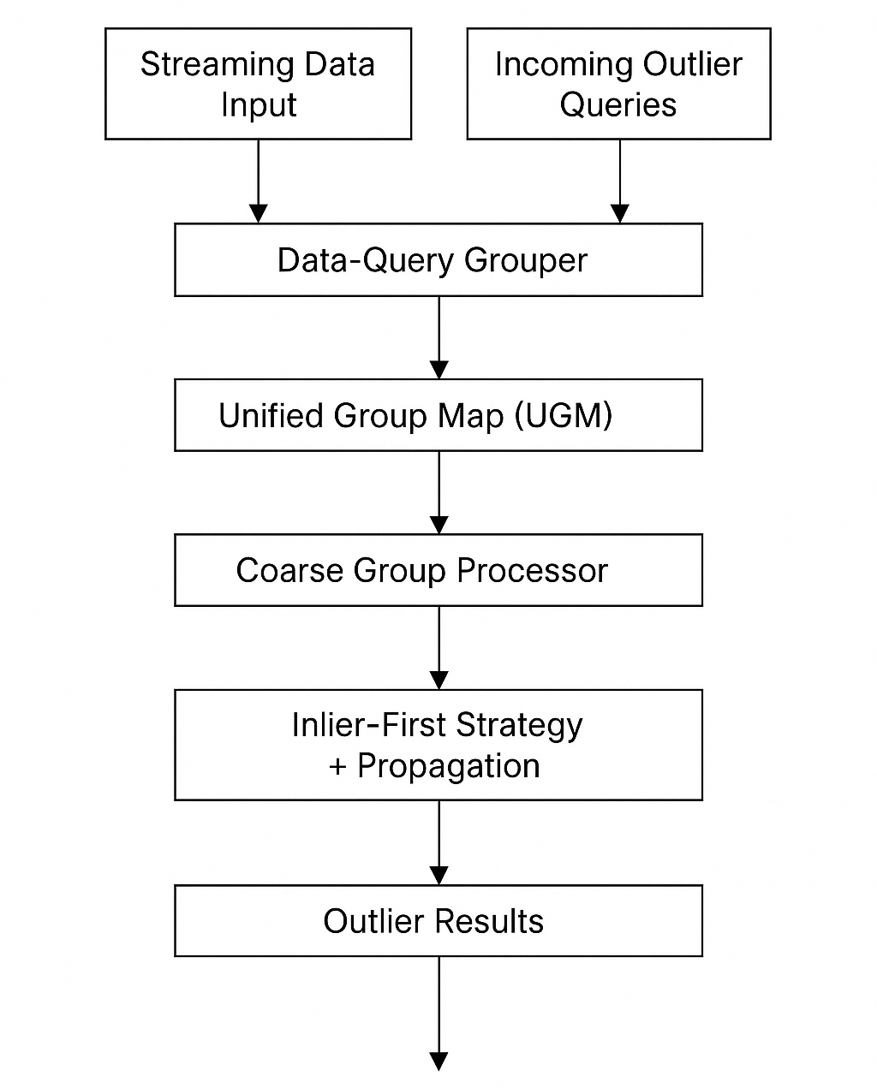
MDUAL System Architecture

Slide 9


Experimental Results
Datasets Used: STK (Stock Market), TAO (Oceanographic Data)

Slide 10
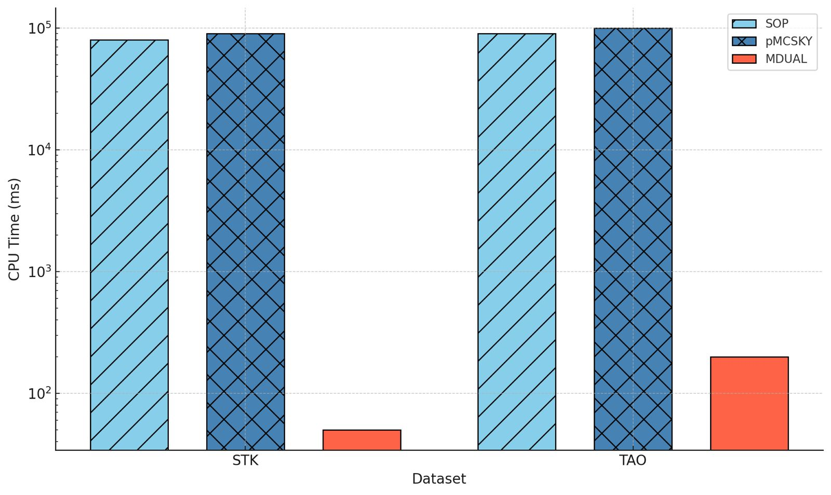
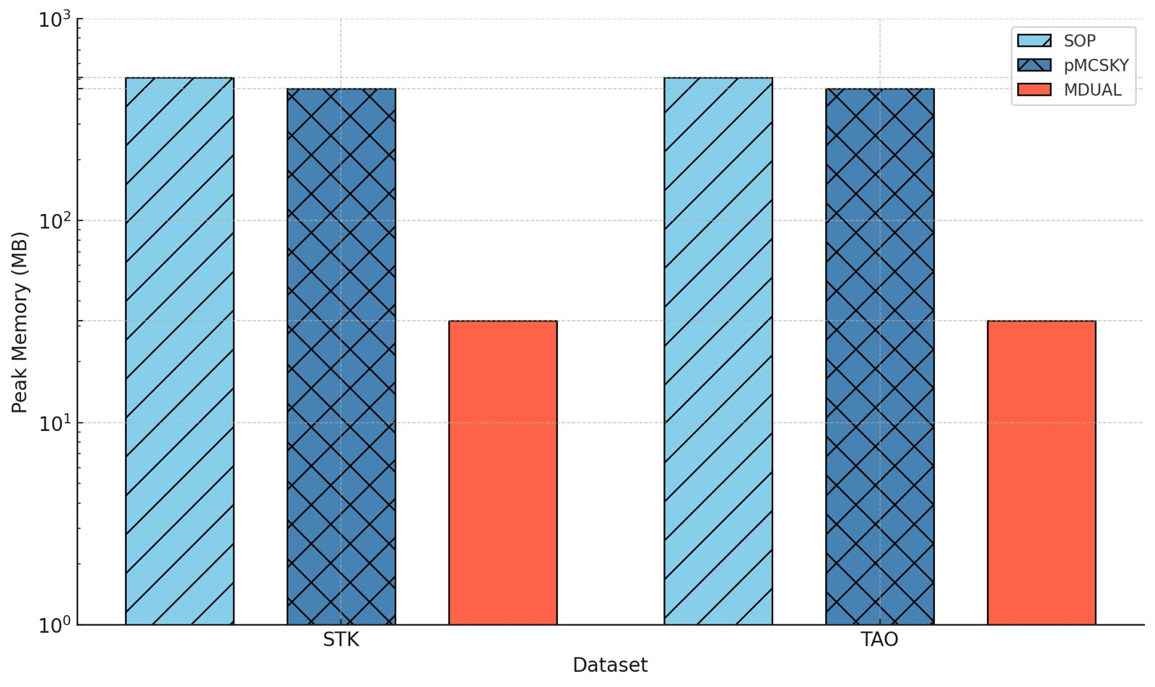
Performance Comparison Between MDUAL vs SOP & pMCSKY
(a) CPU Time
(b) Peak Memory

Slide 11
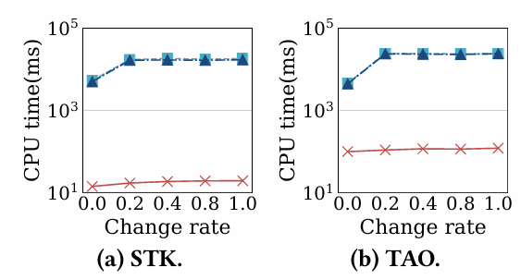
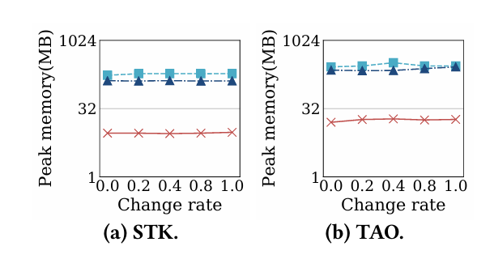
Performance Comparison with Varying no of Queries
(a) CPU Time
(b) Peak Memory

Slide 12
Summary
Successfully implemented the MDUAL framework in C++ for distance-based outlier detection on streaming data.
Introduced a duality-based approach that groups similar data points and queries to avoid redundant computations.
Used Coarse & fine group processing combined with an inlier-first strategy for efficient evaluation.
Achieved significant improvements in:
  Execution time
  Memory usage
  Scalability across dynamic query loads

Slide 13
Thank You…

