Slide 1

A RANDOMIZED BLOCKING STRUCTURE FOR STREAMING RECORD LINKAGE
AUTHORS: DIMITRIOS KARAPIPERIS, CHRISTOS TJORTJIS, VASSILIOS S. VERYKIOS
Presented by: Gokul Sairam Garapati, Yogi Sainadh Thatikonda, Saiteja Myneni

Slide 2
INTRODUCTION TO RECORD LINKAGE
Definition: Identifying records from multiple databases that refer to the same entity.
Importance:
  Improves data quality.
  Essential for accurate data analysis.
Applications:
  Healthcare: combining patient records.
  Security: identifying criminals from passenger data.
  Marketing: consolidating customer information.

Slide 3
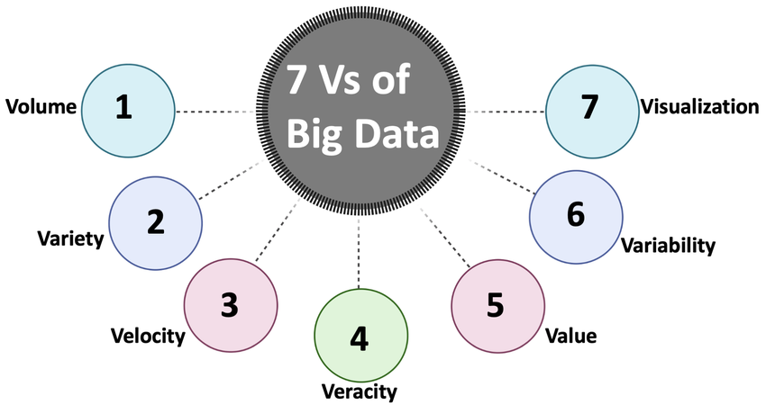

Slide 4
BASELINE METHODS
UNI - maintains the most frequently accessed blocks
TASK - creates a redundant block collection where each record appears in multiple blocks
TIME - uses a time window to keep only the most recent records in memory.

Slide 5
CHALLENGES IN STREAMING RECORD LINKAGE
High data velocity: Constant and rapid data generation.
Large data volume: Millions of records requiring processing.
Real-time constraints: Immediate data processing and linkage.
Memory management: Limited memory resources require efficient usage.

Slide 6
GOALS AND OBJECTIVES OF EXPBLOCK
Effectively handle high-speed streaming data.
Maintain frequently accessed and recent data records.
Efficiently update memory blocks to continuously reflect new data.
Optimize balance between accuracy, performance, and simplicity.

Slide 7
KEY TERMS
Block: Collection of records sharing common characteristics.
Hit: Successful access of an existing block.
Miss: Occurs when a requested block is not found in T.
Renewal Process: Mechanism to refresh block contents.

Slide 8
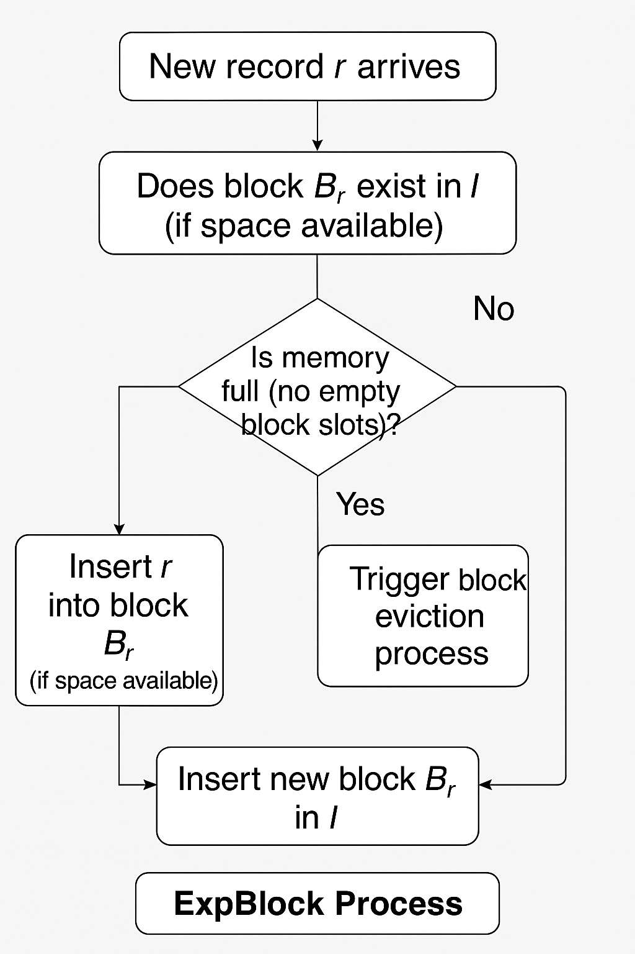
ExpBlock Algorithm

Slide 9
Main Operations of ExpBlock
Storing Records ( put(k,rec))
Fetching Records (get(k))
Deleting Blocks (delete(i))

Slide 10
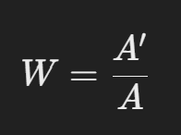
Eviction Strategies in ExpBlock
Eviction of Blocks
Deciding which block to remove.
Activity Factor(W)
A’ = Last time the block is accessed
A = The current time

Slide 11
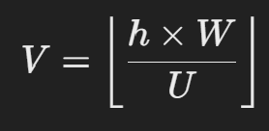
Eviction Strategies in ExpBlock
Final Score(V):
h= how many times the block has been accessed
U= The average number of times blocks are accessed
W = The activity factor

Slide 12
Example:
Imagine 3 toy boxes and how often they were played with:
ExpBlock randomly picks a box, but less used ones are more likely to be picked.
Box | Times accessed(h) | Last accessed(W) | Score(V)
cars | 10 times | 0.9 | High(keep it)
Puzzle | 5 times | 0.5 | Medium(maybe remove)
Dolls | 2 times | 0.1 | Low(likely remove)

Slide 13
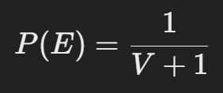
Eviction Strategies in ExpBlock
Probability of removing a Block
The higher the score V, the lower the chance of eviction
The Lower the score V, the higher the chance of eviction

Slide 14

Eviction Strategies in ExpBlock
2. Eviction of Records
Deciding which record to remove from the block.
P= The chance that a record stays in the block
p= A fixed probability(like 0.8 or 0.9)
T= How long the record has been inside the block(its age)

Slide 15
ADVANTAGES OF RANDOMIZATION IN EXPBLOCK
Simplifies memory management by avoiding sorting algorithms.
Reduces computational complexity.
Minimizes memory consumption.
Ensures quick and consistent performance.

Slide 16
EXPERIMENTAL SETUP AND EVALUATION
Existing Methods:
  TASK
  TIME
  UNI
Method Used:
MinHash (with Murmur hashing)

Slide 17
Datasets:
  NCVR
    Voter registry data
    lastname and PO Box
b1,HOLLIFIELD,MYRA,612 SIDEVIEW ST ,GRAHAM,27253
a1_0,HOLLIFIELD,MYmA,612p SIDEVIEW ST ,GRAHAM,27253

Slide 18
DBLP
    - Bibliographic records from computer science (2013-2020)
    - first author and year of publication
<booktitle>Computer Vision, A Reference Guide</booktitle>
<ee>https://doi.org/10.1007/978-0-387-31439-6_100117</ee>
<url>db/reference/vision/vision2014.html#X14bd</url>
</incollection><incollection mdate="2019-01-09" key="reference/vision/Singh14" publtype="encyclopedia">
<author>Manish Singh 0001</author>
<title>Transparency and Translucency.</title>
<pages>815-819</pages>
<year>2014</year>

Slide 19
OAG
Academic papers dataset combining Microsoft Academic Graph(MAG) and Aminer
first author and year of publication

Slide 20
{
"id": "53e9ab9eb7602d970354a97e",
"title": "Data mining: concepts and techniques",
"authors": [
{
"name": "jiawei han",
"org": "department of computer science university of illinois at urbana champaign"
},{
"name": "micheline kamber",
"org": "department of computer science university of illinois at urbana champaign"
},{
"name": "jian pei",
"org": "department of computer science university of illinois at urbana champaign"
}],"year": 2000,

Slide 21
Metrics:
  Recall
    Recall=Total actual matches/Correctly identified matches​
  Precision
    Precision=Total matches identified by method/Correctly identified matches​
  Processing Time
    Speed of executing both blocking and matching pairs

Slide 22
LIMITATIONS
Potential loss in recall accuracy due to random evictions.
Performance may vary based on data distribution.
Memory size limitations can affect efficiency in very large datasets.

Slide 23
CONCLUSION
Efficient streaming data management.
Simplified and effective randomized algorithms.
Suitable for real-time, large-scale applications.

Slide 24
THANK YOU

