Slide 1
Scalable structural index construction for Json analytics
Presented by:
Gautham Chadalavada
GC23M
Sai Pankaj
Peddi
SP23BE
Nithya Sahithi Devisetty
ND23F

Slide 2
Table of contents
Introduction
Motivation
What is Pison?
Project Overview
System Architecture
Implementation and Experimental
Conclusion

Slide 3

Introduction
Modern applications rely heavily on JSON for data exchange but parsing large and deeply nested JSON structures is CPU and memory intensive.
Traditional JSON parsers like Jackson or GSON perform sequential, full-deserialization, making them inefficient for large-scale analytics.
There’s a growing need for high-performance, structure-aware parsing systems that avoid full deserialization and enable fast querying.
This project aims to implement a Java-native structural indexing system, inspired by Pison (C++), to achieve scalable, parallel, and memory-efficient JSON processing.

Slide 4
Motivation
Traditional JSON parsers like Jackson or GSON rely on sequential, full deserialization — a major bottleneck for large-scale or deeply nested JSON data.
As data volumes grow, these parsers become memory-intensive and CPU-bound, leading to poor performance in real-time analytics pipelines.
Native solutions like simdjson and Mison offer high-speed parsing but are C++-based and require JNI for Java integration, which adds complexity and overhead.
There is a clear need for a high-throughput, memory-efficient JSON parsing system that is native to Java and leverages SIMD, parallelism, and off-heap memory.

Slide 5
What is Pison?
Pison is a high-performance C++ system that accelerates JSON analytics by avoiding full deserialization and building structural indices.
It uses SIMD instructions to scan JSON data in parallel, identifying structural characters like and , across multiple bytes at once.
Pison constructs bitmaps representing JSON structure and applies speculative parsing followed by a rectification pass to eliminate false positives.
This approach enables fast, memory-efficient querying directly over raw JSON, achieving 2x–4x speedups compared to traditional parsers.

Slide 6
Project Overview
This project implements a Java-native structural indexing system for JSON parsing, inspired by the high-performance C++ system, Pison.
It eliminates the need for full deserialization by constructing SIMD-accelerated structural indices directly from raw JSON input.
The system leverages Java’s Vector API, off-heap memory via sun.misc.Unsafe, and ForkJoinPool-based parallelism for scalability and low-latency execution.
The goal is to deliver a high-throughput, memory-efficient, and portable solution suitable for enterprise-grade Java environments without relying on JNI.

Slide 7
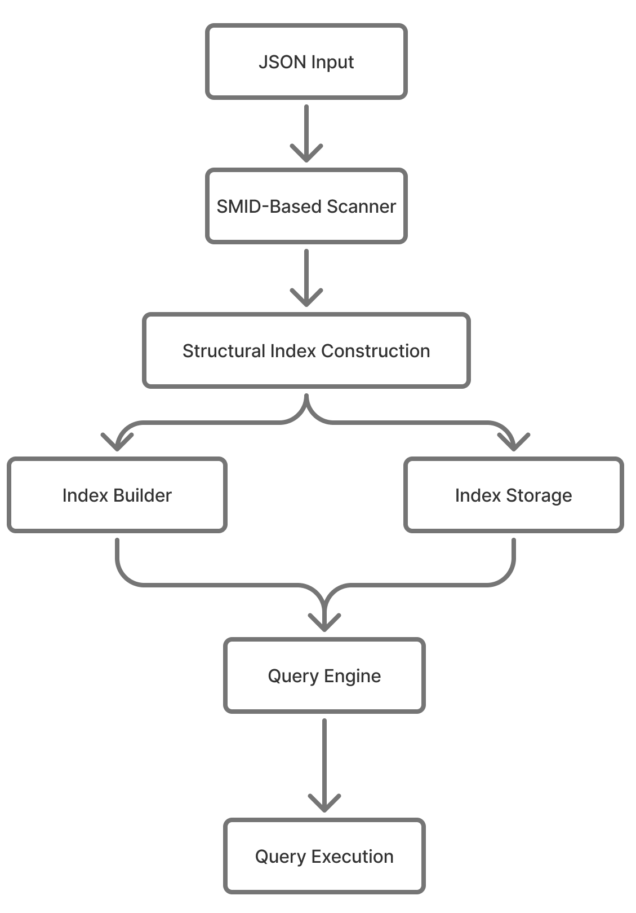
Architecture

Slide 8
Implementation and Experimentation
The system is implemented entirely in Java 21, leveraging the Vector API for SIMD-based character scanning and ForkJoinPool for parallel task execution.
Structural Index Construction involves scanning raw JSON input using 256-bit SIMD vectors to detect structural characters (:, ,, {, }) and encoding their positions into off-heap bitmaps via sun.misc.Unsafe.
Parsed JSON is divided into entropy-aware chunks that are dynamically scheduled to threads using a work-stealing ForkJoinPool, enabling intra-record parallelism.
The query engine operates directly over the structural index, evaluating path-based queries (e.g., JSONPath-style) without full deserialization.
For evaluation, we used real-world JSON datasets from GitHub Archive and StackOverflow Dumps, along with synthetic datasets for stress-testing. Benchmarks were run using JMH to measure parsing throughput, memory usage, and scaling behavior.

Slide 9
Evaluation of Success
Parsing Throughput (MB/s)
Off-Heap Memory Efficiency
Thread-Level Scalability
Query Latency Over Indexed Paths

Slide 10
Conclusion
Proposed a Java-native structural indexing system inspired by Pison for scalable JSON analytics.
Uses SIMD, off-heap memory, and parallelism to avoid full deserialization.
Fully JVM-integrated, removing the need for JNI or native bindings.
Aims to improve parsing speed, memory efficiency, and scalability for large JSON workloads.

Slide 11


