Slide 1
GPU-Based Top-K Query Processing
Efficient Algorithms for Massive Data
Ashwin Sudhir Sonawane (as22dk) & Sanskar Chouhan (sc23bq)
COP5725 Advanced Database Systems
Instructor: Peixiang Zhao
Spring 2025

Slide 2
Introduction
In many applications, we often want to find the top-k results from a large dataset, without having to process everything.
Real-World Example: Imagine you're using a food delivery app like Uber Eats, and you search for "Best Burgers Nearby.“
  The app doesn’t need to sort thousands of restaurants.
  It just needs to quickly find the top 5 with the best ratings and fast delivery.
  That’s a Top-K query.
The Challenge:
  In modern systems, data sizes are huge — sometimes millions of entries.
  Traditional method: Sort the entire dataset, then return the first k.
  Time complexity: O(n log n) — even if k is small!
GPU issues:
  Sorting is branch-heavy (bad for GPU SIMD threads)
  High memory pressure
  Wastes effort on elements that won't make it to Top-K

Slide 3
Problem Statement
Design a GPU-friendly algorithm that efficiently identifies the Top-K elements from a large dataset without fully sorting all entries. The goal is to minimize unnecessary computation, leverage GPU parallelism, and avoid branch-heavy operations common in CPU-based methods, ensuring fast and scalable top-k query processing especially when k is much smaller than the total data size.
Goals:
  Low work (only touch what’s needed)
  High parallelism (GPU-friendly)
  Scalability (millions of records, small k)

Slide 4
GPU-based approaches
Sorting-Based Top-K
  Sorting-based Top-K is a straightforward baseline that sorts the entire dataset in descending order and then selects the first k elements.
Bitonic Top-K
  Bitonic Top-K leverages the bitonic sort network to efficiently extract the top-k elements without sorting the entire dataset. It creates bitonic sequences of size k, then merges and rebuilds them in parallel, discarding unnecessary values at each step. Optimized for GPU execution, it avoids branching and achieves significant speedup, especially when k is small.

Slide 5
Bitonic Top-k ALgorithm
Goal: Find Top-4 elements from an unsorted list of 16 values
Input: [7, 3, 9, 2, 6, 1, 5, 8, 4, 11, 12, 0, 13, 10, 14, 15]
Step 1: Local Sort (Form bitonic sequences of size k)
  Partition the input into blocks of size k=4.
  Each block is sorted into a bitonic sequence: half ascending, half descending.
  Block 1: [7, 3, 9, 2] → [3, 7, 9, 2] → bitonic
  Block 2: [6, 1, 5, 8] → [1, 6, 8, 5] → bitonic
  Block 3: [4, 11, 12, 0] → [0, 11, 12, 4] → bitonic
  Block 4: [13, 10, 14, 15] → [10, 13, 15, 14] → bitonic

Slide 6
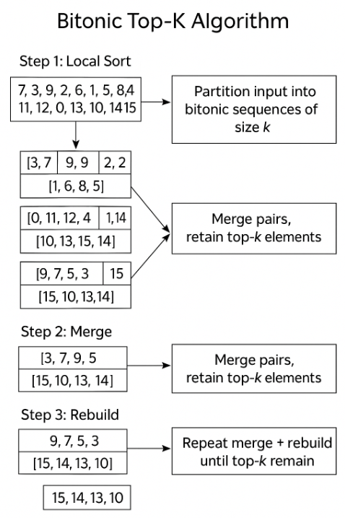
Step 2: Merge (Bitonic Merge – Discard lower half)
Merge every two adjacent sequences and retain the top-k elements only.
  Merge Block 1 & 2 → Compare [3, 7, 9, 2] and [1, 6, 8, 5]
  → Compare pairs: (3,1), (7,6), (9,8), (2,5)
  → Take max of each: [3, 7, 9, 5] → Bitonic top-4
  Repeat for Block 3 & 4:
  → Merge [0,11,12,4] and [10,13,15,14] → [10,13,15,14]
Step 3: Rebuild (Sort merged sequences again)
The merged sequences are bitonic, but need re-sorting.
  Rebuild [3, 7, 9, 5] → Sorted → [9, 7, 5, 3]
  Rebuild [10, 13, 15, 14] → Sorted → [15, 14, 13, 10]
Step 4: Repeat Merge + Rebuild
  Merge the two rebuilt sequences to extract final Top-4.
  Merge [9, 7, 5, 3] and [15, 14, 13, 10]
  → Compare (9,15), (7,14), (5,13), (3,10) → [15, 14, 13, 10]
  → Rebuild → Final Sorted Top-4 → [15, 14, 13, 10] - Output

Slide 7
Environment Setup & Tools
Platform: Experiments were conducted on Google Colab using the NVIDIA Tesla T4 GPU (2,560 CUDA cores). We also considered the GeForce RTX 3090 (6GB), which offers comparable CUDA core performance for local testing.
CUDA Environment: CUDA support was verified using nvcc and nvidia-smi.
CuPy: Utilized for GPU-based array operations and launching custom CUDA kernels.
Custom Kernels: The Bitonic Top-K algorithm was implemented using CuPy’s RawModule for low-level CUDA kernel programming.
Benchmarking: Performance was evaluated across varying values of k to measure scalability and efficiency.

Slide 8
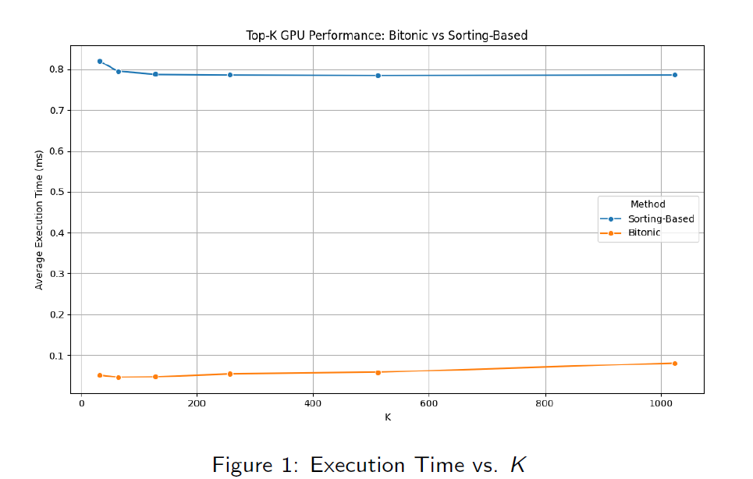
Benchmarking Framework
Compared two methods: Sorting-Based Top-K vs. Bitonic Top-K.
Tested for K = {32, 64, 128, 256, 512, 1024}, with 5 trials per configuration.
Measured average execution times and computed speedup factors.

Slide 9
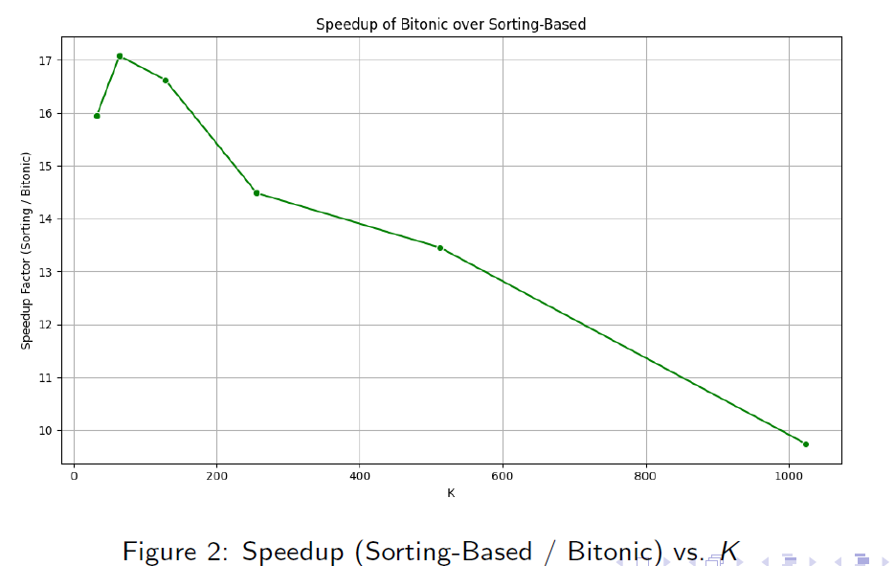
Benchmark Results: Speedup Analysis
Sorting-Based Top-K maintains nearly constant time (around 0.79ms).
Bitonic Top-K varies from 0.046 ms to 0.081 ms, showing up to 17×speedup.
Maximum speedup observed for small K (e.g., K = 64).

Slide 10
Analysis & Discussion
Efficiency: Bitonic Top-K exploits shared memory and parallelism, yielding significant speedups for small K.
Scalability: Sorting-based method is robust for large datasets but less optimal for small result sets.
GPU Advantages: Massive parallelism and optimized memory access reduce query response times.
Trade-Offs: Method selection depends on the value of K and overall data size.

Slide 11
Conclusion & Future Work
Successfully implemented and benchmarked two GPU-based Top-K algorithms: Sorting-based Top-K and Bitonic Top-K.
Bitonic Top-K demonstrated substantial performance gains over traditional sorting-based approaches, especially for small values of k (up to 1024), making it highly efficient for large-scale, high-throughput applications.
Future work:
  Investigate hybrid and adaptive methods.
  Integrate GPU Top-K operators into full-scale database systems.
  Further optimize multi-block bitonic sorting for larger K.

Slide 12
Thank you for your attention!
Any Questions?

