Slide 1
Efficient Maximum Clique Computation over Large Sparse Graphs
Author: Lijun Chang
Presented by:
Shreyas V Khandare (svk23)
Shrey J Choksi(sc23bb)
Qasim Bhabhrawala(qb23a)

Slide 2
Introduction
Graphs are widely used in applications like social networks and Bioinformatics.
Maximum Clique Computation (MCC) is crucial for graph-based analytics, especially in sparse graphs..
Problem: Efficiently computing maximum cliques in large, sparse graphs, which are typically NP-hard.
The paper addresses MCC over large sparse graphs, proposing an algorithm (MC-BRB) and a heuristic (MC-EGO) to solve it efficiently.

Slide 3
Existing Challenges in MCC
.
MCC-Dense Solvers:
Cannot handle large sparse graphs due to memory and time complexities.
MCC-Sparse Solvers:
Not as efficient as MCC-Dense solvers as they lack techniques like graph recoloring and incremental reasoning
MCC-Dense vs MCC-Sparse
    MCC-Dense works well for dense graphs using an adjacency matrix.
    MCC-Sparse deals with sparse graphs, which have fewer edges.
Problem: Need a more efficient solution for sparse graphs.
Notes:
MCC-Sparse deals with sparse graphs, which have fewer edges, leading to efficiency issues in algorithm design.

Slide 4
Proposed Solution
MC-BRB Algorithm:
Transforms MCC-Sparse into KCF-Dense (k-clique finding over dense subgraphs).
Uses ego-network decomposition and optimizations like reduction rules to solve the KCF-Dense efficiently.
MC-EGO:
Heuristic algorithm for near-maximum clique computation.
Leverages the degeneracy of the graph to compute cliques in near-linear time.

Slide 5
MC-BRB Approach
Initial Clique Computation
(via MC-EGO).
Ego-network Processing:
Use degeneracy ordering for efficient clique finding.
Reduction & Bounding: Apply rules to minimize search space.
After pruning and searching ego-networks, the algorithm outputs the largest verified clique as the result.
Benefits:
  - Scalable, Flexible & Memory Efficient for large graphs
  - Reduces unnecessary computation via pruning and reduction techniques.

Slide 6
MC-BRB
Approach
Initial Clique Computation
(via MC-EGO).
Ego-network Processing:
Use degeneracy ordering for efficient clique finding.
Reduction & Bounding: Apply rules to minimize search space.
After pruning and searching ego-networks, the algorithm outputs the largest verified clique as the result.
MC-BRB
Workflow
Optimization Techniques in MC-BRB
a. Branch-and-Bound
b. Pruning via Reduction Rules
c. Ego-Network Decomposition
Benefits:
Scalable, Flexible & Memory Efficient for large graphs
Reduces unnecessary computation via pruning and reduction techniques.
Notes:
a. Branch-and-Bound
The branch-and-bound technique is crucial for eliminating unnecessary searches. It combines both branching (splitting the search) and bounding (limiting the search space) to avoid redundant calculations.
b. Pruning via Reduction Rules
MC-BRB uses reduction rules to remove vertices or edges that do not contribute to the maximum clique. This helps prune large portions of the graph early in the computation.
c. Ego-Network Decomposition
By decomposing the graph into smaller ego-networks, MC-BRB focuses on smaller subgraphs, reducing the complexity of finding cliques in large graphs.
It also leverages the fact that cliques are more likely to be contained within smaller dense subgraphs.

Slide 7
MC-EGO Heuristic
Ego-network: A subgraph centered around a vertex, which consists of the vertex and all its neighbors.
Greedily computes near-maximum cliques by processing ego-networks.
Time Complexity: O(δ(G) * m)
where δ(G) is the degeneracy of the graph (bounded by √(2m + n))
- m is no. of edges & n is no. of vertices
- δ(G) is typically at most a few thousands even for large graphs
- time complexity of MC-EGO is near-linear.
- More efficient for large-scale graphs.
Application: Provides fast results when an exact solution is not required.
Notes:
Greedy Growth: In each ego-network, vertices are added to the clique if they are connected to all vertices already in the clique. This process continues until no more vertices can be added, forming the largest clique possible in that subgraph.

Slide 8
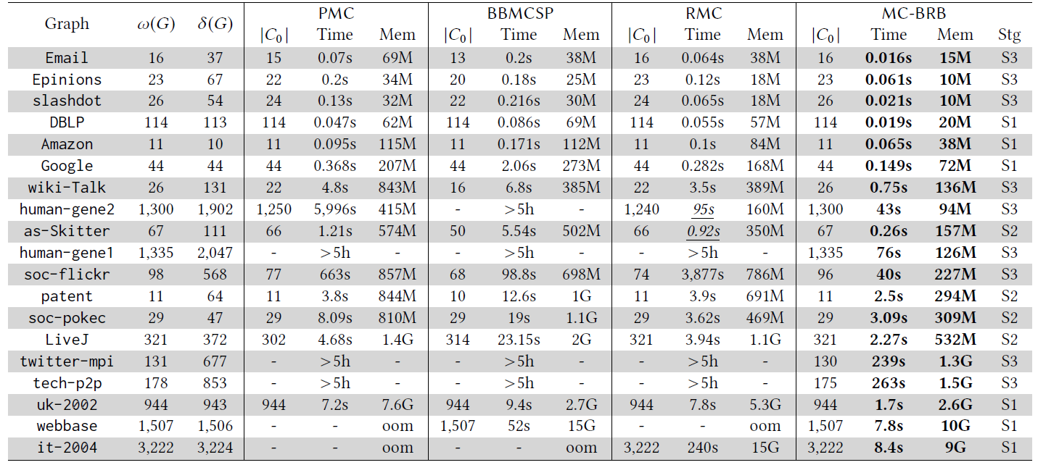
Experimental Setup
  Dataset: 19 large real-world graphs, including social networks, collaboration networks, and biological networks.
  Graphs Tested: Real-world graphs like Twitter-MPI, Human-Gene, Wiki-Talk, etc.
  MC-BRB Performance: Outperforms existing solutions by several orders of magnitude.

Slide 9
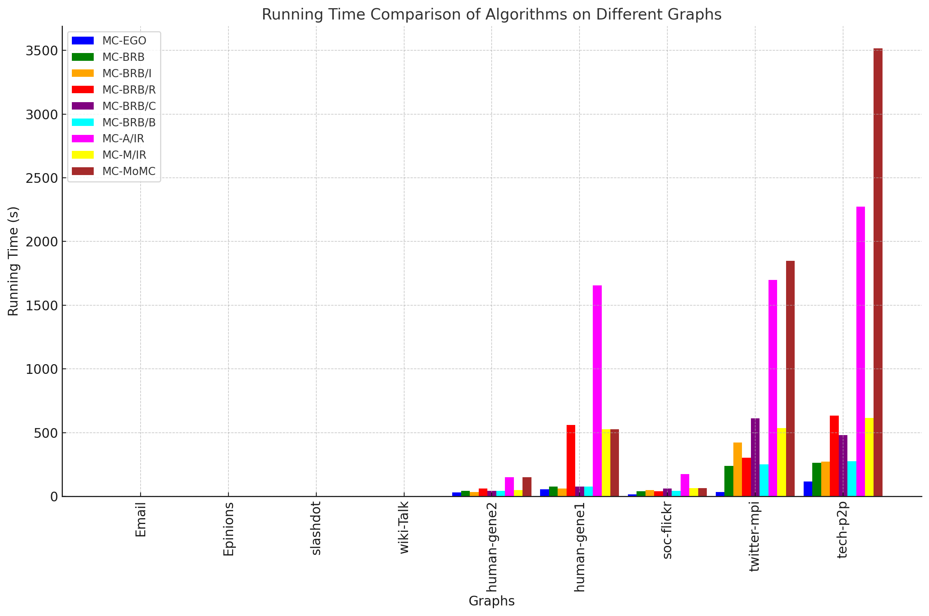
Experimental Results (Time Efficiency)
Comparison with Existing Algorithms:
Speedup: MC-BRB is orders of magnitude faster than existing algorithms (PMC, BBMCSP, and RMC).
  Example: MC-BRB computes the maximum clique for graphs like Twitter-MPI and Tech-P2P in minutes, while other algorithms take several hours.

Slide 10
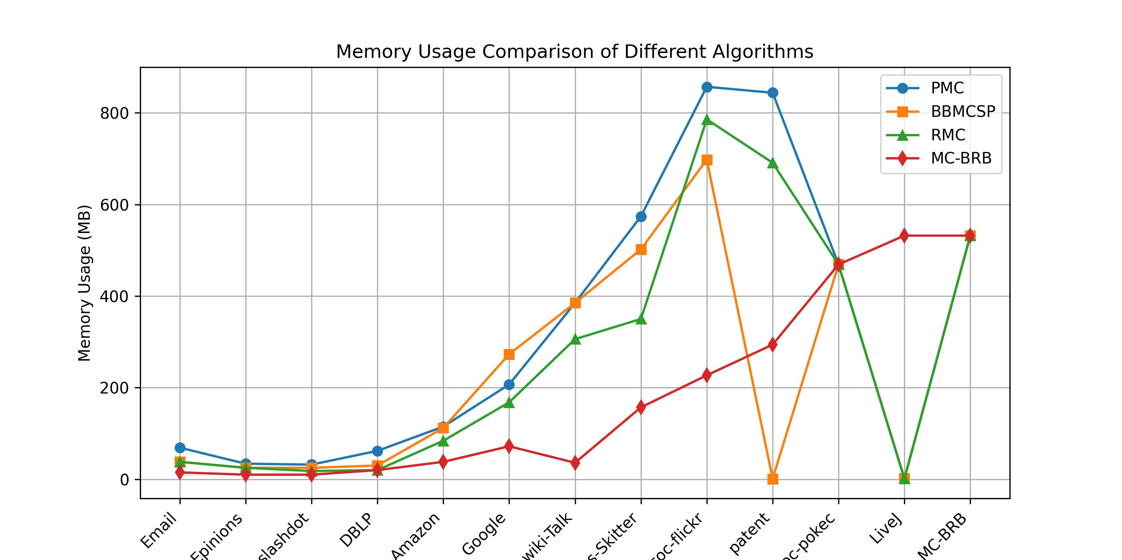
Experimental Results (Memory Usage)
MC-BRB uses less memory compared to other algorithms due to efficient graph representation (CSR).
adjacency matrices for ego-networks are feasible and efficient in memory usage.

Slide 11
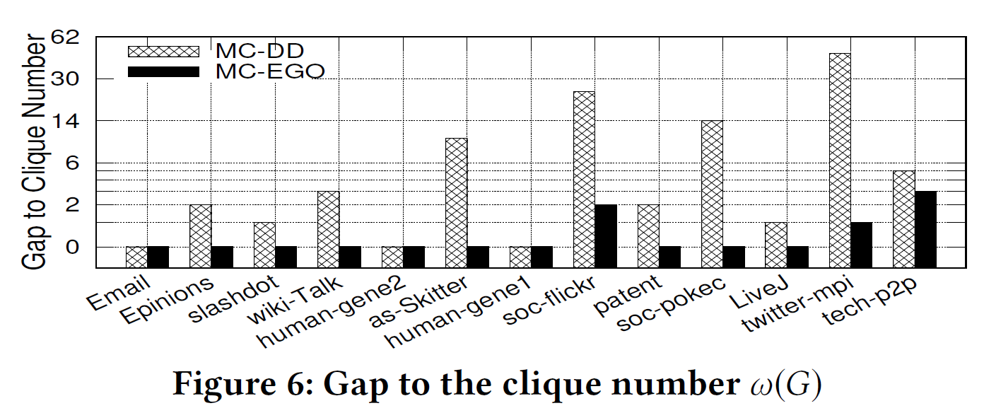
Effectiveness of MC-EGO
Finds cliques within at most 3 vertices of the true maximum
prioritizes speed over absolute accuracy.
fast and scalable for real-world applications.
Suitable for applications needing approximate results.
Notes:
MC EGO uses the output of MC-DD as its starting point if MC-DD fails to find max clique directly.
-MC-DD also computes additional information such as degeneracy ordering, coloring, and core numbers, which are critical for efficiently computing a degeneracy-based clique. These components help improve the efficiency of the MC-EGO algorithm by pruning unnecessary branches in the search process.
-The gap for MC-EGO is much smaller compared to MC-DD. In the case of twitter-mpi graph, the gap for MC-EGO is only 1, while MC-DD has a gap of 47. So, MC-EGO reliably computes near-maximum cliques, with the gap at most 3.
-Provides quick, high-quality approximations for real-time tasks in social networks, bioinformatics, and recommendation systems.

Slide 12
Effectiveness of MC-BRB
Demonstrates significant speedups over existing algorithms on large-scale graphs.
Reduces the search space by 22x to 3.5x
Speed up computation by using Pruning rules to eliminate vertices that cannot participate in a maximum clique.
Enhances the efficiency of vertex coloring
Requires less memory due to its use of compressed sparse row (CSR) representation for graph data.
Notes:
- MC-BRB is highly efficient in finding the maximum clique, especially when compared to traditional methods like PMC, BBMCSP, and RMC. Its effectiveness comes because of its optimization techniques.
- One of the most powerful features of MC-BRB is its ability to reduce the search space significantly (By eliminating unnecessary vertices and edges )
- Pruning rules are used to identify vertices that cannot be part of the maximum clique, and remove them from the search process.
For example, if a vertex has no connections to other potential clique members, it can be safely removed from further consideration.
- minimize the number of colors needed to color vertices to identify the cliques faster. More efficient coloring means quicker decisions about whether a vertex can be added to the current clique.
- CSR stores only the non-zero values in the graph, which reduces the memory footprint and ensures that MC-BRB can scale to very large graphs without running into memory limitations.

Slide 13
Conclusion
MC-BRB provides an exact solution for maximum clique computation, outperforming existing algorithms in both speed and memory efficiency.
MC-EGO offers a fast heuristic for finding near-maximum cliques, making it ideal for large-scale, real-time applications
The paper bridges the gap between MCC for sparse and dense graphs, offering highly efficient algorithms
Both algorithms are scalable and applicable to real-world, large sparse graphs in domains like social networks and bioinformatics.
Notes:
MCC (max clique computation)
MC-BRB (Branch, Reduce & Bound)

Slide 14
Thank You

