Slide 1
Hash Adaptive Bloom Filter
COP 5725 – Advanced Database Systems
Team 5
Krishna Saketh Kamadana – KK23F
Venkat Abhinay Padmanabhuni - VP23G
Ramu Nagalla – RN23I

Slide 2




Membership testing problem?
In many real-world systems, we often need to check if an item exists in a large dataset, without storing the entire set. This is known as the membership testing problem.
Applications
2

Slide 3
How Bloom Filter Works?
Insertion Phase
Hashes the key using K Hash Functions
KEY
H1
H2
Hk
0 | 1 | 0 | 0 | 1 | 0 | 0 | 1 | 0 | 0
3

Slide 4
How Bloom Filter Works?
Query Phase
Using the same k Hash functions,
we get the bit positions we need to check
KEY
If all these bits are 1 in these bit positions, then key is probably present
If any bit is 0, then definitely not present
4

Slide 5
Bloom Filter
We have 10-bit array, 3 hash functions, then 3 bad words
h1, h2, h3 – hash functions
1 | 2 | 3 | 4 | 5 | 6 | 7 | 8 | 9 | 10
0 | 0 | 0 | 0 | 0 | 0 | 0 | 0 | 0 | 0
Construction phase
Keyword | Hashes to Indices (h1, h2, h3)
Blood | 1,4,7
Violence | 2,4,9
gambling | 1,3,9
1 | 2 | 3 | 4 | 5 | 6 | 7 | 8 | 9 | 10
1 | 1 | 1 | 1 | 0 | 0 | 1 | 0 | 1 | 0
5

Slide 6
Bloom Filter
Query phase:
Positive keys: {Blood, Violence, Gambling}
1 | 2 | 3 | 4 | 5 | 6 | 7 | 8 | 9 | 10
1 | 1 | 1 | 1 | 0 | 0 | 1 | 0 | 1 | 0
Keyword | Hashes to Indices (h1, h2, h3) | Indices bits in bit array | Positive or negative
Blood | 1,4,7 | 1,1,1 | True positive
Hospital | 5,8,10 | 0,0,0 | True negative
Emergency | 2,3,7 | 1,1,1 | False positive
Positive key: {Blood}
Negative key: {Hospital, Emergency}
In bloom filters, there is no chance of the false negatives (element is present, but result is negative)
6

Slide 7
Bloom Filter
Existing work:
Standard Bloom Filter
Weighted Bloom Filter
Learned Bloom Filter
Limitations:
Uniform false positive costs
Static Hash Functions
Inefficiency in Dynamic Workloads
High overheads in ML-Based Filters
Suppose the positive key set is denoted by S, the negative key set is denoted by O, the global hash function set is H, the number of hash functions is k, and for a certain key e, the cost of e is Θ(e). Our problem is how to build a Bloom filter so that the overall cost of false positives from O is minimized.
7

Slide 8
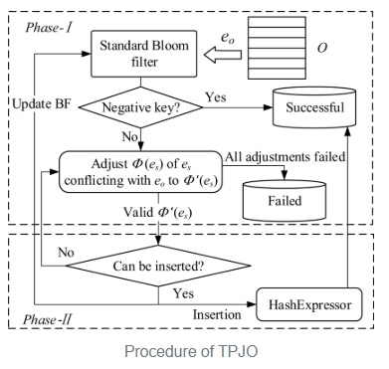
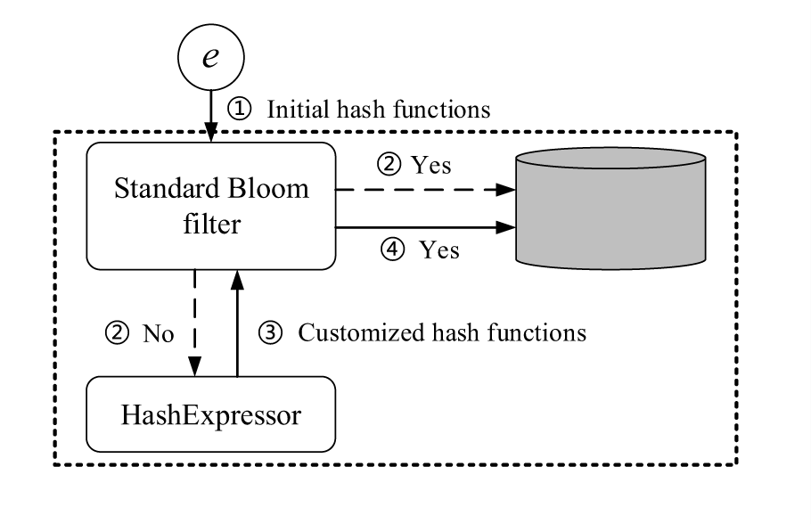
Hash Adaptive Bloom Filter
Construction phase
Query phase
8

Slide 9
Example
Global hash set S = {h1, h2, h3, h4, h5, h6}
Input : positive keys - (Blood, Violence, Gambling)
negative keys - (education - 2, emergency – 12).
Construction phase
1 | 2 | 3 | 4 | 5 | 6 | 7 | 8 | 9 | 10
Bloom Filter: 10 bit array, initial H = {h0, h1, h2}
0 | 0 | 0 | 0 | 0 | 0 | 0 | 0 | 0 | 0
Keyword | Hashes to Indices (h1, h2, h3)
Blood | 1,4,7
Violence | 2,4,9
gambling | 1,3,9
1 | 2 | 3 | 4 | 5 | 6 | 7 | 8 | 9 | 10
1 | 1 | 1 | 1 | 0 | 0 | 1 | 0 | 1 | 0
9

Slide 10
Example
Collision key: “emergency” ⇒ hashes {2,3,7} all 1, but 7 only set by “blood”
Adjust “blood”:
Drop h₃→7, pick new h₄→5
Store this φ(blood)={h₁,h₂,h₄} (modified H) in the Hash Expressor
Collision key: “education” ⇒ hashes {4,7,9} 7 is 0, so we don’t adjust anything for this.
1 | 2 | 3 | 4 | 5 | 6 | 7 | 8 | 9 | 10
1 | 1 | 1 | 1 | 0 | 0 | 1 | 0 | 1 | 0
1 | 2 | 3 | 4 | 5 | 6 | 7 | 8 | 9 | 10
1 | 1 | 1 | 1 | 1 | 0 | 0 | 0 | 1 | 0
This two phases are called Two Phase Joint Optimization
10

Slide 11
Hash Adaptive Bloom Filter
Query Phase
positive keys - (Blood, Violence, Gambling)
negative keys - (education - 2, emergency – 12).
Query | Indices | Round 1 bits | Round 1 Result | φ(e) from HashExpressor | Round 2 bits | Round 2 Result | Original outcome
blood | {1,4,7} | [1,1,0] | Negative | {h₁,h₂,h₄} | [1,1,1] | Positive | Positive
hospital | {5,8,10} | [1,0,0] | Negative | H₀ | [1,0,0] | Negative | Negative
emergency | {2,3,7} | [1,1,0] | Negative | H₀ | [1,1,0] | Negative | Negative
education | {4,7,9} | [1,0,1] | Negative | H₀ | [1,0,1] | Negative | Negative
violence | {2,4,9} | [1,1,1] | Positive | H₀ | — | — | Positive
gambling | {1,3,9} | [1,1,1] | Positive | H₀ | — | — | Positive
This phase follows Two-round pattern
11

Slide 12
HABF technical merits:
Cost-Aware Hashing: Adjusts hashes to avoid collisions with costly negatives, cutting weighted false positives by up to 40%.
Two-Phase Optimization: Refines hashes (Phase I) and stores them efficiently (Phase II) using HashExpressor.
Two-Round Query: Fast Round 1 with global hashes; Round 2 for adjusted keys—zero false negatives, ~5% overhead.
Lightweight Storage: HashExpressor adds only ~5% memory, avoiding large storage overheads.
Theoretical Bounds: Guarantees on weighted false positive rate under cost skew.
Empirical Wins: Outperforms other filters in accuracy, speed, and space on real datasets.
Constructed a variant of HABF by reducing the construction phase time, but this has some performance limitation.
Datasets:
Shalla’s Blacklists: a URL‐blacklist dataset containing 2.927 million distinct keys, of which 1,491,178 are “positive” (in the set) and 1,435,527 are “negative” (not in the set).
YCSB: a synthetic key–value workload of 24,074,812 keys (12,500,611 positive, 11,574,201 negative), each a 4‑byte prefix plus a 64‑bit integer.
12

Slide 13
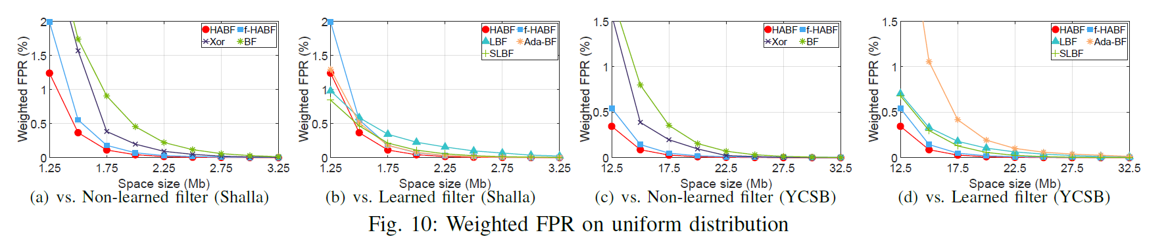
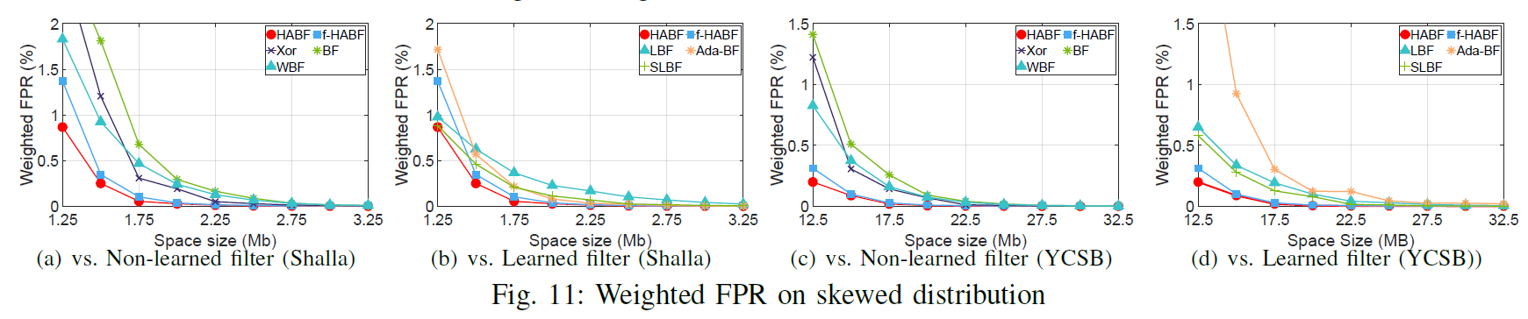
Results
13

Slide 14
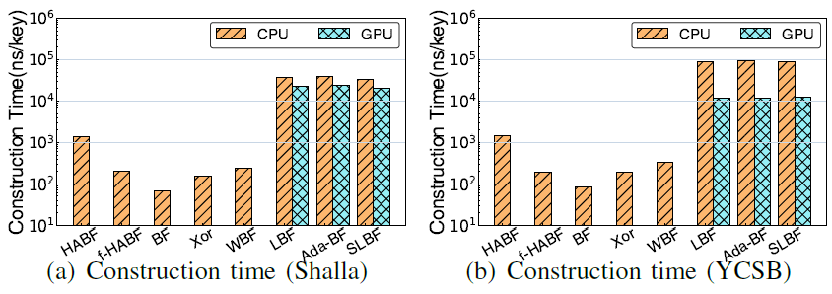
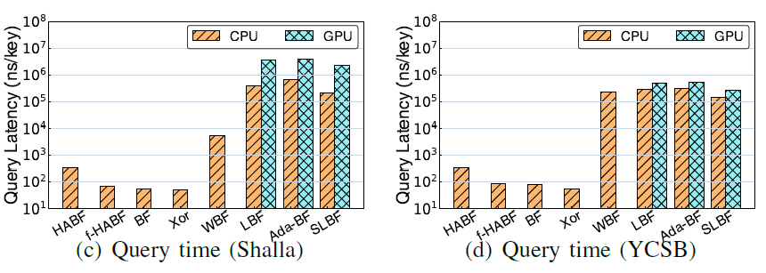
Results
14

Slide 15
Thank you!
Any Questions?????
15

