Slide 1
BClean: A Bayesian Data Cleaning System
40th IEEE International Conference on Data Engineering, ICDE 2024
Author: Jianbin Qin, Sifan Huang, Yaoshu Wang, Jing Zhu, Yifan Zhang, Yukai Miao, Rui Mao, Makoto Onizuka, Chuan Xiao
Presenters: Yazhu Song (ys21j),
Xueling Tang (xt23),
Yuki Hanyan Zhang (hz19)
Date: 4/10/2025

Slide 2
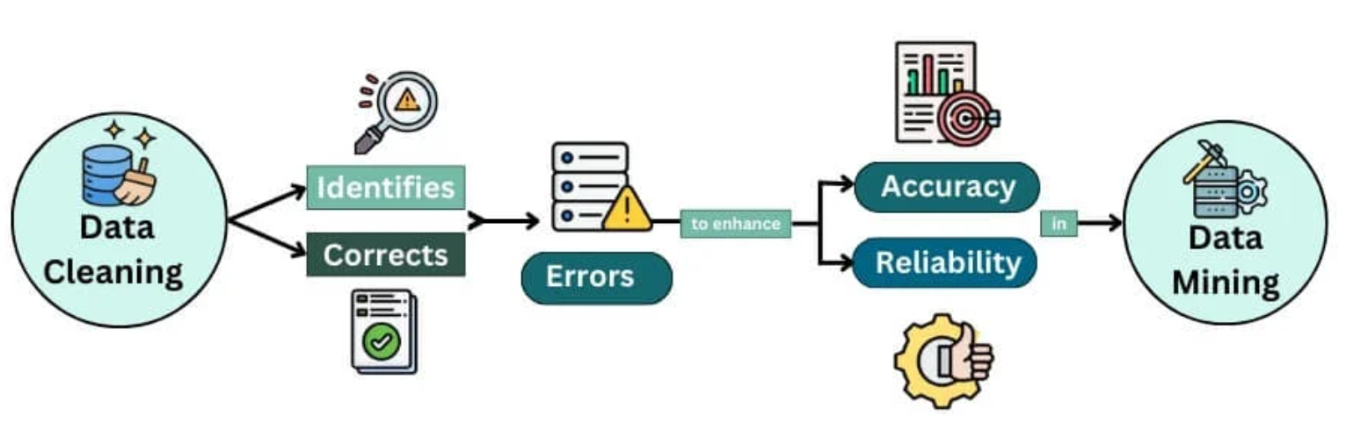
Introduction
Data Cleaning Importance:
Essential for reliable data analysis and machine learning.
By removing errors, it enhances both accuracy and reliability.

Slide 3
Comparison of Existing Methods and BClean
Existing methods:
ML-based Methods
Probabilistic Programming
Bayesian Methods
Limitation:
Complex Implementation
Noise Sensitive
High Manual Effort
Our approach:
Bclean
Solution:
Automatic & User-friendly: Automatically constructs Bayesian network, no expert coding required.
Robust to Noisy Data: Leverages Bayesian inference and compensatory scoring to reduce noise impact.
Fully Unsupervised: No manual labeling

Slide 4
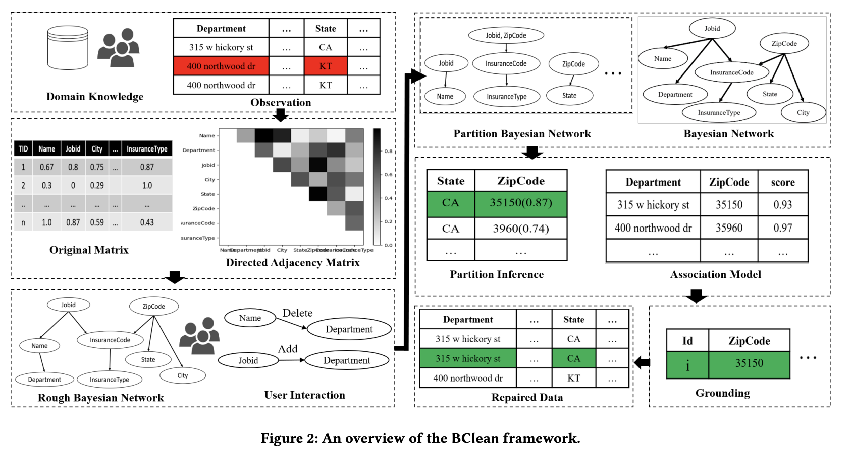
BClean Model Overview
Main steps of the BClean framework:
Probabilistic Modeling
  Create a Bayesian Network (BN) that represents the dependencies among attributes in the dataset.
  Graphical Lasso is used to generate the covariance matrix and the directed graph that represent the BN.
  Compensatory score is computed to correct biases and mitigate errors that can arise during inference in a BN.
Inference Grounding and Pruning
  Generate candidate values for each cell in the dataset and compute their probabilities.
  Narrow down the possible values that an attribute can take based on the context provided by BN.

Slide 5
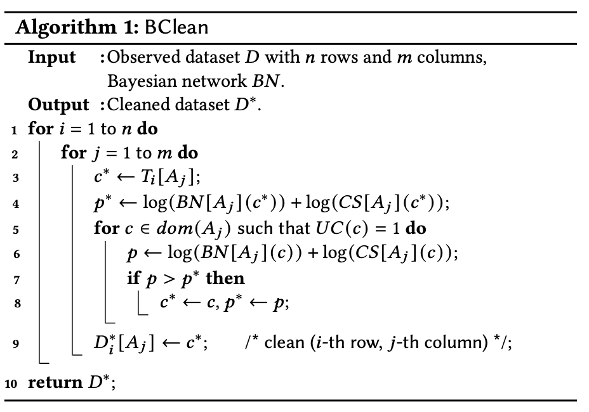
BClean Algorithm

Slide 6
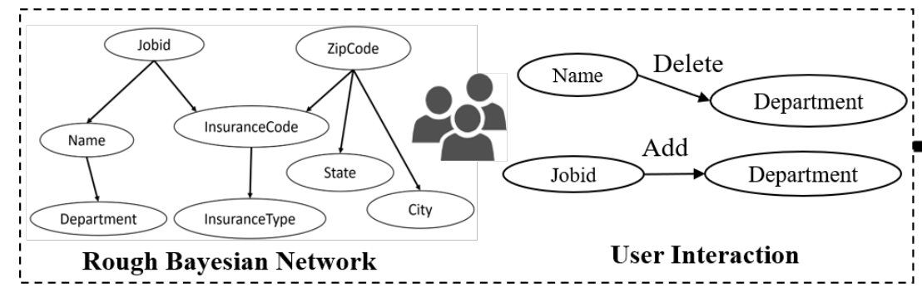
Constructing Bayesian Network (BN) Overview
Automatically constructing a BN using dirty dataset is challenging.
A structure learning algorithm working with domain knowledge is used to construct an approximate BN instead.

Slide 7
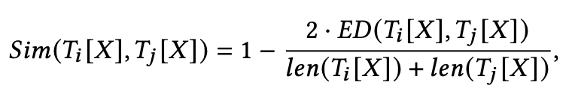

Constructing BN
Use functional dependencies (FDs) to model relationships between attributes.
Soften the FDs by introducing a similarity measure: ranges between 0 and 1.
Using the similarity values to compute pairwise similarities between variables.
Graphical Lasso is then used to calculate the covariance matrix of the dataset.
Construct the inverse covariance matrix.
Prune weak edges using a threshold to get the BN skeleton.
Allow users to edit BN skeleton.

Slide 8
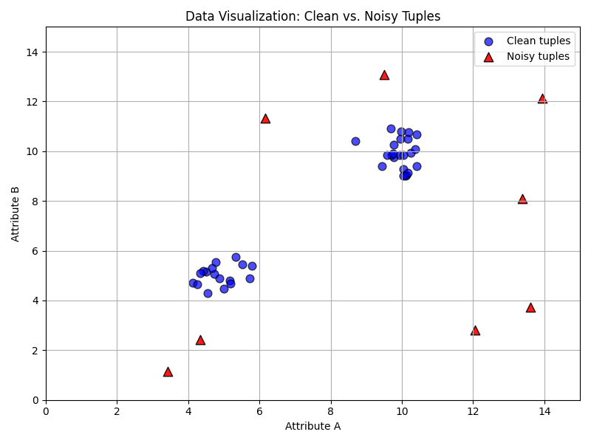
Compensatory Score
Compensatory Score: a data-driven correction term added to Bayesian inference to reduce the impact of errors learned from noisy data.
Why?
BClean builds a Bayesian Network (BN) from noisy data to model probabilistic dependencies among attributes.
However, directly using MAP inference from a BN is problematic because:
  BN may be trained on unclean data, leading to inaccurate conditional probabilities.
  Error propagation: a wrong repair based on a flawed BN can corrupt subsequent inferences.

Slide 9
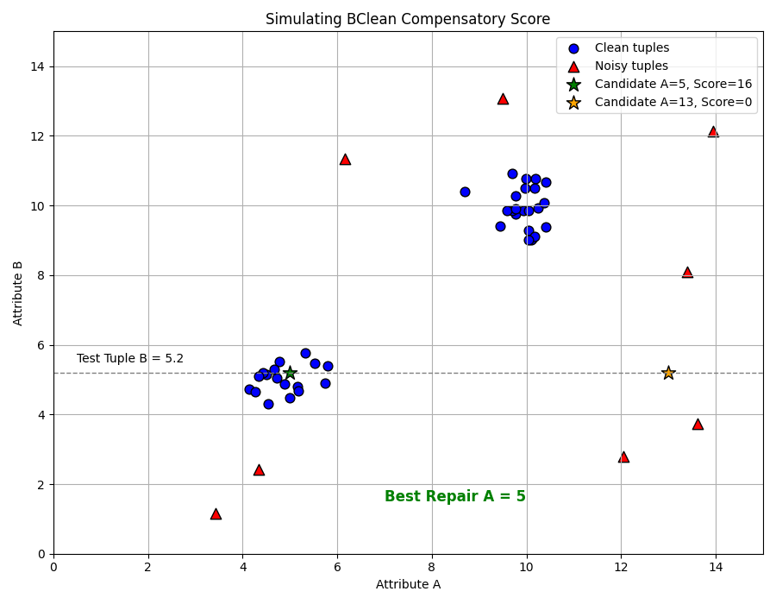
Compensatory Score
Instead of choosing based only on BN probabilities, we also compute a compensatory score, it measures how often the candidate co-occurs with other values in the tuple across trusted rows.
This gives us a more balanced score that accounts for actual patterns in the dataset.

Slide 10
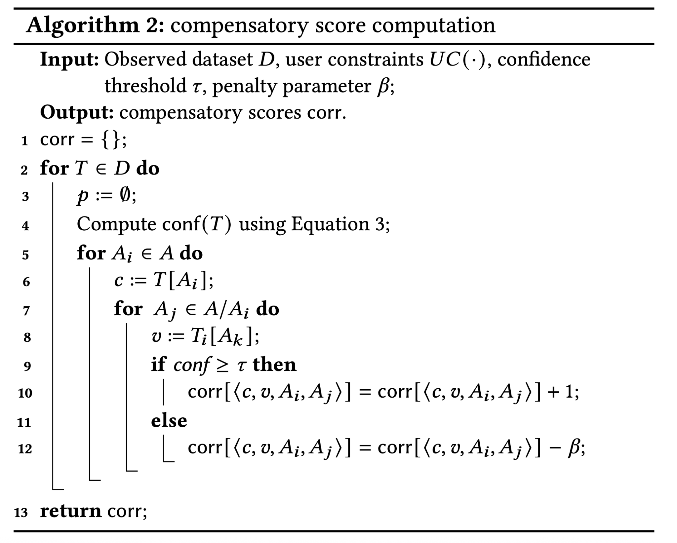
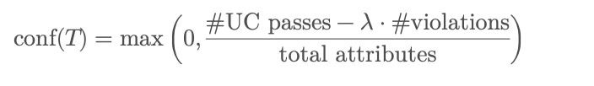
Compensatory Score Algorithm
•D: Dataset with tuples (may contain errors)
•UC(·): User Constraints (e.g., regex, min/max check)
•τ: Confidence threshold (above this means the tuple is reliable)
•β: Penalty for co-occurrence from unreliable tuples
Confidence reflects how many values in the tuple satisfy user constraints
!Noisy

Slide 11
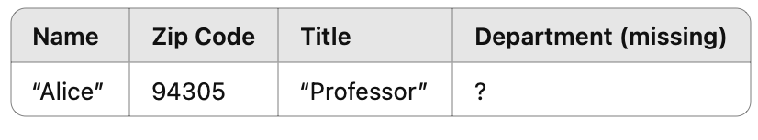
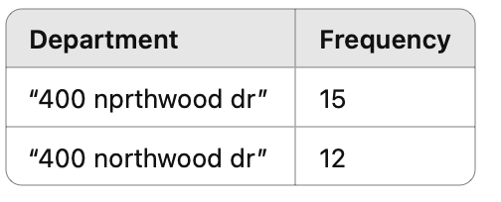
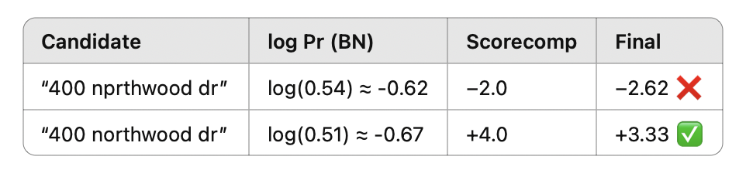
Compensatory Score Algorithm
Real-World Example:
Task: Fill the missing value in the “Department” column for tuple t6
• Candidate values:
• "400 nprthwood dr" ← typo
• "400 northwood dr" ← correct
Bayesian Network Output:
• BN suggests:
• Pr("400 nprthwood dr" | t6) = 0.54
• Pr("400 northwood dr" | t6) = 0.51
BN alone selects the typo, because it has slightly higher conditional probability
Compensatory Score Fixes It:
  "400 nprthwood dr" only co-occurs with low-confidence tuples (fails constraints like spelling) → Penalized with β
  "400 northwood dr" co-occurs with high-confidence tuples → Score boosted

Slide 12
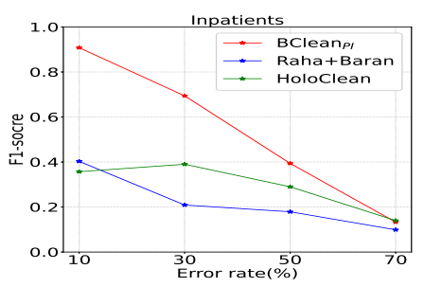
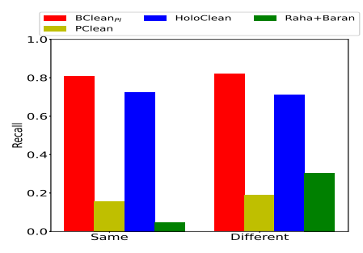
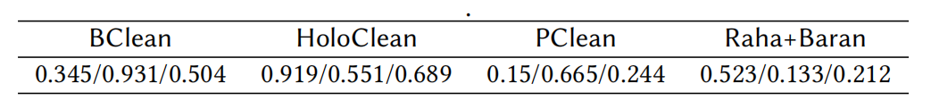
Experiment
Dataset: Real and synthetic datasets
Baseline: Raha+Baran, HoloClean
Metrics: Precision, Recall, and F1-score.
Results:
BClean’s precision is inferior to HoloClean due to a limited context capture.
BClean’s Recall and F1-score significantly exceeds other baselines
(a) Inpatient: varying error ratio.
Table 1: Precision / Recall / F1-score on sampled Soccer
(b) Inpatient: swapping value errors.

Slide 13
Conclusion
• BClean automatically constructs a Bayesian network and enables user interaction for refinement.
• BClean leverages a compensatory scoring model to enhance inference accuracy.
• BClean outperforms existing Bayesian methods by ~2% and other cleaning methods by ~15% in F1-score.

Slide 14
Thank You!

